Slide 1
FCX Monthly Safety Content
The following slides have been provided to aid in compiling content for monthly Health & Safety meetings, tailgates, etc. with FCX employees and contractors.
Please keep in mind - some of this information is preliminary and may be pending complete investigations.
Best Practices
Be familiar with content prior to presenting
Hide/Unhide incidents that are relevant to your team
Interact with your audience, relating information to your specific work
Update dashboards to share meaningful data (Incident Summary - Power BI, FRM - Power BI). Contact your local H&S staff for site-specific dashboards or external access.
1

Slide 2
FCX Safety Updates
January 2024
(Incidents and Communications from December 2023)
fcx.com

Slide 3
FCX Safety Incidents, Successes, & Alerts
December 2023
fcx.com
3

Slide 4
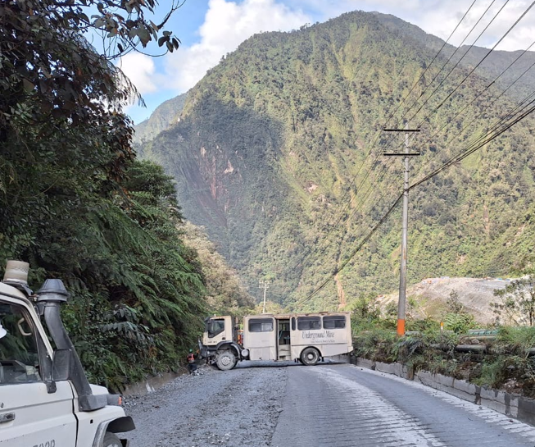
PTFI Bus Near Miss
Event ID # 20011788
Incident Details
Operation | PT Freeport Indonesia
Date / Time | December 1, 2023 / 10:15 a.m.
Type | Near Miss
Summary | A bus traveling down MP74 about 100 meters (330 feet) from Davey Tunnel moved onto a section of concreate road to allow an excavator traveling uphill to be on a concrete-free section. The bus tires slipped on the slick concrete, causing the bus to skid and block the access road.
Fatal Risk | Vehicle Collision or Rollover
Risk Category | Actionable
Pre / Post Rating | Catastrophic (4) Possible (2)
Absent / Insufficient Controls | operator not using the proper gear when going down the road incline.
Applicable Policies / Procedures | Low speeds Berms GPS Tracking Systems Operational Safety Mobile Assets.
Employee Condition | N/A
Contact | Andri Abdullah, UG Health and Safety Manager
Final position of the bus blocking the road

Slide 5
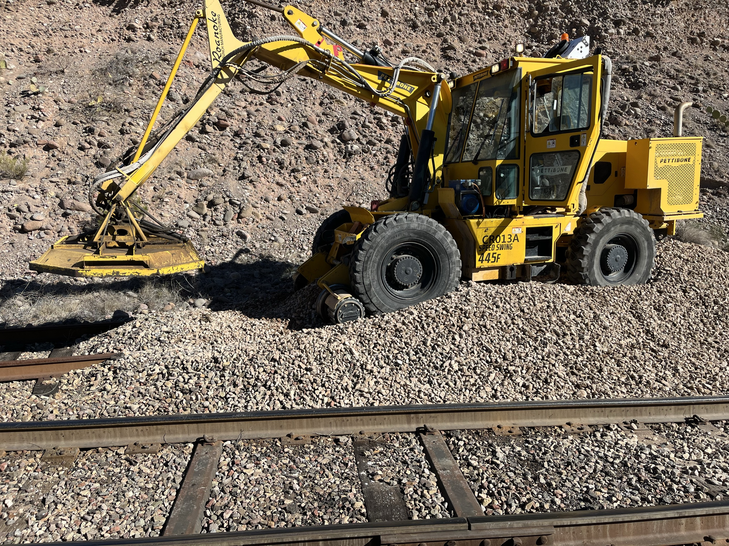
Morenci Railroad Near Miss
Event ID # 20012432
Incident Details
Operation | FM Americas: Morenci
Date / Time | December 28,2023 / 9:00 am
Type | Near Miss
Summary | A Railroad employee was using a rail mounted piece of equipment (Petty Bone) to trim vegetation along the Railroad when he stopped at the Columbine Gate crossing to dismount the rail. He stopped and was getting ready to disengage the wheels when he felt the Petty Bone rolling away. He couldn't stop it with the brake system, so he dismounted the equipment and the equipment continued down the track approximately 1.76 miles coming to a stop at the derailer.
Fatal Risk | Railroad Collision
Risk Category | Actionable
Pre / Post Rating | Significant (3), Likely (3)
Absent / Insufficient Controls
Applicable Policies / Procedures
Employee Condition | N/A
Contact | Rassie Ras, Health & Safety Manager

Slide 6
PFE Events
December 2023
fcx.com
8

Slide 7
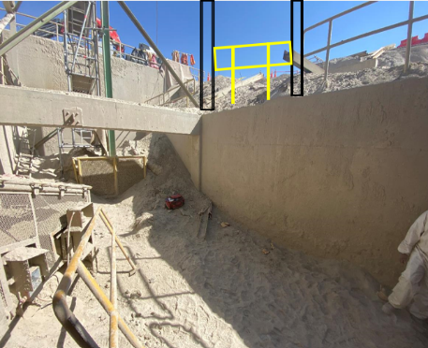
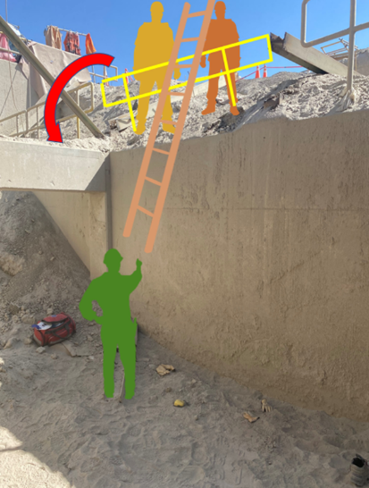
Fall from Heights
PFE # 2023-35 Event ID # 20011698
Preliminary Incident Details
Operation | Cerro Verde
Date / Time | November 27, 2023 / 2 p.m.
Type | Injury
Summary | Two workers were trying to pass a ladder from a platform to a coworker approximately 3 meters (9 feet) below. They rested the ladder on the railing, which gave way. The two workers and the ladder fell onto the coworker below. Earlier that day, the three workers had cut/removed two beams used to support the railing as part of demolition activities.
Fatal Risk | Fall from Heights
Risk Category | Actionable
Risk Rating | Significant (3) Likely (3)
Findings / Missing Controls | After removing the primary support structures, no new inspection was conducted to check the integrity of the handrails.
Applicable Policies / Procedures | Working at Heights Policy / Standard Workplace inspections
Employee Condition | The three workers sustained several contusions.
Contact | Jorge Chavez Rivera, Mine, Tailings and Water Project Manager
Above: Initial placement of railing with beams attached.
At right: Position of the three workers while passing the ladder.

Slide 8
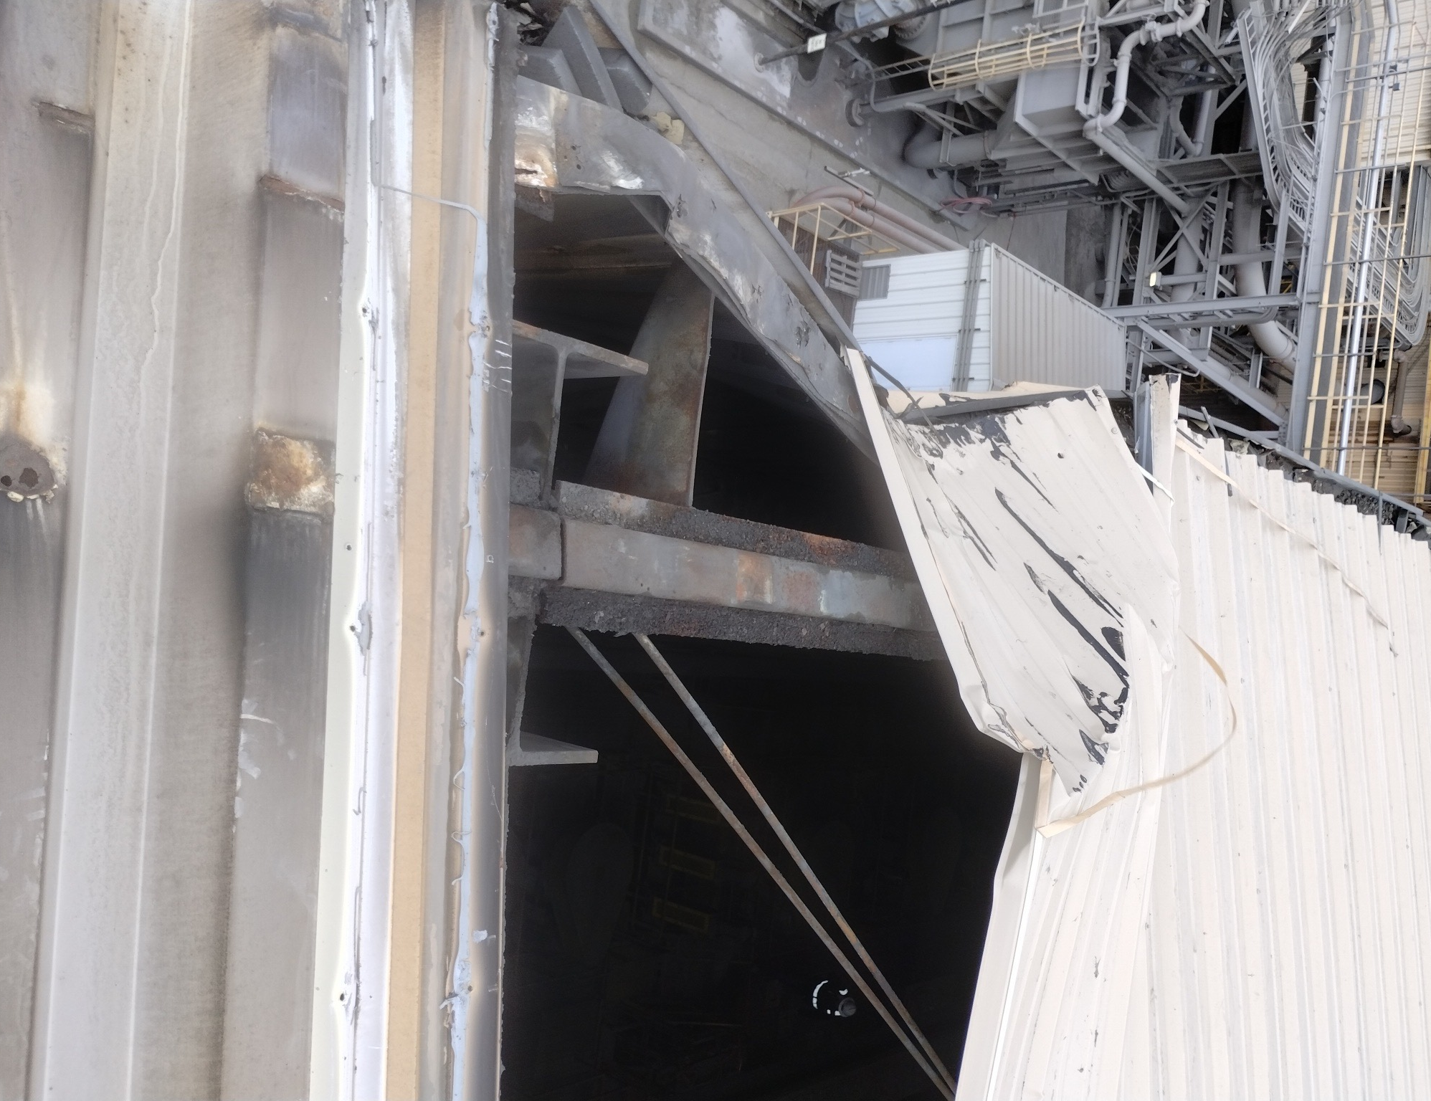
Lifting Operations
PFE # 2023-36 Event ID #20011818
Preliminary Incident Details
Operation | Chino
Date / Time | December 1, 2023 / 10:00 am
Type | Property Damage
Summary | A crane was lifting roof panels to be installed on the roof of the mill when a void opened under the left front outrigger, causing the crane to tip forward and hit the building. There were four employees working on the roof installing the roof panels – three were standing about 25 feet away as the load was being flown in and one was guiding the load with a tag line. When the crane tipped forward into the building, the load swung and came within 4-5 feet of hitting the employee holding the tag line.
Fatal Risk | Lifting Operations
Risk Category | Monitor
Pre / Post Rating | Significant (3) Likely (2)
Findings / Missing Controls | The drainage system was not identified when setting the crane up. The drainage system does not show on the prints of the area.
Applicable Policies / Procedures | Crane and Rigging Policy Crane and Rigging Critical Lift TS
Employee Condition | No injuries
Contact | Sean Maddock, Superintendent-Mill Maintenance, Herman Armijo, Senior Supervisor-Health and Safety
Position of the crane after the event
Location of where the crane hit the roof
Cavity that the outrigger fell into
Damage to the roof

Slide 9
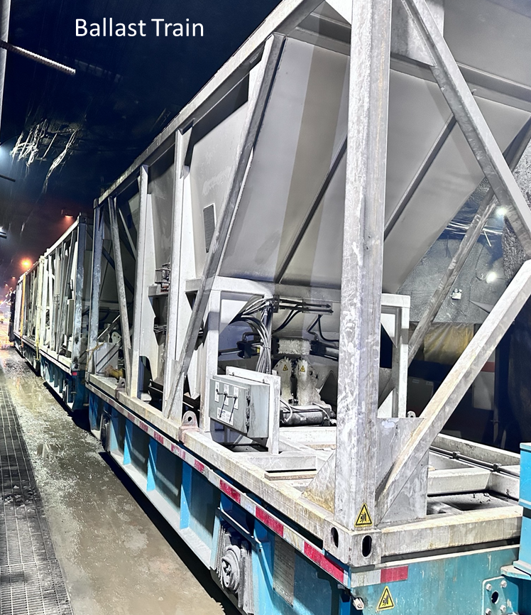
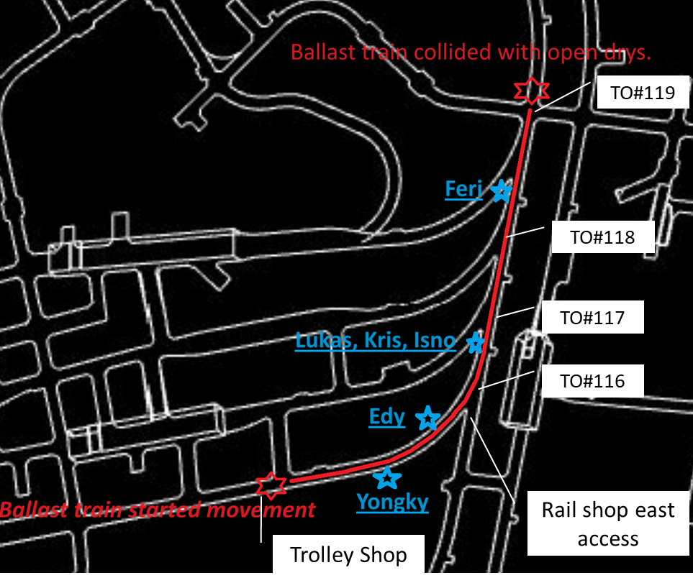
Runaway Ballast Car
PFE # 2023-37 Event ID # 20011829
Preliminary Incident Details
Operation | PT Freeport Indonesia
Date / Time | December 1, 2023 / 1:30 p.m.
Type | Near Miss
Summary | Upon completion of loading the ballast wagon, the rail maintenance team parked the four-wagon set in the trolley shop and decoupled them from the open tray and Zephyr shunting locomotive. A few minutes later the fully loaded ballast wagons, each with 25 tons of material, rolled unattended approximately 190 meters (625 feet) from the trolley shop to a turnout at the rail shop east access. The set collided with a moving freight car and stopped. Six people were exposed during the incident.
Fatal Risk | Rail Impact on Person
Risk Category | Monitor
Pre / Post Rating | Significant (3) Possible (2)
Findings / Missing Controls | Lack of controls and poor work practice for securing wagons before decoupling from the Zephyr locomotive. Failure to install wheel chocks.
Applicable Policies / Procedures | SOP-6.01-UG-T16 Ballast Train Delivery and Ballast Discharging
Employee Condition | No Injury
Contact | Matthew Sullivan, Sr. Vice President-Underground Mine Division
Ballast Train
STOP
START
Path the ballast train followed.

Slide 10
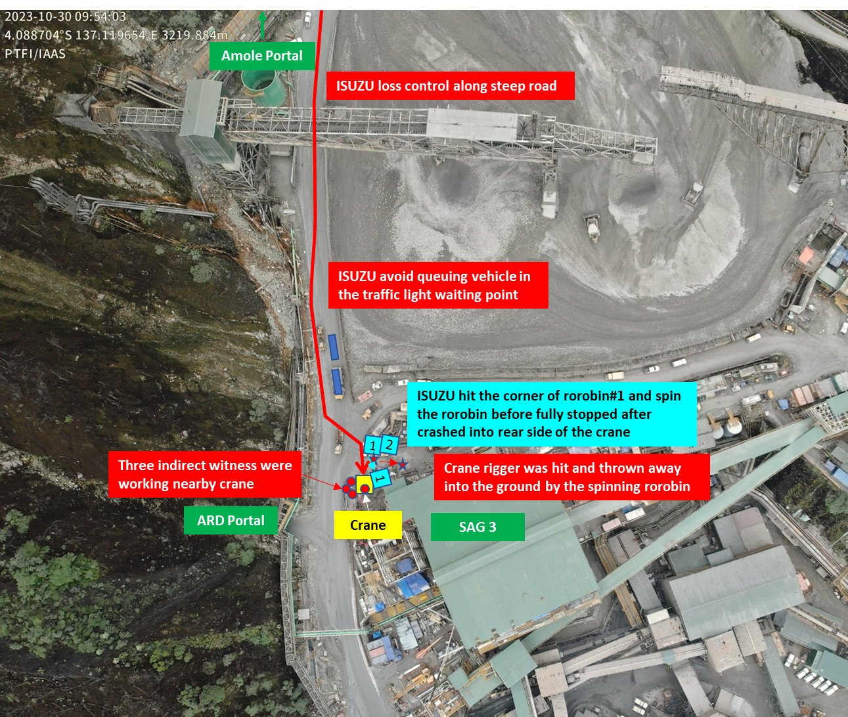
Manhaul Truck Collided with Crane
PFE # 2023-38 Event ID 20011847
Preliminary Incident Details
Operation | PT Freeport Indonesia
Date / Time | December 4, 2023 / 11:30 a.m.
Type | Injury
Summary | An Isuzu passenger transport truck was heading to Kasuang when the driver lost control along a steep downhill road segment. The vehicle hit a trash bin, causing it to spin, before striking a crane and coming to a stop. The trash bin struck a rigger who was standing nearby, resulting in injury. The truck operator’s foot was pinched inside the cabin, requiring extraction to be released from the vehicle.
Fatal Risk | Vehicle Collision or Rollover
Risk Category | Actionable
Pre / Post Rating | Significant (3) Likely (3)
Findings / Missing Controls | Incorrect or unsuccessful use of proper gear selection Failure to operate vehicle according to road conditions Failure to secure control of the vehicle
Applicable Policies / Procedures | SOP-6.01-UGMO03 Operating Procedure Truck Isuzu NPS-75 Type Manhaul, Boom Crane and Rescue Truck in the Underground Mine and Surface Area
Employee Condition | Truck operator received first aid. Rigger sustained chest and hand injuries and is under observation.
Contact | Matthew Sullivan, Sr. Vice President-Underground Mine Division

Slide 11
Haul Truck Collided with Isuzu Man Haul
PFE # 2023-41 Event ID 20012287
Preliminary Incident Details
Operation | PT Freeport Indonesia
Date / Time | December 20, 2023 / 6:30 a.m.
Type | Injury
Summary | The operator of an AD60 haul truck lost control of the vehicle and accelerated into an Isuzu man haul unit coming from the opposite direction. The haul truck collided with the man haul’s front cabin structure, pushing the Isuzu backward ~10 meters (30 feet) before turning it ~90 degrees. The man haul driver and five passengers were able to exit the vehicle without emergency team assistance.
Fatal Risk | Vehicle Collision or Rollover
Risk Category | Monitor
Pre / Post Rating | Significant (3) Possible (2)
Findings / Missing Controls | Failure to operate equipment properly – Prior to hitting the man haul, the haul truck accelerated toward the rib. The operator tried to apply the service brake with the left foot while still applying the throttle. The haul truck hit the rib and articulated right. The sudden change in direction caused the operator’s left foot to came off the brake and right foot to apply full throttle.
Applicable Policies / Procedures | •SOP-6.01-UG-J05 Operating Procedure Truck Elphinstone Series AD30, AD55, AD55B and AD60 •SOP-6.01-UG-J08 Elphinstone AD55, AD55B and AD60 Truck Operating Procedure and Truck Guidance System
Employee Condition | Man haul operator sustained a hand abrasion and shin contusion and was released fit for work after undergoing medical observation at Ridge Camp Clinic.
Contact | Matthew Sullivan, Sr. Vice President-Underground Mine Division
Above: Map of incident location
Right: Photos of damage to the man haul

Slide 12
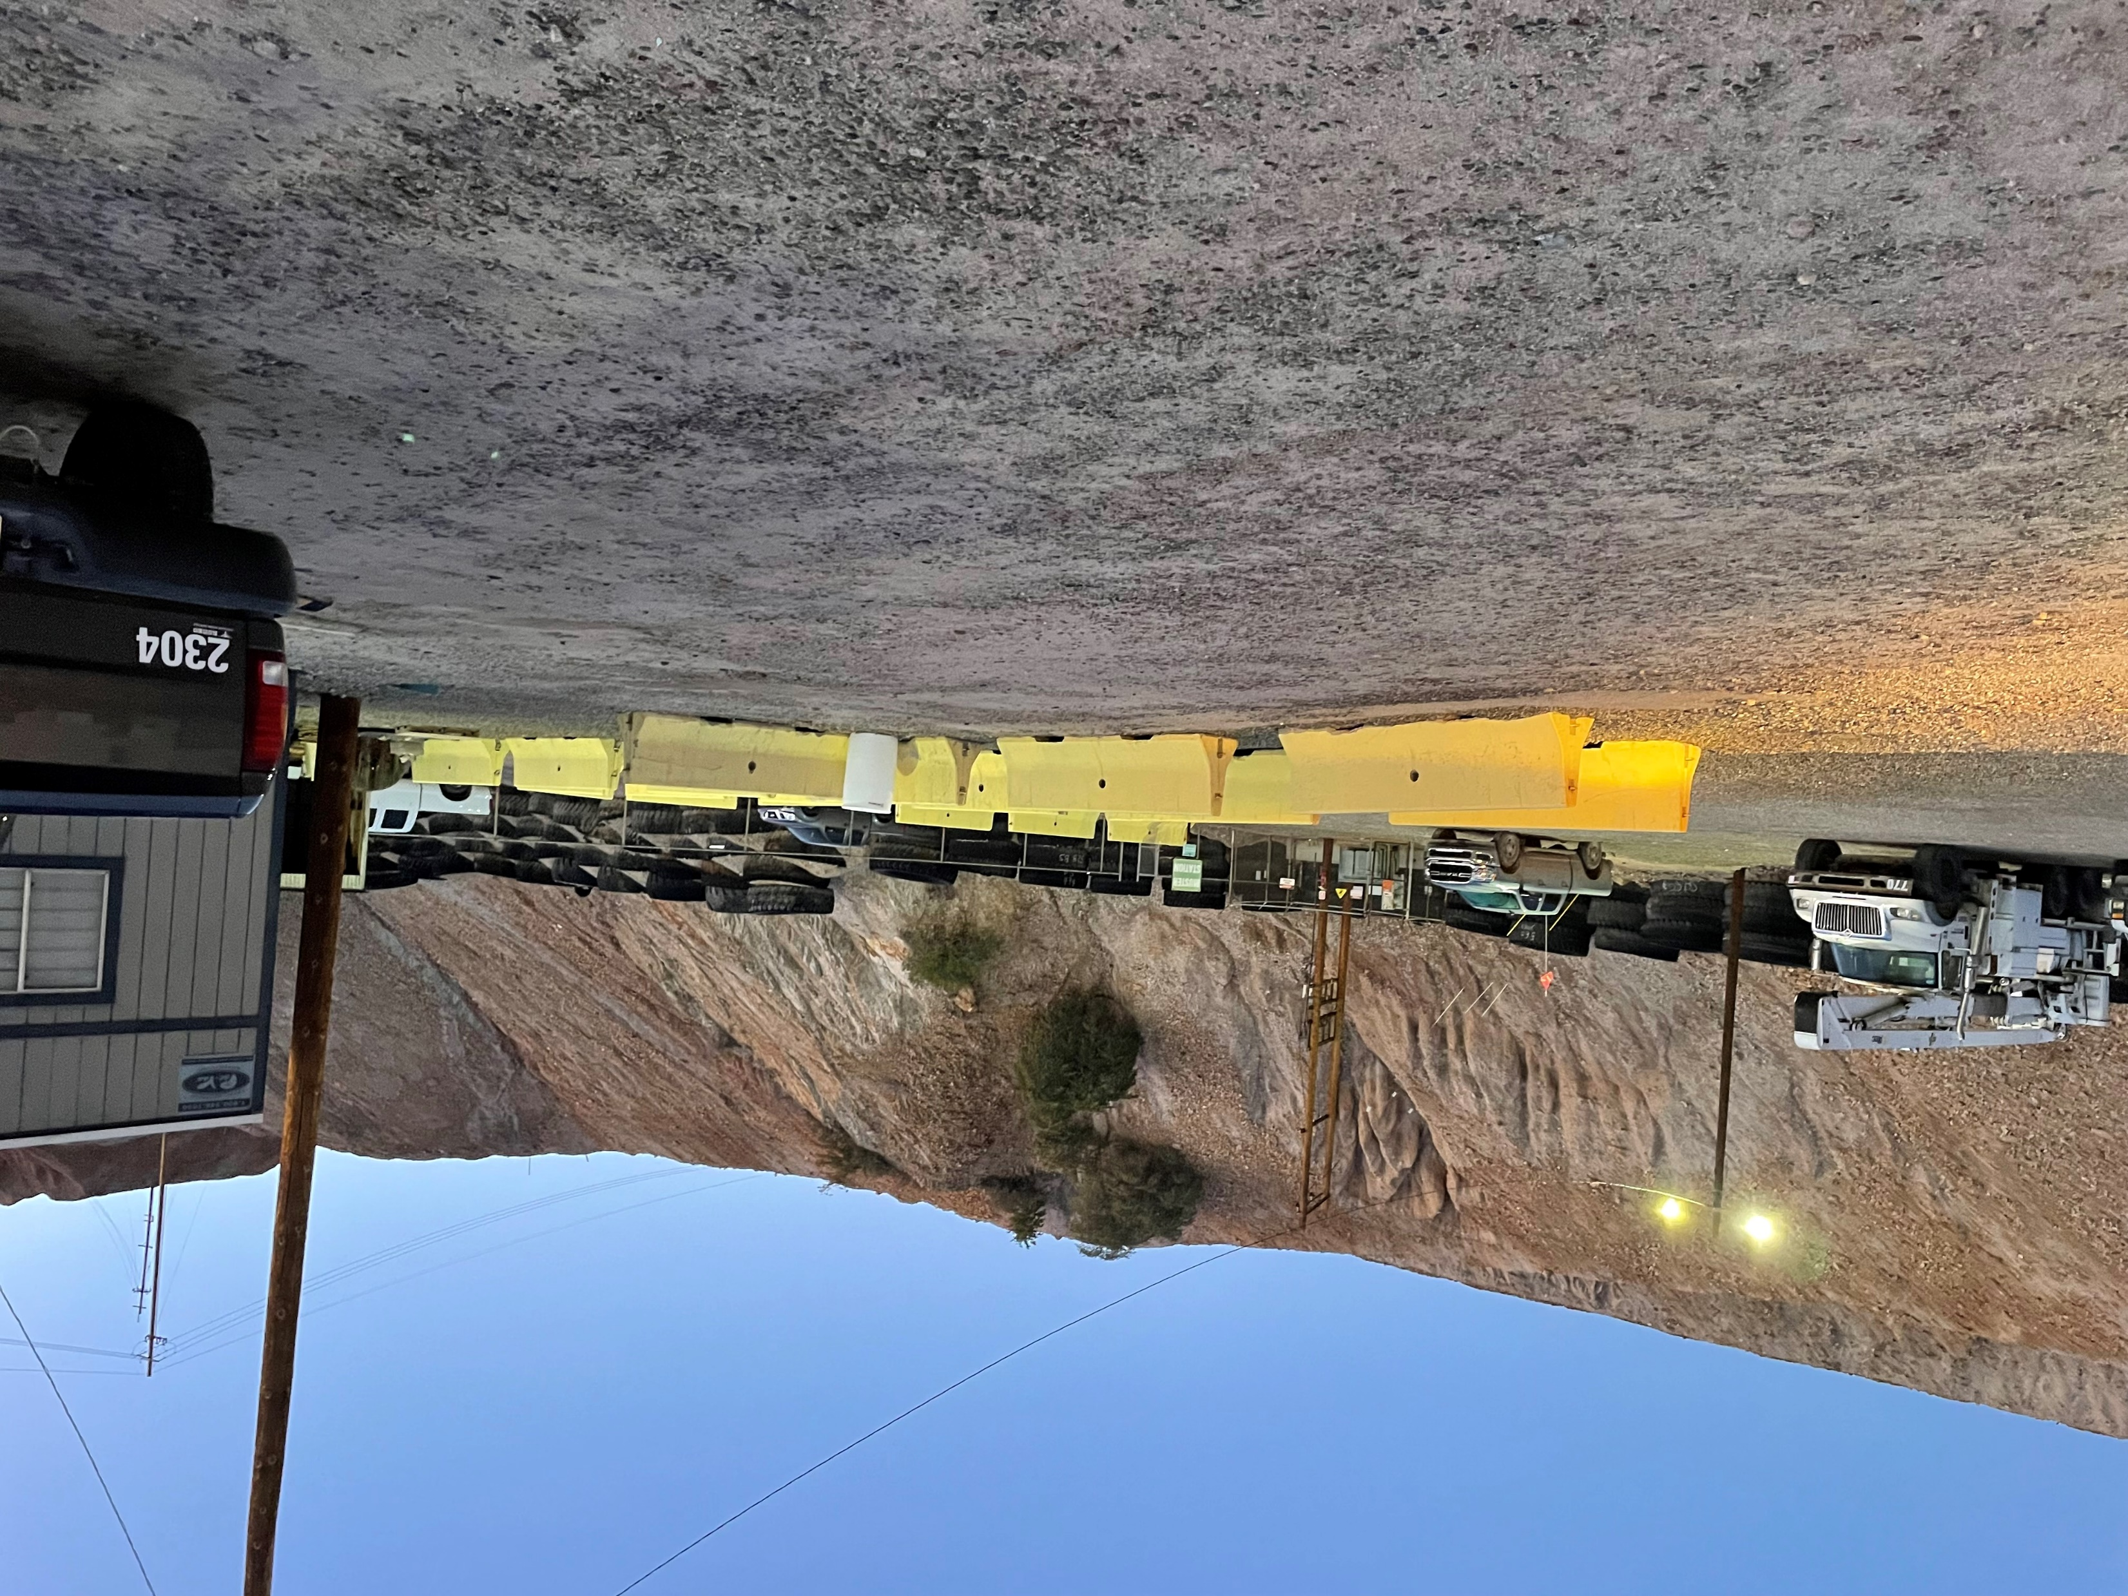
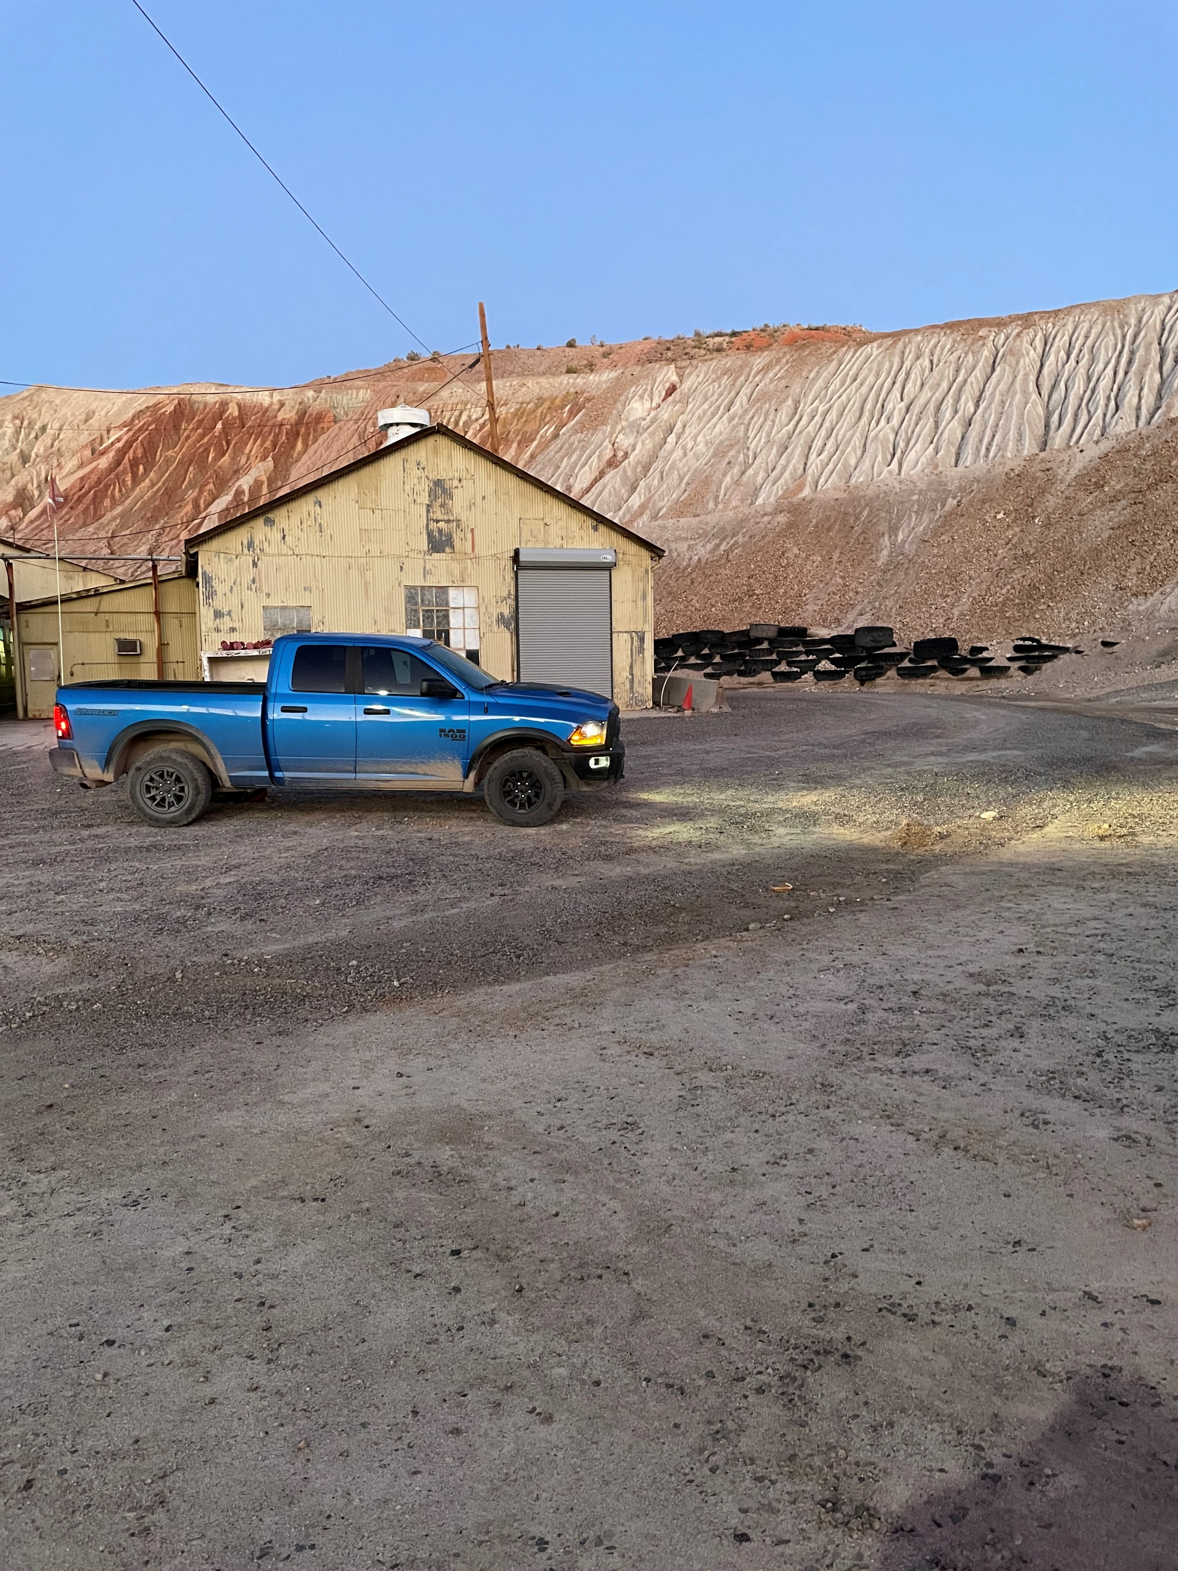
Pedestrian Struck By Light Vehicle
PFE # 2023-42 Event ID # 20012413
Preliminary Incident Details
Operation | Miami Smelter
Date / Time | December 27, 2023 / 5:57 a.m.
Type | Injury
Summary | An employee was walking through a parking lot to join a lineout meeting when a pickup truck made a wide turn into a parking spot and struck the employee, who was knocked to the ground.
Fatal Risk | Vehicle Impact on Person
Risk Category | Monitor
Pre / Post Rating | Significant (3) Possible (2)
Findings / Missing Controls | No documented vehicle inspection performed Employee was crossing parking lot outside of designated walkway Light vehicle windows were not fully defrosted, reducing visibility Speed
Applicable Policies / Procedures | Interaction with Heavy Mobile Equipment – Surface
Employee Condition | The employee was taken to the regional medical center with a scraped knee and abdominal pain and was released with no restrictions.
Contact | Louie Barreras, Senior Supervisor Health and Safety
The light vehicle (left) that struck the employee and the parking spot.

Slide 13
Agency Shares
December 2023
fcx.com
15

Slide 14
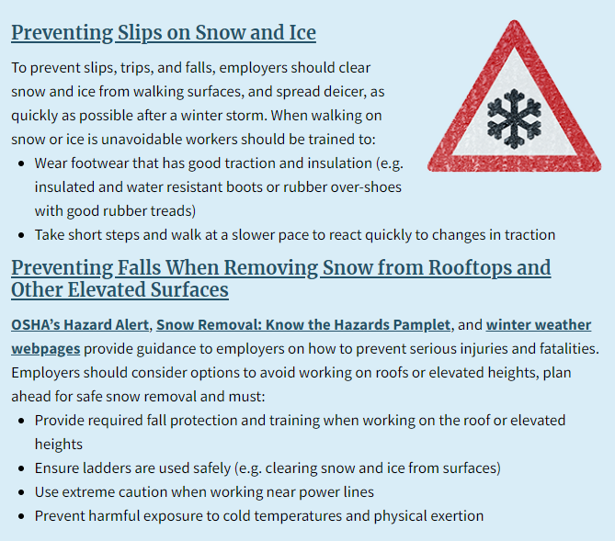
OSHA – Winter Weather
PDF LINK

