Slide 1
Freeport Safety Updates
July 2024
(Incidents and Communications from June 2024)

Slide 2
Freeport Monthly Safety Content
The following slides have been provided to aid in compiling content for monthly Health & Safety meetings, tailgates, etc. with Freeport employees and contractors.
Please keep in mind - some of this information is preliminary and may be pending complete investigations.
Best Practices
Be familiar with content prior to presenting.
Hide/unhide incidents that are relevant to your team.
Interact with your audience, relating information to your specific work.
Update dashboards to share meaningful data (Incident Summary - Power BI, FRM - Power BI). Contact your local Health and Safety staff for site-specific dashboards or external access.

Slide 3
Freeport Safety Incidents, Successes & Alerts
June 2024

Slide 4

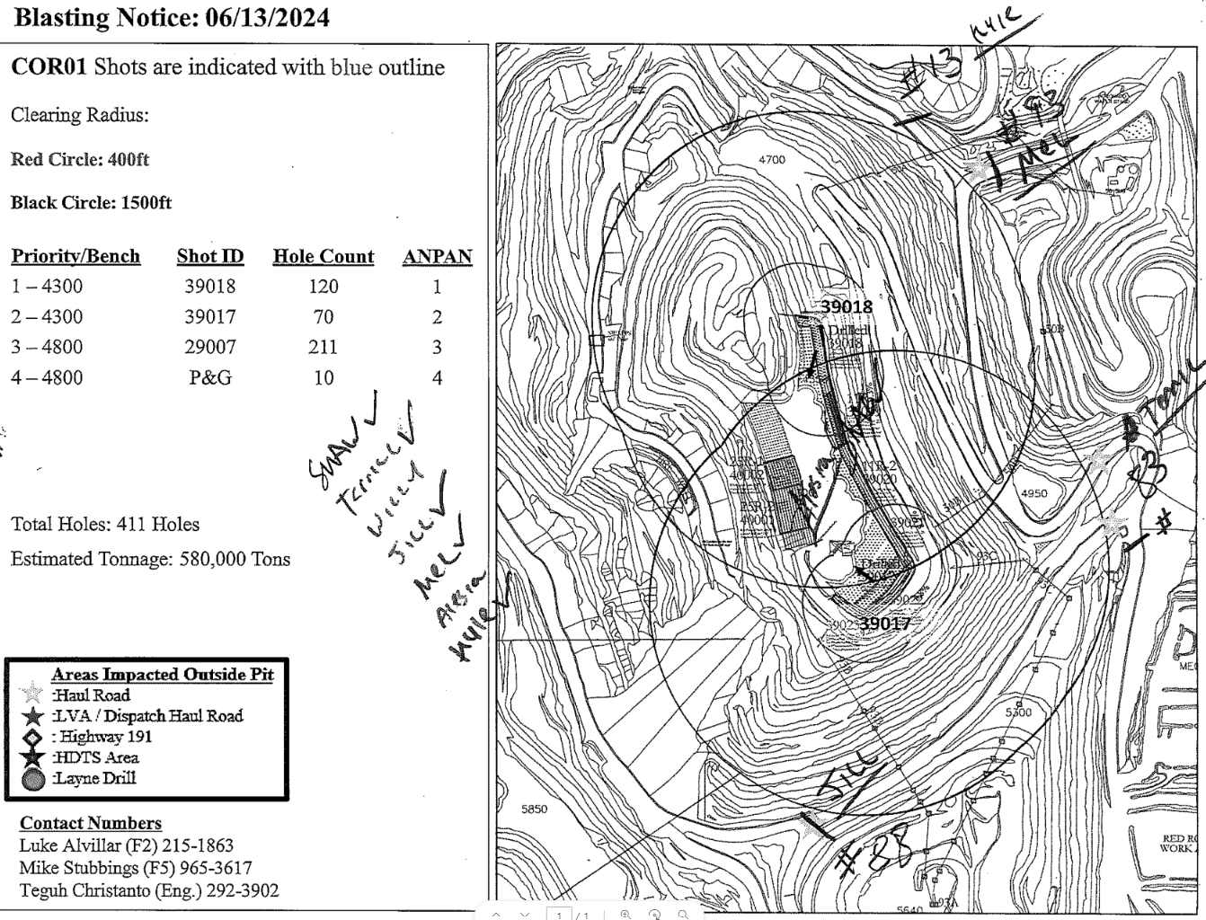
Clearing of Charged Blast Area
Actionable ID # 2024-18 Event ID # 20016455
Blasting
Preliminary Incident Details
Operation | Morenci
Date / Time | June 13, 2024 / 2 p.m.
Event Type | Near Miss
Summary | A drill operator was not cleared during the sweeping process for a planned blast in the Coronado pit. The drill was outside the required 400-foot blasting radius for equipment, but the operator was not clear from the required 1500-foot blasting radius for personnel. The operator reported hearing a radio announcement for the blast and assumed it was the 45-minute reminder because no one came by to pick them up. The operator continued to drill when the blast was initiated. At the end of the day shift, the operator reported they were not cleared for the blast.
Risk Category | Actionable – Significant (3) Likely (3)
Findings / Missing Controls | Failure to properly clear blast zone – employee was never picked up.
Applicable Policies / Procedures | FCX - HS15 Surface Blasting Policy - 2021
Employee Condition | No injuries.
Contact | Rassie Ras, Manager-Health and Safety Kudir Haris, Manager-Fragmentation and Loading
Clearing map from June 13, 2024.

Slide 5
Potential Fatal Events
June 2024

Slide 6

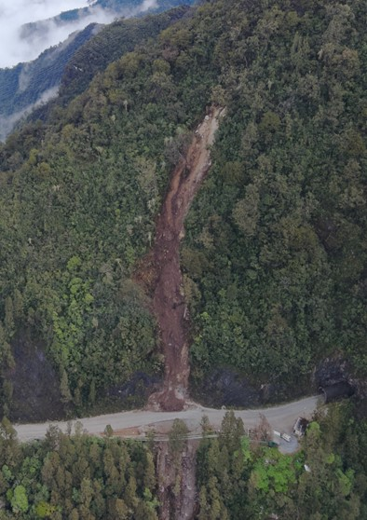
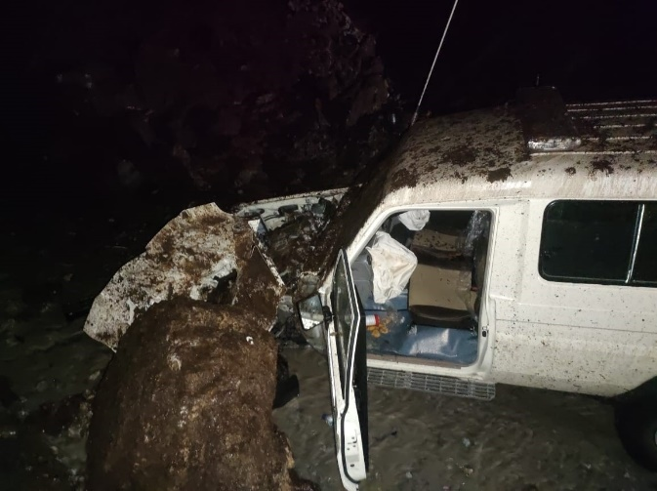
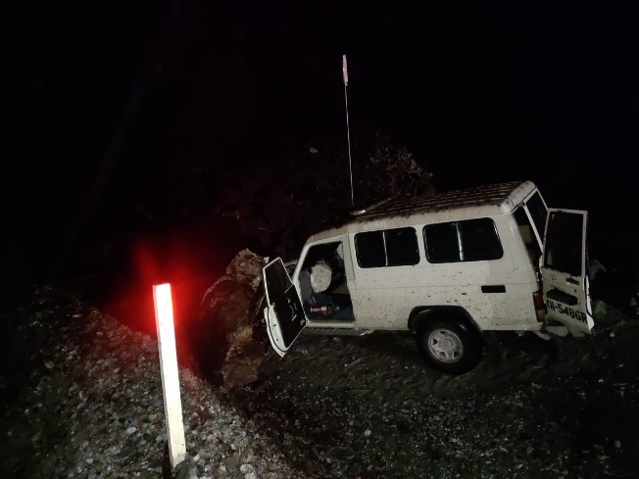
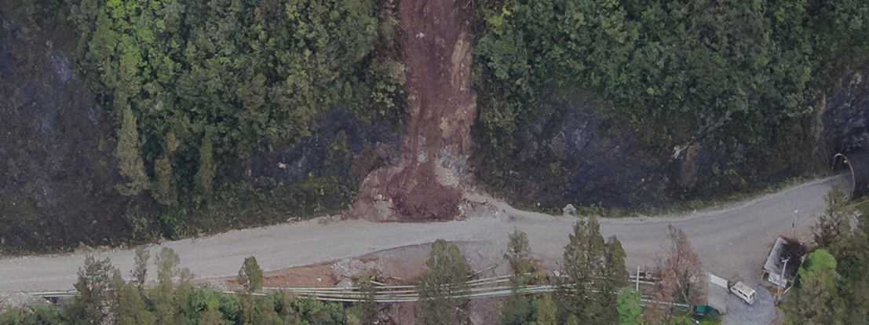
Landslide Hits Light Vehicle
PFE # 2024-13 Event ID #20016577
Vehicle Collision
Preliminary Incident Details
Operation | PTFI – Road Maintenance and GeoEngineering
Date / Time | June 11, 2024 / 1:58 a.m.
Event Type | Property Damage
Summary | A light vehicle was escorting a cargo convoy on the Mine Supply Route (MSR). The vehicle was hit by landslide material, damaging the vehicle’s hood and left front end. A driver and three passengers were in the vehicle and sustained no injuries. The landslide came from hanging material on the upper slope, which was residual hazard from a landslide on June 3, 2024.
Risk Category | Actionable – Significant (3) Possible (3)
Findings / Missing Controls | A Trigger Action Response Plan (TARP) was in place at the time of the incident. It triggered an inspection of the previous landslide area approximately two hours before the new slide but did not require a road closure. A newly developed TARP was in the review process the night of the incident. The new process proposed a road closure trigger, which was implemented the next day (June 12).
Applicable Policies / Procedures | Site standard operating procedure – 4.04.10-KPI-MTCLL-32TRL-011, Entering and Exiting Unit Site Trigger Action Response Plans – TARP-4.04-GEO-GIMC-014-05 and TARP MSR MP50-57 Area
Employee Condition | No injuries.
Contact | James Dellinger, Vice President-Operations Support Ardhin Yuniar, Senior Vice President-GeoEngineering and Environmental
N
Source failure
Approx. Elv. 2640
~ 130 meters
Boulder from the landslide struck light vehicle after passing though a tunnel.
Road / LV Elv. 2520
Source of the landslide came from upper slope. Consisted of topsoil, vegetation and boulders.
Small material retained inside the temporary berm.
Front and rear passengers were able to exit the vehicle uninjured.

Slide 7

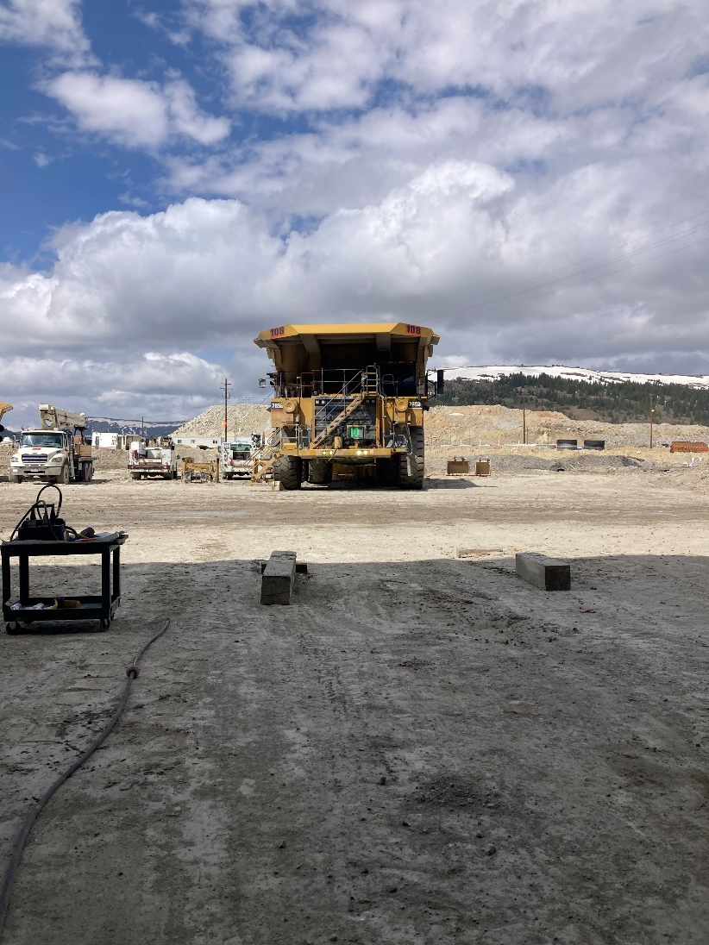
Unoccupied Haul Truck Rolls Backward
Vehicle Impact to Person
PFE # 2024-14 Event ID # 20016572
Preliminary Incident Details
Operation | Climax
Date / Time | June 19, 2024 / 10:25 a.m.
Event Type | Near Miss
Summary | As part of routine maintenance activities, an employee set up a haul truck on wood planks in front of a bay at the shop to remove both outer tires. The employee noticed the truck wasn’t properly centered and went to move it, but it wouldn’t start. The employee called over two other technicians, who went under the truck and behind the front left tire to air start it. When air was applied, the truck started and rolled backward, missing the two technicians underneath. The truck traveled about 25 yards in reverse across the road before coming to a stop against a berm. Initial review indicates the park brake was not set and only one chock was set.
Risk Category | Actionable – Significant (3) Likely (3)
Findings / Missing Controls | Failure to follow proper protocols Park brake was not set Only one chock was placed to prevent movement
Applicable Policies / Procedures | N/A
Employee Condition | No injury
Contact | Amy Reyes, Senior Supervisor-Health and Safety
A view of the haul truck after it rolled off the wood planks and crossed the road in reverse before coming to a stop against a berm.

Slide 8

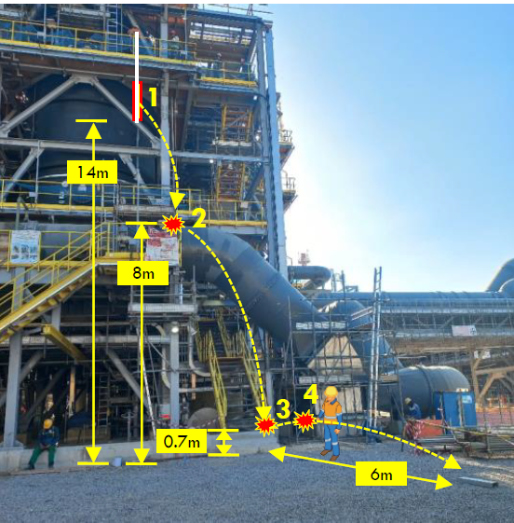
Dropped C-channel Strikes Employee
PFE # 2024-15 Event ID # 20016606
Falling Objects
Preliminary Incident Details
Operation | Manyar Smelter Project
Date / Time | June 20, 2024 / 1:30 p.m.
Event Type | Injury - Medical Treatment
Summary | While performing housekeeping activities, a C-channel (approximately 25 lbs) was hoisted with a 12-mm nylon rope from the third to the second level of the structure. While being hoisted, the C-channel beam became untied and fell. It bounced off the structure three times and struck the right hand of an employee who was walking before landing on the ground.
Risk Category | Monitor – Significant (3) Likely (2)
Findings / Missing Controls | The area immediately below the structure was barricaded, but the beam bounced outside the exclusion zone.
Applicable Policies / Procedures | Site Dropped Object Prevention Plan Site Permit to Work procedures Flagging and Barricading Policy
Employee Condition | Employee suffered a contusion on the hand and a fractured finger.
Contact | Zachary Scrivner, Manager-Corporate Project Engineering Safety
Diagram of the dropped channel path, contact points and elevations.

Slide 9
Agency Shares
June 2024

Slide 10
Safety Share – Heat Related Illness
According to the Center for Disease Control and Prevention, heat stroke is the most serious type of heat-related illness and occurs when the body can no longer control its temperature. Heat stroke can cause permanent disability or death. By contrast, heat exhaustion is the body’s response to an excessive loss of water and salt, usually through excessive sweating.
HEAT STROKE | HEAT EXHAUSTION
Confusion Altered mental status Slurred speech Loss of consciousness (coma) Hot, dry skin or profuse sweating Seizures Very high body temperature Fatal if treatment is delayed | Headache Nausea Dizziness Weakness Thirst Irritability Heavy sweating Elevated body temperature Decreased urine output
Eliminate Hazards and Prevent Injury
Drink enough hydrating fluids.
Hydrate before, during and after work – drink water or electrolyte-containing beverage every 20 minutes, avoid energy drinks.
Take breaks as needed. Consider your needs based on temperature, humidity and work conditions.
Wear appropriate loose-fitting and breathable clothing whenever possible.
Monitor yourself and others for signs of heat illness.

