Slide 1
Freeport Safety Updates
June 2024
(Incidents and Communications from May 2024)

Slide 2
Freeport Monthly Safety Content
The following slides have been provided to aid in compiling content for monthly Health & Safety meetings, tailgates, etc. with Freeport employees and contractors.
Please keep in mind - some of this information is preliminary and may be pending complete investigations.
Best Practices
Be familiar with content prior to presenting.
Hide/unhide incidents that are relevant to your team.
Interact with your audience, relating information to your specific work.
Update dashboards to share meaningful data (Incident Summary - Power BI, FRM - Power BI). Contact your local Health and Safety staff for site-specific dashboards or external access.

Slide 3
Freeport Safety Incidents, Successes & Alerts
May 2024

Slide 4
Railcar Acid Burns
Exposure to Hazardous Substance - Acute
ID # 2024-16 Event ID # 20015586
Preliminary Incident Details
Operation | Fort Madison
Date / Time | May 13, 2024 / 12:10 pm
Event Type | Injury – Medical Treatment
Summary | A contractor was depressurizing an acid railcar. While attempting to check the low side pressure valve tree, the employee was unable to maintain a tight seal on the valve and was sprayed with 93% sulfuric acid. The contractor was wearing chemical gloves, a suit, boots, face shield and goggles.
Risk Category | Actionable – Significant (3) Likely (3)
Findings / Missing Controls | Acid tank was not properly depressurized. Operator deviated from depressurizing procedures. Improper depressurizing training. Missing and improperly worn personal protection equipment. Failure to conduct periodic monitoring and assessment of contractor transload operations.
Applicable Policies / Procedures | FCX-HS28 – Sulfuric Acid Bulk Handling Policy FCX-HS01 Administration Requirements Policy
Employee Condition | Contractor sustained second-degree burns.
Contact | Michael Alsbrook, Manager-Health and Safety Sarah Johnson, Manager-Moly Operations
Re-enactment of valve assembly.
Contractor suit following acid exposure.
Railcar tank set up.

Slide 5
Tractor Slid Down Bench
Vehicle Collision or Rollover
ID # 2024-17 Event ID # 20015876
Preliminary Incident Details
Operation | Cerro Verde
Date / Time | May 25, 2024 / 11:17 p.m.
Event Type | Injury – First Aid
Summary | A dozer was tasked with pushing down a corniced overhang in fill material to two loaders below. The dozer used an existing ramp to access the top and decided to move a small windrow in the access; which wasn’t part of the job. While doing so, the operator moved too close to the corniced crest and rolled one-and-a-quarter times down an 8-meter bank before stopping. A loader operator immediately issued a Mayday.
Risk Category | Actionable – Significant (3) Likely (3)
Findings / Missing Controls | Dozer operator expanded access on the upper mining face. The dozer was working parallel to the corniced ridge. The weight of the dozer was not supported.
Applicable Policies / Procedures | Site-specific standard operating procedures.
Employee Condition | Dozer operator was transported to the Cerro Verde medical center by emergency personnel. Operator sustained multiple injuries.
Contact | McKay Pugmire, Manager-Fragmentation and Loading
A CAT truck was leaving the loading front when the dozer fell. The loader operator activated the emergency button and activities were stopped.
Dozer position following the roll. The operator exited the machine without assistance.
Trajectory of the tractor, to the point where it slid and rolled down an 8-meter bank.

Slide 6
Potential Fatal Events
May 2024

Slide 7
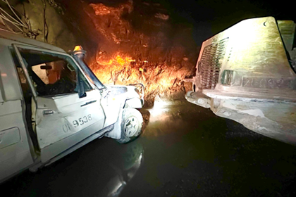
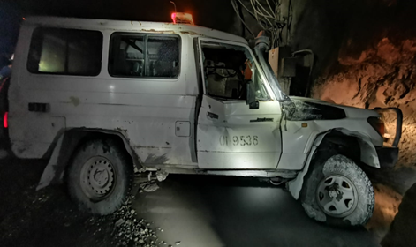
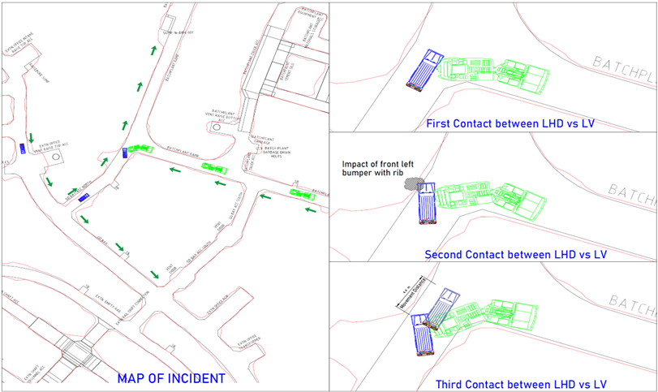
Loader Hit Light Vehicle in GBC Mine
PFE # 2024-10 Event ID # 20015423
Vehicle Collision
Preliminary Incident Details
Operation | PTFI – Underground Mines Division, GBC Mine
Date / Time | May 8, 2024 / 2:55 a.m.
Event Type | Property Damage
Summary | A loader (LHD) was travelling up a ramp in reverse toward an intersection to turn left. Before entering the intersection, the operator stopped, sounded the horn four times and flashed the lights. A light vehicle (LV) – unaware of the LHD and stop sign – approached the intersection in third gear, slowed and sounded the horn about 4 meters before entering the area. Upon doing so, the LV was struck by the LHD’s rear tow hook and cabin side wings. The LV was pushed into the rib and then back about 4.4 meters, resulting in significant damage to the driver's side door and front, righthand-side quarter panel. In addition, the driver's side window and windshield were broken, and both tires on the passenger side were pulled off the rim.
Risk Category | Actionable – Significant (3) Likely (3)
Findings / Missing Controls | Failure by LV to follow procedure for approaching and safely passing through intersection. Failure by LHD to follow the Traffic Management Plan – the area is listed as one-way. The reverse camera was not functioning, which increased the LHD blind-spot while reversing. The reverse camera is a critical component on pre-start inspection, but the operator used an outdated pre-start checklist without the camera listed.
Applicable Policies / Procedures | SOP-6.01-UG-J01 LHD Operation Procedure SOP-4.04-PTFI-002 Light Vehicle Operation
Employee Condition | No employees were injured.
Contact | Anthony Hall, Manager-GBC Development Andri Abdullah, Manager-Health & Safety UG Division
Damage to light vehicle.
Incident sketch.

Slide 8
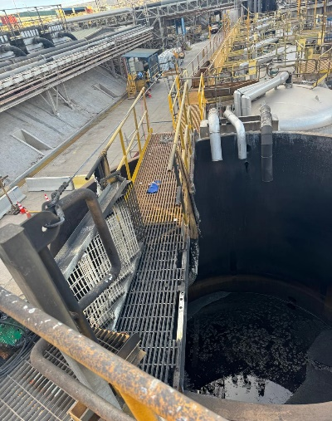
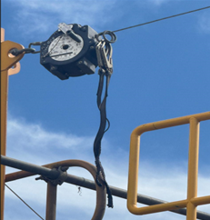
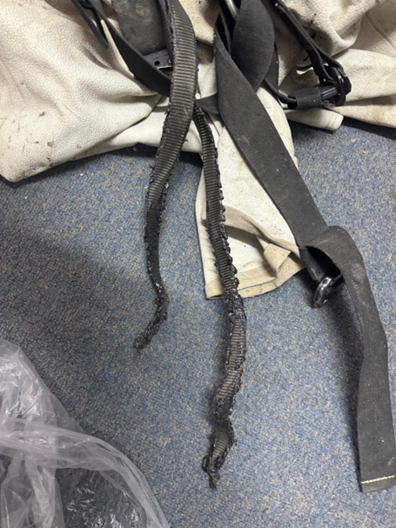
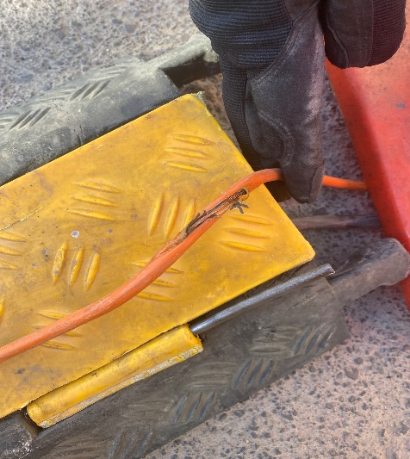
Hydromet Tank Fire
PFE # 2024-11 Event ID # 20015578
Fire
Preliminary Incident Details
Operation | El Abra
Date / Time | May 13, 2024 / 4:05 p.m.
Event Type | Injury – First Aid
Summary | Three contractors were performing hot work on a platform at the tank farm. A failure in the undersized extension cord caused a fire at the welding machine, which subsequently spread to the fire blanket. One employee who was tied-off was unable to get free from the harness until the lanyard was completely burned through by the fire. The other employee attempted to suppress the fire with a portable fire extinguisher but was unsuccessful. The emergency response team was notified and quickly arrived on scene to extinguish the fire.
Risk Category | Actionable – Significant (3) Likely (3)
Findings / Missing Controls | Improper selection of appropriately rated extension cord. Improper evaluation of fire risk and exposure to electrolyte backwash tank. Improper use of fire blanket – the blanket was left in place for a week and was subsequently contaminated with organic. Standard operating procedures was not developed for hot work around the tank farm.
Applicable Policies / Procedures | FCX-HS06 Hot Work Policy FCX-HS02 Working at Heights Policy GAre0012 El Abra Hot Work Regulation
Employee Condition | One employee sustained superficial burns to right ear.
Contact | Mack Rojas, Manager-Safety, Health and Technical Training José Guzman, Senior Manager-Engineering and Services
Platform where fire started.
Reactor and burned lanyard.
Burned lanyard.
Burned welding machine.
Failed extension cord.

Slide 9
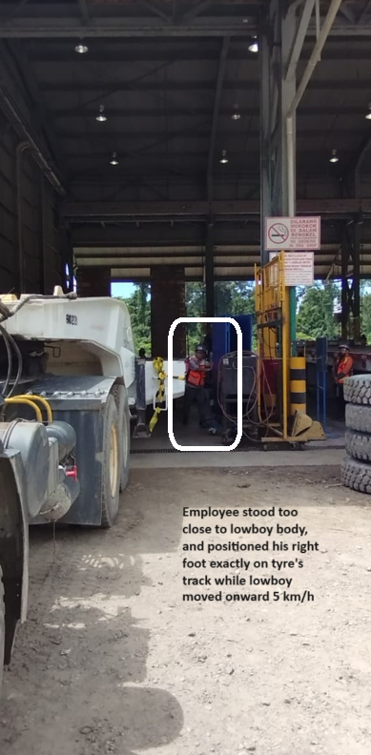
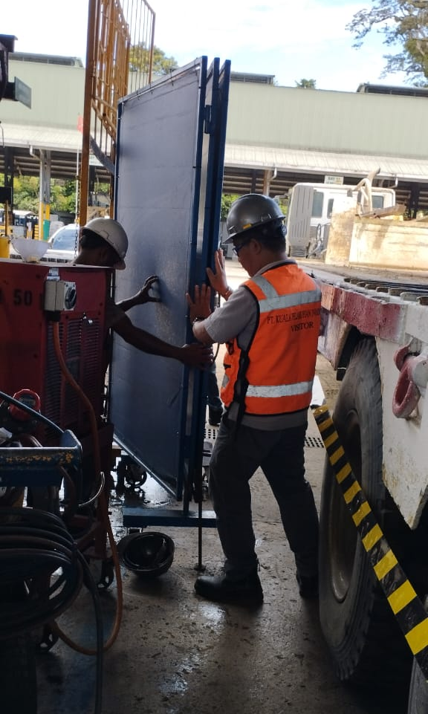
Lowboy Runs Over Employee’s Foot
Vehicle Impact to Person
PFE # 2024-12 Event ID # 20015984
Preliminary Incident Details
Operation | PTFI Technical Services – Maintenance Support Division
Date / Time | May 29, 2024 / 7:59 a.m.
Event Type | Injury – Medical Treatment
Summary | A lowboy was moving out of the trailer shop at 5km/h (3 mph) with a spotter on the right side. Another employee approached the moving equipment from the left side to move a welding screen that had potential to be hit. The employee was positioned facing the welding screen. The left rear tire of the lowboy ran over the employee’s right foot, resulting in major leg and foot injuries.
Risk Category | Actionable – Significant (3) Likely (3)
Findings / Missing Controls | Failure to maintain safe distance from moving vehicles. Failure to maintain safe visibility (victim unseen by spotter). Failure to maintain positive communication between operator, spotter and offsiders.
Applicable Policies / Procedures | Site standard operating procedure 4.04.10-KPI-MTCLL-32TRL-011, Entering and Exiting Unit
Employee Condition | Employee sustained a crushing injury to the right foot and multiple fractures below the knee. Employee is under medical observation.
Contact | Lucky Hermawan, Vice President-Maintenance Support Division
Incident reenactment. Position of employee to moving equipment.
Incident reenactment. Position of employee’s right foot and the welding screen. The lowboy was moving 5km/h (3 mph).

Slide 10
Agency Shares
May 2024

Slide 11
MSHA Health Locator Tool
The MSHA Health Locator Tool for Miners was developed to address your unique health needs as a miner and connect you with essential healthcare services. You can use this Locator to quickly and easily access a diverse range of health information and care resources such as medical support, specialized services, and helpful information, based on your selected location and search distance.
Find more info here

Slide 12
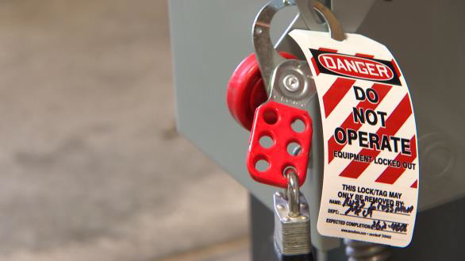
Safety Share – Lock Out Tag Out Try Out
Lock Out/Tag out/Try out (LOTOTO)
Protects miners by preventing others from turning on equipment or from a release of energy while working on or servicing equipment & machinery. Using LOTOTO controls hazardous energy.
Lock Out / Tag Out
Each person must apply their own locks & tags to the power sources to ensure that the machine or equipment being worked on cannot be started. In some instances, the equipment directly before or after the machinery or equipment you are working on may need
Try Out
Test to see if the equipment is properly locked out by trying to start it.
Steps to use LOTOTO
Identify the equipment/ machinery that needs to be shut down and ALL its energy sources
Determine if there are any stored energy sources
Notify all affected workers about the shutdown
Properly shut down equipment and machines
Properly shut off the power sources at the source. Emergency shut off switches should not be used as a power source.

Slide 13
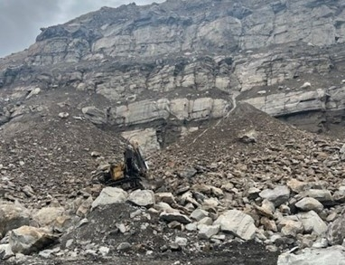
MSHA Fatality Alert
MINE FATALITY – On May 16, 2024, a miner died when the excavator he was operating traveled over a 200-foot highwall.
Eliminate hazards and prevent injuries:
Reduce fall hazard exposure by limiting the distance equipment can safely operate near the edge of highwalls.
Examine benches to identify hazards related to insufficient bench width, locations of other equipment, loose material, etc.
Discuss highwall hazards with miners and train miners to recognize these hazards.
Address hazards in the mine’s Surface Mobile Equipment Safety Program. Include safe work practices for weather conditions (fog, heavy rain, or snow) that could reduce visibility.
PDF LINK

