Slide 1
Freeport Safety Updates
May 2024
(Incidents and Communications from April 2024)
fcx.com

Slide 2
Freeport Monthly Safety Content
The following slides have been provided to aid in compiling content for monthly Health & Safety meetings, tailgates, etc. with Freeport employees and contractors.
Please keep in mind - some of this information is preliminary and may be pending complete investigations.
Best Practices
Be familiar with content prior to presenting.
Hide/unhide incidents that are relevant to your team.
Interact with your audience, relating information to your specific work.
Update dashboards to share meaningful data (Incident Summary - Power BI, FRM - Power BI). Contact your local Health and Safety staff for site-specific dashboards or external access.
1

Slide 3
Freeport Safety Incidents, Successes, & Alerts
April 2024
fcx.com
3

Slide 4
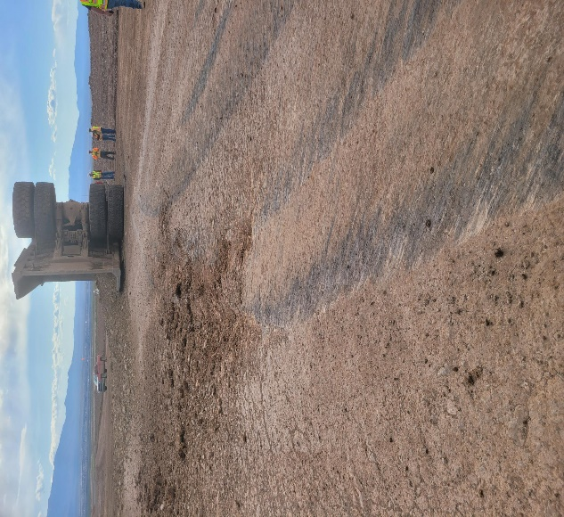
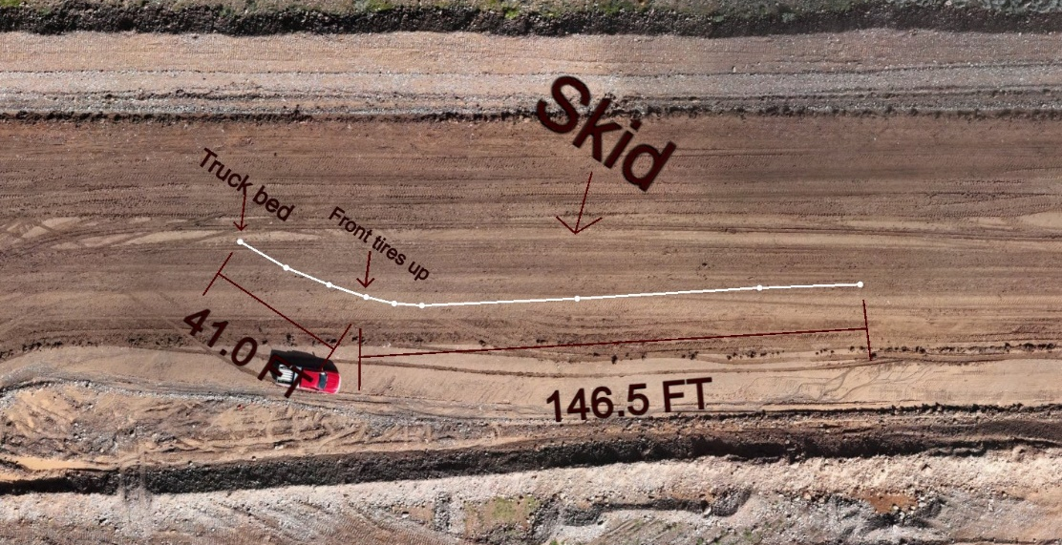
Contractor Haul Truck Tips Over
ID # 2024-15 Event ID # 20014787
Vehicle Collision
Preliminary Incident Details
Operation | Safford
Date / Time | April 9, 2024 / 3:25 p.m.
Event Type | Property Damage
Summary | A 773D haul truck operator was traveling on the west side of a leach pad, hauling the final load of the day, when the truck slid approximately 146 feet and tipped on its side.
Risk Category | Actionable – Significant (3) Likely (3)
Findings / Missing Controls | Truck speed was estimated as higher than allowed. 773 trucks were not initially planned to be used for leach pad operations. The trucks are not governed for speed like the 777 fleet.
Applicable Policies / Procedures | FCX23 - Interaction with Heavy Mobile Equipment
Employee Condition | The contractor employee was able to exit the truck and was evaluated by site rescue, then released as uninjured.
Contact | Duane Sexton, Senior Project Manager-Engineering Drew Borcherding, Manager-Health and Safety
Skid marks and roadway.
Front of truck
Truck slide and tip over area.

Slide 5
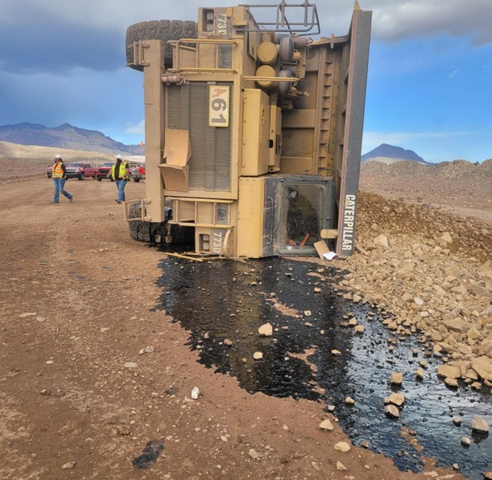
ACTIONABLE LESSONS LEARNED: Contractor Haul Truck Tips Over
Causal Factors
Vehicle Collision
A haul truck was travelling approximately 40 mph down a 3-4% grade, fully loaded. The operator aggressively applied the retarder brake, causing the haul truck to skid, fishtail and flip.
Incident Overview
Safford, April 9, 2024
A 773D haul truck operator was traveling on the west side of a leach pad, hauling the final load of the day, when the truck slid approximately 146 feet and tipped on its side.
Site Specific Actions
Engineering – 773D haul trucks, specific to the Safford leach pad construction project, have been governed to limit speeds to the appropriate level.
Administrative – Contractor to present documented process to Freeport project managers regarding expectations of contractor supervision. Process to universally enforce and hold operators accountable when actions violate safety standards and policies.
Administrative – Freeport project managers to approve contractor accountability process. Contractor to share/communicate how this will be applied and enforced going forward.
Administrative – Evaluate the need for global action items for earthmoving projects. Define when governors and technology should be applied to equipment, including haul trucks, as opposed to a reliance on behavioral speed adherence.
Corporate Projects Group Actions
We Champion a Work Environment Where Everyone Goes Home Safely

Slide 6
Steps YOU Can Take to Prevent Repeat Incidents
Mine Employees
Vehicle Collision
Always follow posted speed limits and drive at slower speeds when adverse driving conditions exist.
Hold one another accountable – if you see a co-worker driving in an unsafe manner, stop the job and have a conversation regarding applicable risks.
Incident Overview
Safford, April 9, 2024
A 773D haul truck operator was traveling on the west side of a leach pad, hauling the final load of the day, when the truck slid approximately 146 feet and tipped on its side.
Mine Leadership
Make frequent visits to the field to observe driving practices. Verify the safety of operators and other employees working in the area.
Set the example for your teams. Be present, be intentional, and showcase the culture and behaviors you want your team to be influenced by.
Stop the job when appropriate. Share high-risk incident examples during tailgate meetings to demonstrate stop work expectations.
All of Us
Take time to get the job done right, even if it's nearing the end of shift.
Stay focused on safety so everyone can go home safely.
Turning Our Commitment into Action

Slide 7
Potential Fatal Events
April 2024
fcx.com
8

Slide 8
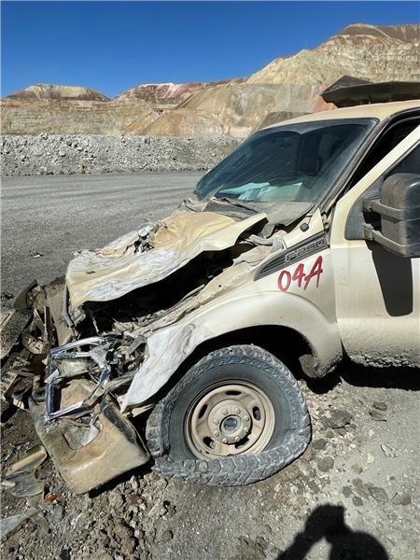
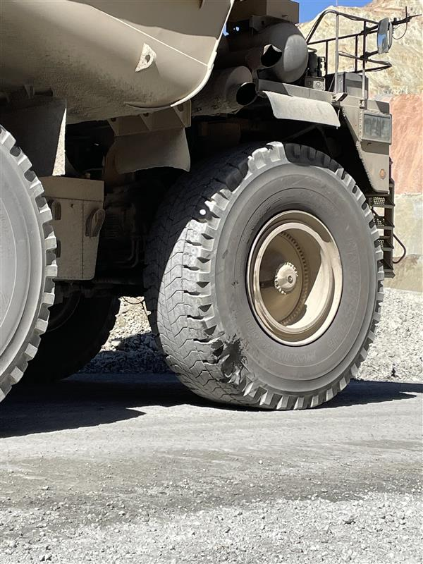
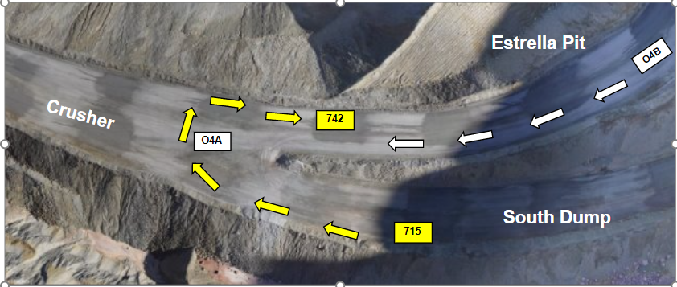
Haul Truck Runs Over Pickup
PFE # 2024-8 Event ID # 20014938
Vehicle Collision
Preliminary Incident Details
Operation | Chino
Date / Time | April 16, 2024 / 3:42 p.m.
Event Type | Property Damage
Summary | A pickup truck, travelling from Estrella Pit towards the Crusher, entered an intersection at the same time as a haul truck travelling down a ramp from the South Dump to the Estrella Pit. The pickup did not see the haul truck and proceeded into the intersection, running into the front tire of the haul truck as it was making a right turn. The rear dual tires of the haul truck ran over the hood of the pickup truck.
Risk Category | Actionable – Significant (3) Likely (3)
Findings / Missing Controls | Poor road design Failure to yield to traffic Poor vehicle cleanliness obstructed the pickup driver’s view
Applicable Policies / Procedures | Interaction with Heavy Mobile Equipment Surface
Employee Condition | No employee injuries.
Contact | James Cook, Manager-Health and Safety Chris Allen, Manager-Mine Chino
Pickup truck following incident
Damage to haul truck from impact.
Intersection of incident. Yellow arrows – haul truck. White arrows – pickup truck.

Slide 9
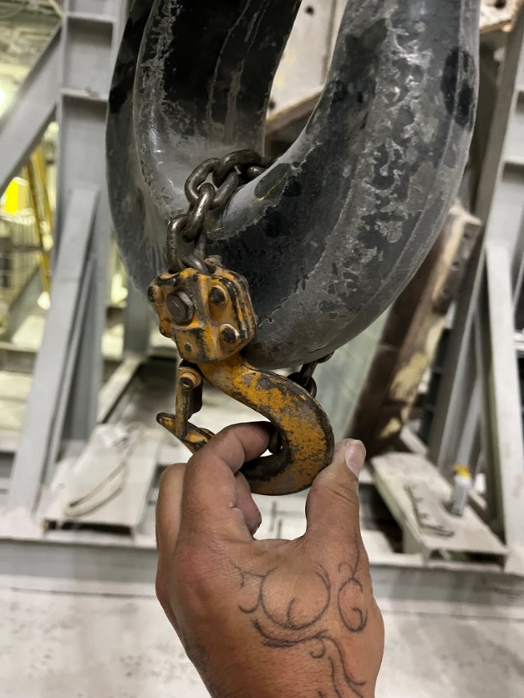
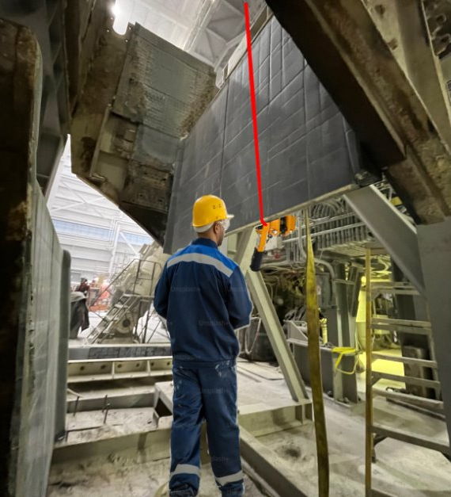
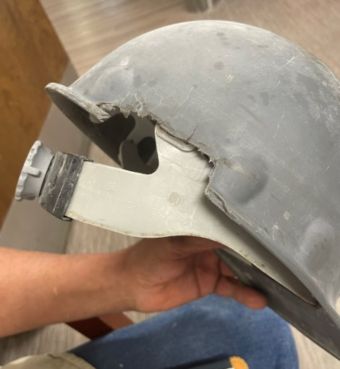
Employee Struck with Rigging
Uncontrolled Release of Energy
PFE # 2024-9 Event ID # 20014989
Preliminary Incident Details
Operation | Morenci
Date / Time | April 18, 2024 / 3:15 p.m.
Event Type | Injury – Restricted Duty
Summary | A mechanic was lowering guides with a crane. A come-along was attached to the crane and the guide to stabilize and balance the load. The mechanic observed signs of over-tension and tried to loosen the come-along. While adjusting, the chain broke, causing a component to strike the employee's hard hat.
Risk Category | Actionable – Significant (3) Likely (3)
Findings / Missing Controls | Lifting execution – improper use of equipment
Applicable Policies / Procedures | FCX-HS32 Crane and Rigging Policy Original equipment manufacturer procedures
Employee Condition | Employee sustained two lacerations and was treated with multiple staples.
Contact | Jacob Sweet, Manager-Health and Safety John Murphy, Manager-Metcalf Mill
Come-along secured to the crane hook.
Reenactment of employee’s position and chain location (red line).
Employee’s hard hat after impact.

Slide 10
Agency Shares
April 2024
fcx.com
15

Slide 11
MSHA Final Ruling on Silica Standard
30 CFR Parts 56, 57, 60, 70, 71, 72, 75 and 90 – Published 4/18/2024
MSHA has amended its existing standards to better protect miners against occupational exposure to respirable crystalline silica, a significant health hazard, and to improve respiratory protection for miners from exposure to airborne contaminants. MSHA’s final rule also includes other requirements to protect miner health, such as exposure sampling, corrective actions to be taken when a miner’s exposure exceeds the permissible exposure limit, and medical surveillance for metal and nonmetal mines.
Effective date: The final rule is effective June 17, 2024, with exceptions for specific amendments.
Compliance dates: Compliance with this final rule is required April 14, 2025 for coal mine operators and April 8, 2026 for metal and nonmetal mine operators.
Find more on the new standard here

Slide 12
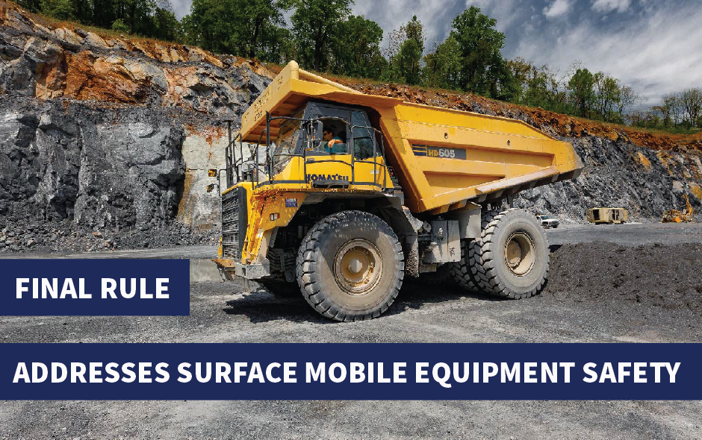
MSHA Safety Program for Surface Mobile Equipment
30 CFR Parts 56, 57, and 77– Published 12/20/2023
MSHA is requiring that mine operators develop, implement, and update, periodically or when necessary, a written safety program for surface mobile equipment (excluding belt conveyors) at surface mines and surface areas of underground mines. The written safety program must be developed and updated with input from miners and their representatives. The written safety program must include actions mine operators will take to identify hazards and risks to reduce accidents, injuries, and fatalities related to surface mobile equipment. The final rule offers mine operators flexibility to devise a safety program that is appropriate for their specific mining conditions and operations
Effective date: The final rule was effective January 19, 2024.
Compliance dates: Compliance with this final rule is required by July 17, 2024.
Find more on the standard here

Slide 13
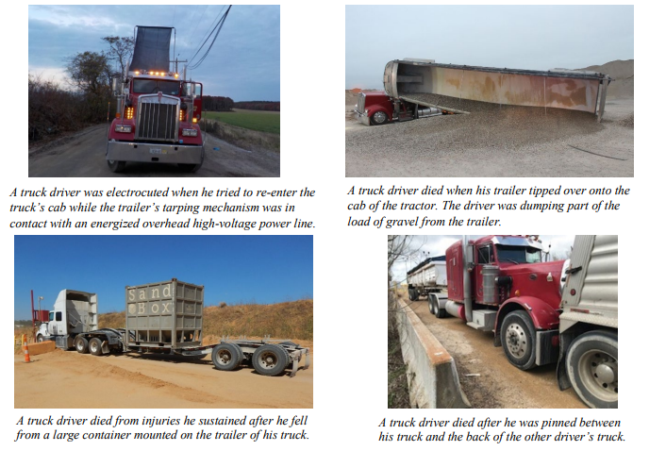
Safety Share – Customer Truck Drivers
Since 2021, customer truck drivers have been involved in six fatal MSHA accidents.
Eliminate hazards and prevent injuries:
Provide site-specific hazard awareness training to customers, including commercial over-the-road truck drivers.
Alert customer truck drivers to changes in traffic procedures, patterns, or road conditions.
Provide fall protection or safe means of access to customers who need to gain access to containers or tankers on their vehicles if there is danger of falling.
Provide and maintain a safe location for drivers to tarp their loads.
Ensure customers follow proper loading and dumping procedures.
Resources LINK

Slide 14
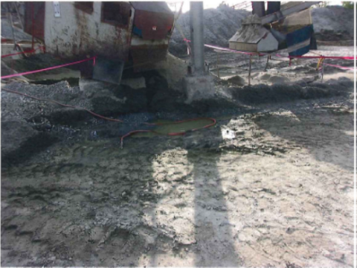
MSHA Fatality Alert
MINE FATALITY – On April 25, 2022, co-workers found a maintenance worker lying face down in a pool of water. The maintenance worker was using a water hose to wash out fine material that had gathered under a tail pulley.
Eliminate hazards and prevent injuries:
Maintain workplaces in a clean and dry condition when possible.
Where wet processes are used, maintain drainage platforms, mats, or other dry standing places.
Ensure that miners have communication systems available when assigned to work alone.
Routinely check in on miners working alone.
Conduct workplace examinations before work begins in an area
PDF LINK

