Slide 1
FCX Monthly Safety Content
The following slides have been provided to aid in compiling content for monthly Health & Safety meetings with FCX employees and contractors.
Please keep in mind - some of this information is preliminary and may be pending complete investigations.
Best Practices
Be familiar with content prior to presenting
Hide/Unhide incidents that are relevant to your team
Interact with your audience, relating information to your specific work
Update dashboards to share meaningful data (Incident Summary - Power BI, FRM - Power BI). Contact your local H&S staff for site-specific dashboards or external access.

Slide 2
FCX Safety Updates
November 2023
(Incidents and Communications from October 2023)

Slide 3
FCX Safety Incidents, Successes, & Alerts
October 2023

Slide 4
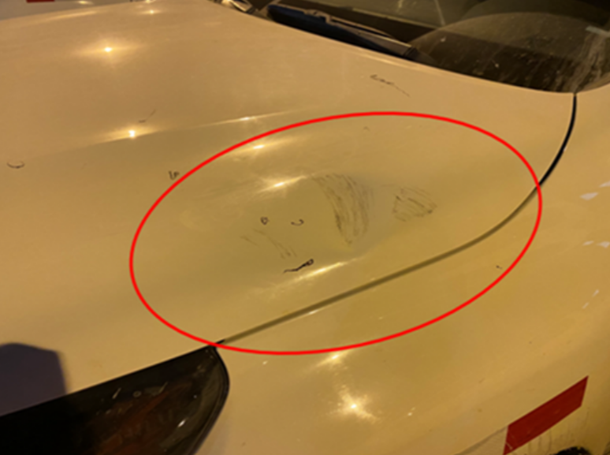
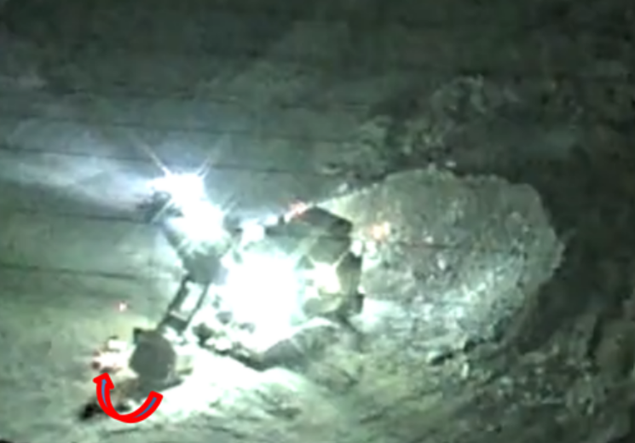
Shovel Hit a Parked Truck
Event ID #20009761
Incident Details
Operation | Cerro Verde
Date / Time | September 20, 2023 / 12:30 a.m.
Type | Property Damage
Summary | During a shovel operator change, the outgoing operator placed the bucket on the ground, and the incoming operator parked near the shovel. The bucket began to rotate slowly and hit the hood of the parked vehicle.
Fatal Risk | Vehicle Collision or Rollover
Risk Category | Actionable
Pre / Post Rating | Significant (3) Likely (3) NOT A PFE
Absent / Insufficient Controls | Non-compliance of Procedures: Entering and parking within shovel rotation radius without authorization Failure to apply equipment brakes after bucket was placed on the ground
Applicable Policies / Procedures | FCX-23 Interaction with Heavy Mobile Equipment
Employee Condition | No Injury
Contact | Frank Tapia, Superintendent – Mine Operations

Slide 5
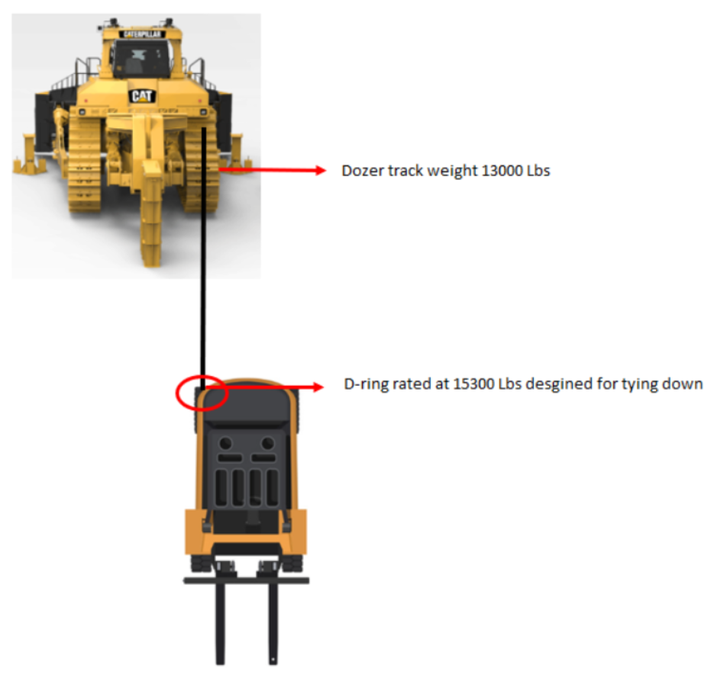
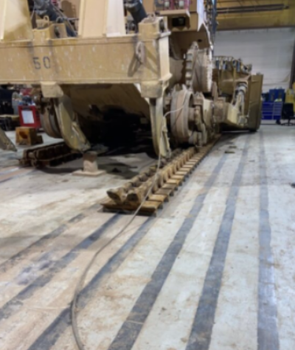
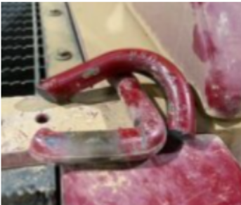
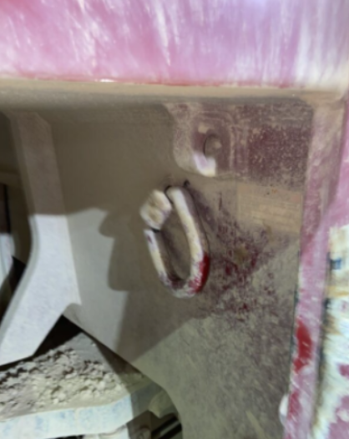
D-Ring Failure
Event ID #20010111
Incident Details
Operation | Morenci
Date / Time | September 29, 2023 / 10:30 p.m.
Type | Near Miss
Summary | While rigging up the cable to the D-rings on the back of the FL090A Forklift for a track change, the operators put tension to the track for installation of the track and the D-ring on the right side of the forklift failed, causing the ring to break and be projected across the shop area striking a toolbox in its path.
Fatal Risk | Uncontrolled Release of Energy
Risk Category | Monitor
Pre / Post Rating | Significant (3) Possible (2) NOT A PFE
Absent / Insufficient Controls | The wire rope sling was connected to the forklift D-ring that is not designed for pulling or lifting.
Applicable Policies / Procedures | SOP – Changing a Bulldozer Track
Employee Condition | No Injury
Contact | Joseph Rodriquez, Superintendent Mine Maintenance

Slide 6
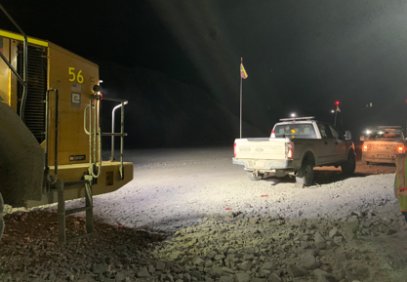
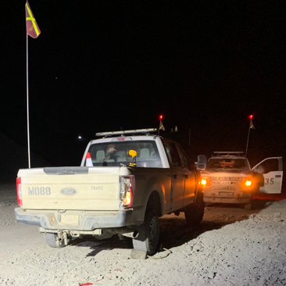
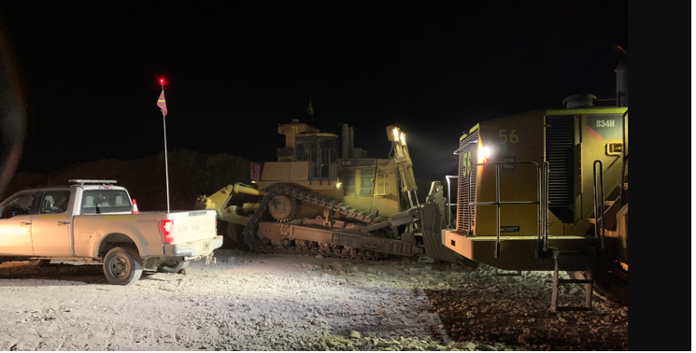
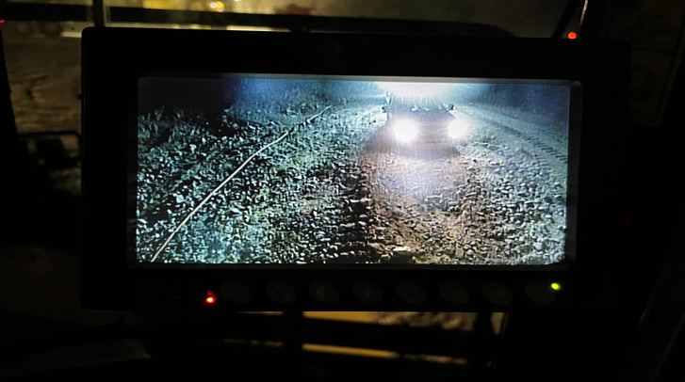
RTD Backed into Light Vehicle
Event ID #20010258
Incident Details
Operation | Sierrita
Date / Time | October 3, 2023 / 10:10 p.m.
Type | Property Damage
Summary | Rubber tire operator backed his rubber tire into the rear tailgate area of the oiler’s pickup, which was parked approx. 15ft from the rear of the rubber tire. This caused damage to the MO88's right rear taillight.
Fatal Risk | Vehicle Collision or Rollover
Risk Category | Monitor
Pre / Post Rating | Significant (3) Possible (2) NOT A PFE
Absent / Insufficient Controls | Failure to Utilize Mirrors/Cameras on Equipment Standard of work or SOP being reviewed with crews on parking distance between light Vehicles and Heavy Equipment
Applicable Policies / Procedures | Interaction with Heavy Mobile Equipment- Surface Road Design, Light vehicle& Ground Personnel Policy
Employee Condition | No Injury
Contact | Allen Bruce Kinney, Mine Superintendent

Slide 7
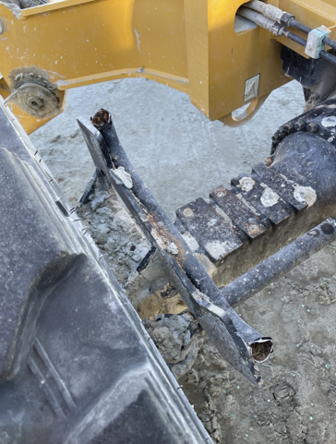
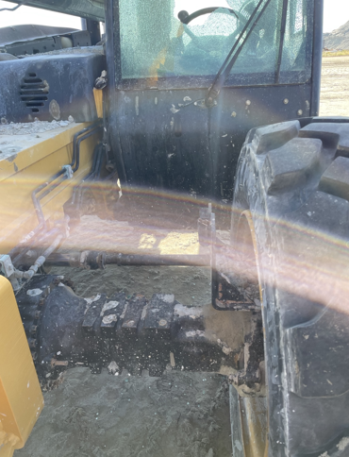
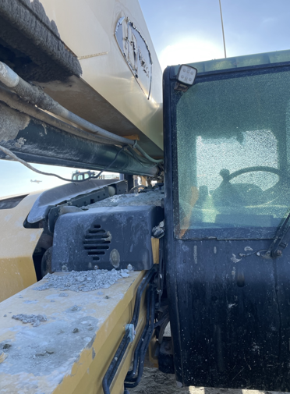
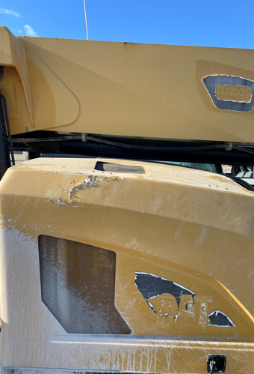
Discharge Line Struck Reach Fork
Event ID #20010422
Incident Details
Operation | Sierrita
Date / Time | October 11, 2023 / 7:40 a.m.
Type | Property Damage
Summary | While working to relocate the berm builder discharge line, the pipe became stuck on the impoundment berm. In the process of repositioning the reach fork to free the line, the pipe fell off the forks and struck the reach fork, breaking the fender, mirror, and windshield.
Fatal Risk | Uncontrolled Release of Energy
Risk Category | Actionable
Pre / Post Rating | Significant (3) Likely (3) NOT A PFE
Absent / Insufficient Controls | No specific SOP
Applicable Policies / Procedures | Develop standard of work and train employees HDPE Pipe Handling Policy
Employee Condition | No Injury
Contact | Chris Fiedler, Tailing Superintendent

Slide 8
PFE Events
October 2023

Slide 9
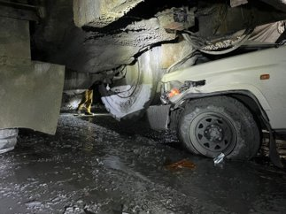
SVS Mixer Contacts Light Vehicle
PFE # 2023-25 Event ID # 20009530
Preliminary Incident Details
Operation | PT Freeport Indonesia
Date / Time | September 12, 2023 / 2:25 p.m.
Type | Property Damage
Summary | A light vehicle was traveling along a drift to the crane bay shop and came up behind an SVS mixer that was stopped behind a line of vehicles blocked by a Jumbo drill. The LV along with other vehicles began to reverse to seek alternative access. The LV stopped when the truck behind it stopped, but the SVS mixer kept reversing. The LV driver sounded the horn. The SVS mixer continued to reverse and contacted the LV, pushing it into the rib. The front left tire burst, damaging the front end and hood. No one was injured.
Fatal Risk | Vehicle Collision or Rollover
Risk Category | Actionable
Pre / Post Rating | Significant (3) Likely (3)
Findings / Missing Controls | Failure to initiate correct action – SVS mixer lost visual of the LV and continued to reverse Competing sounds made the LV horn inaudible
Applicable Policies / Procedures | Mobile Equipment Interaction SOP UM.2.18.GBC.SVS-MTO.02.03/19 SVS Mixer Truck Operating Procedure SOP-4.04-PTFI-002 Light Vehicle Operation
Employee Condition | No Injury
Contact | Andri Abdullah or Phillip Murphy

Slide 10
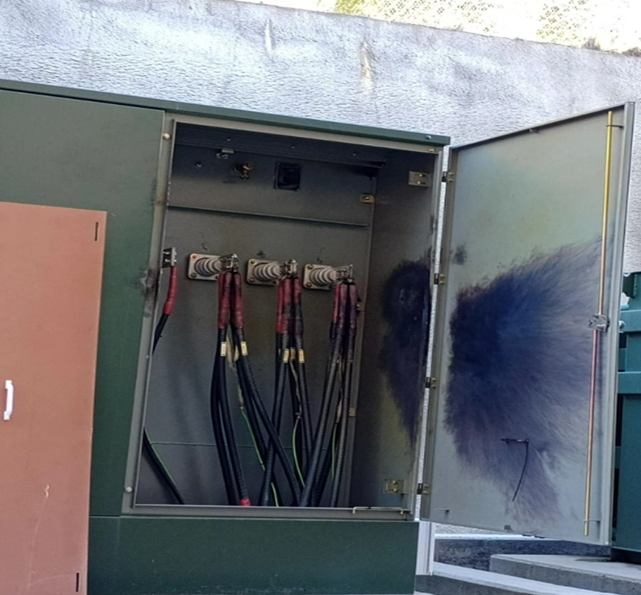
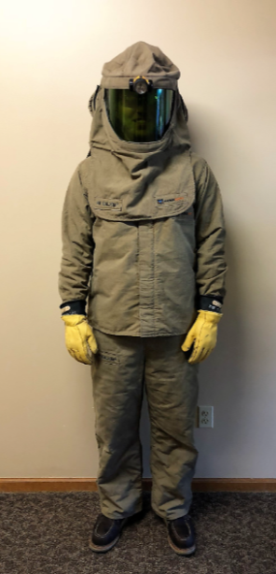
4160-Volt Transformer Arc Flash
PFE # 2023-22 Event ID # 20010129
Preliminary Incident Details
Operation | Climax
Date / Time | September 30, 2023 / 8:10 a.m.
Type | Injury
Summary | Two electrical subcontractors involved in rerouting a power line for the new water treatment plant under construction at Climax were preparing to check the phase rotation of a 4160-volt transformer that had not been de-energized. When they attempted to attach the meter, an arc flash occurred. The workers were not wearing the proper PPE, and both sustained burns to the face. One was treated at the hospital and released while the other was hospitalized with second-degree burns.
Fatal Risk | Exposure to Electrical Hazards
Risk Category | Monitor
Pre / Post Rating | Significant (3) Possible (2)
Findings / Missing Controls | Contractors were not using appropriate PPE Instrumentation was rated for 600 volts
Applicable Policies / Procedures | FCX-HS03 Electrical Safety Policy
Employee Condition | Both workers sustained first- and second-degree burns to the face.
Contact | Chris Young, Mill Manager, or Amy Reyes, Senior Supervisor-Health and Safety
At left: Proper PPE required for the job (not worn during the incident)

Slide 11
Contact with Live Power Line
PFE # 2023-23 Event ID # 20010240
Preliminary Incident Details
Operation | El Paso Rod Mill
Date / Time | October 3, 2023 / 3 p.m.
Type | Near Miss
Summary | Electrical contractors installing communication line conduit inside of a motor control center got ahead of schedule and began installing the conduit on the wall outside of the MCC near an overhead crane rail. Unaware the crane was energized, one of the workers contacted the rail's 480-volt power line, causing a short and arc to ground. No injuries were sustained, and power to the overhead crane tripped off.
Fatal Risk | Exposure to Electrical Hazard
Risk Category | Monitor
Pre / Post Rating | Significant (3) Possible (2)
Findings / Missing Controls | Contractors proceeded with work in an area outside the original scope of work and did not lockout, assuming the crane rail was de-energized.
Applicable Policies / Procedures | FCX – HS04 Control of Hazardous Energy/Job Risk Assessment
Employee Condition | No injuries
Contact | Alejandro Valadez, Rod Mill Manager
Overhead crane rail and wall
Contractors were installing conduit using scissor lift
Conduit that contacted the 480v line

Slide 12
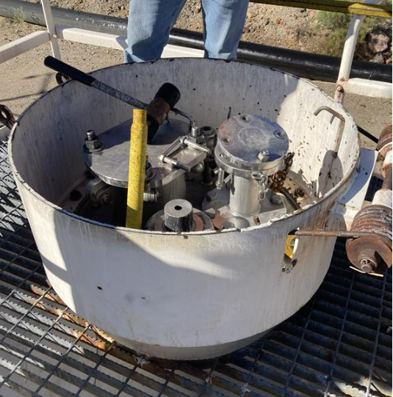
Pressurized Acid Exposure
PFE # 2023-24 Event ID # 20010262
Preliminary Incident Details
Operation | Chino
Date / Time | October 4, 2023 / 8:27 a.m.
Type | Injury
Summary | A mechanic was cutting the bolts off the flange of a depressurized acid tank car when there was a sudden and unexpected burst of pressurization, causing acid to spray into the air. The employee was wearing a face shield but not other personal protective equipment. A small amount of acid got on the neck of the employee, who immediately rinsed off at the nearby safety shower.
Fatal Risk | Fire
Risk Category | Actionable
Pre / Post Rating | Significant (3) Likely (3)
Findings / Missing Controls | Wrong tool for the job – angle grinder used to cut bolt created a spark that ignited hydrogen buildup in the tank Failure to monitor lower explosive limit before performing hot work Failure to wear proper acid suit
Applicable Policies / Procedures | FCX-HS06 Hot Work Policy
Employee Condition | The worker was evaluated at the local clinic and allowed to return to work without restrictions. Employee received first aid treatment, sustained small rash to the neck and head.
Contact | Joseph Lightner, Senior Supervisor-Mill, or Daniel Coyle, Senior Supervisor-Health and Safety
Flange where bolt was cut.
Condition of overalls after exposure to acid.
Work platform above the acid tanker car.

Slide 13
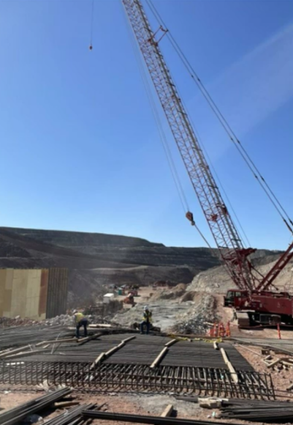
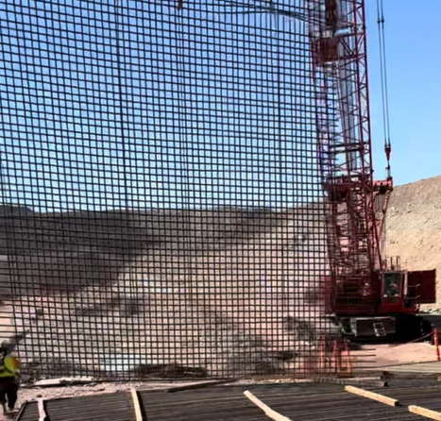
Falling Rebar Mat
PFE # 2023-26 Event ID # 20010509
Preliminary Incident Details
Operation | Safford
Date / Time | October 16, 2023 / 1:45 p.m.
Type | Lost-Time Injury
Summary | A contractor crew was preparing to lift a rebar mat into place to form a reclaim chamber wall at the fine ore stockpile construction site. The mat was 36 feet tall (66 rebar sticks) by 35 feet wide (57 rebar sticks). Upon reaching the vertical position, the rebar ties towards the top began to fail, causing the rebar to fall to the ground. Two individuals were in the area manning taglines. One of them ran away unharmed while the other (foreman) was struck by falling rebar, resulting in a broken right elbow and dislocated left wrist.
Fatal Risk | Falling Objects
Risk Category | Actionable
Pre / Post Rating | Significant (3) Likely (3)
Findings / Missing Controls | Insufficient rebar ties Inadequate rigging
Applicable Policies / Procedures | Rigging/Signaling Strength calculations for load prior to lift
Employee Condition | Immediately after event, employee was transported to the local emergency room for CT scans (negative), then air-lifted for surgery on right elbow. Employee is in stable condition and recovering.
Contact | Drew Borcherding, Manager-Health and Safety
Circled in red is the area where the rebar ties first began to fail.
The incident area after the rebar mat fell. The arrow at left points to the location of the chamber wall where the rebar mat was to be placed.

Slide 14
Fall Through an Open Hole
PFE # 2023-27 Event ID # 20010740
Preliminary Incident Details
Operation | Miami Smelter
Date / Time | October 25, 2023 / 11:30 a.m.
Type | Injury
Summary | A contractor worker carrying a junction box with both hands in front was following a fellow worker on a catwalk. A hatch door was open in the catwalk to provide access to a lower platform. The first worker stepped over the open hatch. The second worker, who was carrying the junction box, could not see the open hatch. Without warning, the worker fell through and dropped approximately nine feet before hitting the platform below, sustaining minor injuries.
Fatal Risk | Fall From Heights
Risk Category | Monitor
Pre / Post Rating | Significant (3) Possible (2)
Findings / Missing Controls | Chain guards not used Hard barricade and flagging not used Failure to initiate correct action to close hatch door before proceeding
Applicable Policies / Procedures | FCX-HS02 Working at Heights
Employee Condition | Worker sustained abrasions and contusions along left arm and leg. Released to full duty after evaluation at the local emergency room.
Contact | Cameron Coon, Senior Supervisor-Health and Safety
The open hatch the worker fell through and platform below (looking top down).
An example of how the catwalk with hatch and chains are to be used when the hatch is open.

Slide 15
Agency Shares
October 2023

Slide 16
MSHA Safety Alert – Water Related Fatalities
PDF LINK

Slide 17
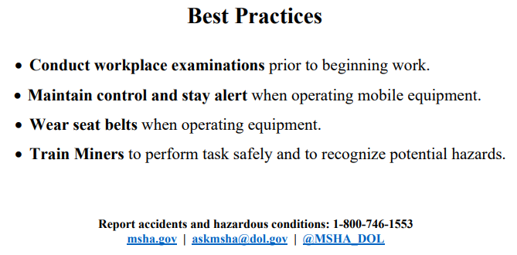
MSHA Safety Alert – Bulldozer Related Fatalities
PDF LINK

Slide 18
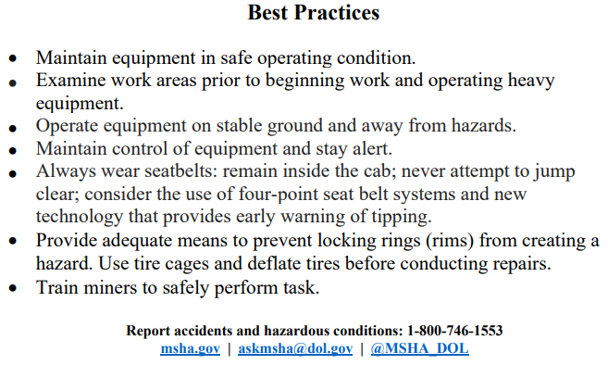
MSHA Safety Alert – Machinery Related Fatalities
PDF LINK

Slide 19
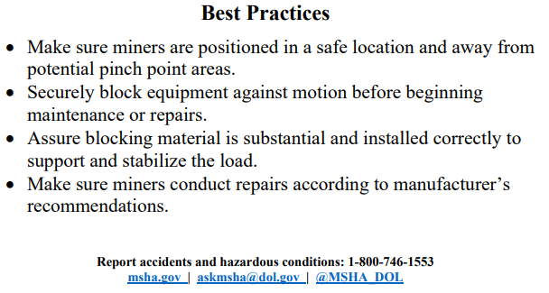
MSHA Safety Alert – Maintenance Hazard
PDF LINK

Slide 20
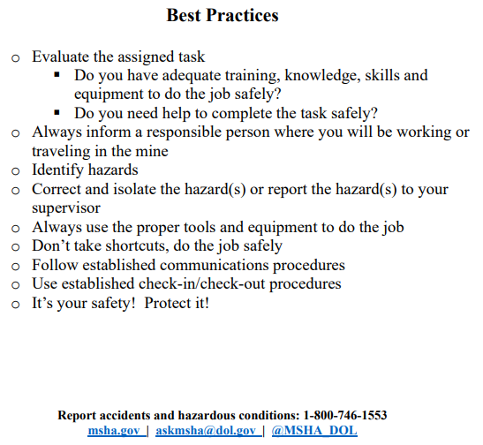
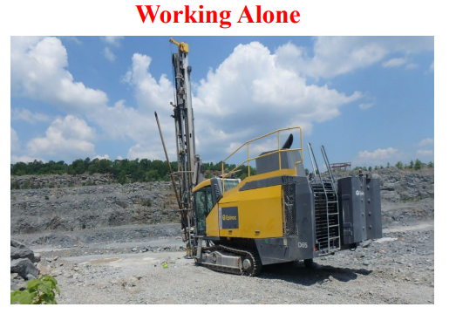
MSHA Safety Alert – Working Alone
PDF LINK

