Slide 1
Monthly Contractor HSE / GSC Meeting
March 2024
(Incidents and Communications from February 2024)

Slide 2
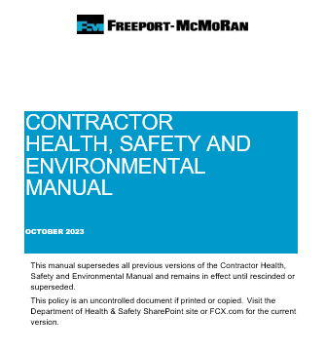
Introduction / Purpose of Meeting
Welcome
Introductions
Housekeeping
Purpose
Frequency
  Remote
  2nd Wed / month
Attendance Requirements

Slide 3










FCX Safety Updates
March 2024
(Incidents and Communications from February 2024)
fcx.com

Slide 4
FCX Safety Incidents, Successes, & Alerts
February 2024
fcx.com

Slide 5



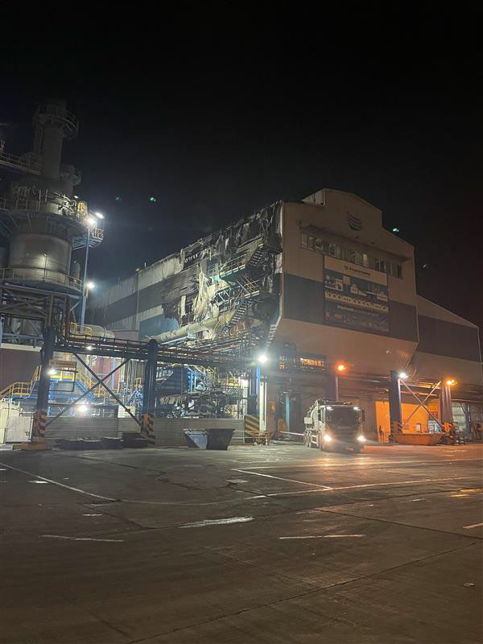
Actionable Event:Atlantic Copper Anode Barrel Fire
Event ID #20013221
Incident Details
Operation | Atlantic Copper
Date / Time | February 3, 2024 / 10:15 p.m.
Type | Property Damage
Summary | Copper matte combined with slag oxide during the transfer of materials from the PS Convertor to the anode barrel. This resulted in a violent reaction that blew material from the barrel onto nearby platforms, fiberglass panels and plant control wires. A fire started and lasted about 10 minutes before it was extinguished. No employees were in the area per SOP guidelines.
Fatal Risk | Contact with Molten Material
Risk Category | Actionable
Pre / Post Rating | Significant (3), Likely (3)
Absent / Insufficient Controls | Communication failure between crane operators and foreman Failure to follow Material Transport SOP
Applicable Policies / Procedures | Material Transport SOP
Employee Condition | N/A
Contact | Ignacio Romero, Health and Safety Manager
Photos / Links

Slide 6

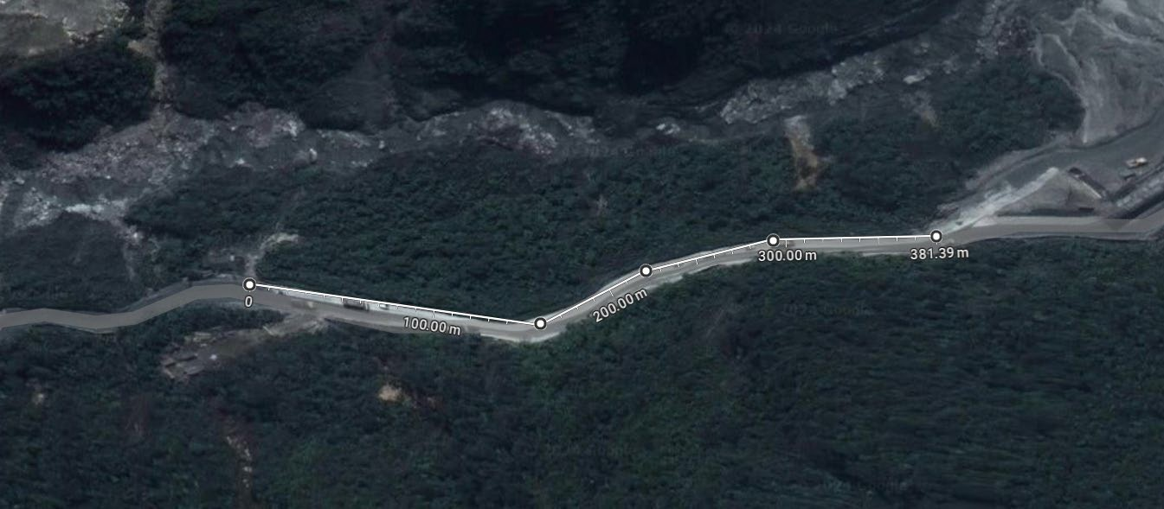
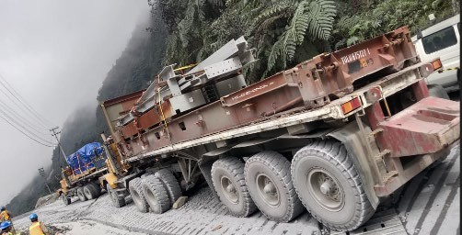
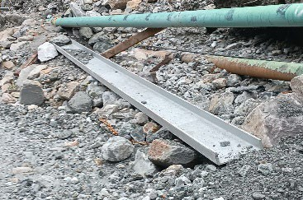
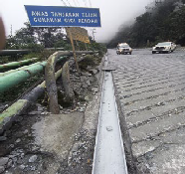
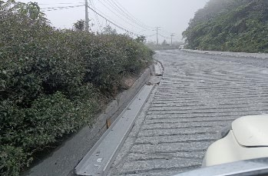
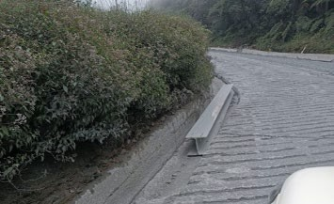
Actionable Event: H-Beams Fall from Trailer during Transport
PFE # N/A (Non PFE) Event ID # 20013522
Falling Objects
Preliminary Incident Details
Operation | PTFI
Date / Time | February 16, 2024 / 2:15 p.m.
Event Type | Near Miss
Summary | During transportation, two steel H-beams, and six purlins fell from a trailer and slid approximately 320 meters passing two LVs and one Bus. The steel was tied with a cargo strap to the flat track. The truck operator immediately parked and notified a supervisor.
Risk Category | Actionable – Significant (3) Likely (3)
Findings / Missing Controls | Site lacking loadmaster Maintenance road crews not present
Applicable Policies / Procedures | Material Mobilization Checklist (MOC) KPI-CTR-011: Truck Operation of Flatbed, Trailer, & Lowboy
Employee Condition | No personnel were injured.
Contact | Harriadi Rasidi, Project Safety Manager Mill Optimization Construction (MOC)
Photos / Links
Steel uncontrolled
movement

Slide 7

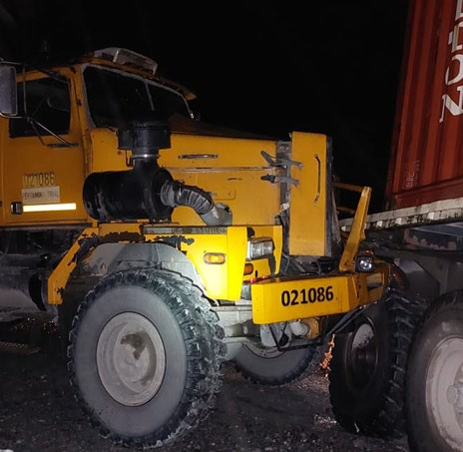
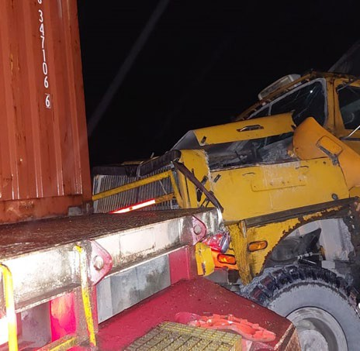
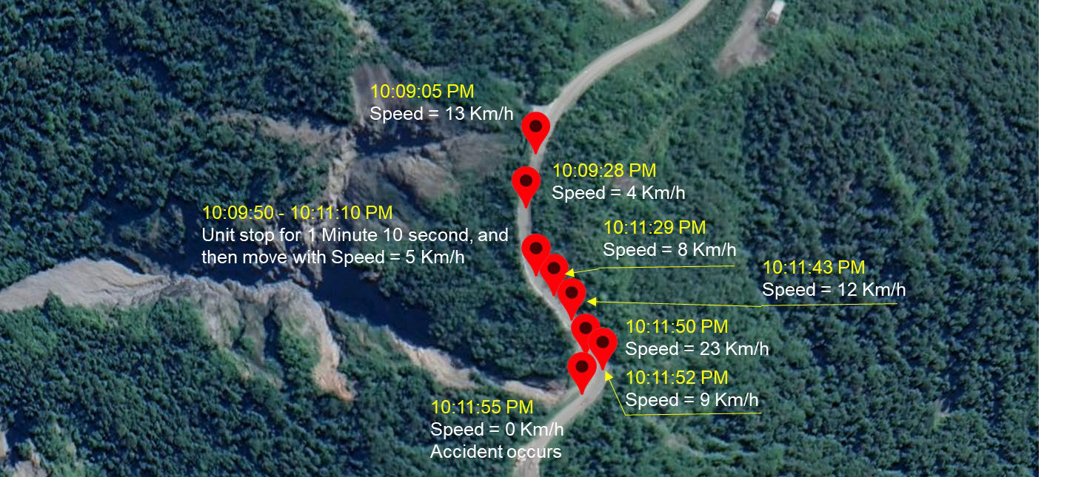
Actionable Event: Truck Collision
PFE # N/A (Non PFE) Event ID # 20013522
Vehicle Collision
Preliminary Incident Details
Operation | PTFI
Date / Time | February 19, 2024 / 10:55 p.m.
Event Type | Property Damage
Summary | During transport, a trailer truck had brake failure leading to a collision with a second trailer truck. Damage resulted to both vehicles.
Risk Category | Actionable – Significant (3) Likely (3)
Findings / Missing Controls | Driver overused brake causing the truck to continue moving even after applying the brake.
Applicable Policies / Procedures | KPI-CTR-011: Truck Operation of Flatbed, Trailer, & Lowboy
Employee Condition | No personnel were injured.
Contact | Lucky Hermawan, VP Maintenance Support
Photos / Links
Final position of trucks
Geotab Speed Information – 021086
10:09 PM to 10:12 PM

Slide 8
PFE Events
February 2024
fcx.com
8

Slide 9

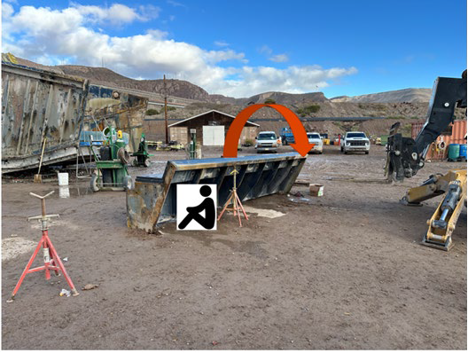
Feed Box Rollover Onto Contract Worker
Actionable Event:
PFE # PFE-2024-2 Event ID #20013230
Preliminary Incident Details
Operation | Morenci
Date / Time | February 6, 2024 / 12pm
Type | Injury
Summary | A contractor was installing liners on a wet screen feed box that had been placed on the ground for maintenance. As the liners were added, the two-ton box rolled over onto the worker, who was trapped underneath. After unsuccessful attempts to move the box by hand, a forklift was used to free the worker.
Fatal Risk | Uncontrolled Release of Energy
Risk Category | Actionable
Risk Rating | Significant (3) Likely (3)
Findings / Missing Controls | Blocking for maintenance work and energy isolation Inadequate risk assessment Pipe stands were BO and not intended for this use Pipe stands were used instead of cribbing or engineered cradle Placement of the stand cradle was not secure to the feed box Ground was not level/potentially soft
Applicable Policies / Procedures | Control of Hazardous Energy
Employee Condition | Minor injuries resulting in restricted duty
Contact | Chris Seick, Metcalf Mill Manager Jacob Sweet, Health and Safety Manager
Photos / Links
Position of employee, placement of pipe stands and direction the feed box tipped.

Slide 10


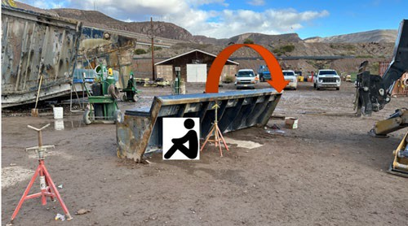


PFE LESSONS LEARNED: Feedbox Rollover Onto Contractor
Causal Factors
Uncontrolled Release of Energy
Contractor used pipe stand to support weight of feedbox.
Incident Overview
Morenci, February 6, 2024
A contractor was installing liners on a wet screen feed box that had been placed on the ground for maintenance. As the liners were added, the two-ton box rolled over onto the worker, who was trapped underneath. After unsuccessful attempts to move the box by hand, a forklift was used to free the worker.
Site Specific Actions
Engineering control – Engineer a stand to secure feedboxes when liners are being changed outside of wet screen. Immediately eliminate the practice of changing liners outside of wet screen until new stand is fabricated.
Administrative control – Create SOP for task that includes the following safety guidelines:
  Only use engineered stand
  Use cement slab in yard for level, stable ground
  Ensure stand placement adequately and evenly supports feedbox weight
We Champion a Work Environment Where Everyone Goes Home Safely

Slide 11



Steps YOU Can Take to Prevent Repeat Incidents
Contractors
Set clear safety expectations for work execution with employees.
Commit to a having clear safety plan and monitoring system to help ensure safety controls for routine work are clearly identified and additional rigor is in place for non-routine work.
Audit the system to correct gaps and reinforce the process.
Uncontrolled Release of Energy
Incident Overview
Morenci, February 6, 2024
A contractor was installing liners on a wet screen feed box that had been placed on the ground for maintenance. As the liners were added, the two-ton box rolled over onto the worker, who was trapped underneath. After unsuccessful attempts to move the box by hand, a forklift was used to free the worker.
Freeport Leadership
Incorporate contractors into your planning process.
Review and audit work identified through planning.
Ensure contractor’s safety plan meets current safety expectations.
Drive ownership with your team – we are responsible for contractors working in our areas.
Frontline Supervisors, Sr. Supervisors, Superintendents, Managers: When walking department and work areas, evaluate tasks where cribbing is used to help ensure the equipment is adequate.
All of Us
Evaluate all equipment and tasks requiring cribbing for potential crushing hazards, not just those associated with liners or feedboxes. Verify appropriate cribbing is used for each task.
Support the planning and safety processes intended to help us execute safe work.
Audit and reinforce often a clear safety plan and monitoring system to help ensure consistency and sustainability.
Turning Our Commitment into Action

Slide 12

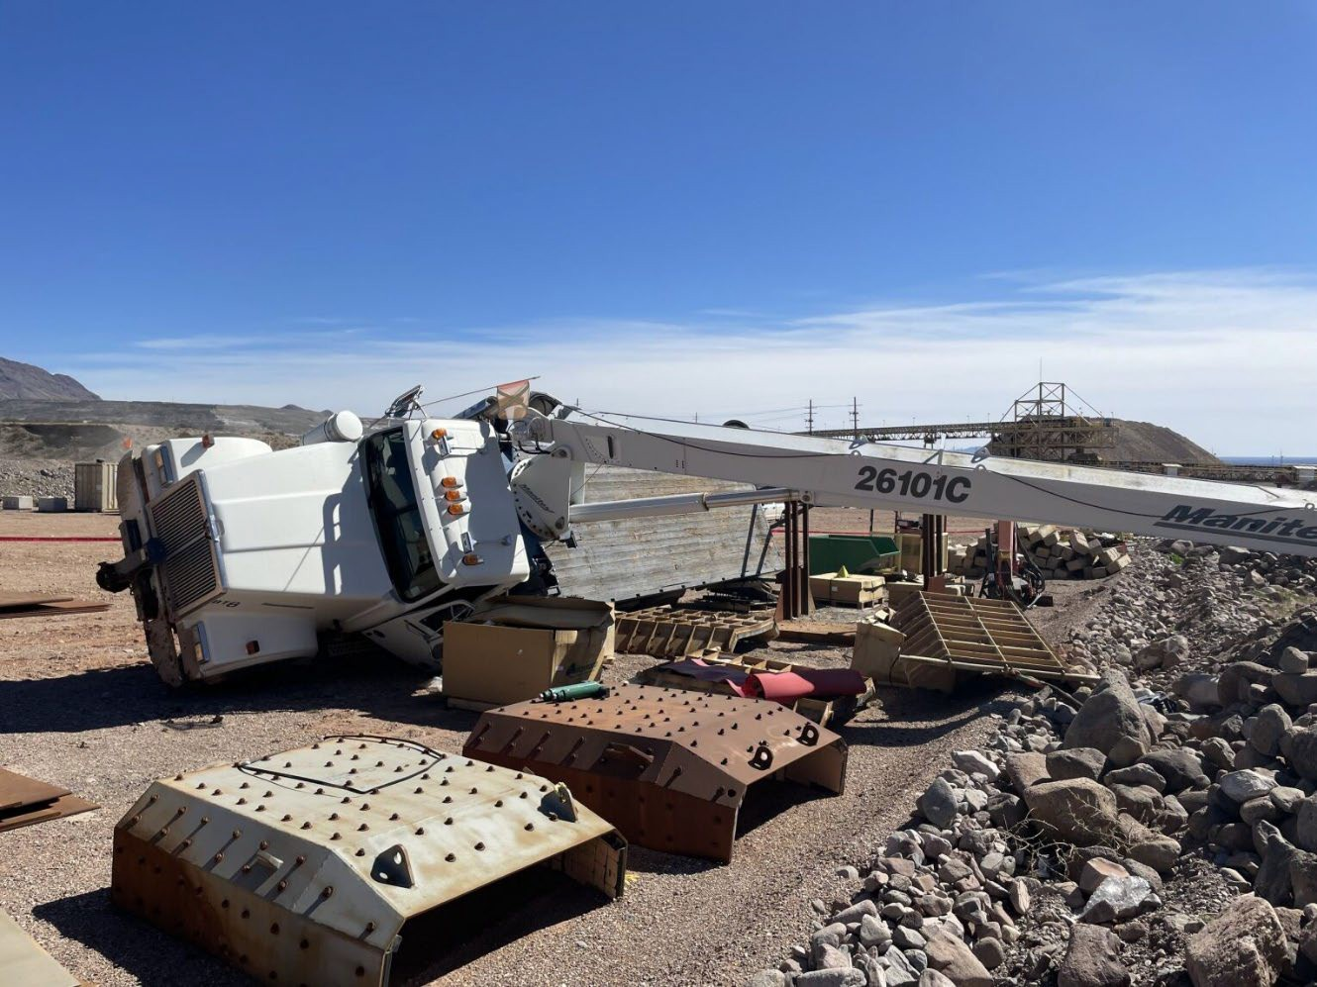
Actionable Event:
26-ton Boom Truck Tipped Over
PFE # 2024 - 3 Event ID # 20013448
Lifting Operations
Preliminary Incident Details
Operation | Safford
Date / Time | February 15, 2024 / 11:55 a.m.
Event Type | First Aid
Summary | Two mechanics and an apprentice were using a 26-ton boom truck to offload a bangboard (feed plate distributor) at the C4 laydown. As the load swung to the driver’s side, the truck tipped over. The mechanic operating the boom and another mechanic standing on the bed of the truck jumped out of the way to avoid being in the line of fire. The apprentice was standing on the ground and out of the line of fire.
Risk Category | Actionable – Significant (3) Likely (3)
Findings / Missing Controls | Only the rear stabilizers had been deployed No footpads were placed under the rear stabilizers The main outriggers were not used
Applicable Policies / Procedures | Lifting Operations Mobile Crane/Boom Truck Training
Employee Condition | The mechanic who jumped from the bed of the truck experienced first-aid level injuries to the ankle, wrist and neck (strains/sprains).
Contact | Drew Borcherding, Manager-Health and Safety; Richard Sanchez, Manager Crush/Convey
Photos / Links
The boom truck tipped onto the driver’s side when the load swung.

Slide 13

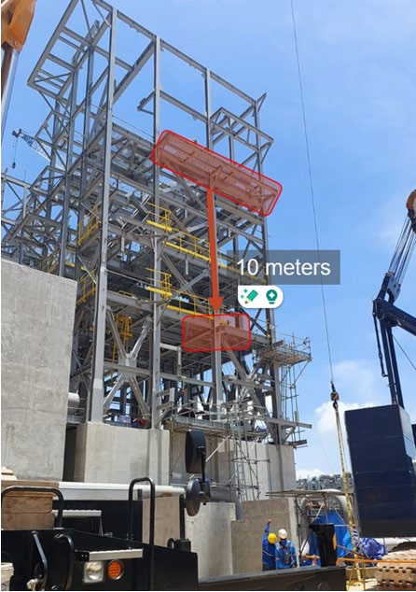
Actionable Event:
Falling Grating
PFE # 2024-4
Event ID # 20013614
Falling Objects
Preliminary Incident Details
Operation | Manyar Smelter Project
Date / Time | February 22, 2024 / 8:42 PM
Event Type | Injury- Restricted Duty
Summary | While moving steel, a crane’s cable contacted a piece of scaffold grating weighing 20 kilograms. The grating fell 10 meters and struck one of two employees performing structural steel work from a man basket at a height of 15 meters.
Risk Category | Falling Objects – Significant (3) Possible (2)
Findings / Missing Controls | Failure to identify unsecured grating during installation and inspection Falling objects were identified as a fatal risk on completed FRM verification but did not distinguish grating as potential risk Failure to prevent crane cable contact with structure
Applicable Policies / Procedures | Chiyoda Grating Installation Method Statement Chiyoda Permit to Work Procedure
Employee Condition | Employee sustained a sprained shoulder.
Contact | Zach Scrivner, Manager-Corporate Project Engineering Safety Chris McCoy, Project Director
Photos / Links
Scaffold grating weighing 20 kilograms fell 10 meters, striking an employee in a man basket.

Slide 14
Liability Management Recordable Incidents
February 2024
fcx.com
15

Slide 15
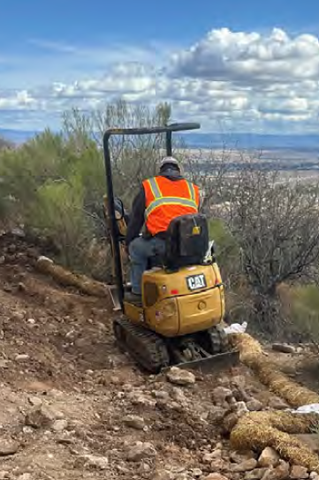
Recap of Liability Mgmt. Incident
Incident Overview
On 2/27/24 an Operator was tracking a mini-excavator Cat 300.1 backwards when it tipped over and into a propane tank. This caused the tank to slide off the platform, onto it’s side and crack the service line which began leaking gas. The operator sustained injuries to his left side and was placed on restricted duty.
Small berm

Slide 16
Incident Investigation Findings
Positive findings
Seat belt being worn
Spotter in right place
ROPS on equipment
Opportunities
Inaccurate positioning of equipment – see operator’s manual
Operator not trained or assessed on model of excavator
Spotter did not evaluate area prior to operation
Inadequate communication between spotter and operator regarding operating area

Slide 17
Incident Corrective Actions
Use skid steer/walk-behind vs mini-excavator
Additional equipment training for operators and verification through operator assessments
  Revisions to Operator Assessments, examples include:
  Specific assessments for grouping of similar units, for example 303/304/305 Mini-Excavators vs. 300.9/301 Mini-Excavators due to different controls, stability, etc.
  Skid steers
  Walk-behind skid steers
Improvement of documentation in daily task forms by Contractor personnel
Equipment travel plan including boom in direction of travel;
Better define spotter responsibilities; additional spotters may be necessary;
Operator/Spotter Communication;
How work area is established, work sequence, and how/where stockpiling;
Ensure operator is capable and comfortable with task.
All Contractors – Verify all operators have been assessed for similar operating units and training has been documented

Slide 18
Liability Management
Stop Work Safety Success Recognition

Slide 19
2023 Stop Work Recognition & Award
ARCADIS
Dante: An employee (Sampler) was collected samples from the SEEP onsite when another operation was about to start rock back fill over the SEEP, the operator placing stone could not see the sampler, a third employee saw this and called a stop work. Rock Placement was continued after samples were completed.
Carteret: During backfill and restoration activities, an employee, placing rip rap along the berm and proposed fence line, recognized that the rip rap could pose as a potential tripping hazard during fence installation. Work was stopped to contact the site construction manager about the potential issue. After discussing, it was decided that the fence should be installed prior to the completion of the rip rap to minimize the associated risks.
SUNDT:
Copper Queen: Work was stopped when an operator pushing material noticed a void in the bench and upon inspection noticed a potential detonator cord in the void.
ENTACT
USVP Clarkdale: Stop work was called when a bolt and washer from a dump truck was observed on the ground. Work resumed once bolt, and washer were reinstalled on break canister on underside of dump truck.
CONGRATULATIONS

Slide 20
Agency Shares
February 2024
fcx.com
15

Slide 21
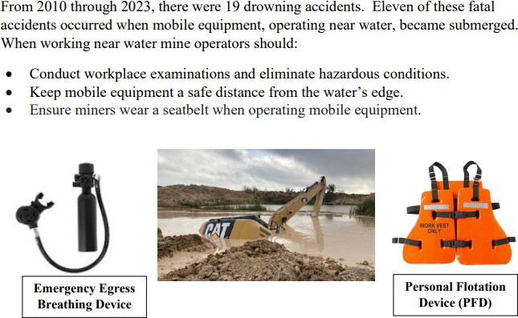
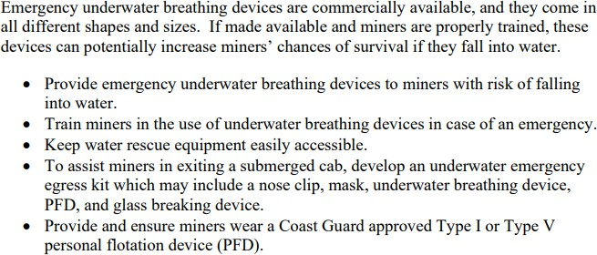
MSHA Safety Alert – Operating Equipment Near Water
PDF LINK

Slide 22
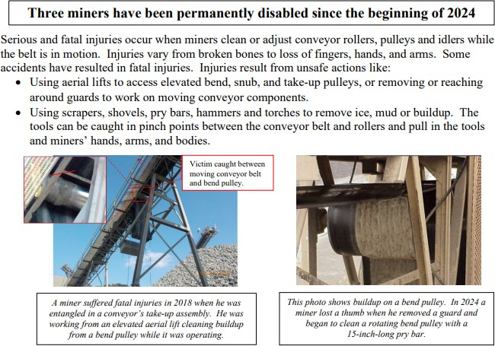
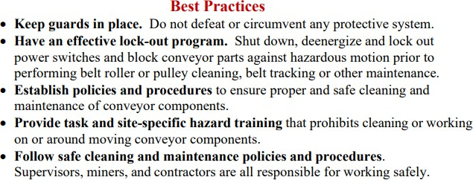
MSHA Safety Alert – Rotating Conveyor Rollers
PDF LINK

Slide 23
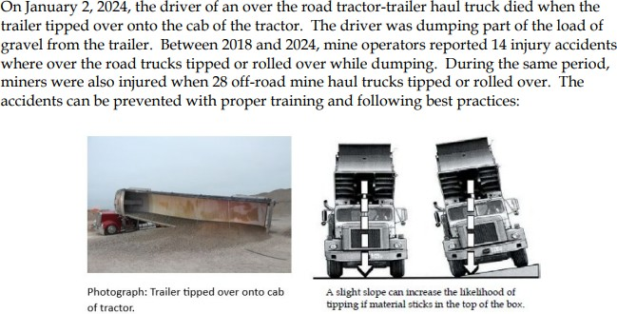
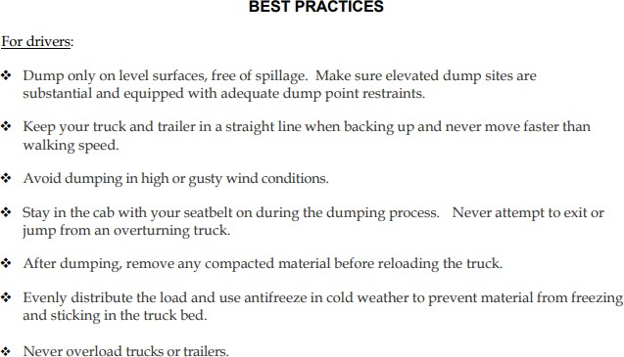
MSHA Safety Alert – Truck Dumping Safety
PDF LINK

Slide 24
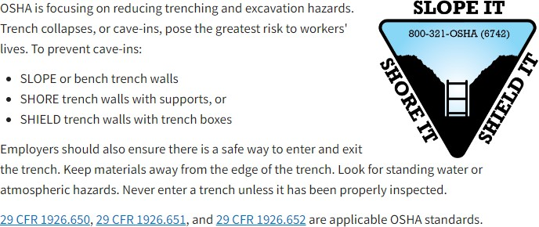
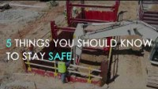
OSHA Share – Trenching & Excavation
Resources LINK

Slide 25

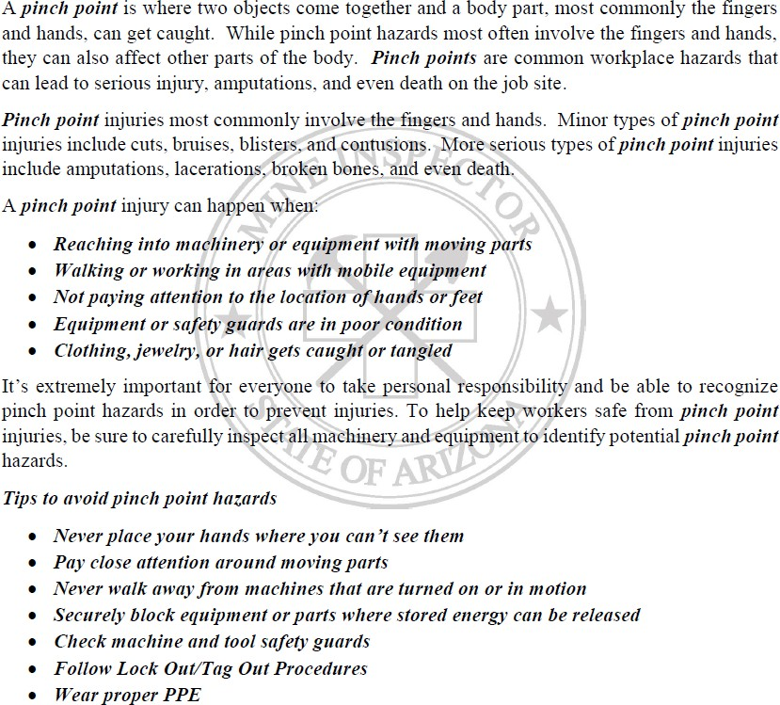
ASMI – Pinch Point Safety Awareness

Slide 26

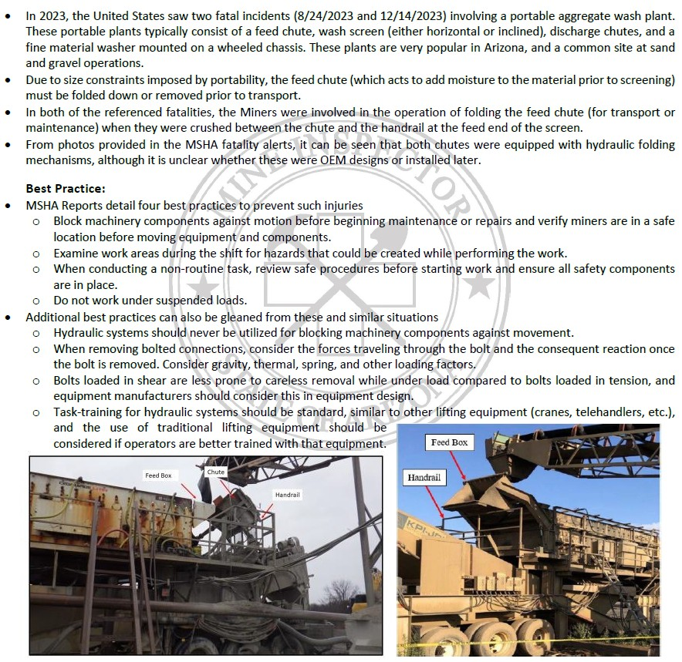
ASMI – Mechanisms & Hydraulics

Slide 27
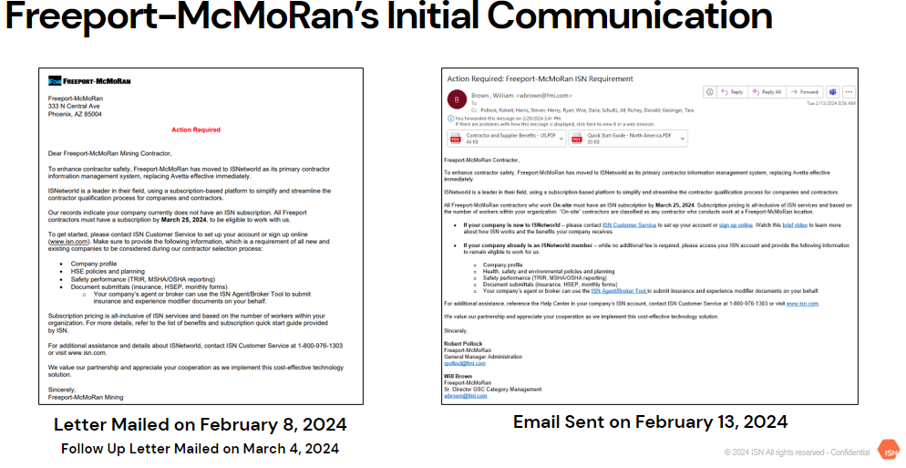
Contractor Process Update - IsNetworld
General Guidelines
The scope of this implementation is Freeport North America.
Contractors performing physical work that exposes them to a significant HSE hazard must be on ISN
Smaller Contract values can generally be excluded from the requirement (contact GSC)
Contractor companies that will never access a Freeport location and provide only off-site consultation type services can be excluded. If a contractor has been sent a letter but believes they should be excluded from this requirement, have them reach out to our implementation team. We will verify with the contract owner and contract responsible prior to excluding the contractor from this requirement

Slide 28
Contractor Process Update - Other
Contractor HS&E Manual Revised
  Communication with summary of changes expected soon
    Additional monthly reporting requirements
    Expanded environmental requirements
    Updated Drug & Alcohol testing requirements
    New HSE Plan Template
New Public Portal Home | Freeport-McMoRan Public Portal (fmi.com)
  Onboarding forms (e.g. Risk assessment, HSEP, site access request, etc.)
  Training materials
  Communications

Slide 29
Questions
GSC:
Sam White swhite2@fmi.com
Sean Byro sbyro@fmi.com
Emma Kurneta Ekurneta@fmi.com
H&S:
Jill Schultz jschultz@fmi.com
Environmental:
Bill Grief wgrief@fmi.com
fcx.com
15

