Slide 1
Monthly Contractor HSE/GSC Meeting May 2024
(Incidents and Communications from April 2024)

Slide 2
Introduction / Purpose of Meeting
Welcome
Introductions
Purpose
Frequency
Remote
2nd Wed / month
Attendance Requirements

Slide 3
Project Highlights
April 2024

Slide 4
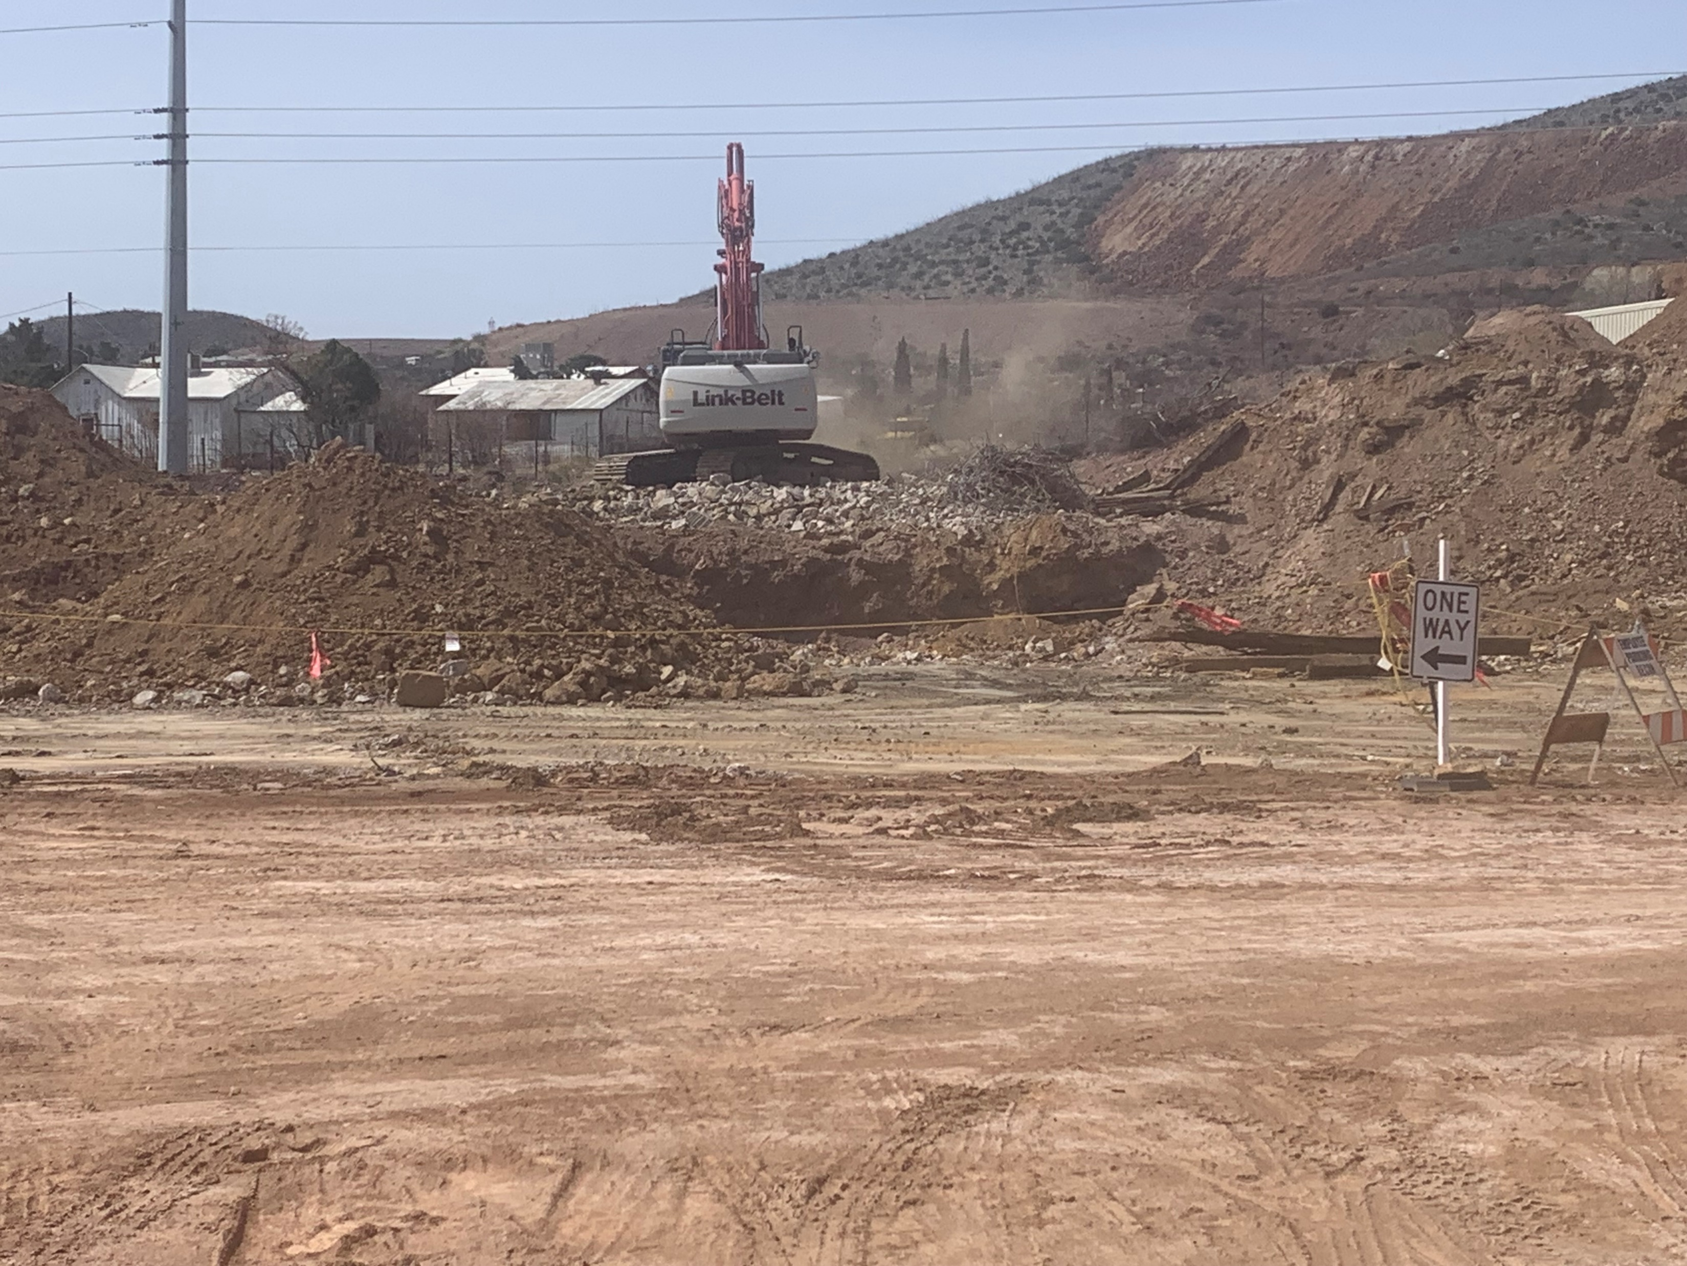
RECON DEMO- Bisbee Copper Queen Branch
Old Precipitation Plant Demolition

Slide 5
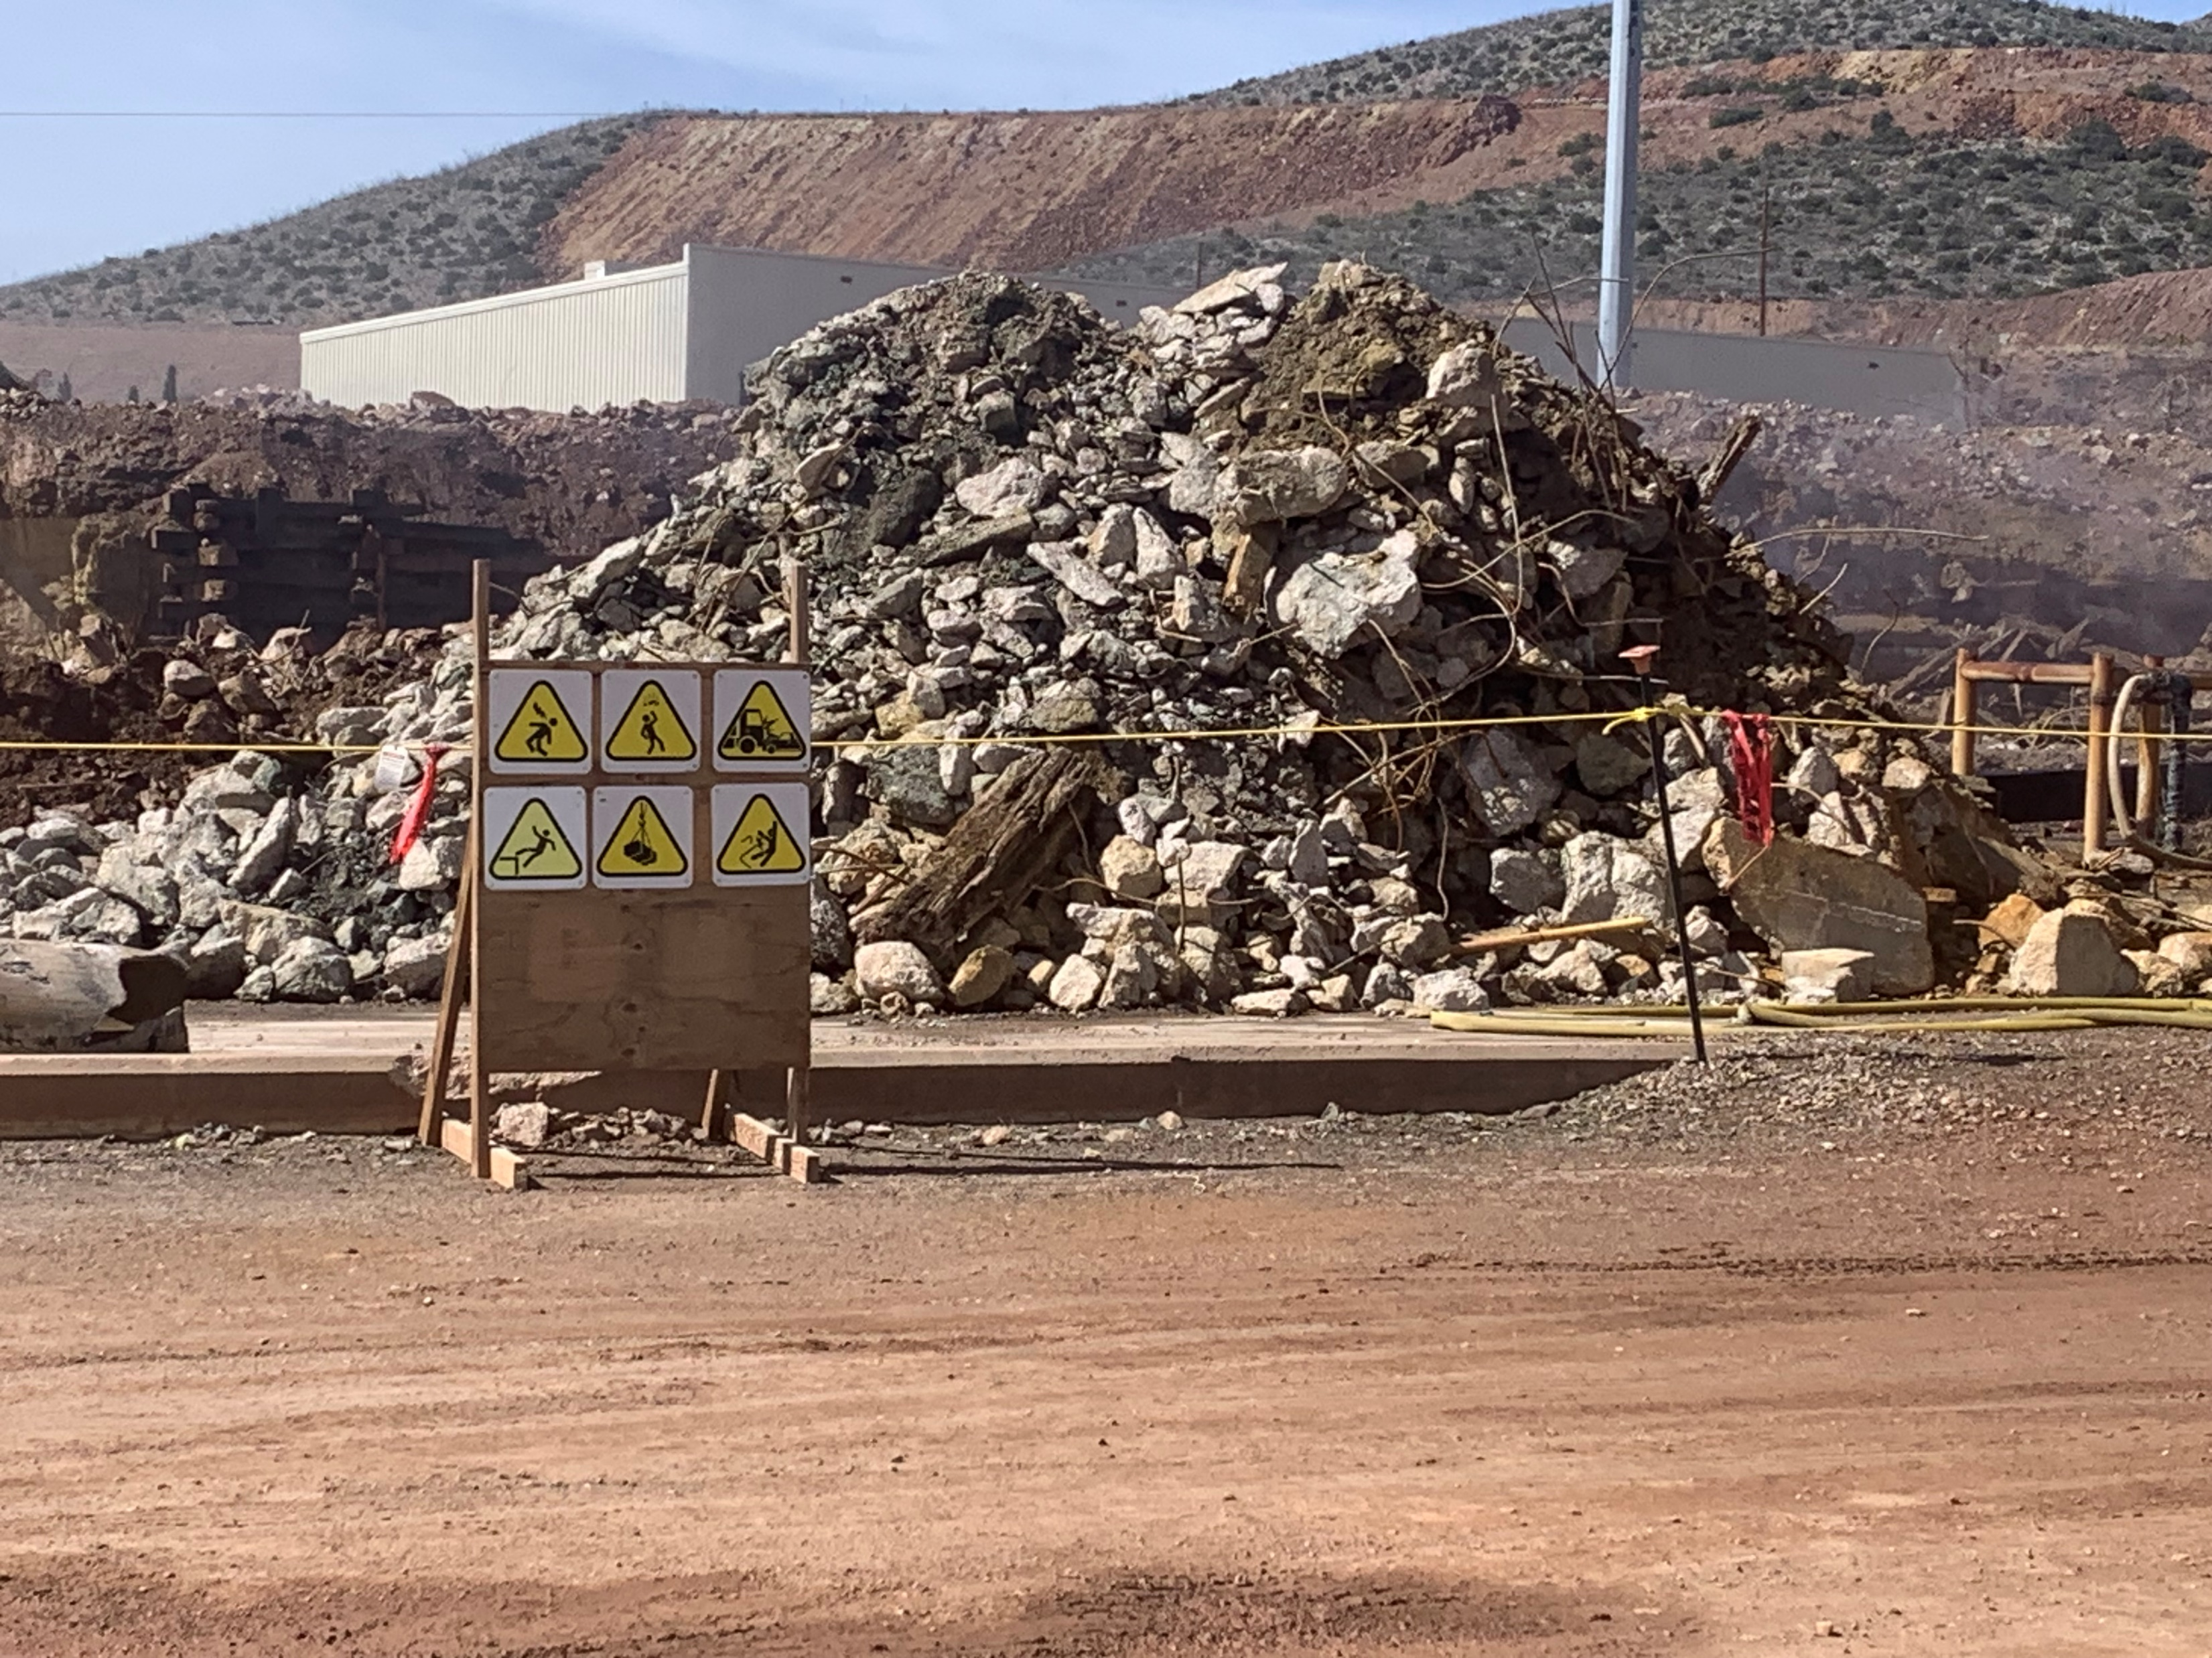
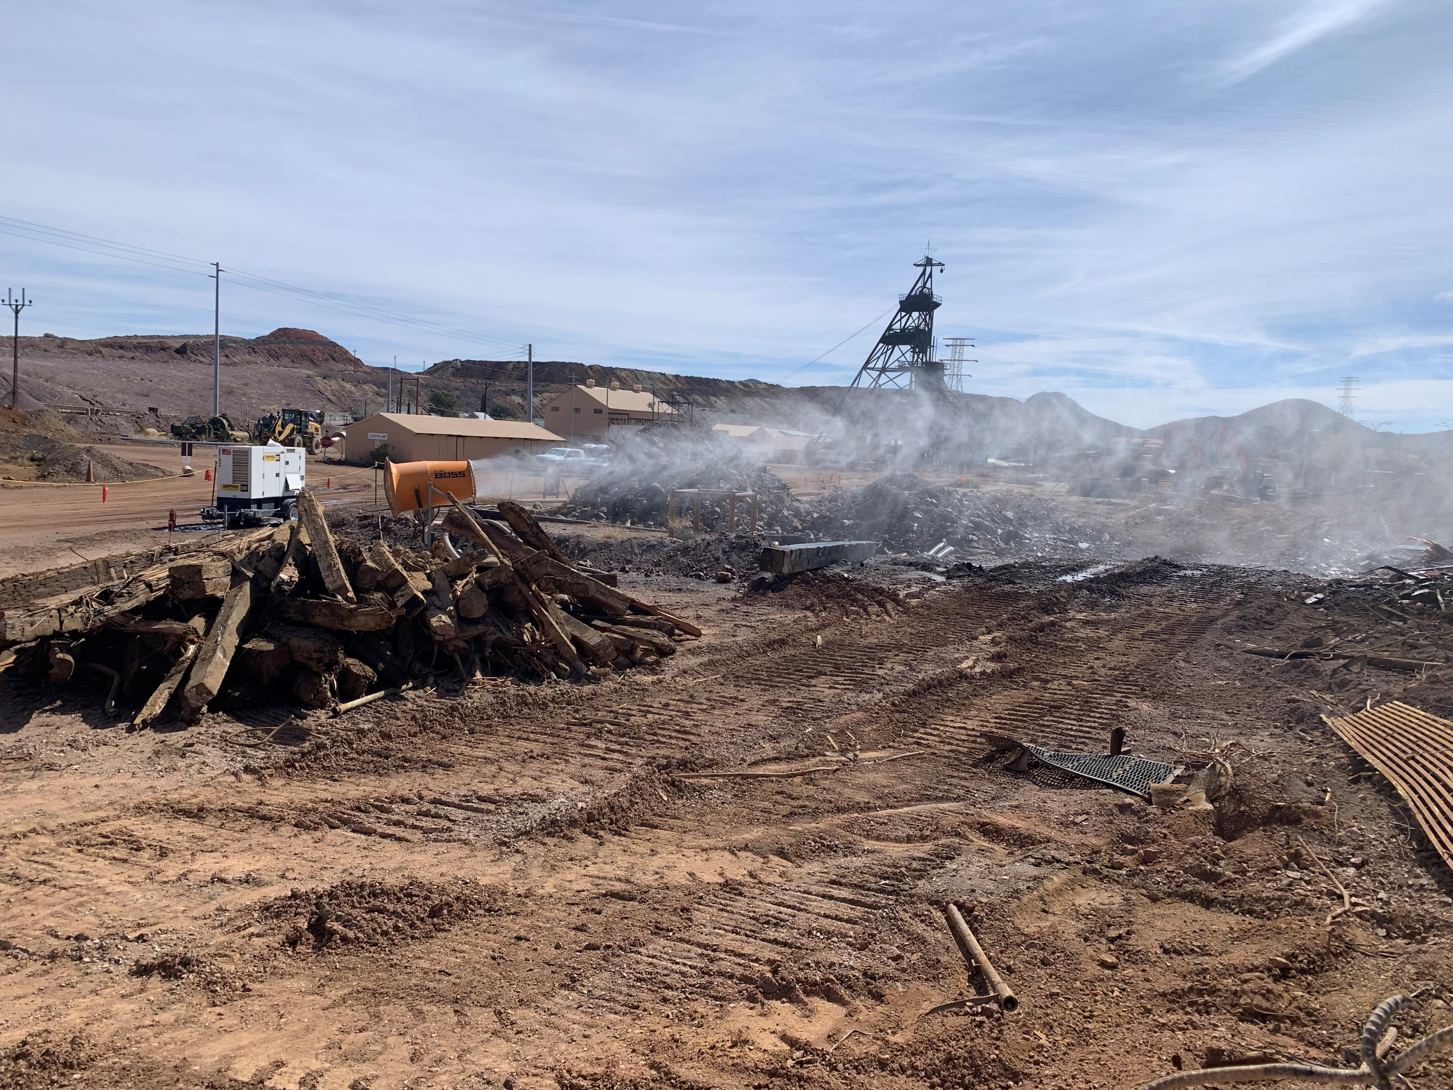
RECON DEMO- Bisbee Copper Queen Branch
Fatal Risks Signage
Dust Boss

Slide 6
Project Highlights
Langeloth April: 78,000 hours, no recordables or lost time

Slide 7
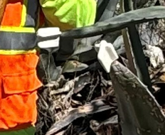
Project Safety Share – thinking outside the box

Slide 8
Potential Fatal Events and High Risk Events
April 2024

Slide 20
Agency Shares
April 2024

Slide 21
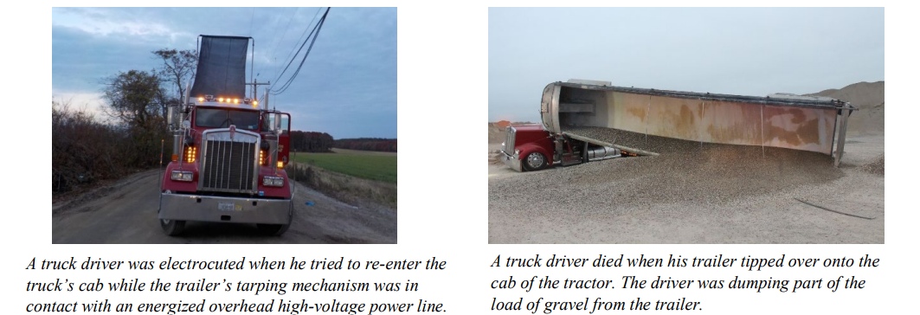
MSHA Safety Alert – Customer Truck Drivers
Since 2021, customer truck drivers have been involved in six fatal accidents.

Slide 22
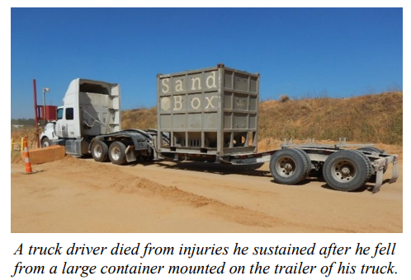
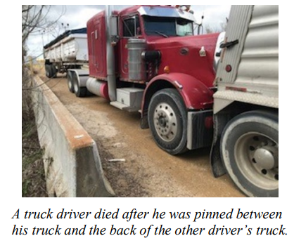
Customer Truck Drivers – Best Practices
Best Practices
Provide site-specific hazard awareness training to customers, including commercial over-the-road truck drivers.
Alert customer truck drivers to changes in traffic procedures, patterns, or road conditions.
Provide fall protection or safe means of access to customers who need to gain access to containers or tankers on their vehicles if there is danger of falling.
Provide and maintain a safe location for drivers to tarp their loads.
Ensure customers follow proper loading and dumping procedures

Slide 23
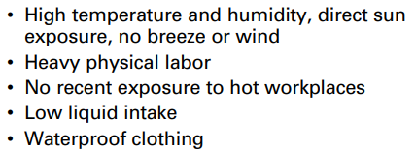
OSHA Safety Topic
Exposure to heat can cause illness and death. The most serious heat illness is heat stroke. Other heat illnesses, such as heat exhaustion, heat cramps and heat rash, should also be avoided.
There are precautions that can be taken any time temperatures are high and the job involves physical work.
Protecting Workers from Heat Stress (osha.gov)

Slide 24
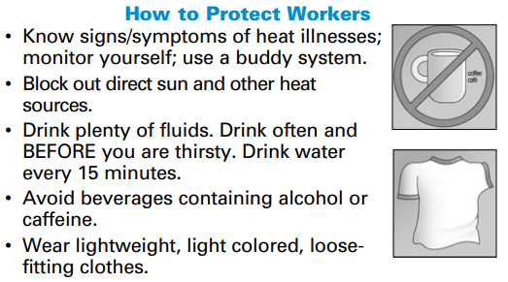
OSHA Safety Topic

Slide 25
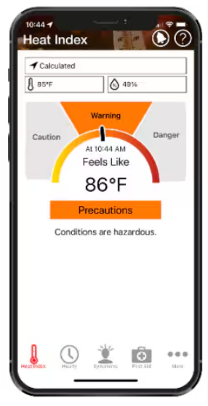
Resources for Heat Safety
OSHA-NIOSH Heat Safety Tool App | NIOSH | CDC
Heat index (HI) values were created for shady, light wind conditions, so exposure to full sunshine can increase heat index values by up to 15 degrees

Slide 26
Updates
April 2024

Slide 27
Contractor HS&E Manual - Update
Published on the Public Portal Home | Freeport-McMoRan Public Portal (fmi.com)
FCX Contractor Health Safety and Environmental Manual
Changes / updates summary posted on Liability Management Site
Communication - Contractor HSE Manual Changes Mar 2024 final v2.docx (live.com)

Slide 28
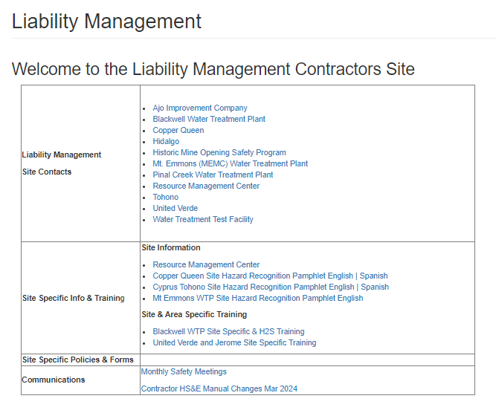
Freeport Public Portal
Liability Management Information
New HSEP Addendum Template
HS&E Policies and
Contractor HSE Manual
CHSE Manual Changes Summary

Slide 29
Global Action Item – Sonic Drills
Due to the number of recent incidents involving sonic drills at our mining sites and project sites the following action items are required for ALL mine and project sites:
Action Item:
1. Installation of dead man switch on the control panel will be required to engage rotation
2. Install additional E-Stops on the trailer (if no trailer a designated place outside of the line of fire)
3. Ensure that when rotation barrier is opened, it triggers low power mode, which equals a maximum of 20 RPM
4. Presence of adequate pipe clamps (not engineering)
Inventory question to also be completed:
1. How many (if any) of your rigs have hands-free/auto rod-changing?
Please contact your Freeport H&S rep if you have any questions regarding this Global Action Item list

Slide 30
MSHA Silica and Respiratory Protection Final Rule
MSHA published final rule Lowering Miners’ Exposure to Respirable Crystalline Silica and Improving Respiratory Protection – LINK
Changes to:
Respirable Crystalline Silica Exposure Limit – 50 μg/m³
Sampling Requirements and Reporting
Medical Surveillance
Respiratory Protection based on ASTM F3387-19
Training Requirements
Metal/Nonmetal Mine Compliance Date: April 8, 2026
If you are engaged at an MSHA site, review published rule (691 pages) early to ensure that your program elements are in compliance and that costs are accounted for come 2026.
Additional enforcement guidance will be needed/is expected from MSHA.

Slide 31
2024 Monthly Meeting Facilitators
DATE | NAME | EMAIL | CELL PHONE
May 8th | Tami Benavidez | tbenavid@fmi.com | 520-240-7460
June 12th | Adam Green | agreen2@fmi.com | 520-268-7909
July 10th | Jason Pingel | jpingel@fmi.com | 480-637-1846
August 14th | Frank Maldonado | fmaldona@fmi.com | 928-965-0219
September 11th | Ryan Munoz | rmunoz4@fmi.com | 480-670-3058
October 9th | Amy Salas | asalas2@fmi.com | 520-345-0166
November 13th | Tim Alvarado | talvarad@fmi.com | 520-649-6864
December 11th | John Acosta | jacosta@fmi.com | 520-508-7427

Slide 32
QUESTIONS?
GSC:
Sam White swhite2@fmi.com
Sean Byro sbyro@fmi.com
Emma Kurneta Ekurneta@fmi.com
H&S:
Tami Benavidez tbenavid@fmi.com
Environmental:
Bill Grief wgrief@fmi.com
Industrial Hygiene
Tim Gustafson tgustafs@fmi.com

