Slide 1
Site Specific Miami
Contractor Orientation
Notes:
45-50 min for this module

Slide 2
Objectives Miami Site Specific Training
Site Emergency Response Plan (ERP) (Slide)
Miami Operations Property Entry Requirements (Handout)
Hazard Recognition (Pamphlet)
Process Safety Management (PSM L1) (Video/Quiz)
Molten Metal and Water (Video)
Regulated Area (Video/Quiz)
Miami Respiratory Protection Program (Handout)
Site Specific PPE Requirements (Slide)
Dark Lenses Safety Glasses/Family Members Access to Property (Handout)
Communication-Portable Electronic Device Policy (Handout)
Environmental (Slide)
Demolition Policy (Handout)

Slide 3
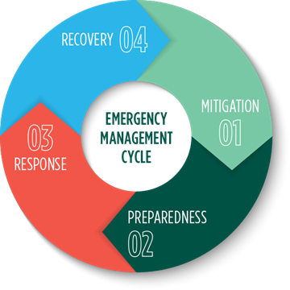
Emergency Response Plan (ERP)
Notes:
The purpose of the ERP is to provide guidance, planning, and control measures to be implemented by FMMI in response to facility emergencies involving a fire, health related incident, or chemical spill or release. The ERP also provides measures to respond in a safe, effective, and timely manner to mitigate the impacts to the overall facility operation. In addition, the ERP also contains the necessary preparedness and contingencies for the management of hazardous materials and a potential spill or release.
"One Call Does it All"
Security personnel will be the first point of contact for all incidents except chemical spills or releases that do not endanger personnel. They will have the responsibility to call the emergency coordinator and/or appropriate party upon notification of the incident.
Any person (FMMI or contractor) discovering an employee injury, fire, explosion or any imminent danger involving FMMI's chemicals should immediately notify Security using an in-plant telephone (473-7555) or cell phone 928-701-8701. Security will immediately notify the environmental department of all emergencies involving chemical spills or releases.
Emergency response flowcharts have been established to cover the three most common emergencies (e.g., fire, chemical spill etc.) presented in the Emergency Response Plan on the Miami share point.
Emergency Response Team of FMMI employees with Security EMS First responders, Emergency Coordinators, Crisis management team, and Emergency response contractors (Tri City Fire).

Slide 4
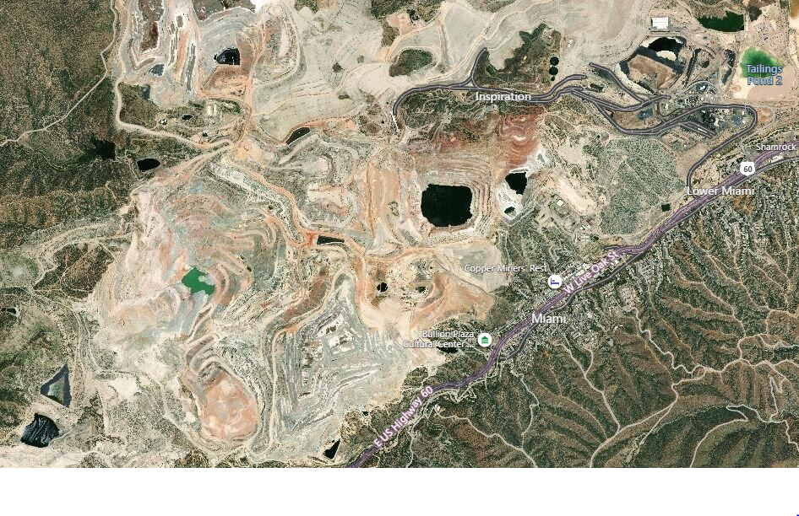
Miami Overview
Tank house
Smelter
Live Oak Pit
Lower yard
Bluebird
Notes:
This provides a brief overview of the more than 45,000 acers of Miami property with different areas.
Miami operations was nearly self sufficient, consisting of several inactive open pits, mine lower yard, Hydromet, smelter, and rod plant. In addition, it is essential that the requirements are met and knowledge of the area is obtained before travelling or planning to conduct activities. For instance, before working in the Tank house or travelling to the pit, additional training and authorization is required. It is important to understand what PPE is required before entering different areas and performing different tasks. Know the location of different plant equipment such as; fire extinguishers, emergency evacuation routes, muster locations, emergency equipment, safety showers, eyewash stations, etc. Understand the different plant emergency and equipment alarms.
If you see something out of the ordinary or questionable, bring it up promptly to the appropriate individual or a supervisor.

Slide 5
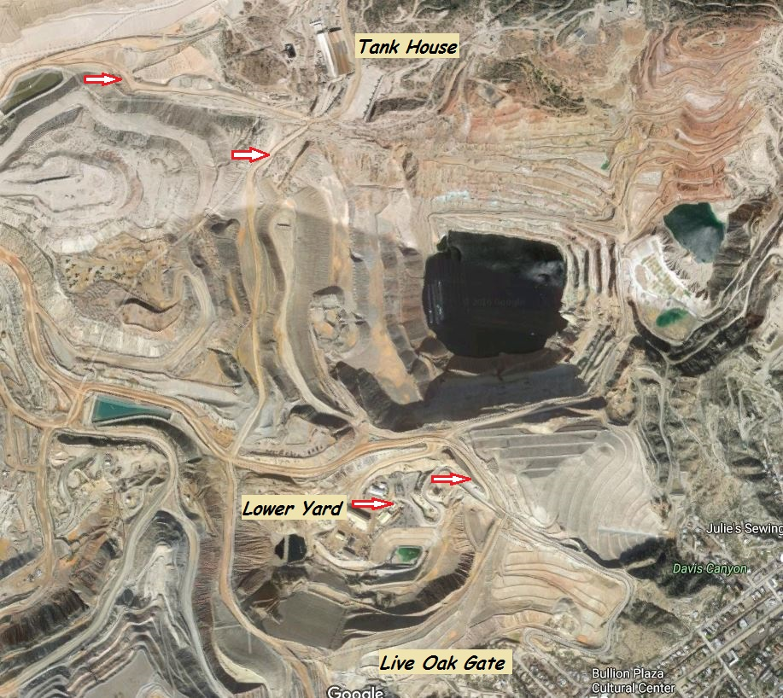
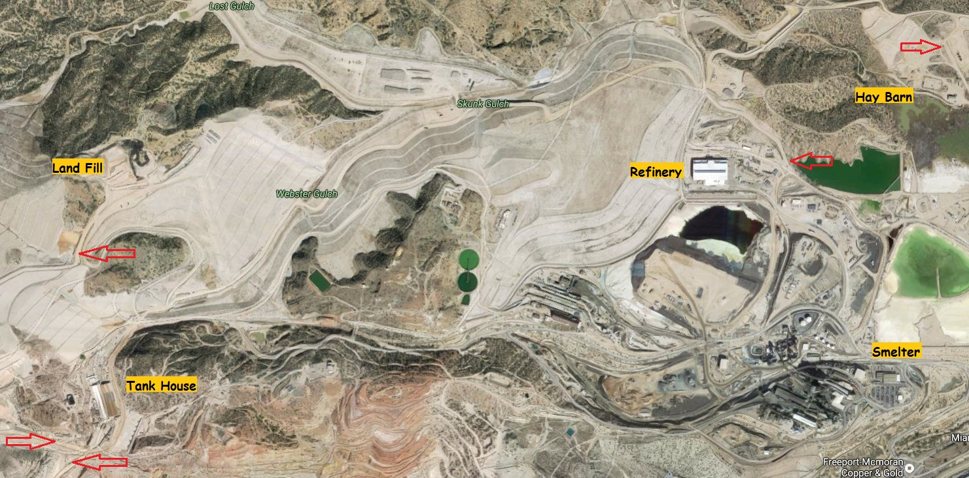
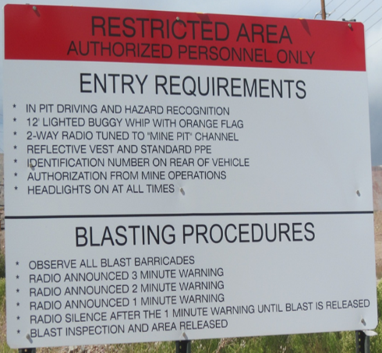
Mine Entry Points
Crossover points
Notes:
There are several mine entry points on property. The mine can be entered from the Live Oak Gate or past the Tank House from the smelter side. There are several mine entry points denoted by cross-overs and entry requirement signage. There is a cross-over point located before entering the mine lower yard, the lower yard bypass road, past the Tank House near the TJ pit, across from the SX plant on the acid haul road, and two near the hay barn north of the smelter. There is also a cross-over point near the 31-land fill. Some smelter personnel regularly travel to the land fill. Remember that pit driving certification is required before entering left hand traffic. There may be times that some of the access roads are closed due to various reasons, such as HDPE pipe moves, repair and other reasons.

Slide 6
Process Safety Management Level 1
Notes:
18 min video 2 min Quiz review
https://fcx365.sharepoint.com/teams/MiamiProcessSafetyManagementPSM/_layouts/15/stream.aspx?id=%2Fteams%2FMiamiProcessSafetyManagementPSM%2FShared%20Documents%2FGeneral%2FTraining%20Materials%2FPSM%20L1%2FAcid%20Plant%20PSM%5FL1%20Safety%5FHazRec%20Video%20v1%2E4%2Emp4&referrer=StreamWebApp%2EWeb&referrerScenario=AddressBarCopied%2Eview

Slide 7
Molten Metal and Water
Notes:
8 min

Slide 8
Regulated Area
Notes:
7 min video and 2 min quiz review

Slide 9
Site Specific PPE Requirements
Smelter
Goggles or foam-fitted safety glasses with side-shields on your person.
Respirators are required in all smelter operational areas.
At a minimum long sleeve jackets are required in regulated areas
If performing work, then the appropriate type of coveralls are required.
Tankhouse
Rubber gloves anytime you are on the active cell line.
Boots must have a 6 inch. Top, hard toe, with metatarsal protection and well-defined heel.
Notes:
1:00 Min

Slide 10
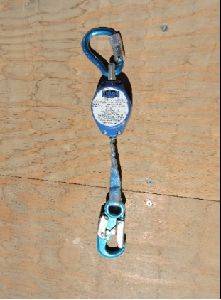
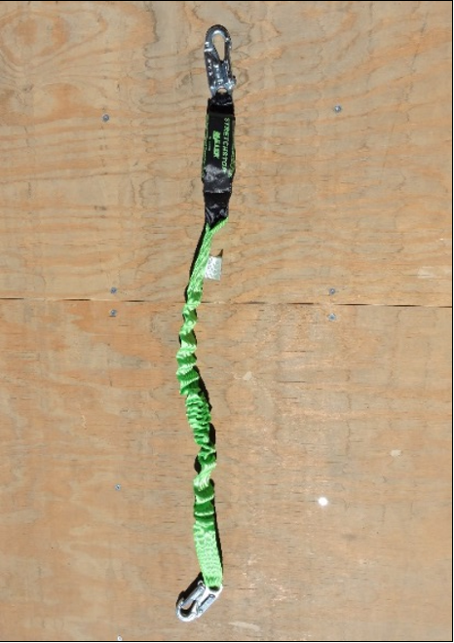
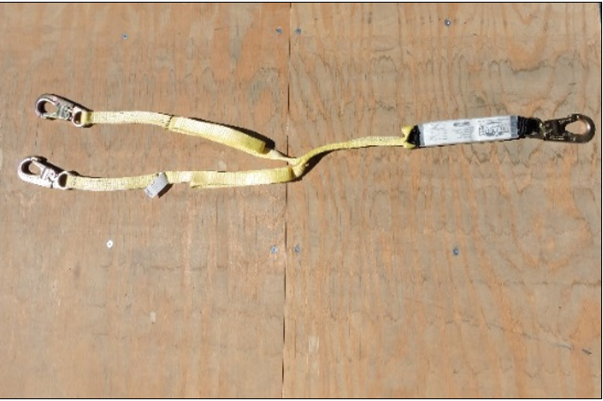
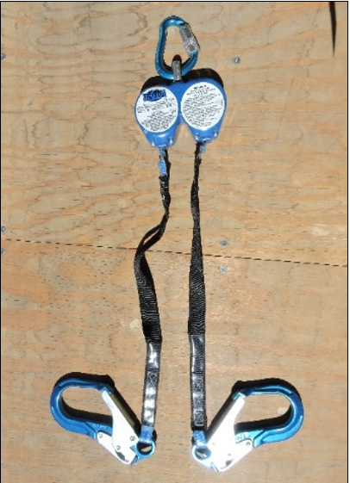
Connecting device Miami specific
Miami Specific: Use of Shock Absorbing Lanyards is Prohibited. Utilize Self Retracting Lanyards for Fall Arrest applications
Notes:
When selecting a Lanyard for fall arrest systems the only acceptable device on Miami property is a Self Retracting Lifeline, commonly referred to a Yo-yo.
When using a SRL one must calculate deceleration distance and safety factor to determine the total fall clearance distance
Way easier than shock absorbing lanyard and safer too

Slide 11
Miami Environmental Phone # (928)473-7005
Notes:
3:50
https://fcx365.sharepoint.com/teams/mttlinksforppt/_layouts/15/stream.aspx?id=%2Fteams%2Fmttlinksforppt%2FShared%20Documents%2FStream%20Migrated%20Videos%2FMiami%5FEnvironmental%5FTraining%2D%5FModule%5F2%5Fdefault%2D20210505%5F092103%2Emp4&referrer=StreamWebApp%2EWeb&referrerScenario=AddressBarCopied%2Eview

