Slide 1
Morenci In-Pit Site Specific

Slide 2
Computer Based Training (CBT)
Pit Driving Link

Slide 3
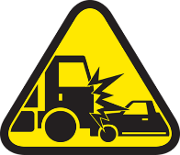
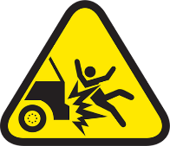
Fatal Risks
Vehicle Collision or Rollover
Collision with another vehicle or fixed/moving object; driving over an edge; rolling over
Vehicle Impact with Person
Person struck by vehicle/mobile equipment

Slide 4
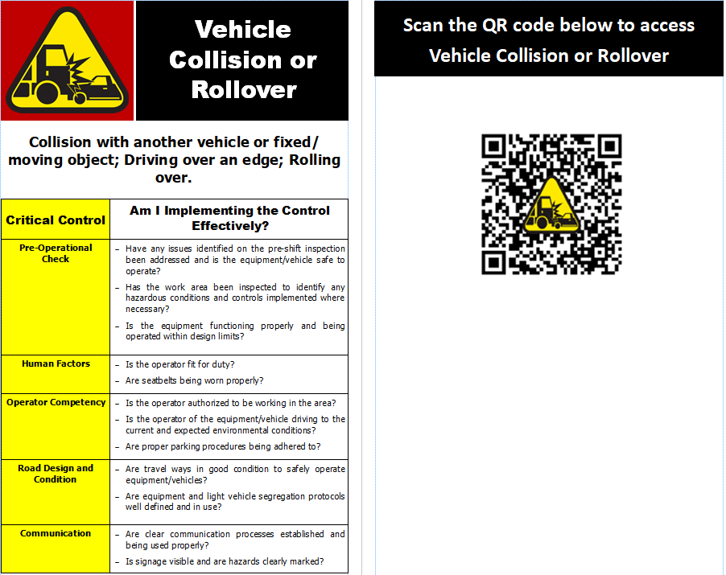
Critical Controls

Slide 5
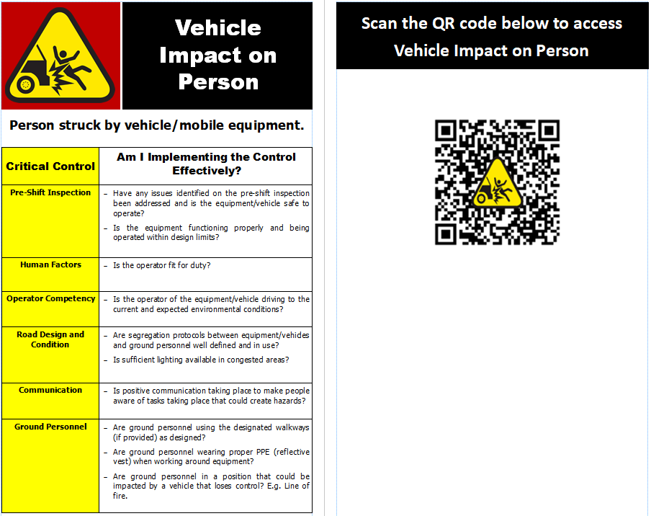
Critical Controls

Slide 6
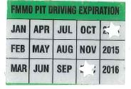
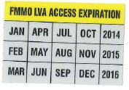
Critical Controls
To reduce risk between light vehicle traffic, heavy equipment and risks associated with pit driving. In order to do that the following strategies will be employed.
Creating two pit driving stickers: ‘Yellow’ LVA Only and ‘Green’ Full Pit Access placed on the back of your badge.
Reducing access into the pit through defining left-hand driving and pit access zones.
Eliminating unnecessary pit traffic by permitting pit access only to those required to enter the pit.
Notes:
Reduce LV (light vehicle) traffic in the pit.
Raise standards for receiving pit certification.

Slide 7


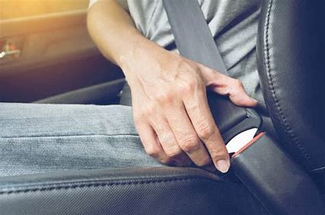
General Requirements
Seat Belts must always be worn on FMI property!
If you aren’t wearing your seat belt, it can’t save your life!
It doesn’t matter if you are driving a pickup truck, a highway haul truck an off-highway haul truck, dozer, or scraper!
Collisions, roll over's, over travel of stop blocks and berms, running off the roads or backing off benches are accidents with something important in common!
Notes:
PUT IT ON and BUCKLE
UP EVERY TIME you get in the driver’s or passenger seat!
When you do, you have a real chance of surviving your own or someone else’s mistake.
Don’t leave your spouse without a partner or
your child without a parent ….
SEAT BELTS CAN SAVE YOUR LIFE!It doesn’t matter if you are on your way to work, at work, or going on vacation!

Slide 8

Expectations: Electronic Devices
Expectations: Electronic Devices
Telephones at Freeport-McMoRan have 7 digits
If you are at a Morenci Extension or on a cell phone, dial (928) 865-6600 for all emergencies. Please call 928-215-5443 for all emergencies or spills during a communication network outage.
Corporate Cell Phone Policy states:
    Never place or receive a call on your cellular phone while driving. If you must answer your phone pull safely off the road. Blue Tooth calling is also prohibited.
Notes:
NOTE Quick means of communication. Pre-program for emergencies.
In an emergency, pull safely off the road to call for assistance.
Do not use cellular phone while fueling.: Please call 928-215-5443 for all emergencies or spills during a communication network outage.

Slide 9
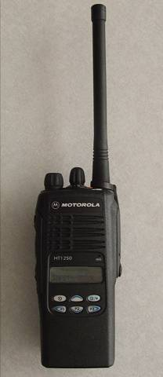
Required Equipment to Enter Pit
Required Equipment to Enter Pit
Radio with required haul truck channels is required when driving off LVA.
Primary source of communication for work activities.
Keep conversations to a minimum.
Why?
In accordance with FCC rules, radios should ONLY be used for “necessary mining activities” (English Only).
Notes:
What are some of the problems encountered by the use of radios?
Radio conversations can be picked up by scanners.
Use of wrong frequency/channelPersonal communicationsCoronado/Garfield
Metcalf/Western Copper
Dispatch 3
Singing
Noise
Obscene or confrontational communications
Any communications not necessary to support mining/business activities.

Slide 10
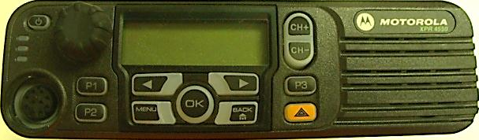
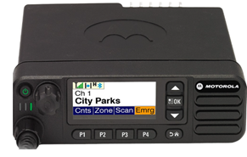
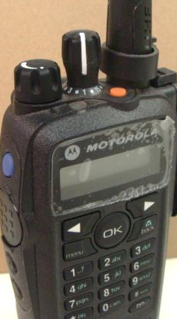
General Requirements
General Requirements
New XPR 5550e model
Orange button
Radio Silence
  During MAYDAY situations.
  Prior to blasting and until a “shot” has been cleared
  What do you do in the event of an emergency?
  Push the Orange or P4 button depending on the radio.
  You will be called back immediately by the mine gate.
All equipment stops immediately to allow for passage of emergency vehicles.
P4=Emergency button on newer digital radios
Push for 1.5 seconds
Notes:
When talking about the “Orange” button be sure to explain the procedure completely. Also explain what to do if button is hit on accident.

Slide 11
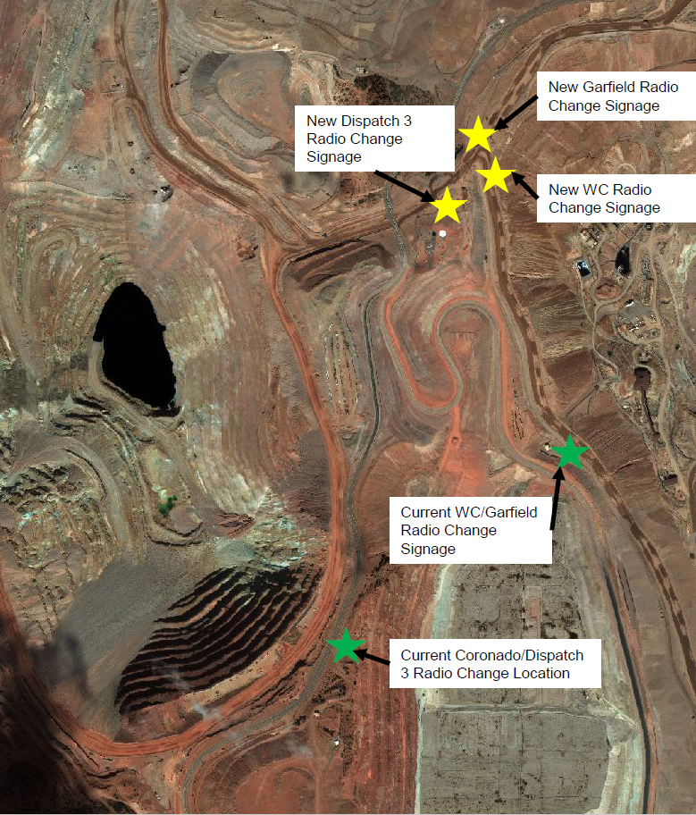
Radio Change: AMT/Coronado/Garfield/WC
Traffic heading west of the intersection will switch radio to Dispatch 3. This will now cover Sun Ridge, Coronado, American Mountain and Silver Basin.
Traffic heading north will switch radio to Garfield. This will cover the King/PCR stockpiles, Garfield, Phase 14 and Shannon.
Traffic heading south will switch radio to Western Copper

Slide 12

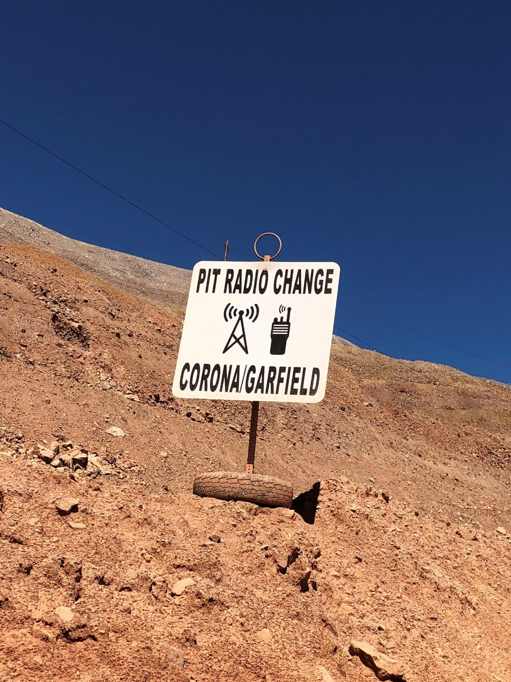
Western Copper Pit Phase-14 area (Shovel#44 and Shovel #46) up to Metcalf-Shannon Intersection will be using “METCALF/W COPPER Channel effective May 1,2023.
OLD
NEW
FROM TO

Slide 13
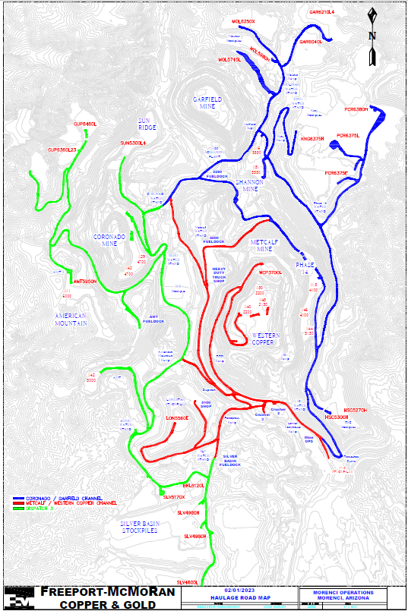
Mine Radio Channels
Dispatch 3 (West and South of Hwy 191)
Coronado/Garfield (North and East Side of the Mine
Western Copper (Center of the Mine)
Change coming May 1st
Added to Western Copper

Slide 14
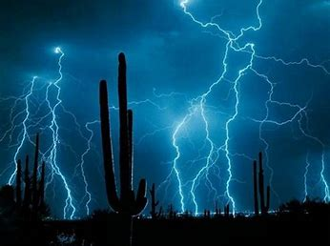
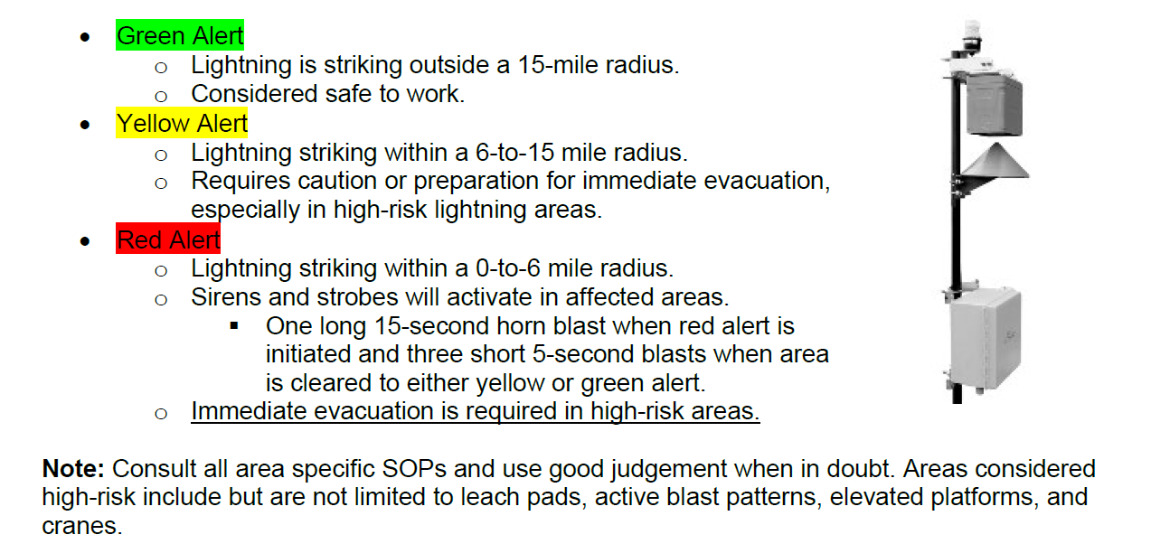
Lightning
Notes:
The mines lightning detection system will be used to communicate the presence of lightning activity to all mine personnel. When explosives are loaded a RED Alert will trigger evacuation of affected area. Evacuation must proceed without any delay. Re-entry to affected area is allowed once the Red alert has cleared. Other work may also be impacted by lightning such as outdoor line crew activities or working at heights. Check with your area supervisor for information. Remain Aware of Your Surroundings: Pay attention to changing weather conditions. Stop Work and Seek Shelter: If you can hear the thunder within 5-7 seconds of witnessing lightning; the storm is generally close enough to strike

Slide 15
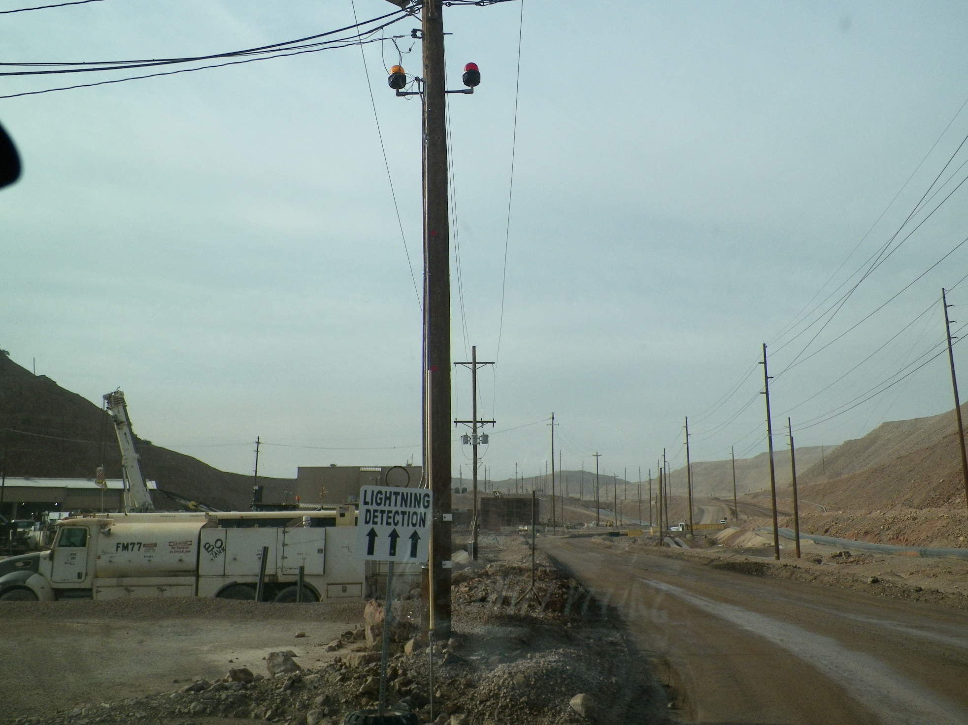
Lightning Detection Beacons
Notes:
Metcalf office area across from the Shovel and Drill shop.
Are also located at the RW entrance

Slide 16
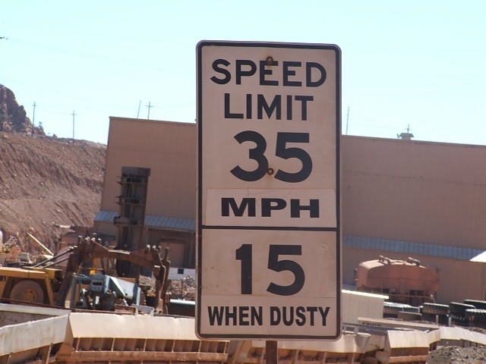
Speed Limit & Road Conditions
Speed Limit & Road Conditions
Speed limits:
35 mph max on Haul Roads (in the mine)
35 mph max on LVA, 15 mph when dusty on the LVA
5 mph around shops, fuel docks, queue points
Always drive according to road conditions and obey all traffic signs.

Slide 17
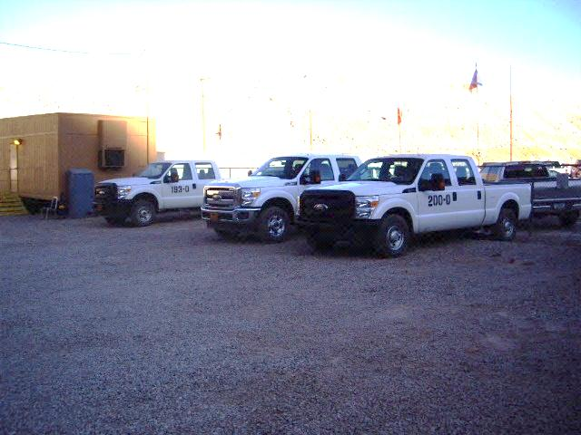
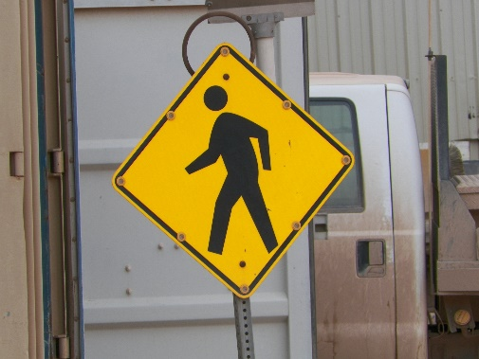
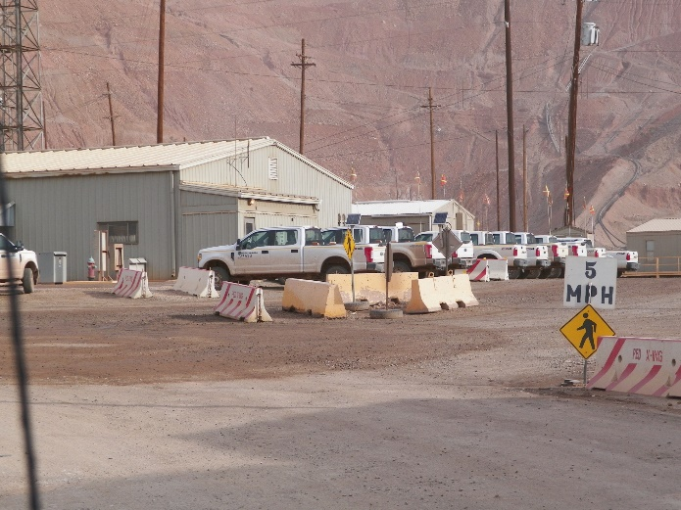
General Requirements
General Requirements
  FMMO Parking Standard
  Within the mine area (Shops & Offices) unless otherwise visibly signed, back-in parking is required.
Pedestrian Crosswalks have
been made available around
the shop & office areas.
Be on the lookout and remember
Pedestrians have the right of way

Slide 18
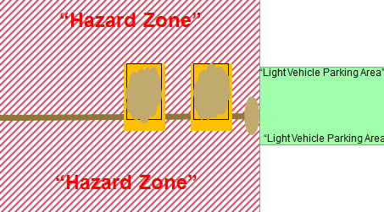
Parking Procedures
  NOTE: In the mining area, parking ditches are designed for heavy equipment and should not be used for light vehicle parking. Light vehicles should park in a safe area outside of the “Hazard Zone” and the vehicle must be chocked with park brake set.

Slide 19
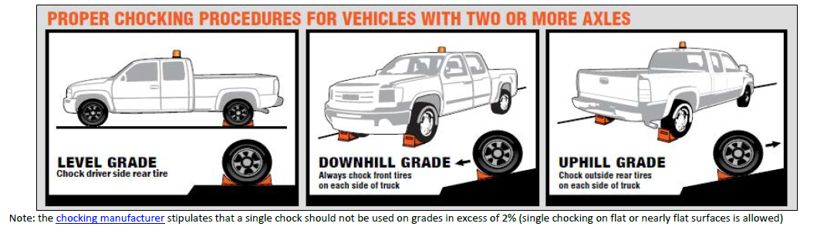
Wheel Chocks
Effective 1/1/2020
New Chocking Procedures
Placement
  Level ground – Rear Tires Driver Side
  Downhill Grade – both front tires
  Uphill Grade – both rear tires
Size
  Light Vehicles
  Services Trucks, Semi Trucks and other medium sized vehicles
  Large Equipment (haul Trucks, etc.)
Be sure that:
Transmission engaged
Park Brake set
Engine off

Slide 20
Critical Controls
LVA - Separates light vehicles from
Heavy Equipment – USE IT!
Utilization of the LVA is not optional and should be utilized whenever possible.
Intersections
There are many intersections through out the mine that expose you to interaction with large mining equipment, always take extra caution in these areas.

Slide 21
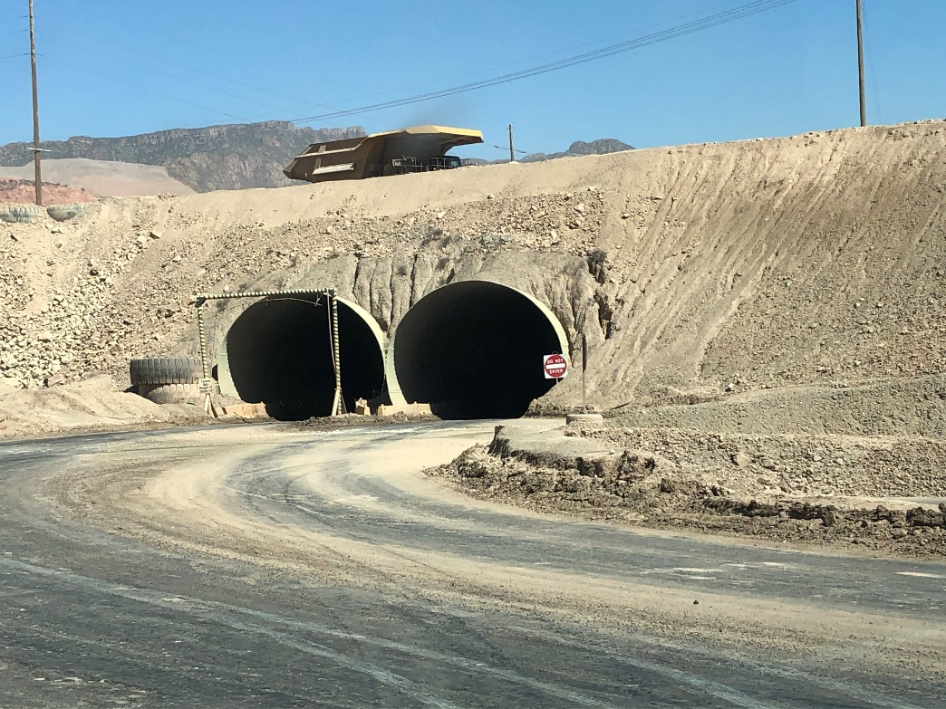
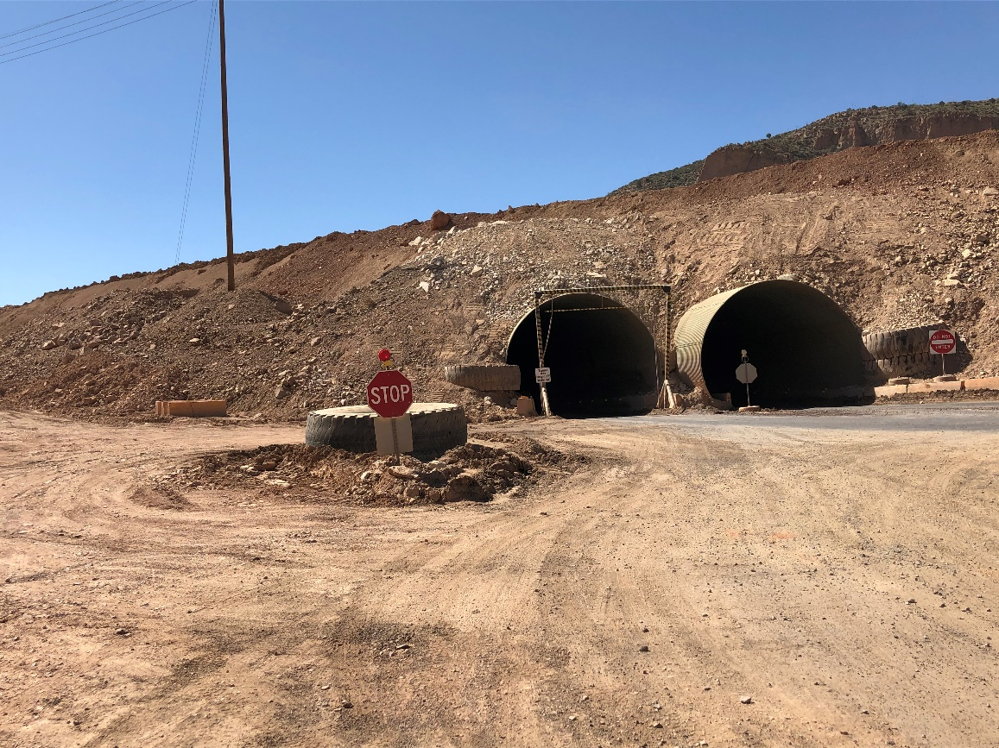
South Tunnel to Western Copper LVA
Visibility can be reduced coming in and out of the Tunnels
Please use extra caution when driving through tunnels

Slide 22
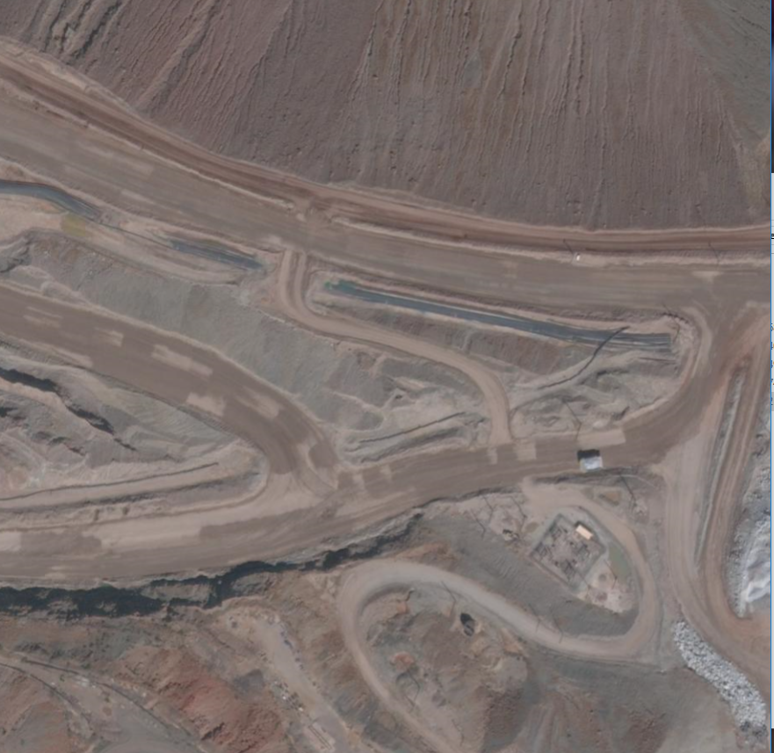

3-Way Stop on LVA
Light vehicles traveling on the LVA should stop & give
right of way to any vehicles merging onto LVA from
Dispatch Haul Road OR vehicles trying to cross the
Haul road coming from IPC 3,Ponderosa,B-Hill areas
LVA
Dispatch Haul Road
IPC3,Ponderosa,B-Hill Areas

Slide 23
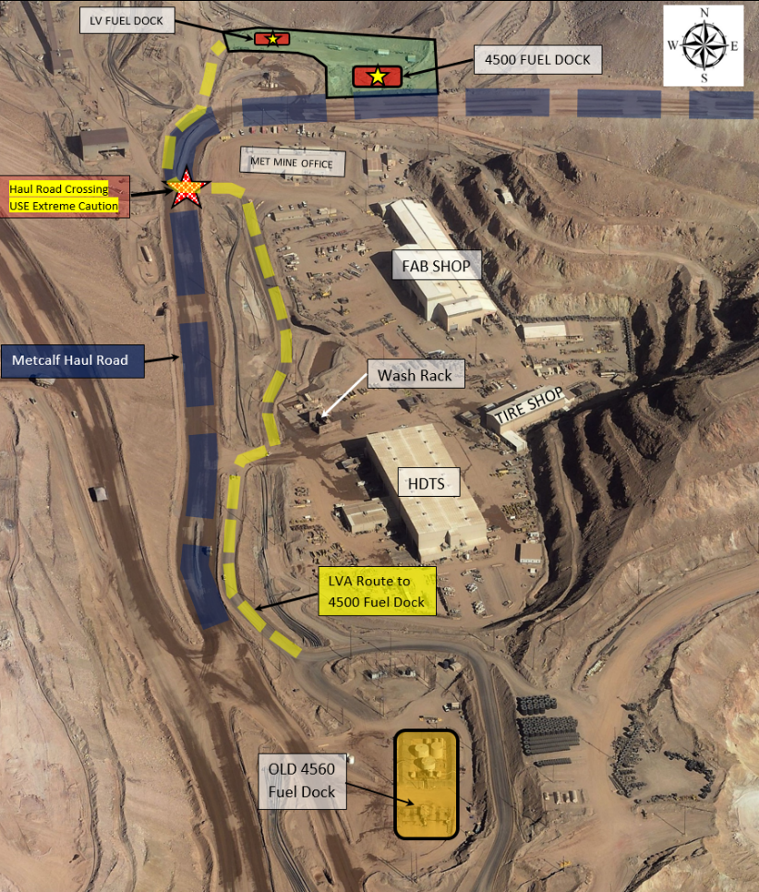
LVA ROUTE to Metcalf 4500 Fuel Dock

Slide 24
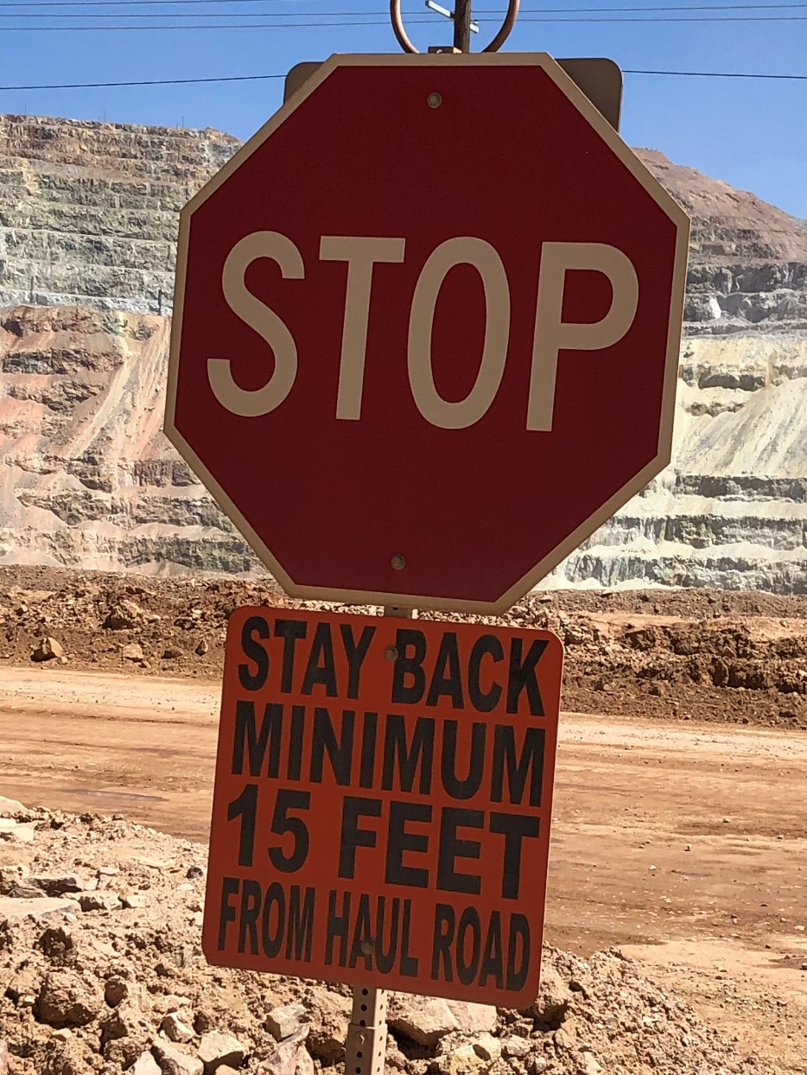
LVA Crossings
At LVA Crossings, stay 15 feet back
from the haul road.

Slide 25
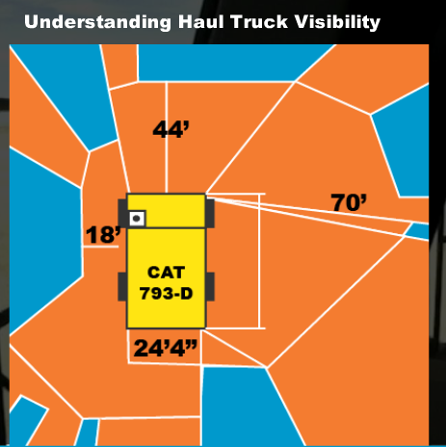
Blind Spot Review
Due to the limited visibility haul truck operators have, it is important that you are aware of their blind spots.
Never assume a haul truck operator can see you! As you can see in this image, the haul truck’s blind area is very large. You must be at least 44 feet in front of the haul truck to be seen and at least 70 feet to the right side of the haul truck to be seen.

Slide 26
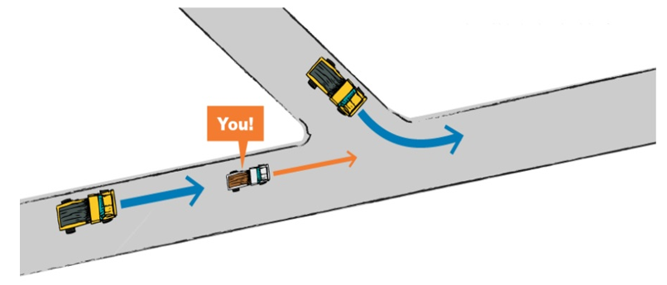
Right of way
You are driving up the ramp and would like to go straight. There is a haul truck coming up to the intersection in front of you.
Another haul truck is driving 250 feet behind you. What do you do?

Slide 27
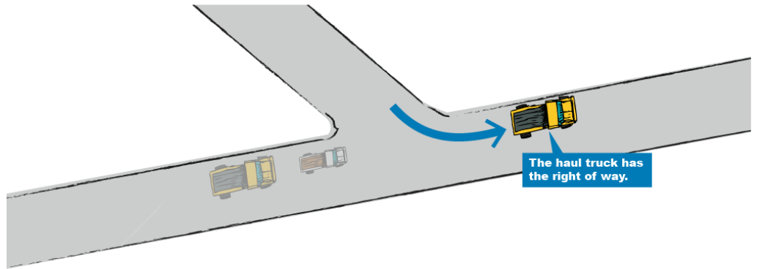
Right of Way
The haul truck coming up to the intersection in front of you
cannot see you. You are in the haul truck driver's blind spot. Yield for the haul truck turning left.

Slide 28
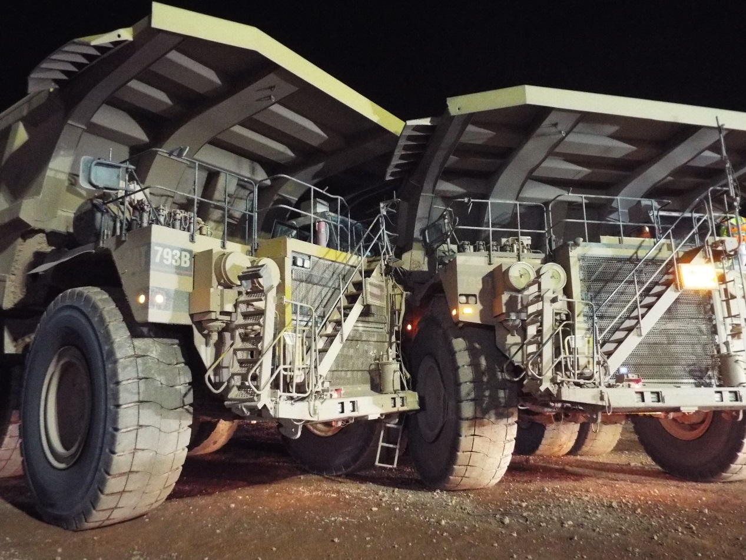
Roundabout
Purpose Of Roundabout
Safety
Less chance of metal to metal and/or less severe collisions due to slower speeds
Forces traffic to slow down through the intersection
Facilitate U-Turns
Efficiency
Improve fuel efficiency and less
component wear

Slide 29
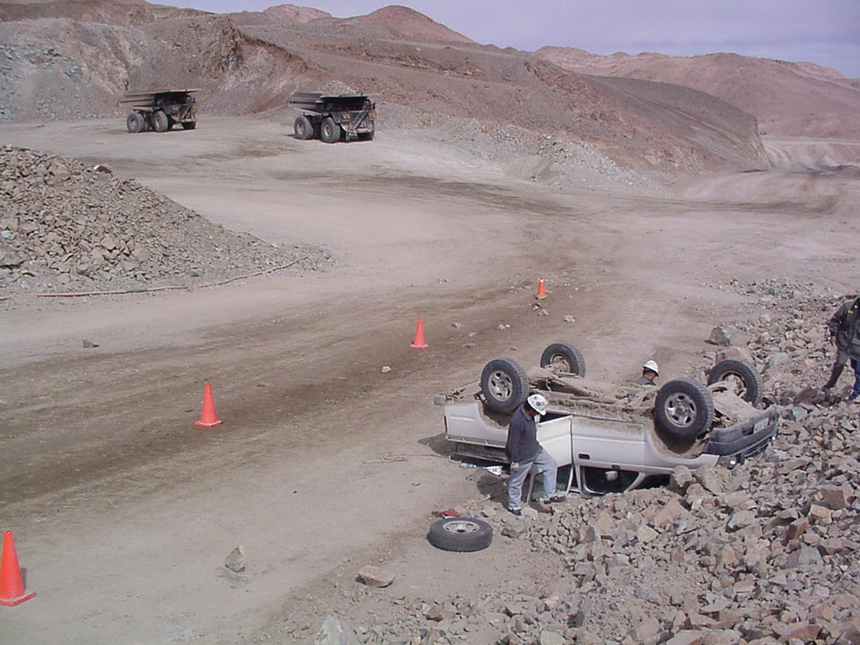
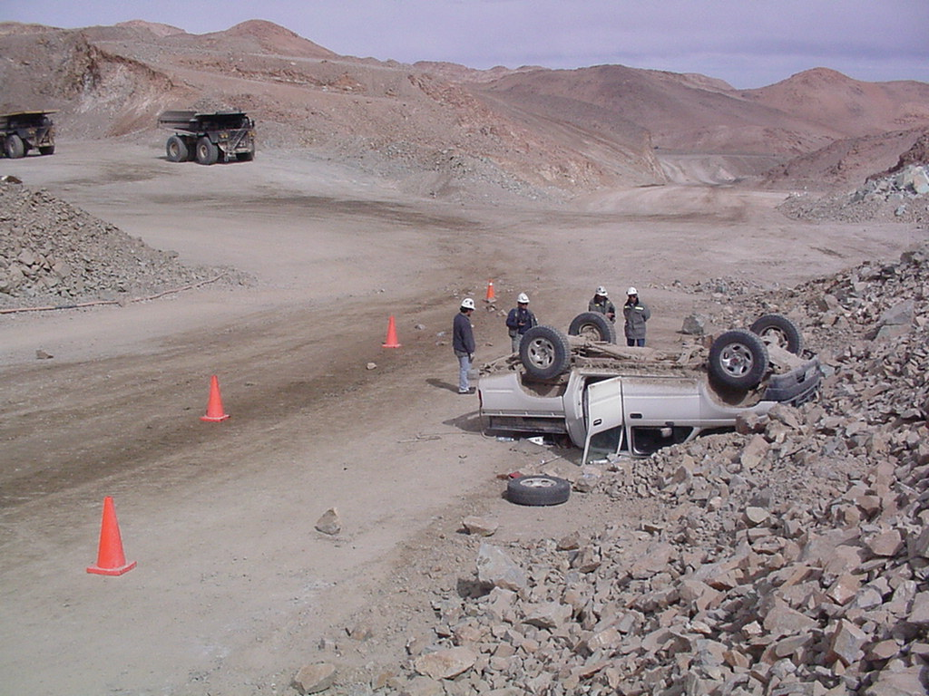
Hazardszards
Spillage
Haul trucks are required to go around spillage so always travel at a safe distance. They may have to travel in your lane.

Slide 30
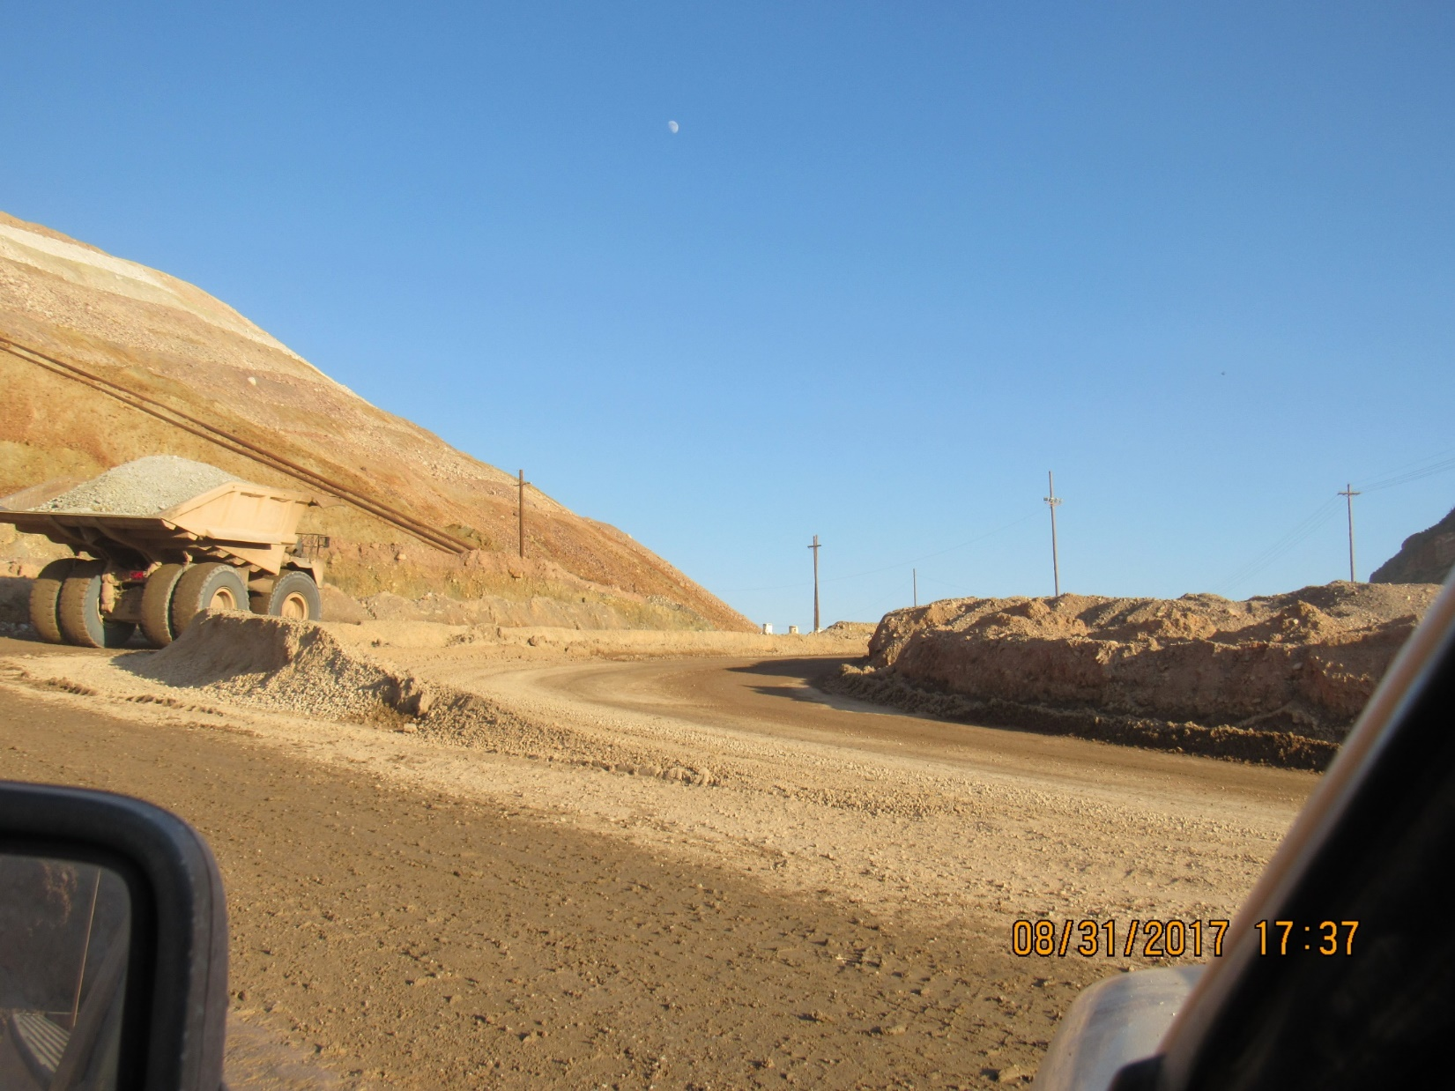
Blind Corners - Can you see me now? Stay Visible – Stay Alive!
Haul Truck moving at 25 mph +
Can haul truck see the LV?
Don’t put yourself in danger.
Drive further down the road to make your turn.
Ensure that all haulage traffic can see you and has time to stop!
LV
Waiting to make a right / U-turn.
Buggy whips are no guarantee and can be difficult to see.
Why LVAs are so important

Slide 31
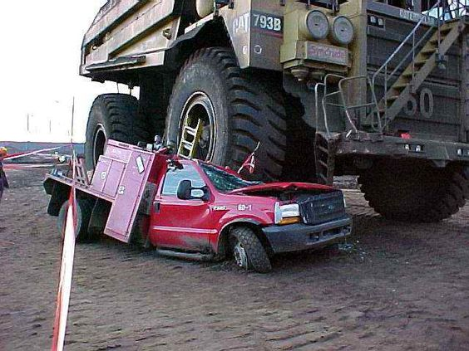
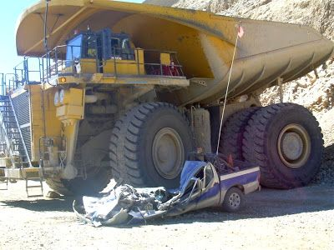
No matter who’s at fault YOU LOSE!
  Haul trucks must see you in time to stop
  Don’t be a statistic

Slide 32
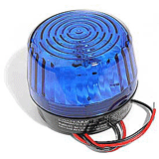
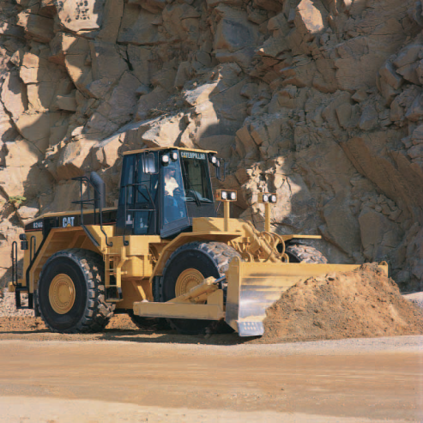
General Requirements
General Requirements
  Blue Strobe Light
  Used on support equipment - do not pass without direct verbal permission to do so
Note: Passing is allowed only when the “Blue” light has been turned off and verbal permission has been granted.
If traveling in the opposite
direction passing is allowed
Only if the spill does not extend
Into your lane
Slow down to 15mph or less
When in doubt YIELD

Slide 33
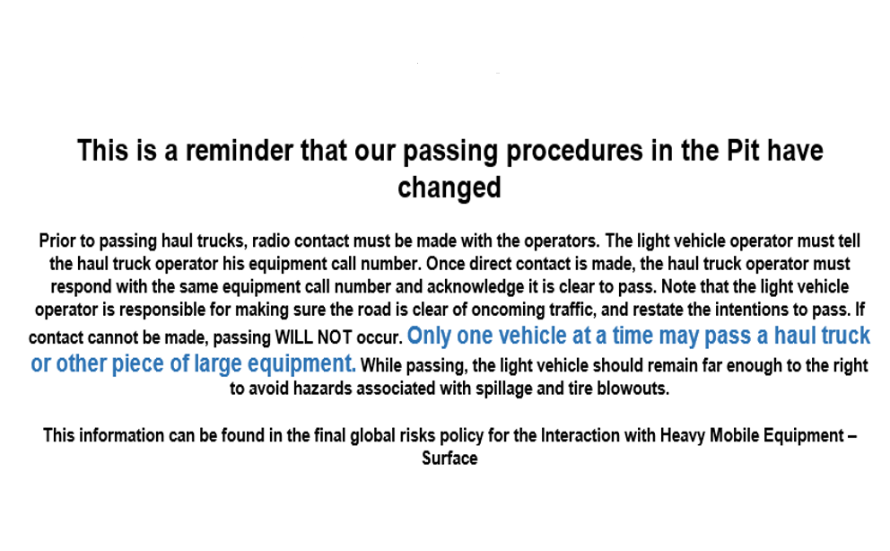
Passing Procedures
Passing Procedures

Slide 34
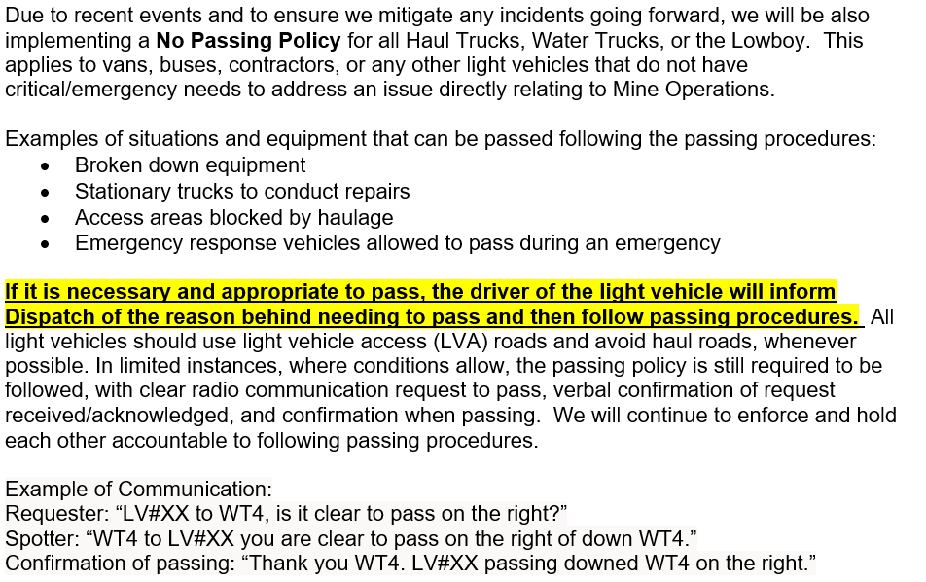
Passing Procedures

Slide 35
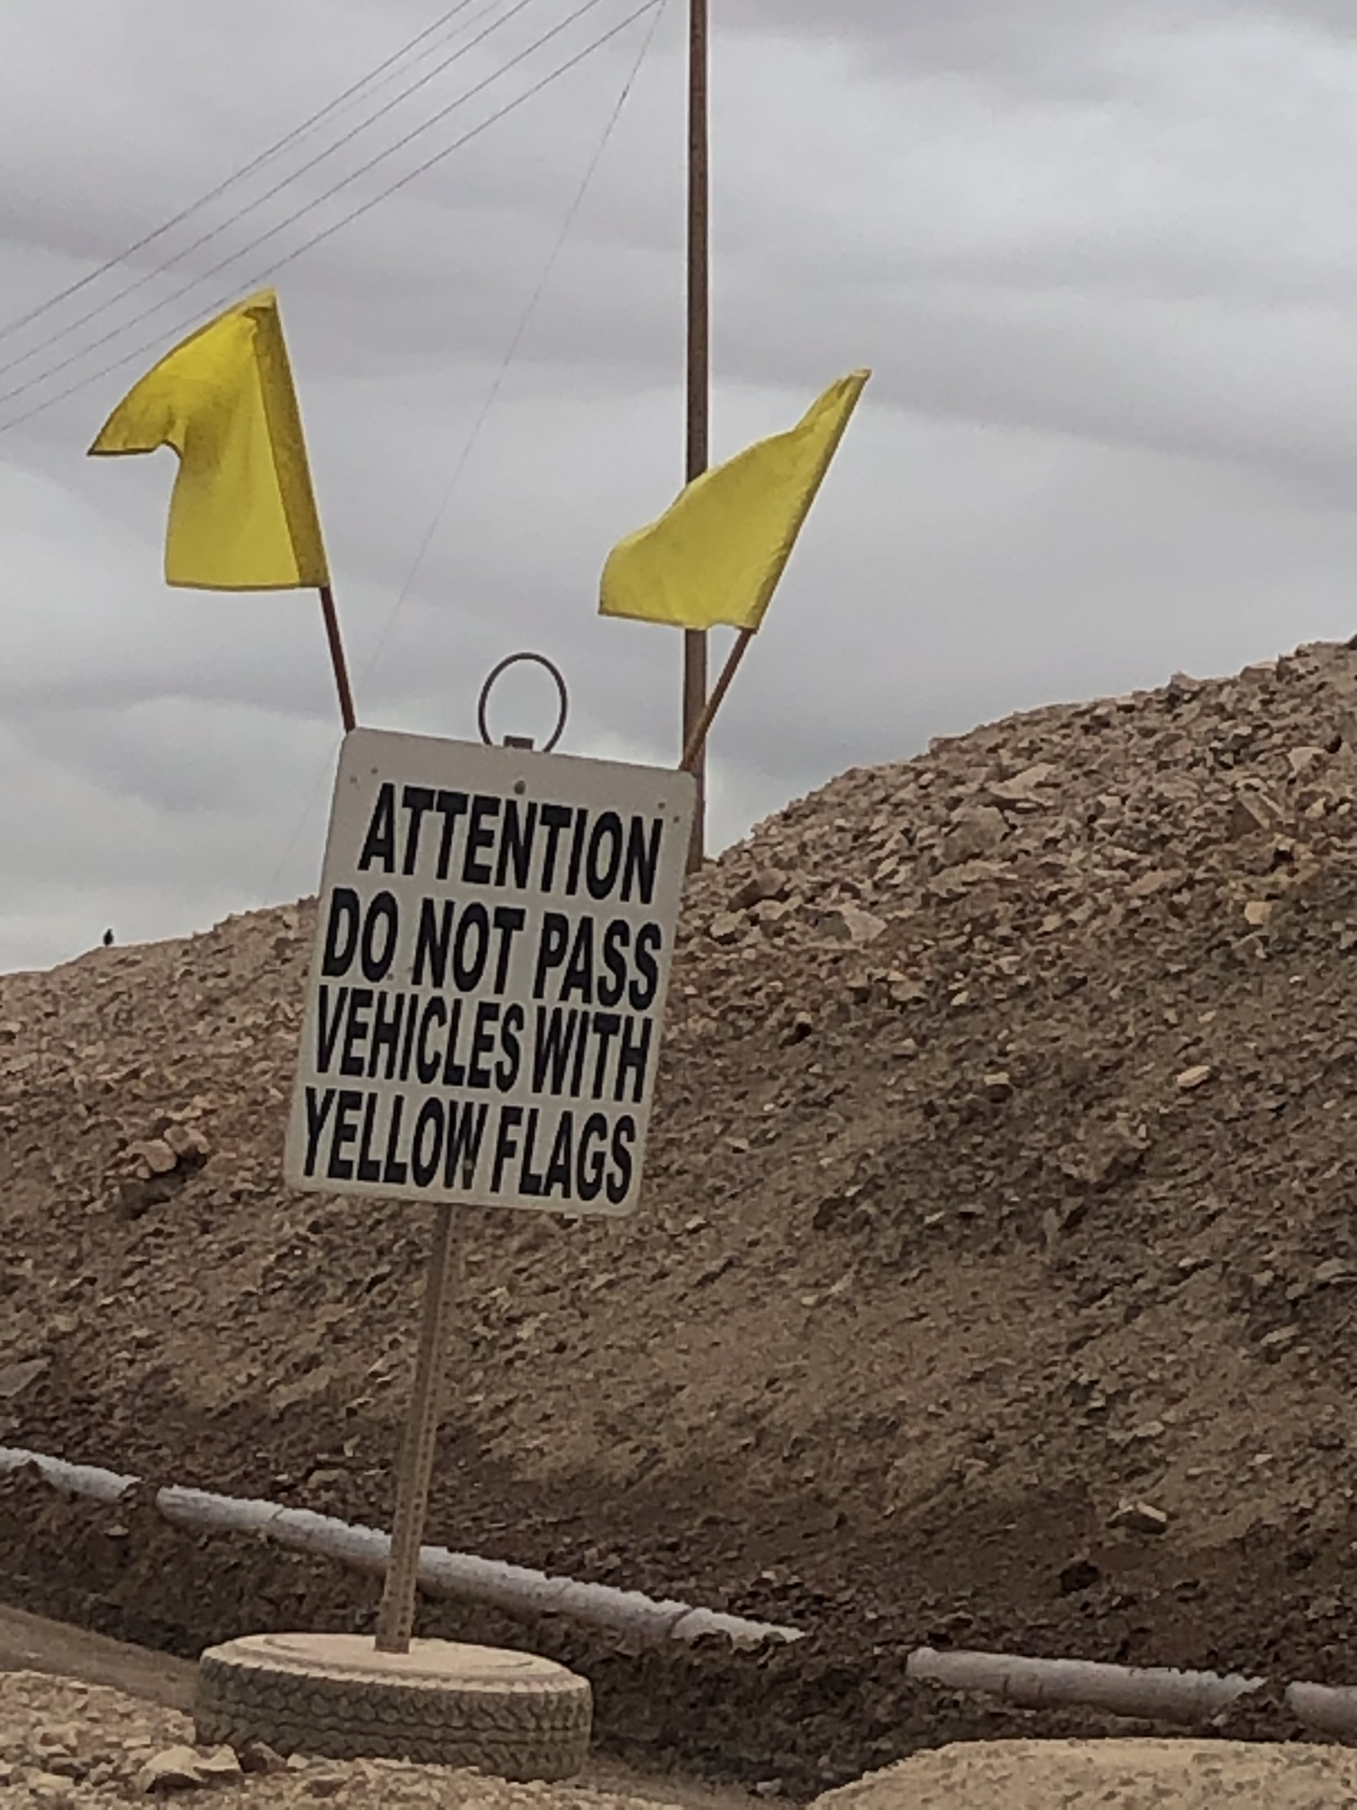
Who Uses Yellow Flags?

Slide 36
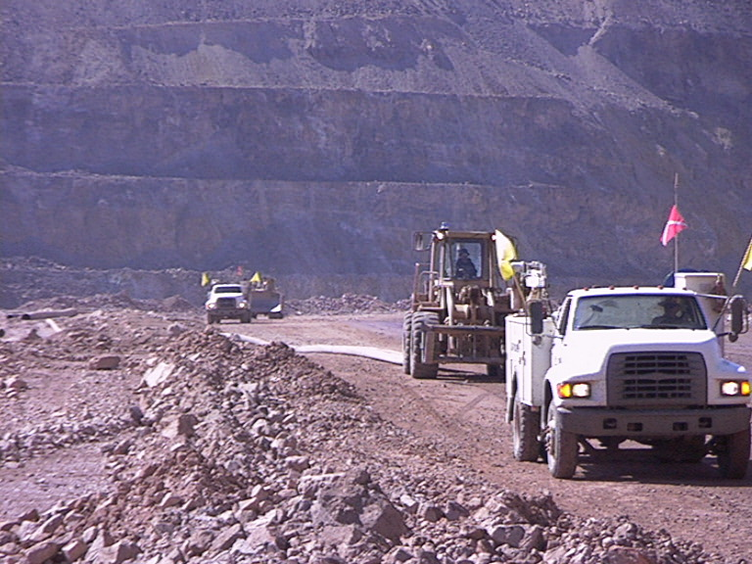
Pulling HDPE Pipe
Pulling HDPE Pipe
You should also see a blue light while pipe is actively being pulled
Escort vehicles may consist of a van, a pick-up truck, service truck, boom truck or any piece of equipment.
2-3 escorts may be used, depending on the traffic and layout of the haul roads.
Traffic can be blocked from both directions of travel.

Slide 37
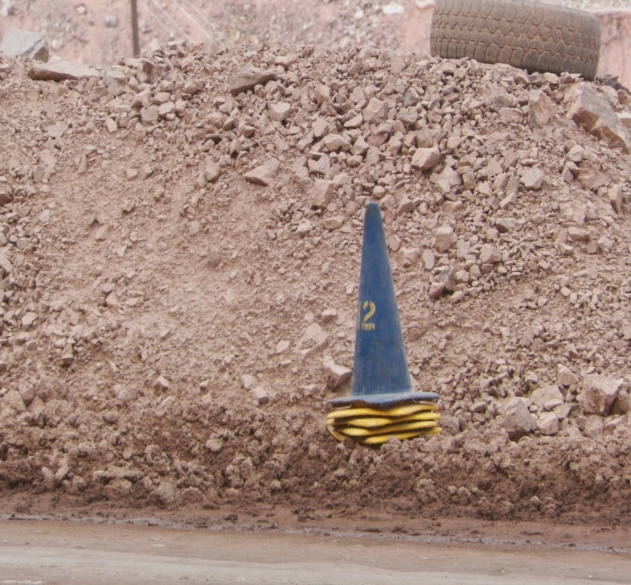
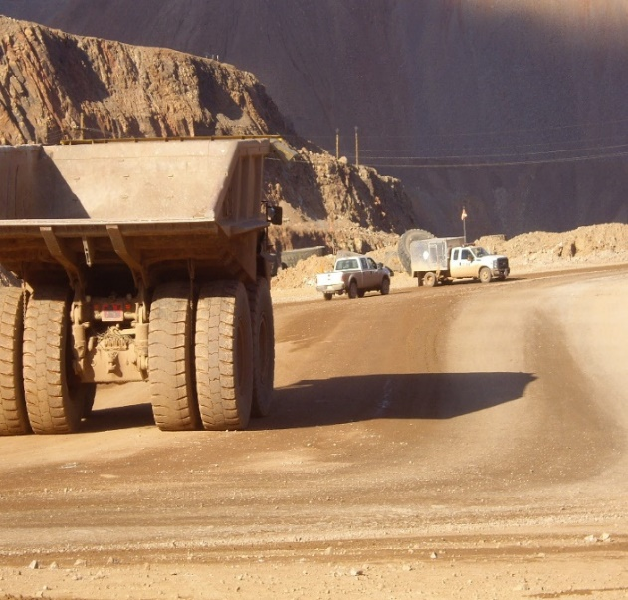
Shot Clearing & Blocking
Shot Clearing & Blocking
Prior to Blast haul road being blocked will have a ‘BLUE’ cone alongside the haul road.
All personnel must clear the affected shot area.
Blast team members will clear the area.
It is imperative to obey the instructions of the blast clearing team.
Roadways will be blocked to prevent entry to the affected area. All vehicles must stop.
No one shall pass until the shot area is cleared and the blasting crew releases the area back to normal operations.
THIS IS A RESTRICTED AREA!
If you are working in the active mining areas –
know where blasting will occur.

Slide 38
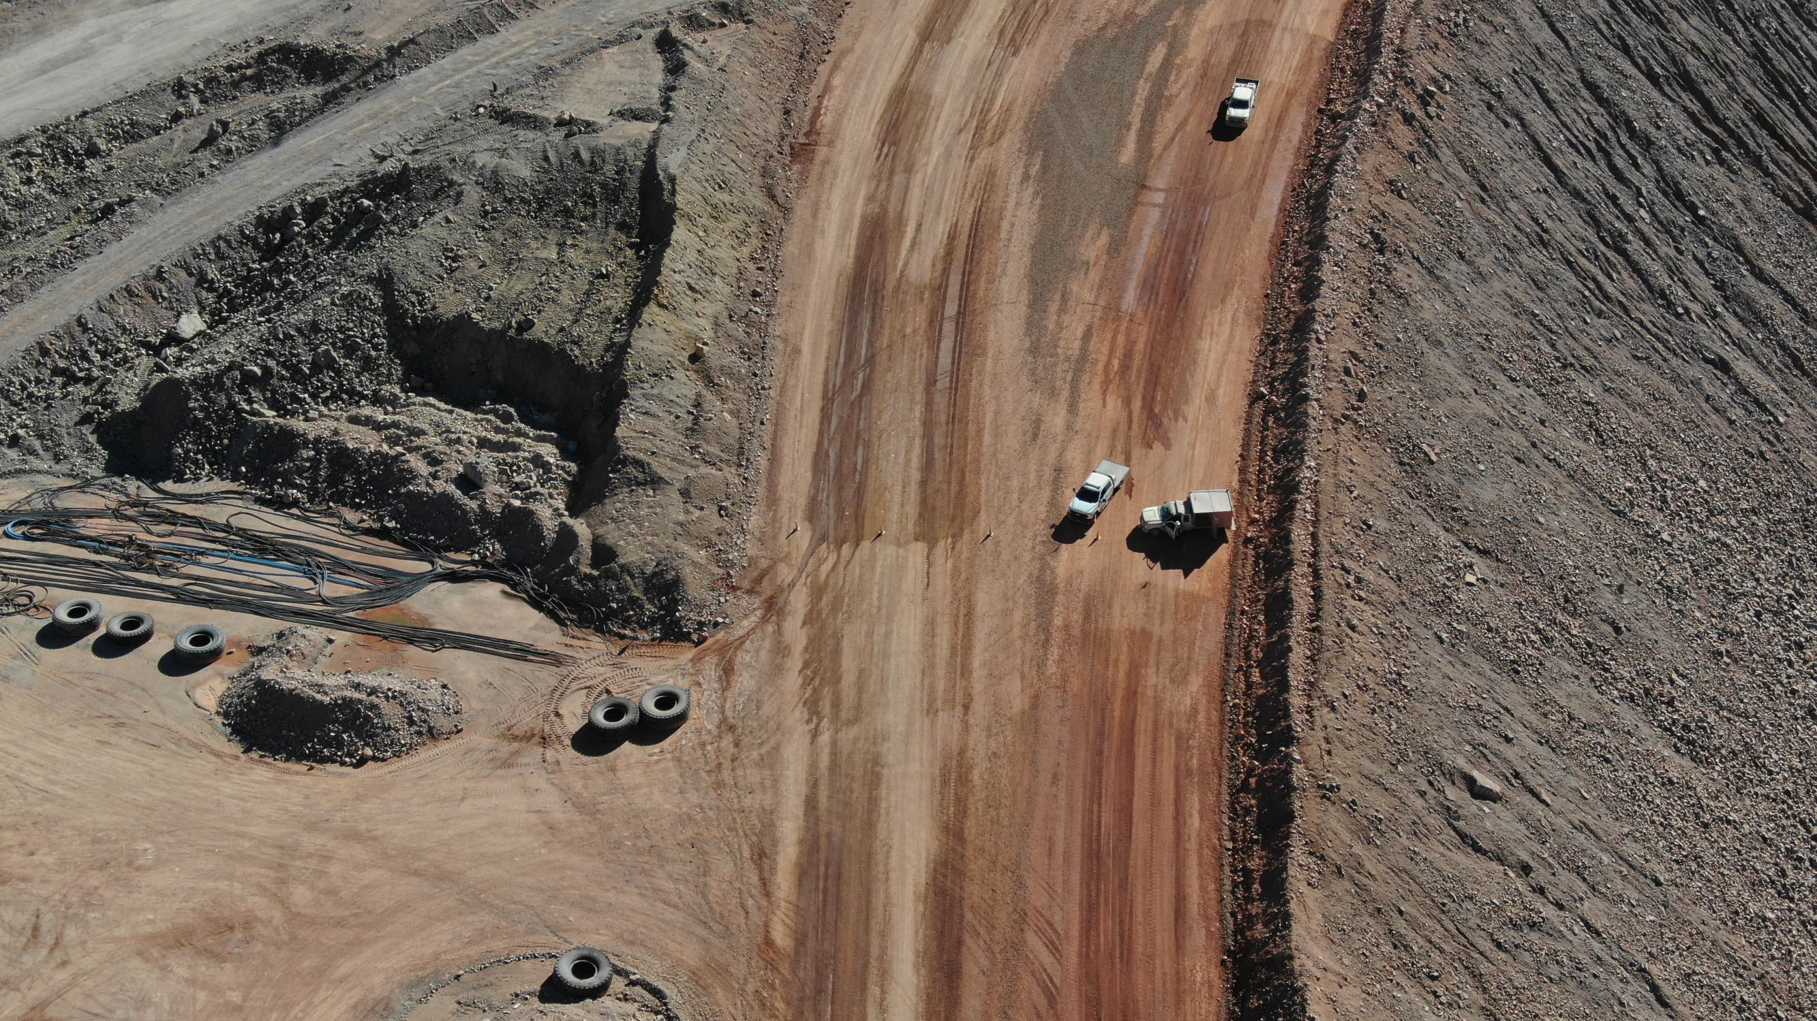
Blasting Perimeter
Notes:
When yellow cones are placed across the haul road or LVA with the blasting crew parked blocking the road, equipment and vehicles must stay 150’ away from blockers. If you are approaching a blocker and yellow cones across half of the road, stop, do not go around! Yellow cones across half of the road is allowing traffic to leave blast area. Area will remain restricted area until blast is cleared, all cones picked up and Blast Crew has left the area.

Slide 39
Hazardous Areas
Equipment shall not be left unattended within hazardous zones of active mining areas (i.e. dumps, queue points, shovel pits, fueling stations, haul roads) normally traveled by haulage equipment unless the following controls are in place:
The location and status is communicated to all haulage traffic (if equipment will remain in the hazardous area for multiple shifts the communication must be given to each affected crew); and
The equipment is identified using methods that will increase the likelihood that haulage traffic is able to readily identify the location of the equipment
Vehicle is removed from the hazardous area within 12 hours of identification or is segregated from haulage traffic through use of berms, tires, or other substantial barriers.

Slide 40
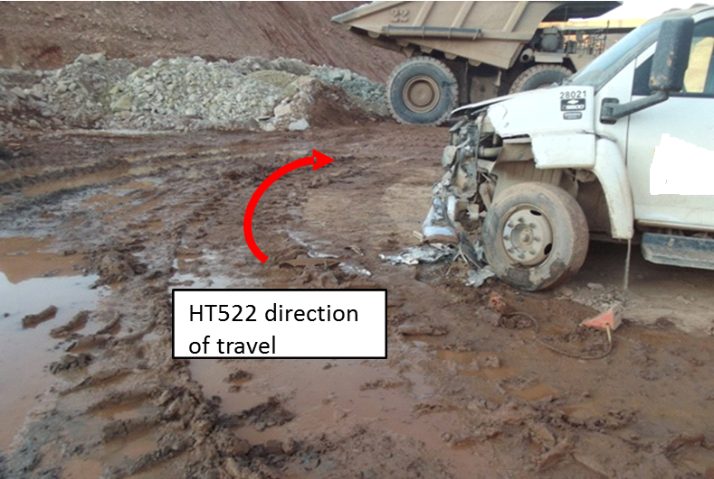
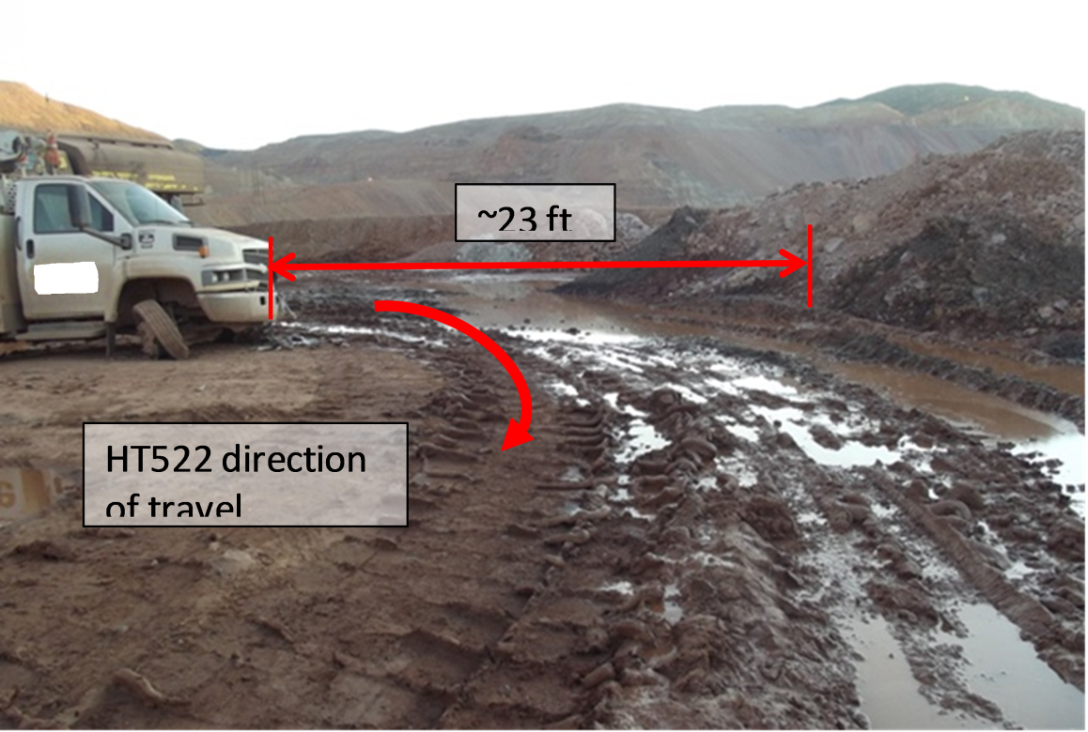
The consequences are real
The consequences are real
Morenci Incident: 12-31-11

Slide 41
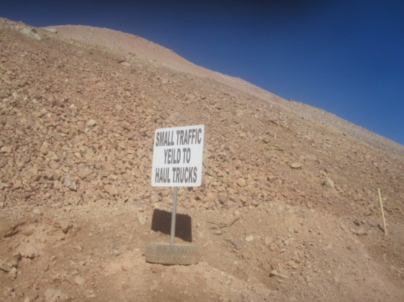
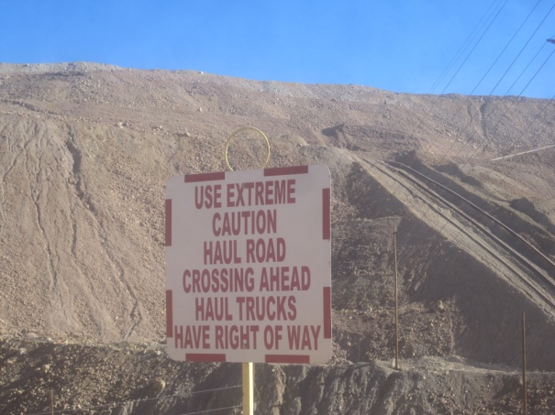

Control of Personal Factors:
Judgment - Make right Decision
Think about the next 15 seconds
Use consequence thinking
Think safety at all times when traveling in the mine
Always look both ways before proceeding
Obey all signs
Always park at a safe distance from the high wall depending on the height of the high wall.
Notes:
30 CFR § 56.20011 Barricades and warning signs.
Areas where health or safety hazards exist that are not immediately obvious to employees shall be barricaded, or warning signs shall be posted at all approaches. Warning signs shall be readily visible, legible, and display the nature of the hazard and any protective action required.

Slide 42




Restricted Areas in the Mine

Slide 43
Restricted Area
Geomechanical/Slope Hazard Areas
The Slope Stability Group (Geomechanics/GMX) has been using slope restriction signs to keep employees aware of active slope stability hazards. Due to lower visibility issues with the current signs, Geomechanics/Slope stability group have changed the signage procedure to “Green Cones”.
  The green cones will have reflective striping with lettering stating “GMX” to identify ownership.
  The green cones will be placed in slope hazard areas.
  Going behind the cones can only be done after getting permission from the on-call slope engineer. Contact dispatch 402 to get the on-call slope engineer contact information.

Slide 44

Drill Corrals
You can enter a drill corral without calling a drill operator if you are not within 50 foot of the active pattern.
However, Remember that the powder crew often works in drill corrals with active drilling in affect. Always look for blasting operations. Never pass by yellow cones without verbal permission from the F5 or F2.

Slide 45

Entering Production Drill Site
Call required at berm entrance
Active Drill Pattern: The drill pattern is defined as any pattern with a drill on it. you must have verbal permission to be within 50ft of an active pattern.
Notes:
Must have verbal contact

Slide 46

Entering Production Drill Site
Verbal Permission must be granted by the driller on ‘Mine development channel if your path or work is within 50 ft. of an Active Drill Pattern.
No call required at berm entrance.
Notes:
You can pass without verbal permission. However, operator should be notified if you are going to be working in this area. And any parking should be done at a safe distance. As drills often move to other patterns

Slide 47




Restricted Area
25’
25’
25’
25’
Notes:
At times, there will be drills that are being serviced by the PM crew. There will be an area marked with cones. That is a restricted area as well. If for any reason you should need to enter that area you must follow the lock out procedure being used at the time and sign paperwork at the barricade.

Slide 48
Approaching Manned Drills
Radio contact is required to enter the 25 foot restricted zone on occupied equipment
Any time a person needs to enter the 25 foot restricted area, all drilling operations must come to a halt. Air and water will be turned off, Engine turned to Idle, and controls placed in neutral. The operator will then step out onto the deck and watch that person approach.
All radio communication must include all equipment numbers.
Service equipment should wait 50`outside the active pattern until granted permission to enter.

Slide 49

COHE

Slide 50

COHE – Drill Arrival
When personnel arrive to a drill, they will encounter a perimeter barricade. The lock box should be facing out. Personnel will inspect lock box for equipment key, if equipment key is in lock box, and the person is taking possession of the drill they can take the key and turn the sign to the “equipment may move” side.
Persons who need to work in the 25 foot restricted area and are not taking possession of the drill will leave the equipment key in the box and lock it with their LOTOTO lock.
If the Danger equipment may move side is facing out, contact is required with the person in control of the machine.

Slide 51
Restricted Area
Action Required
Know the area you are working in or traveling through. Be knowledgeable of policies and procedures in the mine.
Employees must be aware of their surroundings at all times.
When in doubt on where production-drilling operations are currently conducted, STOP and contact the Drilling Supervisor (F4) on the Mine Development Channel.
If you do not have the Mine Development Channel, contact the 402 Tower on either Metcalf, Garfield/Coronado, or Dispatch 3 channels for contact information.

