Slide 1
2021 Hazardous Gas Awareness
Moly Plant

Slide 2
Fatal Incident
March 27th, 2008 at approximately 5:00am a metallurgical sampling technician was exposed to hydrogen sulfide and nitrogen when he opened the window on a cell in the moly processing cleaning line to take a sample.
Apparently, exposure to H2S and N2 resulted in toxic asphyxiation and the death of the operator.
A plugged CO2 control valve that fed the moly rougher circuit, directed 100% of the CO2 feed to the conditioning tank that feeds the first cleaner flotation line.
The increased CO2 flow reduced the pH of the cell where the sample was being taken to low enough levels to generate H2S.

Slide 3
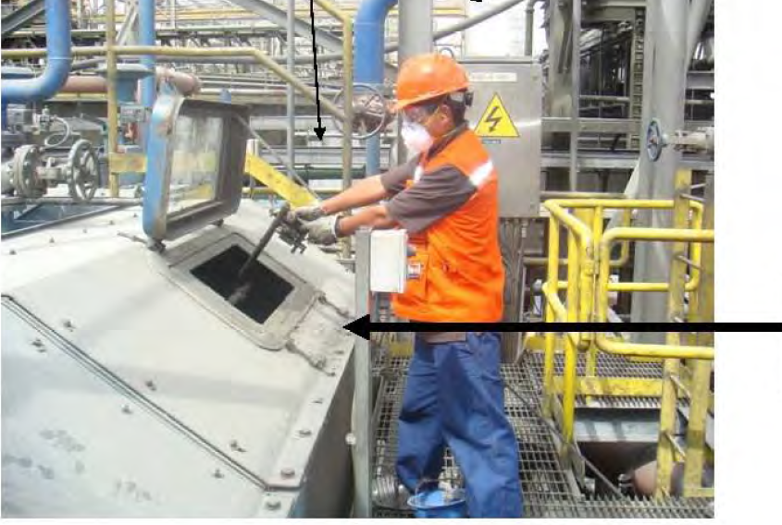
Fatal Incident
Example of Technician of
taking sample from Moly Cleaning Circuit

Slide 4
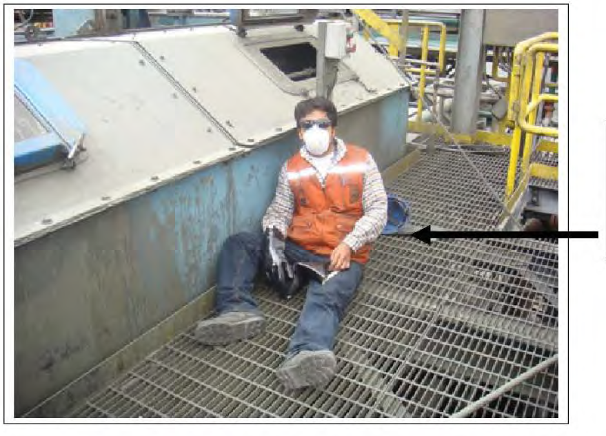
Fatal Incident
Location where sampler
was found after being overcome with toxic
Hydrogen sulfide and nitrogen

Slide 5
Probable Direct/Root Causes
Direct Causes
Root Causes
Failure to wear approved respiratory protection
Failure to have existing H2S and pH sensors tied to alarm systems
Failure to adequately address the repeated non-use of required PPE by sampling technician
Failure to follow design and modification standards for the phase II modifications to the moly processing plant

Slide 6
Immediate Corrective Action Taken
Shutdown of moly plant until critical action items were implemented.
Tied H2S and pH sensors in to alarm system
Specify required PPE usage in moly processing plant
Installed automatic shut-off valves for CO2 feeder lines
Re-educate moly plant personnel on hazards associated with H2S

Slide 7
Restricted Access Area
TRAINING REQUIRMENTS FOR ENTRANCE
Hazardous Gas Awareness Training
Evacuation Procedures
Personal Gas Monitor Training
Escape Respirator Training
Hardhat sticker declaring that required training occurred is required. Annual refresher training is required.
Access is NOT permitted without the above required training.

Slide 8
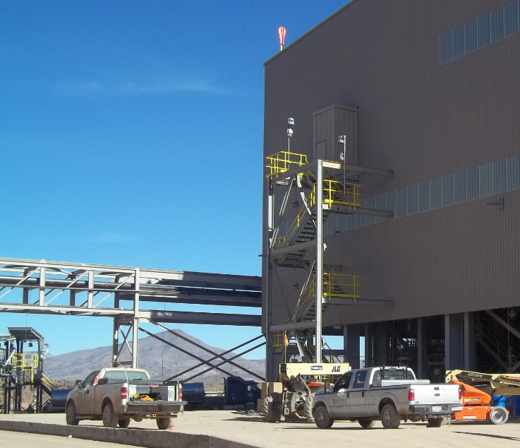
Moly Plant Control Room Entrance
Moly Plant Entrance

Slide 9
Restricted Access Area
H₂S gas is potentially generated anywhere that NaHS is present. Although operational controls are in place to minimize this, it is still a concern.
Acid addition is not the only cause of the H₂S gas generation.
Changes in pH within the process solution can also trigger this occurrence.
Awareness to this is critical in maintaining the safety of all involved.
Areas where this gas could be generated include:
Anywhere within the Moly Plant building
Thickener Tank Areas
Reagent Storage Tanks

Slide 10
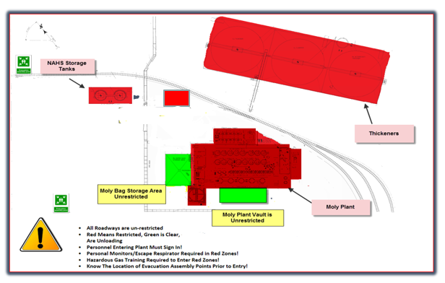
Restricted Access Area
NaHS Unloading
Notes:
Need to make the change on the NaHS unloading area to

Slide 11
Copper-Moly Separation
DEPRESSION OF COPPER SULPHIDES
The objective of the Molybdenite Plant is to float the molybdenum sulphides and depress the copper sulphides.
The most used reagent is NaHS, considering its safety and environmental aspects.

Slide 12
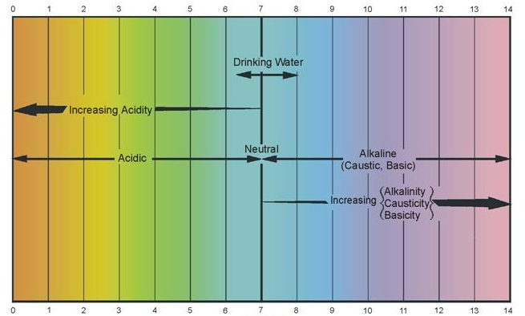
pH Definition
pH is a value used to indicate acidity or alkalinity of a substance.
Raw Water
Process Water
Notes:
Potential of Hydrogen = pH acid/alkaline balance

Slide 13
Modification of the pulp pH
Use of CO2
The pH of the pulp that comes from the Copper Plant is 11.5(highly alkaline or basic), due to the use of quicklime.
We need an acidifying medium to lower pH
Our Moly Plant uses CO2 to lower the pH

Slide 14
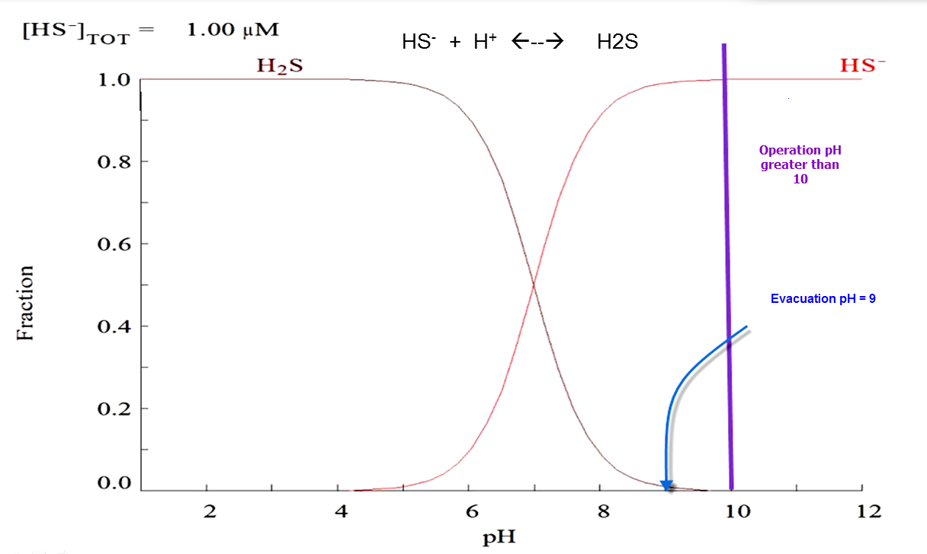
H2S – HS Equilibrium Diagram
Notes:
At a higher pH, the equilibrium of he equation below shifts to the right, keeping the sulphide in soluble form, therefore preventing any hydrogen sulphide odor from escaping.
pH control is effective at controlling hydrogen sulfide

Slide 15
Use of Nitrogen in Moly Plant
NaHS loses efficiency in the presence of Oxygen.
  Due to this reason we use nitrogen to displace oxygen.

Slide 16
Hazardous Gas Awareness

Slide 17
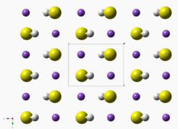
NaHS(Sodium Hydrosulfide)
Sodium Hydrosulfide (NaHS)
NaHS is a chemical that is a highly alkaline solution used to suppress separation of copper/moly plant
This compound is the product of Hydrogen Sulfide with Sodium Hydroxide
Isolation distance of a NaHS Spill is 150ft
Notes:
The objective of the moly plant is floating the sulfides of molybdenum and depressing the copper.

Slide 18
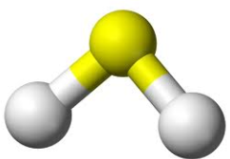

Hazards
The most serious safety concern with NaHS is its ability to produce large amounts of deadly hydrogen sulfide (H₂S) when it reacts with an acid or is exposed to high heat
NaHS is corrosive and is potentially harmful to the skin and eyes

Slide 19
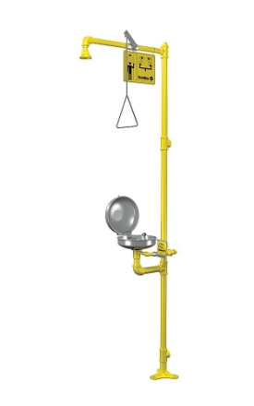
Hazards
Health
  Solution is highly alkaline pH11.5-12.5
    Contact with eyes potential corneal damage…
      Flush with large quantities of water
  Skin contact will cause skin irritation or burning sensation

Slide 20
Hazards
  Ingestion:
  Will result in severe burning of the mouth, throat and the stomach.
  Do NOT induce vomiting. Immediately give 4 to 8 ounces of water.
  Inhalation:
      Remove victim from contaminated atmosphere. If breathing is labored, administer oxygen. If breathing has ceased, clear airway and start artificial respiration with the aide of a pocket mask equipped with a one way valve or other proper respiratory medical device.

Slide 21
What is H2S
Most commonly biological degradation
  By product of volcanoes
  Hot springs
  Natural Gas and oil refineries
  It is the breakdown of plant and animal life.
  It is present in our bodies. Our bodies have a natural
  defense mechanism to expel it.

Slide 22
H2S
H2S binds with the red blood cells
Our red blood cells also bind with Oxygen.
When we have H2S in high amounts, it beats out the oxygen for a spot on the red cells
We do not circulate oxygen
Notes:
H2S binds with the iron in the body. Red blood cells get their color from iron. If it binds with iron, it’s binding to the red blood cells. Large amounts of H2S can have fatal consequences.

Slide 23

Early Warning Signs
Rotten Egg Smell
Eye irritation
Nose irritation
Cough
Nausea
Headache
Smell will be diminished but H2S is still in the atmosphere. Higher levels will dull the sense of smell.
Notes:
Recognize the warning signs. There is an offensive “rotten egg” odor with H2S which is very strong, but it goes away rather quickly because it interferes with the sense of smell. The odor may remain but you can’t smell it. That first whiff should be your first clue. Eye irritation, nose irritation , cough, nausea, and headache are the early symptoms.

Slide 24


Later Warning Signs
Vomiting
Fatigue
Visual disturbances
Shortness of Breath
At higher levels can cause unconsciousness
  Term Knock Down
Notes:
Vomiting, fatigue, visual disturbances, and shortness of breath are expected if the employee doesn’t remove himself from that environment.

Slide 25
Fatalities
75% were from employees who did not follow guidelines and practices.
50% had been working less than one year
25% due to rescue attempt by co-worker
  Is my scene safe
  Fire Fighters with SCBA’s will have to be called.
  Antidote kit is at the clinic

Slide 26
Exposure is Unlikely
Numerous experts have designed the system with your safety in mind.
Follow the guidelines and procedures
Do not become complacent.
Training and prevention is priceless.

Slide 27
Evacuation Procedures
Notes:
Two Conditions for Evacuation
H2S gas is potentially generated anywhere that NaHS is present. Although operational controls are in place to minimize this, it is still a concern. Changes in pH within the process solution can trigger this occurrence. Awareness to this is critical in maintaining the safety of all involved. All Areas where this gas could be generated include anywhere around the Moly Plant Building, Storage Tanks and Thickener Tanks.
Blue Strobe Light alarm along with sound will indicate a full evacuation. 42 fixed Sensors in place throughout moly plant and thickeners and tunnel.

Slide 28
Four Conditions for Evacuation
When two or more fixed H2S in an area alarm at 10 PPM for over 10 seconds
When any fixed H2S monitor alarms at 20 PPM for over 30 seconds
When any fixed H2S monitor alarms at 30 PPM for over 20 seconds
When any fixed H2S monitor alarms at 40 PPM for over 10 seconds
Notes:
When an evacuation is triggered an audio evacuation alarm will sound throughout the Moly plant, and Thickeners. Once activated, it will continue to sound until it is reset by the HazMat team or trained Moly processing personnel. These evacuation alarms can be tested manually by a qualified technician through the process control department by bump testing the sensors with calibrated gas.
When an alarm in the Moly Plant, Storage Tanks and Thickeners are activated, all entire personnel will evacuate.
Sensors are tested every first Tuesday of the month.

Slide 29
Evacuation Guideline
The Control room operator will initiate the emergency alarm and announce the evacuation on the mill channel. The supervisor/control room will contact 865-6600 for the rescue teams to report to the Moly Plant area for an H₂S emergency.
Emergency response team members will bring the emergency vehicle and ambulance to the Concentrator Area.
Notes:
It is imperative that you do not stop to render aid, sign out or make process adjustments while evacuating.

Slide 30
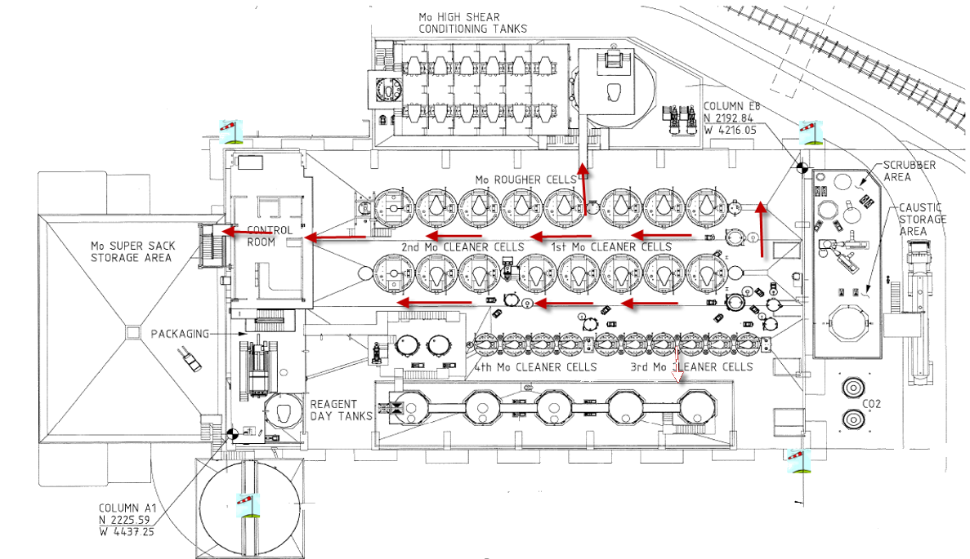
Moly Plant - Upper Level
Notes:
**** In the case of an H2S gas emergency all will proceed by evacuating up and out****

Slide 31
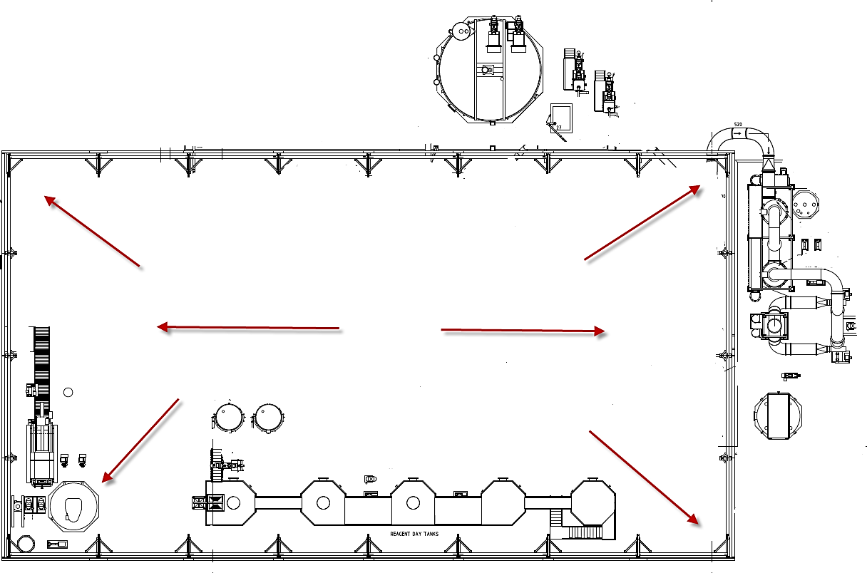
Moly Plant_Bottom Floor

Slide 32
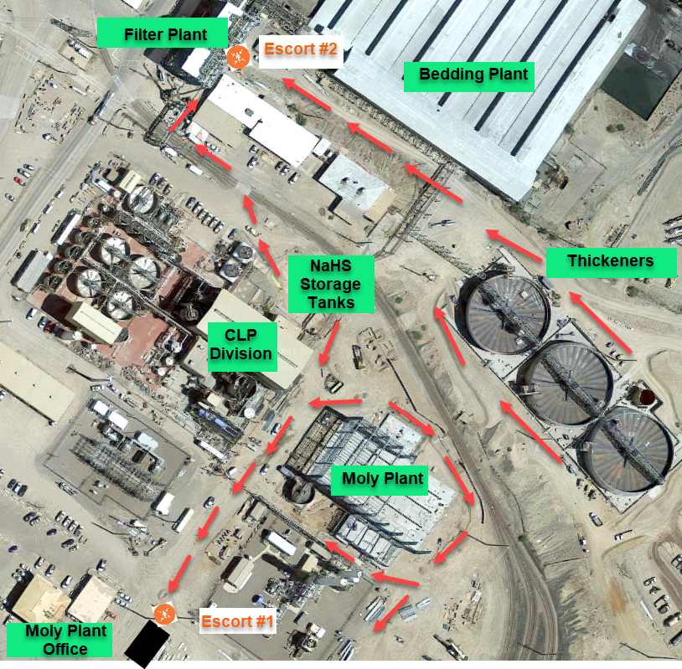
Meeting Points
Upper Level –
Main Meeting Assembly Point
Lower Level – Secondary Assembly Meeting Point
Notes:
Upper Level – Main Assembly Meeting Point
Lower Level – Secondary Assembly Meeting Point

Slide 33
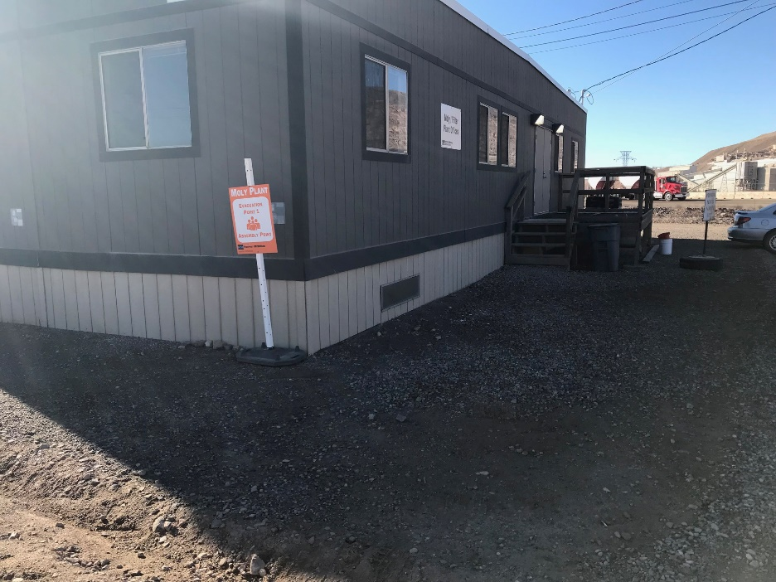
Upper Level

Slide 34
Re-Entry
Incident commander, or fire department personnel will clear the area and reset the evacuation alarm. The Hazmat team or trained Moly processing personnel will clear the area and reset the evacuation alarm.
Re-entry to the Moly Plant will only be allowed after the supervisor, incident commander, or fire department personnel has issued an “All Clear”.

Slide 35
Personal Gas Monitors

Slide 36
H2S Definitions
Each monitor is for a dual specific gas
***All personnel entering Moly Plant must wear a monitor***
Low alarms are based on OSHA PEL and/or NIOSH values.
High alarms are based on 2 times OSHA PEL values.
TWA and STEL alarms are based on ACGIH TWA and STEL values.
PEL-Permissible Exposure Limit - Level of gas (in PPM) a worker can be exposed to 8 hours a day / 40 hours a week for the rest of their life with no long term health effects.
H2S = <10

Slide 37
H2S Definitions
TWA – Time Weighted Average - The average amount of gas (in PPM) a worker can be exposed to over a certain time period. This time is defined as 12 hours to represent a normal work day.
H2S=<10
STEL-Short Term Exposure Limit - The average amount of gas (in PPM) a worker can be exposed to in a 15 minute period with no long term health effects. This may occur 4 times a shift with one hour between 15 minute exposures.
H2S =10 to 15

Slide 38
H2S Definitions
IDLH: Immediately Dangerous to Life and Health - refers to acute respiratory exposures that pose an immediate threat or loss of life. Exposures at this level may result in irreversible or severe health effects. Level could impair an employees ability to escape.
IDLH for H2S 100ppm
H₂S Low alarm 10 High alarm 20 TWA 10 STEL 15
O₂ Low alarm 19.5% High alarm 23%

Slide 39

Gas Monitor
The gas monitor is a life saving instrument.
It must be put through a series of tests each day to ensure that is working properly and the sensors are measuring properly.
Notes:
Industrial Scientific Ventis MX4

Slide 40
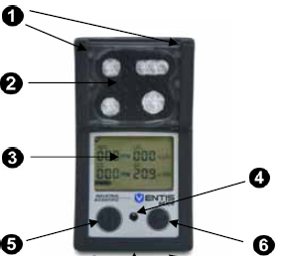
Ventis MX4
Visual Alarm Indicator
Pump Inlet
LCD Display
Audible Alarm Ports
On/Off Button
Enter Button

Slide 41
Turning on a Monitor
There are 2 buttons on the front of the monitor.
The on/off button is on the left as you look at it.
The enter button is on the right.
To turn the instrument on hold down the On/Off button on the left.
Notes:
Normal Oxygen level should read at 20.5%

Slide 42
User Functions
You will then see the number of days until full calibration is due. (Once every month)
Let the instrument warm up for 20 seconds.
You will see the count down.
The type of gas it is measuring is in the right corner.
At this point you should see a check mark. This means the instrument is ready.
If you see and exclamation point (!) Do not use the instrument.

Slide 43
User Functions
The final screen is your instrument reading screen. This should read O.OO.
You will also see a battery in the lower corner. Make sure you have battery life for the entire shift.

Slide 44


Docking Station
Provides ultimate flexibility for managing your gas monitors where ever you use them.
The DS gives you all the of the benefits of consistent automated calibration, record keeping, battery recharging, and instrument diagnostics for your monitors to limit your liabilities and safety hazards.

Slide 45
Let the Docking Station Do the Work.
The docking station will do all the calibration, zero, bump testing and clearing of the peaks for you.
Prior to each use, install the monitor into the docking station. (This must be done each time you use the monitor)
The docking station has three different alarm colors which consists of:
Yellow = wait has not completed the calibration, etc.
Red = do not use the instrument.
Green = the instrument is ready for use. Remove the monitor and turn it on.
Notes:
Inoperable monitors must be properly tagged and removed from service. Return the inoperable monitor the moly/filter plant control to ensure proper disposal procedures are followed.

Slide 46
Alarm
Three things will occur in the event that the personal monitor alarms…
Alarm
Vibrate
Blink
Monitors are to be carried on the upper chest area at all times.
Monitors on hard hats will NOT be tolerated…

Slide 47
Alarms
Low alarm levels.
  H2S will alarm at 10ppm. This will start your 15 minute exposure. You can only be exposed 4 times per shift with one hour between exposures.
High alarms levels.
  H2S will alarm at 20ppm. Must leave the area and must apply escape hood respirator.

Slide 48
Alarms
TWA alarm- This indicates you have reached your time weighted average for the shift. You may have no additional exposure.
STEL alarm. You have reached your 15 minute exposure. You must stay out of exposure for 1 hour. This can only occur 4 times per shift.
The SOP for personal alarm exposures must be posted and all employees entering the area must be trained on the proper use, care and alarms.

Slide 49
Prior to Entry and Exit
Must do’s prior to entry:
Sign in to Moly plant
Bump Test
Turn on & Check
Must do’s prior to exit:
Sign Out
Return Monitor
Hood if borrowed

Slide 50
 | H₂S Toxicity Table
.13ppm | Minimal Odor
4.60ppm | Easily Detectable
10ppm | Beginning Eye Irritation
27ppm | Strong Unpleasant Odor
100ppm | Coughing, Eye irritation loss of sense of smell
300ppm | Respiratory Tract Irritation after one hour
500-700ppm | Loss of consciousness, possible death in 30 minutes -1 hour
1000ppm | Rapid unconsciousness, stopping of breathing
2000ppm | Unconsciousness at once, death even if the person is moved to fresh air
Notes:
Review the H2S Toxicity Table

Slide 51
Procedures for Moly Openings
Opening any pump boxes, analyzer covers, cell windows, or other openings that gases can escape must be treated similar to permit required, and the means of using a portable gas monitor.
Gas monitoring must occur in the following steps:
Check with moly supervisor to ensure conditions in area that will be open are safe to access. pH of slurry must be in a safe range and ORP conditions as well.
  If any scrubber H2S monitors are reading above a safe level plant conditions must be modified to address to unsafe condition for opening cover/window. Once permission is granted…

Slide 52
Escape Respirator
Training

Slide 53
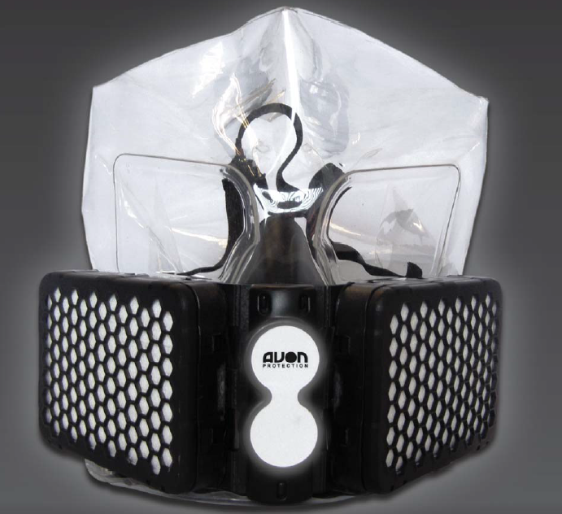
NH15 Escape Hood Respirator
Notes:
All personnel entering the Moly plant must have a respirator on their possession.

Slide 54

NH15 Escape Hood Video

Slide 55
Remember
Escape Hood shall only be donned when a personal monitor reaches an H2S high of 20ppm
When evacuating keep eyes on path
Use three points of contact on stairs
Do NOT stop to render aid and evacuate in an orderly manner.

Slide 56
Questions

