Slide 1
CLP Hazard Awareness Refresher
June 28, 2021
Revision #1

Slide 2
Topics Discussed Today
What is the CLP?
CLP Entry Requirements
CLP Evacuation Plan
CLP Specific Hazards
  H2S Gas Hazards
  Personal Gas Monitors

Slide 3
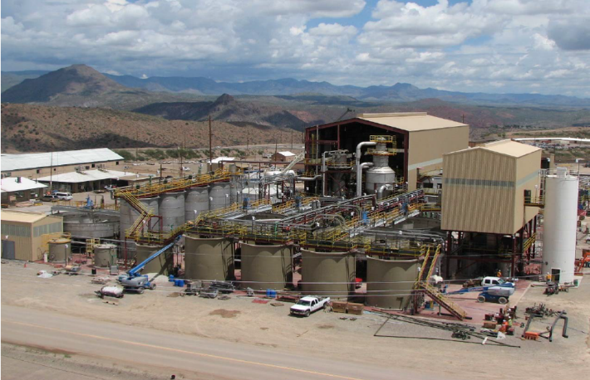
Concentrate Leach Plant

Slide 4
Restricted Access Area
CPL Processing Department
Hydromet Division

Slide 5
Access To CLP
CLP is a restricted access only plant
Training Requirements:
Must have attended Concentrate Leach Plant Hazard Awareness & Access class
Must have signed training acknowledgement for CLP Access
Have CLP Sticker on Hard hat for current year
Access is NOT permitted without the above required training.

Slide 6

c
Access To CLP

Slide 7
CLP Access
Sign in and out at the control room is REQUIRED.
Personal gas monitors will be checked out at the control room when signing in and returned when signing out.

Slide 8
Evacuation Procedures

Slide 9
Evacuation Guideline
In the event of an emergency that requires an evacuation of the CLP area the following actions should be taken:
Initiate a MAYDAY by pressing the orange button on your radio or call 865-6600
Notify Supervisor of situation and where you need assistance.
Supervisor will then contact control room to sound alarm and/or notify personnel over radio or phone.
When a CLP evacuation is called immediately proceed to the evacuation point associated with the CLP.
Notes:
It is imperative that you do not stop to render aid, sign out or make process adjustments while evacuating.

Slide 10
Evacuation Guideline
Any CLP personnel that are not in the CLP area at the time of evacuation should report to supervisor in person, by radio or by phone.
The supervisor at the evacuation point will take headcount. Once the headcount has been completed, all personnel should remain at the evacuation point until the evacuation has been cleared. The supervisor will be responsible for counting any contractors or non-operations personnel working in the CLP area to verify headcount
MOLY EVACUATION
When the Moly plant evacuates. The CLP supervisor will then look at the Moly plant windsock to determine if evacuation is needed. If evacuation is needed, all employees working in the CLP area will report to the control room

Slide 11
Nash Tank Evacuation
If the NaHS (H2S) Tanks go into alarm, CLP employees working on second level areas need to report to the control room
Any employees working at ground level need to stay at ground level and report to nearest evacuation point away from the NaHS (H2S) Storage Tanks

Slide 12
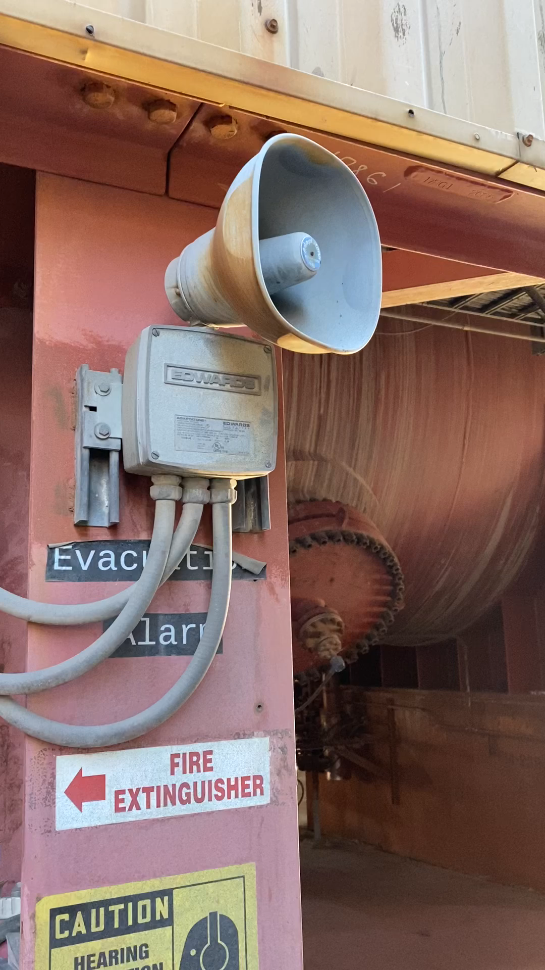
Evacuation Alarm

Slide 13
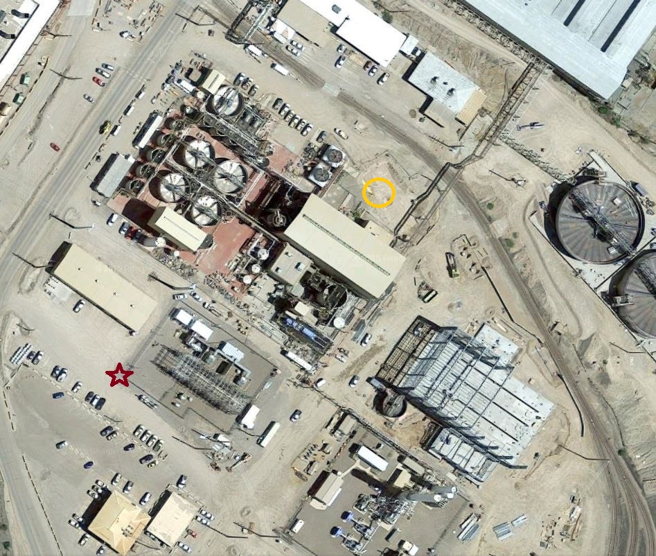
Evacuation Points
The CLP primary evacuation point is by the smoking area by the Sandcastle. If in the red for lightning meet inside the reagent barn.
Secondary Evacuation Point is the control room for H2S only
Note four windsocks on Moly Plant building and on top of NaHS tank will tell you which way the wind is blowing.
This indicates evacuation points.
NaHS Tanks

Slide 14
Re-Entry
Incident commander, or fire department personnel will clear the area and reset the evacuation alarm. The Hazmat team or trained CLP processing personnel will clear the area and reset any other alarms.
Re-entry to the CLP Plant will only be allowed after the supervisor, incident commander, or fire department personnel has issued an “All Clear”.

Slide 15
Conditions for Evacuation
When your gas monitor alarms at 10ppm!
  Beware you can breath on it and cause it to alarm
Fire/Explosion
When the CLP Plant alarm is sounded. Yellow lights and audible alarm you must leave the area
  The overhead crane in the vessel building has an alarm that is not for clearing area.
Notes:
When an Molly evacuation is triggered an audio evacuation alarm will sound throughout the Moly plant, and Thickeners. Once activated, it will continue to sound until it is reset by the HazMat team or trained Moly processing personnel. These evacuation alarms can be tested manually by a qualified technician through the process control department by bump testing the sensors with calibrated gas. If only Molly plant is activated then come to the CLP control room till all clear is given.
When an alarm in the CLP Plant or NASH Tanks are activated, all entire personnel will evacuate.
Sensors are tested every first Tuesday of the month.

Slide 16
Concentrate Leach Plant Hazards

Slide 17
Hazards in the CLP
High Pressure Vessels- PLV Pressure Leach Vessel operates at High Temperatures (380-400F degrees and approximately 285psi)
Pure Oxygen- Pure Oxygen is injected into the pressure vessels to facilitate the reaction within the PLV. The dangers are fire and explosion if proper balance of flow is not adhered too.
Radiation- Although the risk of exposure is minimal you must be aware attached to the PLV & Flash vessel is a radiation source used for level indication.
  The only exposure to radiation will be from the employees working on the specified equipment.
Any questions – Contact Safety Department or Radiation Safety Officer Jill Leavitt at 928-215-5251 or 928-865-6965

Slide 18
Hazards in the CLP
Titanium fire potential- As with any fire you should initiate an emergency response and evacuate the area. A titanium fire although not likely but possible would be located starting inside the PLV. Do Not try To fight a fire anywhere around the PLV, explosion highly possible if wrong chemical extinguisher or water is used.
Chemicals (Sulphuric Acid, Flocculent, Concentrate, Weak PLS (2-6gpl), Strong PLS (18-60gpl), and Milk of Lime.
  As with any Chemical, refer to the SDS Sheet located on the Health and Safety SharePoint site before handling.
Vapor Clouds – The areas around the scrubber’s U-Tubes can be come enveloped in vapor clouds if the tubes “blow”. The cloud itself is harmless, but it can limit visibility and be startling if you don’t know what is happening.

Slide 19
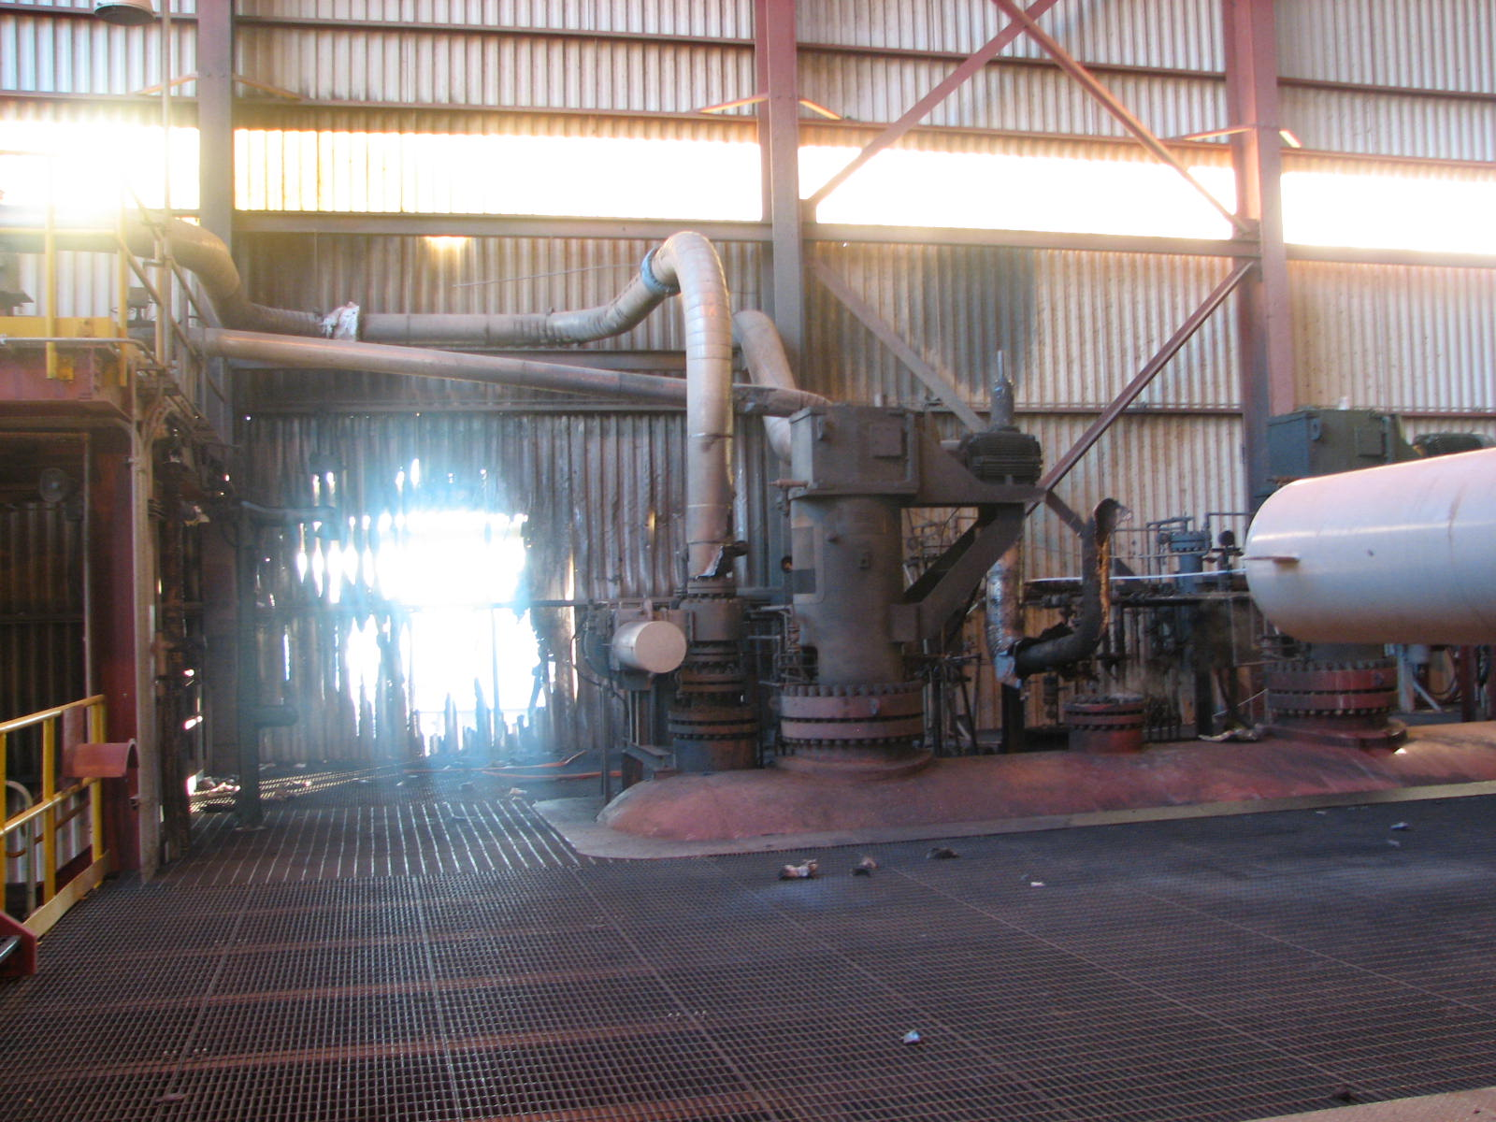

Slide 20
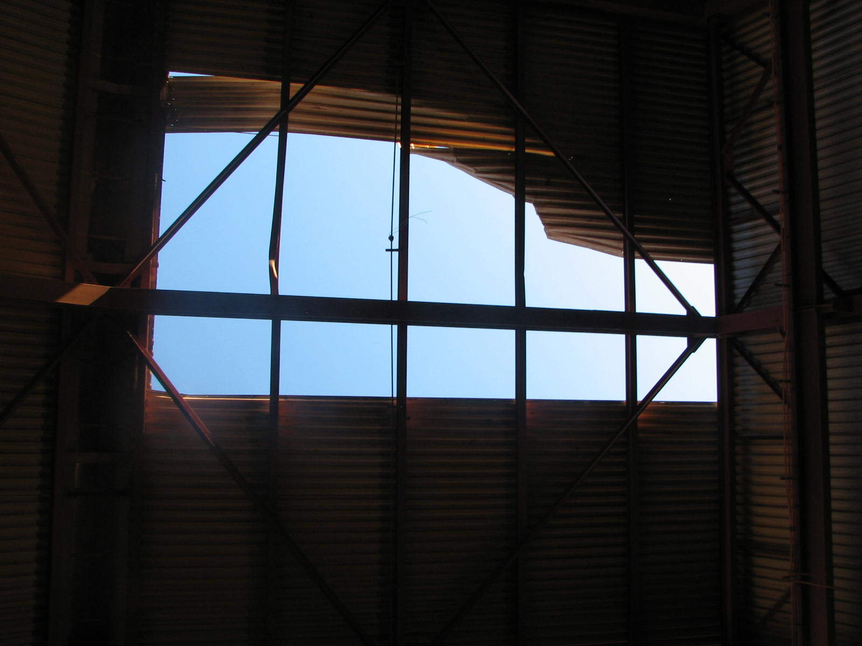

Slide 21
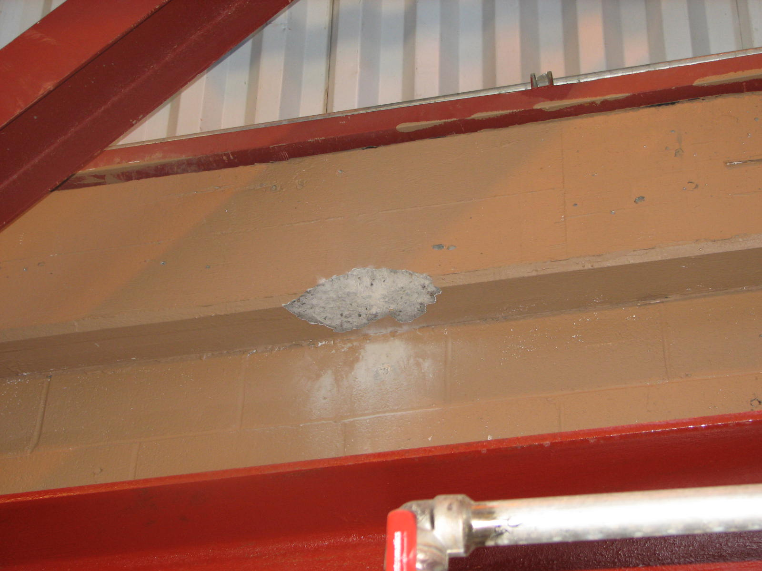

Slide 22
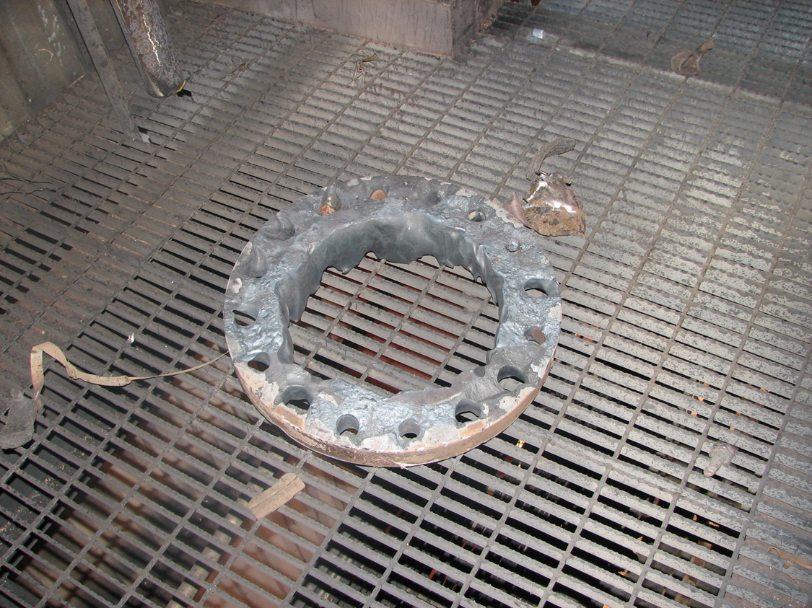

Slide 23
Vapor Cloud Locations:
The following pictures show the locations where vapor clouds can form at any moment.
Do not enter into a vapor cloud unless its absolutely necessary.
If a vapor cloud forms around you, do not panic there is no immediate danger. Calmly walk out of the affected area and notify the control room operators.

Slide 24
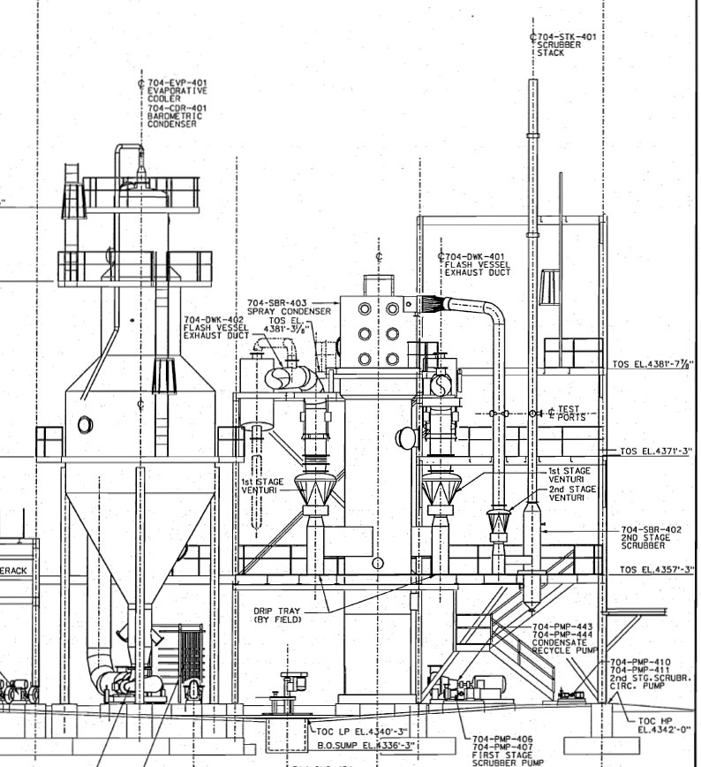
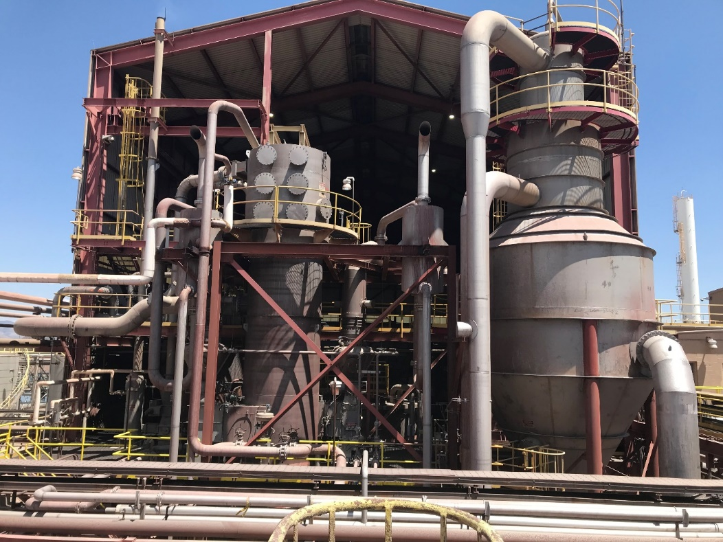
Vapor Cloud Locations: Outside Looking into the CLP

Slide 25
Hazardous Gas Awareness

Slide 26
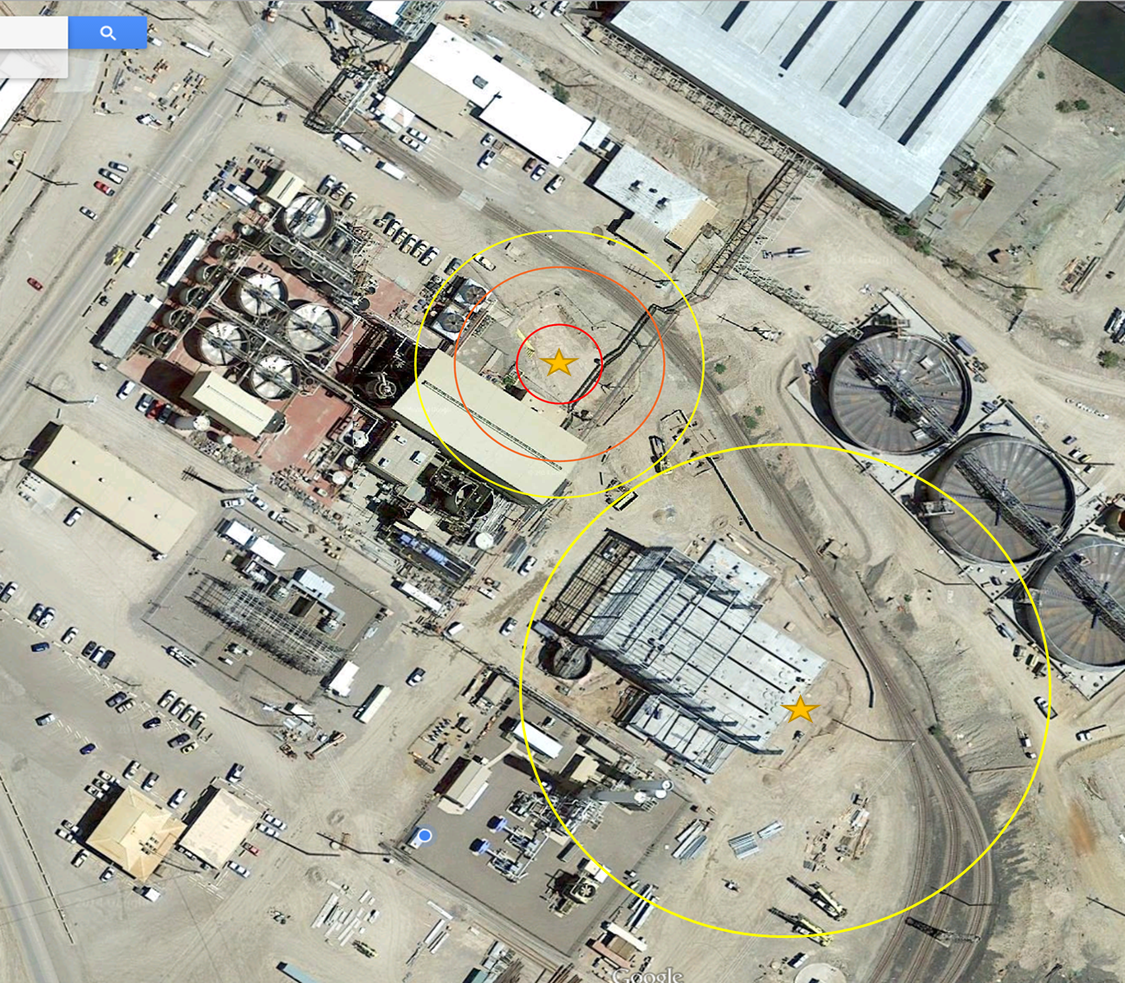
Hazardous Gas
Hydrogen Sulfide Gas is a known hazard of the Moly plant’s process.
The CLP DOES NOT generate this hazard.
The plant’s location to a point source is why we need to be aware of this hazard.
CLP AREA

Slide 27
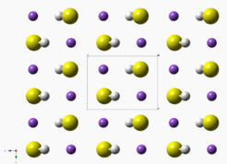
NaHS(Sodium Hydrosulfide)
Sodium Hydrosulfide (NaHS)
NaHS is a highly alkaline chemical solution that is used to suppress separation of copper/molybdenum.
This compound is the product of Hydrogen Sulfide with Sodium Hydroxide.
NaHS is the reagent commonly used and is considered to be a good environmental and safety aspect.
Notes:
The objective of the moly plant is floating the sulfides of molybdenum and depressing the copper.

Slide 28

NaHS Hazards
The most serious safety concern with NaHS is its ability to produce large amounts of deadly hydrogen sulfide (H₂S) when it reacts with an acid or is exposed to high heat
NaHS is corrosive due to its high alkalinity (pH 11.5-12.5) and is potentially harmful to the skin and eyes

Slide 29
What is H2S?
H₂S gas is potentially generated anywhere that NaHS is present. Although operational controls are in place to minimize this, it is still a concern.
Changes in pH within the process solution can also trigger this occurrence, such as contact with acid or water.
Awareness to this is critical in maintaining the safety of all involved.
Areas in the CLP where this gas could be generated include:
NaHS Storage Tanks

Slide 30
What is H2S?
Most Common Occurrence
  Biological degradation
  Byproduct of volcanoes
  Hot springs
  Natural Gas and oil refineries
H2S is present in our bodies. Our bodies have a natural defense mechanism to expel it at natural levels.

Slide 31

Early Warning Signs of H2S exposure…
Rotten Egg Smell
Eye irritation
Nose irritation
Cough
Nausea
Headache
At 100ppm, H2S Gas can paralyze olfactory senses, rendering your ability to smell the gas impaired. Just because you don’t smell it any more, doesn’t mean it isn’t there.
Notes:
Recognize the warning signs. There is an offensive “rotten egg” odor with H2S which is very strong, but it goes away rather quickly because it interferes with the sense of smell. The odor may remain but you can’t smell it. That first whiff should be your first clue. Eye irritation, nose irritation , cough, nausea, and headache are the early symptoms.

Slide 32


Later Warning Signs that you’ve been exposed…
Vomiting
Fatigue
Visual disturbances
Shortness of Breath
At higher levels can cause unconsciousness
Notes:
Vomiting, fatigue, visual disturbances, and shortness of breath are expected if the employee doesn’t remove himself from that environment.

Slide 33
H2S Table
 | H₂S Toxicity Table
.13ppm | Minimal Odor
4.60ppm | Easily Detectable
10ppm | Beginning Eye Irritation - PEL
27ppm | Strong Unpleasant Odor
100ppm | Coughing, Eye irritation loss of sense of smell
300ppm | Respiratory Tract Irritation after one hour
500-700ppm | Loss of consciousness, possible death in 30 minutes -1 hour
1000ppm | Rapid unconsciousness, stopping of breathing
2000ppm | Unconsciousness at once, death even if the person is moved to fresh air
Notes:
Review the H2S Toxicity Table

Slide 34
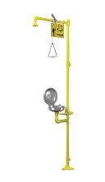
NaHS First Aid
  Vision
  Contact with eyes can potentially cause corneal damage.
  Flush with large quantities of water for a minimum of 30 minutes *You must report to your supervisor.
  Skin
  Contact with skin will cause skin irritation or
  burning sensation.
  Ingestion
  Will result in severe burning of the mouth, throat and the stomach.
  Do NOT induce vomiting. Immediately give 4 to 8 ounces of water. *You must initiate a mayday.
  Inhalation
  Initiate a mayday and wait for help to arrive.

Slide 35
H2S Definitions
Our Monitors measure H2S gas and O2 (oxygen):
***All personnel working in the CLP Plant must wear a monitor***
Low alarms are based on OSHA PEL and/or NIOSH values.
High alarms are based on 2 times OSHA PEL values.
TWA and STEL are based on ACGIH TWA and STEL values.
PEL-Permissible Exposure Limit - Level of gas (in PPM) a worker can be exposed to 8 hours a day / 40 hours a week
Notes:
OSHA = Occupational Health and Safety Administration,
NIOSH = National Institute of Health and Safety,
ACGIH = American Conference of Governmental Industrial Hygienists.
TWA = Time weighted Average,
STEL = Short term exposure limits,
PEL = Permissive exposure limits.

Slide 36
H2S Definitions
TWA – Time Weighted Average - The average amount of gas (in PPM) a worker can be exposed to over a certain time period. This time is defined as 12 hours to represent a normal work day.
H2S = <10
STEL-Short Term Exposure Limit - The average amount of gas (in PPM) a worker can be exposed to in a 15 minute period with no long term health effects. This may occur 4 times a shift with one hour between 15 minute exposures.
H2S = 10 to 15

Slide 37
H2S Definitions
IDLH: Immediately Dangerous to Life and Health - refers to acute respiratory exposures that pose an immediate threat or loss of life. Exposures at this level may result in irreversible or severe health effects. Level could impair an employees ability to escape.
IDLH for H2S = 100ppm
H₂S Low alarm = 10 High alarm - 20

Slide 38
Exposure to H2S is Unlikely
Numerous experts have designed the system with your safety in mind.
Follow the guidelines and procedures
Do not become complacent.

Slide 39
Personal Gas Monitors

Slide 40
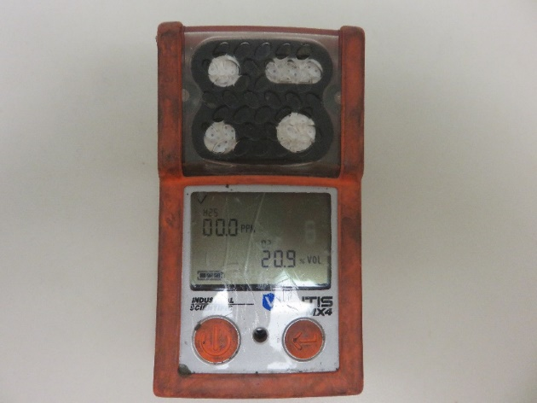
Gas Monitor
The gas monitor is a life saving instrument.
It must be put through a series of tests each day to ensure that is working properly and the sensors are measuring correctly.

Slide 41
User Functions
Turn the monitor on by holding the power button until the battery appears on the screen.
You will then see the number of days until full calibration is due. (Every 30 days)
Let the instrument warm up for 20 seconds.
It will display the types of gas it is measuring.
At this point you should see a check mark in the upper left corner. This means the instrument is ready.
If at any time you see and exclamation point (!) Do not use the instrument. Tag the instrument as BO and set aside.
The final screen is your instrument reading screen. This should read O.OO on H2S and 19.5 – 23.5 on O2.
You will also see a battery in the lower left corner. Make sure you have battery life for the entire shift.

Slide 42
Battery Life Indicator
Blinking means you need to have the monitor changed out.
If the battery dies you will see FAILED with “!” Remember, do not use any of the instruments if they show an “!” Instead of a check mark.

Slide 43
Let the Docking Station Do the Work.
The docking station will do all the calibration, zero, bump testing and clearing of the peaks for you.
Prior to each use, install the monitor into the docking station. (This must be done each time you use the monitor)
The docking station has three different alarm colors which consist of:
Green = Instrument is ready for use. Remove the monitor and turn it on.
Yellow = Wait; has not completed the calibration, etc.
Red = Do not use the instrument.
Notes:
Inoperable monitors must be properly tagged and removed from service. Return the inoperable monitor the moly/filter plant control to ensure proper disposal procedures are followed.

Slide 44
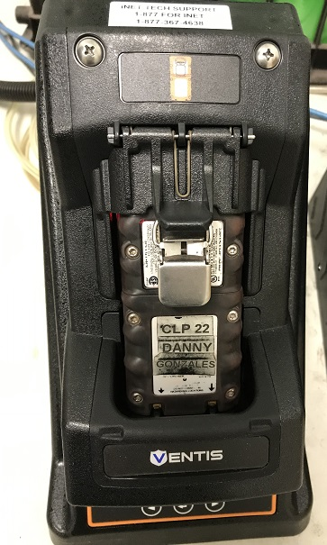

Industrial Scientific Gas Badge Pro
Manual Bump Test Procedure
Lift cover and install the monitor into the docking station face forward.

Slide 45
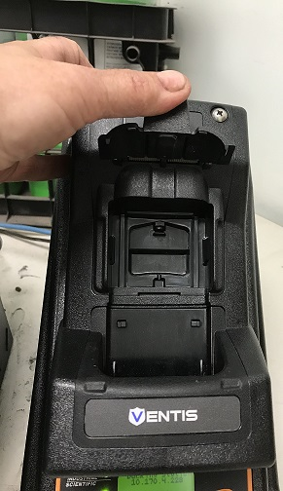
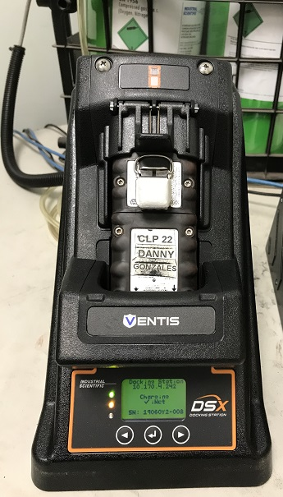
Industrial Scientific Gas Badge Pro
Manual Bump Test Procedure
Release cover
Wait until the docking station has finished. If successful it will illuminate a green light

Slide 46
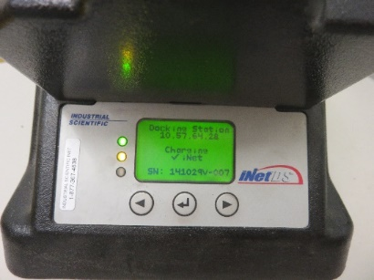

Industrial Scientific Gas Badge Pro
Manual Bump Test Procedure
If unsuccessful, the red light will
Illuminate here. Do not use this
Monitor. Tag BO and set aside.
If green all the necessary tests have been completed, downloaded and the monitor is ready for use.
Lift cover, remove the monitor, turn it on and take it with you for the day

Slide 47
Alarm
Three things will occur in the event that the personal monitor alarms…
Alarm
Vibrate
Blink
Monitors are to be carried on the upper chest area at all times.
Monitors on hard hats will not be tolerated.

Slide 48
Any Questions?????
Thank you
Any Questions????

