Slide 1
X-Ray Safety Training
Revised 2022

Slide 2
Training Outline
What is radiation
Sources of radiation
Why is radiation a concern?
Exposure Limits & Regulations
Exposure Prevention & Monitoring
Radiation Safety Program

Slide 3
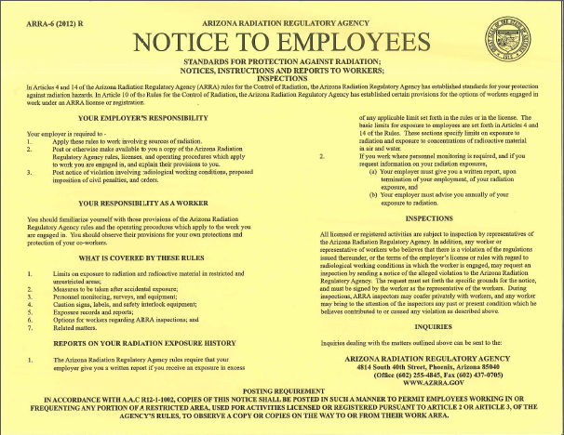
Why Are You Here?
Certain occupations have a potential for exposure to ionizing radiation. These occupations can include:
  Lab technicians
  Field technicians
  Emergency response personnel
  Others?
Notes:
Because there is a potential to each of you being exposed to small amounts of radiation, this training has been put together. We want to give you accurate information about what you are dealing with. There is a lot of fear around the word radiation because of atomic bombs and such. By helping you to understand radiation we hope to dispel some of the fears that you may have about it and to give you the information you need to keep yourself safe. If there are any questions/comments/concerns along the way, please feel free to ask.

Slide 4
Non-Radiation Workers
Most FMI employees are considered non-radiation workers
This means that you are not expected or required to use or handle any material or equipment labeled as “Radioactive”
Radioactive material can only be used by authorized personnel that have received training and dosimeter according to FMMO radiation safety program.

Slide 5
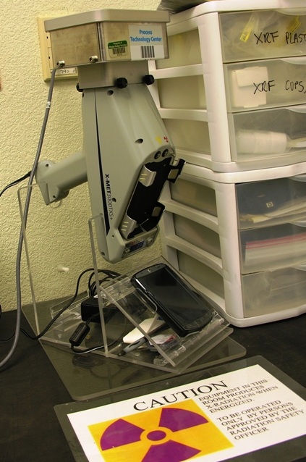
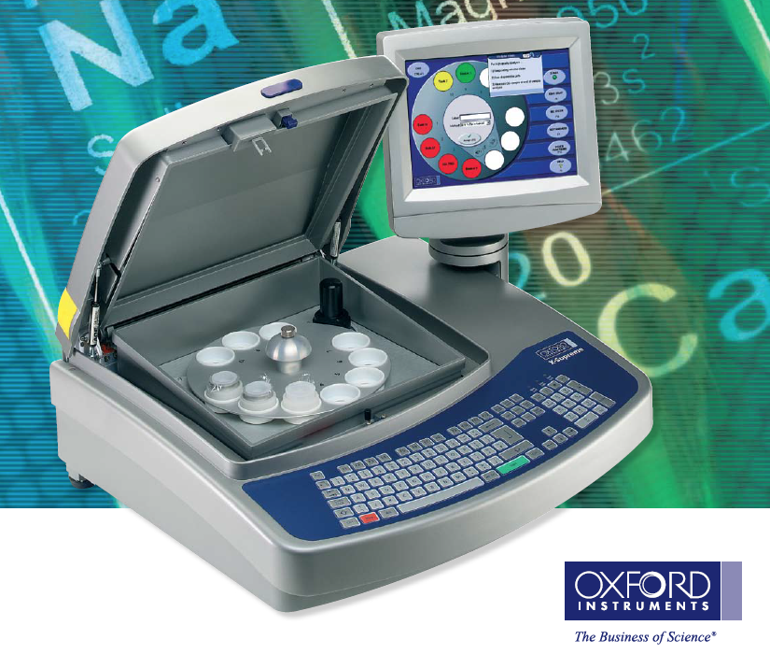
X-Ray Machines at Morenci
Bench XRF (Oxford Supreme 8000), Produces X-Rays Inside During Operation.
Handheld XRF Mounted on Stand with Shielded Sample Holder on Top

Slide 6
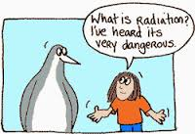
What is radiation?
Radiation is energy travelling through space in the form of waves or particles.

Slide 7
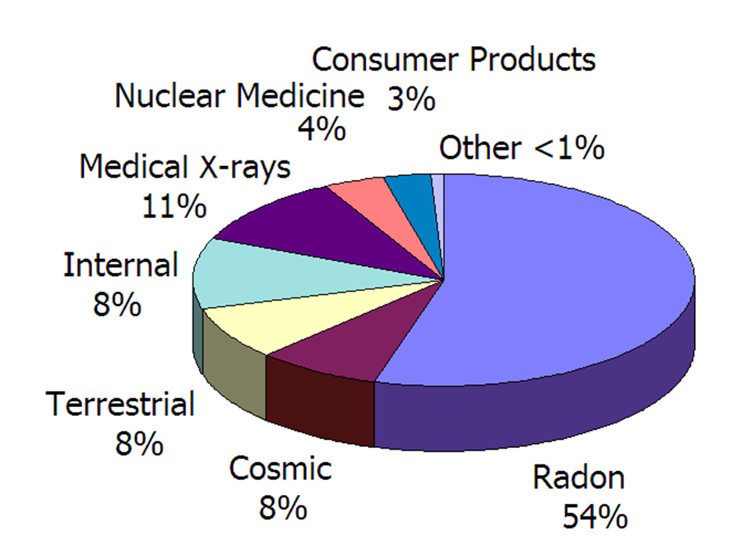
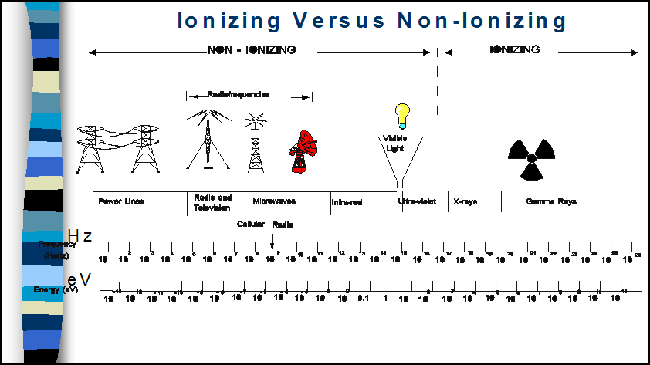
Types of Radiation
Non-Ionizing Radiation: Radiation that does not have sufficient energy to dislodge orbital electrons.
E.g. non-ionizing radiation: microwaves, ultraviolet light, lasers, radio waves, infrared light, and radar.
Ionizing Radiation: Radiation that has sufficient energy to dislodge orbital electrons.
E.g. of ionizing radiation: alpha particles, beta particles, neutrons, gamma rays, and x-rays.
Other Includes XRD and XRF Labs
X-Ray – Can occur naturally or can be man made. Can also travel thousands of feet in the air at the speed of light.
Of these many types of radiation, only X-Rays are ionizing. Ionizing radiation is what we are mainly concerned with.

Slide 8
Types of Radiation
TENORM-Technologically Enhanced Naturally Occurring Radioactive Material
Naturally occurring radioactive materials that have been concentrated or exposed to the accessible environment as a result of human activities such as manufacturing, mineral extraction, or water processing.
Can be found in some of our process's where material is concentrated and can accumulate resulting in machine parts that may produce low level radiation.
Notes:
When removing the Choke Tube from the CLP vessel. The build up of concentrated material has the potential for low low levels of radiation. After the removal of the Choke Tube North Star should Hydro blast the Choke Tube before sending out for a rebuild.

Slide 9



Radiation Protection Regulation
US EPA
US NRC – Nuclear Regulatory Commission
ARRA – Arizona Radiation Regulatory Agency

Slide 10
Annual Radiation Exposure Limits
        Occupationally Exposed Worker:
        rem mrem
        Whole body 5 5000
        Eye 15 15,000
        Shallow 50 50,000
        Minor 0.5 500
        Pregnant Worker 0.5* 500* *9 Months
        General Public: 100 mrem/year or 2mrem/hour
        Natural Background ~ 300 Millirem/Year
        rem = roentgen equivalent man
Notes:
The millirem is a unit of measurement of radiation absorbed dose Millirem is the special unit of any of the quantities expressed as dose equivalent in thousandths of a rem. The dose equivalent in rems is equal to the absorbed dose in multiplied by the quality factor (1 rem=0.01 sievert) 1.

Slide 11
Dose and Effect
Dose
Less than 25 REM’s
25 – 50 REM’s
100 – 600 REM’s
  (500=median lethal dose)
Above 600 REM
Effect
No observed effect
Loss of white blood cells
“Radiation sickness”
  Red and white blood cells
  Bone marrow
  Intestinal walls
  Immune system function
  Nausea and fatigue
Fewer than 50% survive

Slide 12

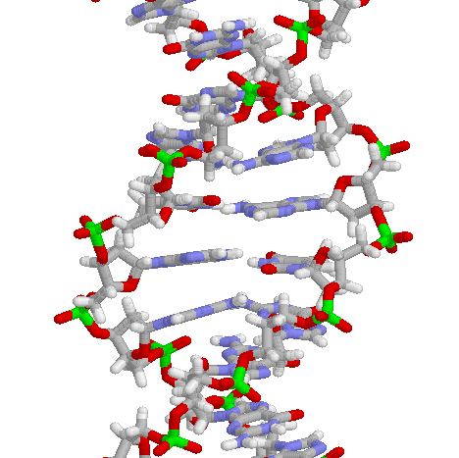
Why is Radiation a Concern?
Many groups exposed to ionizing radiation at high levels resulted in adverse effects.
Somatic Effects
  Prompt/Acute - skin burns and cataracts
  Delayed/Chronic – cancer, leukemia, and cataracts
Genetic Effects
Teratogenic Effects
Critical Target
DNA

Slide 13
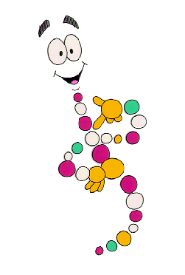
Cancer
Radiation can damage cells through two methods;
  Production of free radicals and
  Direct damage to the DNA.
Risk factor for radiation dose:
  4% increase in risk of dying of cancer for every 100 rem of dose.
  Normal cancer risk is 20%.

Slide 14
X-Ray Accident Detection
X-rays are invisible (No sight or sound).
X-rays do not generate heat in tissue. 400 rad (≈rem) will raise the skin temperature 0.001°C (No touch).
X-rays do not produce detectable amounts of ozone, nitrous oxide etc. (No Smell)
If an X-ray Accident occurred you probably would not realize it for hours or days until the acute symptoms start showing up.
Notes:
RAD Means Absorbed dose.

Slide 15
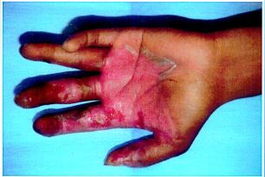
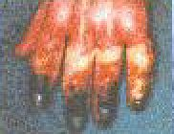
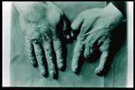
X-Ray Burns - Days to Decades
Radiation burns like these lead to radiation-induced mutations, cell damage and nearly always lead to cancer decades later.

Slide 16
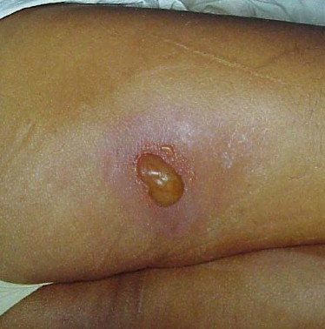
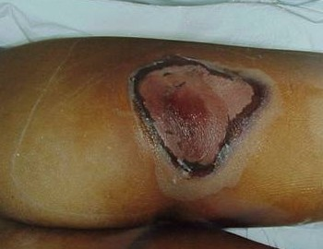
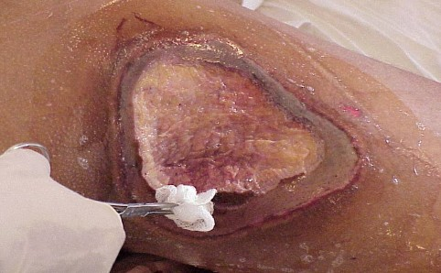
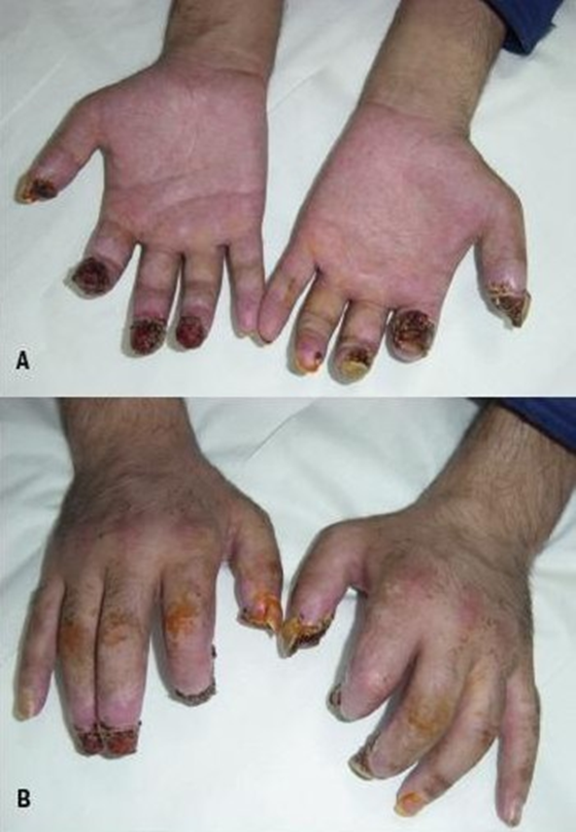
Acute Radiation Effects: Localized Exposure

Slide 17
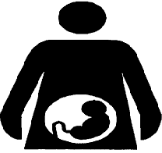
Is It Safe to Work Here?
Burns like the previous slide occurred by accidentally putting the hand directly into the X-ray Beam.
Our X-ray beams are totally enclosed in shielded cabinets (except the handheld XRF) and will not allow that type of accident as long as the shielding is in place and interlocks are not defeated.
The handheld XRF requires the most care in use. It is a very low power X-ray tube but has the greatest risk of X-ray exposure. The manufacturers safety instructions must be thoroughly understood and strictly followed. Dosimetry must be worn.
  What if I am pregnant?
  There’s a “pregnant worker” program. RSO should be notified of a pregnancy.

Slide 18
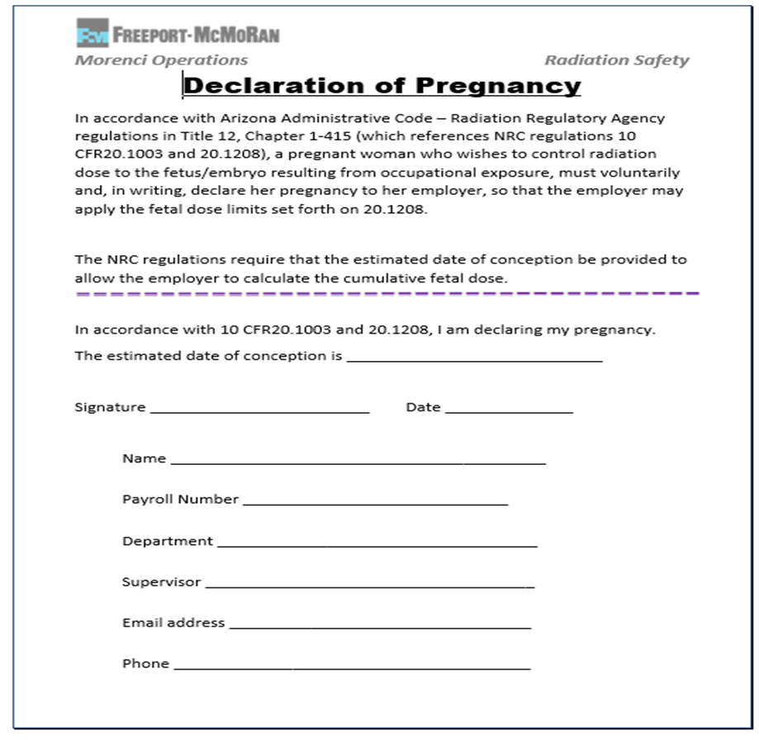
Declaration of Pregnancy
Available for those radiation workers who are pregnant or planning a pregnancy.
Purely VOLUNTARY!
To be apart of the program, you must DECLARE your pregnancy in writing to the RSO and provide the estimated date of conception.

Slide 19

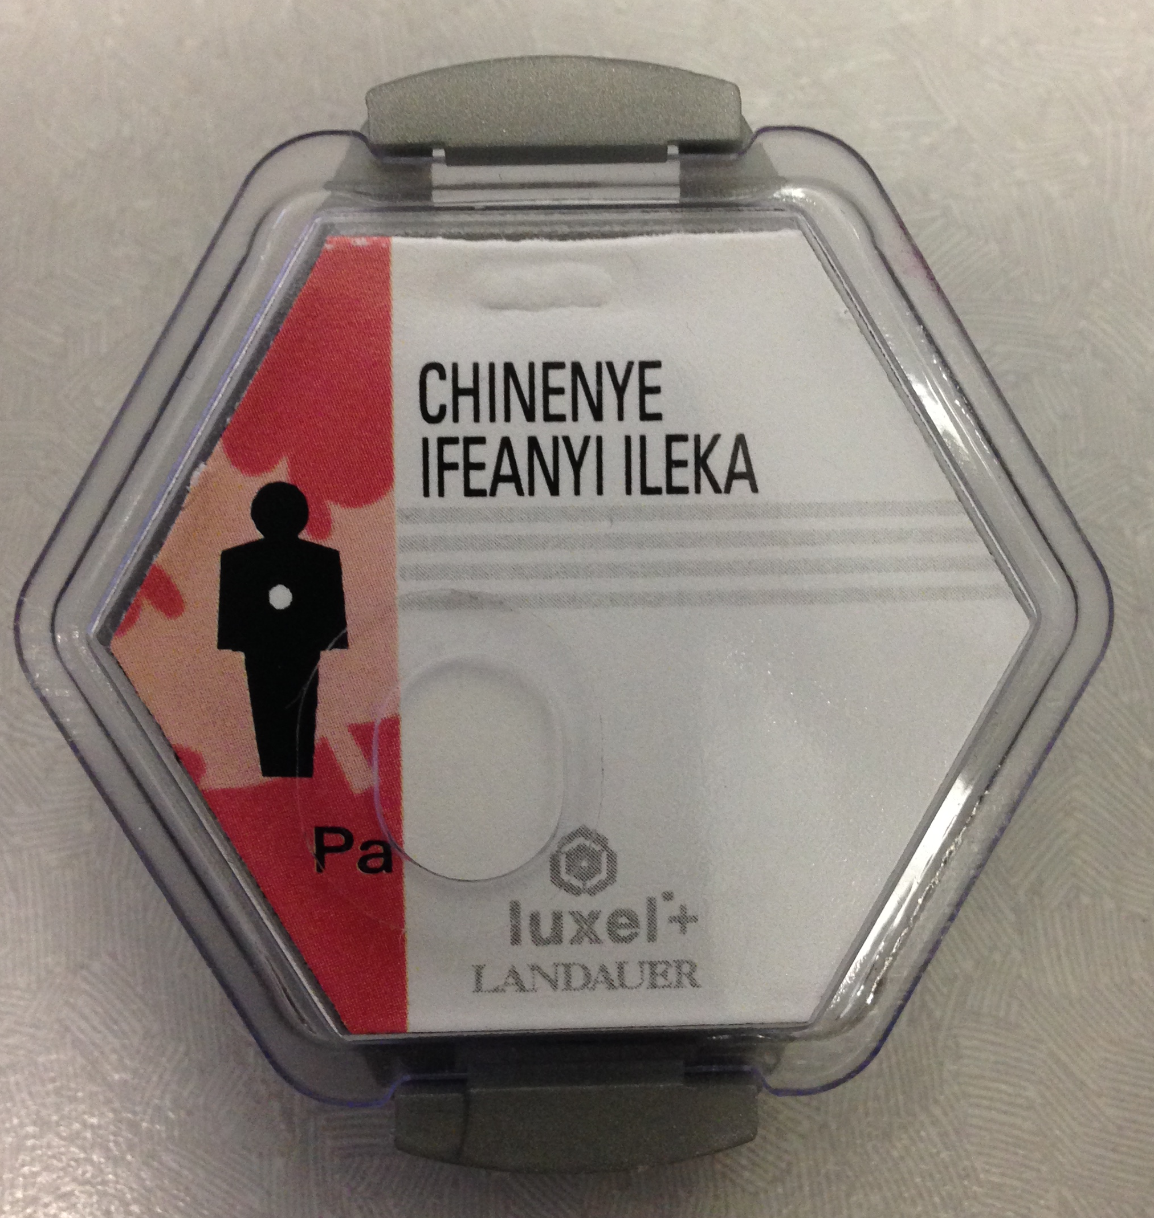

How Do We Know Our Exposure?
Personal & Area
LANDAUER Dosimetry
Geiger Counters

Slide 20
General Rules for Use of Dosimetry
Wear your own badge/ring.
Badges/rings should not be taken home
Wear your whole body (WB) badge whenever working with radiation sources if enrolled.
Notify the RSO immediately when a badge/ring is lost.
Wear rings under gloves.
Store badges/rings in safe areas at the end of each day of work.
Ensure your badge/ring is available during quarterly change-out

Slide 21
Personnel Dosimetry - FYI
Dosimetry does not protect you from radiation.
Dosimetry is not a warning device (i.e. it will not alarm, beep or change color)
Dosimetry documents the radiation dose an individual receives when working with radiation sources.
It is ILLEGAL to intentionally expose an individual’s dosimeter.

Slide 22
Personnel Dosimetry - FYI
Dosimetry does not protect you from radiation.
Dosimetry is not a warning device (i.e. it will not alarm, beep or change color)
Dosimetry documents the radiation dose an individual receives when working with radiation sources.
It is ILLEGAL to intentionally expose an individual’s dosimeter.
Review:
Each monitoring period dose report is reviewed by the Radiation Safety Officer
The report is compared against the company’s limit levels:
Action Required: Written notification from RSO to worker and investigation when limit is reached.

Slide 23
Personnel Dosimetry - FYI
Review:
Each monitoring period dose report is reviewed by the Radiation Safety Officer
The report is compared against the company’s limit levels:
Action Required: Written notification from RSO to worker and investigation when limit is reached.

Slide 24
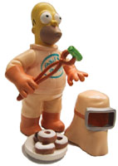
Minimizing Radiation Exposure - (ALARA Concept)
As Low As Reasonably Achievable
Reduce Time Spent in Radiation Zone
Increase Distance from Source
Use or Increase Shielding Around Source
Shielding Reduces Our Exposure To Background Levels
Ensure integrity of shielding
Consistent with our operating philosophy and supporting procedures, it is the policy of FMI to conduct its radiological operations in a manner which ensures the health and safety of its employees and the general public.

Slide 25
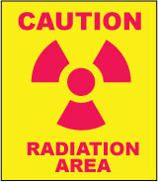
Radiation Safety Signs
Signs
  Posted in areas around sources
  Keep clean
  Legible
  Include level of potential exposure
Posting Requirement:
Area Classification: Radiation Area
Criteria: “potential to receive in excess of 5 milliREM in any one hour @ 30 cm from the radiation source
Required Wording: “Caution Radiation Area”

Slide 26
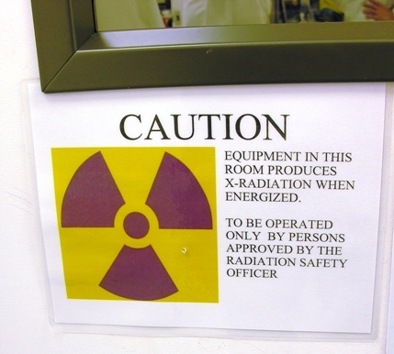
Radiation Warning Signs
Entrance to labs is not restricted because of radiation.
Exposure levels are at or near background.

Slide 27
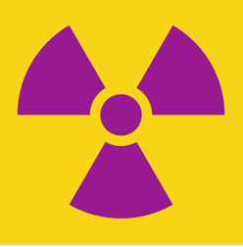
CAUTION
EQUIPMENT IN THIS ROOM PRODUCES CONTAINED X-RADIATION WHEN ENERGIZED.
TO BE OPERATED ONLY BY PERSONS APPROVED BY THE RADIATION SAFETY OFFICER.

Slide 28
Emergency Procedures
Any person who suspects over-exposure to radiation from any source must immediately contact the Radiation Safety Officer (RSO). If they cannot be reached, contact the safety professional on-call.
  (Per regulation, an over-exposure is considered to be a dose exceeding 5 rem per year to the whole body or 50 rem per year to the most exposed 10 cm2 portion of the skin or an extremity.)
RSO: Jill Leavitt:
928-215-5251 or 928-865-6965
  Safety Pro On-Call:
  928-965-6605

Slide 29
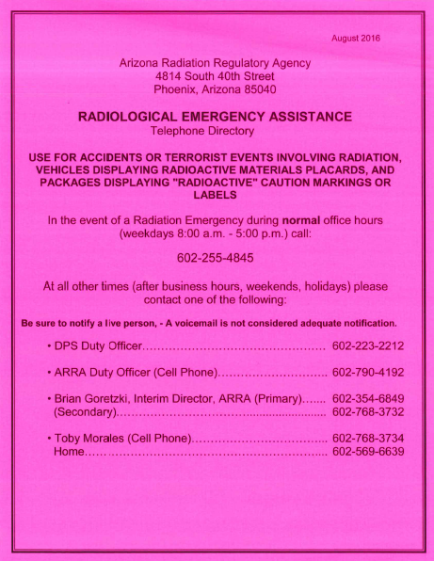
Emergency Procedures
When calling the radiation safety officer (or safety professional on-call), state:
  Type of radiation emergency
  Your name
  Where emergency assistance is needed
Warn others in the area of the emergency
Vacate the area
Prohibit entry to the area

Slide 30
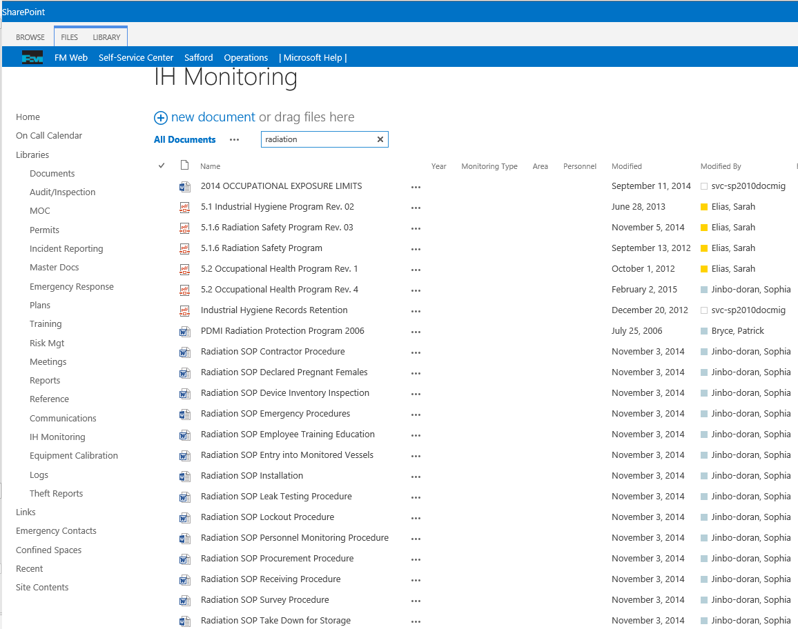
FMMO Radiation Safety Program
SOP’s:
Contractor Procedure
Declaration of Pregnancy
Device Inventory Inspection
Emergency Procedures
Employee Training/Education
Personnel Monitoring Procedure
Procurement Procedure
Receiving Procedure
Notify RSO before acquiring or moving any equipment that produces radiation an MOC must be submitted in most cases prior to movement or purchase.

Slide 31
Summary
It is safe to work around our X-ray equipment. Exposure is shielded to background level.
Shields must remain in place and interlocks must not be defeated for normal operations.
Annual refresher is mandatory - part of MSHA Refresher
Contact the RSO for any questions.

Slide 32


Slide 33
Quiz
1. You can reduce your exposure to radiation by doing the following:
  a) Increasing your distance from the source
  b) Decreasing the amount of time near the source
  c) Provide shielding between yourself and the source
  d) All of the Above
  e) None of the above
2. What is the principal reason for wearing a dosimeter (ring or badge)
  a) It signifies that the worker is authorized to work with radiation
  b) The results from a film badge, TLD badge, or TLD ring comprise a permanent record of an individual’s occupational radiation exposure history
  c) The use of the badge replaces the need for surveys in the lab
  d) The dosimetry will absorb the radiation and reduce the individuals exposure
3. RSO must be notified before acquiring or moving any equipment that produces radiation. True / False
4. Exposure to ionizing radiation can cause cancer. True / False
5. Annual radiation refresher training is a mandatory requirement. True / False
6. Present radiation safety standards for occupational exposure to whole body radiation limits an individual’s dose equivalent to:
  a) 170 mrems/year
  b) 5000 mrems/year
  c) 100 mrem in one week
  d) 12.5 mrem in one hour
  e) 5 x (worker’s age - 18 years) rems in one year
7. Jill Leavett_ is FMMO’s current Radiation Safety Officer
8. As part of the program, declaration of pregnancy is mandatory. True / False
9. X-rays are visible and can easily be detected by their smell. True / False
10. Radiation workers can reduce exposure to radiation by Reducing Time, Exposure_, and _Shielding_______

