Slide 1
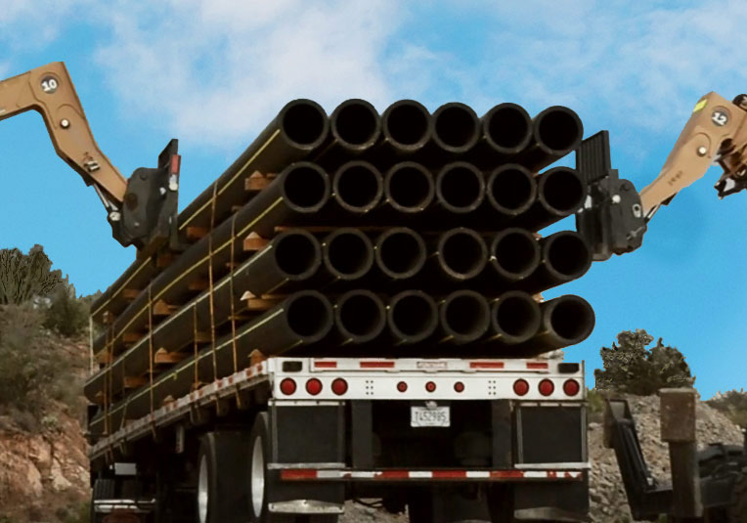
HYD FCX2027C
HDPE Pipe
Handling
VERSION 3 / FEBRUARY 2020
Notes:
SG N/A
Instruction
Welcome students to class
Facilitator introduces self by stating
your position at FMI
how long you have worked for FMI
how long you have worked in mining
Ask students what they want from the course
Discuss what they want to gain from the course
WIFM – “What’s in it for me?”
This increase engagement by getting students vocalizing their opinions from the start of the course
This increases motivation by showing students their ideas matter
Option – Write down or remember what they want to learn. In a few slides, connect their responses to the learning objectives

Slide 2
Expectations
Before We Start
Safety
Breaks/Restrooms
Technology
Participation
Class Ground Rules
Notes:
SG N/A
Instruction
Administrative/Classroom policies
Safety – Identify items such as evacuation procedures, gathering areas, emergency exits, and fire extinguisher locations
Breaks and Restrooms
Establish and announce a break schedule to the class. Take breaks after about every hour of instruction
Identify the location of restrooms and smoking areas
Technology policy – Review expectations on cell phone and laptop use during the training
Participation
This course requires significant participation
Students should be prepared for discussions and small group activities
Class ground rules – Verbalize expectations. Suggestions include
Participate
Be on time
Stay on task
Listen when others talk
Respect the opinions and attitudes of others
Student Course Evaluation
Direct students to the Student Course Evaluation at the end of the SG
Tell students to work on this throughout the course
This helps students write ideas down as they have them
Filling it out as they go, also helps gather more substantial feedback as they are not rushed to complete the entire evaluation at the conclusion of the course when they are anxious to leave

Slide 3
Icebreaker
Directions
Participate in an activity getting to know each other
Activity 1
Notes:
SG N/A
Time
Approximately 10 minutes
Materials
Choose an icebreaker from the FG and gather appropriate materials
Purpose
Successful icebreakers encourage students to contribute ideas and experiences thus increasing motivation and engagement in the class
The FG has many icebreakers to use now, after breaks, or any other time

Slide 4
Knowledge Pre-Assessment
Directions
Complete the Knowledge Pre-Assessment
Grade assessments as a class
Return assessments to facilitator
Assessment
Notes:
SG N/A
Instruction
The knowledge pre-assessment helps gauge student knowledge coming into the course
Give students about 30 minutes to complete
Grade as a class
Collect assessments
Compare these scores to the knowledge post-assessment at the end of the course to determine each student’s increase in knowledge

Slide 5
SG iii
Learning Objectives
Module 1: Introduction
Describe the history and purpose behind FXC-HS12
Notes:
SG page iii
Instruction
State objective(s) for each module
Learning objectives are also located at the beginning of each module
Option – If you wrote down or remember the student’s ideas of what they want to learn in the course, connect each response they gave to an objective (even if it’s a vague connection). This increases motivation by showing students their ideas matter

Slide 6
SG iii
Learning Objectives
Module 2: Risk Management
Describe the purpose and process for hazard recognition before performing tasks related to working with HDPE Pipe
Identify the personnel who will be associated with the task, as well as their roles and responsibilities, to ensure the task is being performed safely and all involved abide by the policy
Notes:
SG page iii
Instruction
State objective(s) for each module
Learning objectives are also located at the beginning of each module
Option – If you wrote down or remember the student’s ideas of what they want to learn in the course, connect each response they gave to an objective (even if it’s a vague connection). This increases motivation by showing students their ideas matter

Slide 7
SG iii
Learning Objectives
Module 3: Pipe Handling
Describe safe practices and requirements of FCX-HS12 regarding receiving, loading, unloading, and storage of HDPE Pipe on FCX properties
Identify when to use the Receiving/Loading/Unloading Checklist, and describe how to fill out this form correctly
Notes:
SG page iii
Instruction
State objective(s) for each module
Learning objectives are also located at the beginning of each module
Option – If you wrote down or remember the student’s ideas of what they want to learn in the course, connect each response they gave to an objective (even if it’s a vague connection). This increases motivation by showing students their ideas matter

Slide 8
SG iii
Learning Objectives
Module 3: Pipe Handling (cont’d)
Identify the difference between a properly loaded shipment of HDPE Pipe and one that does not comply with the company’s shipping standards
Describe the procedure in place to report loads that do not meet company standards
Describe how to safely store HDPE Pipe according to policy requirements
Notes:
SG page iii
Instruction
State objective(s) for each module
Learning objectives are also located at the beginning of each module
Option – If you wrote down or remember the student’s ideas of what they want to learn in the course, connect each response they gave to an objective (even if it’s a vague connection). This increases motivation by showing students their ideas matter

Slide 9
SG iii
Learning Objectives
Module 4: Rigging
Describe the proper procedures required to safely pull various sizes and lengths of HDPE Pipe according to policy requirements
Identify the proper equipment required for the task
Identify appropriate forms for the tasks that will be performed and describe how to fill these forms out correctly
Notes:
SG page iii
Instruction
State objective(s) for each module
Learning objectives are also located at the beginning of each module
Option – If you wrote down or remember the student’s ideas of what they want to learn in the course, connect each response they gave to an objective (even if it’s a vague connection). This increases motivation by showing students their ideas matter

Slide 10
SG iv
Learning Objectives
Module 5: Fusing and Data Loggers
Identify the hazards associated with fusing, installation, and repair of HDPE Pipe as they relate to the FCX-HS12 policy and describe the proper procedures in place to mitigate those hazards
Notes:
SG page iv
Instruction
State objective(s) for each module
Learning objectives are also located at the beginning of each module
Option – If you wrote down or remember the student’s ideas of what they want to learn in the course, connect each response they gave to an objective (even if it’s a vague connection). This increases motivation by showing students their ideas matter

Slide 11
SG iv
Learning Objectives
Module 6: Audits and Training
Define the roles and responsibilities of the Corporate and site Pipe Safety Steering Teams
Explain the training requirements needed to safely handle or participate in the handling of HDPE Pipe
Notes:
SG page iv
Instruction
State objective(s) for each module
Learning objectives are also located at the beginning of each module
Option – If you wrote down or remember the student’s ideas of what they want to learn in the course, connect each response they gave to an objective (even if it’s a vague connection). This increases motivation by showing students their ideas matter

Slide 12
SG V
Introduction
Committed to health and safety of employees
Development of FCX-HS12
Purpose of training
One page policy document
Notes:
SG page v
Instruction
Committed to health and safety
Freeport-McMoRan Inc. is committed to the health and safety of its employees
The Corporate Safety and Health Policy expresses this well: “We consider safety and health programs, both on and off the job, to be an investment in our most valuable resource – our employees”
With this in mind, it is important to note not only is the company taking responsibility for the safety of its employees, they also recognize proper training and personal responsibility are critical components to this
Development of FCX-HS12
Due to the stored energy and potential hazards related to working with High-Density Polyethylene (HDPE) Pipe
Collaborative team methodically designed FCX-HS12 to address:
Potential hazards and
Mandated critical controls in order to mitigate the potential hazards from affecting the employees
It was determined all employees and contractors who must work with this pipe be trained in all related aspects of technical skills and procedures, as well as health and safety factors
It is essential employees follow all facets of FCX-HS12
Purpose of training
Ensure anyone who will work with HDPE Pipe has been trained according to HDPE Pipe Handling Policy (FCX-HS12) prior to performing that work
Policy does not cover every aspect of handling HDPE Pipe
If at any time someone has questions related to the work, they have an obligation to stop the job and seek out clarification.
There are many forms and permits designed to help the teams plan and execute their jobs safely
These forms and permits will be presented during this training
The goal is for all to go home safely each day
Discuss the one page policy document on the next slide

Slide 13
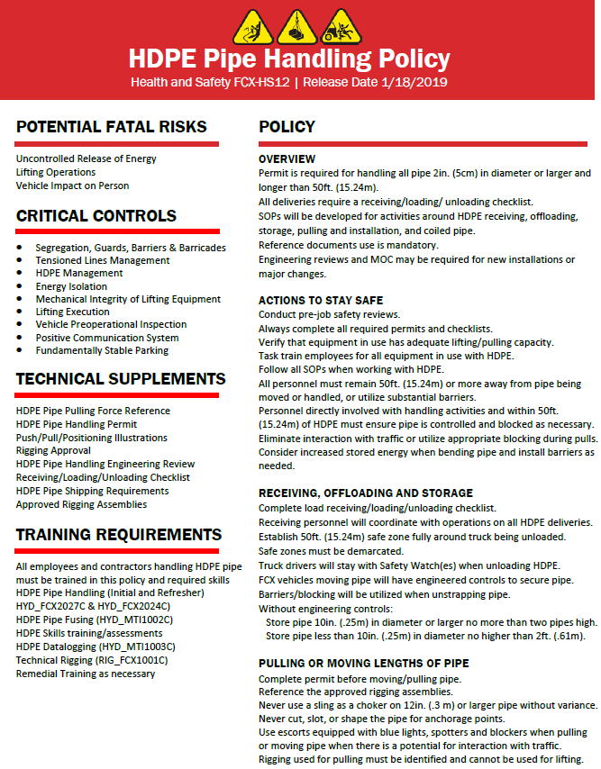
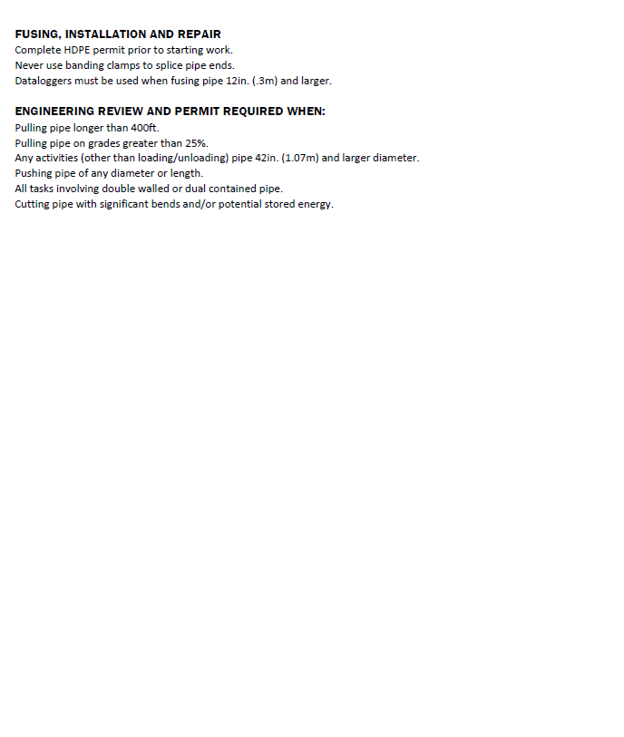
One Page HDPE Pipe Handling Policy
Notes:
SG page v
Instruction
Developed in accordance, with
HDPE Pipe Handling Policy – FCX-HS12 (One Page)
Administration Policy – FCX-HS01
Technical Supplements
Administration Standard Glossary
Located on the main website under Health and Safety > Policies (H&S Policies) > HDPE Pipe Handling

Slide 14
SG vi
Fatal Risk and Critical Controls
Fatal Risk Management Program
Fatal Risk – uncontrolled risk that will kill you
Critical Control – implemented to eliminate or reduce the risk for a task/job
Notes:
SG page vi
Instruction
Fatal Risk Management
Continuation of the Fatality Prevention Program
Focus is placed on identifying Fatal Risks and Critical Controls in an attempt to safeguard all employees
Standardizes communication for twenty-three Fatal Risks by implementing icons, definitions, and Critical Controls.
Fatal Risks are based on safety issues that have resulted in catastrophic events such as severe injury or death.
For each identified Fatal Risk a list of necessary Critical Controls was developed to prevent or mitigate the most serious consequences of these risks. Once the Fatal Risk is identified, applying the most effective Critical Control is crucial.
A Critical Control is a device, system, or process implemented to eliminate or reduce the risk for a task/job, and if missing or overlooked has the potential to lead to catastrophic outcomes such as serious injury or death.
These Critical Controls are considered the most impactful on preventing a fatality or injury and have been previously established based on data.
The absence or failure of a Critical Control significantly increases the risk of severe injury or death despite the existence of other controls.
The Fatal Risk(s) and Critical Controls relevant to this course are provided next.

Slide 15

SG vi
Lifting Operations
Loss of control of load suspended by lifting equipment
Critical Controls
Notes:
SG page vi
Instruction
The Lifting Operations Fatal Risk is defined as exposure to loss of control of a load suspended by a crane (fixed or mobile), hoist, forklift, boom or other lifting equipment
Discuss the Critical Controls
Barriers and Segregation
Lifting Execution
Mechanical Integrity of Lifting Equipment

Slide 16

SG vii
Uncontrolled Release of Energy
Stored energy from pressure
Items under tension or compression
Critical Controls
Notes:
SG page vii
Instruction
The Uncontrolled Release of Energy Fatal Risk is defined as exposure to stored energy from pressure (e.g., pneumatic systems, hydraulic systems, steam, tires, etc.); Items under tension or compression (e.g., mooring lines, springs, counterweights, etc.)
Discuss the Critical Controls
Energy Isolation/LOTOTO
Guards, Barriers, and Barricades
Hose Coupling Lock System
Pipe Management
Piping Hoses and Equipment Mechanical Integrity
Relief Valves
Tensioned Lines Management
Tire Management

Slide 17

SG vii
Vehicle Impact on Person
Person struck by vehicle/mobile equipment
Critical Controls
Notes:
SG page vii
Instruction
The Vehicle Impact on Person Fatal Risk is defined as person struck by vehicle/mobile equipment.
Discuss the Critical Controls
Fundamentally Stable Parking
Positive Communication System
Segregation
Signage and Demarcation
Vehicle Preoperational Inspection

Slide 18
Module 1: Introduction
Notes:
SG page 3
Instruction
Review learning objectives for the module
Upon completion of this module, students will be able to
Describe the history and purpose behind FCX-HS12

Slide 19
Safe Production
“Safe Production is an integral part of our culture and our top priority.”
Red Conger, President
Freeport-McMoRan Inc. Americas
High-Density Polyethylene Pipe
Introduction Video
Notes:
SG page N/A
Instruction
Safe Production is the driving force behind standardizing HDPE Pipe Handling
HDPE stands for High-Density Polyethylene Pipe
The video introduces HDPE, its characteristics, its inherent hazards, and safe handling techniques

Slide 20
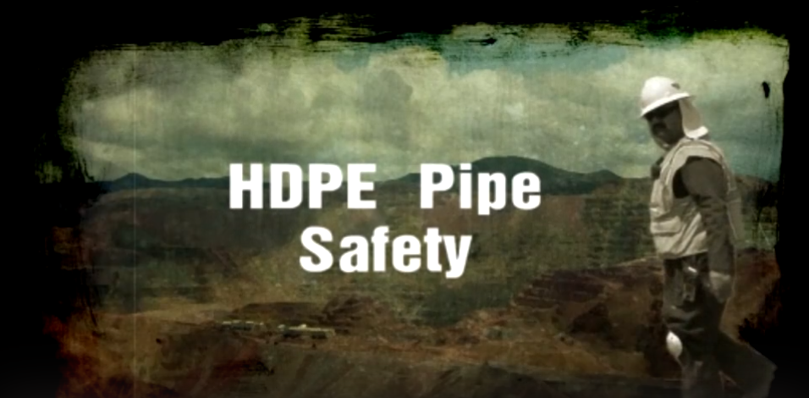
HDPE Pipe Handling
Notes:
SG page N/A
Instruction
Click on the link below to play the video- check the volume ahead of time
https://web.microsoftstream.com/video/60697858-3637-4a11-842c-77653e599429

Slide 21
SG 5
HDPE Pipe Characteristics
Valuable Asset
  Durability
  Flexibility
  Thick walls
  Resilience
Hazards
  Heavy
  Stores Energy
Notes:
SG page 5
Instruction
Many in the mining industry commonly use High-Density Polyethylene Pipe
It is a valuable asset due to its:
Durability and flexibility
Thick walls and resilience to most any material
These same characteristics can make it hazardous due to its:
Ability to store and release energy quickly
Doubled with the heavy weight
Serious injuries or fatalities could occur due to mishandling of the HDPE Pipe

Slide 22
SG 5
Fatality Prevention
Policy developed
Pipe Safety Steering Team (PSST)
Notes:
SG page 5
Instruction
Policy was developed to prevent incidents with HDPE Pipe
Focus on this quote from SG page 5: “The safety and health of all Freeport-McMoRan Inc. (“FCX”) employees is of the highest priority and a core value of the company. Our objective is zero workplace injuries and occupational illnesses. Production and costs are critical to the well-being of the company, but these considerations must never take precedence over safety, employee health or protection of the environment.”
PSST developed to address incidents occurred in relation to HDPE Pipe
Developed a policy of best practices to work safely with HDPE Pipe
All sites who handle HDPE Pipe must follow policy (FCX-HS12)

Slide 23
SG 5
Policy Scope
Who must attend HDPE Pipe handling training?
Which commonly used pipe are not included in the policy?
Notes:
SG page 5
Instruction
All employees and contractors who handle or participate in the handling of HDPE Pipe must attend the training course
Drip line or corrugated pipe does not present the same hazard as HDPE Pipe

Slide 24
SG 7
Just the Facts
Directions
From the Learn from Others presented, answer the questions in your student guide.
Discuss and share your thoughts about what could have been done differently.
Activity 2
Notes:
SG page 7
Time
Approximately 10 minutes
Materials
Student Guide
Pens/Pencils
Purpose
This activity gives students the opportunity to learn about one of the incidents that prompted improved coordinated guidelines, training, and policy.
Instruction
Divide the class into three groups.
Have each group read/discuss and be ready to summarize one of the next three “Learn From Others.”
Have students take notes on page 7 of SG.
Group 1- page 8 (included here on page 25)
Group 2- page 9 (included here on page 26)
Group 3- page 10 (included here on page 27)
Animation- During their summaries, when you click, the picture will enlarge for easier visibility.
[Note: Include directions that recognize varying class sizes by doing one of the following
Provide an activity where class size does not matter
Incorporate suggestions to alter the given activity for larger and smaller than defined class sizes
Provide alternate activity for larger and smaller than defined class sizes]

Slide 25
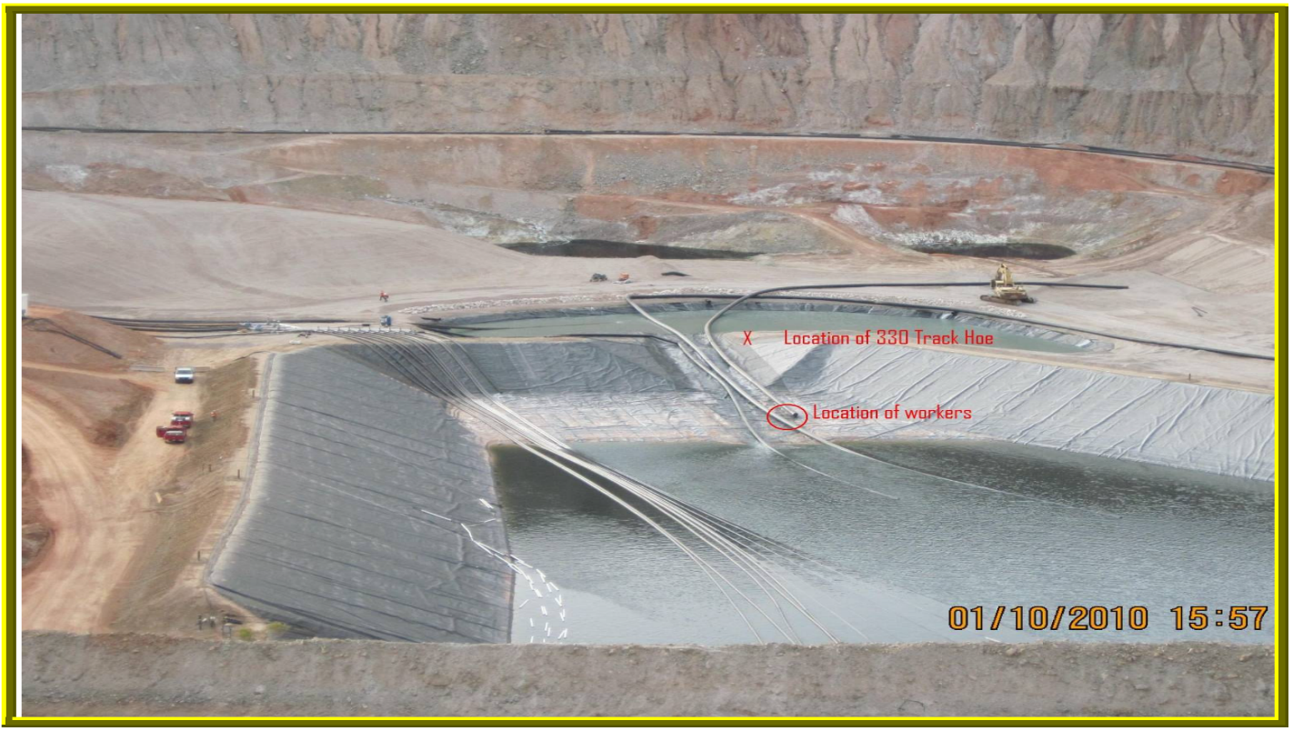
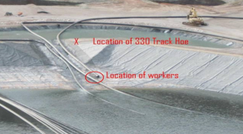
SG 8
Learn from Others
Notes:
SG page 8
Instruction
Have a student read on page 8 of the SG
Discuss
Click to show an enlarged portion of the picture to show details of the positioning

Slide 26
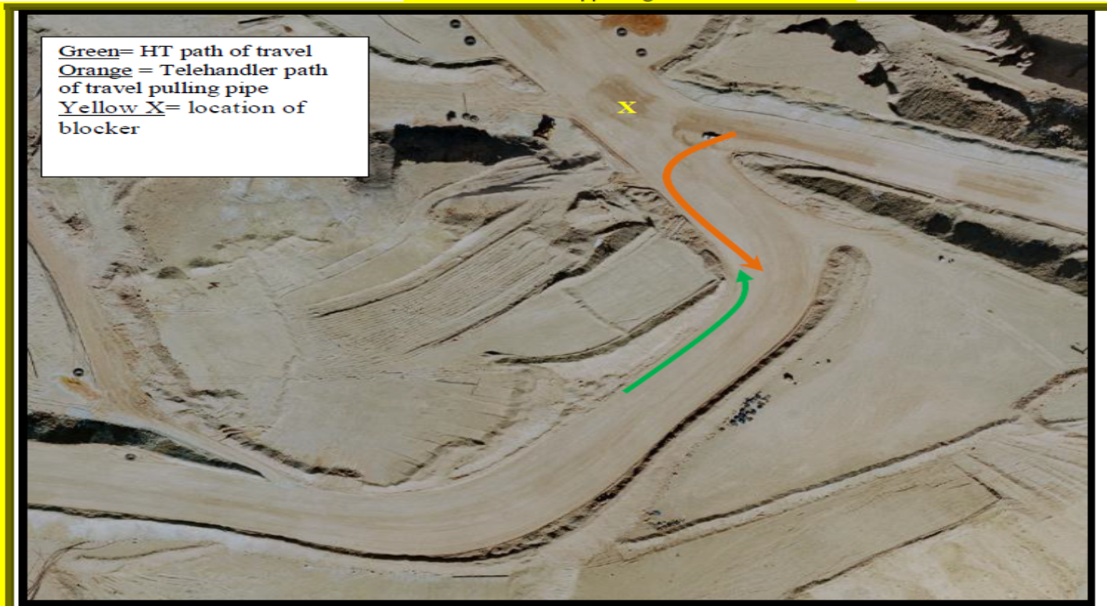
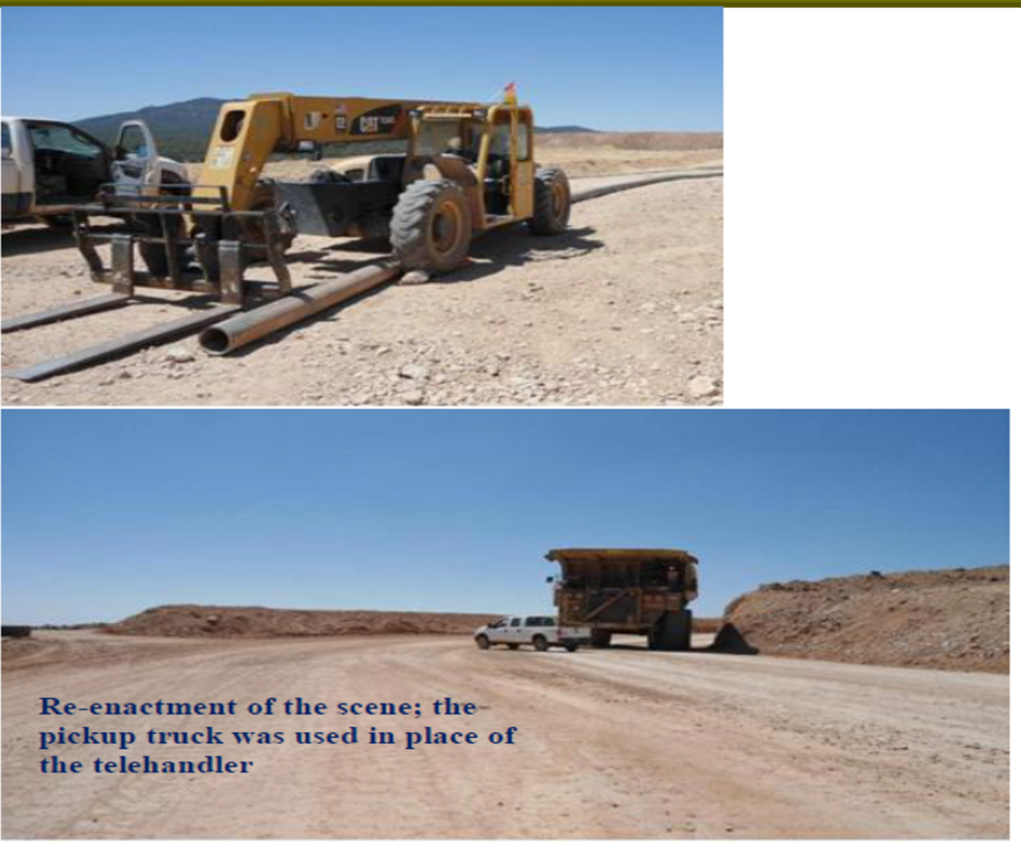
SG 9
Learn from Others
Notes:
SG page 9
Instruction
Have a student read the first on page 9 of the SG
Discuss
Click to show 2 more pictures to illustrate the scene

Slide 27
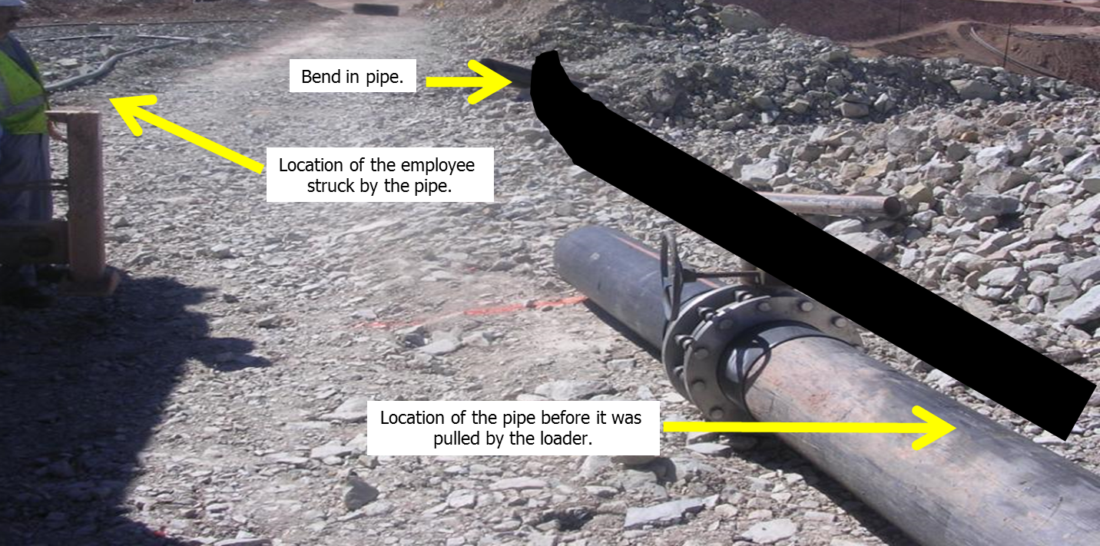
SG 9
Learn from Others
Notes:
SG page 9
Instruction
Have a student read the second one found on page 10 of the SG
Discuss
Click the picture to enlarge for easier visibility

Slide 28
SG 12
Module 1 Quiz
Directions
Complete the quiz in the Student Guide (p. 12)
Discuss the answers as a class
Quiz
Notes:
SG page 12
Instruction
Give students time to write answers to the quiz questions in the SG
Review the answers as a class using the slides

Slide 29
SG 12
Module 1 Quiz
What does HDPE stand for?
  High Density Polyethylene
  High Density Plastic Energy
  High Density Polycarbonate Emergence
Notes:
SG page 12
Instruction
Discuss answer as a class
Click to circle the answer
Quiz Answer
a, SG page 5

Slide 30
SG 12
Module 1 Quiz
What properties make handling HDPE Pipe so hazardous? (circle all that apply)
  Heavy
  Elasticity
  Easy to install
  Impervious to many chemicals and solutions
Notes:
SG page 12
Instruction
Discuss answer as a class
Click to circle the answer
Quiz Answer
a, b, d, SG page 5

Slide 31
SG 12
Module 1 Quiz
What should be done if you feel unsafe, or if a co-worker is in danger?
  Stop the job and abandon the task
  Stop the job and receive clarification
  Walk away from the task and have someone else complete it
  Wait until the task is complete and discuss the situation with your supervisor.
Notes:
SG page 12
Instruction
Discuss answer as a class
Click to circle the answer
Quiz Answer
b, SG page 6

Slide 32
Debrief
What are some key concepts learned in this module?
What do you need to understand better?
What information surprised you?
Notes:
SG N/A
Instruction
Discuss questions on slide

Slide 33
Module 2: Risk Management
Notes:
SG page 15
Instruction
Review learning objectives for the module
Upon completion of this module, students will be able to
Describe the purpose and process for hazard recognition before performing tasks related to working with HDPE Pipe
Identify the personnel who will be associated with the task, as well as their roles and responsibilities, to ensure the task is being performed safely and all involved abide by policy

Slide 34
SG 17-18
Hazard Assessment
Risk Registers
Workplace Examinations
Job Safety Analysis
Notes:
SG pages 17-18
Instruction
Ask the following questions to begin discussion:
What happens when a crew does not complete an adequate hazard assessment at their work site?
What happens when they do not think through the job steps and look for potential hazards?
What happens when they do not have proper controls in place, or if they skip steps?
Hazards in the workplace are the things that could hurt you, or lead to incidents with serious and potentially fatal consequences
Overlooking hazards in the workplace can have catastrophic, yet completely preventable, outcomes
Discuss the following types of Hazard Assessments:
Risk Registers
Tasks involving HDPE Pipe handling will be listed on divisional risk registers at each site
Evaluation to reduce or eliminate risk will be completed according to safety policies
Listed on Risk Registers will be:
Analysis of the risks involved
Controls that must be in place in order to mitigate risks
Bringing the hazard level down to an acceptable level
Placed within the policy as a directive from the company
If the steps and actions are completed as described, the employees handling the HDPE Pipe have the greatest probability of completing their job safely
Workplace Examinations
Before any work commences
Critical to look around and assess all areas connected to the job, from staging to installation
Guide workers as they take a critical review of the physical space in which they will work
Form has room for documentation of any hazardous situation within the physical space, such as:
Areas that need cleanup
Situations that could create a hazardous situation, such as:
Equipment
Guarding
Walkways that need to be fixed
Within the context of jobs including HDPE Pipe handling, looking at physical locations and assessing the ground and roadways
Job Safety Analysis
Performing a job considered high risk and non-routine
Plan well
Anticipate any risks they may face.
Tool to assist the workers as they:
Think through their job
Discuss the steps
Look for the potential hazards they could encounter with each step
When a potential risk is identified, they must:
Decide on the most effective critical control to keep the risk from creating an unsafe working environment
The JSA form gives an opportunity to record these steps, as well as the controls chosen to mitigate the risks
After the work has been completed, there is a section for the workers to write:
Notes and document any ideas
Consequences
Thoughts
Descriptions
Anything that will help the next team of workers to have the necessary information

Slide 35
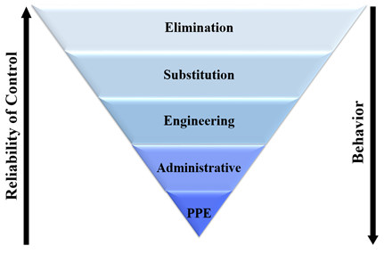
SG 18
Hierarchy of Controls
Notes:
SG page 18
Instruction
Ask “What do you remember about the Hierarchy of Controls?”
Review each level below:
Elimination: most effective, as it completely eliminates the hazard
Substitution: is there something that can be used in place of the item/process so as to keep the employees safer?
Engineering: Is there anything we can design/build that will keep us away from the hazard?
Administrative: Rules, policies, signage (depends on employees to read and follow, so not as effective)
PPE: Personal Protective Equipment- what we put on to keep us “safe” from the hazards. This is the least effective, as it is completely dependent on human behavior. Does the person choose the correct equipment to protect them from the specific hazards, and then did they actually put it on , and put it on correctly?

Slide 36
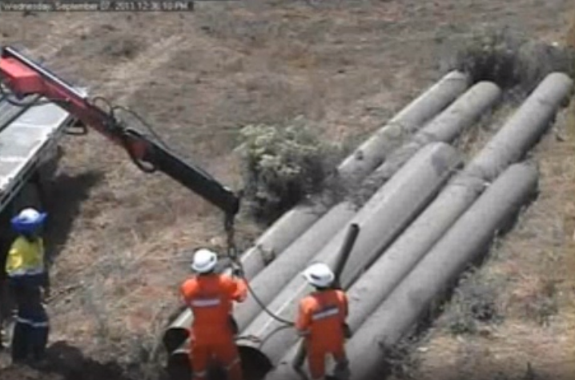
SG 19
Be On the Lookout
Notes:
SG page 19
Instruction
Click on the following link to play video
https://web.microsoftstream.com/video/26fd9ad0-1776-490d-ad2d-2a7285c9d204
Have a student read (or you can read) the scenario on page 19 of the student guide
Discuss the following questions:
What happened?
Could this have been prevented?
How?

Slide 37
SG 20
Planning
Per FCX-HS12 requires four main considerations:
Safe work procedures
Equipment manufacturer’s procedures
Training
Repair
Notes:
SG page 20
Instruction
As per FCX-HS12, planning for work which involves HDPE Pipe handling requires four main considerations:
Establish safe work procedures and identify and remove hazards before beginning a task
Follow the equipment manufacturer's procedures for the work being performed to ensure all hazards have been addressed
Train persons to recognize the hazards associated with performing a task
Repair all equipment found to be damaged prior to performing the work, or take the equipment out of service and replace it with another piece of equipment appropriate for the task
A few key concepts and definitions need to be clearly defined and taken into account regarding the necessary people and appropriate circumstances needed when planning a job that includes HDPE Pipe handling

Slide 38
SG 20-21
Team
The following people must be included in planning a job:
A qualified individual
Project lead
Supervisor
Project Managers
Notes:
SG pages 20-21
Instruction
A Qualified Individual is an employee is:
Familiar with the operation and safety hazards of the task through training and experience
Qualified using the applicable skills assessments
The Project Lead is:
Intimately familiar with the task
Could be a supervisor, engineer leading the project, or other Qualified Individual
Supervisors at each site will be responsible to ensure that practices are being followed
Project Managers will:
Audit work practices of contractors
Ensure compliance with site HDPE Pipe procedures and this policy

Slide 39
SG 20-21
Team
Engineer
Pipe pulling escorts
Safety watch
Spotter
Notes:
SG pages 20-21
Instruction
An engineer is:
“A person trained in or follows as a profession a branch of engineering”
Someone who works with and is knowledgeable of the characteristics and hazards associated with HDPE Pipe
Pipe Pulling Escorts:
A Lead Escort and Trail Escort are required for:
Pulling pipe in addition to the pulling equipment when there is potential for interaction with other traffic
All equipment involved with this task must be equipped with a:
Flashing blue light
Blue light easily visible during daylight hours
Trail Escort must maintain a distance of at least 50 feet behind the pipe that is being pulled
Lead Escort and Trail Escort used during a pipe pull must not have any other assignments or responsibilities
Safety Watch is a:
Qualified Individual set to monitor a job involving HDPE Pipe
A person who must remain on the job at all times and have no other job assignments or responsibilities
If this person must leave the area:
There must be positive relief by another Qualified Individual
Requirement determined by the hazards associated with specific tasks, including specific policy requirements for example:
When substantial barriers are used
Must be well versed in the equipment being used
Needs to know when to “stop the job” and reassess the situation
A Spotter is a person:
Assigned to assist or direct flow of work for someone performing a task, such as unloading or moving pipe
Who must be cautious and stay out of the line of fire of the pipe while staying in the line of sight for the equipment operator

Slide 40
SG 22
Circumstances and Requirements
Safety reminders:
Block material
Position
Monitor
Notes:
SG page 22
Instruction
Listed below are several safety reminders while performing work with HDPE Pipe:
Block material against motion to assure energy cannot be released
Do not place yourself in a position that will expose you to hazards
Monitor personnel routinely to determine safe work procedures are followed

Slide 41
SG 22
Circumstances and Requirements
When planning consider the following:
Management of Change (MOC)
Load/Move
Notes:
SG page 22
Instruction
Understand and consider the following circumstances and requirements when planning any job that includes HDPE Pipe handling:
Management of Change (MOC)
Corporate initiative
Required by all Freeport-McMoRan properties since company is ISO 14001 certified
Must be submitted and completed before attempting jobs that create any addition or change to the company properties
Gives Health and Safety Department and Environmental Department opportunity to evaluate changes for potential impacts on the following:
Safety
Environmental
Production
Quality
Health and Safety Department and Environmental Department need time to determine and must be done before work begins if:
Specific samples need to be taken
Other permits need to be obtained
Land needs to be surveyed
Endangered plants and animal studies need to be performed
According to FCX-HS12, each site’s MOC system must be considered when planning a job that requires working with HDPE Pipe.
Load/Move
Information for each piece of equipment:
Must be gathered
Must be available to the planning team
Will be used to assist decisions
Will include site-specific equipment

Slide 42
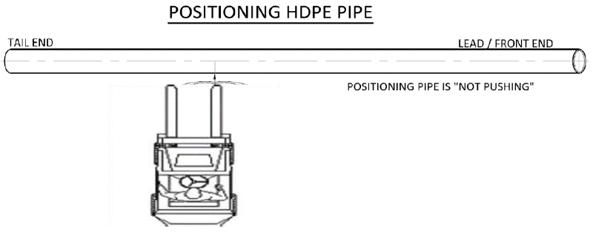
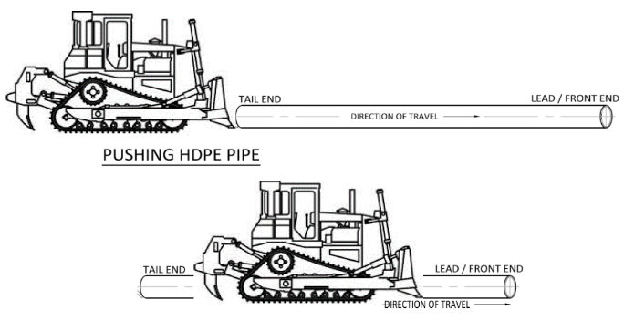
SG 22-23
Circumstances and Requirements
Engineering Review
Pushing Pipe
Positioning Pipe
Notes:
SG pages 22-23
Instruction
Engineering Review
For specific tasks where the policy covers the general safe practices, but not details of the engineering
The Engineering Review may be used for the following situations:
Pulling pipe of any diameter that is longer than 400 feet
Pulling pipe up or down grades greater than 25%
Pushing pipe
Tasks involving dual-walled or dual-contained pipe
Fusing pipe that is not consistent or without manufacturer specifications or ASTM standards
Pulling or fusing pipe 42 inches in diameter and greater
While the engineering review is being completed, all manufacturer and company-defined safety standards must be utilized
The details of the engineering review must be attached to the request, or be readily available if an attachment is not practical
Pushing Pipe
Pulling will be used over pushing wherever possible
Pushing is very dangerous, it is extremely difficult to control the stored energy created by this activity
An Engineering Review is required for pushing pipe
If there is no alternative to pushing pipe, this job can only be performed by a Qualified Individual once the job has received the appropriate planning and approvals
More specific information regarding pushing pipe will be covered in Module 4
Positioning Pipe
Click on the picture to show a video about Positioning Pipe
Final Positioning can be as simple as nudging the pipe into place
Final positioning can still be dangerous because the pipe may build up a small amount of stored energy or move unexpectedly
Those completing this task must still be aware of the hazards and stay out of the line of fire
Potential stored energy may still create risk to the employee, so careful planning should take place before commencing Final Positioning

Slide 43
SG 24
Circumstances and Requirements
Substantial Barriers
Pipe Guide
Dual-Walled Pipe
Notes:
SG page 24
Instruction
Substantial Barriers
Object used for controlling the energy in the pipe to protect personnel must be within the 50-foot safe zone
Examples of barriers:
Dirt berms
Concrete barriers
Properly placed equipment
Requirements for the use of a Substantial Barrier are determined by:
Hazards associated with specific tasks
Specific policy requirements
Pipe Guide
Equipment or material used to maintain control of the energy of the pipe while being moved
Must not present a hazard to the operator or equipment.
Equipment used must be appropriate for the size and potential energy of the pipe
Equipment used can be within the 50-foot safe zone
Requirements for the use are determined by the hazards associated with specific tasks, including specific policy requirements
Dual-Walled Pipe (Dual-contained pipe)
May require different rigging or equipment or both specific to the pipe and task
Engineering Review is required
Applies specifically to pipe manufactured as dual-walled or dual-contained pipe
Does not apply to sleeved pipeline assembled on site

Slide 44
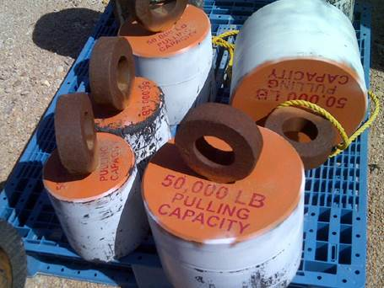
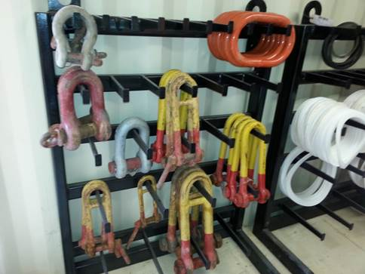
SG 24-25
Circumstances and Requirements
Preventative Maintenance
Variance Request
Notes:
SG pages 24-25
Instruction
Preventative Maintenance
Establish process for inspection of pipes using each site’s existing PM process
Perform inspections for the following issues:
Sagging
Ground erosion
Condition of equipment for example pulling heads, slings, shackles, and swivels
Components will be described in greater detail and available to handle during the hands-on portion of Module 4
Variance Request
Process outlined within FCX-HS01 “Policy Administration Requirement” allows for justifiable variances from the policies
When a Health and Safety Policy cannot be met, a Variance Request must be completed, reviewed and approved
When HDPE Pipe work falls outside of the scope of FCX-HS12 or the “Policy Administration Requirements”, FCX-HS01 states a “Short-Term Variance” is required in “Situations that are temporary in nature where work is in progress and the specific conditions of the work area or other parameters may not allow for full compliance with a policy
The following are situations a Short-Term Variance are used:
One-time events
Emergency situations
Work in regions where equipment to comply is not immediately available
Site conditions which do not allow for compliance
Where alterations to the facility would be required
Short-term variances should be:
Restricted to non-routine work activities where unanticipated conditions make compliance infeasible or more hazardous
Evaluated as part of continuous improvement of safe work practices

Slide 45
SG 26
Tell Me That Again
Directions
Your instructor will divide you into groups
Follow the instructions in each box below.
Activity 3
Notes:
SG page 26
Time
Approximately 10 minutes
Materials
Student Guide
Pen/Pencil
Purpose
This activity gives students the opportunity to review and summarize from the policy several key definitions.
Instruction
Divide class in half (thirds if you have enough).
First group will read pages 20-21 and be ready to discuss the team players, along with a 10 second description of each.
Second group will read pages 22-25 and be ready to discuss the circumstances and requirements that must be part of the planning process (10 second summary).
If your class is large enough to divide into thirds, you can have the last group review and be ready to explain pages 17-18. If not, go over this quickly as a review with everyone.
The groups are welcome to divide and conquer their information or work together as needed.
[Note: Include directions that recognize varying class sizes by doing one of the following
Provide an activity where class size does not matter
Incorporate suggestions to alter the given activity for larger and smaller than anticipated class sizes
Provide alternate activity for larger and smaller than anticipated class sizes]

Slide 46
SG 27-28
Module 2 Quiz
Directions
Complete the quiz in the Student Guide (pp. 27-28)
Discuss the answers as a class
Quiz
Notes:
SG pages 27-28
Instruction
Give students time to write answers to the quiz questions in the SG
Review the answers as a class using the slides

Slide 47
SG 27
Module 2 Quiz
The following are Hazard Recognition tools you can use when planning jobs that include HDPE Pipe handling (Circle all that apply):
  Risk Register
  Workplace Exams
  Job Safety Analysis
  HDPE Safety Reminders
Notes:
SG page 27
Instruction
Discuss answer as a class
Click to circle the answer
Quiz Answer
a, b, c, SG pages 17-18

Slide 48
SG 27
Module 2 Quiz
Match these terms with their definitions:
Qualified Individual | ___ Assigned to assist or direct flow of work for someone performing a task, such as unloading or moving pipe.
Project Lead | ___ “A person who is trained in or follows as a profession a branch of engineering” and someone who works with and is knowledgeable of the characteristics and hazards associated with HDPE Pipe.
Supervisor | ___ Intimately familiar with the operation and safety hazards of the task.
Project Manager | ___ Required for pulling pipe in addition to the Pulling Equipment when there is potential for interaction with other traffic.
Engineer | ___ Will audit work practices of contractors that perform HDPE Pipe tasks to ensure compliance with site HDPE Pipe procedures and this policy.
Pipe Pulling Escort | ___ Qualified Individual who is set to monitor a job including HDPE Pipe.
Safety Watch | ___ An employee that through training and experience is familiar with the operation and safety hazards of the task.
Spotter | ___ Responsible to ensure that practices are being followed.
Notes:
SG page 27
Instruction
Discuss answer as a class
Click to circle the answer
Quiz Answer
h, e, b, f, d, g, a, d, SG pages 20-21

Slide 49
SG 28
Module 2 Quiz
What are the three main considerations when planning for work with HDPE Pipe handling? (Circle all that apply)
  Repair broken or damaged equipment immediately
  Train person to recognize the hazards associated with performing a task
  Establish safe work procedures and identify and remove hazards before beginning a task
  Assign a team member to complete the hazard recognition forms, such as the JSA and Workplace Exam
Notes:
SG page 28
Instruction
Discuss answer as a class
Click to circle the answer
Quiz Answer
a, b, c, SG page 20

Slide 50
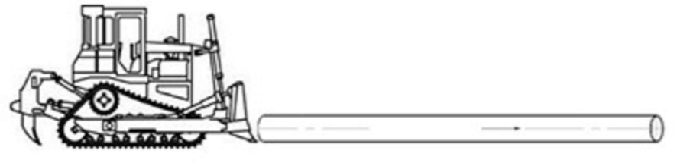
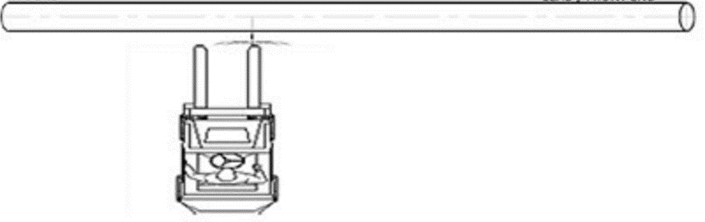
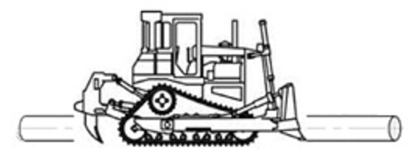
SG 28
Module 2 Quiz
Label these drawings “Pushing” or “Positioning”
a. __________________________
b. __________________________
c. ________________________
Notes:
SG page 28
Instruction
Discuss answer as a class
Click to circle the answer
Quiz Answer
Pushing, Positioning, Pushing, SG page 23

Slide 51
Debrief
What are some key concepts learned in this module?
What do you need to understand better?
What information surprised you?
Notes:
SG N/A
Instruction
Discuss questions on slide

Slide 52
Module 3: Pipe Handling
Notes:
SG page 31
Instruction
Review learning objectives for the module
Upon completion of this module, students will be able to
Describe safe practices and requirements of FCX-HS12 regarding receiving, loading, unloading and storage of HDPE Pipe on FCX properties
Identify when to use the Receiving/Loading/Unloading Checklist, and describe how to fill out this form correctly
Identify the difference between a properly loaded shipment of HDPE Pipe and one that does not comply with the company’s shipping standards
Describe the procedure in place to report loads that do not meet company standards
Describe how to safely store HDPE Pipe according to policy requirements

Slide 53
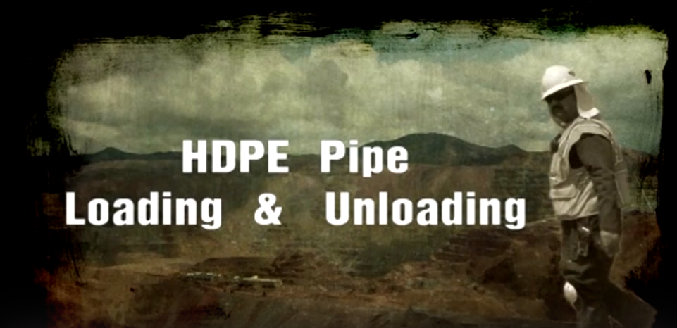
HDPE Pipe Loading & Unloading
Notes:
SG page N/A
Instruction
Click on the link below to play video
https://web.microsoftstream.com/video/4fb1e8b2-5dd1-4707-983c-7ee35273c380

Slide 54
SG 33
Receiving from External Source
Safe practices must be followed when:
  Receiving
  Storing
Notes:
SG page 33
Instruction
HDPE Pipe is shipped to properties by vendors
Safe practices must always be adhered to when receiving the pipe:
Arrival of the shipping truck at the unloading site must be coordinated
Trucks will not be unloaded until checklist is complete
If load not compliant with Shipping Requirements the following is required prior to unloading:
Additional evaluation
Superintendent approval
Includes a reporting system for communicating improper loads to Global Supply Chain (GSC)
Requirements found on the FCX-DOHS SharePoint Site
For further questions, contact your Supervisor or Project Lead
Safe practices must always be adhered to when storing the pipe:
Without engineered controls:
Stored no more than two pipes high for 10 inch diameter and larger
Stored no more than 2 feet high for pipe smaller than 10 inch diameter
HDPE Pipe can be stored higher with engineered controls to prevent the stack from collapsing

Slide 55
SG 33
Shipping
Variance Request
Follow company shipping requirements
Notes:
SG page 33
Instruction
Variance Request is required for pipe being shipped off-site
HDPE Pipe must be shipped according to the company shipping requirements according to FCX-HS12
Located in the HDPE Pipe Shipping Requirements document
Found on the FCX-DOHS SharePoint Site

Slide 56
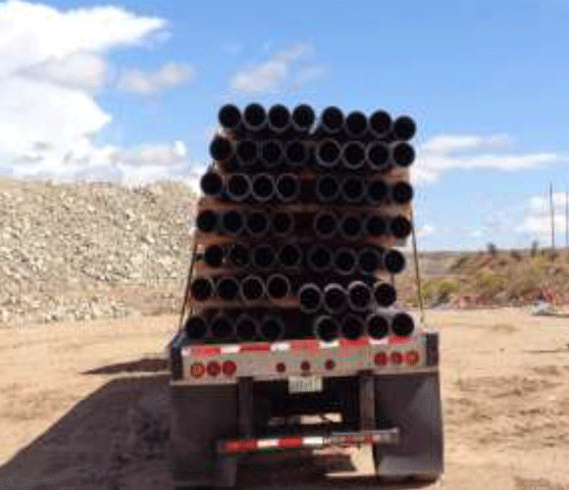
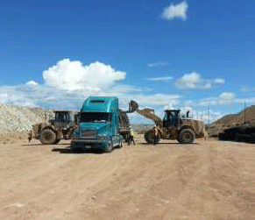
SG 34-35
Be On the Lookout
Safety Success (September 27, 2013)
Notes:
SG pages 34-35
Instruction
Divide the class in half-one half will discuss the Be On the Lookout while the other will discuss the Learn From Others
Students should pair up and read their assigned section
Students should take notes about the situation in preparation for the discussion
After partner discussion, have each group summarize the details
As a whole class, discuss the similarities and differences between the two

Slide 57
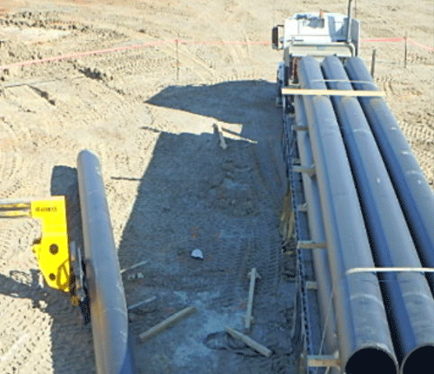
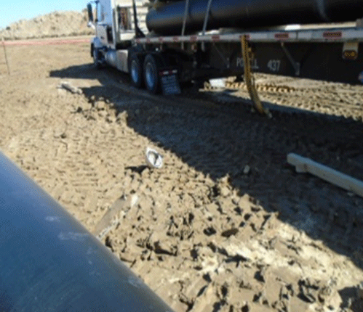
SG 35
Learn from Others
MSHA Fatality Overview (MAI-2016-01)
Notes:
SG page 35
Instruction
Divide the class in half-one half will discuss the Be On the Lookout while the other will discuss the Learn From Others
Students should pair up and read their assigned section
Students should take notes about the situation in preparation for the discussion
After partner discussion, have each group summarize the details
As a whole class, discuss the similarities and differences between the two

Slide 58
SG 36
On-Site Transfers and Movement
HDPE Pipe Receiving/Loading/Unloading Checklist
Site trailers
Notes:
SG page 36
Instruction
On-Site Transfers require the following prior to beginning a task:
HDPE Pipe Receiving/Loading/Unloading Checklist needs to be completed
Adhere to established procedure for ensuring the checklist is completed
Site trailers used for on-site transfers of HDPE Pipe must be:
Equipped with engineered stints, or
Other engineered means of securing the load

Slide 59
SG 36
On-Site Transfers and Movement
Equipment
Safe Zone
Notes:
SG page 36
Instruction
Equipment
There are several requirements to consider when planning to move HDPE Pipe from one location to another on the site
The requirements are listed below:
The site must ensure equipment has been evaluated for adequate lifting capacity, and the equipment operator is aware of the limitations of the equipment
Equipment operators must have documented training for the equipment used in the loading/unloading process
Documented rigging task training is required for employees loading/unloading pipe using a mobile crane
Safe Zone
A 50-foot Safe Zone around the truck must be:
Established
Marked with a Safety Watch in place to keep ground personnel out of the loading/unloading zone any time the load is not secure
Truck driver must remain with the Safety Watch any time the load is not secure
Safety Watch must:
Be a qualified individual who is experienced and knowledgeable in the job being completed
Remain on the job at all times and have no other job assignments
A Substantial Barrier must be in place for personnel to enter the Safe Zone when:
Load is not secured
Load is being strapped or unstrapped
Example: a loader with forks to block the load when unstrapping

Slide 60
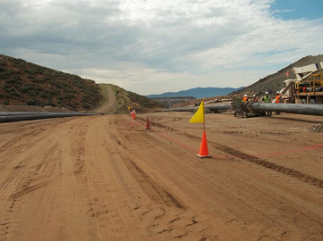
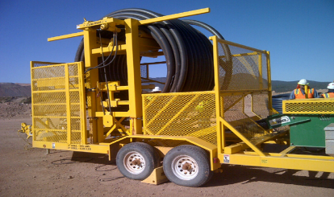
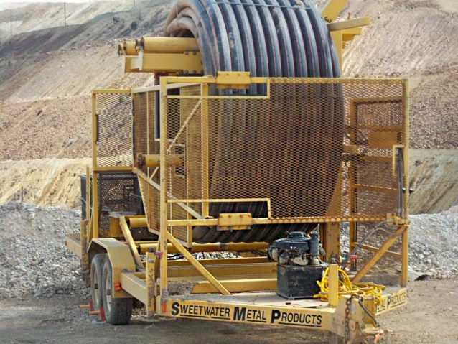
SG 37
On-Site Transfers and Movement
Hazard Boundary
Pipe Coils
Notes:
SG page 37
Instruction
Hazard Boundary
Area which task hazards exist must be reviewed and defined
Must include the need for any boundary markings
Anyone who is inside this area will review and sign the completed HDPE Pipe Handling Permit
Required to ensure all personnel are aware of the hazards
Additional review(s) may be needed if there is more than one task taking place on the same pipeline
Pipe Coils
Specific procedures will be developed for any diameter and length
HDPE Pipe Handling Permit will be issued prior to starting work
This procedure must include:
Where the pipe will be staged after it is unrolled
Controls used to maintain a secure area
The process of unrolling HDPE Pipe coils up to the staging area is not:
Considered pulling pipe
Restricted to the 400 foot maximum length
After the unrolled pipe has been staged, the pipe is subject to the pipe pulling requirements
An engineered device for controlling the stored energy in the coil (such as a Line Tamer) must be used when unrolling coils
No restrictions on the length of pipe in a coil to be unrolled

Slide 61
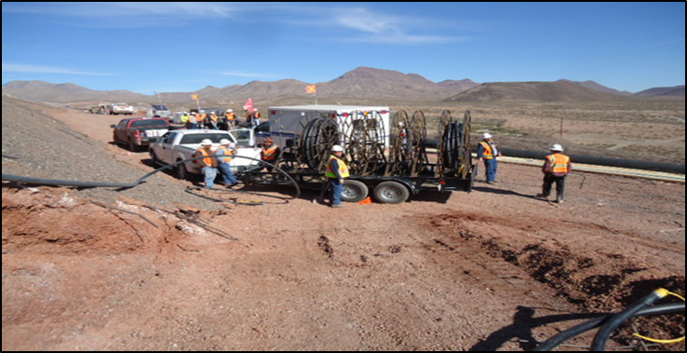
SG 38-39
Learn from Others
Notes:
SG pages 38-39
Instruction
Have the students read/skim through this Learn from Others individually
As a class:
Summarize the scenario
Actions taken
Key findings

Slide 62
SG 40
Specific Forms
HDPE Pipe Handling Permit
HDPE Pipe Handling Engineering Review
Receiving/Loading/Unloading checklist
Notes:
SG page 40
Instruction
HDPE Pipe Handling Permit
Main form needed for most situations concerning HDPE Pipe handling
Filling out this form completely is Step #1 when planning out the job
HDPE Pipe Handling Engineering Review
Complete and submit this form along with the Permit in order to develop a plan to accomplish a task not specifically covered in the Policy
Receiving/Loading/Unloading checklist
Must be completed prior to the loading/unloading activity and when receiving HDPE
These documents and all HDPE Pipe Handling permits, policy, and technical supplements can be found on the DOHS SharePoint under H&S Policies, HDPE Pipe Handling

Slide 63
HDPE Pipe Handling Permit
When to complete the Permit
How long is it good
Who is it reviewed by
Who signs the form
Notes:
SG page 40
Instruction
Completed for
Any work with HDPE Pipe that is 2 inches in diameter or larger and longer than 50 feet where the pipe will be pulled, installed, and/or repaired
Unrolling HDPE Pipe coils, regardless of diameter and length
Good for the task duration as long as conditions do not change
Examples include weather, equipment, pipe size, terrain, slope, project lead, etc.
Permit must be reviewed by all employees associated with the task each time prior to work beginning
Each employee must print, sign, and date the bottom of the permit in the designated area (or the reverse side of the permit) after the permit is reviewed

Slide 64
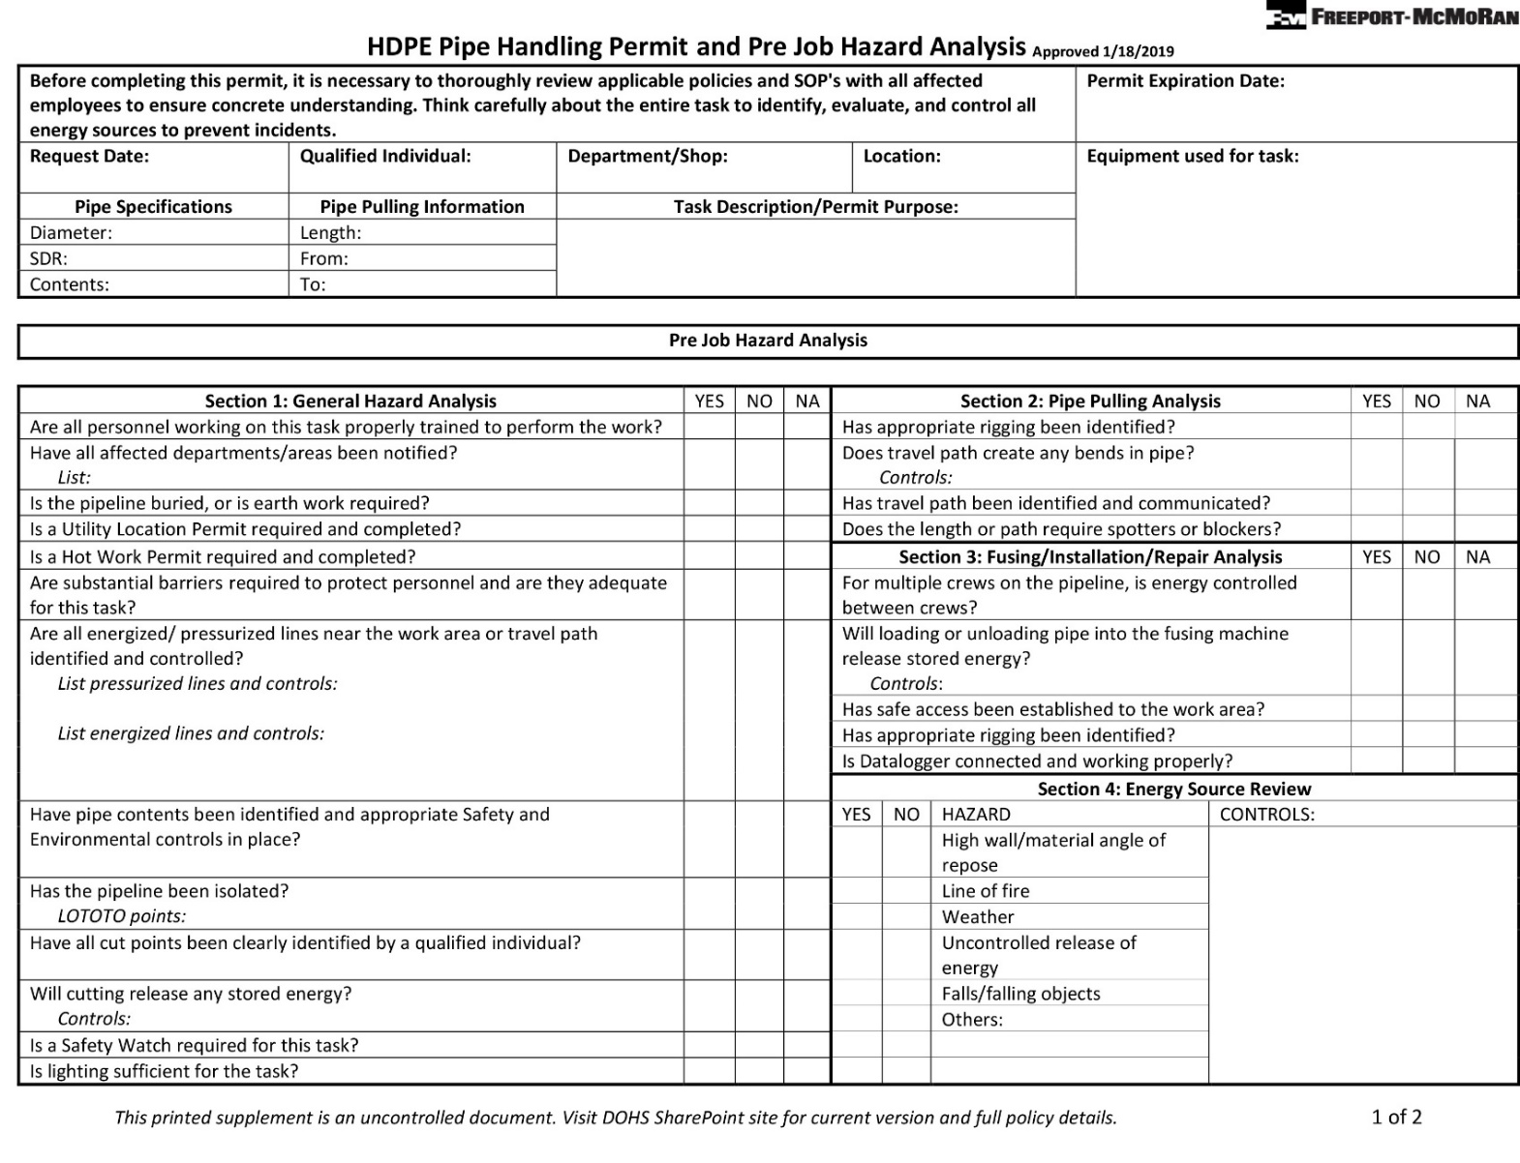
SG 41
HDPE Pipe Handling Permit, Page 1
Notes:
SG page 41
Instruction
This is page one of the HDPE Pipe Handling Permit
We will discuss the details of the form in the upcoming slides

Slide 65
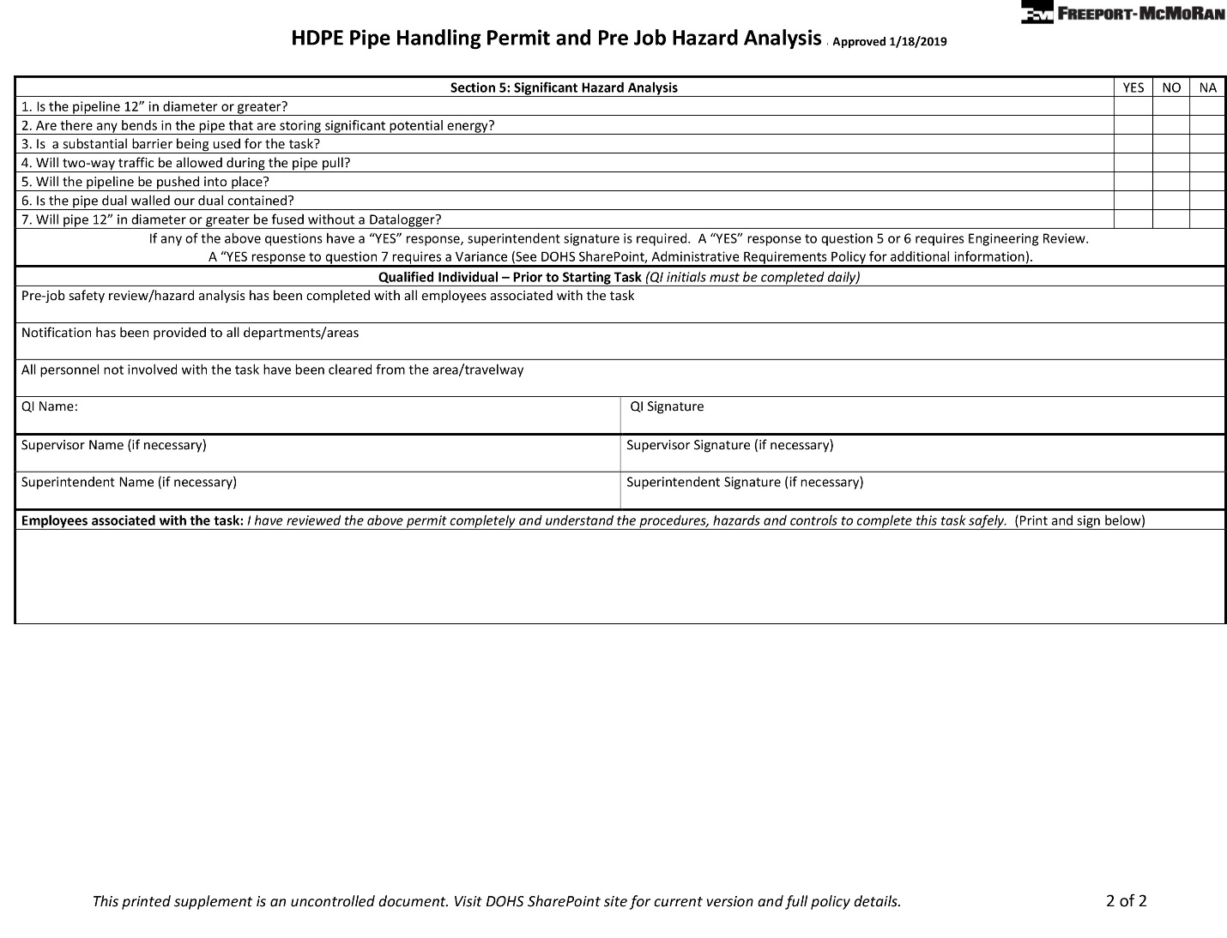
SG 42
HDPE Pipe Handling Permit, Page 2
Notes:
SG page 42
Instruction
This is page two of the HDPE Pipe Handling Permit
We will discuss the details of the form in the upcoming slides

Slide 66
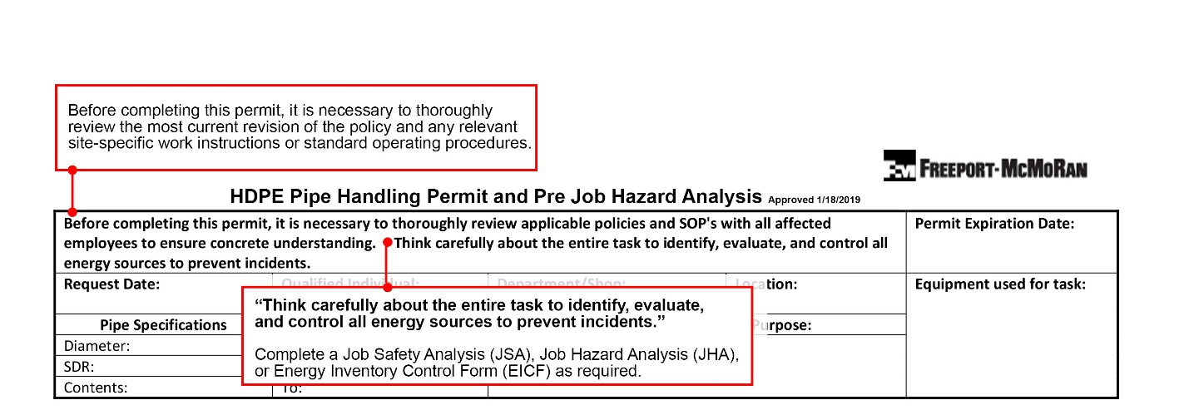
SG 43
Think Safely
Notes:
SG page 43
Instruction
Discuss the information in the red boxes

Slide 67
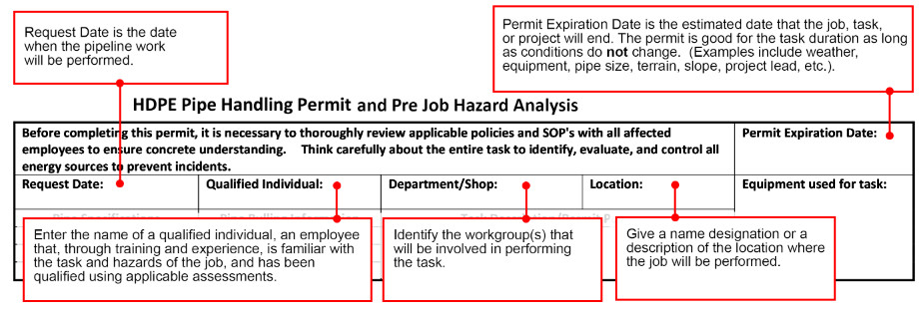
SG 43
Initial Information
Notes:
SG page 43
Instruction
Discuss the information in the red boxes

Slide 68
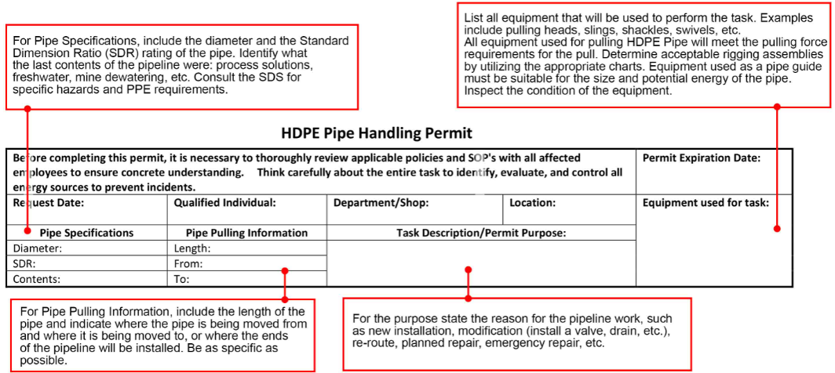
SG 44
Description
Notes:
SG page 44
Instruction
Discuss the information in the red boxes

Slide 69
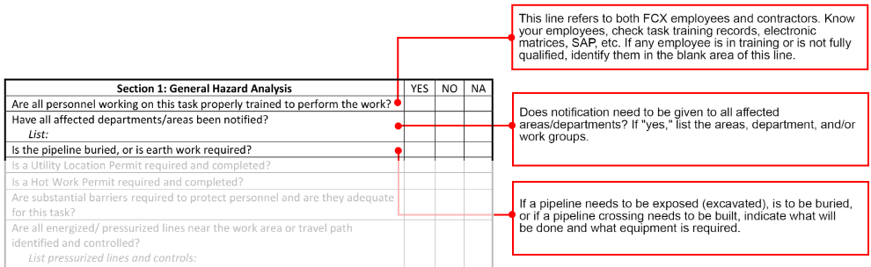
SG 44
Section 1: General Hazard Analysis
Notes:
SG page 44
Instruction
Pre-Job Analysis portion of the permit
Section 1 covers questions related to a General Hazard Analysis
Each line item must be reviewed and the appropriate box checked
Advisable to enter additional information on some of the line items to document specific details
Discuss the information in the red boxes

Slide 70
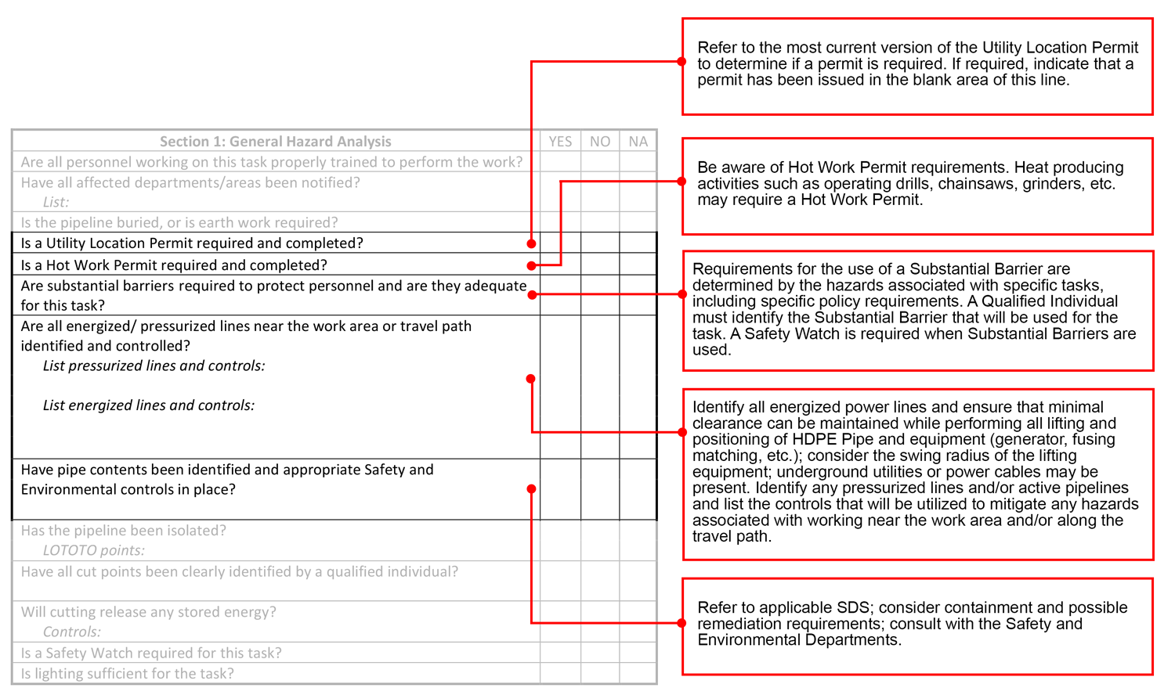
SG 45
Section 1: General Hazard Analysis cont’d
Notes:
SG page 45
Instruction
Discuss the information in the red boxes

Slide 71
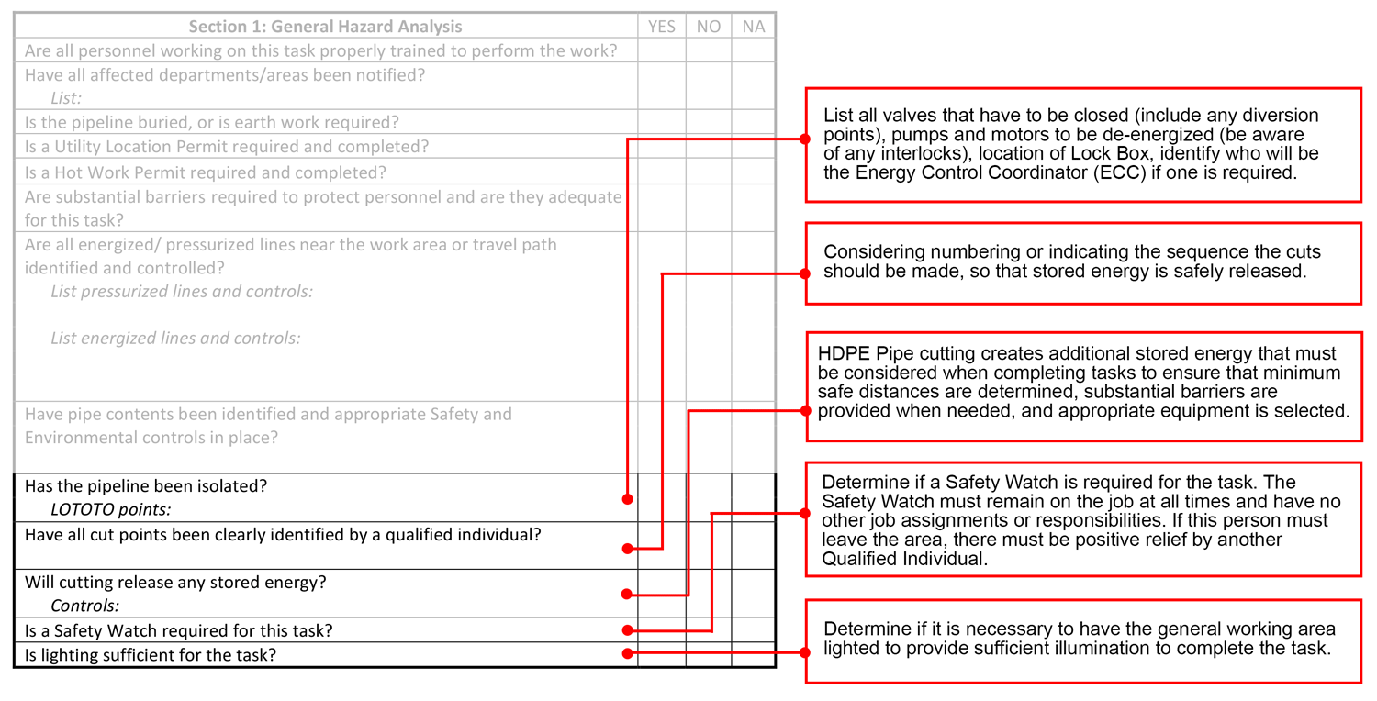
SG 45
Section 1: General Hazard Analysis cont’d
Notes:
SG page 45
Instruction
Discuss the information in the red boxes

Slide 72
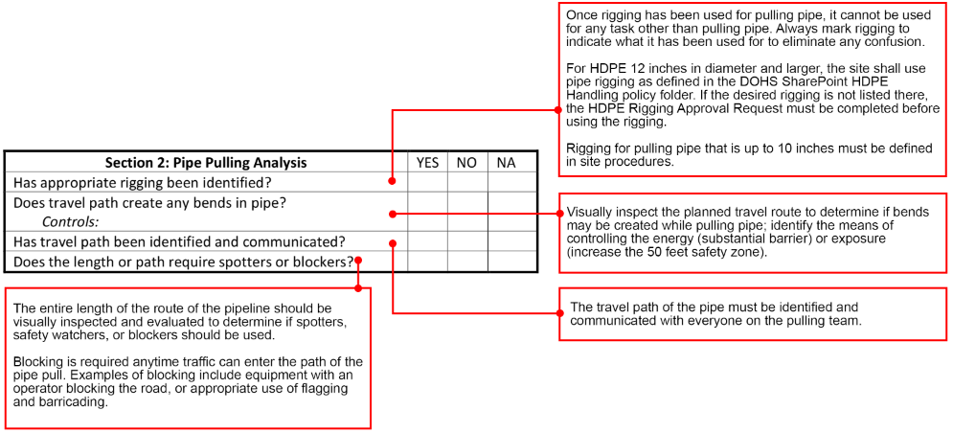
SG 46
Section 2: Pulling Analysis
Notes:
SG page 46
Instruction
Analyzing the pulling of pipe
If the task you are performing does not require pipe pulling, you may mark this section as NA
Discuss the information in the red boxes

Slide 73
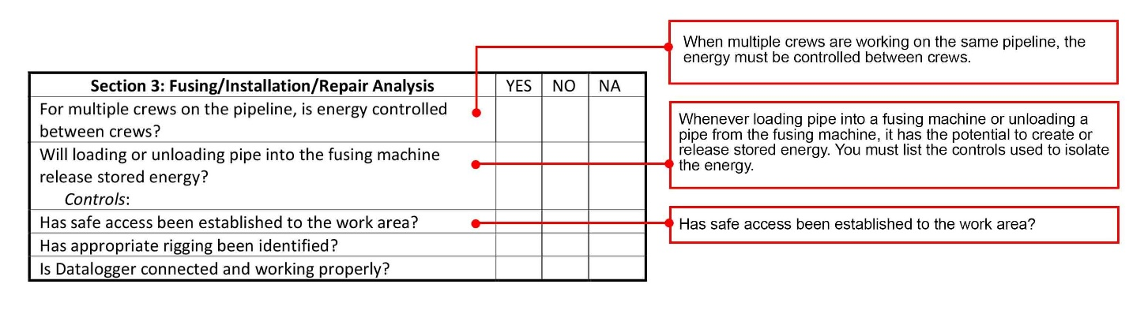
SG 46
Section 3: Fusing/Installation/Repair
Notes:
SG page 46
Instruction
If the task you are performing does not require pipe fusing, installation or repair, you may mark this section as NA
Discuss the information in the red boxes

Slide 74
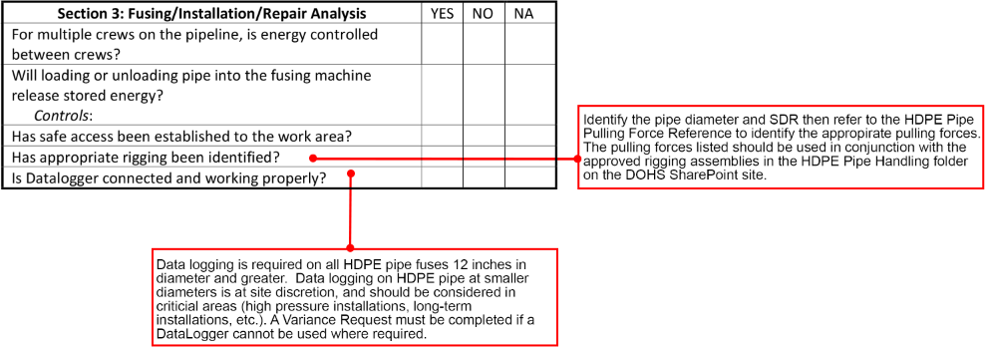
SG 47
Section 3: Fusing/Installation/Repair cont’d
Notes:
SG page 47
Instruction
Discuss the information in the red boxes

Slide 75
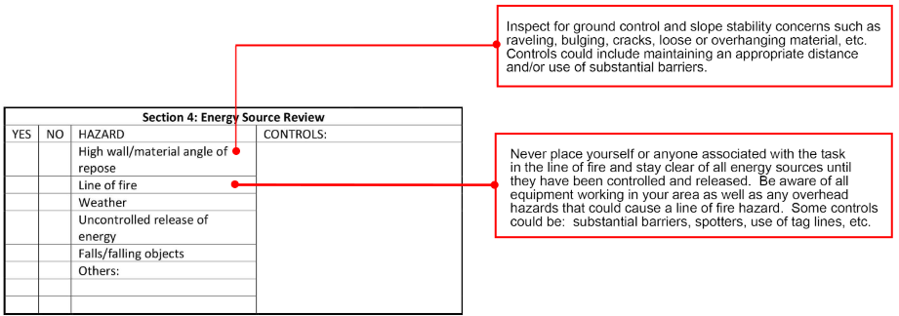
SG 47
Section 4: Energy Resource Review
Notes:
SG page 47
Instruction
Discuss the information in the red boxes

Slide 76
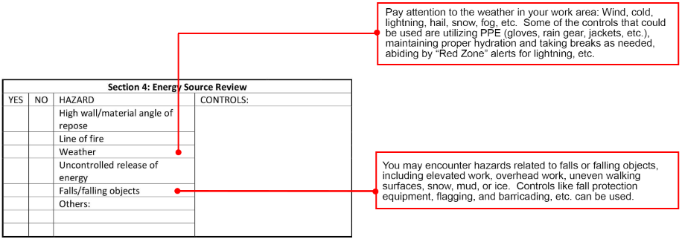
SG 47
Section 4: Energy Resource Review cont’d
Notes:
SG page 47
Instruction
Discuss the information in the red boxes

Slide 77
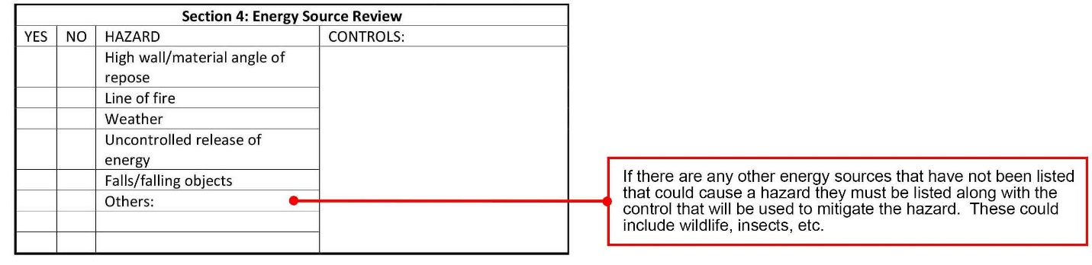
SG 48
Section 4: Energy Resource Review cont’d
Notes:
SG page 48
Instruction
Discuss the information in the red boxes

Slide 78
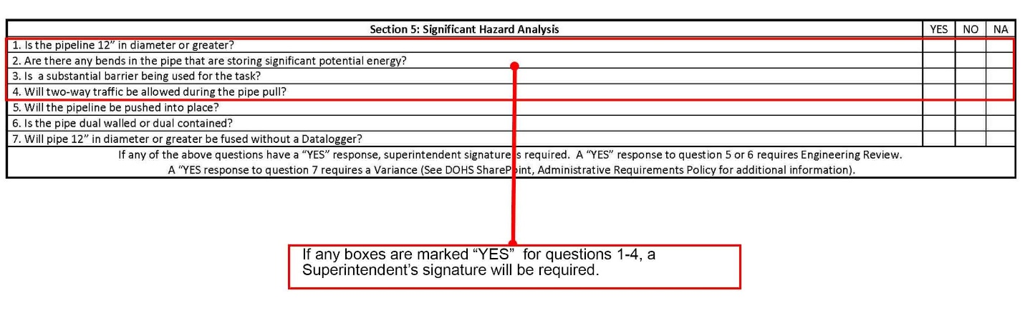
SG 48
Section 5: Significant Hazard Analysis
Notes:
SG page 48
Instruction
Discuss the information in the red box

Slide 79
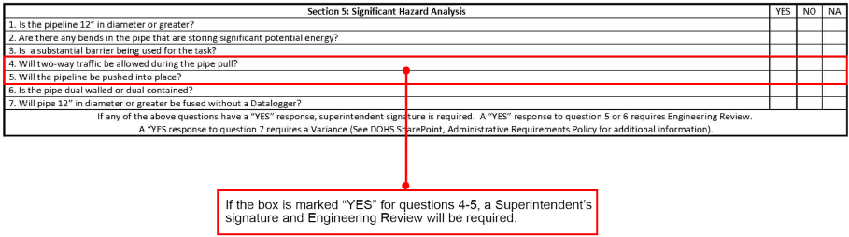
SG 48
Section 5: Significant Hazard Analysis cont’d
Notes:
SG page 48
Instruction
Discuss the information in the red box

Slide 80
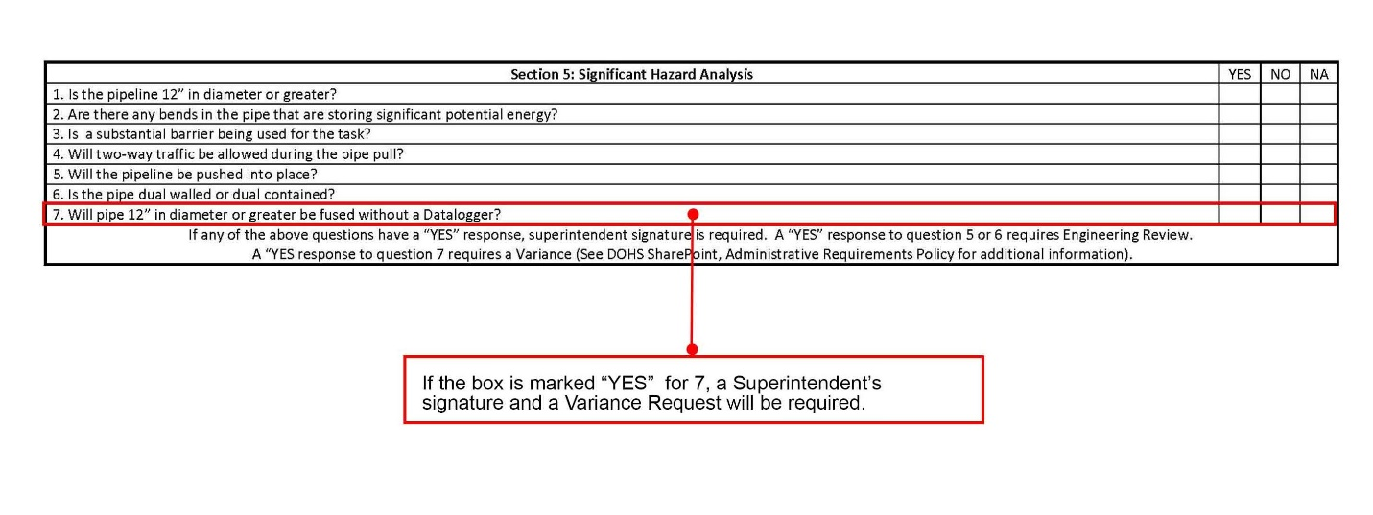
SG 49
Section 5: Significant Hazard Analysis cont’d
Notes:
SG page 49
Instruction
Discuss the information in the red box

Slide 81
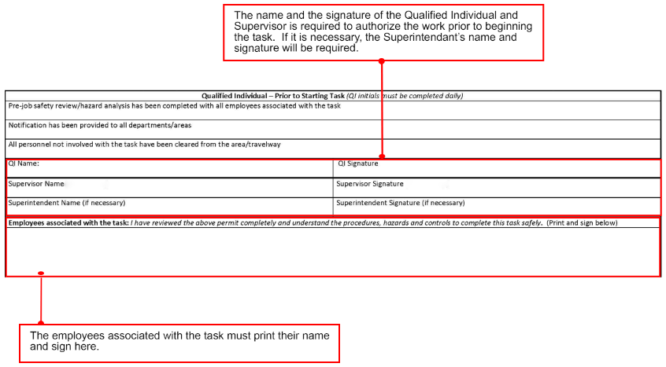
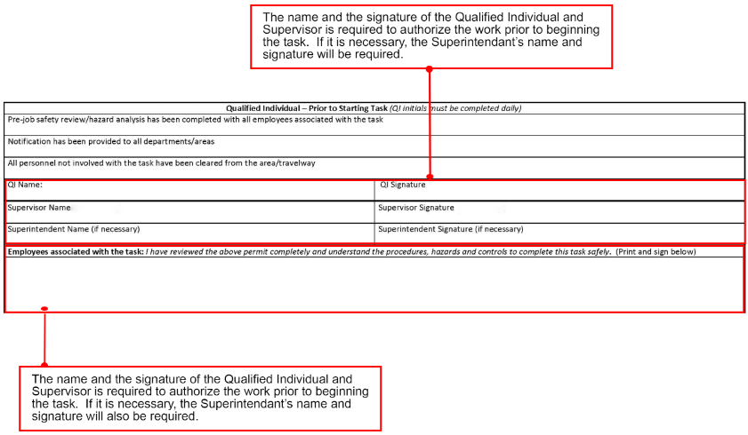
SG 49
Qualified Individual
Notes:
SG page 49
Instruction
Discuss the information in the red boxes

Slide 82
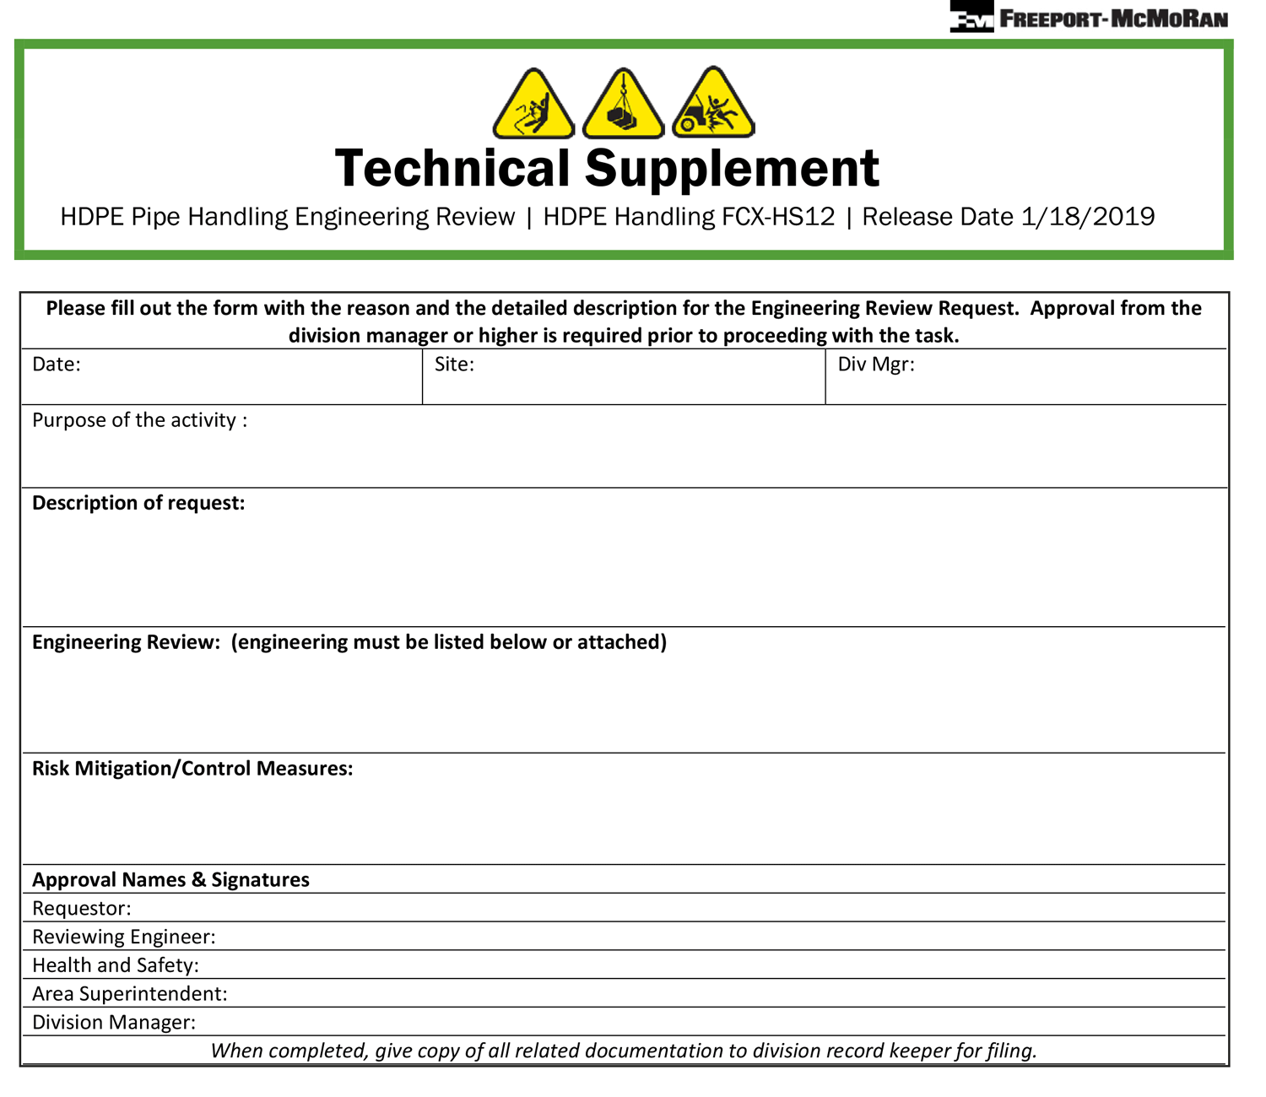
SG 50
HDPE Pipe Handling Engineering Review
Notes:
SG page 50
Instruction
Depending on the task being performed, an Engineering Review may be required
For specific tasks where the policy covers the general safe practices, but does not cover the details of the engineering
May be used for the following situations:
Pulling pipe of any diameter that is longer than 400-feet
Pulling pipe up or down grades greater than 25%
Pushing pipe
Tasks involving dual-walled or dual-contained pipe
Fusing pipe that is not consistent or without manufacturer specifications or ASTM standards
Pulling or fusing pipe 42 inch in diameter or greater
All manufacturer and company-defined safety standards must be used
Details of the engineering review must be:
Attached to the request or be readily available if an attachment is not practical
Retained according to the FCX Records Retention Policy

Slide 83
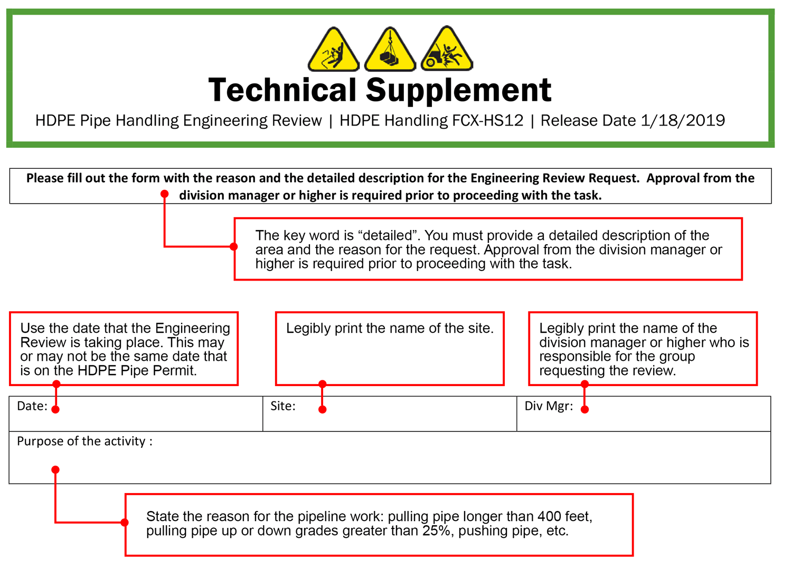
SG 51
Initial Information
Notes:
SG page 51
Instruction
Discuss the information in the red boxes

Slide 84
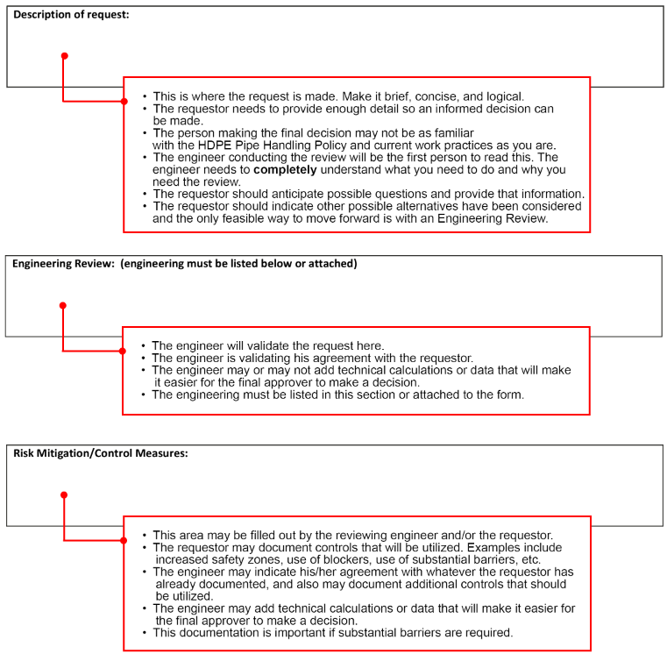
SG 52
Description·Review·Controls
Notes:
SG page 52
Instruction
Discuss the information in the red boxes

Slide 85
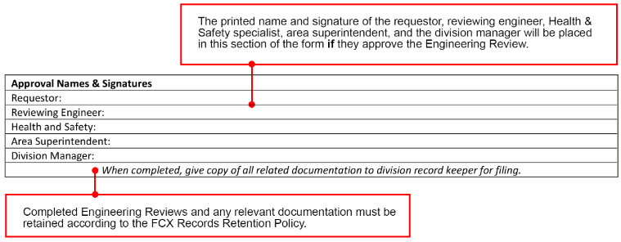
SG 53
Approvals
Notes:
SG page 53
Instruction
Discuss the information in the red boxes

Slide 86

SG 54
HDPE Pipe Receiving/Loading/Unloading Checklist
Notes:
SG page 54
Instruction
An HDPE Pipe Receiving/Loading/Unloading Checklist must be:
Completed prior to receiving, loading, or unloading HDPE Pipe
Reviewed by all employees associated with the task
Signed by all personnel involved with the task in the appropriate locations
HDPE Pipe must be shipped according to company shipping requirements
Located in the HDPE Pipe Shipping Requirements document
Arriving loads not compliant with the HDPE Pipe Shipping Standards require the following:
Additional evaluation
Superintendent approval prior to unloading as indicated on the checklist
A reporting system for communicating improper loads to GSC

Slide 87

SG 55
Initial Information
Notes:
SG page 55
Instruction
Discuss the information in the red boxes

Slide 88

SG 55
Part 1 – HDPE Pipe Load Checklist
Notes:
SG page 55
Instruction
Discuss the information in the red boxes

Slide 89

SG 56
Part 2 – HDPE Pipe Load Checklist
Notes:
SG page 56
Instruction
Discuss the information in the red boxes

Slide 90

SG 57
Part 2 – HDPE Pipe Load Checklist cont’d
Notes:
SG page 57
Instruction
Discuss the information in the red boxes

Slide 91

SG 57
Part 2 – HDPE Pipe Load Checklist cont’d
Notes:
SG page 57
Instruction
Discuss the information in the red boxes

Slide 92

SG 58
Part 3 – HDPE Pipe Load Checklist
Notes:
SG page 58
Instruction
Discuss the information in the red boxes

Slide 93

SG 58
Part 3 – HDPE Pipe Load Checklist cont’d
Notes:
SG page 58
Instruction
Discuss the information in the red boxes

Slide 94

SG 59
Part 3 – HDPE Pipe Load Checklist cont’d
Notes:
SG page 59
Instruction
Discuss the information in the red boxes

Slide 95

SG 60
Part 3 – HDPE Pipe Load Checklist cont’d
Notes:
SG page 60
Instruction
Discuss the information in the red boxes

Slide 96

SG 61
Part 3 – HDPE Pipe Load Checklist cont’d
Notes:
SG page 61
Instruction
Discuss the information in the red boxes

Slide 97

SG 62
Part 3 – HDPE Pipe Load Checklist cont’d
Notes:
SG page 62
Instruction
Discuss the information in the red boxes

Slide 98
SG 63
Circle Up
Directions
Complete this activity by circling the correct section within the Pipe Handling Permit you would find these questions.
Activity 4
Notes:
SG page 63
Time
Approximately 10 minutes
Materials
SG page 63
Pen/Pencil
Purpose
This activity gives students the opportunity to individually process the materials just discussed. They will be able to review the sections of the Pipe Handling Permit.
Instruction
This activity is completed individually.
Complete this activity by circling the correct location within the Pipe Handling Permit that you would find these questions.
Take time to go over the answers (slide 115-116) with them before going into the module quiz.
Answers
5
4
5
2
2
1
4
3
2
Note: Include directions that recognize varying class sizes by doing one of the following
Provide an activity where class size does not matter
Incorporate suggestions to alter the given activity for larger and smaller than anticipated class sizes
Provide alternate activity for larger and smaller than anticipated class sizes]

Slide 99
SG 64
Module 3 Quiz
Directions
Complete the quiz in the Student Guide (p. 64)
Discuss the answers as a class
Quiz
Notes:
SG page 64
Instruction
Give students time to write answers to the quiz questions in the SG
Review the answers as a class using the slides

Slide 100
SG 64
Module 3 Quiz
Only portions of the Pipe Handling Permit, which apply to the task being performed, need to be completed.
  True
  False
Notes:
SG page 64
Instruction
Discuss answer as a class
Click to circle the answer
Quiz Answer
a, SG page 40

Slide 101
SG 64
Module 3 Quiz
When must the Pipe Handling Engineering Review be used? (Circle all that apply)
  Every time the Permit is used
  When pushing the pipe is the only alternative
  When pipes are dual-contained or dual-walled
  Pulling or fusing pipe ≥ 42 inches in diameter
  When the pipe handling job has scenarios not covered in the Policy
Notes:
SG page 64
Instruction
Discuss answer as a class
Click to circle the answer
Quiz Answer
b, c, d, SG page 50

Slide 102
SG 64
Module 3 Quiz
When must a HDPE Pipe handling permit be completed? (Circle all that apply)
  When unrolling HDPE Pipe coils
  When HDPE Pipe is being loaded and unloaded
  Any time you are working with HDPE Pipe regardless of length
  When performing any work with HDPE Pipe 2 inches in diameter or larger and longer than 50 feet
Notes:
SG page 64
Instruction
Discuss answer as a class
Click to circle the answer
Quiz Answer
a, d, SG page 40

Slide 103
Debrief
What are some key concepts learned in this module?
What do you need to understand better?
What information surprised you?
Notes:
SG N/A
Instruction
Discuss questions on slide

Slide 104
Module 4: Rigging
Notes:
SG page 67
Instruction
Review learning objectives for the module
Upon completion of this module, students will be able to
Describe the proper procedures required to safely pull various sizes and lengths of HDPE Pipe according to policy requirements
Identify the proper equipment required for the task
Identify appropriate forms for the tasks that will be performed and describe how to fill out these forms correctly

Slide 105

Pulling/Moving HDPE Pipe
Notes:
SG page N/A
Instruction
Click on the link to play video
https://web.microsoftstream.com/video/e7a8465a-2e73-4683-9069-31d173717d6d

Slide 106
SG 69
Pulling Pipe Versus Pushing Pipe
Ways to move pipe from one location to another:
  Pushing
  Pulling
  Positioning
Notes:
SG page 69
Instruction
Ways to move the pipe from one location to another on a property
Pulling Pipe
Pushing Pipe
Final Positioning of Pipe
Each have their specific hazards associated due to:
Control, or
Lack of control, of the stored energy that can be created during the process of moving

Slide 107

SG 69
Pulling Pipe Versus Pushing Pipe
Pulling
Notes:
SG page 69
Instruction
Requires connection to a large piece of equipment that can handle the amount of weight associated with pulling the pipe to where it will be needed to complete a job
Specific planning is needed to determine the appropriate rigging assemblies that will need to be used
Technical supplements are provided in FCX-HS12 to guide this planning process

Slide 108
SG 69-70
Pulling Pipe Versus Pushing Pipe
Pushing
Notes:
SG pages 69-70
Instruction
Requires the appropriate equipment to move the pipe from behind or alongside the pipe, moving it a significant distance to the desired location
According to FCX-HS12, pulling will be used over pushing wherever possible due to the additional hazards created when pushing
Pushing pipe requires an Engineering Review before it can be performed

Slide 109

SG 70
Pulling Pipe Versus Pushing Pipe
Positioning, or Final Positioning
Notes:
SG page 70
Instruction
Different than pushing or pulling
Can be as simple as using a piece of equipment to nudge the pipe into the desired position as needed for the job
Potential stored energy could still create a risk to the employee, so careful planning should still take place before commencing positioning, or Final Positioning

Slide 110



SG 71-72
Learn from Others
Notes:
SG pages 71-72
Instruction
Read this situation to the class
Ask these questions:
What went wrong?
Could they have done something differently to get a different outcome? What could they have done differently?
If you were part of this crew, would you have had any questions before starting the job? What are those questions?

Slide 111
SG 73
Pulling Pipe Criteria
Pulling over pushing when possible
HDPE Pipe Handling Permit Required
Established procedures and controls
Notes:
SG page 73
Instruction
Pulling over pushing when possible due to additional hazards created when pushing
An HDPE Pipe Handling permit is required to be completed prior to pulling pipe that meet this criteria:
Greater than or equal to (≥) 2 inches in diameter, and
Greater than (>) 50 feet
Sites must establish procedures and controls, such as rigging equipment, for pulling pipe that meet this criteria:
Greater than or equal to (≥) 2 inches in diameter, and
Less than (<) 12 inches in diameter

Slide 112
SG 73
Restrictions
Pulling pipe up or down an incline
Notes:
SG page 73
Instruction
Sometimes it is necessary to pull pipe up or down an incline
An Engineering Review is required for:
Pulling pipe up or down grades greater than 25%
Pulling pipe that is longer than 400 feet regardless of diameter

Slide 113


SG 74
Rigging
Approved Rigging Assemblies Technical Supplements
Approved rigging form
HDPE Pipe 12 inches in diameter and larger
Notes:
SG page 74
Instruction
Approved Rigging Assemblies Technical Supplements provide details for:
Approved rigging that may be used for pulling pipe 12 inches in diameter and greater
Rigging for pulling pipe that is greater than or equal to 2 inches in diameter and less than 12 inches in diameter must be defined in site procedures
Rigging forms
Completed and approved are located on the DOHS SharePoint under the HDPE Pipe Handling folder
Not in the approved folder, the rigging approval request must be completed and approved prior to use
HDPE Pipe 12 inches in diameter and larger
Site shall use approved pipe rigging as defined in the HDPE Pipe Handling folder on the DOHS SharePoint
If desired rigging is not listed, the HDPE Pipe Rigging Approval Request must be completed prior to using
Rigging for pulling pipe that is greater than or equal to 2 inches in diameter and less than 12 inches in diameter must be defined in site procedures

Slide 114


SG 74-75
Rigging
Rigging for multiple uses
Use of a sling as a “choker”
Pipe slotting
Notes:
SG pages 74-75
Instruction
Rigging for multiple uses
Ones for multiple uses must have:
Approval request submitted to the Company PSST for approval
Approved rigging
Once rigging has been used for pulling pipe, it cannot be used for any other tasks other than pulling
Rigging that has been used for pulling cannot be used for lifting
Rigging must be marked to indicate what it has been used for to eliminate any confusion
Sling as a “choker”
Not acceptable for pulling HDPE Pipe 12 inches in diameter or larger
Including pulling lengths of pipe while fusing in a laydown area
Is acceptable to use a sling to lift and position pipe (positioning a pipeline in a fusing machine or removing it from the machine)
Pipe slotting
Pipe slotting (cutting a slot or shape into the pipeline to be used as an anchor point) is not acceptable for any pipe pulls regardless of diameter and length
All equipment used for pulling HDPE Pipe will meet the pulling force requirements for the pull along with adhering to the rigging assembly specifications within the technical supplements

Slide 115
SG 75
Standard Dimension Ratio (SDR)
SDR
Correlation (dimension and thickness)
Lower SDR
Higher SDR
Weight to be supported
Notes:
SG page 75
Instruction
SDR term used when discussing the geometry of the HDPE Pipe and when rating piping pressure
Correlation between the pipe dimension and the thickness of the pipe wall
“A lower SDR ratio indicates that the pipe has a high-pressure rating because the pipe wall is thick compared to its diameter”
“A higher SDR ratio indicates that the pipe wall is thin compared to its diameter and therefore has a low-pressure rating”
SDR is used to determine the weight that the rigging and equipment must support (if needed, the references are in Student Guide, page 101)

Slide 116

SG 76
Proper Layout and Attachment
Step 1
Level one text
  Level two text
  Level two text
Level one text
Notes:
SG page 76
Instruction
The following is a step-by-step illustration for the proper layout and attachment of the rigging devices to the pipe and towing equipment for pulling HDPE Pipe stringer
Pipe shown has a 20 inch Nominal Pipe Diameter and a Pipe SDR Rating of 17.00
Table 2 from the Pipe Pulling Force Technical Supplement will be used to determine the pulling force for this pipe
Equipment will be able to pull the pipe up to a 25% grade
Pulling force is listed as 12,500 pounds
Scenario:
Use Rigging Assembly F
Assembly has a total working load limit of 50,000 lbs
From the chart on page 2 of the Rigging Assembly F Technical Supplement, rigging is approved for this scenario
Step 1:
Ensure the pipe has been secured to prevent it from moving
Lay out the center of the 2 inch or 2.5 inch diameter holes 10 inch from the end of the pipe
Two holes will be drilled on opposite sides of the pipe from each other

Slide 117



SG 76-77
Proper Layout and Attachment
Step 2
Level one text
  Level two text
  Level two text
Level one text
Notes:
SG pages 76-77
Instruction
Step 2:
Drill the (2) 2 inch or 2.5 inch holes in each side of the pipe
A 2 inch or 2.5 inch Composite Core drill bit is recommended for this task
Both holes are now drilled in the end of the pipe

Slide 118

SG 78
Proper Layout and Attachment
Step 3
Level one text
  Level two text
  Level two text
Level one text
Notes:
SG page 78
Instruction
Step 3:
Install first 2-inch shackle onto pipe
Insert shackle pin from the outside
Shackle weight is approximately 60 pounds
Get assistance when needed
Remember to use proper lifting techniques, watch for pinch points, and not drop shackles

Slide 119

SG 78
Proper Layout and Attachment
Step 4
Level one text
  Level two text
  Level two text
Level one text
Notes:
SG page 78
Instruction
Step 4:
Install the retainer in the shackle pin
Always install shackle pin so that retainer is on the inside to avoid damage

Slide 120

SG 79
Proper Layout and Attachment
Step 5
Level one text
  Level two text
  Level two text
Level one text
Notes:
SG page 79
Instruction
Step 5:
Thread a UTS10-95T x 5 foot round sling through the eyes in the end of the shackles

Slide 121

SG 79
Proper Layout and Attachment
Step 6
Level one text
  Level two text
  Level two text
Level one text
Notes:
SG page 79
Instruction
Step 6:
Install the remaining shackle on the other side
Repeat steps 3 and 4

Slide 122

SG 80
Proper Layout and Attachment
Step 7
Level one text
  Level two text
  Level two text
Level one text
Notes:
SG page 80
Instruction
Step 7:
Install a 1.5-inch screw pin shackle through the eyes of the sling
Connect the shackle to the eye of the 15 ton swivel
Connect the other end of the 15 ton swivel to the 1.5-inch master link

Slide 123

SG 81
Proper Layout and Attachment
Step 8
Level one text
  Level two text
  Level two text
Level one text
Notes:
SG page 81
Instruction
Step 8:
The completed rigging can now be attached to the towing vehicle
Be sure the tow vehicle being used has sufficient towing capacity for the load being pulled
This picture shows two clevises being used to anchor to the pulling equipment
Anchoring combinations may be used as long as they meet the minimum working load limit of an approved rigging assembly
This picture shows Assembly D with a working load limit of 50,000 pounds pulling capacity as defined in the technical supplement

Slide 124

SG 81
Proper Layout and Attachment
Step 9
Level one text
  Level two text
  Level two text
Level one text
Notes:
SG page 81
Instruction
Step 9:
When all connections are complete and all personnel are clear of the equipment, the pipe can be moved
This picture shows a completed pulling assembly secured to the pulling equipment.
Anchoring combinations may be used as long as they meet the minimum working load limit of an approved rigging assembly
Pulling equipment may have different anchor points to attach the pulling assembly
This picture shows Assembly D with a working load limit of 50,000 pounds pulling capacity as defined in the technical supplement

Slide 125
SG 82
Pipe Bending
Creates additional stored energy
Things to consider
Notes:
SG page 82
Instruction
Pipe bending creates additional stored energy
The following must be considered when completing tasks:
Minimum safe distances are determined
Substantial barriers are provided when needed
Appropriate equipment is selected

Slide 126
SG 82
Pipe Pull Requirements and Allowances
Designated Blocking Equipment
Pulling Force
Working Load Limit
Notes:
SG page 82
Instruction
Designated Block Equipment
Only equipment allowed to pass the pipe being pulled
To set up blocks along the path of travel
Pipe is no longer in motion
Proper passing communication procedures are followed
Pulling Force
Is the amount of force required to pull the pipe based on the task conditions (i.e., diameter of pipe, SDR rating of pipe, and grade that the pipe will be moved)
Required for a specific task can be found on Table 1 or 2 of the Pipe Pulling Force Technical Supplement
If the pulling force required exceeds those found in Table 1 or 2, then an Engineering Review will be required
Working Load Limit
Maximum rated pulling force that can be applied to the rigging equipment (i.e., “Rigging Assembly A” HDPE Fused Pulling Head, 5-Ton Swivel has a working Load Limit of 16,667 pounds)
Never exceed the working load limit of the rigging assemblies

Slide 127


SG 82-83
Pipe Pull Requirements and Allowances
Pipe Pulling Escorts
Flashing Blue Light
Notes:
SG pages 82-83
Instruction
Pipe Pulling Escorts
A Lead Escort and Trail Escort are required for:
Pulling pipe
There is the potential for interaction with other traffic
Blocking is required any time other traffic could enter the path of the pipe pull
Examples of blocking include
Equipment with an operator blocking the road
Appropriate use of flagging and/or barricading
Two-way traffic
Allowed if roads wide enough to maintain 50-foot safe zone around pipe
Establish controls within the lane of travel
Superintendent approval is needed for two-way traffic pulls
Flashing Blue Light
Required on all equipment involved with pulling pipe where there is the potential for interaction with other traffic
Must be easily visible during daylight hours

Slide 128

SG 83-84
HDPE Pipe Pulling Force
Information Provided
Use with Approved Rigging Assemblies
Notes:
SG pages 83-84
Instruction
The specific technical supplements that will be included in this module are:
Pipe Pulling Force
Approved Rigging Assemblies (A-F)
Push/Pull/Positioning Illustrations
Rigging Approval Request
There are exercises with scenarios to help all interact with these documents and get used to working with them.
The first one is the Pipe Pulling Force:
Provides pulling force requirements over a range of pipe diameters and SDR ratings
Pulling forces are based on pulling an empty 400-foot pipeline with a 0.8 coefficient of friction up a 17.5% grade (Table 1) and up a 25% grade (Table 2)
Designed to be used in conjunction with the Approved Rigging Assemblies to:
Assist in determining the appropriate rigging
Associated equipment that can be used to safely perform the task

Slide 129

SG 85
Table 1
Grade is 17.5% or less
Notes:
SG page 85
Instruction
Table 1 is used for pulling pipe when the grade is 17.5% or less

Slide 130

SG 85
Table 2
Grade is 25% or less
Notes:
SG page 85
Instruction
Table 2 is used for pulling pipe when the grade is 25% or less
Ask the following questions. Discuss the answers, if needed.
What is the pipe pulling force for 16-inch pipe with SDR of 19 on a 25% grade?__________
What is the pipe pulling force for 20-inch pipe with SDR of 15.5 on a 17.5% grade? ________

Slide 131

SG 86-87
Approved Rigging Designs
Subheading
Level one text
  Level two text
  Level two text
Level one text
Notes:
SG pages 86
Instruction
The approved rigging designs for pulling HDPE Pipe are located on the DOHS SharePoint under H&S Policies, HDPE Pipe Handling
Each assembly consists of a two page document
First page of the document gives details about the assembly such as:
The name of the rigging assembly - this is new to the technical supplement which helps to identify the rigging assembly
Working load limit
Results of the engineering review including a diagram of the assembly
Parts list

Slide 132

SG 87
Assembly A Fused Head, 5-Ton Swivel
Subheading
Level one text
  Level two text
  Level two text
Level one text
Notes:
SG page 87
Instruction
This is one of the six currently approved rigging designs

Slide 133

SG 88
Assembly B Single 1 ½” Skookum Shackle, Bushing
Subheading
Level one text
  Level two text
  Level two text
Level one text
Notes:
SG page 88
Instruction
This is one of the six currently approved rigging designs

Slide 134

SG 89
Assembly C Fused Pulling Head, 15-Ton Swivel
Subheading
Level one text
  Level two text
  Level two text
Level one text
Notes:
SG page 89
Instruction
This is one of the six currently approved rigging designs

Slide 135

SG 90
Assembly D Two 1 ½” Skookum Shackles, 15-Ton Swivel
Subheading
Level one text
  Level two text
  Level two text
Level one text
Notes:
SG page 90
Instruction
This is one of the six currently approved rigging designs

Slide 136

SG 91
Assembly E Two 1 ½”, 2” Sch Bushing, 15-Ton Swivel
Subheading
Level one text
  Level two text
  Level two text
Level one text
Notes:
SG page 91
Instruction
This is one of the six currently approved rigging designs

Slide 137

SG 92
Assembly F Two 2” Skookum Shackles, 15-Ton Swivel
Subheading
Level one text
  Level two text
  Level two text
Level one text
Notes:
SG page 92
Instruction
This is one of the six currently approved rigging designs

Slide 138

SG 93
Scenario Example
What assemblies can be used to pull a 30-inch pipe with an SDR rating of 26 up a grade of 16%?
Level one text
  Level two text
  Level two text
Level one text
Notes:
SG page 93
Instruction
To answer this question
Use the Pipe Pulling Force document to determine the pipe pulling force for the scenario
The pipe is being pulled up a grade of 16%, use Table 1
Based on the information provided:
30-inch pipe with an SDR of 26
Pipe pulling force is 17,700 lbs
Rigging assemblies A and B have a working load limit of 16,667 lbs. which is less than the requirement of 17,700 lbs
Neither of these assemblies can be used
Rigging assemblies C, D, E, and F have working load limits of 50,000 lbs
These are potential rigging assemblies for this job
Determine which of these assemblies can be used
Look at the charts on page 2 of the Technical Supplements for each assembly
Charts determine if the assembly can be used by considering factors other than the working load limit such as the wall thickness of the pipe

Slide 139

SG 94
Rigging Approval Request
Notes:
SG page 94
Instruction
For rigging not in the approved folder on the DOHS SharePoint, a Rigging Approval Request must be completed and approved prior to use
The HDPE Pipe Handling Rigging Approval Request provides the details of the rigging used to pull pipe 12 inches in diameter and greater

Slide 140

SG 95
Initial Information
Notes:
SG page 95
Instruction
Discuss the information in the red boxes

Slide 141

SG 95
Engineering Review and Summary
Notes:
SG page 95
Instruction
Discuss the information in the red boxes

Slide 142

SG 96
Shackle
Notes:
SG page 96
Instruction
Discuss the information in the red boxes

Slide 143

SG 96
Assembly Description and Diagram
Notes:
SG page 96
Instruction
Discuss the information in the red boxes

Slide 144

SG 97
Parts List
Notes:
SG page 97
Instruction
Discuss the information in the red boxes

Slide 145

SG 97
Approvals
Notes:
SG page 97
Instruction
Discuss the information in the red boxes

Slide 146

SG 98-100
Pipe Handling Illustrations
Notes:
SG pages 98-100
Instruction
The Pipe Handling Illustrations document demonstrates the differences between HDPE Pipe pulling, pushing, and positioning

Slide 147
SG 101
Plan It Out
Directions
Fill in the chart using the HDPE Pipe Pulling Force and Approved Rigging Assembly Technical Supplements.
List all of the rigging assemblies that can be used for each scenario.
Activity 5
Notes:
SG page 101
Time
Approximately 10 minutes
Materials
Student Guide
Pen/Pencil
HDPE Pipe Pulling Force chart
Approved Rigging Assembly Technical supplements
Purpose
This activity gives students the opportunity to practice planning for the working load limits and choosing an appropriate Rigging Design.
Instruction
Have the students fill in the chart on page 101 using HDPE Pipe Pulling Force and Approved Rigging Assembly Technical Supplements.
Go over the answers with them when they have completed the activity.
Answers:
WL= 35,400; Rigging = C, D, E, & F
WL= 37,500; Rigging = C, D, E, & F
WL= 21,000; Rigging = C, D, E, & F
WL= 16,200; Rigging = A & B
WL= 28,900; Rigging = C, D, E, & F
N/A- Engineering Review Required
[Note: Include directions that recognize varying class sizes by doing one of the following
Provide an activity where class size does not matter
Incorporate suggestions to slightly alter the given activity for larger and smaller than expected class sizes
Provide alternate activity for larger and smaller than expected class sizes]

Slide 148
Debrief
What are some key concepts learned in this module?
What do you need to understand better?
What information surprised you?
Notes:
SG N/A
Instruction
Discuss questions on slide

Slide 149
Module 5: Fusing and Data Loggers
Notes:
SG page 105
Instruction
Review learning objectives for the module
Upon completion of this module, students will be able to
Identify the hazards associated with fusing, installation, and repair of HDPE Pipe as they relate to the FCX-HS12 policy and describe the proper procedures in place to mitigate those hazards

Slide 150

SG 107-108
Fusing Machines
Stored Energy
HDPE Pipe Handling Permit
Significant Bends
Banding Clamps
Specifications and Standards
Notes:
SG pages 107-108
Instruction
Stored energy sources
Must be considered and controlled when loading and unloading pipe from a fusing machine
Documented procedures will be established for fusing, installing, and repairing HDPE Pipe, in accordance with Policy expectations
An HDPE Pipe Handling Permit is required:
For tasks involving fusing, installation, and/or repair for HDPE Pipe 2 inches in diameter and greater
Where the final result of the task creates a pipe longer than 50 feet
Significant Bends
A Qualified Individual must review tasks involving cutting pipe with significant bends
A pre-job safety meeting will also be held to discuss hazards and precautions, and to determine safe distances, substantial barriers, and adequate equipment to perform the task safely
Banding Clamps
It is important to remember banding clamps are not designed to splice the ends of two pipes together, and cannot prevent axial pipe movement
Pipes should be fused or secured with a coupling designed for this application
Specifications and Standards
Manufacturer specifications and applicable ASTM standards for fusing must be followed at all times
If the specifications cannot be followed, or they do not exist for the pipe being used, an Engineering Review is required
This includes the use of recycled HDPE Pipe

Slide 151
SG 108
Recording the Data – Data Loggers
When data logging is used
Why data logging is used
Notes:
SG page 108
Instruction
When data logging is used
Data logging is required on all HDPE Pipe fuses involving HDPE Pipe 12 inches in diameter and greater
Data logging on HDPE Pipe at smaller diameters is at site discretion, and should be considered in critical areas (such as high pressure installations, long-term installations, etc.)
Data review process is at the discretion of each site
Data logging does not guarantee the quality of a fuse
Why data logging is used
A tool that assists operators with the pipe fusing process by providing fuse specifications and real-time process information for each fuse
Helps to increase the likelihood of fuses meeting required specifications
When fusing HDPE Pipe, there is specific information that must be captured and recorded
This course is not designed to teach this process, as that will come in a later course
It is important, though, to know what FCX-HS12 says about recording this data

Slide 152
SG 108
Hands-On Training
Further HDPE education
Notes:
SG page 108
Instruction
As per company need,
Employees who take this class will continue their HDPE education within their sites
Data Logging and Fusing will be separate classes that focus on the specific skills needed in those areas
Going through this class does not qualify employees to work with the Data Loggers, nor to work with the fusing machines and fusing process
If you have further questions, please contact your supervisor or training representative

Slide 153
SG 109-110
Arm Chair Quarterback
Directions
Partner up with another student
Read the “Learn From Others” scenario on SG p. 110
Discuss the results from the investigation found in the table
Use the questions on SG p. 109 to guide your discussion
Activity 6
Notes:
SG pages 109-110
Time
Approximately 10 minutes
Materials
Student Guide
Pen/Pencil
Purpose
This activity gives students the opportunity to use the information they have learned so far in analyzing a fatal scenario.
Instruction
Ask the students to pair up with a partner and read the scenario in their Student Guide, page 110
When finished reading the scenario, ask them to look at the breakdown of the investigation, Student Guide page 109 (Root Cause, Corrective Action)
These are the questions they should be asking and taking notes on, so as to discuss as a class:
Do you agree with the findings? Did you think that anything else should have been included?
If you were part of this team planning the job, what would you have done differently to ensure a safer outcome?
Take notes below and be ready to discuss briefly with the class

Slide 154
SG 111
Module 5 Quiz
Directions
Complete the quiz in the Student Guide (p. 111)
Discuss the answers as a class
Quiz
Notes:
SG page 111
Instruction
Give students time to write answers to the quiz questions in the SG
Review the answers as a class using the slides

Slide 155
SG 111
Module 5 Quiz
Stored energy sources must be considered and controlled when loading and unloading pipe from a fusing machine.
  True
  False
Notes:
SG page 111
Instruction
Discuss answer as a class
Click to circle the answer
Quiz Answer
a, SG page 107

Slide 156
SG 111
Module 5 Quiz
An HDPE Pipe Handling Permit is required for tasks involving fusing, installation, and/or repair for 2 inch diameter and greater HDPE Pipe where the final result of the task creates a pipe longer than 50 feet.
  True
  False
Notes:
SG page 111
Instruction
Discuss answer as a class
Click to circle the answer
Quiz Answer
a, SG page 107

Slide 157
SG 111
Module 5 Quiz
An Engineer must review tasks involving cutting pipe with significant bends.
  True
  False
Notes:
SG page 111
Instruction
Discuss answer as a class
Click to circle the answer
Quiz Answer
b, SG page 107

Slide 158
SG 111
Module 5 Quiz
Banding clamps are designed to splice the ends of two pipes together.
  True
  False
Notes:
SG page 111
Instruction
Discuss answer as a class
Click to circle the answer
Quiz Answer
b, SG page 108

Slide 159
SG 111
Module 5 Quiz
Manufacturer specifications and applicable ASTM standards for fusing must be followed at all times.
  True
  False
Notes:
SG page 111
Instruction
Discuss answer as a class
Click to circle the answer
Quiz Answer
a, SG page 108

Slide 160
SG 111
Module 5 Quiz
Data Logging guarantees quality fusing of HDPE Pipe.
  True
  False
Notes:
SG page 111
Instruction
Discuss answer as a class
Click to circle the answer
Quiz Answer
b, SG page 108

Slide 161
Debrief
What are some key concepts learned in this module?
What do you need to understand better?
What information surprised you?
Notes:
SG N/A
Instruction
Discuss questions on slide

Slide 162
Module 6: Audits and Training
Notes:
SG page 115
Instruction
Review learning objectives for the module
Upon completion of this module, students will be able to
Define the roles and responsibilities of the Corporate and site Pipe Safety Steering Teams
Explain the training requirements needed to safely handle or participate in the handling of HDPE Pipe

Slide 163
SG 117
Corporate Team
Pipe Safety Steering Team (PSST)
Members
Visits
Meetings
Notes:
SG page 117
Instruction
Pipe Safety Steering Team (PSST)
Comprised of representatives from each area/site affected by this policy
Oversees the policy for each FCX business unit, and a site team ensures best practices are being followed at each site
Evaluates existing standards, set new guidelines, and monitor site performance
Members
Will consist of these Freeport-McMoRan Inc. employees:
Sponsor – Manager, GM, or Director Level
Lead – Superintendent or Manager Level
Site Champions
Global Sourcing Representative
Health and Safety Representative
Engineering Representative
Training Representative
Visits
Annual site visits at each branch to:
Monitor compliance
Look for best practices
Provide feedback for improvement
Include compliance with this policy, training, procedures, and field practices
Meetings
Quarterly meetings
All members review practices and make recommendations for change where needed
Changes to the current policy and appendices must:
Go through a formal approval process with the PSST
Be brought back to site teams for implementation

Slide 164
SG 117
Site Teams
Members
Field Audits
Notes:
SG page 117
Instruction
Members
Comprised of the following Freeport-McMoRan Inc. employees:
The Site Champion (member of the company’s PSST)
Engineering Representative
Global Sourcing Representative
Health and Safety Representative
Representative from Each Affected Area
Field Audits
Conducted by Site Teams to:
Ensure pipe handling practices are being followed
Identify any improvement opportunities
Take place at minimum once per quarter

Slide 165
SG 118
Low-Frequency Usage Sites
Use other sites
Implement Policy
Notes:
SG page 118
Instruction
Sites that handle HDPE Pipe on a minimal basis or as part of short duration projects will:
Utilize expertise from other sites to assist with review of the project
Implement the policy prior to work commencing

Slide 166
SG 118
Training
Training Format
Refresher
Notes:
SG page 118
Instruction
All employees and contractors who handle or participate in the handling of HDPE Pipe must be trained on this policy
Training includes the hazards associated with the handling of HDPE Pipe and how to effectively complete the forms associated with the policy
Training Format
Interactive
Consist of classroom
Video
Field demonstration of the task
Employees must demonstrate competency (both verbal and visual) to assess understanding
Existing site documents and skills assessment formats may be utilized, but must include the skills listed in the FCX Skills Assessments
Refresher
All employees trained on this policy must receive refresher training every year
At a minimum, the training will include the key elements listed in this section:
Use of the HDPE Pipe Handling Permit
Determination of safe distances to position employees from pipe during movement or after movement and proper use of substantial barriers
Review by a qualified individual of piping that is found to contain residue or solution
Specific rigging task training for pipe handling and pulling
Unloading, loading, and storage of HDPE Pipe
HDPE Pipe pulling and handling
Fusing HDPE Pipe
Inspections of pipe and prevention of hazards and failures
Incident review and potential hazards and problem areas
Mobile equipment used for HDPE Pipe handling

Slide 167
SG 119
Training
Skills Assessment
Documentation
Records
Notes:
SG page 119
Instruction
Skills Assessments will be used for determining qualified individuals on a task-basis
Sites will utilize site specific training as well as the skills assessments developed by the PSST to evaluate individuals and verify competency prior to working with HDPE Pipe
Skills shall include:
Hazard identification
Hazard control procedures
Safe operation of equipment
Skills assessments will be utilized to qualify individuals to:
Train/mentor others
Perform tasks
Complete permits for the areas listed below:
HDPE Pipe Handling Policy
HDPE Pipe Handling Permit
General Equipment HDPE Pipe Handling
General Pipe Selection and Identification
HDPE Pipe Unloading, Loading, and Storage
Pulling Pipe
Rigging Equipment
Pipeline PM and Inspection
HDPE Pipe Unrolling
Flow Isolation and Distribution
Fusing and Fusing Equipment
Documentation
All training will be documented, including a training matrix with employee skills, and will be kept readily available/accessible
Records
The following records must be retained according to the FCX Records Retention Policy:
HDPE Pipe Handling Permits
HDPE Pipe Handling Engineering Reviews
HDPE Pipe Loading/Unloading Checklist
HDPE Pipe Handling Rigging Approval Requests

Slide 168
SG 120
Frequently Asked Questions
Directions
Pick a partner
Together, discuss and write answers to the Frequently Asked Questions
Use the policy as your guide for answering the questions
Be ready to discuss your answers with the class
Activity 7
Notes:
SG page 120
Time
Approximately 10 minutes
Materials
Student Guide
Policy
Pen/Pencil
Purpose
This activity gives students the opportunity to apply their knowledge of FCX-HS12 to find answers.
Instruction
Have students pair up
Have the students use their Policy (FCX-HS12) to answer these questions
Answers:
Policy 3.2 & Technical Supplements
Policy 3.2 & Technical Supplements
Policy 3.2 & Technical Supplements
Policy 2.1
Policy 2.0 & 2.1
Policy 3.1 & Receiving/Loading/Unloading Checklist
Policy 5.0

Slide 169
SG 121
Module 6 Quiz
Directions
Complete the quiz in the Student Guide (p. 121)
Discuss the answers as a class
Quiz
Notes:
SG page 121
Instruction
Give students time to write answers to the quiz questions in the SG
Review the answers as a class using the slides

Slide 170
SG 121
Module 6 Quiz
What does PSST stand for?
P______ S______ S______ T______
Notes:
SG page 121
Instruction
Discuss answer as a class
Click to circle the answer
Quiz Answer
Pipe Safety Steering Team, SG page 117

Slide 171
SG 121
Module 6 Quiz
The Corporate PSST is responsible to do the following: (Circle all that apply)
  Oversee the policy for each FCX business unit
  Site visits
  Field Audits
  Identify site improvement opportunities
  Monitor compliance with FCX-HS12
  Annual Site Audits
Notes:
SG page 121
Instruction
Discuss answer as a class
Click to circle the answer
Quiz Answer
a, b, e, f, SG page 117

Slide 172
SG 121
Module 5 Quiz
The Site PSST is responsible to do the following: (Circle all that apply)
  Oversee the policy for each FCX business unit
  Site visits
  Field Audits
  Identify site improvement opportunities
  Monitor compliance with FCX-HS12
  Quarterly Site Audits
Notes:
SG page 121
Instruction
Discuss answer as a class
Click to circle the answer
Quiz Answer
c, d, e, f, SG page 117

Slide 173
SG 121
Module 5 Quiz
Once you are trained to FCX-HS12, how often will you need to take a refresher training?
  Quarterly
  Annually
  Biannually
  Monthly
Notes:
SG page 121
Instruction
Discuss answer as a class
Click to circle the answer
Quiz Answer
b, SG page 118

Slide 174
Debrief
What are some key concepts learned in this module?
What do you need to understand better?
What information surprised you?
Notes:
SG N/A
Instruction
Discuss questions on slide

Slide 175
Conclusion
Notes:
SG N/A
Instruction
The conclusion covers
Course review
Assessments
Student Course Evaluation
Facilitator Course Evaluation

Slide 176
SG 133
Conclusion
FCX-HS12
Company Pipe Safety Steering Team (PSST)
Safety – who is responsible?
Notes:
SG page 133
Instruction
FXC-HS12
High Density Polyethylene Pipe must be handled with careful planning and care, as it has the potential to have an enormous amount of stored energy
Developed policy FCX-HS12, to give instruction and guidance to all sites who have a business need to use HDPE Pipe.
PSST
The Company Pipe Safety Steering Team (PSST) will:
Conduct annual site visits to each site to monitor compliance
Look for best practices
Provide feedback for improvement
The HDPE Pipe Handling Policy has been created to ensure past incidents involving the handling of HDPE Pipe will not be repeated and provide a path to improve upon successes
With careful planning and compliance, all can work safely when handling HDPE Pipe
Safety
We are all responsible for our own safety, as well as our coworkers
Remember if conditions change, or if something does not appear safe, anyone has the right to stop the job and ask for additional planning and problem-solving to take place
It is our goal that everyone go home safely

Slide 177
Debrief
What are some of the key concepts in each module?
  Module 1: Introduction
  Module 2: Risk Management
  Module 3: Pipe Handling
  Module 4: Rigging
  Module 5: Fusing and Data Loggers
  Module 6: Audits and Training
Are there any additional questions, comments, or concerns?
Notes:
SG N/A
Instruction
As objectives for each module are reviewed, discuss the students’ lingering questions, comments, or concerns
Module 1
Describe the history and purpose behind FCX-HS12
Module 2
Describe the purpose and process for hazard recognition before performing tasks related to working with HDPE Pipe
Identify the personnel who will be associated with the task, as well as their roles and responsibilities, to ensure the task is being performed safely and all involved abide by the policy
Module 3
Describe safe practices and requirements of FCX-HS12 regarding receiving, loading, unloading, and storage of HDPE Pipe on FCX properties
Identify when to use the Receiving/Loading/Unloading Checklist, and describe how to fill out this form correctly
Identify the difference between a properly loaded shipment of HDPE Pipe and one that does not comply with the company’s shipping standards
Describe the procedure in place to report loads that do not meet company standards
Describe how to safely store HDPE Pipe according to policy requirements
Module 4
Describe the proper procedures required to safely pull various sizes and lengths of HDPE Pipe according to policy requirements
Identify the proper equipment required for the task
Identify appropriate forms for the tasks that will be performed and describe how to fill these forms out correctly
Module 5
Identify the hazards associated with fusing, installation, and repair of HDPE Pipe as they relate to the FCX-HS12 policy and describe the proper procedures in place to mitigate those hazards
Module 6
Define the roles and responsibilities of the Corporate and site Pipe Safety Steering Teams
Explain the training requirements needed to safely handle or participate in the handling of HDPE Pipe

Slide 178
Knowledge Assessment
Directions
Complete the assessment
Return the completed assessment to the facilitator
Facilitator scores the assessment
Assessment
Notes:
SG N/A
Instruction
Students complete the knowledge assessment
Use the Answer Key to score each assessment

Slide 179
Performance Assessment
Directions
Read through the student directions
Complete the assessment while the facilitator observes
Assessment
Notes:
SG N/A
Instruction
Students complete the performance assessment according to the directions on the Performance Assessment documents
Score the performance assessment according to the directions on the Performance Assessment documents

Slide 180
SG 133
Student Course Evaluation
Directions
Complete the Course Evaluation in the Student Guide (p. 133)
Carefully tear out the evaluation
Return the completed form to the facilitator
Evaluation
Notes:
SG page 133
Instruction:
Students complete the Student Course Evaluation (in SG)
Collect and return evaluations (including the Facilitator Course Evaluation in the back of the FG) to the Mine Training Institute according to the directions on the form

