Slide 1
Metcalf Tailings
Site-Specific
7.20.2023 (Rev 10)

Slide 2
Morenci Tailings Dams
Morenci Tailings facility stores waste materials left over from the ore separation process from Metcalf and Morenci mills. By building Center line and up stream dams, we recover most of the water in order to re-use it in the milling process. This is accomplished by using a diverse combinations of slurry tanks, pumps, pipes, and cyclones along side other equipment and tailings personnel.

Slide 3
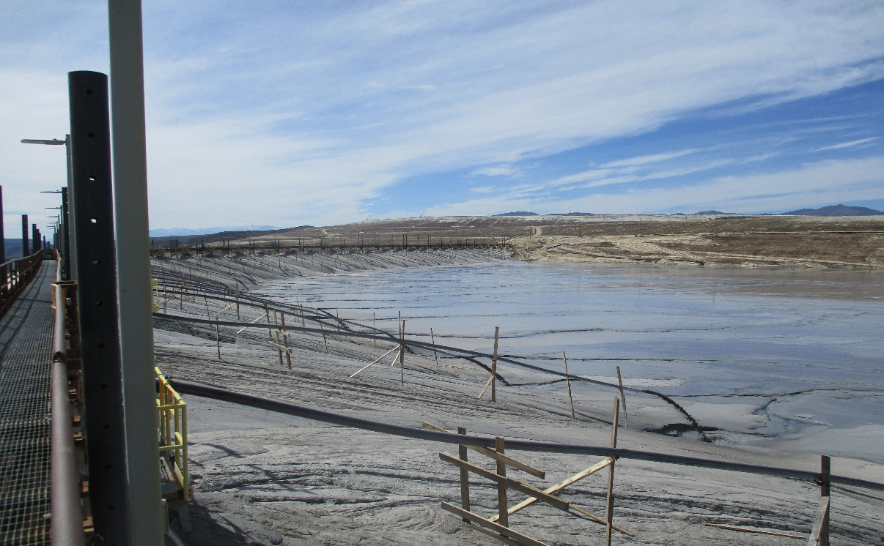
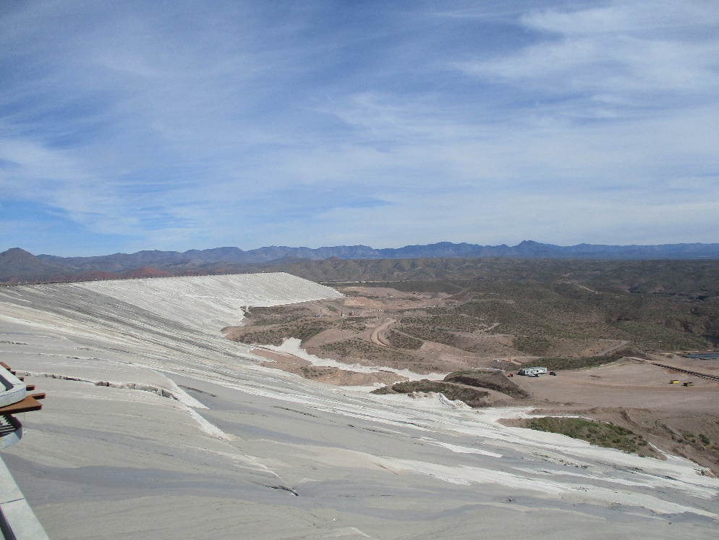
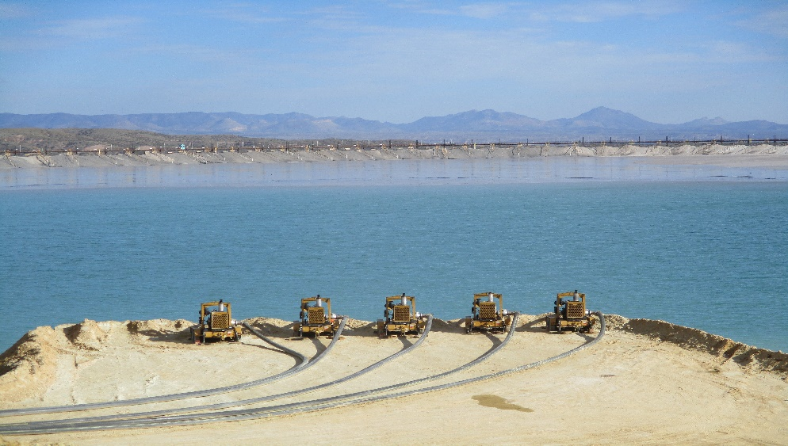
Morenci Tailings Dams
East and West Centerline Dam

Slide 4
Morenci Tailings Dams
4W
3W
2W
SB1
1W
Silver Basin, Southwest 1 And West series Dams all are upstream dams.
SB1-X
SW1

Slide 5
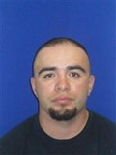
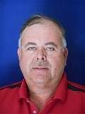
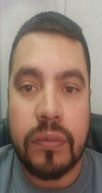
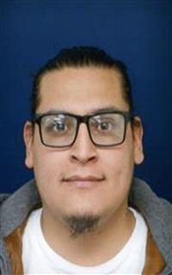
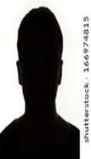
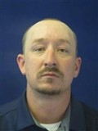
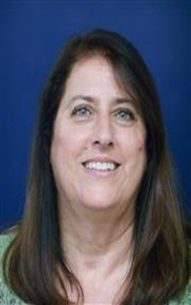
Leadership Team and Admin Support
Tailings superintendent
TBD
Senior Supervisor
Joseph Sanchez
Tailings Tech. Coordinator
Ole Llamas
Tailings Supervision
Maintenance
James Bruce
Operations
Crew A –Rod Albers
Crew B – Luis Montaño
Crew C – Jesus Covarrubias
Crew D – Darrell Holliday
Tailings Operations Technician
TBD
Support Crew Supervisor
Eric Snow
Planner – Brooke Montaño
Admin – Marcy Reid

Slide 6
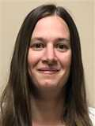
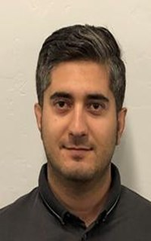
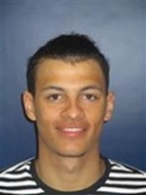
Tailings, Crushed Leach & Water (TCLW)
Mgr. Tailings Crushed Leach & Water
Michael Waldron
Chief Geotechnical Engineer
Oscar Silva
Sr. Geotechnical Engineer
Tyson Parrott
Geotechnical Engineer II
Megan Sprague
Geotechnical Engineer I
Betty Rathbone
Geotechnical Engineer I
Hamid Adarmanabadi
Slope Stability Tech
Paul Still
Civil Engineer II- Water Management
Aws Ajaaj

Slide 7
Drug and Alcohol Policy
To maintain a safe and productive work environment, employees are expected to report for work fit for duty. The unlawful manufacture, consumption, distribution, possession or being under the influence of controlled substances / illegal drugs or alcoholic beverages on Company premises, in Company vehicles, during work hours, or while conducting Company business off-premises is prohibited. It is also against Company policy to report to work or to perform work while prohibited levels of alcohol, illegal drugs or abused prescription or non-prescription drugs are in your system. This is true regardless of whether or not you intended to report to work or work with prohibited levels of alcohol, illegal drugs, or abused prescription or non-prescription drugs in your system.

Slide 8
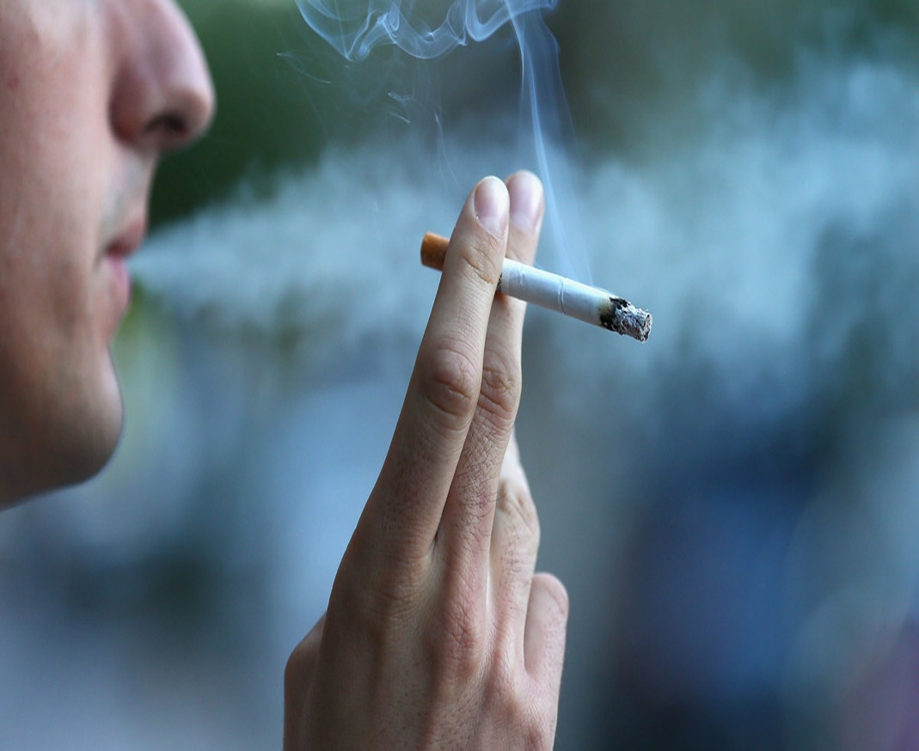
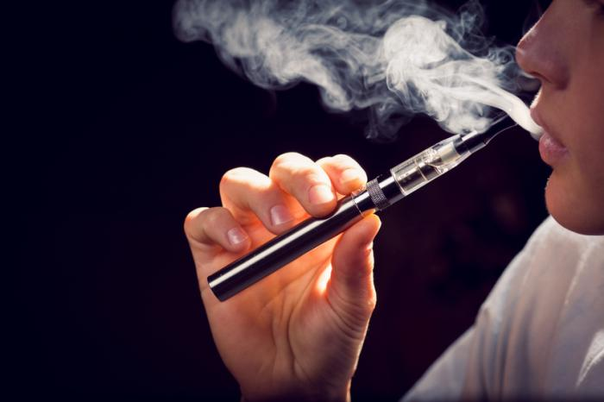
Smoking Policy
We are committed to providing a safe, healthy and smoke-free workplace for all employees. As such, smoking, which includes the use of any lighted tobacco product and the use of electronic cigarettes or any similar type of electronic device, is prohibited within the Company’s facilities and equipment in the U.S. It is the Company’s policy that all facilities and Company vehicles are non-smoking, and smoking is only allowed in designated areas.

Slide 9
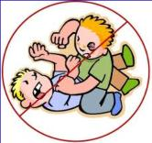
Workplace Violence
Freeport-McMoRan has a zero-tolerance policy with regard to workplace violence. No acts of physical violence, threats of any type (including threats of violence), nor bullying in any form will be tolerated and will result in discipline up to and including termination. Immediately report all workplace violence concerns or violations to a supervisor, security or Human Resources representative. In the case of an emergency, dial 911.

Slide 10
Emergency Procedures

Slide 11
MAYDAY! MAYDAY! MAYDAY!
Press the orange button
DISPATCH WILL CONTACT YOU
If orange button not available, call “Mayday, Mayday, Mayday" on Radio channel that is monitored by the control room.
(Tailings Channel)
DO NOT transmit any names, vehicle or equipment number of any injured party over any radio frequency to avoid any unnecessary stress to friends and family.

Slide 12
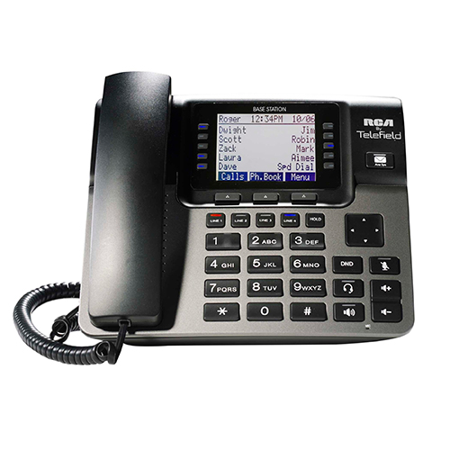
MAYDAY! MAYDAY! MAYDAY!
(928) 865-6600
To report a “Mayday” situation, stay on the phone until you are told to hang up.

Slide 13
In the event of a medical emergency, the following six conditions will constitute a full “MAYDAY” response.
Chest Pains (Any)
Difficulty Breathing
Unconscious/Unresponsive Person
Electrical Shock
Major Trauma
Seizures

Slide 14
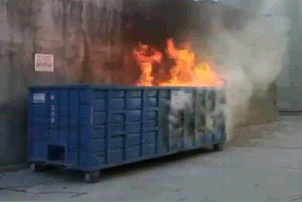
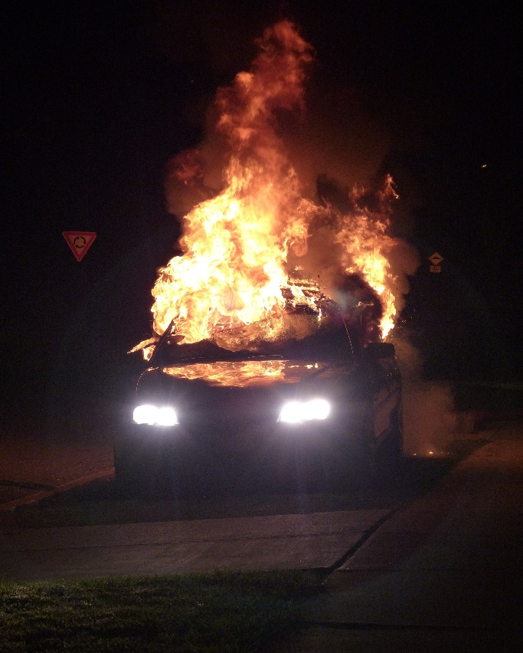
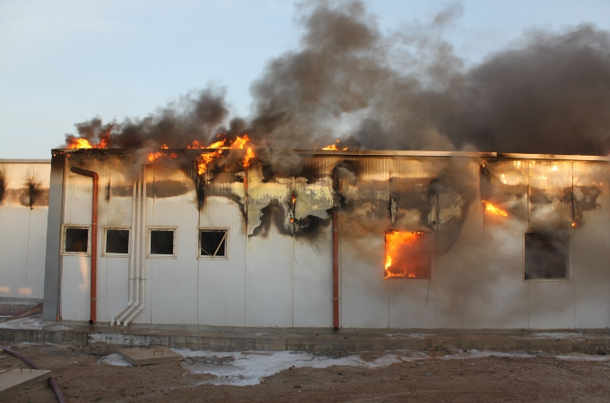
EMERGENCY Non-Medical SITUATIONS
Dumpster Fire
Vehicle Fire
Office or Building Fire

Slide 15
Locker Room
Ops Office
Support Crew Office
ETPS/NTPS Control
Calmly make your way to closest evacuation point.
Inform anyone on way that may not be aware.

Slide 16
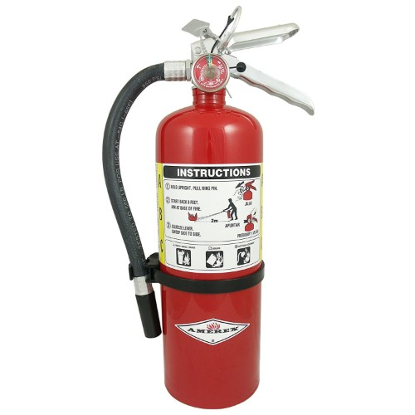
Evacuation Procedures
Fire extinguishers are available by doorways and other areas
With flammable materials. Used only for escape and small basket
Size fires.

Slide 17
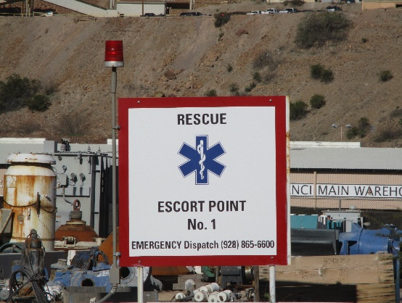
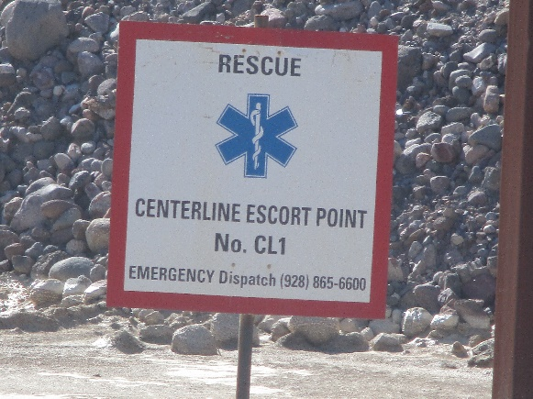
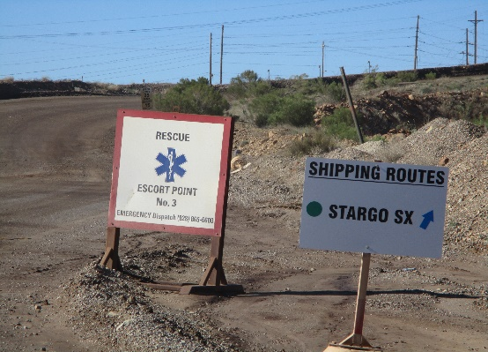
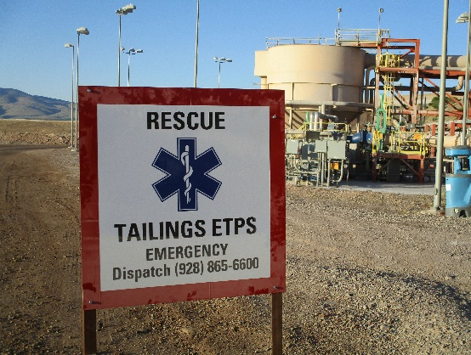
Tailings ERT Escort Points
Escort point No.1 (Warehouse intersection)
4 WEST
Escort point No.3 (Stargo SX/Salvage Yard intersection)
3 WEST
Escort point No.CL1 (South side of #2 Booster)
2 WEST
Escort point (Tailings ETPS)

Slide 18
Tailings ERT Escort Points
Escort point #1 | Escort point #3 | Escort point ETPS | Escort point CL1
4 West Dam | 3 West Dam | Tailings office area and shop | 2 Booster
Columbine tank | SB1 Dam (Back) | NTPS/ETPS/Reclaim pump station and control room | TSP-B,C,and D
3 Booster | SB1 barge site | 2 West | East side Centerline to 330
B-Spur pond | SW1 Dam (back) | SB1-X | NEBS
TSP-G (glory hole) | SW1 Barge site | SW1 Dam (Face) | SW-72 Deep well
East/West gate | Wind Fence Area | SB1 Dam (Face) | Lower water Run from 1X Dam to D-2-1
4 Booster |  | West side Centerline to 329
 |  | SB1-X Booster
 |  | Lower water Run from SW2 to C-2-1
Always be aware of work being performed that might require alternative routes.

Slide 19
Workplace Examination
Support Crew

Slide 20
Workplace Examination

Slide 21
Personal Protective Equipment and Safety Policies

Slide 22
PPE Requirements- Tailings Shop and Parking Area

Slide 23
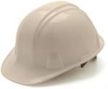
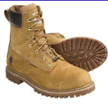
PPE
Hard Hat
Long hair must be tucked in hard hat
ANSI Approved
Work boots
Boots must be at least 6” tall to comply
Good Ankle Support
Steel/Composite Toed
Safety Glasses Rated Z87 to comply
ONLY clear glasses in buildings and at night
Personal prescription glasses must have side shields

Slide 24
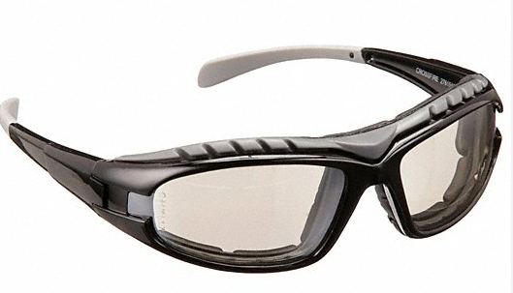
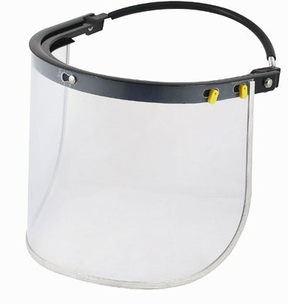
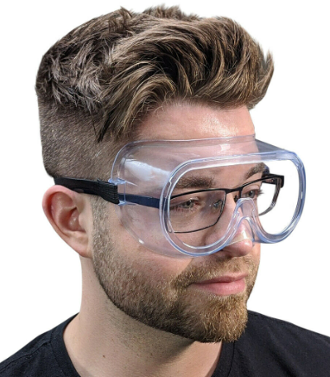
Additional eye protection

Slide 25
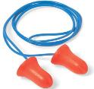
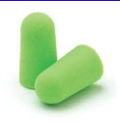
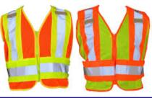
PPE
Hearing Protection (When Required)
Various types available
Reflective Vest
Required for ground visibility and anytime in production areas

Slide 26
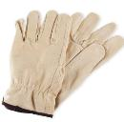
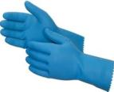
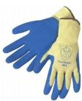
PPE
Gloves
Use the right glove for the job!

Slide 27
Control of Hazardous Energy Policy Health and Safety FCX-HS04 | Release Date 8/5/2019
“COHE”
Ensure equipment is isolated from all sources of energy, locked, tagged, and tried before work begins where individuals could be exposed to dangerous conditions.
The procedure is established for the protection of personnel from injury due to unexpected energization, start-up, recharge, or release of stored energy in, on or around the equipment.

Slide 28
Blue Stake
Tailings Dam area has a yearly blue stake permit. (Not all areas are covered by this).
Any time there will be a penetration to a surface more than one-inch employees must verify with a Supervisor if additional blue stake inspection is need.

Slide 29
Confined Space Policy Health and Safety FCX-HS05 |Version 1 | Release 03/2018
Confined Space
Any location that is large enough for a person to enter
Is not designed for continuous occupancy
Has limited means of entry or exit
There are two classifications of confined spaces:
Permit required confined space
Non-permit required confined space

Slide 30
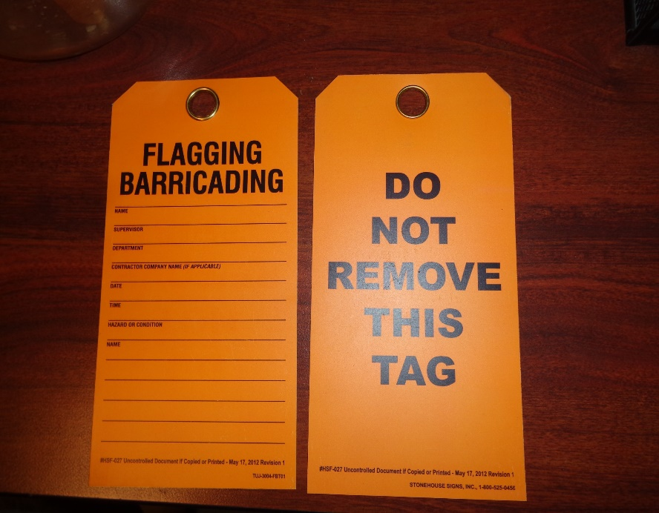
Flagging and Barricading Policy Health and Safety FCX-HS19 | Release Date 1/18/2019
RED TAPE: HIGH ENERGY LEVEL HAZARD
YELLOW: LOW ENERGY HAZARD

Slide 31
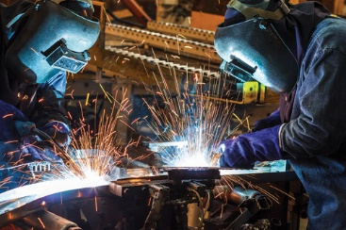
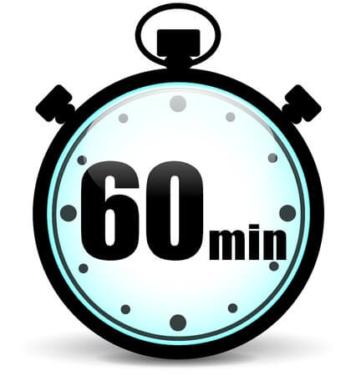
Hot Work Policy Health and Safety FCX-HS06 | Release 3/2018 | Version 1
Hot work permit is required for hot work operations on or near operational processes.
Hot work class is mandatory for anyone involved in hot work, including fire watch.
Fire watch after task is complete

Slide 32
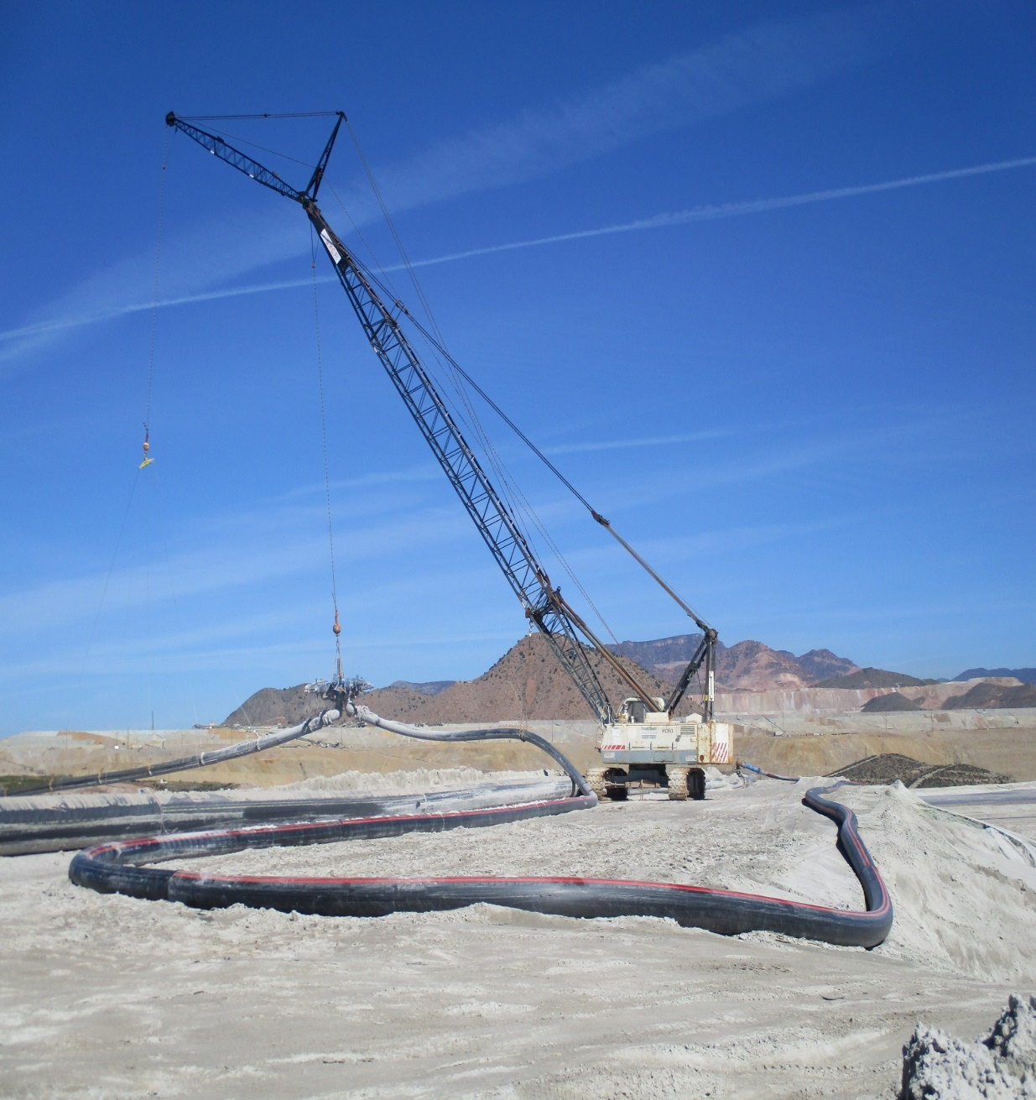
HDPE Pipe Handling Policy Health and Safety FCX-HS12 | Release Date 1/18/2019
HDPE Training is Required!!

Slide 33
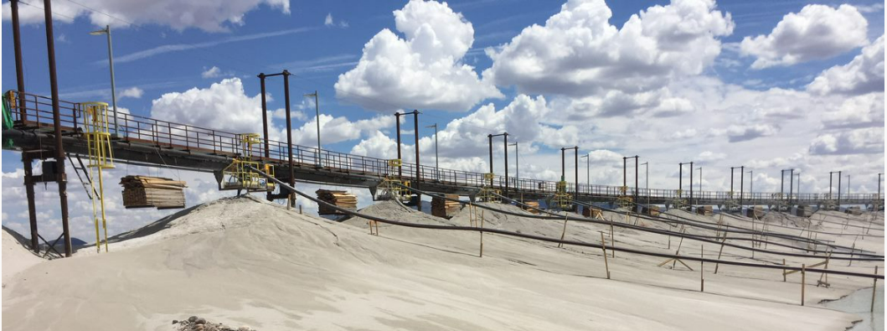
Working at Heights Policy Health and Safety FCX-HS02 | Release 03/2018 | Version 1
Purpose for fall protection is to protect employees conducting work from hazards associated with falling from one surface to another.
You are required to use Fall Protection if there is any chance of a fall.
When all hazards exists, there are two options:
Eliminate the hazard
Provide protection against the hazard
Eliminating the hazard is the best method. This can be done by using handrails around area which prevents a fall hazard or cover the exposed openings or holes.

Slide 34
Corporate Safety portal
Health and Safety policies Require training from training Department.
This presentation is for Awareness only.
All Policies can be found on SharePoint:
https://fcx365.sharepoint.com/Sites/GBL-DOHS/DOHSPolicy/Forms/By%20Policy%20and%20Purpose.aspx

Slide 35
Environmental
Morenci mine is a “Zero” Discharge facility
No water leaves the property Including:
Storm water run off
Seepage water from dams
Reclaim water
Any other water used in the milling process
Dust Control
Fugitive dust is suppressed with water and other materials.

Slide 36
Environmental

Slide 37
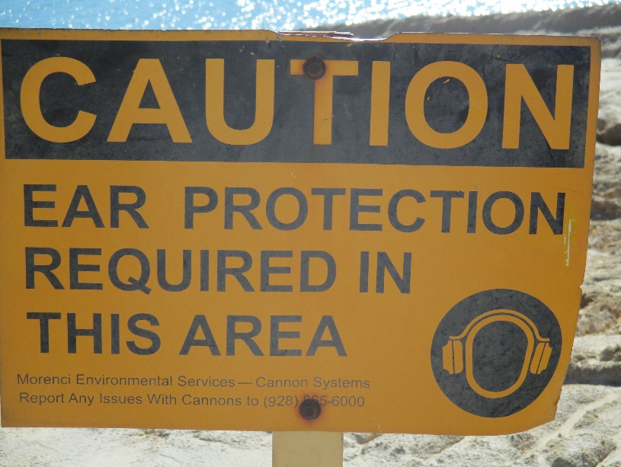
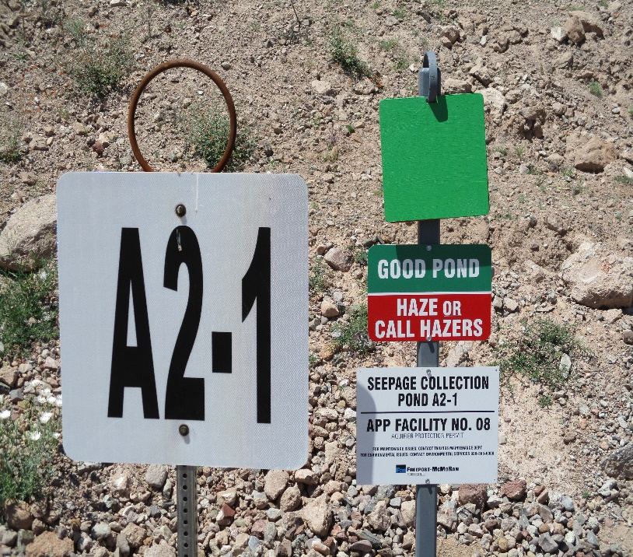
Environmental
Cannon systems are set up by environmental services to haze migratory birds from ponds with low PH water. Hearing protection is required when working around the cannon systems.
PH levels are checked monthly or after rain event and marked green for “good pond” and Red for “Haze if birds are present”. Contact Control Room to report birds in Red marked ponds.

Slide 38
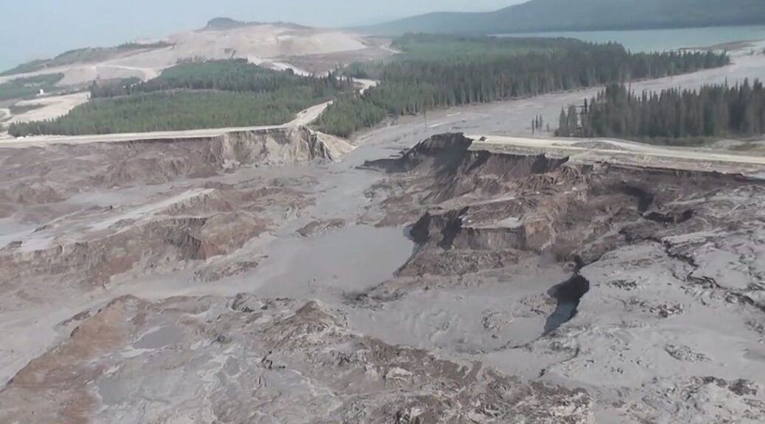
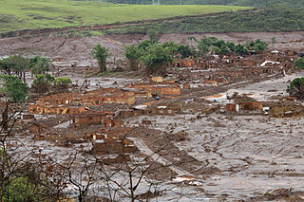
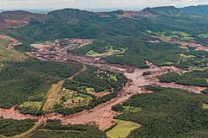
Environmental
Biggest environmental and safety
concern on tailings Dams is
Dam Failure!!!
2014 Mount Polley British Colombia Canada
2015 Mariana Dam Brazil (19 Fatalities)
2019 Brumadinho Dam Brazil (270 Fatalities)

Slide 39
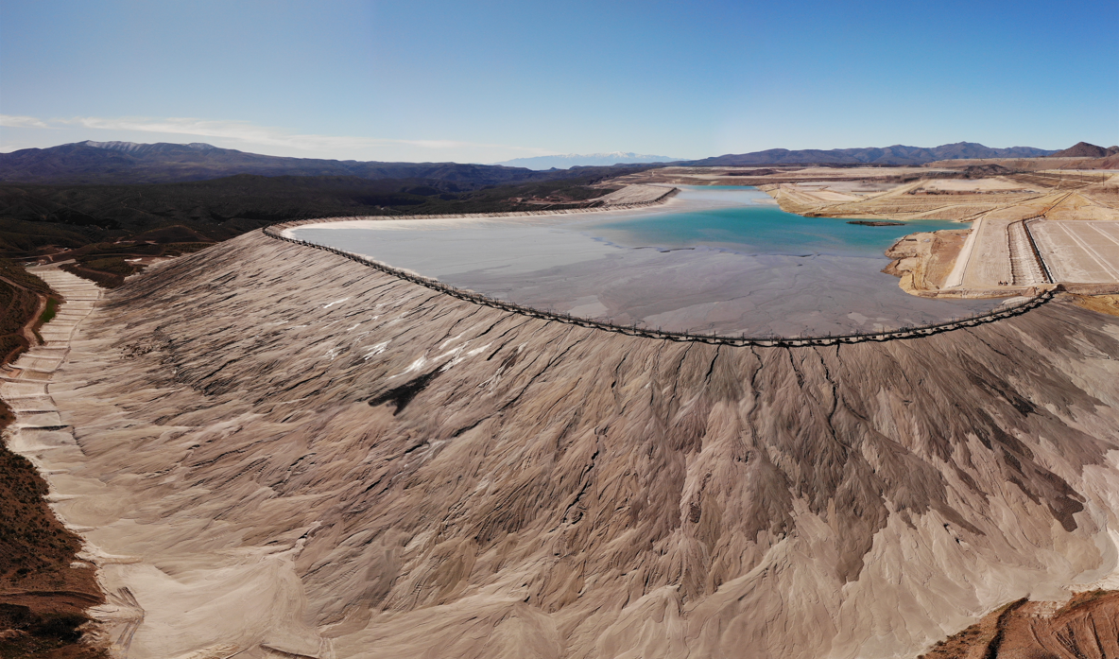
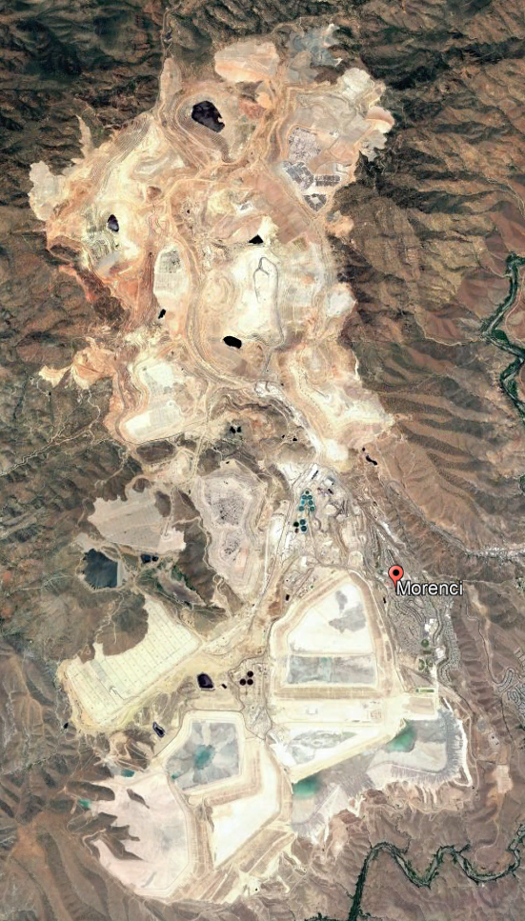
Morenci Mine
Tailings Storage Facility Evacuation Plan
An action plan for employees in pre-determined evacuation areas of the Morenci Tailings Storage Facility
You are receiving this information because you potentially work in an area of the Mine Site that may need to be evacuated in the unlikely event of a structural failure of the Morenci Tailings Storage Facility that could cause rapid flooding and debris downstream.
Please review the instructions and evacuation areas that apply to you in this plan.
If you have an emergency during an evacuation related to the Morenci Tailings Storage Facility, call MAYDAY on your radio.
Notes:
Talking Points:
This evacuation plan was developed after performing a risk assessment on each of the tailings storage facilities (TSF)s.
Of the 8 TSFs, 5 of them have potential to impact employees, either in their place of work, on the facilities, or traveling near the facilities.
Please consider areas you frequent as you review this evacuation plan.
Always remember, if you see something unusual on the facilities, say something.

Slide 40
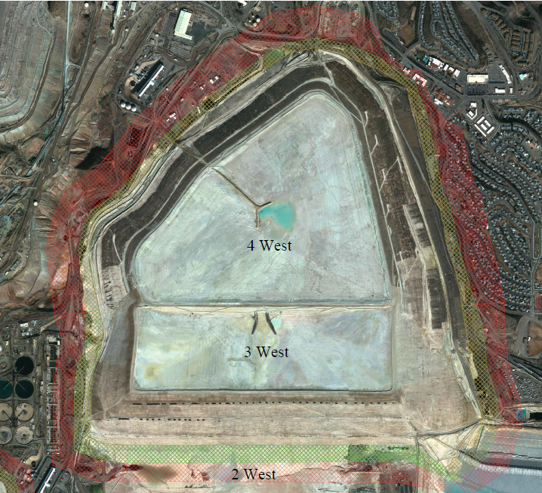
3 West & 4 West
Evacuation Areas
Evacuation Zones
Morenci Warehouse
Asset Recovery/
Salvaged Equipment
Southside EW
MAP KEY
Evacuation Area/
Maximum Predicted Inundation
Minimum Predicted Inundation
Collection Point
Pump & Field Shop
Utility Crew Trailers, Leaching Crew, SW/MFL Trailer, Vac Trucks, Shared Services, EMS Cleaning Services, Savage Molten Crew
Stargo EW & Tailings Shop
WHAT TO DO:
In the event of a tailings storage facility failure evacuation a mayday will be announced on all processing area radio channels per established evacuation protocol by area.
If you are in the area of concern, move up and away from the tailings storage facility and to the collection point nearest to you. If the path to that collection point is routed through an area of concern, choose an alternate collection point or location and report to your supervisor.
When in doubt, always move away and/or uphill from the tailings storage facility.
There may be just minutes to evacuate so choose the best transport available to you – by foot, vehicle, or equipment.
PLEASE KEEP THIS PLAN IN AN ACCESSIBLE LOCATION SUCH AS YOUR DESK, WORK VEHICLE, OR EQUIPMENT
Notes:
Talking Points:
There are two different types of failure modes for a TSF: “Slumping” and “Flow” type failures.
Slumping type failures look like a short landslide that could run out hundreds of feet.
Flow type failures flow more like muddy water downstream, potentially for miles.
3 West and 4 West have a “slumping” type failure mode. This means likely only a small portion of the facility would fail and potentially run out like a landslide. Not all areas would be impacted at once. The failure width could potentially be from a feet to several hundreds of feet wide.
Assumptions can be made about how this could fail, therefore a minimum predicted inundation zone and maximum predicted inundation zone (or distance impacted from the facility) is included in the mapping for reference.
Read slide – “WHAT TO DO:”
In the unlikely event of a 3/4 West Failure near the Pump & Field Shop or Utility Crew Trailers, move to a Collection Point at either the Southside SX or Morenci Warehouse.
In the unlikely event of a 3/4 West Failure near the Southwest corner of the facility, move to the Collection Point at Stargo SX or evacuate the area altogether.
Always remember, in the event of a TSF Failure, it can be time sensitive so simply remember to just move “Up, Up, and Away.”
For more information on the town site evacuation, people who live in town will be receiving a Public Guide to Tailings Storage Facilities in June which will be mailed to their homes.

Slide 41
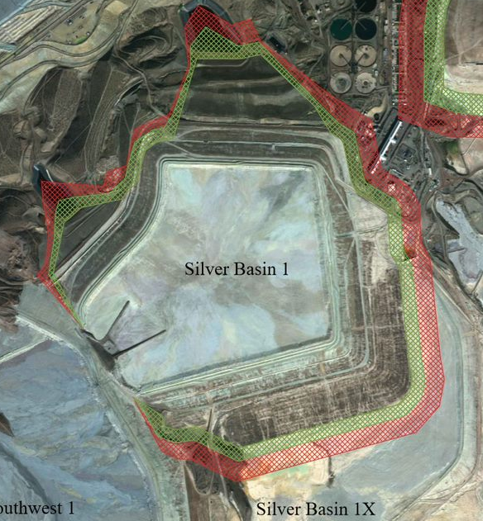
Silver Basin 1
Evacuation Areas
Evacuation Zones
Stargo EW
North Parking Lot, Move to Morenci Warehouse
Tailings Offices/Maintenance
MAP KEY
Evacuation Area/
Maximum Predicted Inundation
Minimum Predicted Inundation
Collection Point
WHAT TO DO:
In the event of a tailings storage facility failure evacuation a mayday will be announced on all processing area radio channels per established evacuation protocol by area.
If you are in the area of concern, move up and away from the tailings storage facility and to the collection point nearest to you. If the path to that collection point is routed through an area of concern, choose an alternate collection point or location and report to your supervisor.
When in doubt, always move away and/or uphill from the tailings storage facility.
There may be just minutes to evacuate so choose the best transport available to you – by foot, vehicle, or equipment.
PLEASE KEEP THIS PLAN IN AN ACCESSIBLE LOCATION SUCH AS YOUR DESK, WORK VEHICLE, OR EQUIPMENT
Notes:
Talking Points:
Silver Basin 1 is also a “slumping” type failure mode.
Not all areas would be impacted at once.
In this case, in the unlikely event of it being near Stargo SX or the Tailings Offices/Maintenance, move to the North end of the parking lots to the collection point and move to the Morenci Warehouse. Help transport others as needed.
Should you end up needing to simply move away and not be able to meet at the collection point, contact your supervisor on the radio and let them know where you are.
Always remember, in the event of a TSF Failure move “Up, Up, and Away.”

Slide 42
Southwest 1
Evacuation Areas
Evacuation Zones
Move to High Ground out of Inundation Zone
MAP KEY
Evacuation Area/
Maximum Predicted Inundation
Minimum Predicted Inundation
WHAT TO DO:
In the event of a tailings storage facility failure evacuation a mayday will be announced on all processing area radio channels per established evacuation protocol by area.
If you are in the area of concern, move up and away from the tailings storage facility and to the collection point nearest to you. If the path to that collection point is routed through an area of concern, choose an alternate collection point or location and report to your supervisor.
When in doubt, always move away and/or uphill from the tailings storage facility.
There may be just minutes to evacuate so choose the best transport available to you – by foot, vehicle, or equipment.
PLEASE KEEP THIS PLAN IN AN ACCESSIBLE LOCATION SUCH AS YOUR DESK, WORK VEHICLE, OR EQUIPMENT
Notes:
Talking Points:
Southwest 1 is also a “slumping” type failure mode.
Not all areas would be impacted at once.
In this case, in the unlikely event of someone being in these areas at time failure, simply move to high ground and assist others as needed.
Note: The areas showing runout on Southwest 1 have steeper slopes. Other areas have potential for instability, but are not shown. These areas given low TSF height would have shorter run-out distances. As always, move away from TSF.
Contact your supervisor and inform them of your location.
Always remember, in the event of a TSF Failure move “Up, Up, and Away.”

Slide 43
West/East
Evacuation Areas
Evacuation Zones
Top of 3 West
Best Route Away from Area
West/East
Coral Rd
Move to High Ground out of Inundation Zone
Train Tracks
MAP KEY
Evacuation Area/
Maximum Predicted Inundation
Collection Point
Direction of Flow
Corrals
(High Ground)
E2-1 Seepage Pond
WHAT TO DO:
In the event of a tailings storage facility failure evacuation a mayday will be announced on all processing area radio channels per established evacuation protocol by area.
If you are in the area of concern, move up and away from the tailings storage facility and to the collection point nearest to you. If the path to that collection point is routed through an area of concern, choose an alternate collection point or location and report to your supervisor.
When in doubt, always move away and/or uphill from the tailings storage facility.
There may be just minutes to evacuate so choose the best transport available to you – by foot, vehicle, or equipment.
PLEASE KEEP THIS PLAN IN AN ACCESSIBLE LOCATION SUCH AS YOUR DESK, WORK VEHICLE, OR EQUIPMENT
Notes:
Talking Points:
The West/East Tailings Storage Facility is a “flow” failure mode. This is different from the others as it runs more like water downstream like a flood wave.
The point of failure would be on the North side of the facility, flowing North, then East, then South to the San Francisco and Gila Rivers as indicated by the red arrows on the map.
In this case, in the unlikely event of someone being in these areas at time failure, people can move to the Top of 3 West or the E2-1 Seepage Pond.
Areas of header far outside the 3-East crossing area (red line on crest in TSF image) of failure are likely safe; however, it would be best to begin walking off the header and off the TSF and away from potential flow paths.
If you are working outside the fenced areas, you may either evacuate North on Coral Rd or Collect at the Corrals.
Contact your supervisor and inform them of your location.
Always remember, in the event of a TSF Failure move “Up, Up, and Away.”

Slide 44
Evacuation Zones
EASE Registration
In addition to radio communications in the Tailings Area, the Freeport EASE system (Employee Alert System Engine) can and will be used to communicate emergency information.
This system increases the speed and efficiency vital information may be communicated to employees, not just for Tailings Emergencies, but all emergencies on or near site.
All employees must sign up for EASE to receive these notifications on their mobile devices.
To sign up for EASE, from any internet connected device, go to:
Home.fmi.com
Select EASE Registration
Note: If you are on a personal device, you will be prompted for your network ID/Password and multifactor authentication.
Scroll down to Contact information and click the pencil icon to provide your personal contact information.
OR
Contact the HRSC by calling 1-888-855-HELP(4357) or email hrsc@fmi.com.
PLEASE KEEP THIS PLAN IN AN ACCESSIBLE LOCATION SUCH AS YOUR DESK, WORK VEHICLE, OR EQUIPMENT
Notes:
In addition to radio communications in the Tailings Area, our EASE system (Employee Alert System Engine) can and will be used to communicate emergency information.
This system increases the speed and efficiency vital information may be communicated to employees, not just for Tailings Emergencies, but all emergencies on or near site.
All employees must sign up for EASE to receive these notifications on their mobile devices.
To sign up for EASE, from any internet connected device go to:
Home.fmi.com
Select EASE Registration
Note: If you are on a personal device, you will be prompted for your network ID/PW and multifactor authentication.
Scroll down to Contact information and click the pencil icon to provide your personal contact information.
Or, contact the HRSC by calling 1-888-855-HELP(4357) or email hrsc@fmi.com.

Slide 45
Additional Hazards

Slide 46
Open Body of Water
Life vests are required around open bodies of water when:
Close enough to water and potential of falling exist like tripping hazards or uneven ground.
On a boat which also requires “Shore watch”
Multiple Vests are provided in Blue Barrels located at each pond along with lifeline and life ring.

Slide 47
Uneven or unstable ground on centerline
Erosion gullies may be present on centerline dam due to poor deposition practices,
Upset conditions of the mill or weather. If present, do not walk on surface within 6
feet of edge or stress cracks surrounding gully. Operations will backfill gullies using
Underflow material from cyclones to mitigate hazard.

Slide 48
HEAVY MACHINERY & RR TRAFFIC
Notes:
Speak of giving right of way to all equipment. Do not pass unless operator expresses permission. Stay well behind when following.

Slide 49
777Haul Road for East/West centerline Gila lift
Must sign in with spotter Daily
Before crossing intersection
Of Haul Road. No light vehicles
on Haul Roads while 777 are Hauling.

Slide 50
Overhead / Mobile Cranes
LOOK UP!

Slide 51
Lightning
YELLOW ALERT: Prepare to evacuate when and if RED Alert comes
RED ALERT: Work is Prohibited in High-Risk Areas. Appropriate shelter from hazards must be taken.
Depending on the work being performed, it is the decision of division management to understand, communicate and enforce specific procedures.
In Tailings areas, light vehicles and centerline storm shelters are the most common shelters available to operator in the field.
Notes:
Explain the different levels of Alerts and what actions to take to be safe.
GREEN: Lightening outside 20 mile radius
YELLOW: Lightening identified as striking in a 7 to 15 mile radius
RED: Lightening striking within 0 to 7 mile radius
YELLOW ALERT: Prepare to evacuate when and if RED Alert comes
RED ALERT: Work is Prohibited in High Risk Areas. Appropriate shelter from hazards must be taken. Depending on the work being performed, it is the decision of division management to understand, communicate and enforce specific procedures.

Slide 52
Heat Stress / Dehydration / Sun Exposure
CDC recommends drinking 8 ounces of water every 15-20 min to prevent dehydration when working in the heat.
Wear protective clothing and or sunscreen 15spf or higher to prevent serious illnesses like melanoma.

Slide 53
Fatigue Awareness
Working tired can lead to:
Fatalities
Injuries
Property Damages

Slide 54
Housekeeping
Housekeeping is an everyday issue. Don’t ignore it! Act on It!
It’s EVERYONE’S job!

Slide 55
Questions?

