Slide 1
Metcalf
Site Specific Training

Slide 2
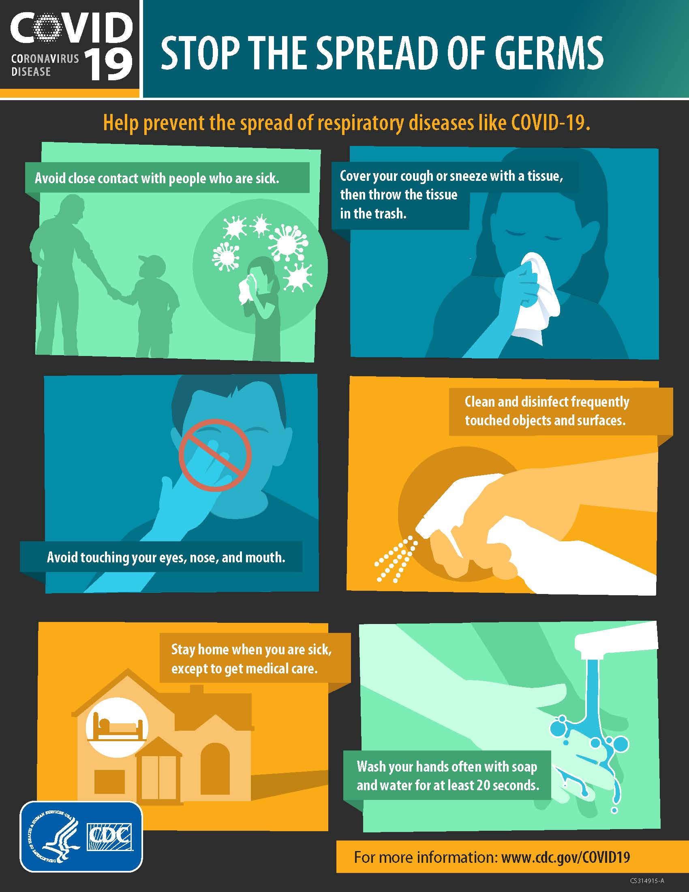

Slide 3
Concentrator Division Emergency Procedures

Slide 4
Emergency Response Procedures “Mayday”
In the event of a medical emergency, the following six conditions will constitute a full “MAYDAY” response.
Chest Pains (Any)
Difficulty Breathing
Unconscious/Unresponsive Person
Electrical Shock
Major Trauma
Seizures

Slide 5
EMERGENCY Non-Medical SITUATIONS
MAYDAY! MAYDAY! MAYDAY!
  Dumpster Fire
  Vehicle Fire
  Office or Building Fire

Slide 6
Responsibilities During a Mayday
Employees in areas with access to two-way radio
Call “Mayday, Mayday, Mayday" on a channel that is monitored by the control room.
(Metcalf Concentrator)
Employees in all areas with access to telephone
Call 865-6600 and report a “Mayday” situation, stay on the phone until you are told to hang up.

Slide 7
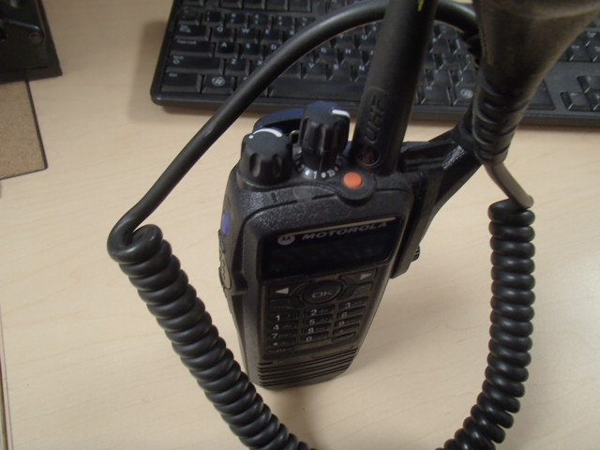
MAYDAY! MAYDAY! MAYDAY!
Press the orange button
DISPATCH WILL CONTACT YOU
DO NOT transmit the name or vehicle/equipment number of any injured party over any radio frequency or cell phones.
Unofficial family notification by people that privately scan radio frequencies places unnecessary stress on injured employee’s family.

Slide 8

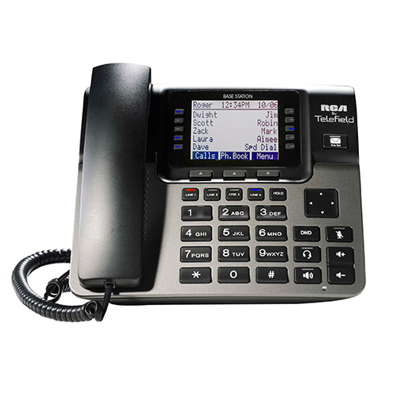
MAYDAY! MAYDAY! MAYDAY!
DIAL
928 865 6600
Also used for non-emergency medical calls.

Slide 9
Evacuation Procedures
Notifying of evacuation:
Alarm sounds 3 times in a row.
Notified by Supervisor
Notified by another operator/employee
Notified by phone
Notified by radio

Slide 10
Evacuation Procedures
In the even of an evacuation:
Calmly make your way to closest evacuation point.
Inform anyone on way that may not be aware.
Locate, and place “do not enter signs” at the bays entering the concentrator on your way out. Located at each bay door.

Slide 11
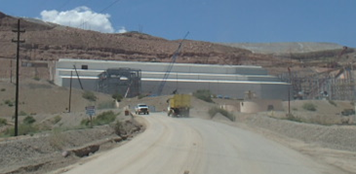
Meeting Points
South Side of Building
North Side of Building
East Side of Building

Slide 12
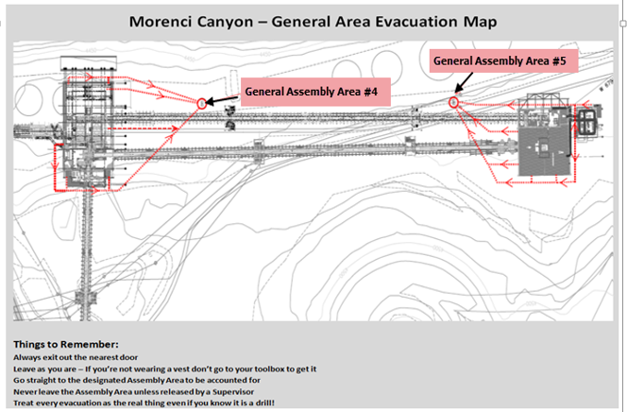
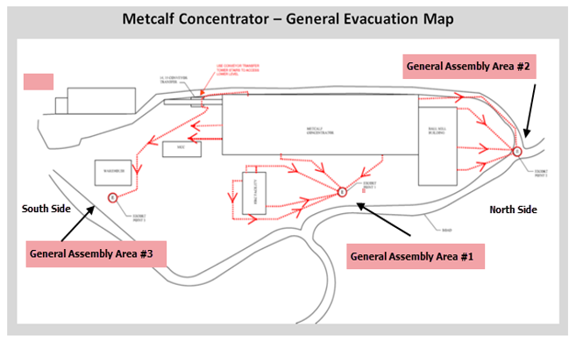
General Assembly Areas

Slide 13
Personal Protective Equipment

Slide 14
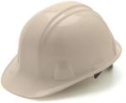
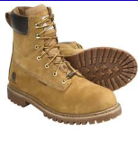

PPE
Hard Hat
  Long hair must be tucked in hard hat
  ANSI Approved
Work boots
  Boots must be at least 6” tall to be in compliance
  Good Ankle Support
  Steel Toed
Glasses w/sides shields
  ONLY clear glasses in buildings and at night
  Prescription glasses must have side shields

Slide 15
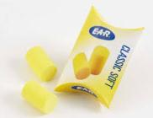
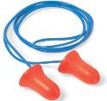

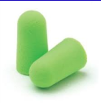
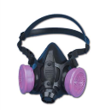
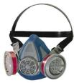
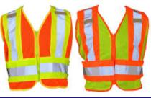
PPE
Ear Protection
  Various types available
Respirator
  Ensure proper cartridge
Reflective Vest
  Required for ground visibility and anytime in production areas

Slide 16
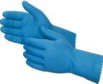
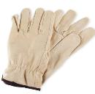
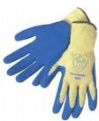
PPE
Gloves
  -Ensure proper types and size of glove for the task at hand.
    Use the right glove for the job!

Slide 17
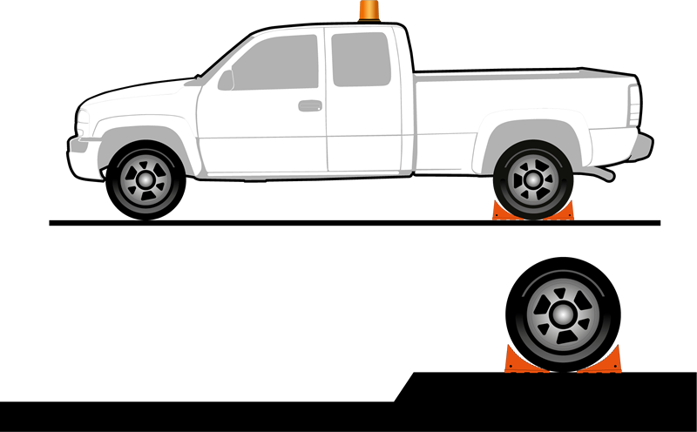
CHOCK YOUR TIRE
Ensure your safety while placing chocks by setting them from the uphill side. Never cross in front of the vehicle on the downhill side.

Slide 18
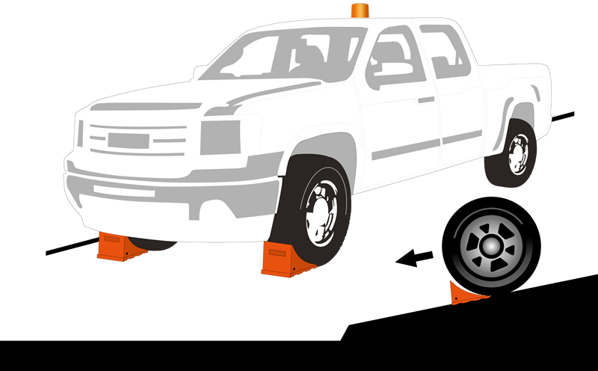
CHOCK YOUR TIRE
Ensure your safety while placing chocks by setting them from the uphill side. Never cross in front of the vehicle on the downhill side.

Slide 19
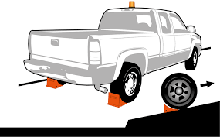
CHOCK YOUR TIRE
Ensure your safety while placing chocks by setting them from the uphill side. Never cross in front of the vehicle on the downhill side.

Slide 20
CHOCK YOUR TIRE
HONK YOUR HORN ONCE BEFORE YOU START YOUR ENGINE
HONK YOUR HORN TWICE BEFORE YOU PULL FOWARD
HONK THREE TIMES BEFORE YOU BACK UP

Slide 21
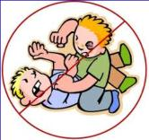
Fighting or Physical Assault
Fighting and Physical Assault Policy States
  No fighting or physical assault of any type permitted in the Concentrator Division.
  Will show and treat our fellow employees with dignity and respect
  Will communicate with our fellow employees in a professional manner
Failure to follow and practice the above rules, can and will lead to disciplinary action.

Slide 22
LOTOTO
“LOCK OUT” “TAG OUT” “TRY OUT”
Ensure equipment is isolated from all sources of energy, locked, tagged, and tried before work begins where individuals could be exposed to dangerous conditions.
The procedure is established for the protection of personnel from injury due to unexpected energization, start-up, recharge, or release of stored energy in, on or around the equipment.
  The LOTOTO policy can be found on Sharepoint:
  http://fmweb/sites/morsafety/MORSafety/default.aspx

Slide 23
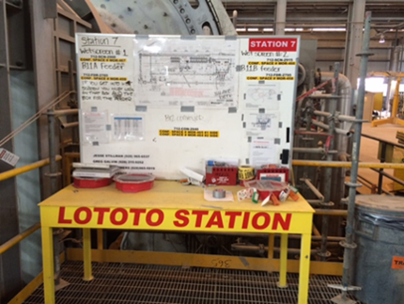
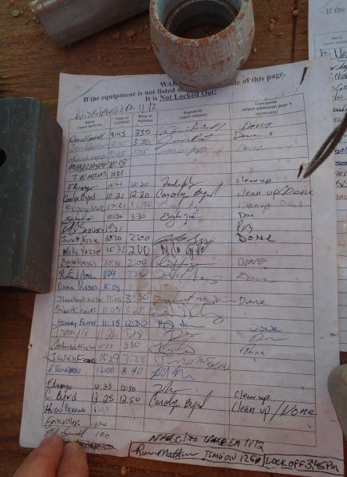
LOTOTO
Performing work on equipment ?
NEED LOTOTO TASK TRAINING

Slide 24
Blue Stake
Any time there will be a penetration to a surface more than one inch employees must contact a Supervisor immediately.
Permit will be required.

Slide 25
Confined Space
Confined Space
Any location that is large enough for a person to enter
Is not designed for continuous occupancy
Has limited means of entry or exit
There are two classifications of confined spaces:
  Permit required confined space
  Non-permit required confined space

Slide 26
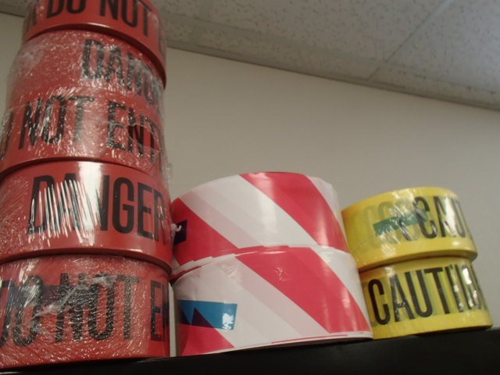
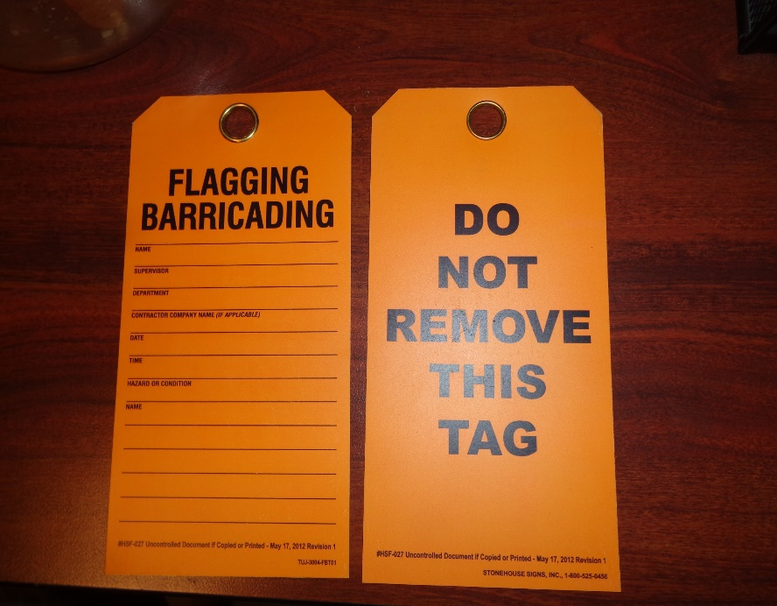
Flagging
RED TAPE: HIGH ENERGY LEVEL HAZARD
YELLOW: LOW ENERGY HAZARD

Slide 27
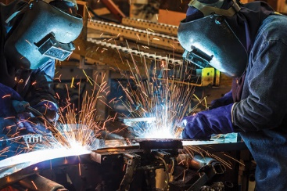
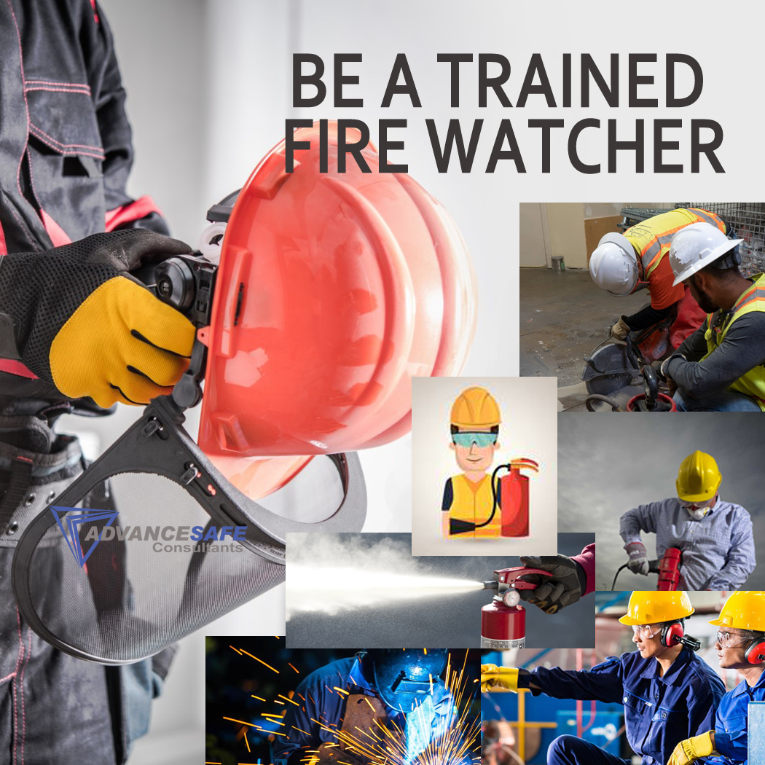
Hot Work
Hot work permit is required for hot work operations on or near operational processes.
Hot work class is mandatory for anyone involved in hot work, including fire watch.

Slide 28
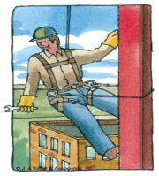
Fall Protection
Purpose for fall protection is to protect employees conducting work from hazards associated with falling from one surface to another.
You are required to use Fall Protection if there is any chance of a fall.
When all hazards exists there are two options:
Eliminate the hazard
Provide protection against the hazard
Eliminating the hazard is the best method. This can be done by using handrails around area which prevents a fall hazard or cover the exposed openings or holes.

Slide 29
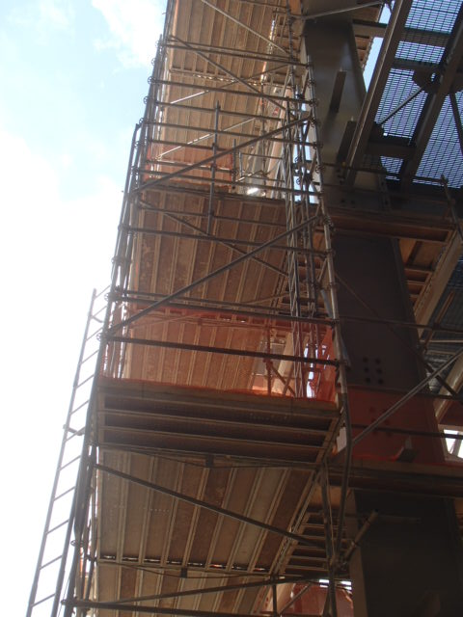
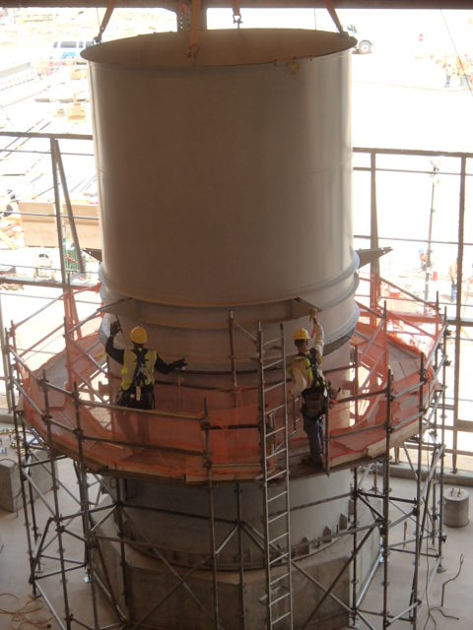
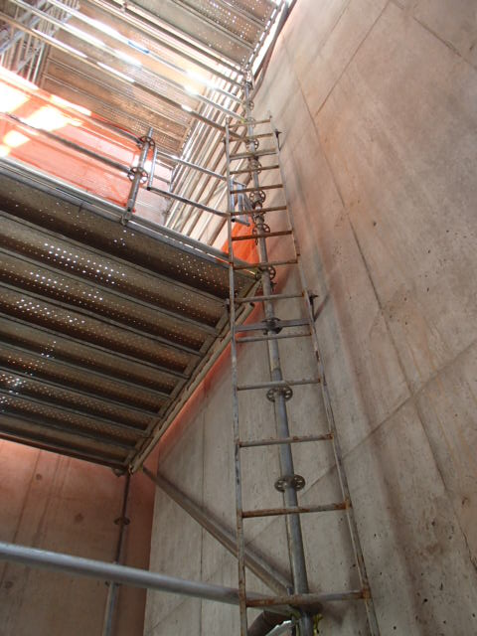
Scaffolding
FALL PROTECTION ?
Has the scaffold been Inspected??

Slide 30
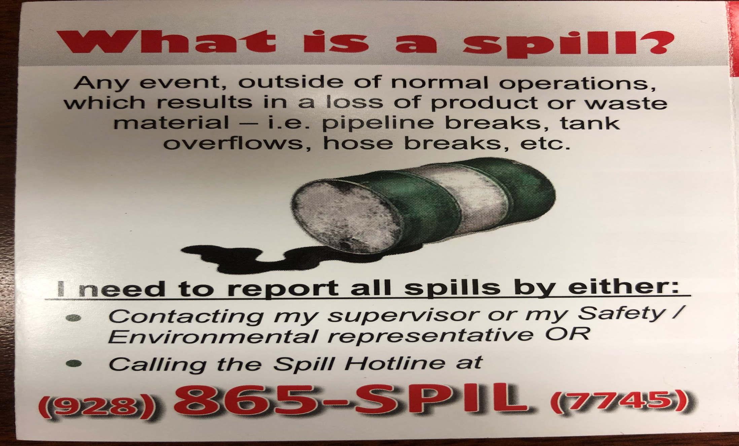
Environmental

Slide 31
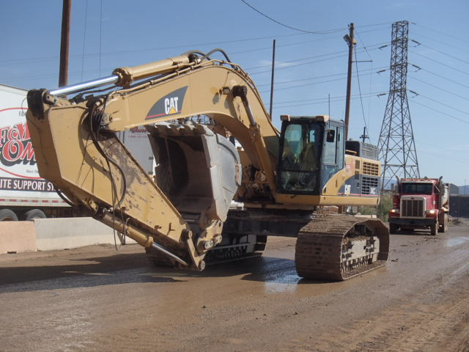
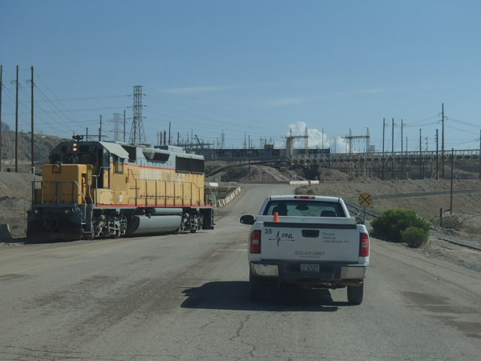
HEAVY MACHINERY & RR TRAFFIC
Notes:
Speak of giving right of way to all equipment. Do not pass unless operator expresses permission. Stay well behind when following.

Slide 32
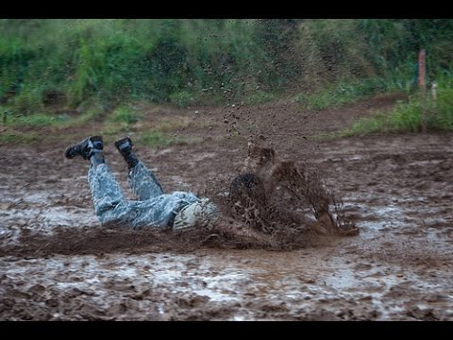
Water Hazard
Inside the Metcalf Building

Slide 33
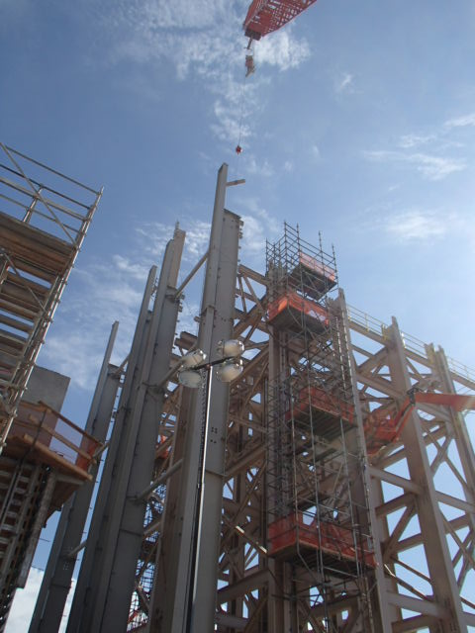
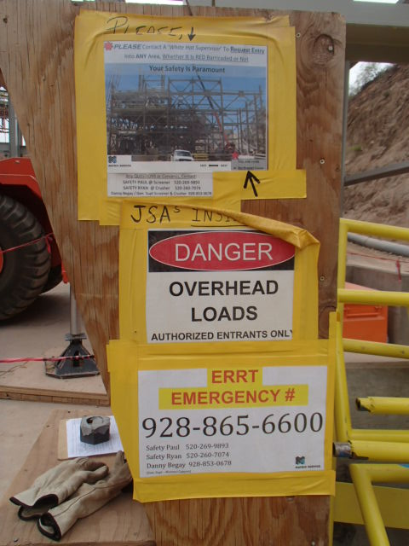
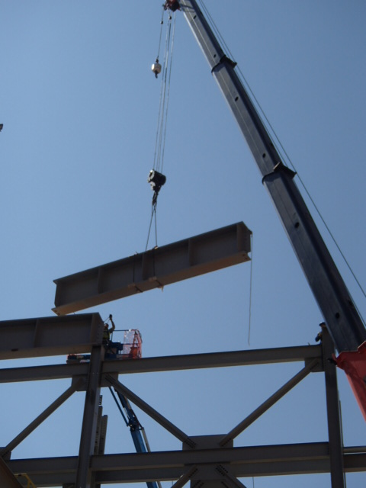

Overhead / Mobile Cranes
LOOK UP

Slide 34
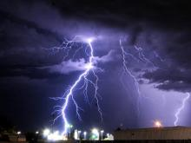
Lightning Alerts
YELLOW ALERT: Prepare to evacuate when and if RED Alert comes
RED ALERT: Work is Prohibited in High Risk Areas. Appropriate shelter from hazards must be taken.
Depending on the work being performed, it is the decision of division management to understand, communicate and enforce specific procedures.
Notes:
Explain the different levels of Alerts and what actions to take to be safe.
GREEN: Lightening outside 20 mile radius
YELLOW: Lightening identified as striking in a 7 to 15 mile radius
RED: Lightening striking within 0 to 7 mile radius
YELLOW ALERT: Prepare to evacuate when and if RED Alert comes
RED ALERT: Work is Prohibited in High Risk Areas. Appropriate shelter from hazards must be taken. Depending on the work being performed, it is the decision of division management to understand, communicate and enforce specific procedures.

Slide 35

Heat Stress / Dehydration / Sun Screen
Be sure and drink plenty of water every day.
Stay out of the Sun if possible/
Use Sunscreen / Protective Clothing.

Slide 36
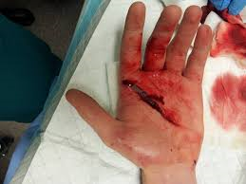
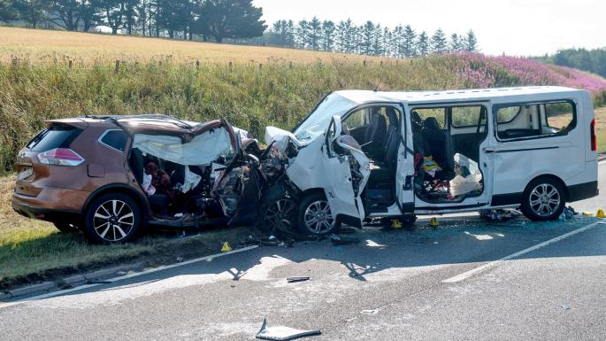
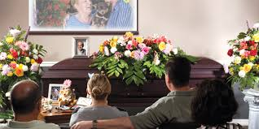
Fatigue Awareness

Slide 37
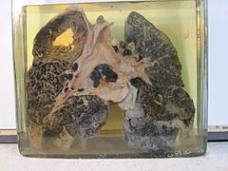
Dust Awareness
Silicosis Prevention

Slide 38
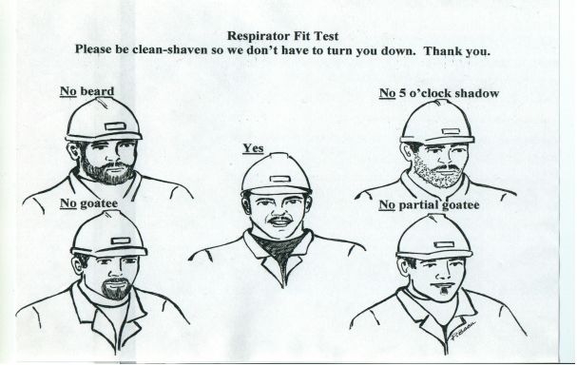
Dust Awareness

Slide 39
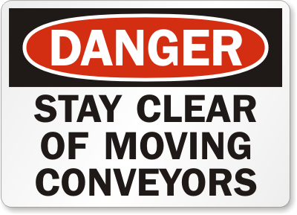
Conveyor Awareness
The concentrator personnel are exposed to more conveyor hazards than most other mine employees.
Conveyors can, and will start at any time.

Slide 40
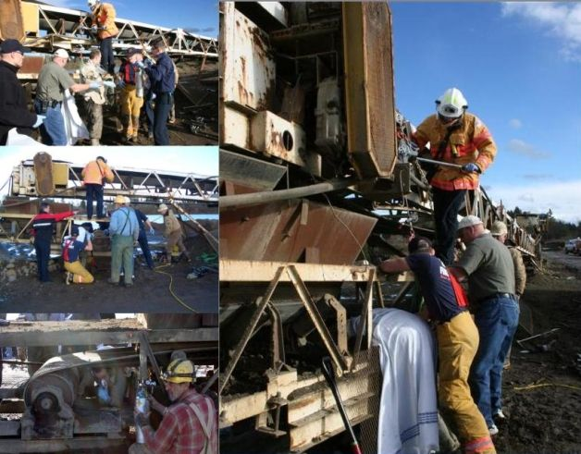
Conveyor Awareness
New picture of conv
Conveyors can grab you…… Don’t get caught up!!!
LOTOTO REQUIRED!!

Slide 41
Reagent Awareness
We use many chemicals and reagents to help with the processes of milling. Some of the chemicals or solutions are abrasive in nature and injuries may occur as a result of contact and rubbing of the eye.
Lime / Collectors
Hazard Awareness - Collector will cause irritation to eye burns and can trigger allergic skin reactions.

Slide 42
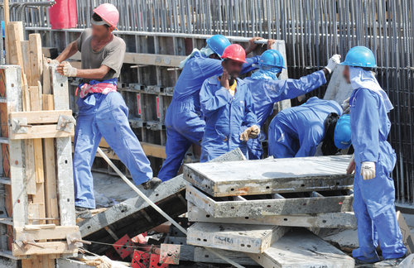
Housekeeping
Housekeeping will always be of prime issue for the concentrator division.
It’ EVERYONE’S job!

Slide 43
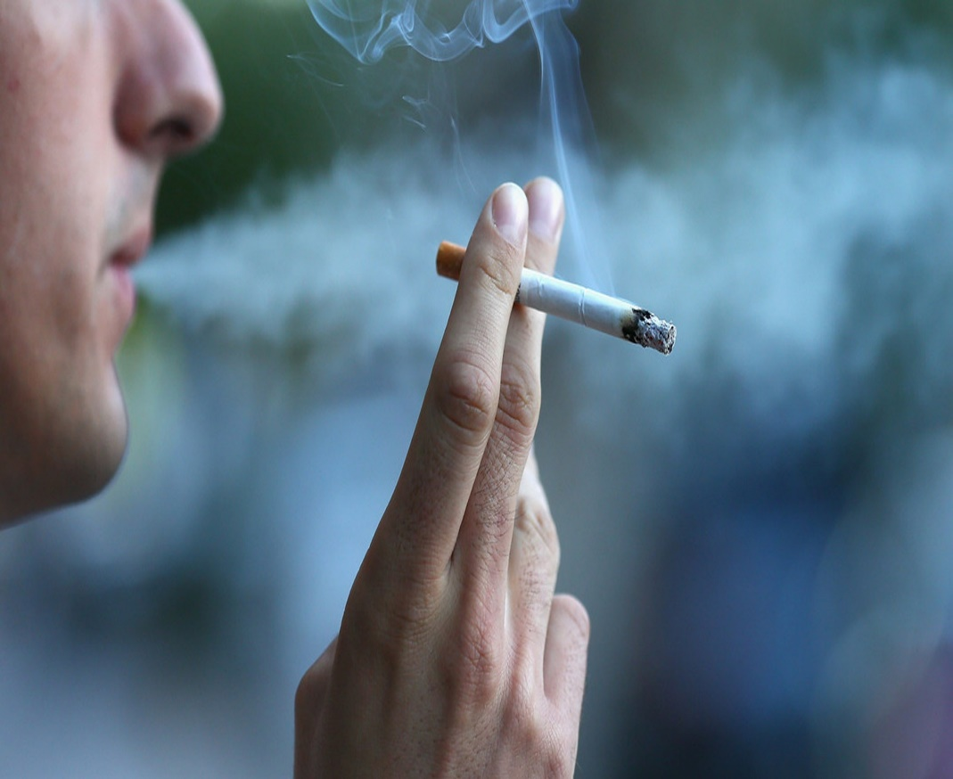
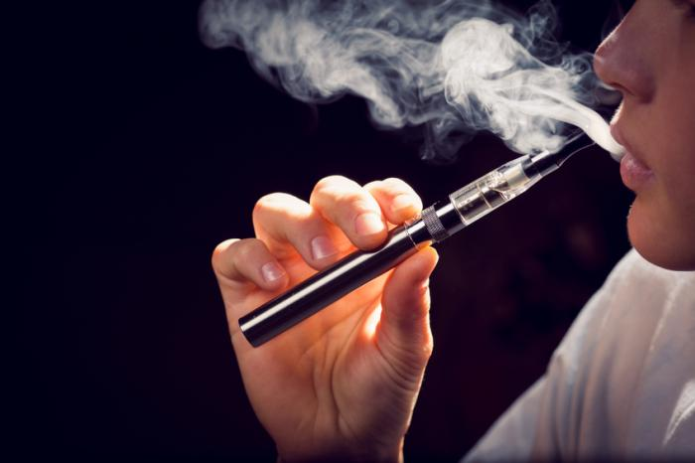
Smoking / Vaping Policy
Metcalf Concentrator is a non-smoking / Vaping facility.
Smoking is authorized in designated areas only.
Disciplinary actions may be initiated for any employees, contractors, or visitors found to be in violation of our policy.

Slide 44
Smoking Policy
Designated Smoking areas

Slide 45
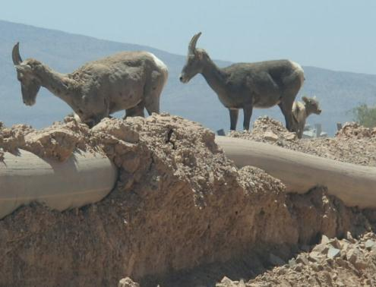




Watch out for critters

Slide 46
Questions

