Slide 1
Morenci Concentrator (Mill) Site-Specific Training
Welcome to the team!

Slide 2
Meet the Team…

Slide 3
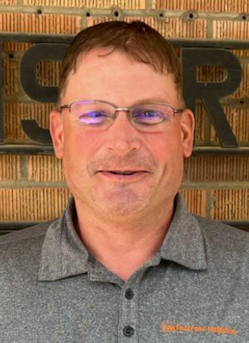
A little bit about our Leadership Team
Jared leads the overall organization which consists of three main departments:
Operations
Maintenance
Electrical
Each of these organizations has its own leadership team, let’s take a look at those teams next.
1
2
3
Jared Sundberg, Morenci Mill Manager

Slide 4

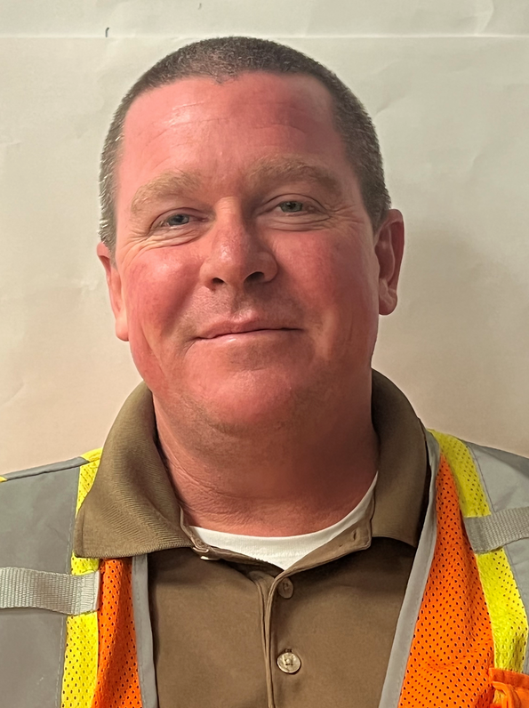
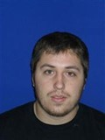
Operations Leadership Team
Daniel Orta, Mill Operations Sr. Supervisor
Jeff Kinnebrew, Operations Superintendent
Enrique Lopez, Crusher Operations
Sr. Supervisor

Slide 5

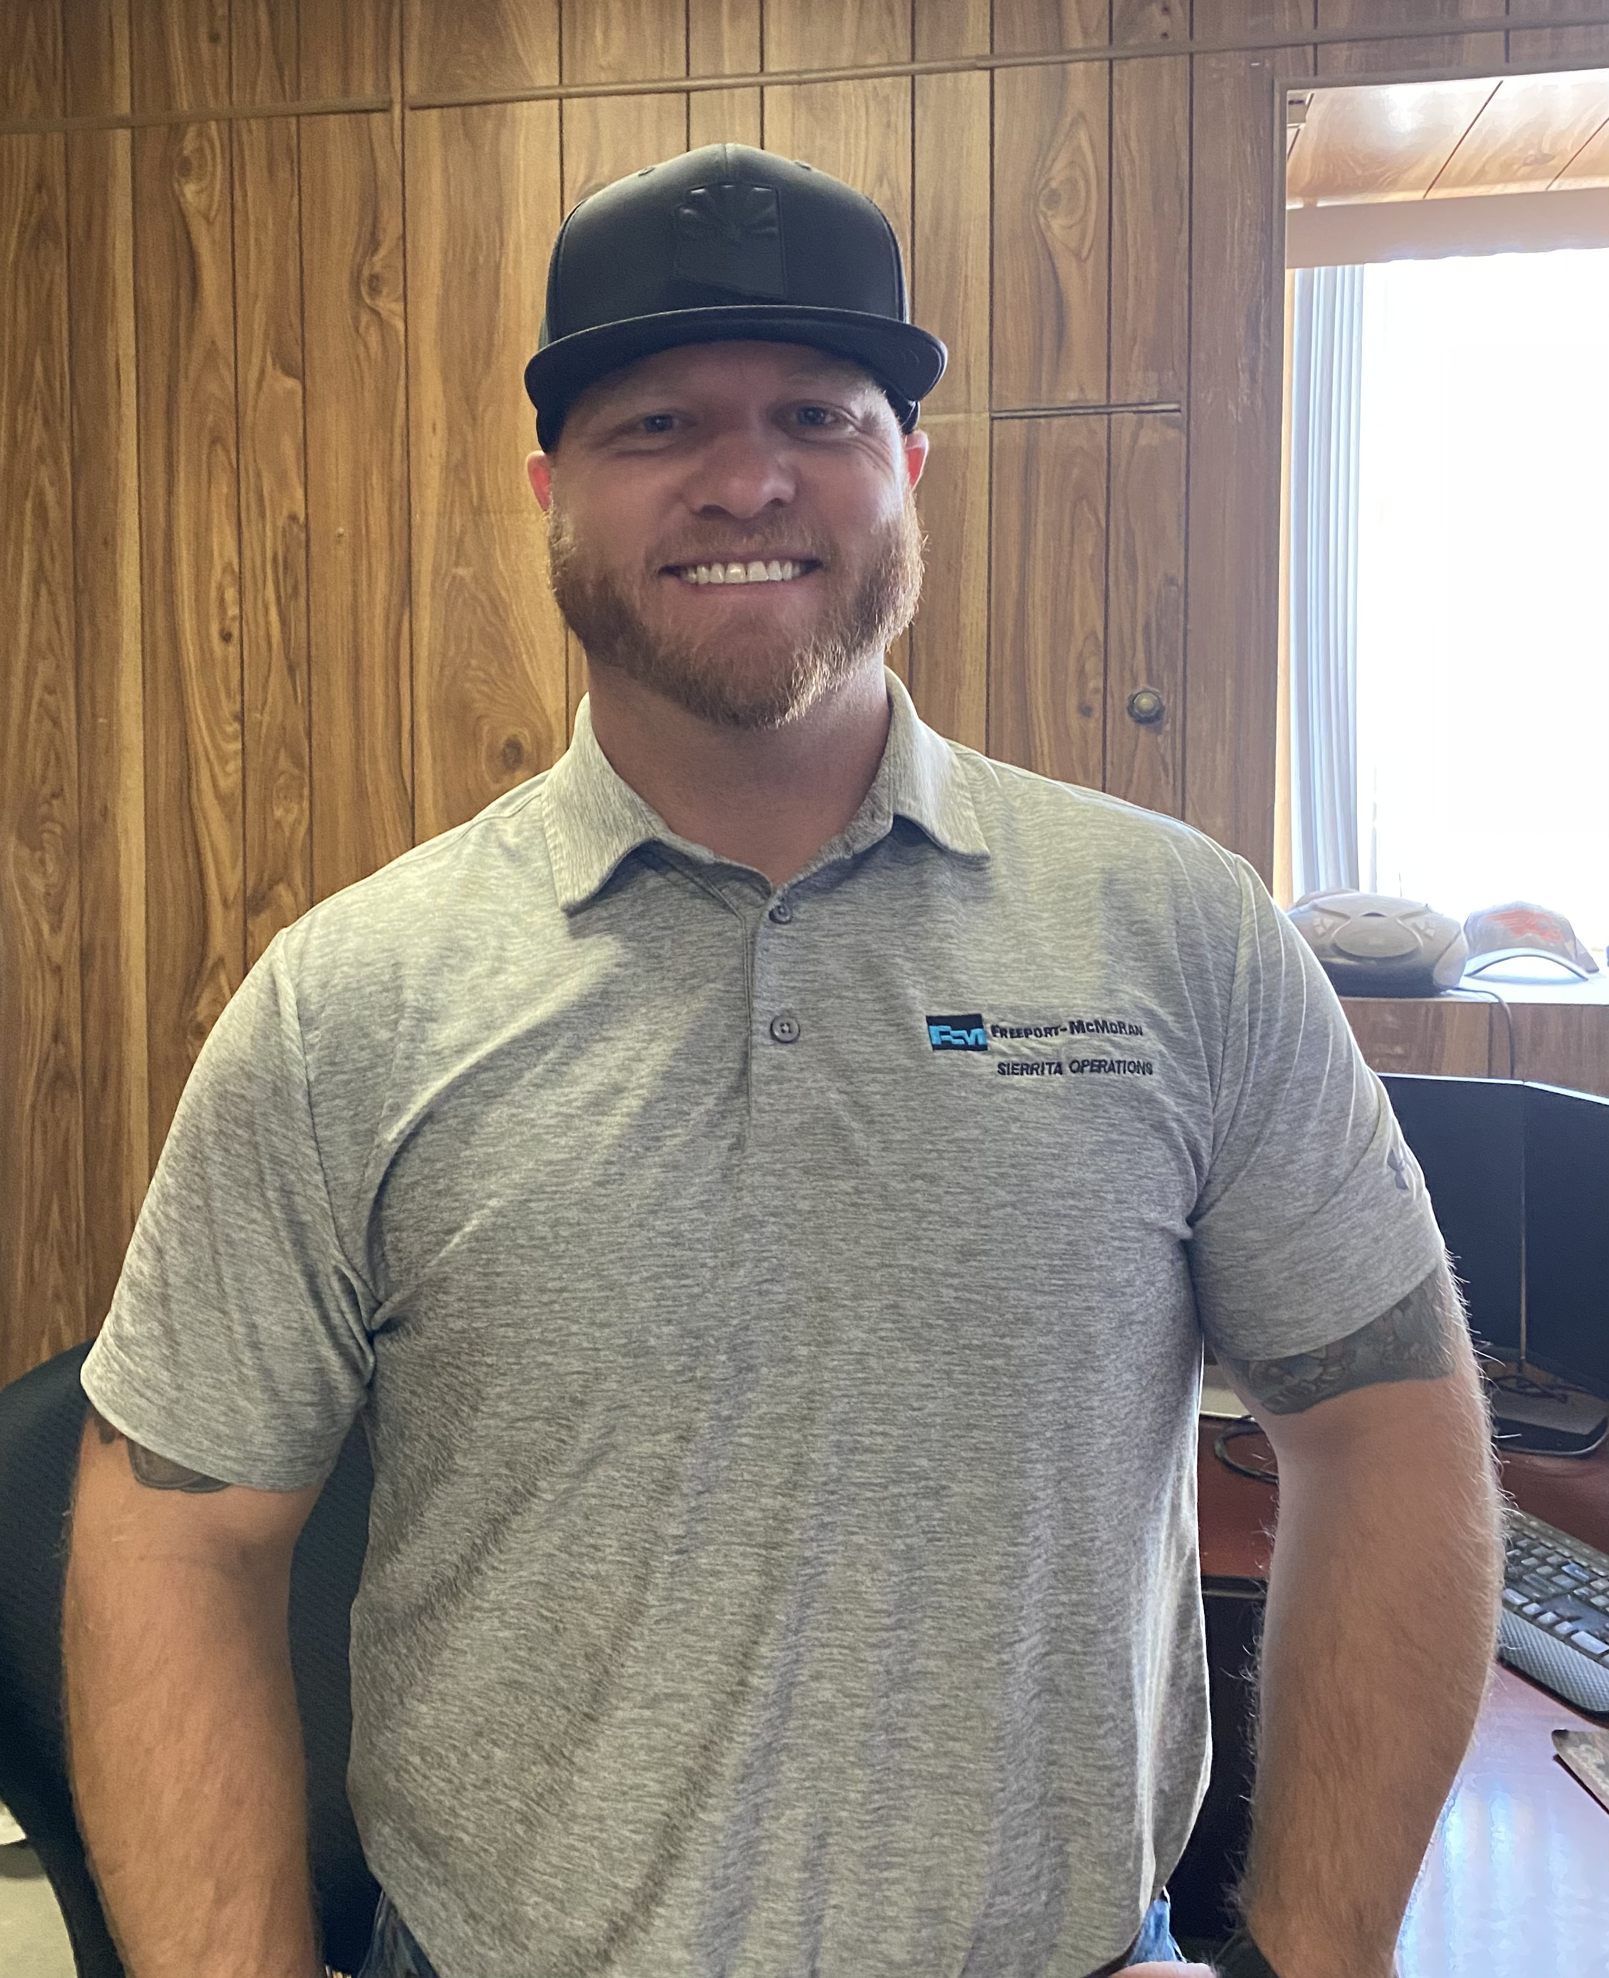
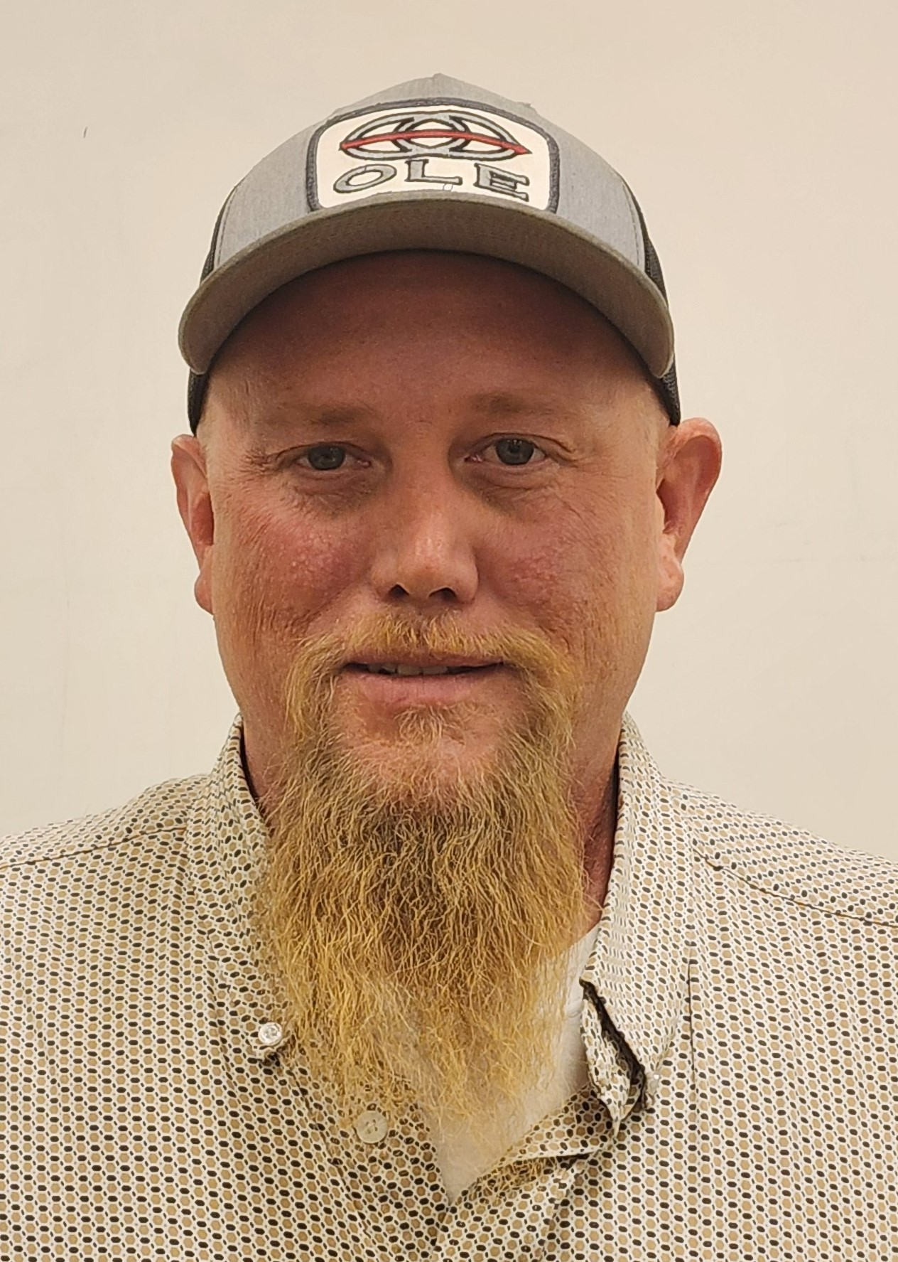
Operations Leadership Team
hen he returns
Xavier Gallegos, Maintenance Sr. Supervisor
Cody McNutt, Maintenance Superintendent
Chase Weaver, Maintenance Sr. Supervisor

Slide 6
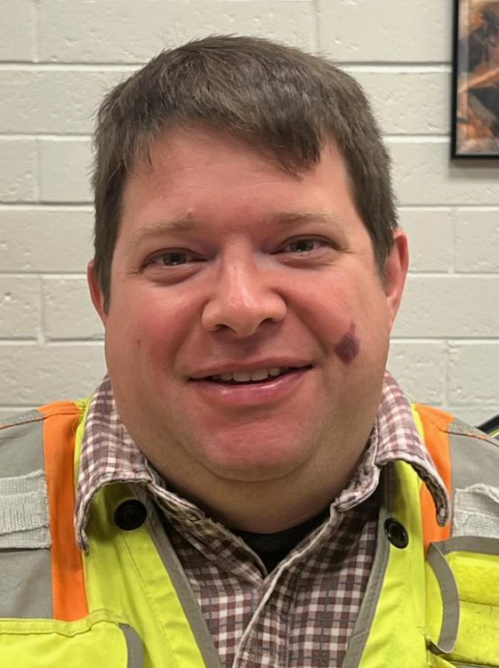
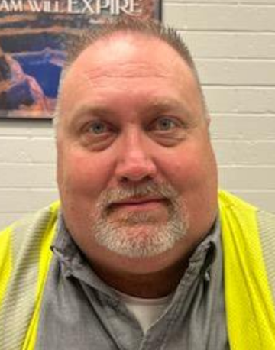
Electrical Leadership Team
Mark Van Arsdale, Electrical Superintendent
John Smith, Electrical Sr. Supervisor

Slide 7

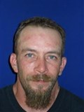
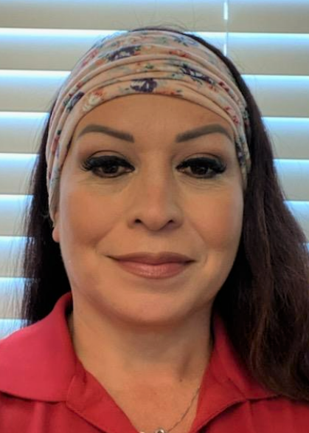
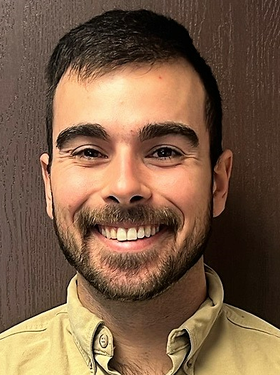

Some additional resources to help you out in the Morenci Mill
Health & Safety
Training
Human Resources
Environmental
Harry Foster
Safety
David Ramey
HS3
Bernadette Ramey
Christiana Mingura
Thomas Ashy

Slide 8
The Morenci Concentrator has several components and areas…

Slide 9
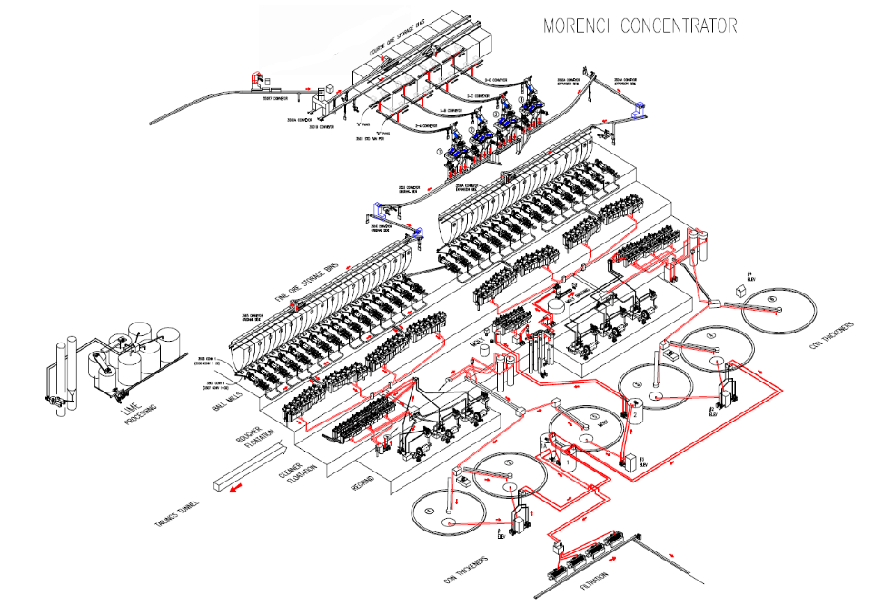
The Mill is a complex system consisting of a number of different areas
The Morenci Concentrator was commissioned in 1942 in support of the war effort
Copper production is now focused on supporting the global electrification effort
The Concentrator is made up of:
  32 Ball Mills
  Rougher Flotation
  Cleaner Flotation
  6 Concentrate Thickeners
Notes:
The feed chute introduces ore into the mill.
Grinding media are loose objects that move freely inside the mill. They break using a tumbling action. Steel rods, balls and large pieces of ore are common types of grinding media.

Slide 10
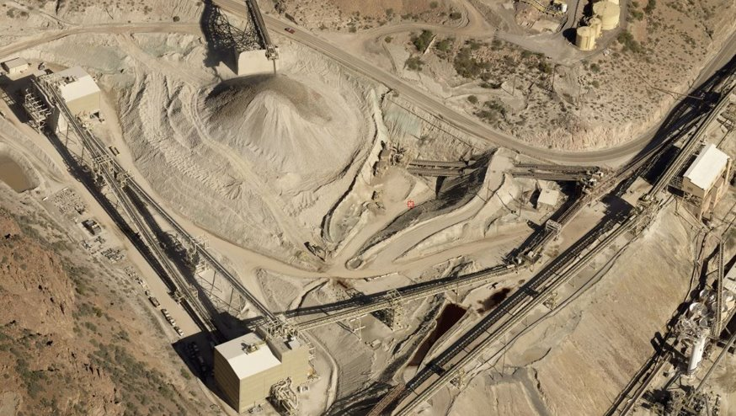
Our process starts with the Mill Intermediate Ore Stockpile/ Canyon…
Stockpile
(Main IOS)
R1A Belt
(top 1)
R1A to R7
Transfer Tower
Morenci Lime Plant

Slide 11
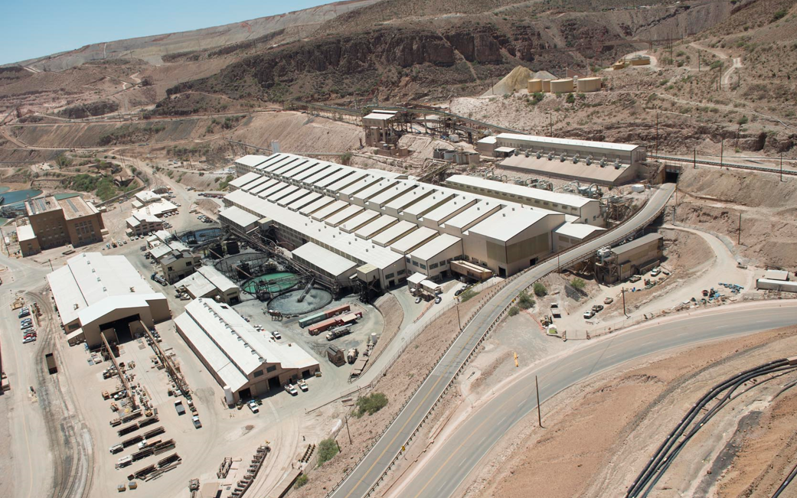
Morenci Concentrator
…and winds up in the Concentrator and moves on to Tailings.
Corse Ore from IOS
MCE Building
Morenci Concentrator
Electrical Shop
Pump Shop
Secondary Crushers
Concentrate Thickeners
Boiler Shop
Industrial Railroad Shop

Slide 12
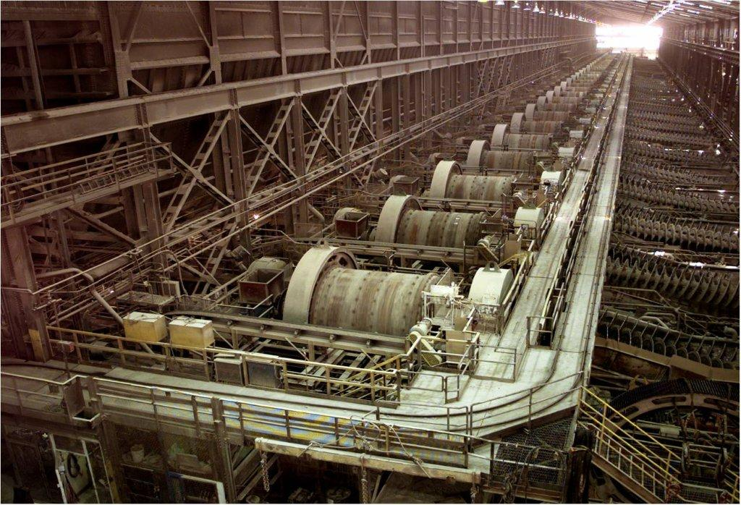
A bird’s eye view of the Morenci Ball Mill Floor
The Ball Mill Floor consists of:
32 Ball Mills in
2 Main areas:
16 Extension Side
+
16 Original Side
Notes:
32 ball mills total. Original side has 16 and extension side has 16. Hearing protection needed between mills till the 6 and 7 belts. Classifiers are used for particle size separation. Classifier overflows feed the Rougher flotation circuit.

Slide 13
In case of emergency it’s important that you know what to do…

Slide 14
Emergency Response “Mayday” Procedures
There are several medical events that are considered serious in nature that require the use of our “Mayday” procedures. Those events include:
ANY Chest Pains
Difficulty Breathing​
Unconscious/Unresponsive Person​
Electrical Shock ​
Major Trauma​
Seizures​
If you experience, or witness, any of these events, activate a Mayday immediately.

Slide 15
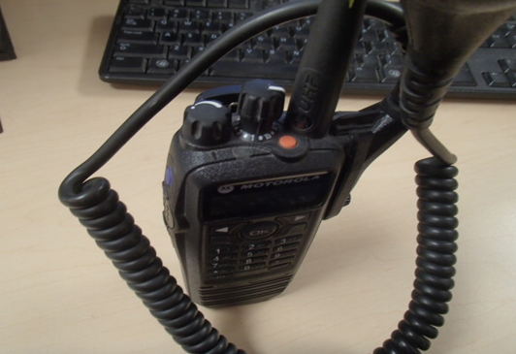
How to activate a Mayday
If you’re in an area and have access to a two-way radio utilize the orange button or:
Call “Mayday, Mayday, Mayday" on a channel that is monitored by the control room (i.e., Morenci Concentrator)
If you’re in an area and only have access to a telephone:
Call 928-865-6600 and report a “Mayday” situation. Stay on the phone until you are told to hang up.
Press the orange button and wait for dispatch to answer

Slide 16
A few more things to keep in mind when calling in a Mayday…
DO NOT transmit the name or vehicle/equipment number of any injured party over any radio frequency or cell phones.
Unofficial family notification by people that privately scan radio frequencies places unnecessary stress on injured employee’s family.
Other reasons a Mayday may need to be activated that aren’t medical related:
  Dumpster Fire
  Vehicle Fire
  Office or Building Fire

Slide 17
What to do if you’re involved in a medical event that doesn’t require a Mayday…
If involved in a medical incident which does not constitute a full Mayday response, call 928-865-6600 and let them know you have a non-emergency situation.
If any of the following criteria is met, contact a member of the ERRT team to determine the correct response. ERRT will help you to determine the safest mode of transport to the clinic.
Conditions which can utilize a non-emergency response:
  Vomiting and become dehydrated
  Experiencing neck pain
  Experiencing complications with personal medical condition,
  (allergies, diabetes, etc.)
  Dehydration

Slide 18
There may be situations that require the Mill to be evacuated
Ways you may be notified of the need to evacuate:
In the event of an evacuation, you should:
Alarm sounds 3 times in a row
Notified By Supervisor or Control Room Operator
Notified by phone
Notified by radio
Remain Calm
Make your way to the closest evacuation point
Inform others on the way out that may not be aware

Slide 19
The mill is a big place, it’s good to familiarize yourself with your closest evacuation point for headcount
Bernadette to follow up on appropriate location for Point 2
Original Cleaner/Regrind Area
Evacuation Point 1
Report outside the S&R Lunchroom
Original Side Ball Mill & Back Alley Offices
Evacuation Point 2
Report outside the West Repair Bay (Tool Room)
Extension Side Flotation & Extension Side Cleaner/Regrinds
Evacuation Point 3
Report outside the east end of the mill in front of the Crusher Safety Assembly room.
Extension Ball Mills and Upper Levels of Secondary Crusher & Feeders
Evacuation Point 4
Report out the back alley
Ore Belts and Corse Ore Area
Evacuation Point 5
Near Transfer Tower to R Belts
Tailings Dam Maintenance
None Needed
Southeast corner of the parking lot

Slide 20
Morenci Concentrator Escort points, know where to go
Evacuation Point 5
Evacuation Point 2
Evacuation Point 1
Evacuation Point 4
Evacuation Point 3

Slide 21
Evacuation Point 1 – Cleaner Regrind Area
Report outside the S&R Lunchroom

Slide 22
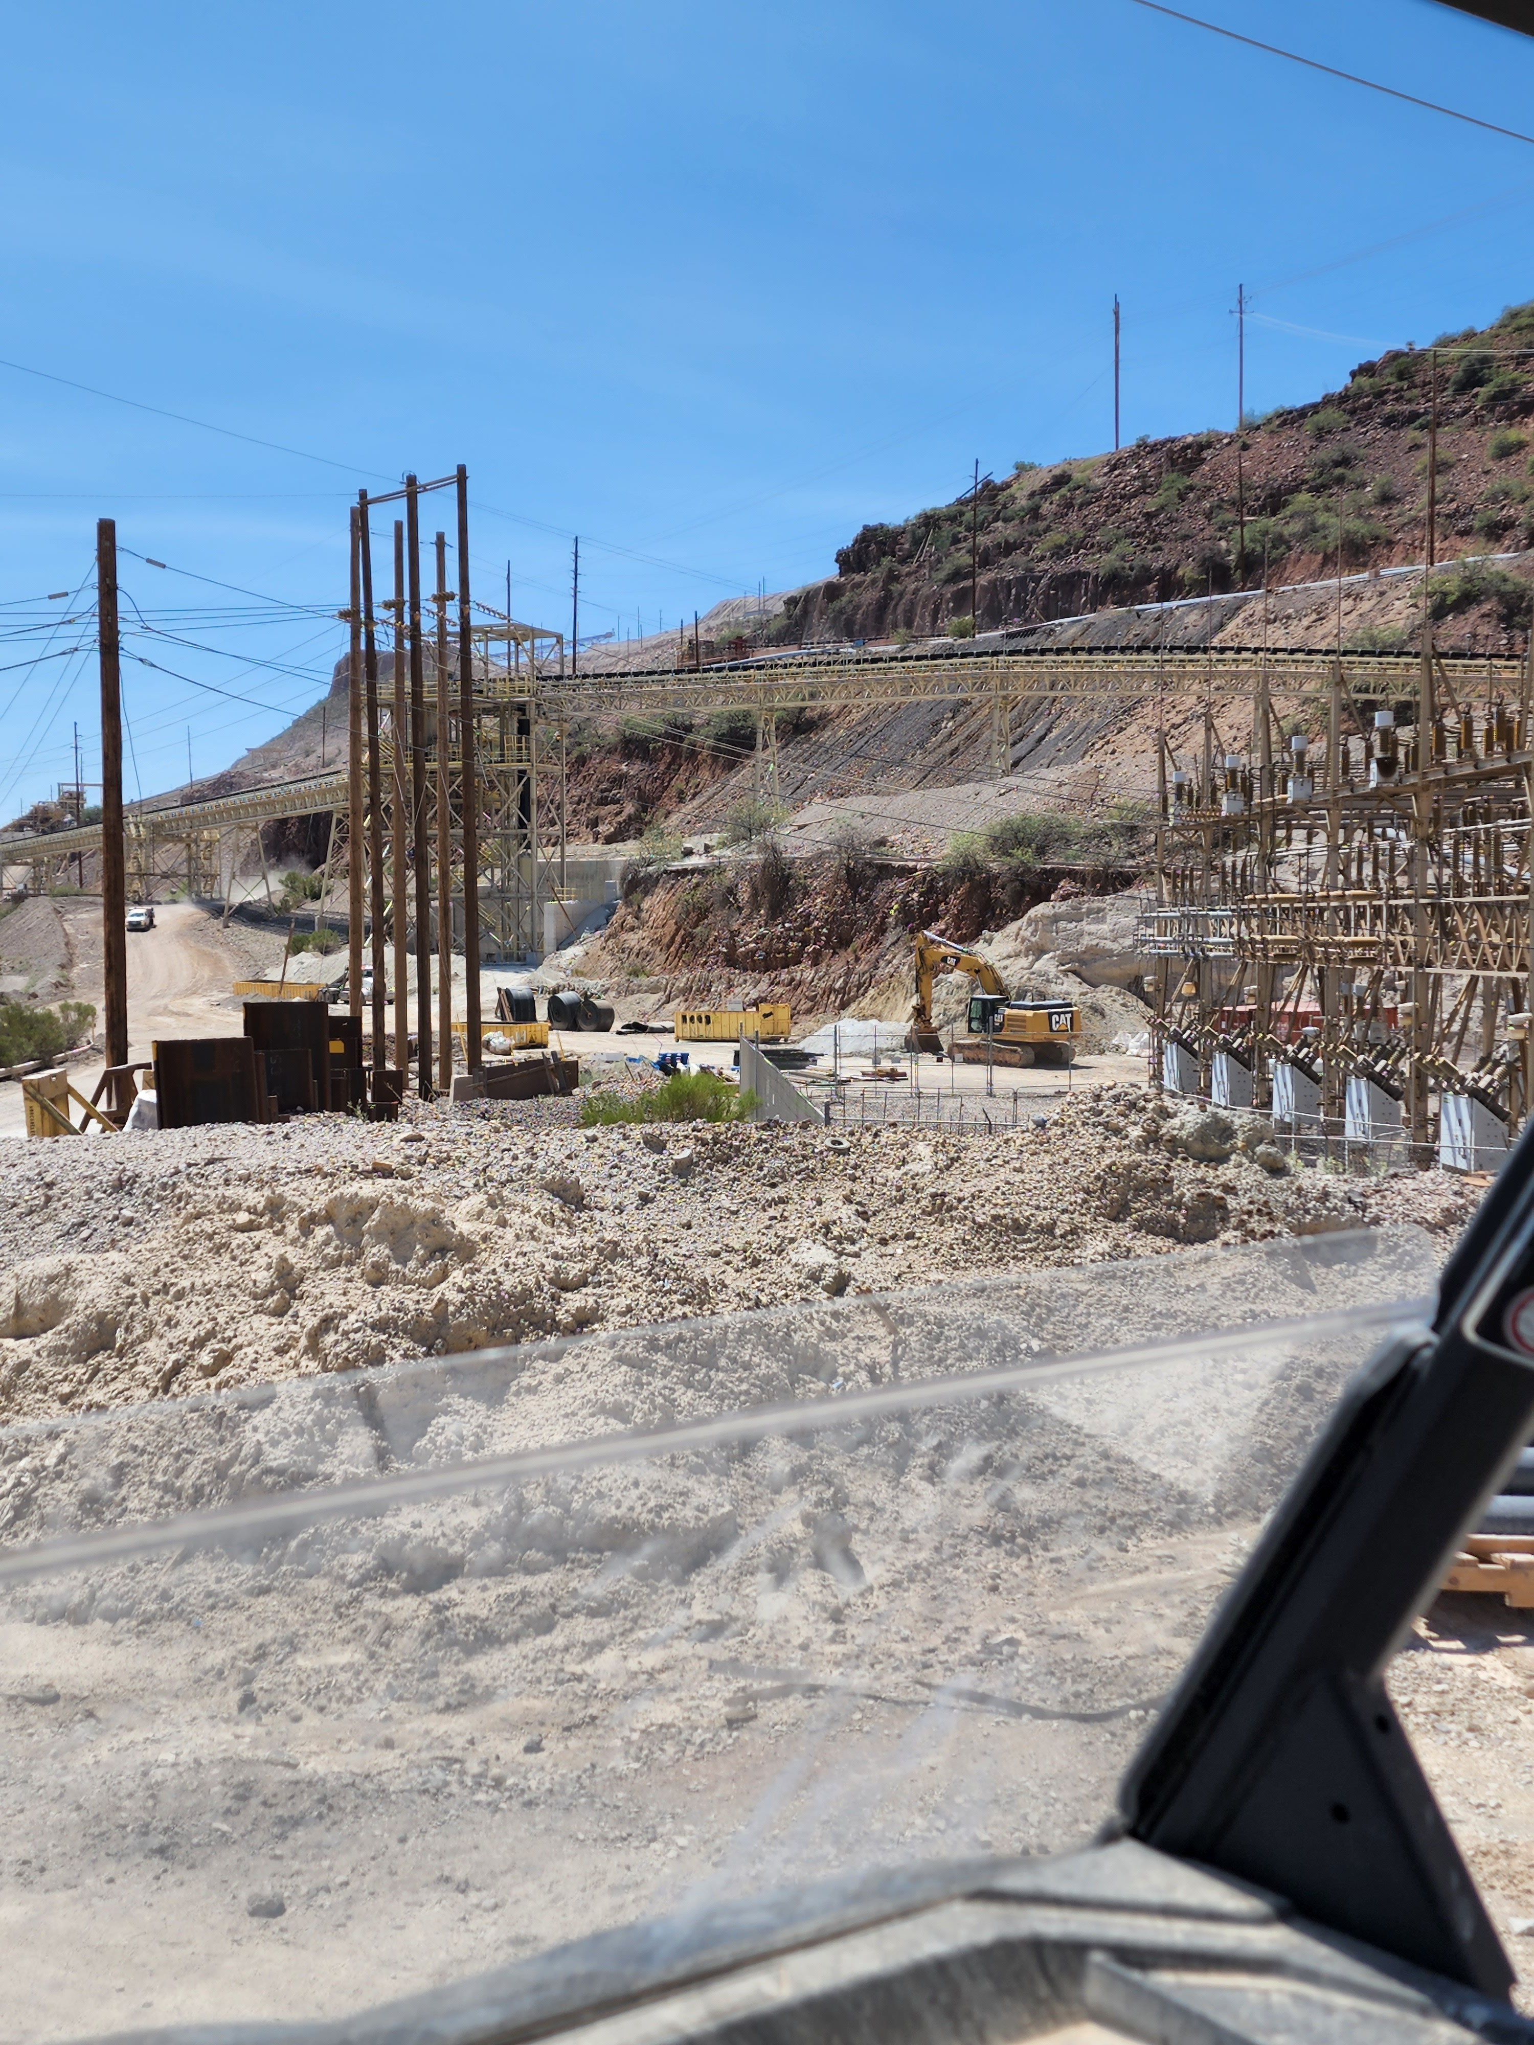
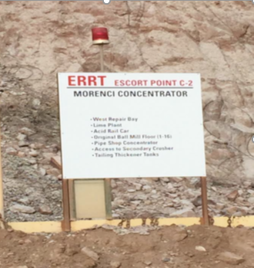
Escort #2
Evacuation Point 2 – Original Side Ball Mill & Back Alley Offices
Bernadette to follow up on appropriate location
Report outside the West Repair Bay (Tool Room)

Slide 23
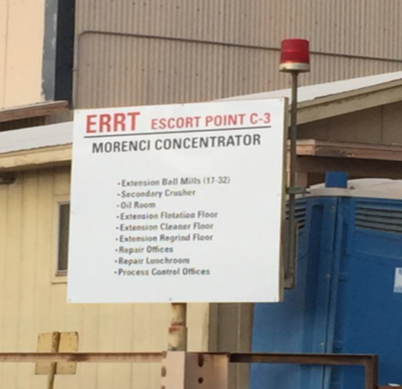
Escort #3
Evacuation Point 3 – Extension Side and Morenci secondary crusher
Report below the Maintenance Lunch Room

Slide 24
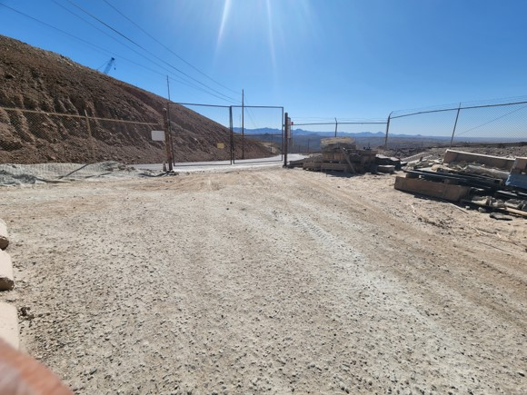
Escort #4
Evacuation Point 4 – Upper Levels and Secondary Crusher & Feeders
Report at the Crusher 1 Gate

Slide 25
Escort #5
Evacuation Point 5 – R Belts and Corse Ore Area
Report to the Transfer Tower

Slide 26
Personal Protective Equipment (PPE)

Slide 27
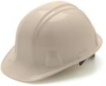
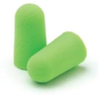
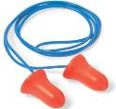

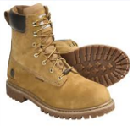
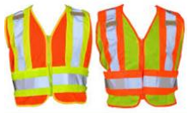
There are some required basic PPE required for all employees entering the Morenci Mill
Hard Hat
  All hard hats must be ANSI approved
  Long hair should be tucked into the hard hat
Glasses w/sides shields
  ONLY clear glasses in buildings and at night
  Prescription glasses must have side shields and be ANSI approved
Work boots
  Must be at least 6” tall
  Provide good ankle support
  Must have a steel toe
Hearing Protection
  A variety of types are available based on user comfort
  Additional hearing protection may be required in various areas
Reflective Vest
  Required for ground visibility and anytime in production areas

Slide 28

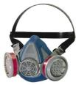
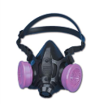
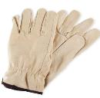
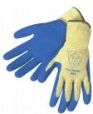
Additional PPE may be required based on the area and exposure, keep your eyes posted for signage with requirements
Ear Protection
  Additional hearing protection may be required in areas where the sound level is above specific decibels.
  Keep your eyes open for signage when additional protection is required
Respirators
  Medical clearance is required to be fit for a respirator
  Ensure you are using the proper cartridge
  Make sure you have a good fit after putting your respirator on
Gloves
  Ensure proper types and size of glove for the task at hand.
  Use the right glove for the job!

Slide 29
Preventing illness when working around fine dust and particulates is important for your long-term health
In an effort to prevent silicosis and other potential harm to your lungs, employees are responsible to use the methods below to control exposure:
  Wear your respirator in mandatory areas
  Use the correct filter for each respirator
  Make sure you have a tight seal
  Inform you supervisor of any air leaks or significant weight loss or gain; You likely need a new respirator fit test.
  Change respirator filters, when needed
  Clean respirator before use and seal in bag when not in use.
  Must be clean shaved due to interference with respirator seal to the face.

Slide 30
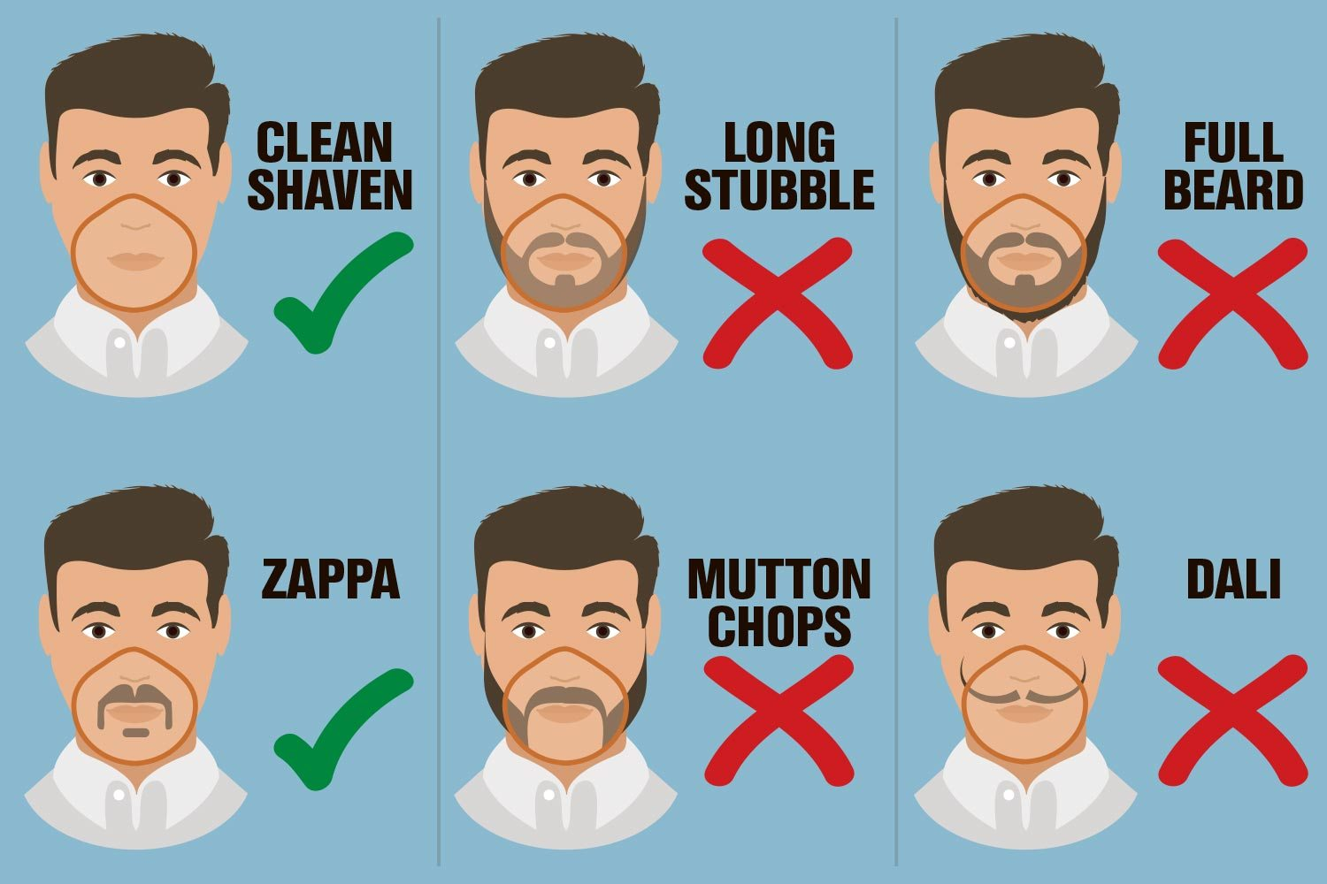
So, what do we mean when we say you must be clean shaven?

Slide 31
Light Vehicle Operation

Slide 32
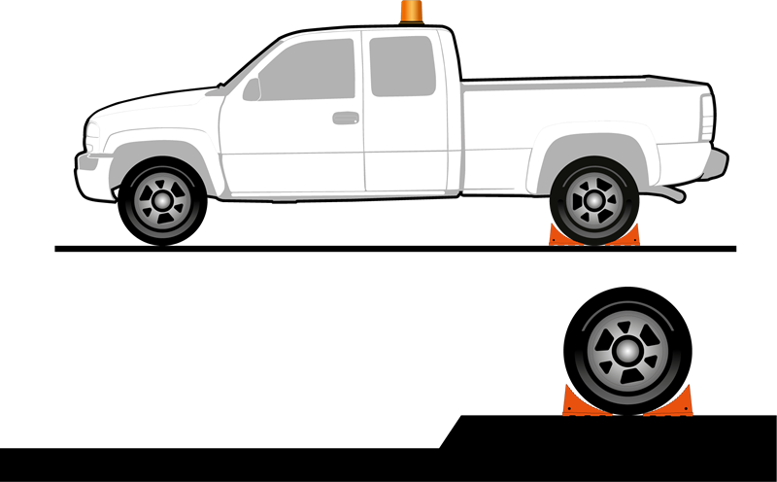
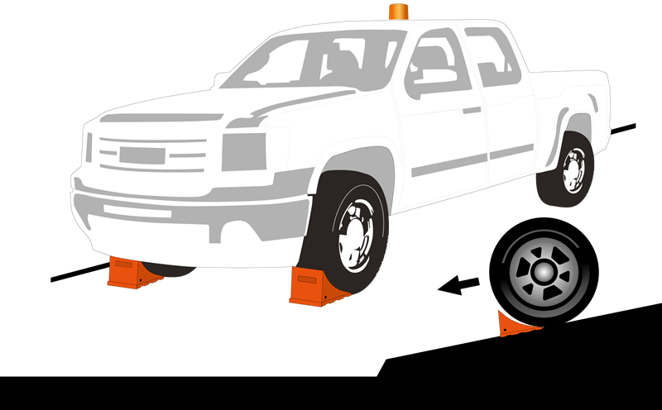
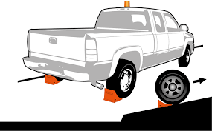
When parking your vehicle, it’s important to ensure it is secured by placing chocks in the appropriate position.
Parking on Level Ground
Parking on a Downhill Grade
Parking on an Uphill Grade
When parking on level ground you are required to place a wheel chock both in front of and behind the rear tire.
When parking on a downhill grade you are required to place a wheel chock in front of both front tires.
When parking on an uphill grade you are required to place a wheel chock behind both rear tires.

Slide 33
Your vehicle’s horn is an important safety feature
Before you even start your vehicle it’s important to honk your horn to ensure anyone in the area is aware you are there and preparing to move.
1
Honk your horn ONCE before starting your vehicle
2
Honk your horn TWICE before you move in a forward motion
3
Honk your horn THREE times before you move in a backward motion

Slide 34
Additional Safety Hazards and Controls

Slide 35
LOTOTO
Before performing work on equipment, ensure you have the right training and tools for the job
If you are performing work on, or working near, hazardous energy you are required to have Control of Hazardous Energy (COHE) Training.
Ensure equipment is isolated from all sources of energy, locked, tagged, and tried before work begins where individuals could be exposed to dangerous conditions. This has been referred to as LOTOTO in the past.
The procedure is established for the protection of people from injury due to unexpected energization, start-up, recharge, or release of stored energy in, on or around the equipment.
  The COHE policy can be found on SharePoint at:
  http://fmweb/sites/morsafety/MORSafety/default.aspx

Slide 36
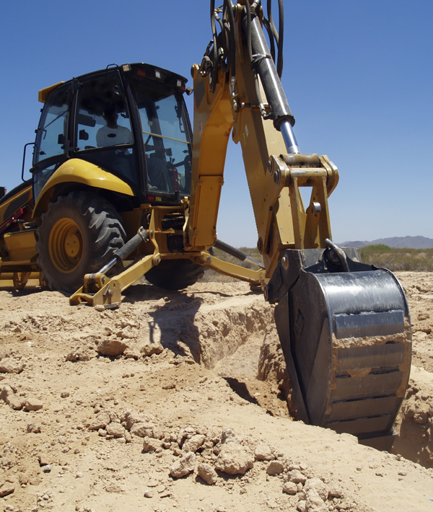
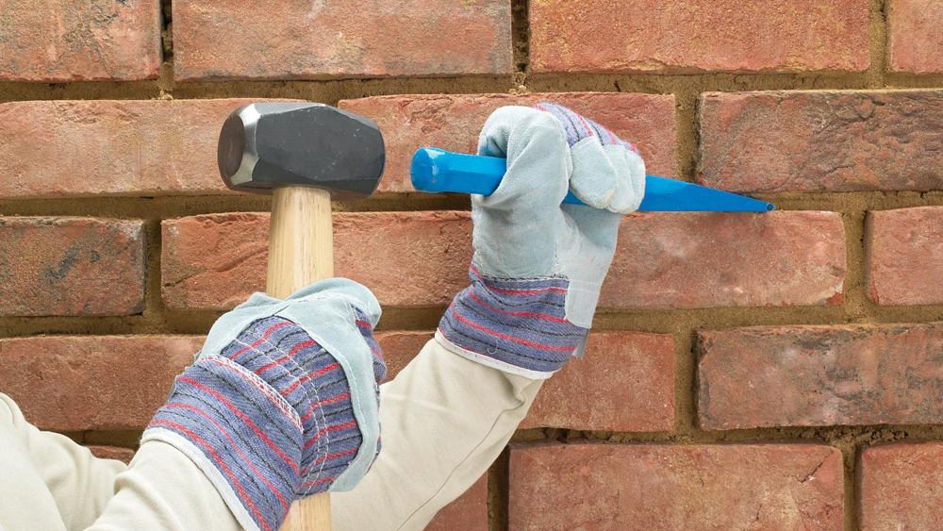
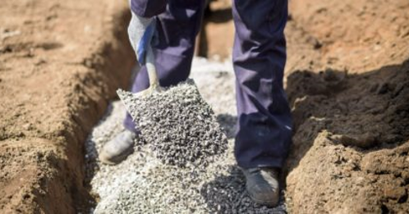
The Blue Stake Policy helps you understand if there are utilities in an area where you’re working
Blue Staking is the act of locating and marking underground infrastructure and facilities, such as electric, gas, water, telephone and cable lines, to prevent them from being damaged, having service disruption and preventing injury during any digging or excavation activities.
      Electric
      Gas
      Water
      Telephone
      Cable
      Other Utilities
Any time there will be a penetration of a surface more than one-inch, employees and/or contractors must obtain a blue stake permit 48 hours in advance.

Slide 37
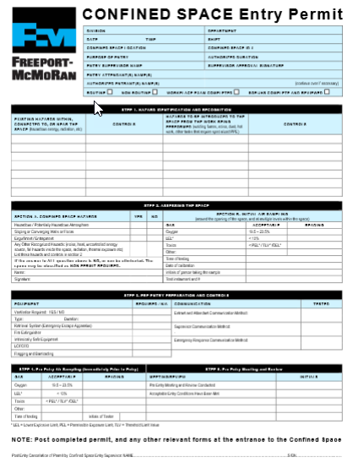
Working in a confined space may require additional training and processes
Confined spaces are defined as any space that:
  any space that is large enough for a person to enter
  is not designed for continuous occupancy
  has limited means of entry or exit
There are two classifications of confined spaces:
  Permit required confined space
  Non-permit required confined space
  **Remember – Do not enter a Confined Space without the proper training and equipment!

Slide 38
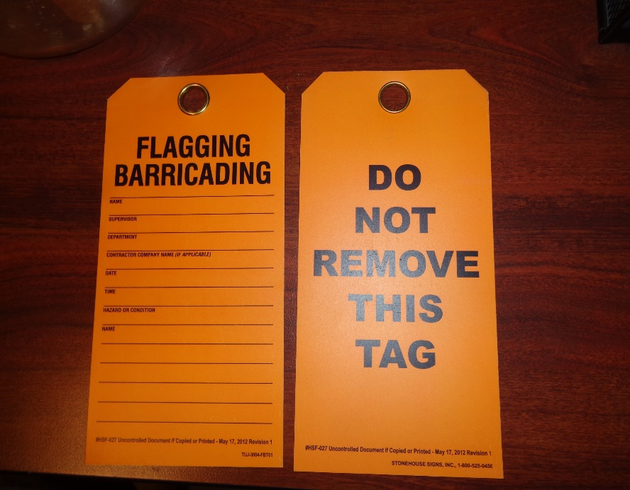
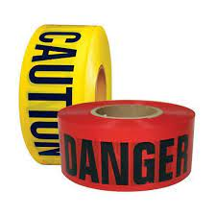
Be aware of Restricted Areas and the appropriate Flagging and Barricading
It’s important to be aware of any areas that are barricaded or marked with flagging and the associated hazards.
Red Tape = High Energy Hazard
Yellow Tape = Low Energy Hazard
Do not enter a flagged or barricaded area unless you are engaged in resolving the specific issue noted on the tag.

Slide 39
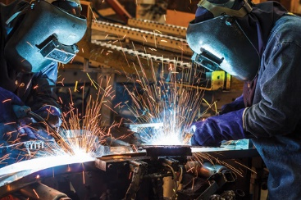
Performing “hot work” requires additional training and skills
Hot work is defined as work involving electric or gas welding, cutting, brazing, or similar flame or spark-producing operations.
A hot work permit is required for hot work operations on or near operational processes.
Hot work class is mandatory for anyone involved in hot work, including fire watch.

Slide 40
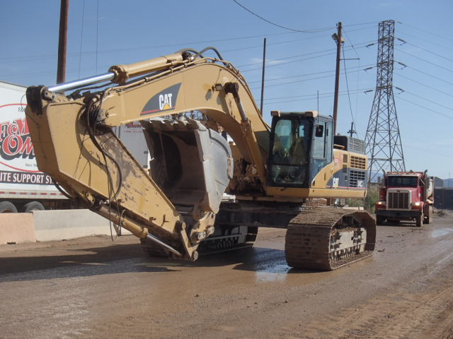
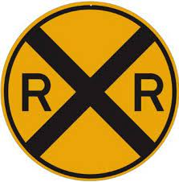
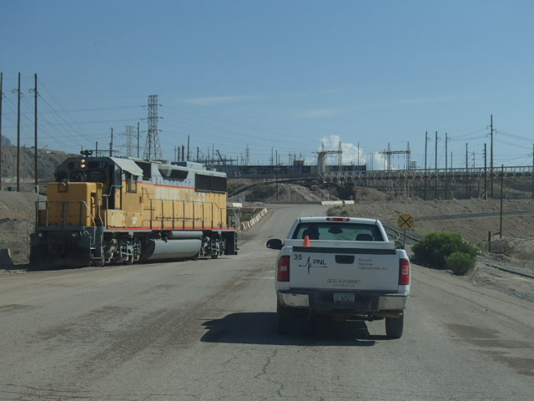
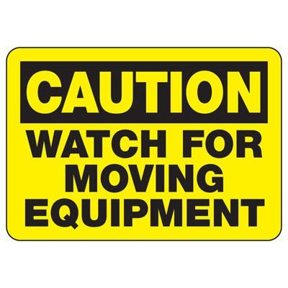
Always be aware of heavy machinery and equipment in the area, including railroad traffic
Be aware of your surroundings. The industrial railroad runs near the Morenci Mill, so always look both ways!
We also utilize a number or pieces of large equipment including industrial cranes. Don’t forget to also look UP!

Slide 41
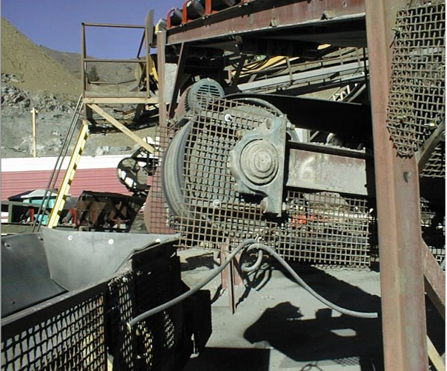
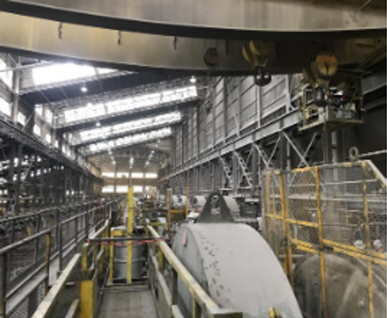
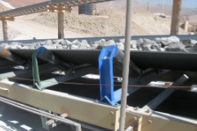
Stay clear of moving machinery and pinch points
In order to prevent anyone getting entangled in moving machinery, there are several precautions in place and actions you should keep in mind:
Safety guards and signage are in place to keep you safe
Don’t wear loose fitting clothing and tie back long hair near moving machinery
Never insert anything (hands, tools, etc) into pinch points or moving machinery

Slide 42
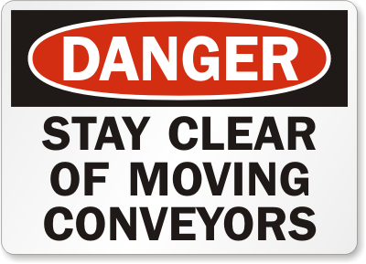
The Morenci Mill consists of a lot of moving parts, including conveyor belts
There are a few important things to remember about conveyor belts:
Conveyors can and will start at any time
Conveyors are equipped with pull chords to stop movement in case of emergency
Never cross a moving conveyor belt, except in areas where a crossover is provided

Slide 43
There are a number of chemicals used in the mill. Let’s take a look at a few of them and the hazards they cause
We use many chemicals and reagents to help with the processes of milling. Some of the chemicals or solutions are abrasive in nature and injuries may occur as a result of contact and rubbing of the eye.
Collector
Forms a thin grease-like film on the outer surface of sulfide ores. This film makes the sulfide minerals able to attach to air bubbles so they can be carried to the surface for the flotation machine and removed in the froth. May cause irritation to eye burns and can trigger allergic skin reactions.
Frother
Lowers the surface tension of the water and produces a bubble which is strong enough to carry the mineral-laden froth up and away from the slurry without breaking up too soon. Will burn if ignited and cause irritation to the skin and eyes.
Lime
Controls the pH of the slurry and helps depress pyrite. It is our primary reagent. Pyrite contains sulfur which will attract the collector, but it likes the calcium in the lime better. When it comes in contact with lime the collector will not attach to the sulfur atoms. Will burn skin whether in pure state or mixed with concentrate. NEVER allow concentrate slurry to enter boots or gloves when wet.

Slide 44
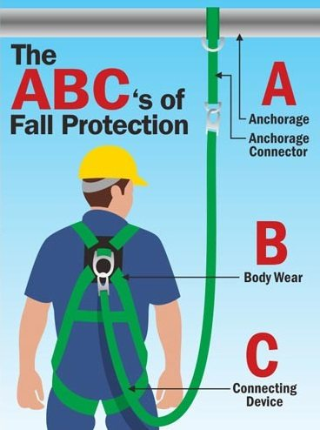
Any time there is a risk of falling, it’s important to ensure you have the right fall protection for the job
The purpose for fall protection is to protect employees from falling from one surface to another.
You are required to use appropriate fall protection if there is any chance of a fall.
When fall hazards exists, you have two options:
Eliminate the hazard
Provide protection against the hazard
Eliminating the hazard is always the best method. This can be done by using handrails, covering an opening or hole or building a secure platform which prevents the fall hazard completely.

Slide 45
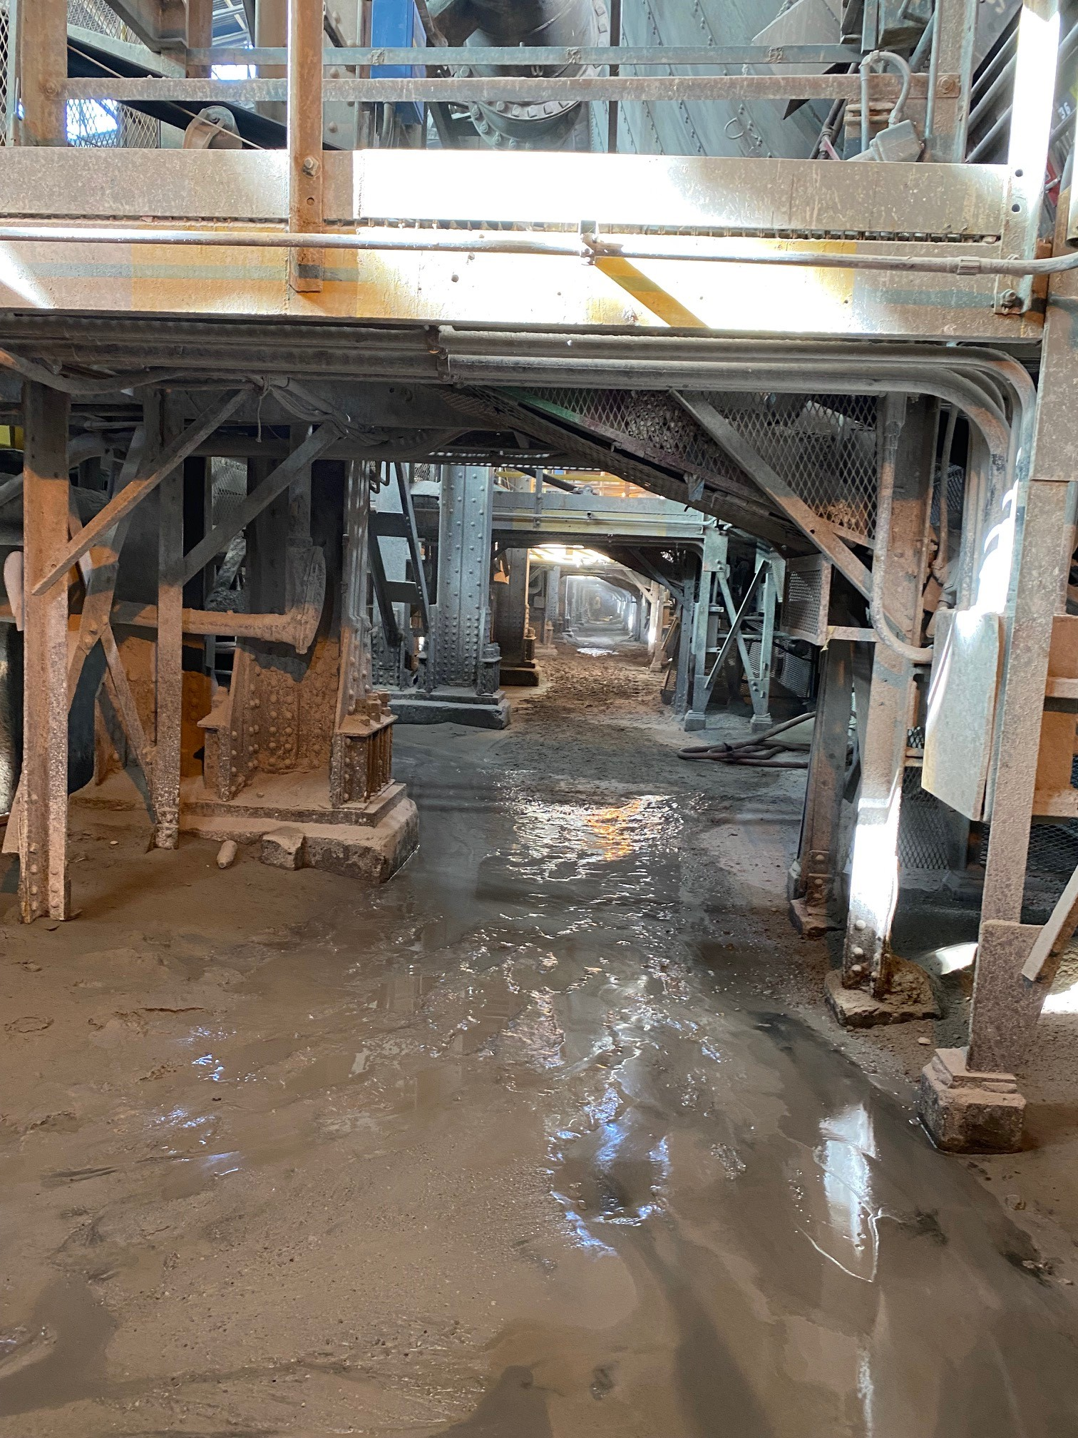
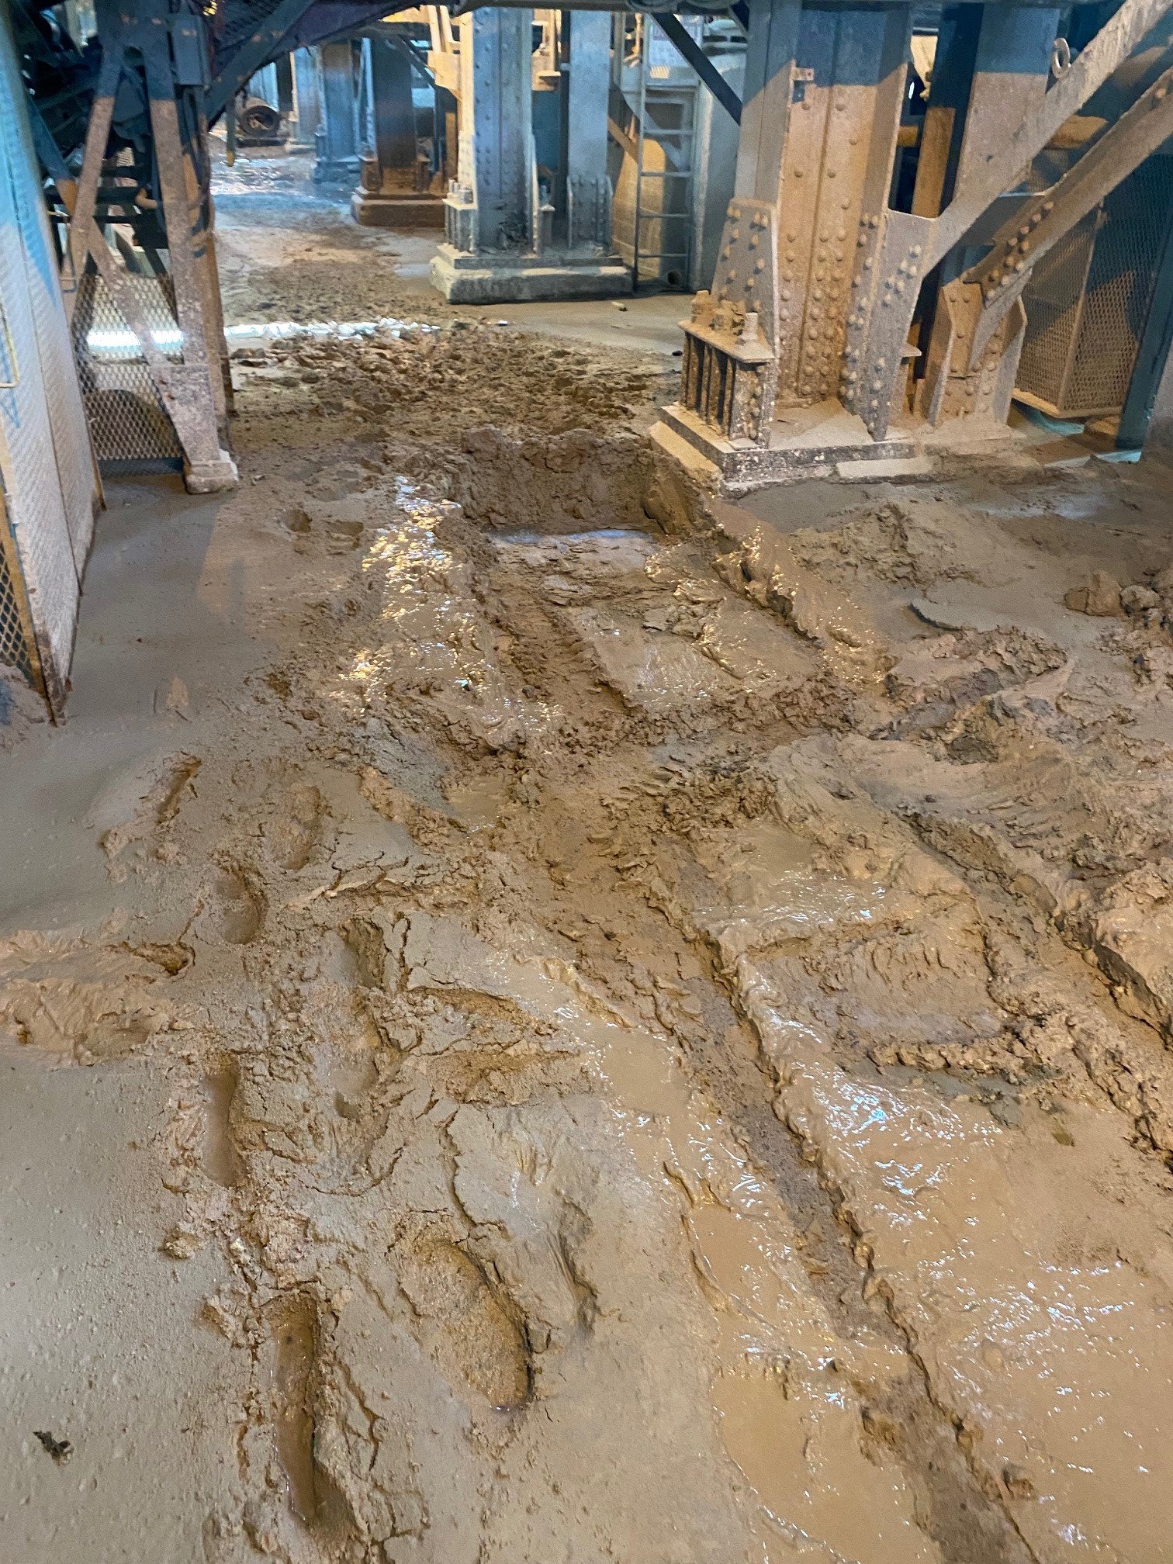

There’s a lot of water in our process…at times it can make for a difficult and risky work environment
WATER
HAZARDS

Slide 46

Our goal is to eliminate any environmental spills. If a spill occurs it’s important to follow the proper procedures
What is a Spill?
A spill is the loss of product or waste, solid, liquid or gas that is released outside normal operations. Spills can occur anywhere, including secondary containments, stockpiles, road ditches, etc.
What to do when a spill occurs
Spills are typically coordinated by the individual department unless Environmental Services advises you otherwise.
Always ask for help if unsure about how to proceed – contact your Supervisor, Environmental Coordinator or or call the Spill Hotline at 928-865-SPIL (7745).
Clean up the spill if it is safe to do so or involve the Surface Department to clean up spills if you need assistance. Contact the Environmental Yard at 928-865-7391 for guidance on how to dispose of the cleaned-up waste if you are unsure.

Slide 47


Keeping your work area clean is the best way to maintain a safe working environment
Housekeeping will always be a prime issue for the concentrator division. Please do your part to keep our workplace clean and safe.

Slide 48

We experience a good deal of lightening in Morenci at times and utilize a lightening detection system to keep you safe
RED – YELLOW – GREEN
GREEN
All is well – keep doing a great job and working!
YELLOW ALERT Prepare to evacuate when and if red alert comes
RED ALERT
Work is Prohibited in High-Risk Areas.
Seek shelter from hazards. Occurs when lightening is 0-4 Miles away
Depending on the work being performed, it is the decision of division management to understand, communicate and enforce specific procedures.

Slide 49

It can get hot out there…make sure you’re prepared to stay safe in the heat and humidity!
Be sure and drink plenty of water every day.
Stay out of the sun, when possible
Apply sunscreen, and repeat as needed throughout the day
Wear lightweight protective clothing.

Slide 50


The Morenci Mill is a strict non-smoking/vaping facility
Smoking is authorized in designated areas only.
Coaching and/or disciplinary action may be taken for any employees, contractors, or visitors found to be in violation of our policy.

Slide 51

Available Outdoor Smoking Areas
West Repair Bay
Outside Main Conference Room
West Staircase leading to Safety Assembly
3 to 4 Conveyor Transfer
Crusher Parking Lot
Crusher East Side of Mill Floor
Outside Coarse Ore Bins
West of electric shop
East of electric shop
1
2
8
3
4
7
9
6
5

Slide 52






We have several “critters” roaming in our work areas; be aware of your surroundings at all times

