Slide 1
Leaching Division
2023

Slide 2
Morenci Leaching Site Specifics

Slide 3
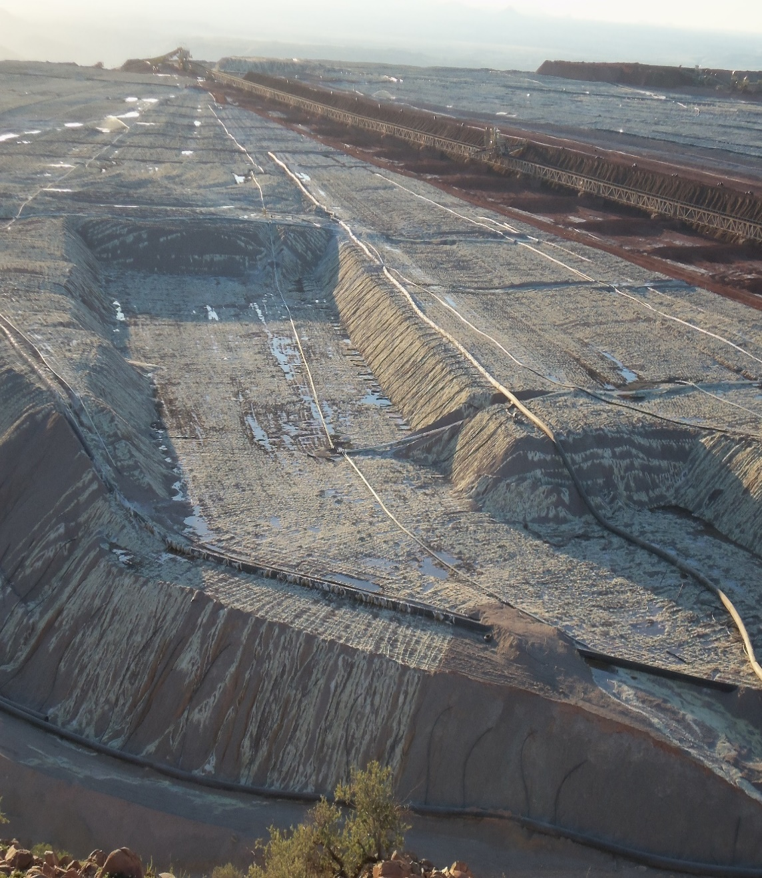
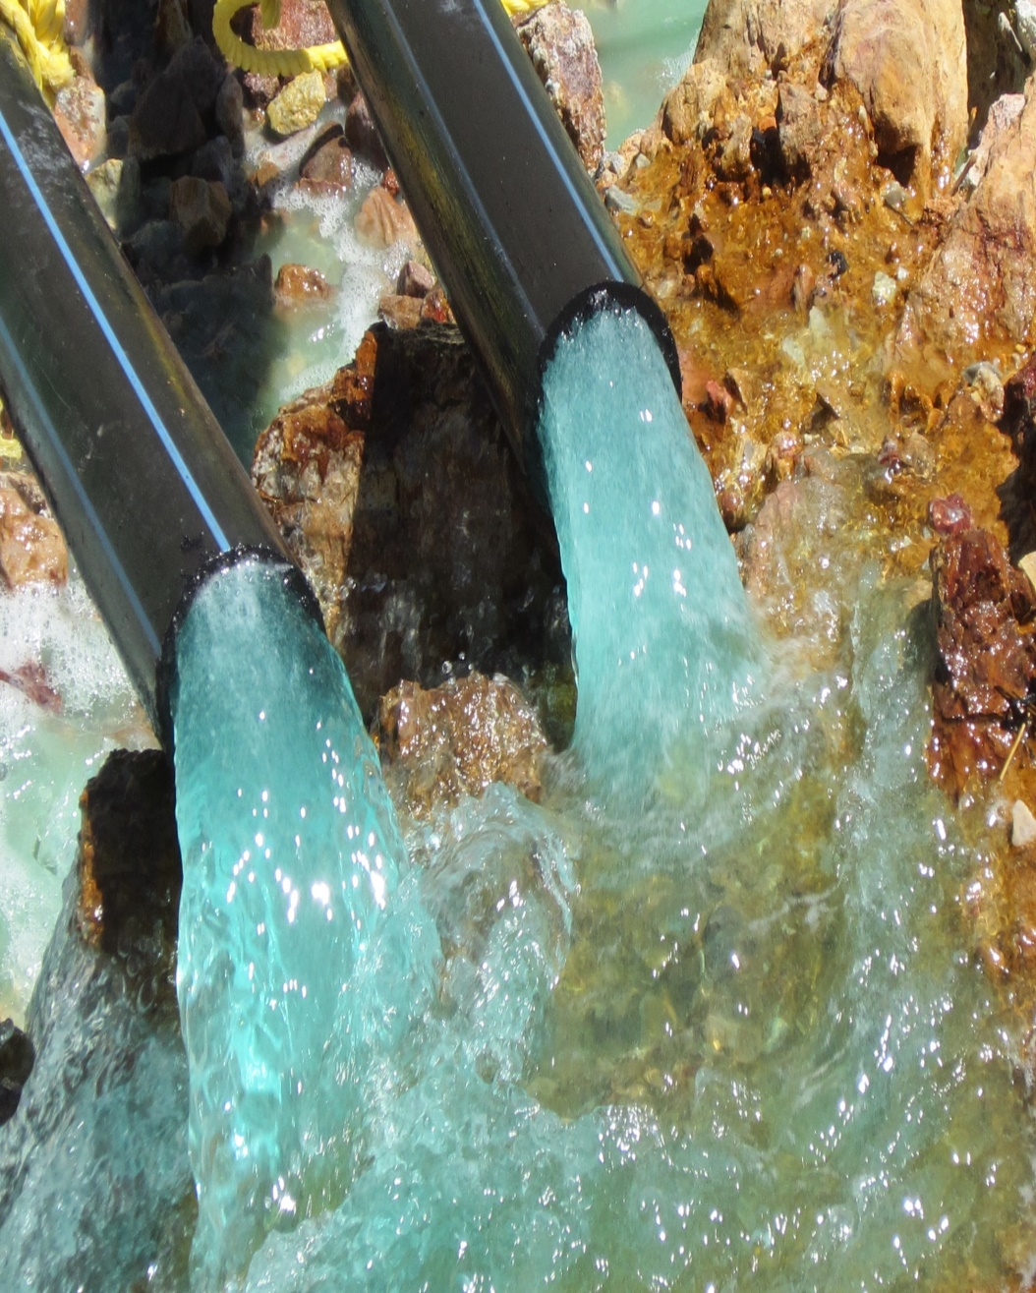
Morenci MFL Leaching Operations

Slide 4
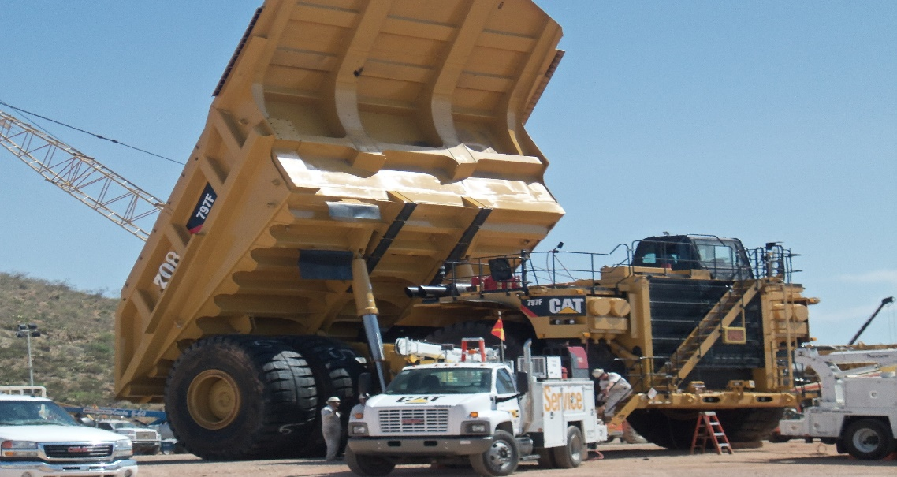
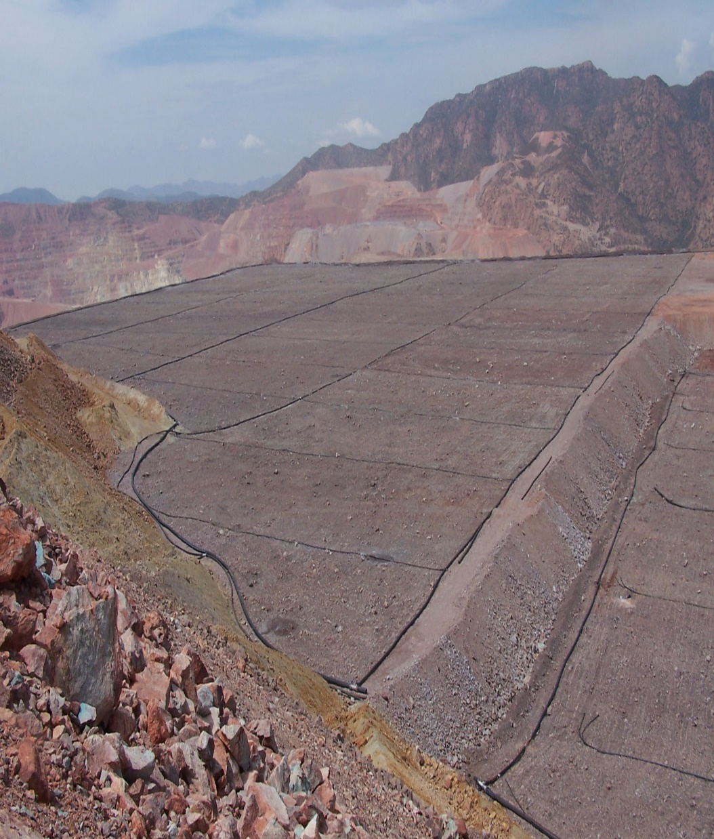
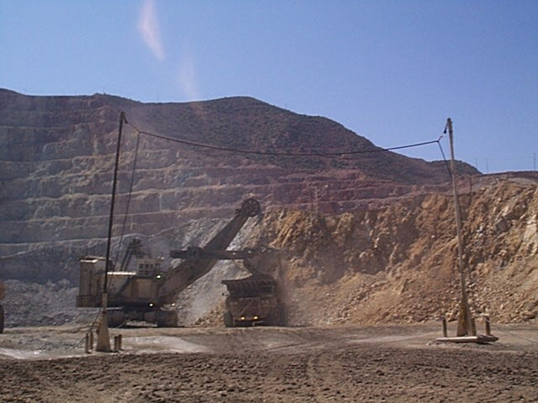
Leaching ROM Operations

Slide 5
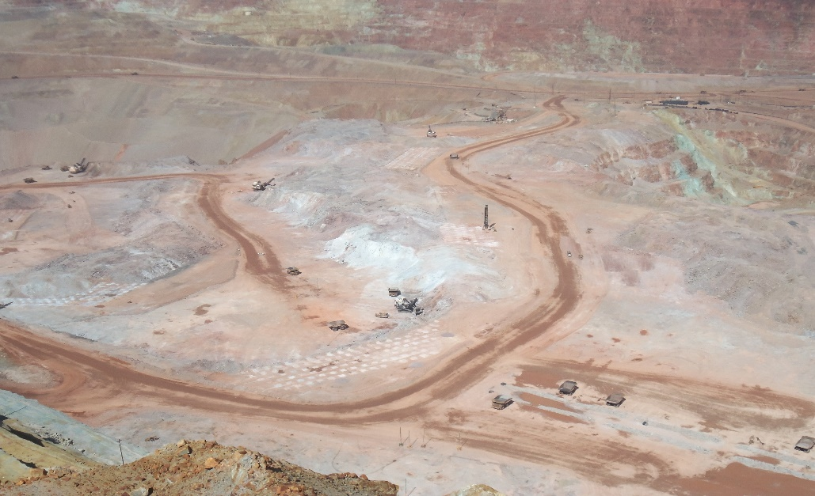
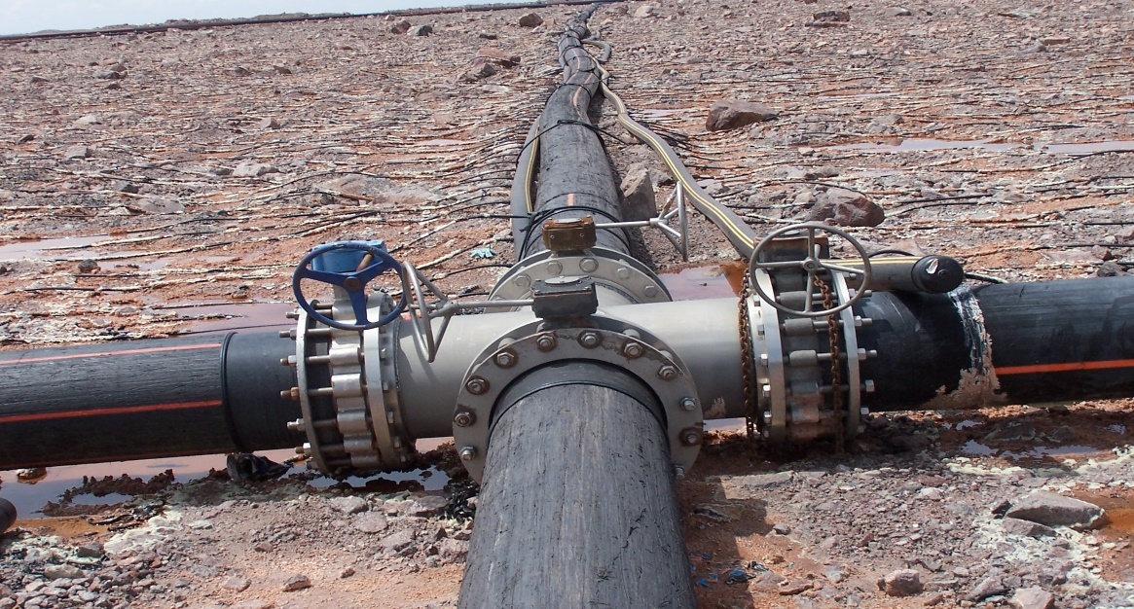
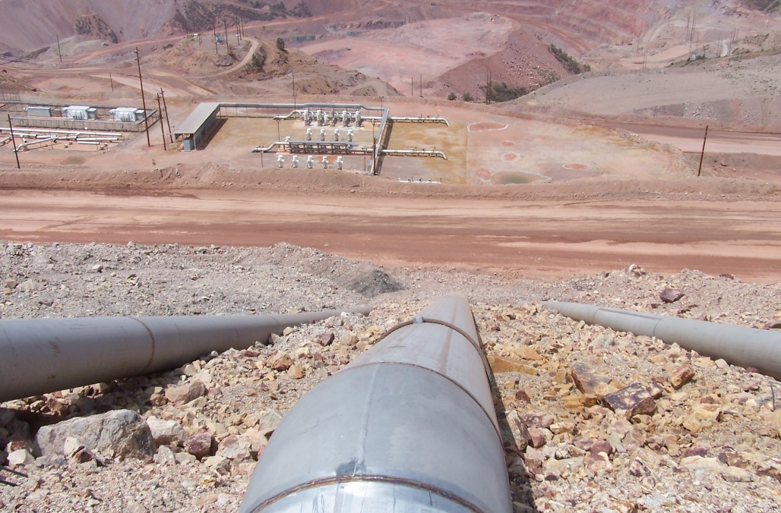

Morenci Leaching Division

Slide 6
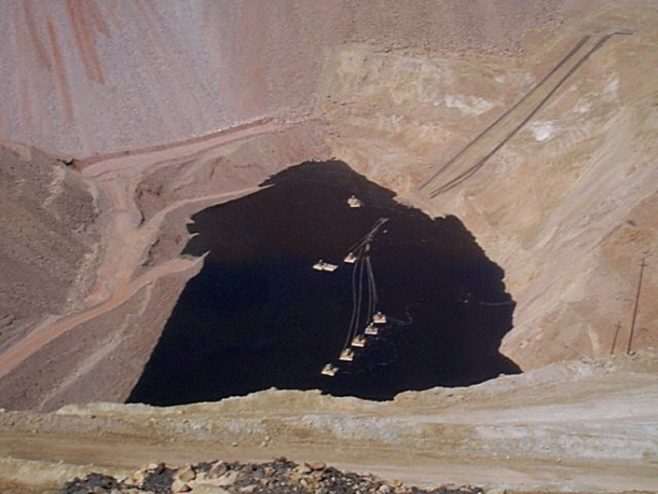
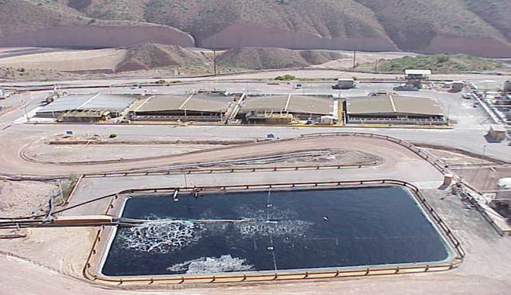
Raff to PLS
Once raffinate solution has leached through a stockpile, it reports at the base of the stockpile as Pregnant Leach Solution (PLS) in a collection sump.
Here is the Central SX Train with the PLS feed pond

Slide 7
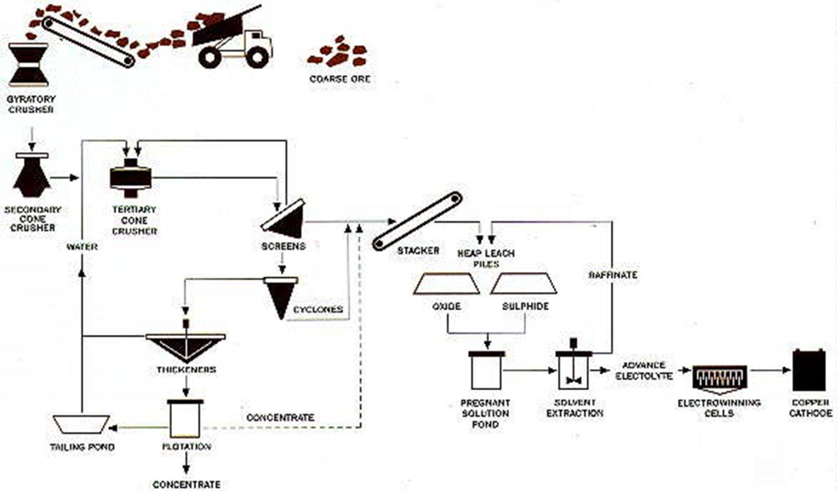
Crushed Ore to Cathode

Slide 8
Introduction
Emergency Response Procedures, "Mayday”
Emergency Procedures
Responsibilities During a Mayday
  Employee
  Security
  Health & Safety Specialists
  ERRT Escort Points & Procedures

Slide 9
Emergency Procedures
All incidents MUST be reported to your supervisor/coach immediately after the incident occurs.
If medical attention is required, it is the supervisor’s responsibility to notify the Emergency Rescue Response Team (ERRT) and the area Health and Safety Specialist.
If you are not feeling well contact your supervisor immediately. Do not continue working or attempt to operate any vehicle or equipment.

Slide 10
Emergency Response Procedures
“Mayday”
In the event of a medical emergency, the following six conditions will constitute a full “MAYDAY” response.
Chest Pains (Any)
Difficulty Breathing
Unconscious/Unresponsive Person
Electrical Shock
Major Trauma
Seizures

Slide 11
EMERGENCY SITUATIONS
MAYDAY! MAYDAY! MAYDAY!
  Fire
  Chest Pains
  Electrical Shock
  Serious Injuries
  Acid Spill
  Hazardous Gas Alarm

Slide 12

Reporting of Emergencies
DIAL
928-865-6600

Slide 13
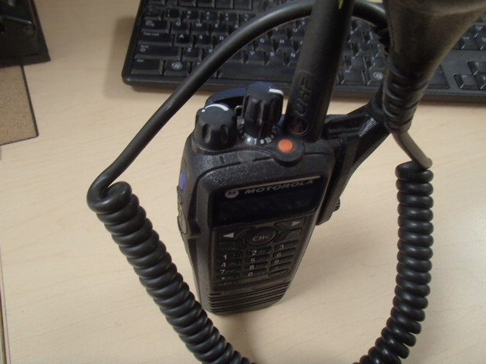
MAYDAY! MAYDAY! MAYDAY!
Press the orange button
DISPATCH WILL CONTACT YOU

Slide 14
Responsibilities for Security
Will write down information from the reporting party.
Will page ERRT (Emergency Rescue Response Team)
Will call ext 7934 if emergency occurs in the mine area.
Will page the Health and Safety Specialist responsible or the “on call” Health & Safety Specialist after hours.
The Mine Gate will record response times and document radio transmissions.
The RW Gate will continue as a resource.

Slide 15
Responsibilities for the Safety Specialist
Will contact the RW Gate to let them know they are responding
Will contact the Incident Commander upon arrival on the scene.
Will serve as a resource and control the scene as necessary for preservation of evidence.

Slide 16
Emergency Procedure
If you are the first person at the scene of an emergency/incident, assess the scene.
  Is it safe for you to enter? If the scene is not safe to enter, make it safe before you attempt to help any injured person.
Set up basic incident command
After you have assessed the scene call for help:
  All Areas by Phone, Dial 865-6600
  All areas, If you have a radio-Call
  “Mayday, Mayday, Mayday”
  Security will notify all necessary emergency response personnel.

Slide 17
Important Information
Provide the following, necessary information:
Location of the emergency/incident-be specific
Nature of emergency and the number of injured people if known
List of scene hazards
What care/treatment has been administered
Caller’s name and phone extension
Location of guide or escort vehicle, if required
Do not hang up until told to do so

Slide 18
DO NOT transmit the name or vehicle/equipment number of any injured party over any radio frequency or cell phones.
Unofficial family notification by people that privately scan radio frequencies places unnecessary stress on injured employee’s family.

Slide 19
Non-Emergency Procedures
If involved in a medical incident which does not constitute a full Mayday response, call 928-865-6600 and let them know you have a non-emergency situation.
If any one of the following criteria is met, it’s advised to contact a member of the ERRT team to determine the correct response. Determine the safest mode of transport to the clinic with the help of ERRT.
If a person is:
  Vomiting and become dehydrated
  Experiencing neck or back pain
  Experiencing complications with personal medical condition,
  (allergies, diabetes, etc.)
  Dehydration

Slide 20
Meeting Points
Employee Parking Lot
Company Vehicle Parking Lot
Off Stockpiles or to Laydown Areas

Slide 21
Escort #4

Slide 22


Slide 23
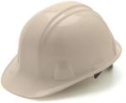
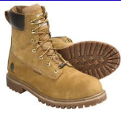

PPE
Hard Hat
  Long hair must be tucked in hard hat
  ANSI Approved
Work boots
  Boots must be at least 6” tall to be in compliance
  Good Ankle Support
Glasses w/sides shields
  ONLY clear glasses in buildings and at night
  Prescription glasses must have side shields

Slide 24
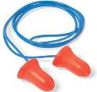

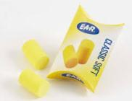
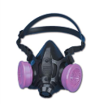
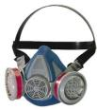
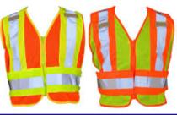
PPE
Ear Protection
  Various types available
Respirator
  Ensure proper cartridge
Reflective Vest
  Required for ground visibility and anytime in production areas

Slide 25
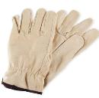
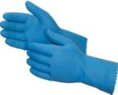
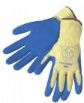

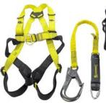

PPE cont’d
Gloves
  -Ensure proper types and size of glove for the task at hand.
    Use the right glove for the job!
      Leather
      Rubber (acid resistant)
      Kevlar
      Cloth
      Latex
PPE Special Tasks
  Welding Gear
  White Suits
  Harness and Lanyard
  Face Shields
  Goggles for dust/chemicals
  Electrician Flame Protection Clothing

Slide 26
Pre-Shift Area & Equipment Inspections

Slide 27
Pre-Shift Area Inspections
30 CFR § 56.14100
Safety defects; examination, correction and records.
  SAFETY DEVICES AND MAINTENANCE REQUIREMENTS
  (a) Self-propelled mobile equipment to be used during a shift shall be inspected by the equipment operator before being placed in operation on that shift.
(b) Defects on any equipment, machinery, and tools that affect safety shall be corrected in a timely
manner to prevent the creation of a hazard to persons.
  (c) When defects make continued operation hazardous to persons, the defective items including self-propelled mobile equipment shall be taken out of service and placed in a designated area posted for that purpose, or a tag or other effective method of marking the defective items shall be used to prohibit further use until the defects are corrected.
  (d) Defects on self-propelled mobile equipment affecting safety, which are not corrected immediately, shall be reported to and recorded by the mine operator. The records shall be kept at the mine or nearest mine office from the date the defects are recorded, until the defects are corrected. Such records shall be made available for inspection by an authorized representative of the Secretary.

Slide 28
Equipment Inspections
30 CFR § 56.18002 Examination of working places.
  (a) A competent person designated by the operator shall examine each working place at least once each shift for conditions which may adversely affect safety or health. The operator shall promptly initiate appropriate action to correct such conditions.
  (b) A record that such examinations were conducted shall be kept by the operator for a period of one year, and shall be made available for review by the Secretary or his authorized representative.
  (c) In addition, conditions that may present an imminent danger which are noted by the person conducting the examination shall be brought to the immediate attention of the operator who shall withdraw all persons from the area affected (except persons referred to in section 104(c) of the Federal Mine Safety and Health Act of 1977) until the danger is abated.

Slide 29
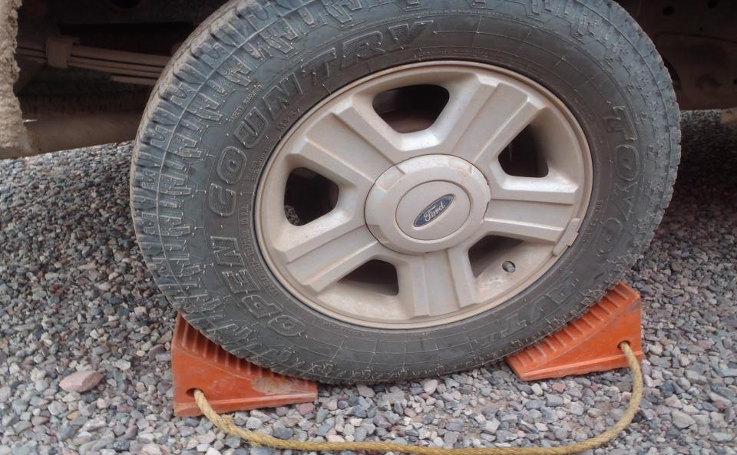
CHOCK YOUR TIRE
HONK YOUR HORN ONCE BEFORE YOU START YOUR ENGINE
HONK YOUR HORN TWICE BEFORE YOU PULL FOWARD
HONK THREE TIMES BEFORE YOU BACK UP

Slide 30
LOTOTO
“LOCK OUT” “TAG OUT” “TRY OUT”
Ensure equipment is isolated from all sources of energy, locked, tagged, and tried before work begins where individuals could be exposed to dangerous conditions.
The procedure is established for the protection of personnel from injury due to unexpected energization, start-up, recharge, or release of stored energy in, on or around the equipment.
  The LOTOTO policy can be found on Sharepoint:
  http://fmweb/sites/morsafety/MORSafety/default.aspx

Slide 31
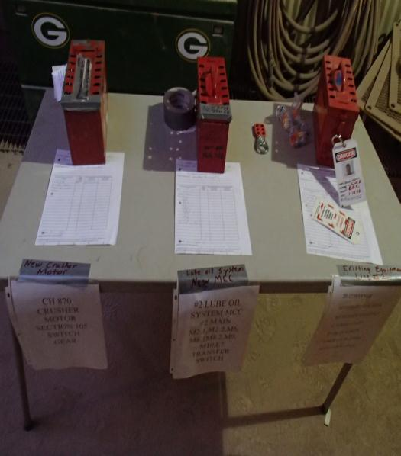
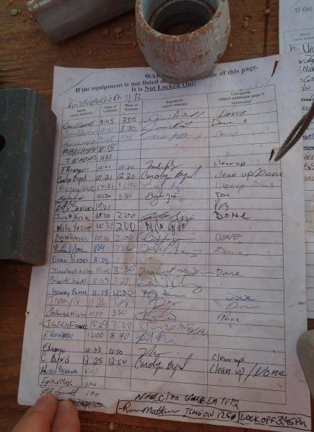
LOTOTO
Performing work on equipment ?
NEED LOTOTO TASK TRAINING

Slide 32
Flagging & Barricading
Flagging: Used as a warning to indicate hazard or unsafe condition exists.
Barricading: Used to physically prevent access to significant hazards and must be installed when falls or other serious hazards exists.
All Flagging & Barricading shall be tagged.
Required on Tag:
Employee name and Identification Number
Name of Employee supervisor
Employee department, or company
Hazard of condition to be flagged/barricaded
Time and date the flagging/barricading was erected

Slide 33
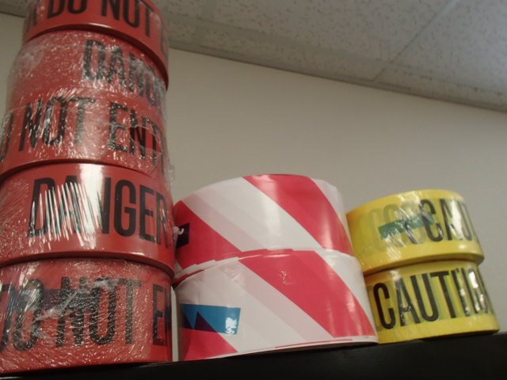
RESTRICTED ACCESS
RED TAPE: HIGH ENERGY LEVEL HAZARD
RED & WHITE: OPEN HOLE HAZARD
YELLOW: LOW ENERGY HAZARD

Slide 34
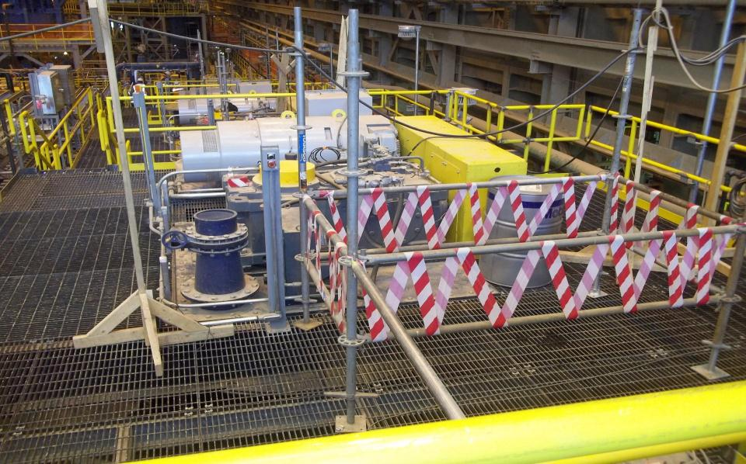
RESTRICTED ACCESS

Slide 35
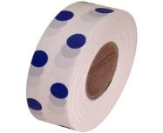

Restricted Access
Other types of flagging:
  Environmental

Slide 36
Environmental

Slide 37
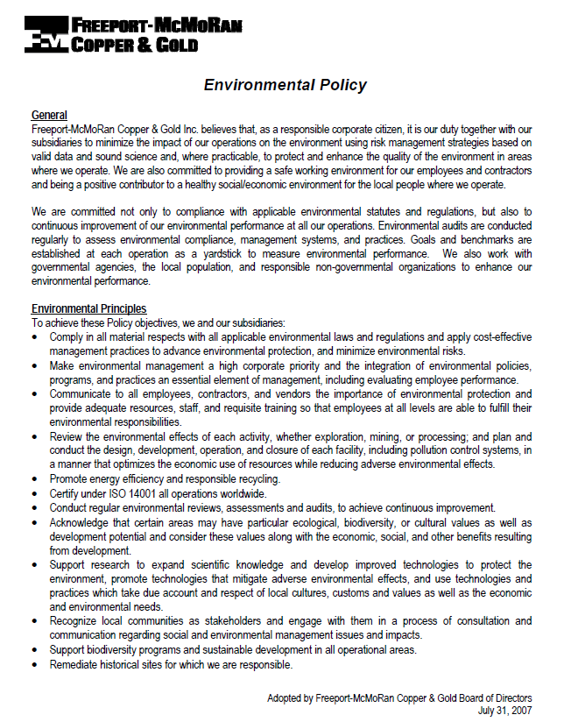
Environmental
Four Key Points
  Commitment to protect our environment
  Continuing to improve environmental performance
  Conform with applicable environmental laws
  Establish environmental goals
  Environmental Aspects
Are elements of an organization’s activities, products, or services that can interact with the environment.
Our significant aspects are:
Dust Emissions, Hazardous Waste Generation (aerosol cans, nordback, etc.) Water Consumption, Universal Waste (batteries), Solid Waste, Spills (Concentrate, diesel, grease, oil, water and solutions).

Slide 38
Environmental
In the event you may need to report a spill call the Spill Hotline
The number is 928-865-SPIL.
Know where to find BMP’s, SOP’s, or MSDS’s. If you have access to a computer, find documents in Sharepoint or you may request your supervisor for information.
When in doubt or have a question?
Contact a member of the environmental services department
(928) 865-6000
To Report Spills: (928) 865-7745
Additional information is available on the Environmental Share Site:
http://fmweb/sites/ems/mor/default.aspx

Slide 39
Hazard
Recognition

Slide 40
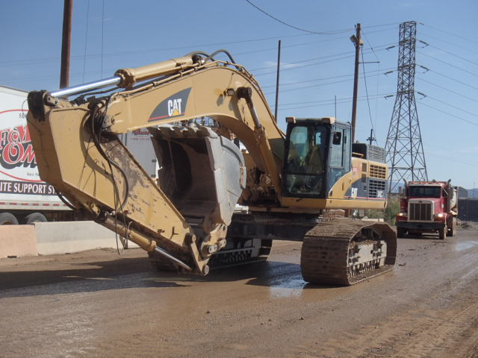
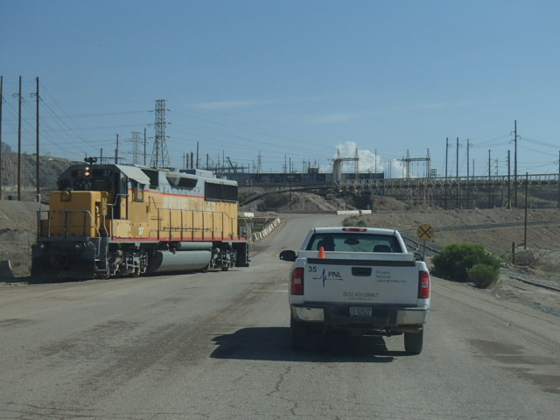
HEAVY MACHINERY & RR TRAFFIC
Notes:
Speak of giving right of way to all equipment. Do not pass unless operator expresses permission. Stay well behind when following.

Slide 41
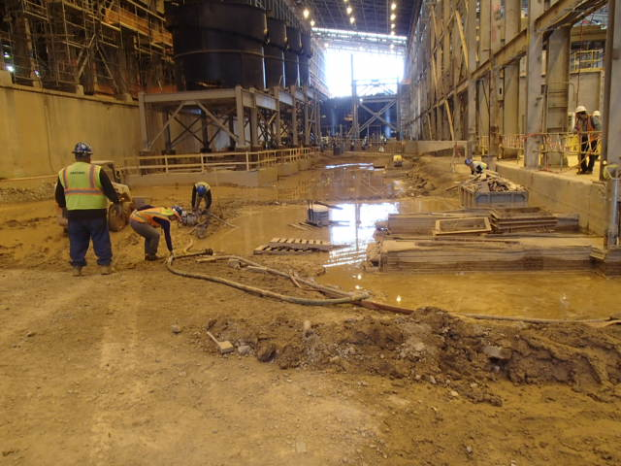
Water Hazard
Inside the Metcalf Building

Slide 42
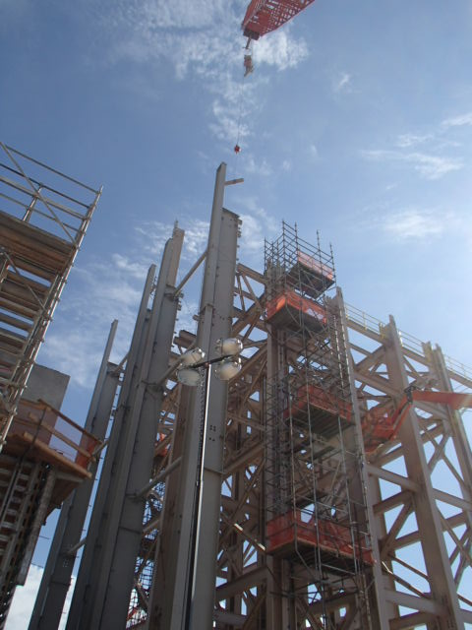
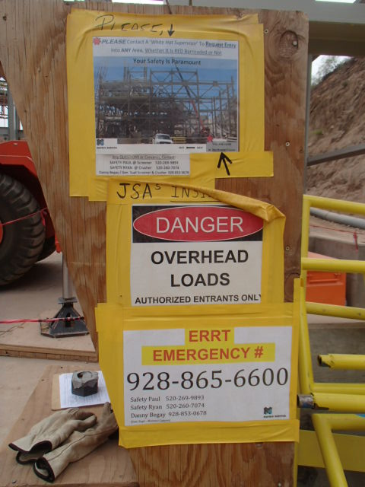
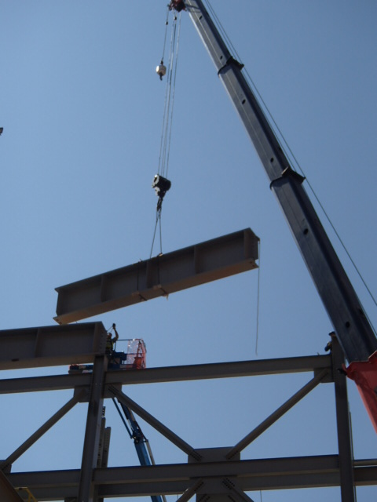

OVER HEAD HAZARDS
LOOK UP

Slide 43
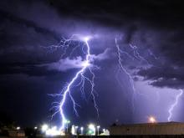
Lightning Alerts
Notes:
Explain the different levels of Alerts and what actions to take to be safe.
GREEN: Lightening outside 20 mile radius
YELLOW: Lightening identified as striking in a 7 to 15 mile radius
RED: Lightening striking within 0 to 7 mile radius
YELLOW ALERT: Prepare to evacuate when and if RED Alert comes
RED ALERT: Work is Prohibited in High Risk Areas. Appropriate shelter from hazards must be taken. Depending on the work being performed, it is the decision of division management to understand, communicate and enforce specific procedures.

Slide 44
Lightning Alerts
YELLOW ALERT: Begin to evacuate Stockpiles when Yellow Alert comes!!
RED ALERT: Work is Prohibited in High Risk Areas. Appropriate shelter from hazards must be taken in buildings or Hard topped vehicle.
Depending on the work being performed, it is the decision of division management to understand, communicate and enforce specific procedures.

Slide 45

Heat Stress
Heat stress prevention is critical on the Stockpiles. Failure to replace water lost in sweat even the day before can cause dehydration.
If a person becomes dehydrated in the previous day or shift you start the day in a “dehydration deficit”.
The water you are drinking today serves you for tomorrow!
Be sure and drink plenty of water every day.
Adequate water is as important in the winter as in the summer.

Slide 46
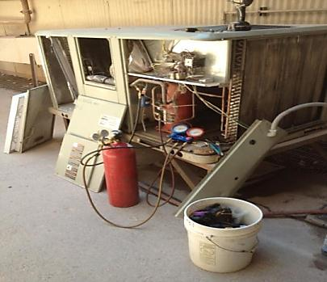
Housekeeping
Housekeeping will always be of prime issue for the concentrator division.
It’ EVERYONE’S job!
Anything wrong here!

Slide 47
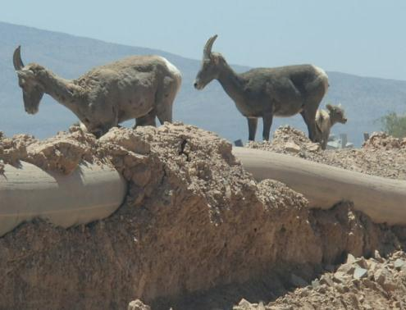
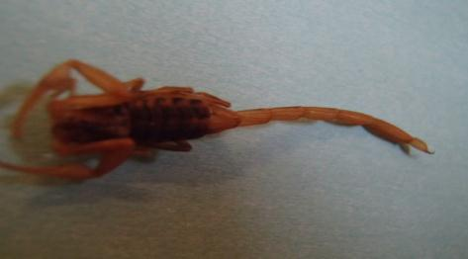
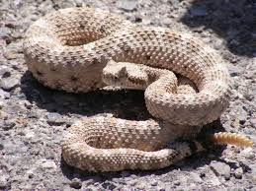
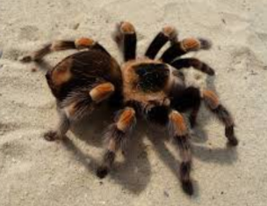
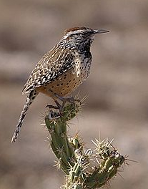
Watch out for critters

Slide 48
Pipe Pulling Procedures
Before pulling pipe, always perform a pre-job inspection and communication with all affected employees.
Use approved rigging devices in good working order. Do not use chains for pulling pipe. The links can break causing damage to equipment or injury to the operator or surrounding personnel.

Slide 49
Notify the 402 tower of route of the pipe being pulled.
Place yellow flags and Blue Strobe Lights on the escort vehicles. Make sure headlights and flashers are on.
Always have constant radio communication between the equipment operator and escort vehicles.
The only time that vehicles or equipment are allowed to pass is when the escort vehicles stop and visibly signal for you to pass.

Slide 50
The lead escort vehicle is to warn on coming traffic of the pipe being pulled along the road.
The rear vehicle drives behind the pipe and is to warn traffic behind about the work in progress. May also have second piece of equipment that helps control the pipe from going to far into the haul road, vendor route or from striking anything.
When the task is complete, notify the 402 tower so that they can let the haul truck drivers know.

Slide 51
Pipe Pulling Procedures
DO NOT attempt to pass unless the pipe pulling equipment and escorts pull over and stop AND give permission for the traffic to proceed.
Keep a safe distance behind the escort vehicle in case of sudden stops.
If a pipe escorting vehicle approaches you from the opposite direction, move over to the left and proceed with caution. Obey any signals from the escorts and stop at a safe distance if the pipe escort signals you to.

Slide 52
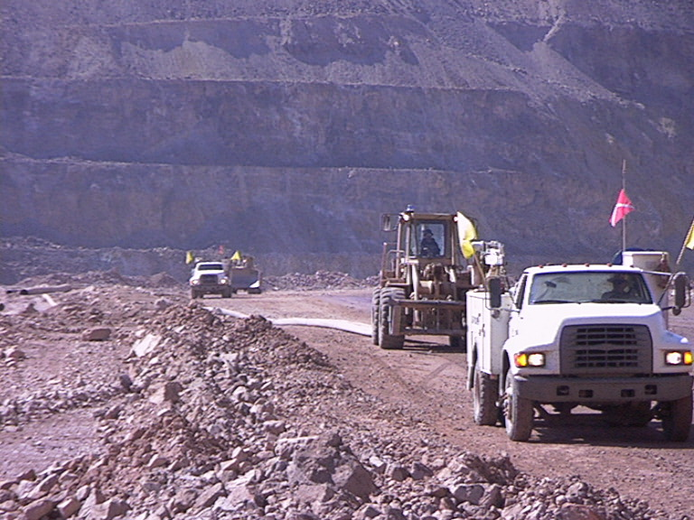
Here’s an example of pipe pulling and escorting.

Slide 53
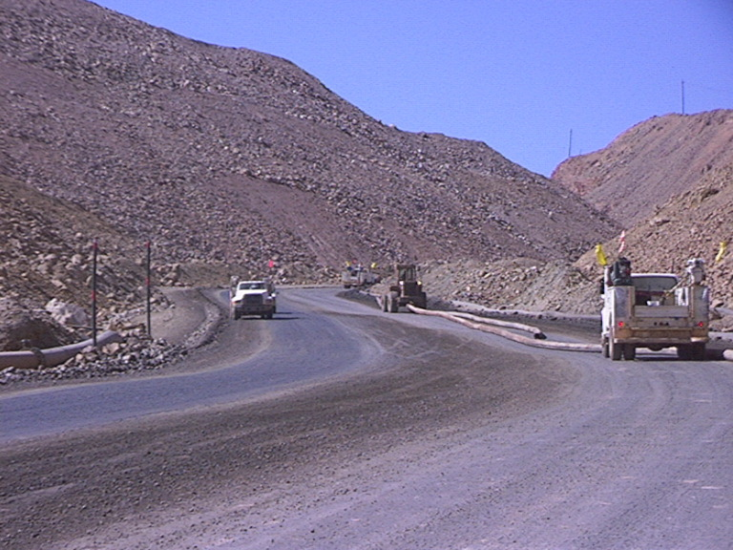

Slide 54
Thank You Questions??

