Slide 1
WELCOME! August Contractor Safety Meeting
August 8th, 2023

Slide 2
Agenda
Safety Share - SWAPP
Environmental share
Safety Events
Safety Stats
FRM TRIR Reduction Plan
Contractor engagement

Slide 3
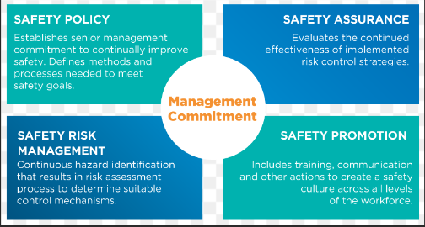
Safety Share
Auditing and Inspections

Slide 4
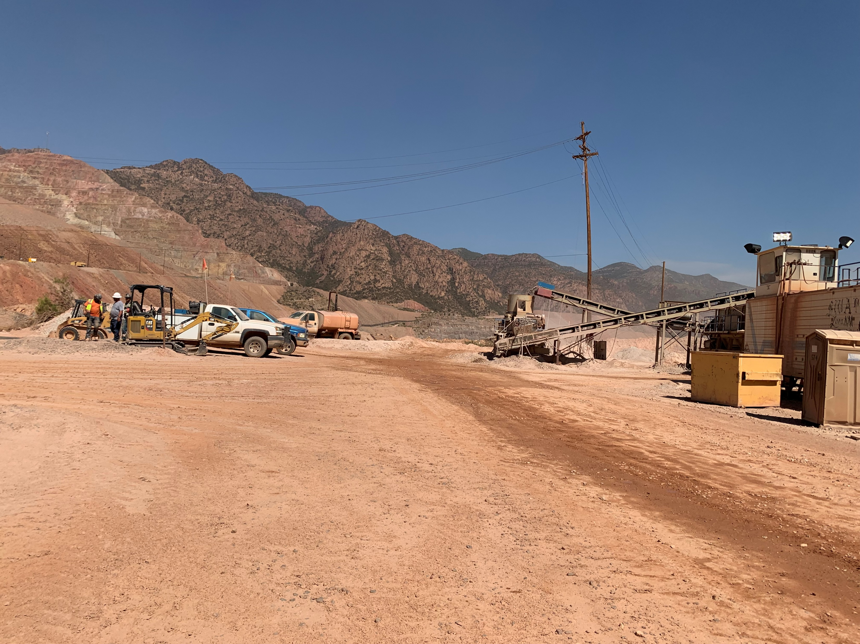
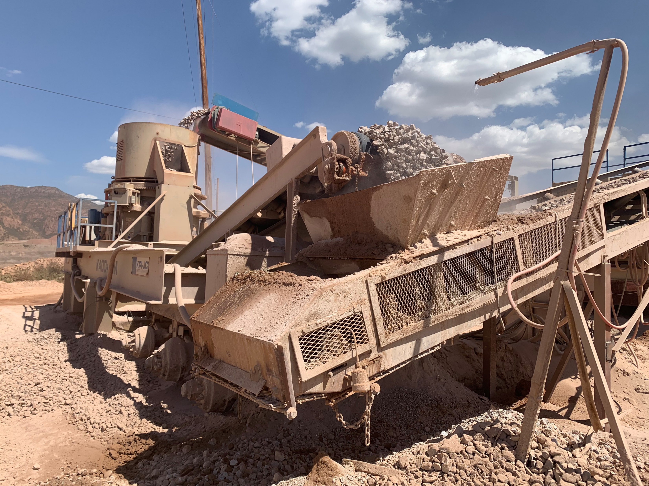
Screening Plant - SWAPP
Increase signage for access heavy equipment routes
Start up alarms
Idler guarding
Additional Water sprays
Access ladders –
Equipment checks

Slide 5
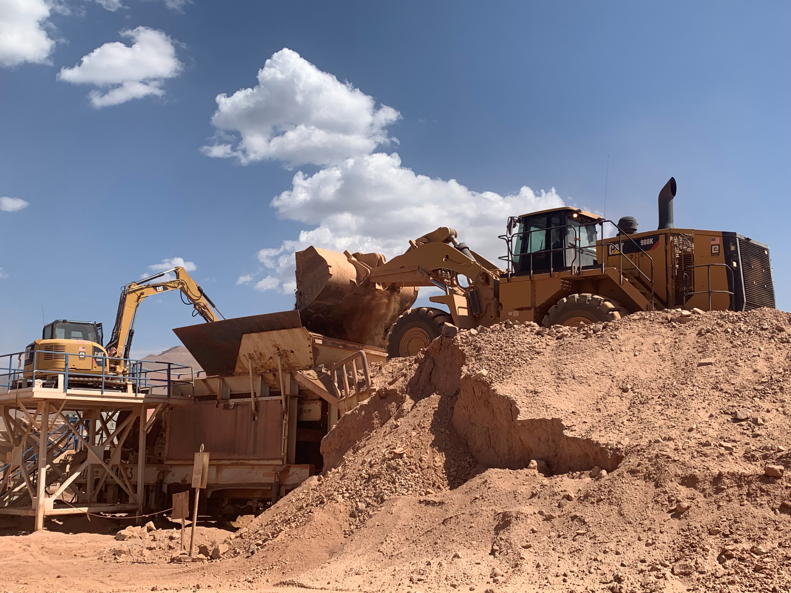
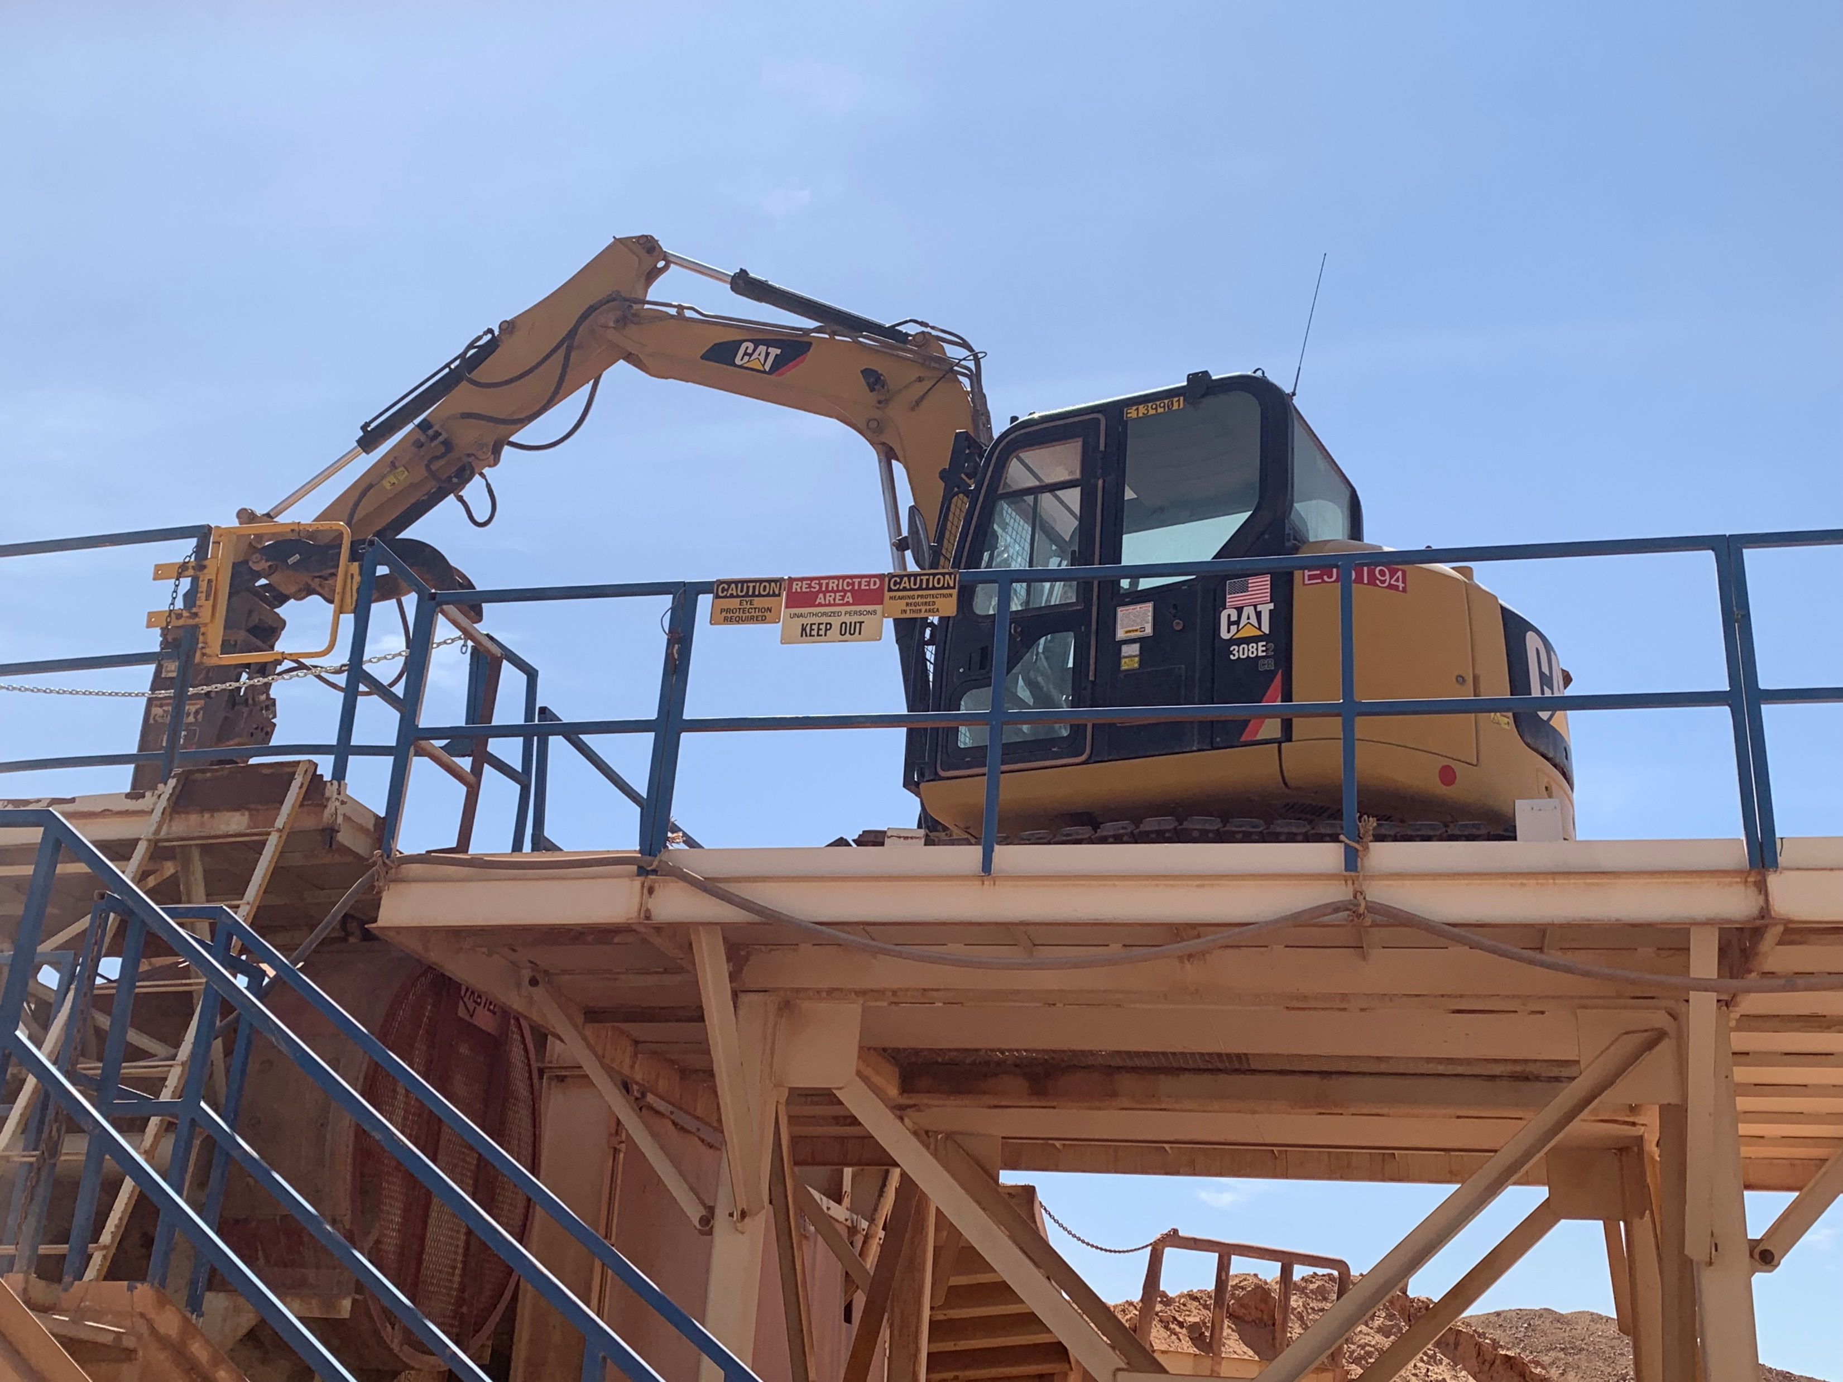
Screening Plant - SWAPP
Falling rocks
Extend barrier

Slide 6
Environmental Share Management of Change MOC
August 2023

Slide 7
Environmental Share Management of Change (MOC)
What is Management of Change (MOC) Process:
A multi-disciplinary review tool to ensure projects move forward with the review of all necessary parties
Why should we submit an MOC:
To evaluate process and/or site changes and to inform of any changes ahead
To ensure compliance with legal, permitting and other requirements and to identify any other potential issues
REFER TO BMP 900
What are some of the events when an MOC should be submitted?
Use of new chemical for site processes
New Projects & Expansions: Plant Engineering and GSC (Notification to Environmental Services)
Installing new equipment, removing equipment, demolition work, or a change in equipment or process
When in doubt “SUBMIT AN MOC”
August 2023

Slide 8
FCX Safety Incidents, Successes, & Alerts

Slide 9
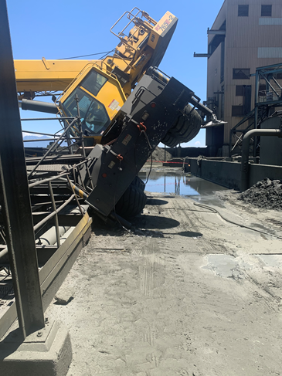
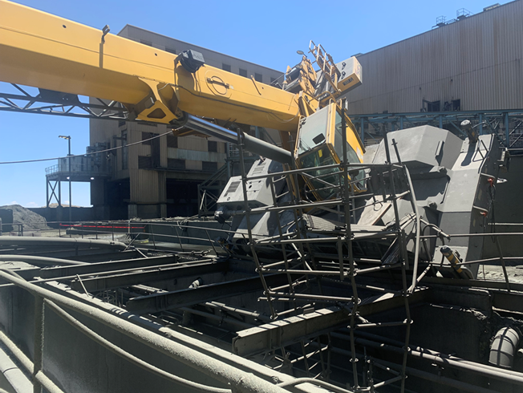
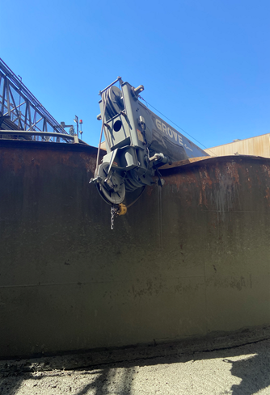
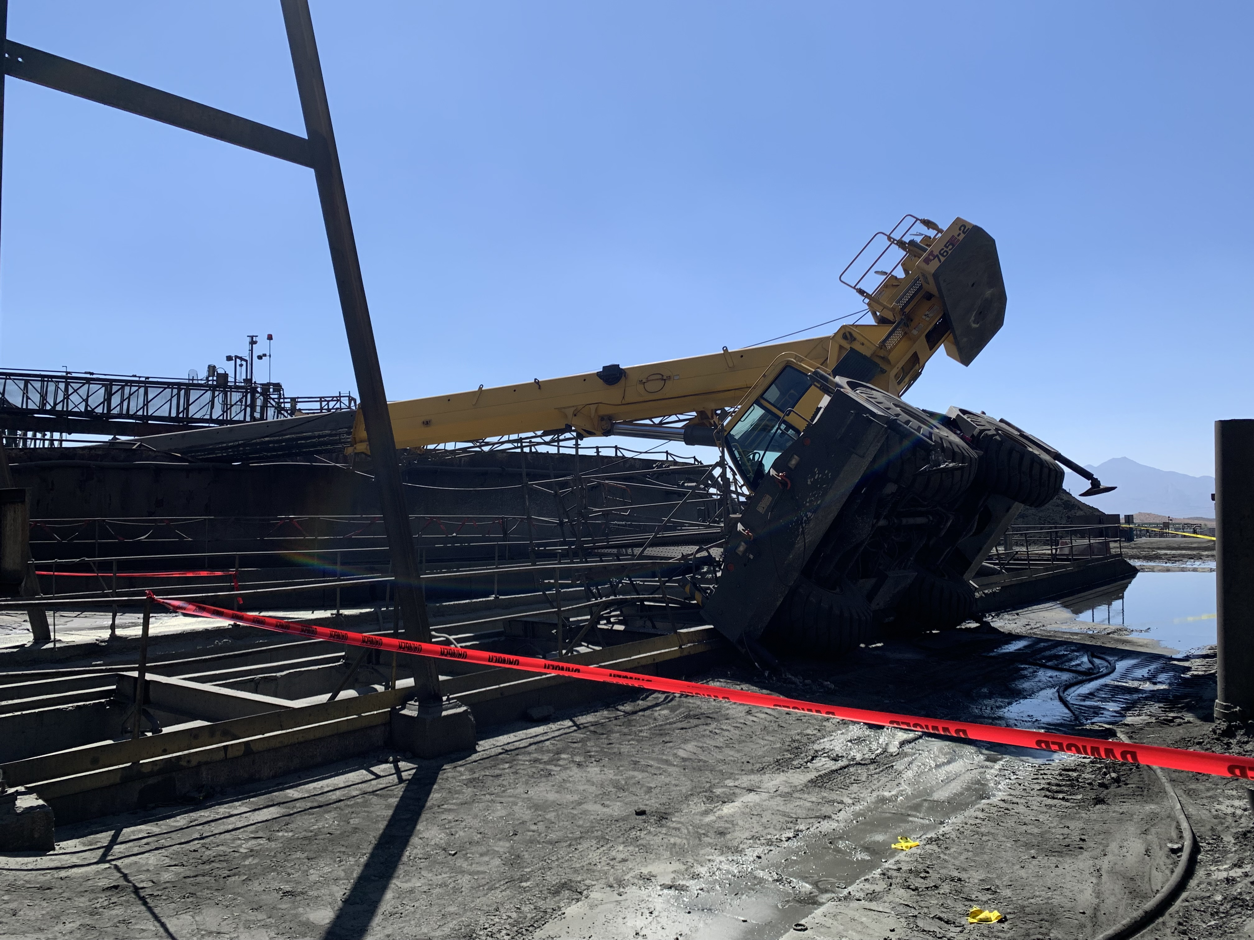
Crane Tip Over
Event ID #20007982
Incident Details
Operation | Sierrita
Date / Time | June 29, 2023 / 9:15 a.m.
Type | Property Damage
Summary | A Grove crane tipped over while installing a door to a copper/molybdenum thickener.
Fatal Risk | Vehicle Collision or Rollover
Risk Category | Actionable
Pre / Post Rating | Significant (3) Likely (3)
Absent / Insufficient Controls | Inadequate/Incorrect Lift Plan
Applicable Policies / Procedures | Crane and Rigging Policy
Employee Condition | No Injury
Contact | Kyle Silvester, Mill Superintendent

Slide 10
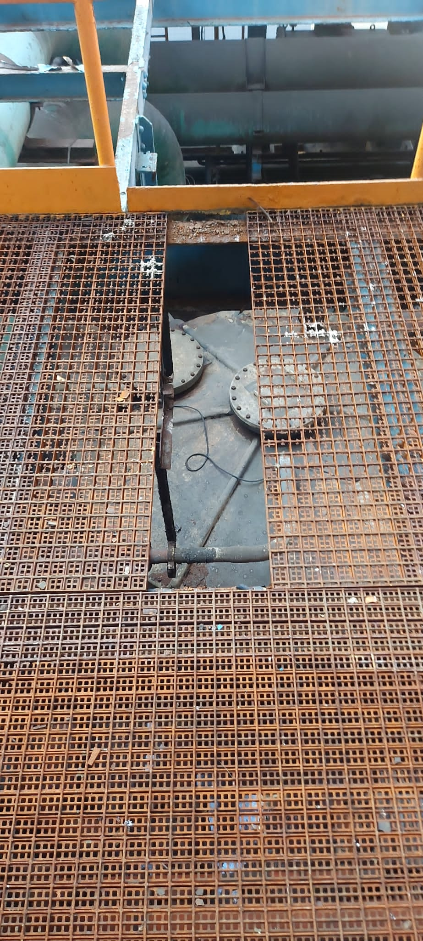
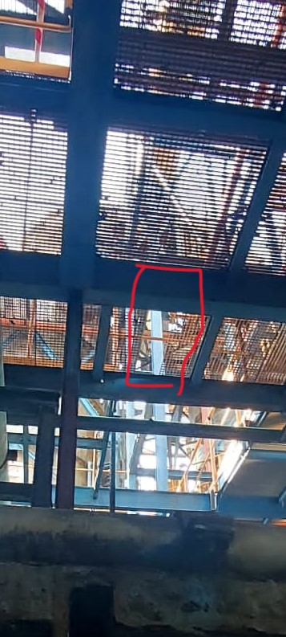
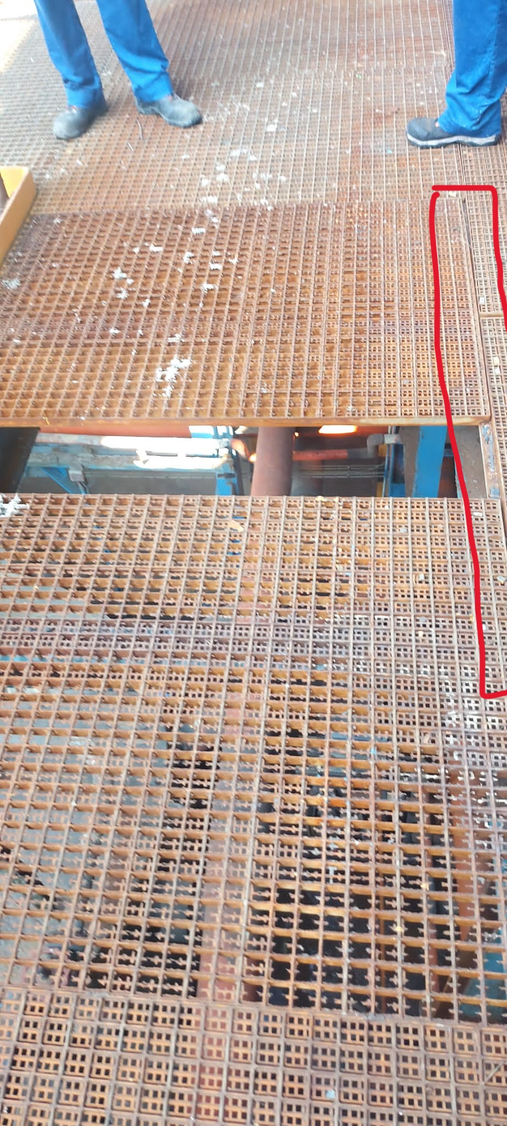
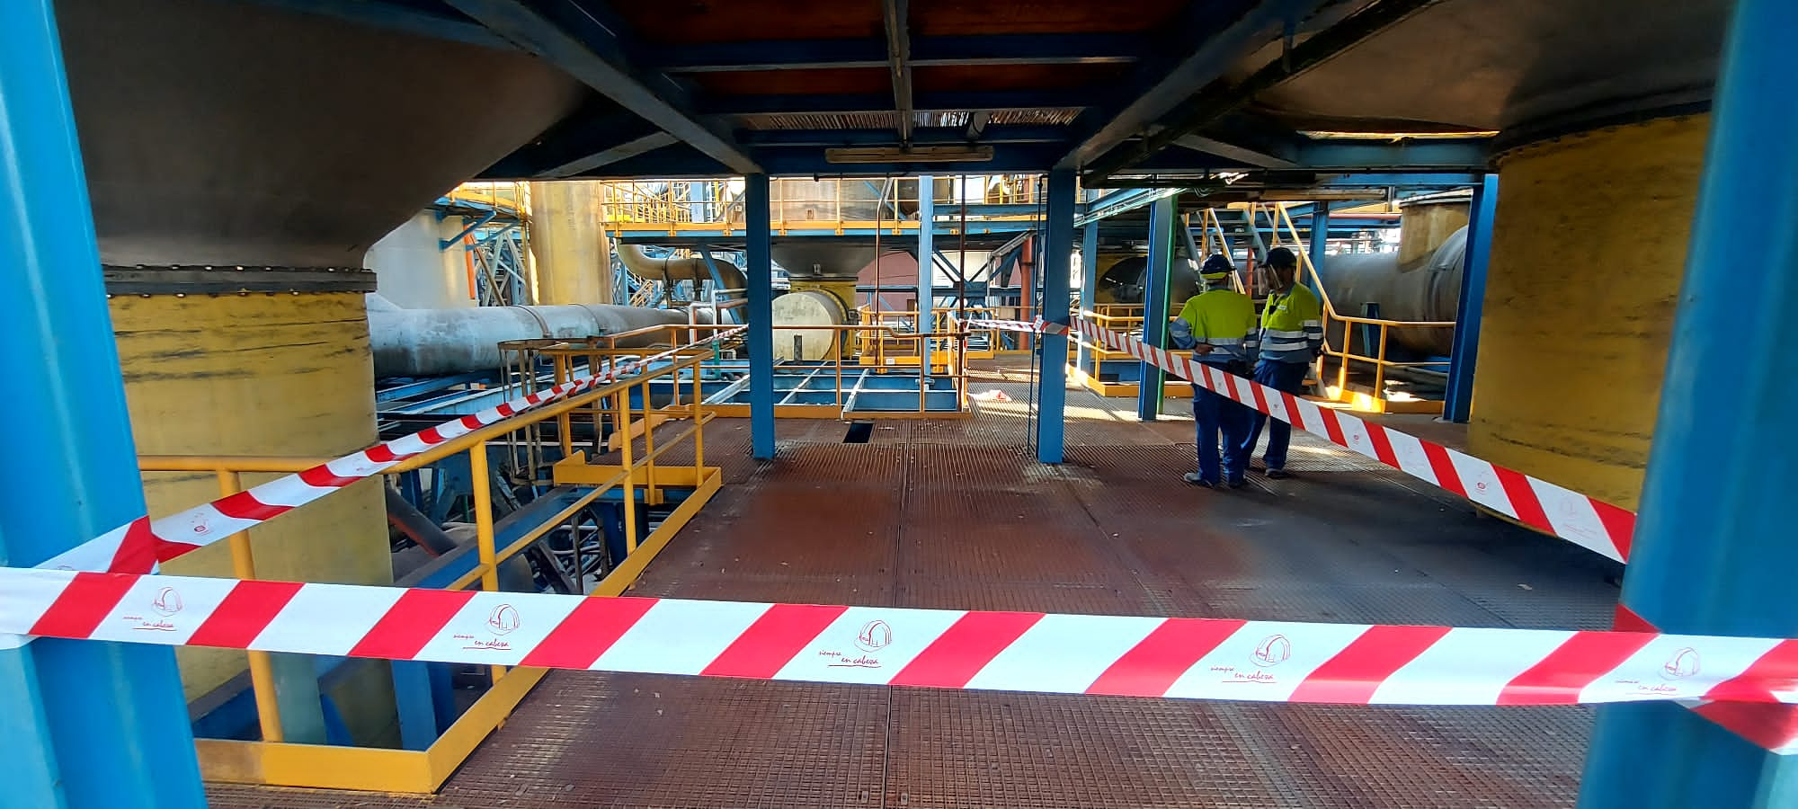
Fall of Loose Tramex to Lower Level
Event ID #20008348
Incident Details
Operation | Atlantic Copper
Date / Time | July 1, 2023 / 8 p.m.
Type | Near Miss
Summary | An operator was performing pressure-taking tasks at the washing plant, when he found a piece of Tramex steel that had fallen to the level below. The panel was not fastened with grating clamping staples. No other employees were in the area at the time of the incident.
Fatal Risk | Falling Objects
Risk Category | Actionable
Pre / Post Rating | Significant (3) Likely (3)
Absent / Insufficient Controls | Fastening pieces of grating missing
Applicable Policies / Procedures | FCX-HS02 Working at Heights
Employee Condition | No Injury
Contact | Alejandro Paz Garcia, Head of Acid Factories

Slide 11
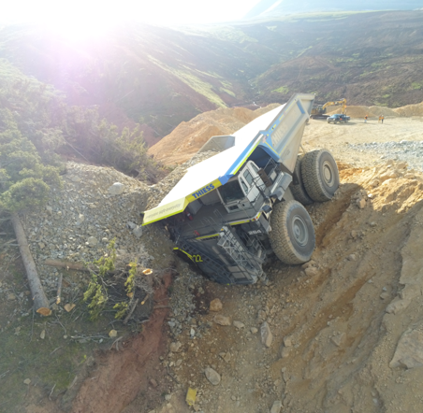
Haul Truck Drives through Berm
PFE # 20008069 Event ID # 2023-13
Preliminary Incident Details
Operation | Climax
Date / Time | July 5, 2023 / 5:18 a.m.
Type | Property Damage
Summary | A fully loaded haul truck was traveling downhill on a haul road and failed to make a turn. The truck went through two berms before coming to a stop against the face of a hill near a steep drop off. The contractor driver was assessed at the clinic and released without any injuries.
Fatal Risk | Vehicle Collision or Rollover
Risk Category | Monitor
Pre / Post Rating | Significant (3) Possible (2) / TBD
Findings / Missing Controls | Failure to engage downhill speed control
Applicable Policies / Procedures | Interaction with Heavy Mobile Equipment (2.6)
Employee Condition | No injury
Contact | Tanner Thetford, Superintendent-Mine Operations
Final location of haul truck

Slide 12
Brush Fire Caused By Dozer Spark
Event ID # 20008113
Incident Details
Operation | Bagdad
Date / Time | July 6, 2023 / 2:15 p.m.
Type | Property Damage
Summary | A brush fire started with a spark from a CAT dozer track while the contractor operator was dressing the slope of an access road to a new work area. The water truck was enroute to refill the tank, and no replacement truck was available. A call to 911 was placed immediately and the local fire department dispatched to site. The contractor company then dispatched multiple vehicles to help contain and disperse the fire. The fire department arrived and monitored the contractor’s response. About two hours later, the fire was extinguished. Smoldering vegetation was covered with soil. A fire watch began and was maintained throughout the night.
Fatal Risk | Fire
Probable Direct Causes | Failure to follow fire prevention plan Water truck was not present and available Dedicated spotter was not at work location
Immediate Corrective Action(s) | Held safety stand down
Required Action(s) | Update fire prevention plan to better specify water availability requirements Require additional 50-foot prewetting buffer Construct additional water ponds and piping Consider fire prevention training with local department for select personnel
Contact | Daniel Olave, Senior Health and Safety Lead

Slide 13
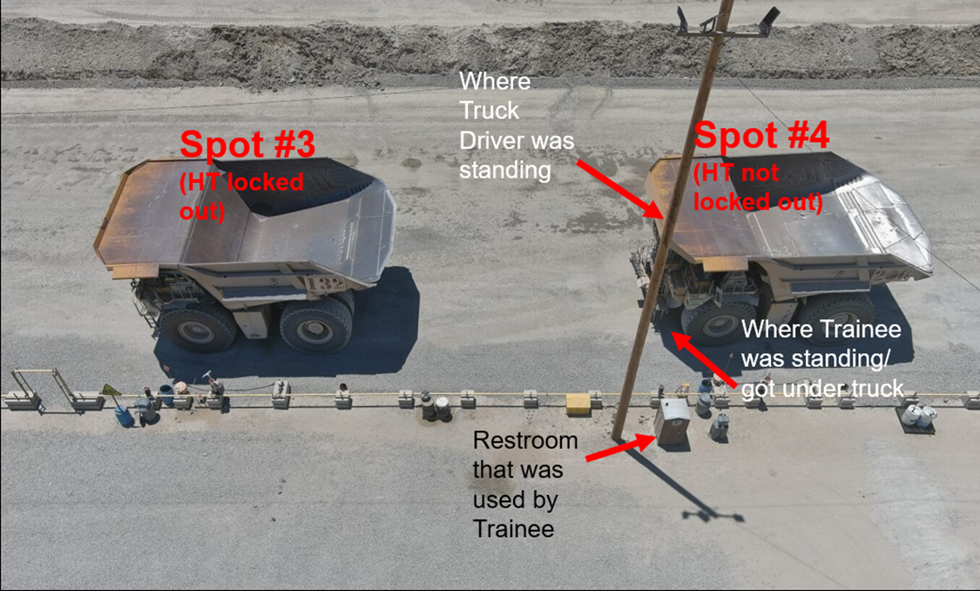
Employee in Wrong Spot at Fuel Dock
Event ID #20008258
Incident Details
Operation | Bagdad
Date / Time | July 12, 2023 / 6:15 a.m.
Type | Near Miss
Summary | Haul truck driver (A) on spot three at the Lucy Fuel Dock had the truck locked out to perform a pre-shift inspection. Driver A needed to use the brown hose, then resumed the inspection but returned to spot four instead of spot three. Haul truck driver (B) on spot four stepped out to clean the driver’s side mirror and saw Driver A step under the truck. Driver B yelled to get the attention of Driver A, who realized the error and called for a supervisor.
Fatal Risk | Vehicle Impact on Person
Risk Category | Monitor
Pre / Post Rating | Significant (3) Possible (2)
Absent / Insufficient Controls | N/A
Applicable Policies / Procedures | N/A
Employee Condition | No Injury
Contact | Zach Maughan, Superintendent-Mine Operations

Slide 14
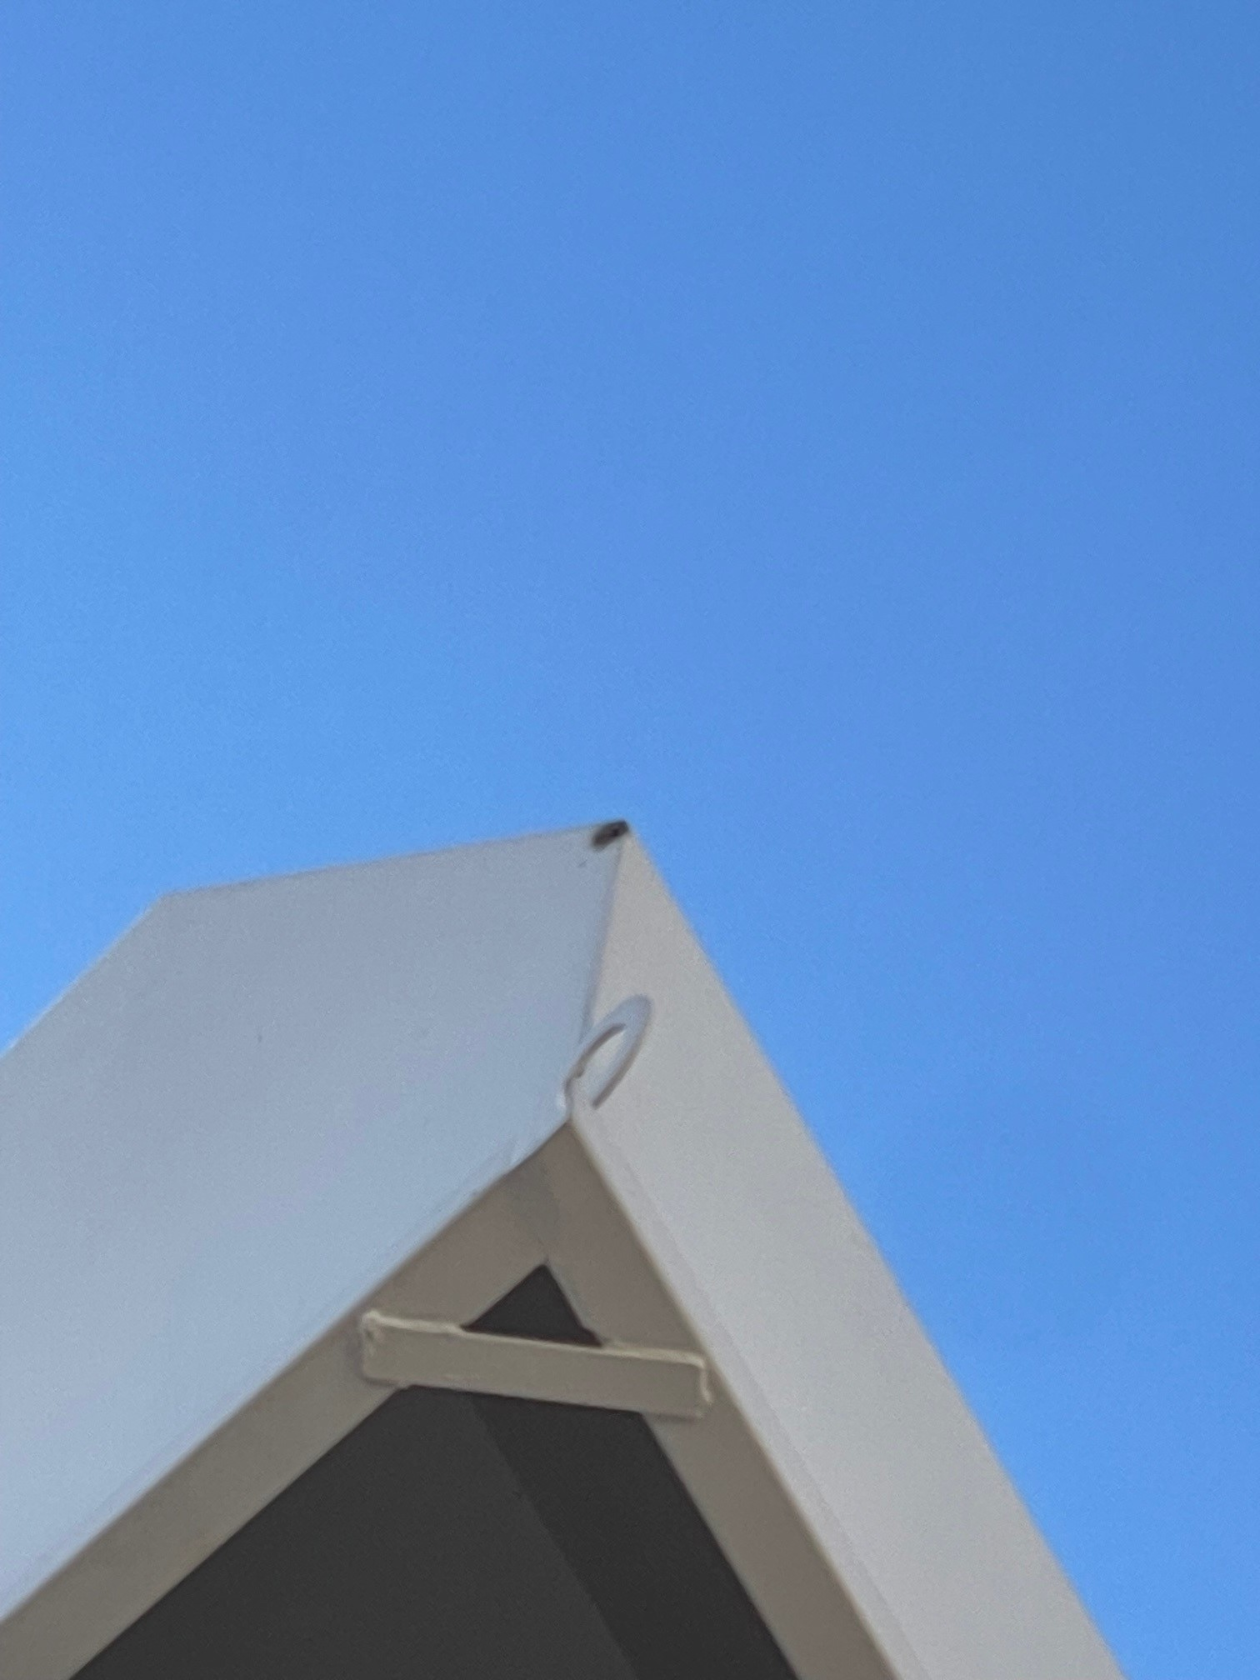
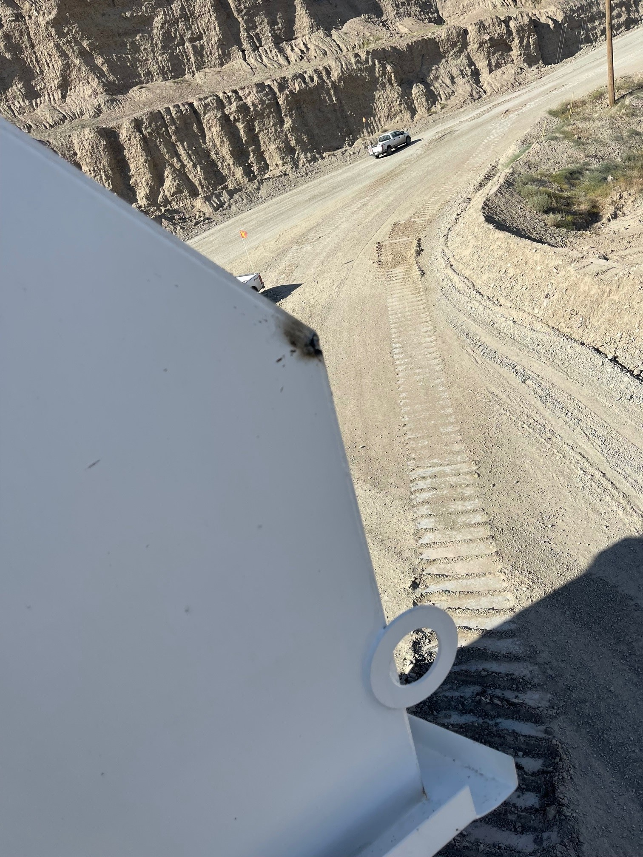
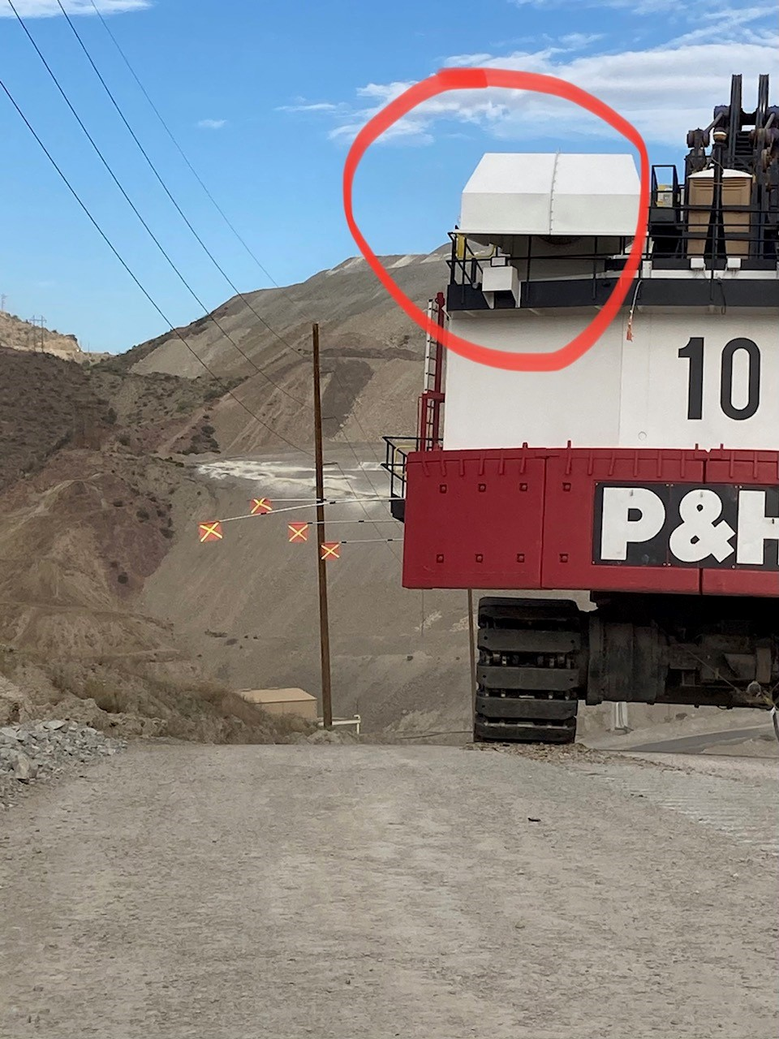
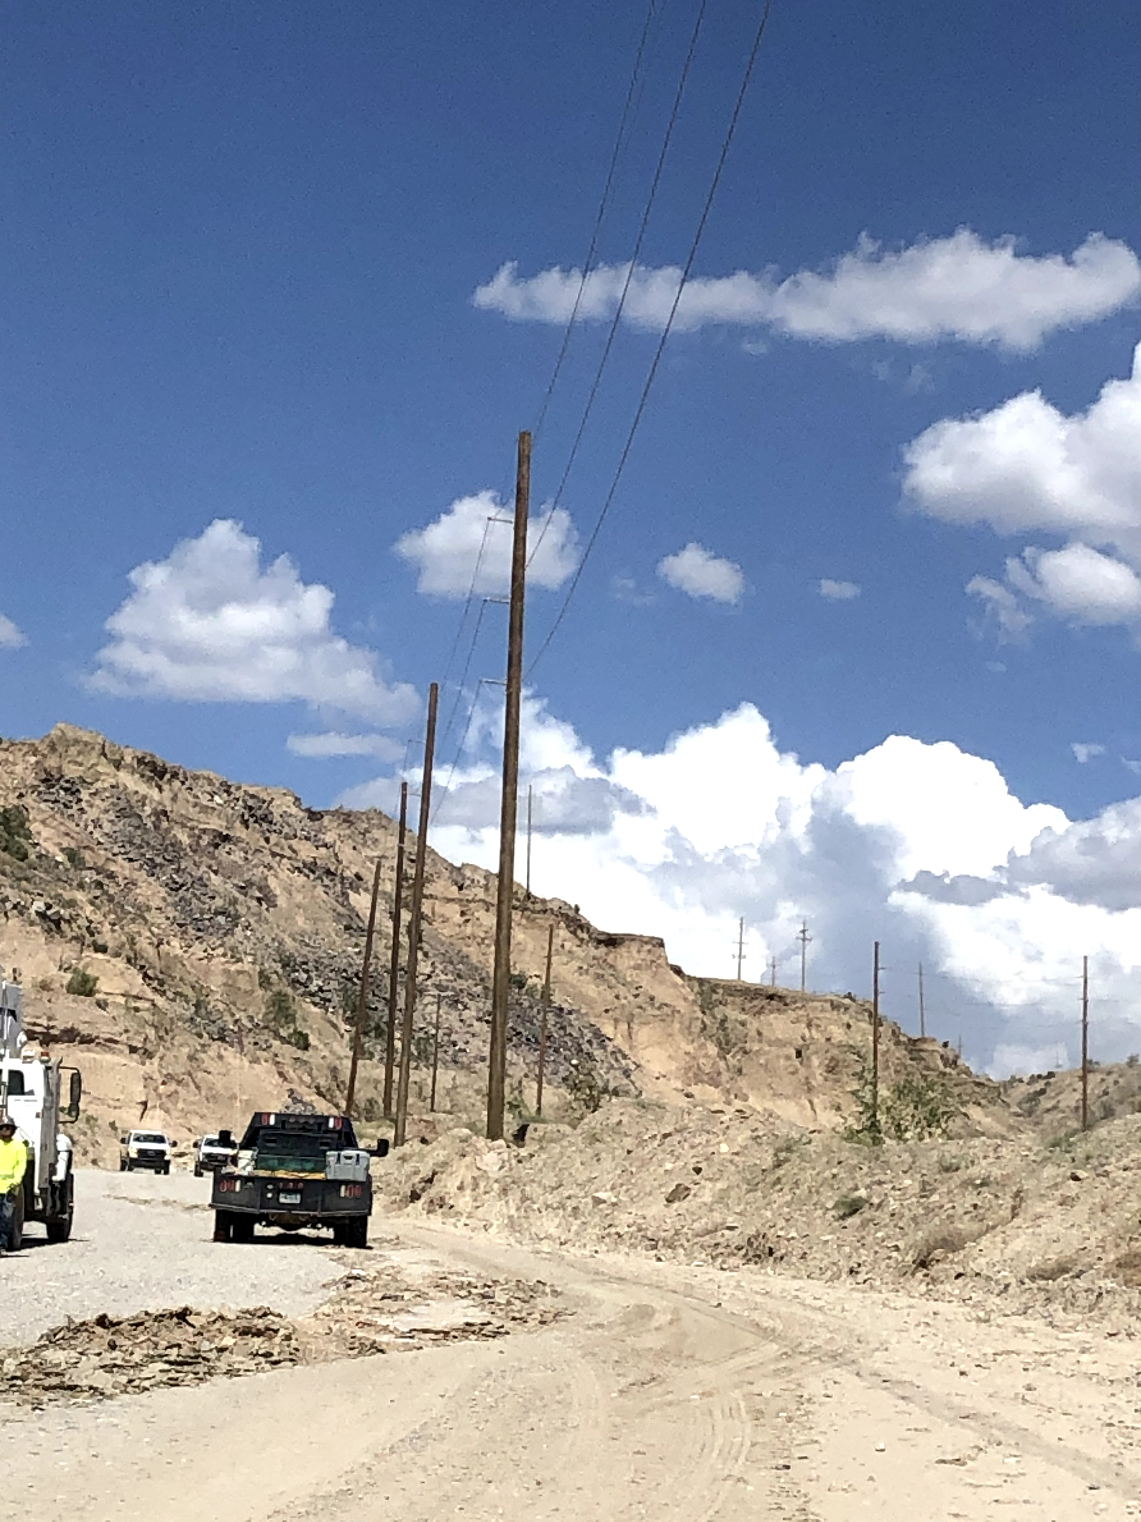
Shovel Contacts Power Lines
Event ID #20008576
Incident Details
Operation | Bagdad
Date / Time | July 24, 2023 / 2:30 p.m.
Type | Near Miss
Summary | While moving the 10 Shovel to the North 3 pushback the shovel interacted (came into contact/proximity, unsure of which) with powerlines on the ramp causing the lines to go to ground and the other shovels 8,11, & 22 to lose power. Berm was moved so the drillers could operate and was not moved back to original location.
Fatal Risk | Exposure to Electrical Hazards
Risk Category | Monitor
Pre / Post Rating | Significant (3) Possible (2)
Absent / Insufficient Controls | Failure to perform spotting expectations Berm was not moved back to original location
Applicable Policies / Procedures | Shovel Move Policy FCX 20
Employee Condition | No Injury
Contact | Zach Maughan, Mine Superintendent

Slide 15
Employee Injured By Skid Steer
PFE # 20008657 Event ID # 2023-14
Preliminary Incident Details
Operation | Morenci
Date / Time | July 26, 2023 / 11 a.m.
Type | Injury/Illness
Summary | An employee was bringing water to the operator of a skid steer when the vehicle abruptly moved forward, knocking the employee to the ground and running over the employee’s leg. The employee sustained minor injuries.
Fatal Risk | Vehicle Impact on Person
Risk Category | Actionable
Pre / Post Rating | Significant (3) Likely (3) / TBD
Findings / Missing Controls | Positive Communication System, Segregation
Applicable Policies / Procedures | Fatal Risk Management Handbook Skid Steer Task Training (Green Carding) Skid Steer Training
Employee Condition | Minor Injuries (First Aid)
Contact | Jacob Sweet, Manager-Health and Safety Jody Beck, Manager-Crush and Convey
An employee was injured when a skid steer lurched forward, knocking the employee to the ground and running over the employee’s leg.

Slide 16
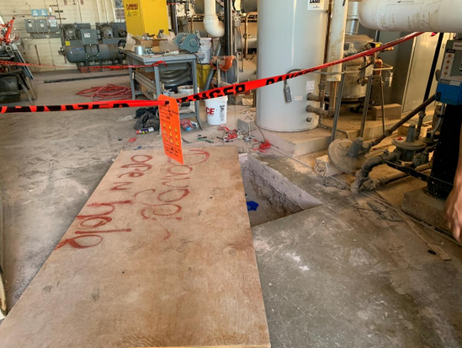
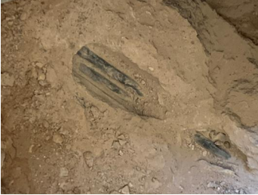
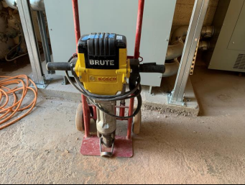
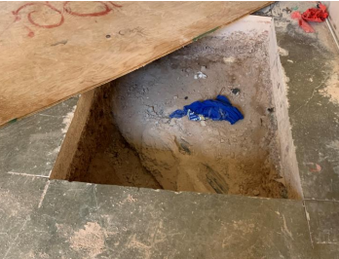
Near Miss Clinic Remodel Initial Learnings
After job was stopped, eval assumed sub floor level concrete was covering the sewer line.
Our thought processes are affected by perspectives. Perspectives are affected by paradigms. Paradigms are frames of reference. Frames of reference are historical files in memory and deadlines.
Include Blue Stake surveyors and Safety.

Slide 17
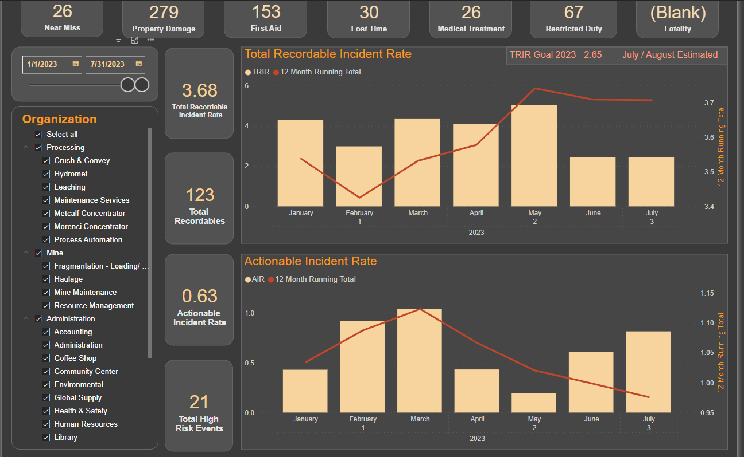
Morenci TRIR

Slide 18
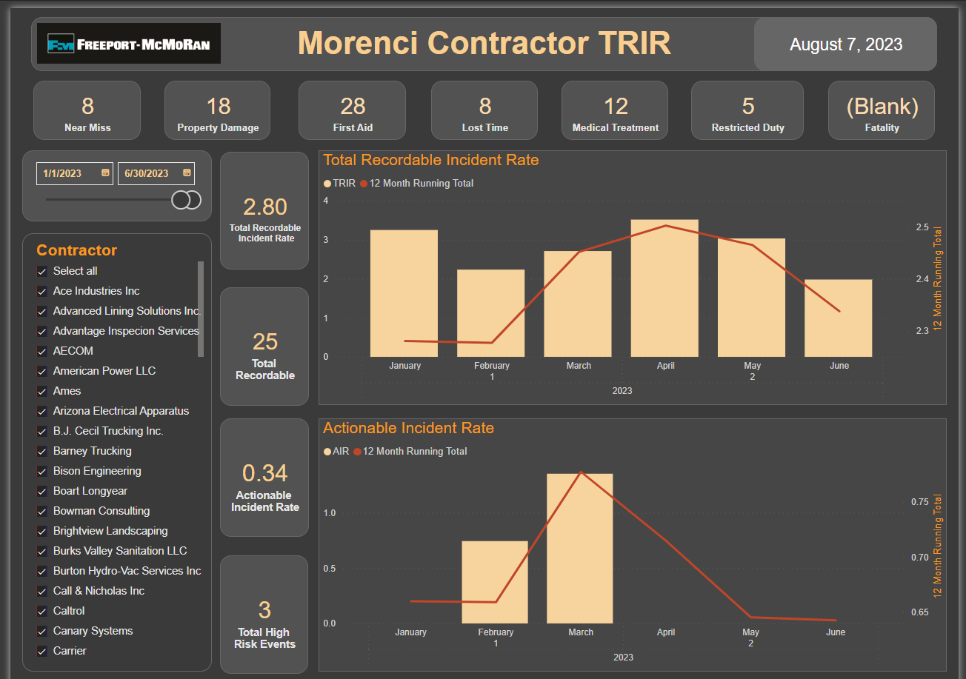
Contractor TRIR

Slide 19
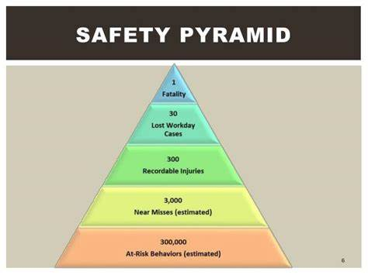
Heinrich Pyramid
Theory
Is there a base layer below the behavior block?
How to address that?

Slide 20
Safety Acknowledgements
Reflect on our recent safety performance
Our safety record is unacceptable.
Uptick in high- and low-energy events points to acceptance of tolerance for incidents?
After refocus efforts, we continue to fall short of our goal to keep people safe.
Commitment to safe production
As a team, we have a responsibility to get safety back on track. It starts today.
All employees receiving a safety commitment card

Slide 21
Safety Process Checks
Jun – Jul
Tail gate meetings
Workplace Exams
Aug – Sep
Oct – Nov
JRAs

Slide 22
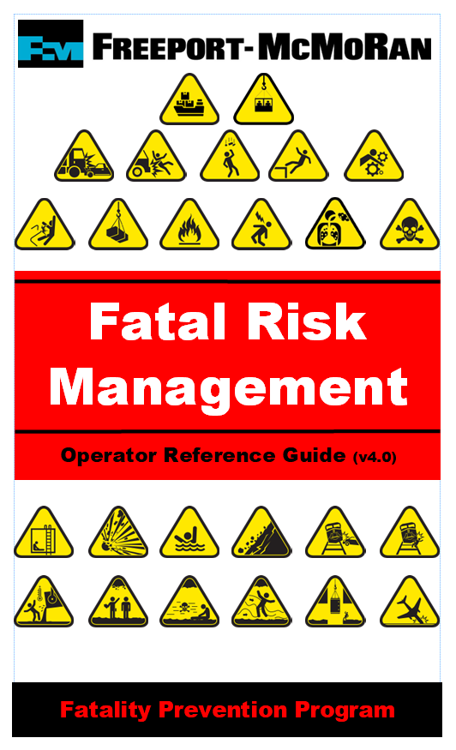
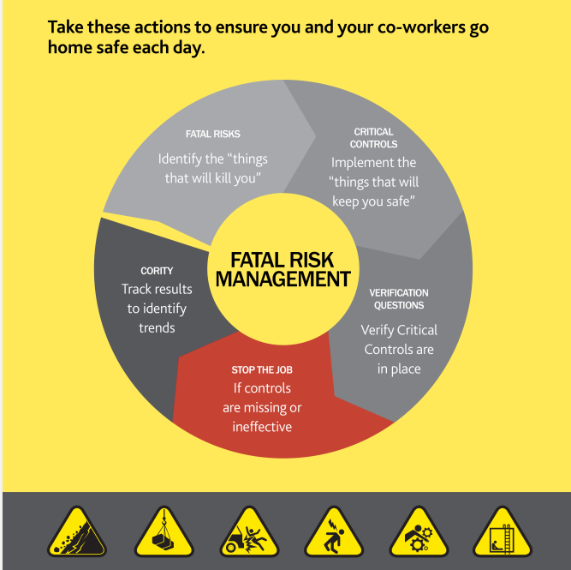
FRM Booklets
We need all employees and contractors to understand fatal risk management
We’ll be handing them out after the meeting. If you aren’t here in person, please schedule a time to pick them up for your employees

Slide 23
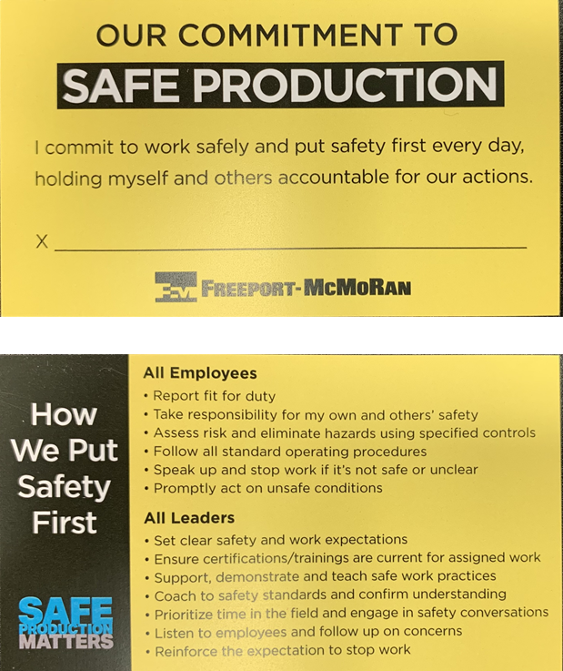
Safety Commitment Cards
Safety is a top priority and core value.
Each of us has a responsibility to put safety first and hold ourselves and each other accountable.
We are doing a recommitment to safety – every employee will sign and carry

