Slide 1
Contractor Safety Meeting
February 21, 2023

Slide 2
Agenda
Safety Share
Environmental Share
Safety Performance
Part 50 – MSHA Reporting
Bluestake

Slide 3
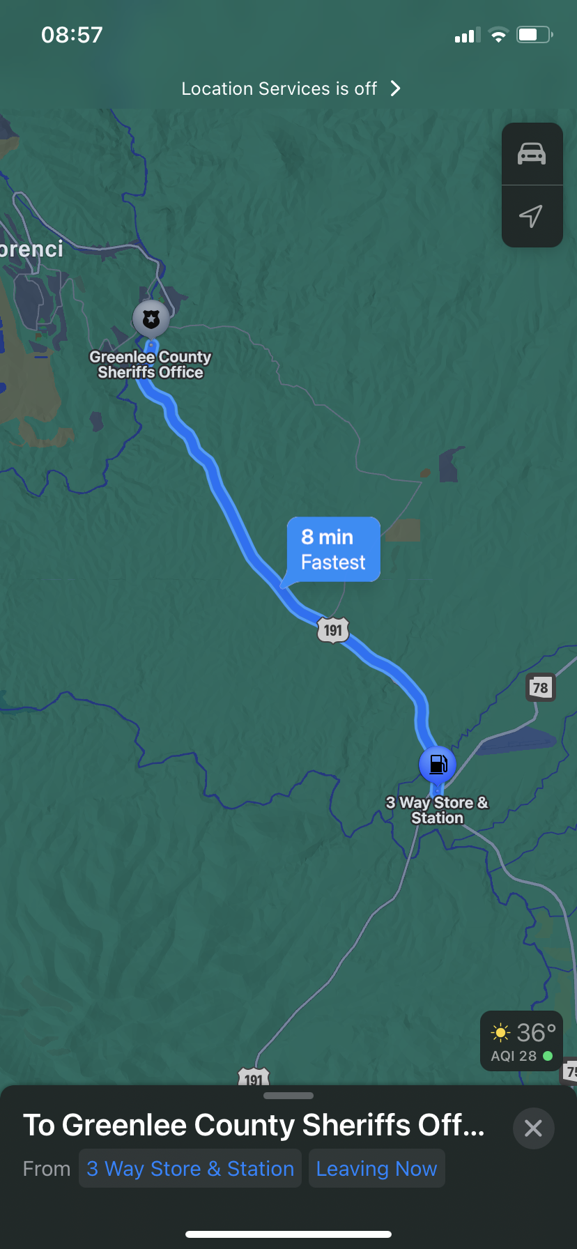
Study
Time vs. Speed
This study is not scientific, but it gives you an understanding of time vs. speed.
The destination from the 3 way
intersection to the 25-mph sign
as you get into Clifton is approximately
8 minutes according to my maps app.
The speed limits range from 45 up to 65 and down to 55, 45, and 35 in this area.
On 3 different days I traveled this road, at 3 different speeds and I marked my times.
70 mph
65 mph
60 mph
The result was interesting!

Slide 4
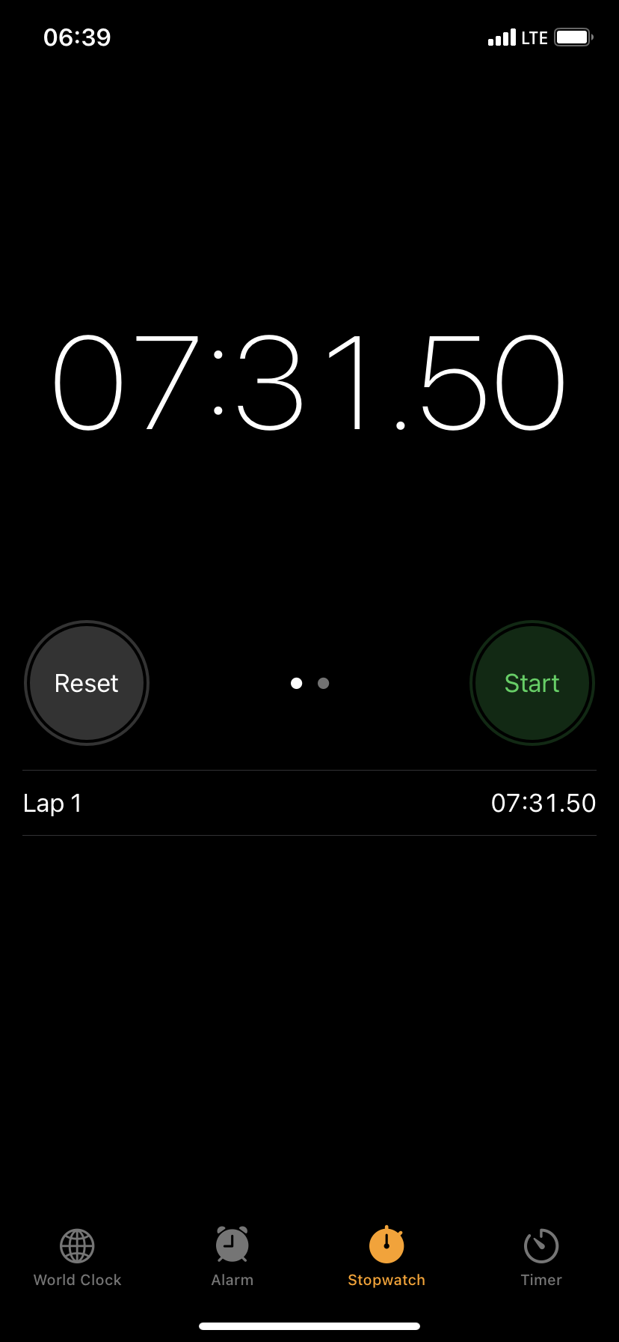
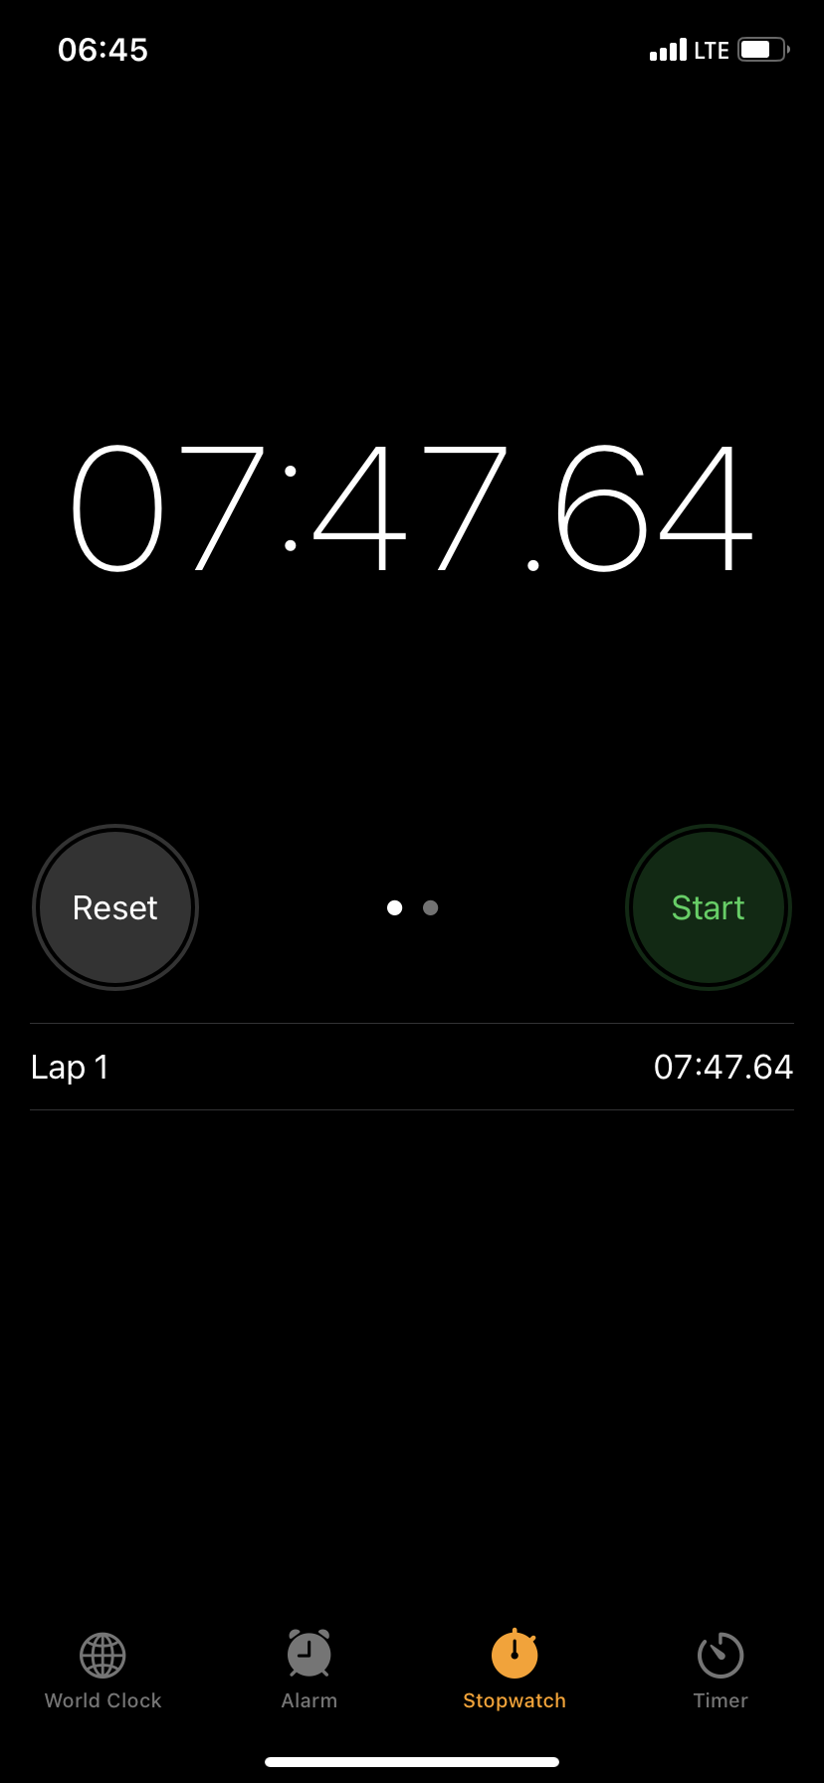
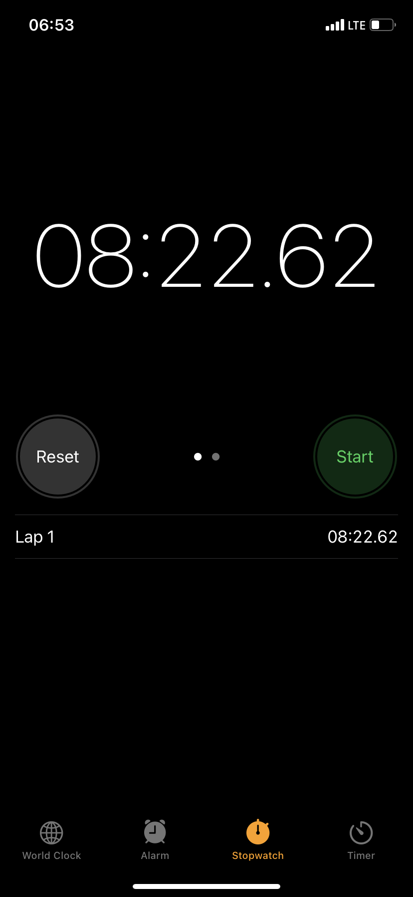
EVIDENCE
Day 1 at 70 mph
Day 2 at 65 mph
Day 3 at 60 mph

Slide 5
Findings
Time vs. Speed
1st day
70 mph – 7:31
2nd day
65 mph – 7:47 with a difference of 16 seconds
3rd day
60 mph – 8:22 with a difference of 35 seconds
Total time saved from 60 mph to 70 mph = 51 seconds
Time measured in minutes and seconds

Slide 6
Environmental Share – Vista Recycling Frontload and Roll-Off Dumpsters
  Vista Recycling provides Frontload and Roll-Off dumpsters across the Morenci Site.
Frontload dumpsters are used to store “trash only”. The dumpsters should be used for trash only, labeled, lids closed at all times, and free of any flowing liquids.
The Roll-Off dumpsters are used to store different types of wastes, such as; wood, trash, leach liners, HDPE, plastic, metal, etc. The Roll-Offs should be labeled properly and loaded with material that matches the label.
Dumpster containers of either type, should NOT be moved by anyone other than Vista Drivers. If a container needs to be moved, replaced, added, or removed from service, please contact Shanna Holguin at 928-965-0245 or a member of the Waste Team.

Slide 7
Positive Recognition
Jennifer Gerrard with Western Industrial
  Stopping the job: Hot Work
Swapps pre-planning
  5180 Corridor Pipe Pull

Slide 8
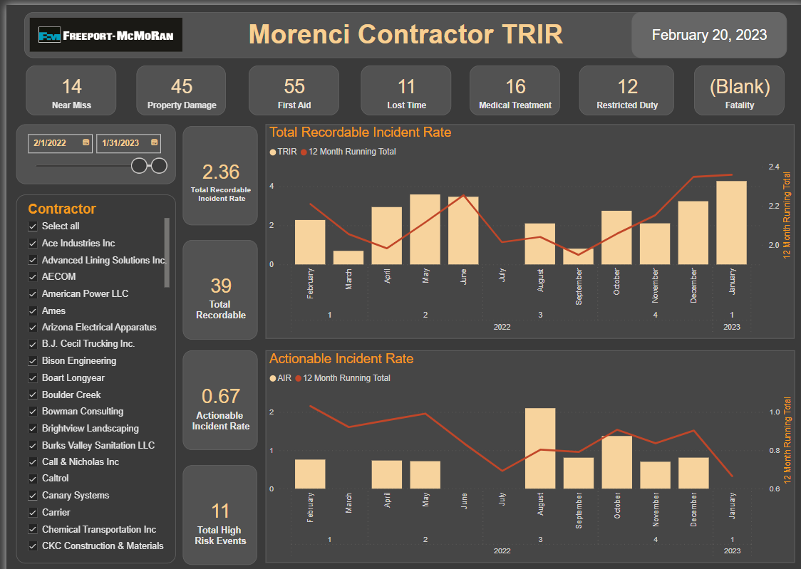
Safety Performance

Slide 9
Part 50
MSHA Reporting & Classification

Slide 10
What is Part 50?
Part 50 regulations require operators and contractors to investigate mine accidents and injuries and report to MSHA those per reporting criteria.
Why do we have to report?
Required so MSHA may evaluate and develop mine safety and health standards and programs.
Failure to report may result in citations and monetary assessments.

Slide 11
Occupational Injury
Any injury to an employee which occurs at a mine. Reportable if any of the following:
  Requires medical treatment
  Results in death or loss of consciousness
  Results in the inability of the injured person to perform all the job duties required by the job
  Requires injured person to be temporarily assigned to other duties
  Requires injured person to be transferred to another job
  Requires injured person to be terminated.
Occupational illness: An illness or disease of an employee. The illness is reportable if it MAY have resulted from work or exposure at a mine or was an illness for which an award of compensation was made

Slide 12
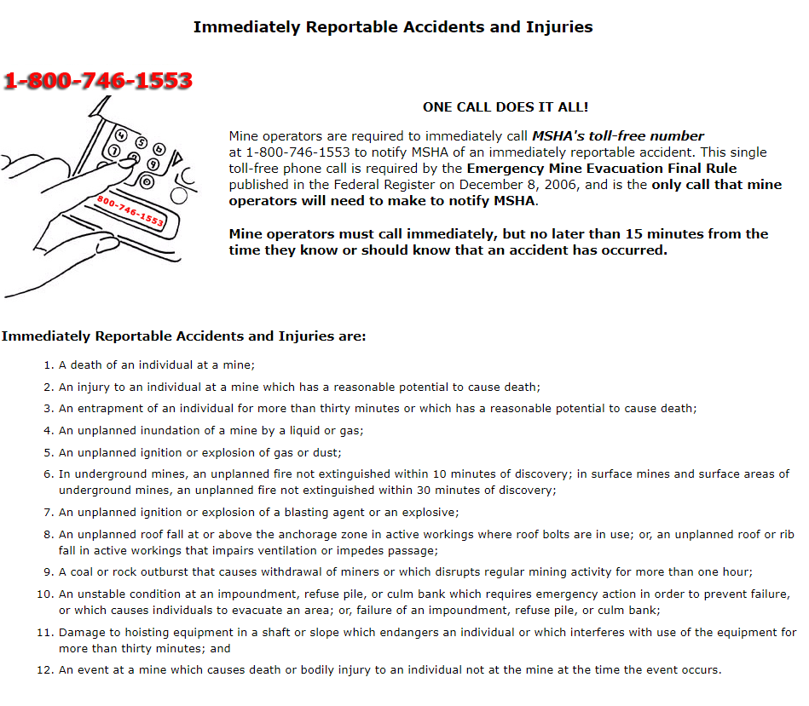
Immediately Reportable to MSHA

Slide 13
Medical Treatment and First Aid
Medically treated injuries ARE reportable.
First aid injuries are NOT reportable provided there are no lost workdays, restricted work activity, or transfer because of the injury.
7000-1)
  Must be completed and submitted within 10 working days
  Must be retained at mine for 5 years

Slide 14
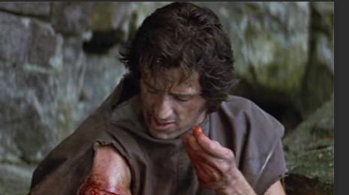
What is First Aid?
One time treatment and subsequent observation of minor scratches, cuts, burns, splinters, and so forth, which do not ordinarily require medical care.
Remember, first aid can be administered by a physician or another medical person, and medical treatment can be administered by someone other than a physician.

Slide 15
Medical Treatment
Suturing (stitching) of any wound.
Treatment of fractures.
Application of a cast, splint, or other means of immobilizing an injured part of the body.

Slide 16
Medical Treatment
Treatment of an infection resulting from work injury.
Treatment of a bruise by the drainage of blood.
Surgical debridement (the removal of foreign material and dead or contaminated tissue).
Treatment of abrasions that occur at greater than full skin depth.
Treatment of second- and third-degree burns is almost always medical treatment.

Slide 17
Abrasion
First Aid Treatment
  Limited to cleaning a wound, soaking, applying antiseptics, nonprescription medication and bandages on the first visit. Includes follow-up visits to change dressing or bandage.
Medical Treatment
  Includes examination for removal of imbedded foreign material, multiple soakings, whirlpool treatment, treatment of infection, or other professional treatments and any treatment involving more than a minor, spot-type injury.

Slide 18
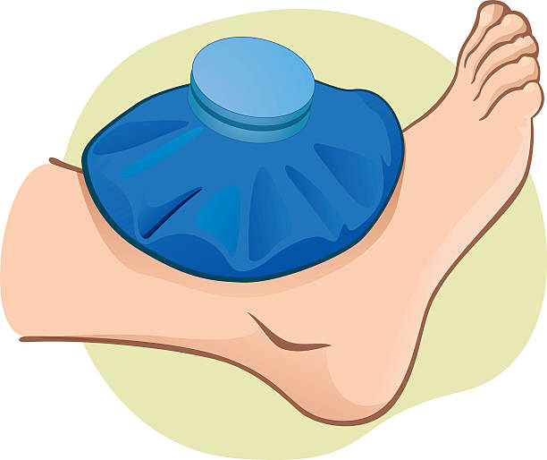
Bruises
First Aid Treatment
  Limited to a single soaking or application of cold compresses, and follow-up visits if they are limited only to observation.
Medical Treatment
  Includes multiple soakings, draining of collected blood, or other treatment beyond mere observation

Slide 19
Burns, Thermal & Chemical
First Aid
  Limited to cleaning or flushing the surface, soaking, applying cold compresses, antiseptics, and bandaging on the first visit.
  Follow-up visits are limited to observation, changing bandages, or cleaning.
  Most first-degree burns only require first aid treatment.
Medical Treatment
  Includes a series of treatments including soaks, whirlpool, skin grafts, and surgical debridement.
  Most second- and third-degree burns require medical treatment.

Slide 20
Cuts and Lacerations
First Aid Treatment
  Is the same as for abrasions except the application of butterfly closures for cosmetic purposes only may be considered first aid.
Medical Treatment
  sutures / stitches (includes the application of butterfly closures for non-cosmetic purposes), surgical debridement, treatment of infection, or other physician-type treatments.

Slide 21

Eye Injuries
First Aid Treatment
  Limited to irrigation, removal of foreign material NOT imbedded in the eye, and application of nonprescription medications.
  Follow-up visits to a physician are limited to observation only.
Medical Treatment
  Involve removal of imbedded foreign objects
  Use of prescription medications
  Other than initial treatment or preventative
  Other physician-type treatment

Slide 22
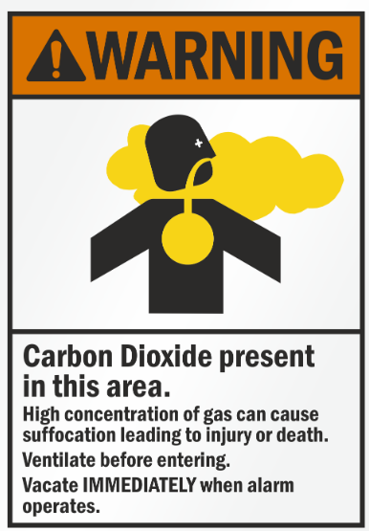
Inhalation of Toxic or Corrosive Gases
First Aid Treatment
  Limited to removal of employee to fresh air or the one-time administration of oxygen for several minutes.
Medical Treatment
  Consists of any professional treatment beyond that mentioned under first aid, and
  ALL cases involving loss of consciousness

Slide 23
Foreign Objects
First Aid
  Limited to cleaning the wound, removal of any foreign object by tweezers or other simple techniques, application of antiseptics and nonprescription medications, and bandaging on the first visit.
  Follow-up visits are limited to observation including changing of bandages.
Medical Treatment
  Removal of foreign object by a physician due to the depth of the embedment, the size or shape of the object, or the location of the wound.
  Treatment for infection, treatment of a reaction to tetanus booster, or other professional treatment is considered medical treatment.

Slide 24

Sprains and Strains
First Aid Treatment
  Limited to soaking, application of hot or cold compresses, and use of elastic bandages on the first visit.
  Follow-up visits for observation, including changing the bandages, are first aid.
Medical Treatment
  Includes a series of hot and/or cold soaks, use of whirlpools, diathermy treatment, or other professional treatments.
Ouch!

Slide 25
Back Injuries
Are strains, sprains, and back injuries reportable?
  Yes, if they occur at the mine, meet the conditions of occupational injuries; and result in lost workdays or restricted activity

Slide 26
Bee/Wasp Stings, Insect/Animal Bites
Are they considered occupational injuries or illnesses if they occur on mine property?
  Classified as occupational injuries because of the instantaneous event.

Slide 27
Chiropractor/ Physical Therapy
Is treatment by a chiropractor considered medical treatment?
  Yes, a chiropractor can perform medical treatment. Look at the severity of the case and what is done instead of who provides it
  P.T. for job related injuries is reportable

Slide 28
Lightning
If an employee is struck by lightning, is it reportable?
  Yes, the employee is on mine property when struck.
The use of prescription medication alone in any case other than for an eye injury is NOT automatically reportable medical treatment for an “occupational injury”.

Slide 29
Off-Mine Property
Are off-mine property injuries reportable to MSHA?
  MSHA has the authority over what occurs on mine property. MSHA exercises no authority over highways and other off-mine locations.
Are parking lot injuries reportable when employees are arriving for work or leaving after the shift?
  Yes, if this parking lot is on mine property. Injuries to employees are reportable if they happen anywhere on mine property.

Slide 30
BE Safe Out there!
……not an option.
Garrit

Slide 31
FMMO Blue Stake
Plant Engineering
2023

Slide 32

FMMO Blue Stake Documents
Blue Stake Policy & Procedures can be found:
Morenci SharePoint: Plant Engineering and Safety – Blue Stake Emergency Contact Procedures, Blue Stake Policy, Blue Stake On Call Weekend Duty Roster
Copies of ALL FMMO blue stake permits are kept on record for 10 years
Copies of annual blue stakes are also kept as electronic copy

Slide 33
FMMO Blue Stake
When or Where…
If the penetration is 1” inch or more, a Blue Stake is required. If the penetration is 1” inch or less, a Blue Stake Permit is not required.
Native ground, top surface of active leach and waste stockpiles, active mining areas where utilities have never been present-a Blue Stake Permit is not required
Sawing into floors requires a Blue Stake permit at all times
FMMO Reduction Works/Pit property, also to include FMI owned commercial buildings within town site

Slide 34

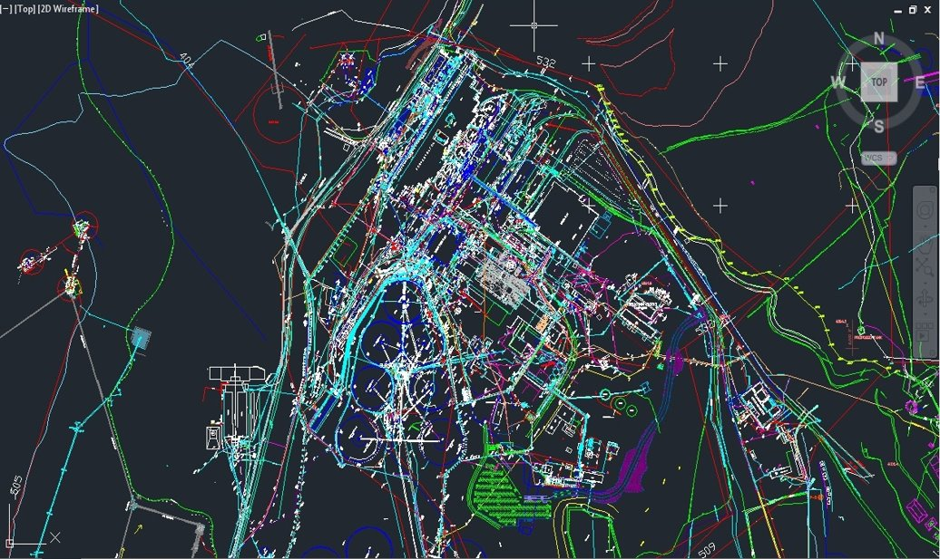
FMMO Blue Stake
RW Utility Map/Drawing
Reduction Works Utility Map
YOUR BLUE STAKE DEPENDS ON THIS!

Slide 35

FMI Blue Stake Policy
1.0 Policy - PURPOSE : Due to the high level of risk during excavations and penetrations of building surfaces, this policy has been developed to minimize risk for injuries, harm to the environment and production losses during such work
2.1 General : Blue Staking is the act of identifying and marking utilities such as electric, gas, water, telephone, fiber optic, etc., so that they do not pose a risk of injury to workers or a risk of being damaged during penetration, excavation, trenching, or digging activities in buildings, surface excavations and underground workings
Blue Stake Representative: A Blue Stake Representative is an engineer, technician, or other qualified individual that has the ability to review drawings or prints and mark out utilities and pipelines accordingly
2.2 Blue Stake Permit: The Blue Stake Representative(s) will determine the necessity for a permit
Purpose: Completing a permit signifies that, to the best of the Blue Stake Representative’s knowledge, inspection, and information available, all known utilities have been identified and marked in the designated area

Slide 36
FMMO Blue Stake When or Where…
If the penetration is 1” inch or less, a Blue Stake Permit is not required
Native ground, top surface of active leach and waste stockpiles, active mining areas where utilities have never been present-a Blue Stake Permit is not required
Sawing into floors requires a permit at all times
Everywhere-within the FMI Reduction Works/Pit property, also to include FMI owned commercial buildings within town site

Slide 37
FMMO Blue Stake
Requestor Responsibilities
Initiate Blue Stake request through work order process
  Reduction Works side only-Plant Eng.
  Pit side-phone call only, no work order necessary
Requestor & Blue Stake representative will coordinate field/site meeting
Requestor is responsible for contacting all parties required (Area Supervisor, Supervisor of Operators, Operators performing work, etc.)
Mark the proposed excavation area in white or pink prior to scheduled field meeting-site visit
Requestor – Best Practices:
  Have accurate scope of work/planning BEFORE the Blue Stake field/site meeting
  Meet at proposed excavation area at the proposed specified time & date to investigate, communicate, & complete Blue Stake documentation
  ALL personal involved will need to be present at the field meeting ie. Requestor, Responsible Area Supervisor, Supervisor of Operators, Operators performing work, etc.
  Have additional information or documentation that is applicable
  Blue Stake permit will be reviewed-communicated with group for appropriate signatures
Communication is the Key!

Slide 38
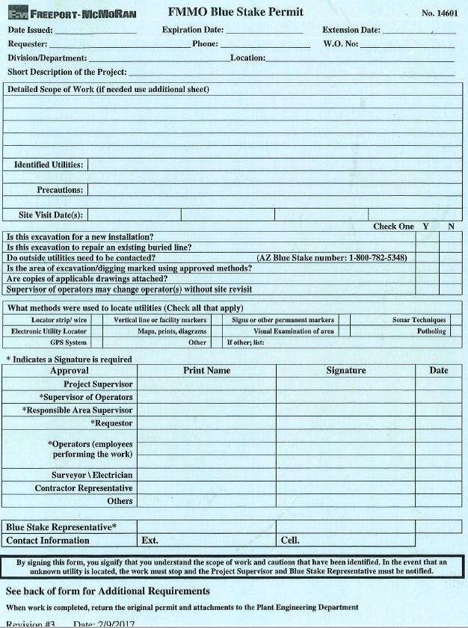
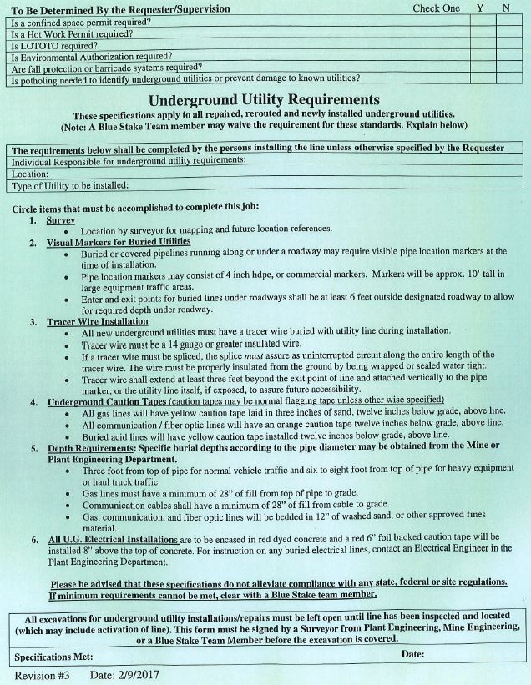
FMMO Blue Stake Permit
ALL Utilities

Slide 39
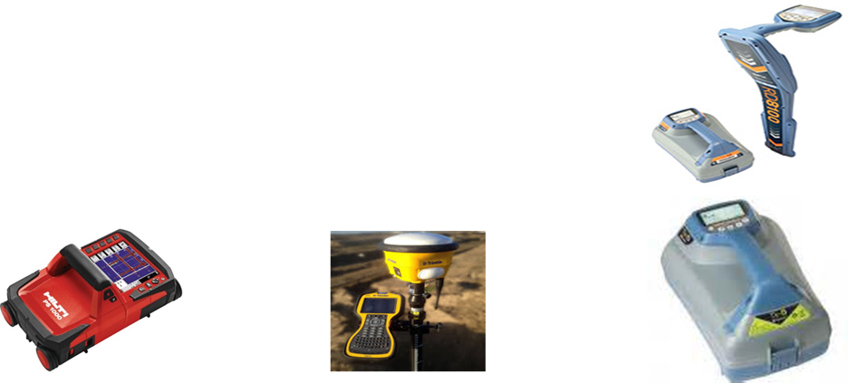
Utility Locating Equipment
Electronic Utility Locator
Concrete Imaging System
Global Positioning System(GPS)
People Knowledge – Area Supervisor

Slide 40
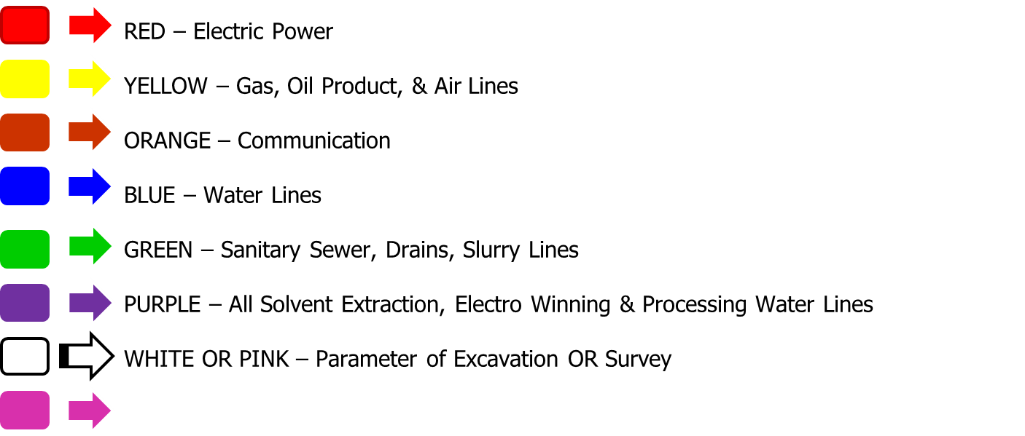
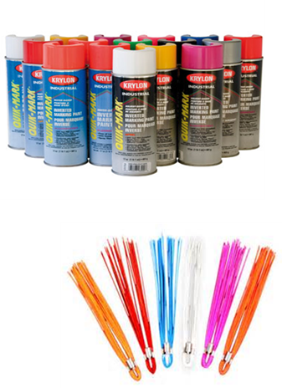

Color Identification Marks

Slide 41
FMMO Blue Stake
New Underground Utility Installations
Specifications apply to ALL repaired, rerouted and newly installed underground utilities.
  (Note: A Blue Stake Team member may waive the requirements for these standards with explanations listed)
  Survey
  Visual Markers for Buried Utilities
  Tracer Wire Installation
  Underground Caution Tapes
  Depth Requirements
  All Underground Electrical Installations
  See back of permit form for Additional Requirements
  FMI representative needs to be contacted to record ALL new utility installation location and depths or if any unmarked utilities are located during the excavation process
  Excavator will not backfill or bury new utility installation prior to survey as-built of new utility

Slide 42
Mine vs Townsite Comparison

Slide 43
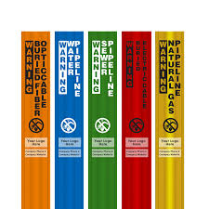



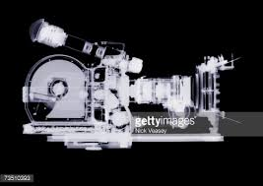
Questions or Comments

Slide 44
THANK YOU!

Slide 45
FMMO Blue Stake
Stop Work Authority
Broken utility during excavation
Found/expose unknown utility during excavation
Excavation within 24” inch of known using hand tools only. Possible utility isolation required
Any deviations, scope of work area expands, or changes
Any safety concern or unsafe act
Any environmental concern

Slide 46
FMMO Blue Stake
Conflicts/Re-occurring Issues
Resource/staff, short notice
Upon original scheduled Blue Stake site/field meeting, requestor asks for additional Blue Stake permit for separate job near same area
Typical FMMO Blue Stakes are valid for 30 days, giving time for date extension

Slide 47
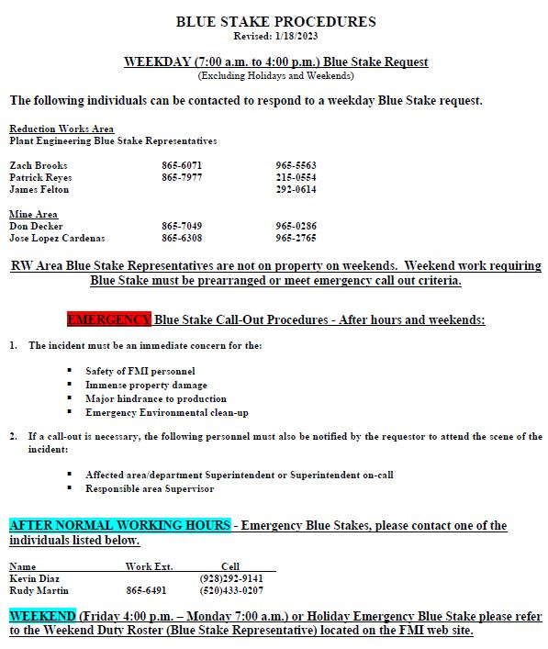
FMMO Blue Stake
Emergency Process/Contact

