Slide 1
WELCOME
Contactor Safety Meeting
May

Slide 2
Agenda
Safety Share
Environmental Share
Safety Stats
  Trends
  MSHA summary
Event Review
  Open Hole Learnings
  Empire Injuries
  Recognition
  AMES Milestone
  BOART
Guest Speaker: Caesar Russell, Fitness and Work Impact

Slide 3
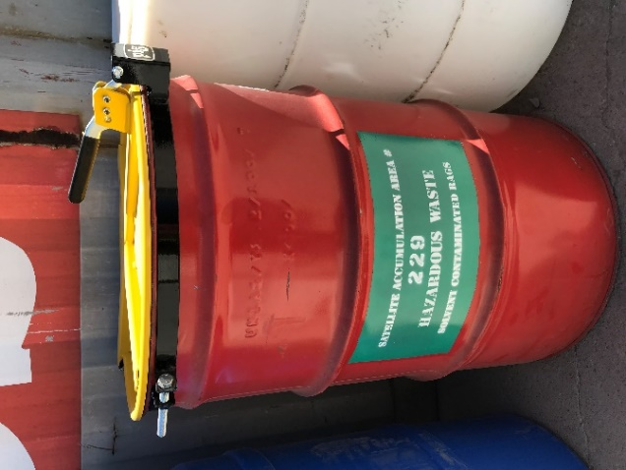
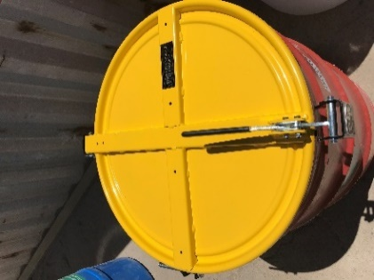

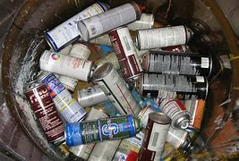
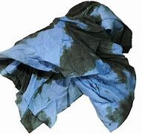
Environmental Share
Satellite Accumulation Areas
Morenci Environmental Services
What is a Satellite Accumulation Area (SAA)?
Any location at or near the point of generation where hazardous wastes initially accumulate, which are under control of the operator of the process generating the waste.
Requirements for SAA:
Must not exceed 55 gallons of one type of hazardous waste in a working area
Must be labeled starting with the words “Hazardous Waste” and area marked with the words “Satellite Accumulation Area”
Container must be closed unless adding or removing waste
Keep all aerosol cans, batteries, solvent rags, etc. always segregated
Containers in a SAA can only be moved from SAA to the Central Accumulation area (aka Environmental Yard). They cannot be moved from one SAA to another SAA.
Lid Closed
Labeled Correctly
Keep waste streams always segregated!
For More Information on Satellite Accumulation Areas, please refer to BMP’s 324 Hazardous Waste Identification and Handling and BMP 325 Aerosol Can and Paint Marker-Pen Management
May 2023

Slide 4

April Safety Results

Slide 5
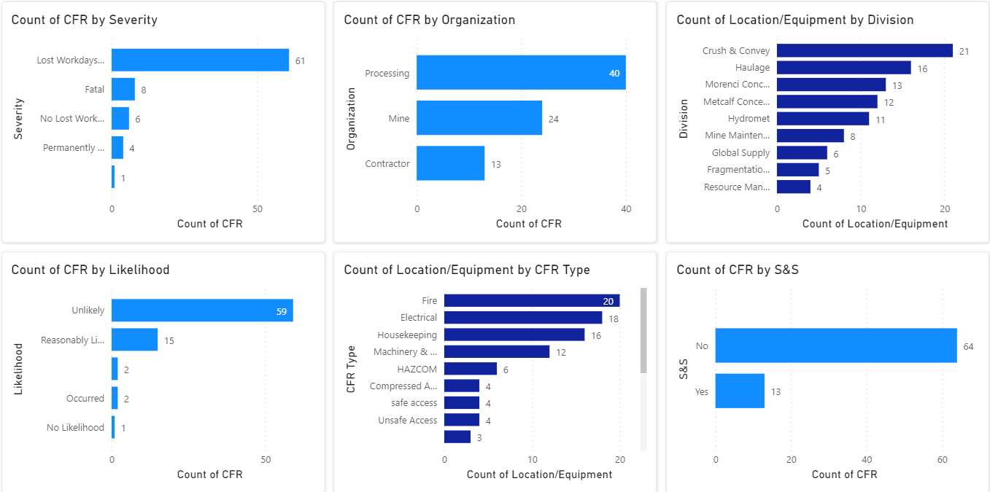
April/May MSHA Results

Slide 6
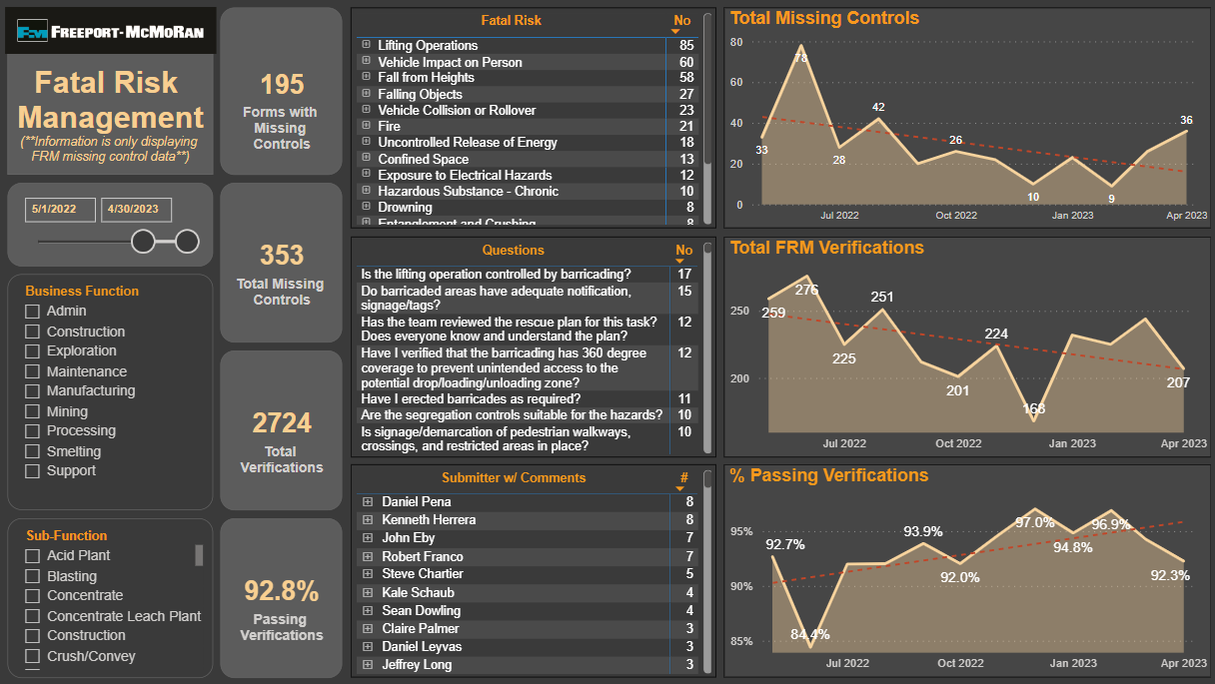
12 Month Rolling TRIR

Slide 7
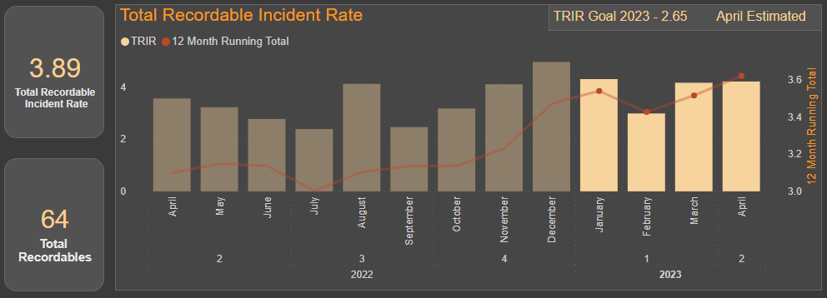
TRIR Opportunities
OKR 1.2: Site safety performance delivers a TRIR of 2.65 or lower for Q22023

Slide 8
All Injuries YTD – By Division
57% <3 years experience
36% <6 months experience

Slide 9
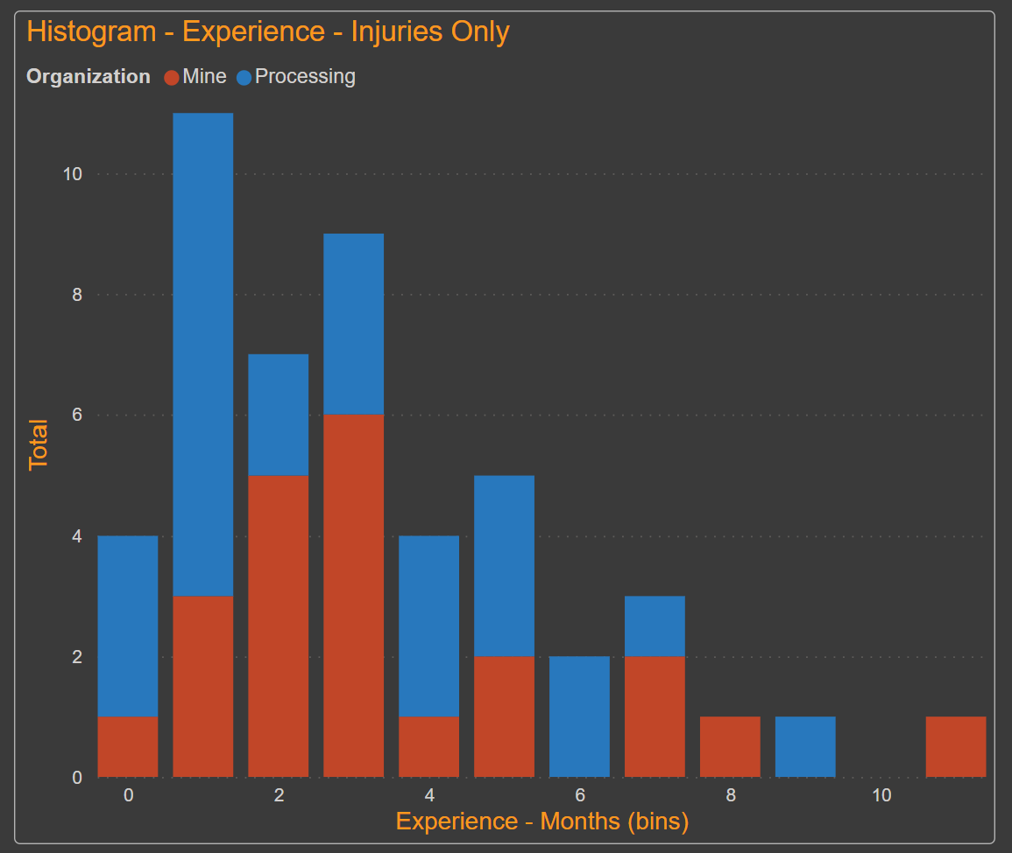
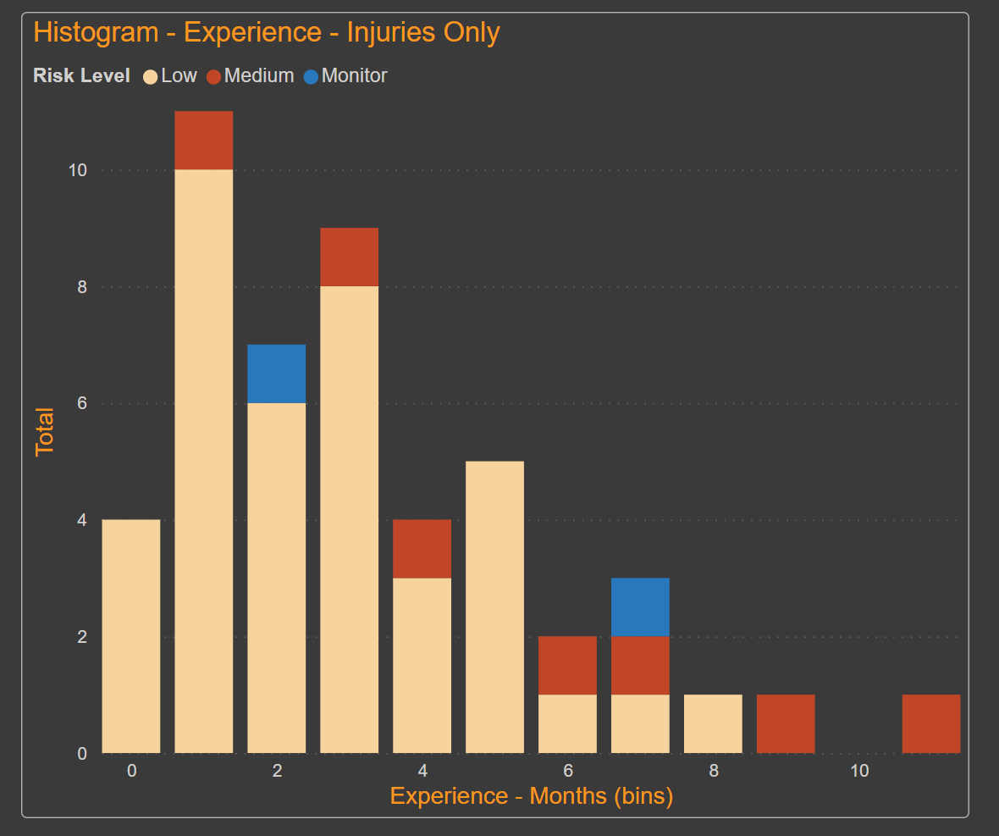
Injuries with <1 Year Experience
Most in 1st 4 Months
Mostly Low Risk

Slide 10
All Injuries YTD – Top Event Types

Slide 11
Insights From Earlier Discussions
Learning from Pockets of Success
Red Hat Program / Onboarding
  Intent vs execution at frontline
Safety Performance scoreboard, making safety performance visible. Promote healthy competition
  What message does our recognition programs send?
Repetitive strain – Labor intensive work adds up
  Encourage crews to plan physical labor
  Work smarter not harder
  Explore opportunities with work groups
Are we executing our current processes effectively?
  Tailgates, WPE, JSA's, discipline around PPE, etc...
Notes:
Also note opportunities with Gila Health, EMTs, etc.

Slide 12
April Safety Incidents

Slide 13
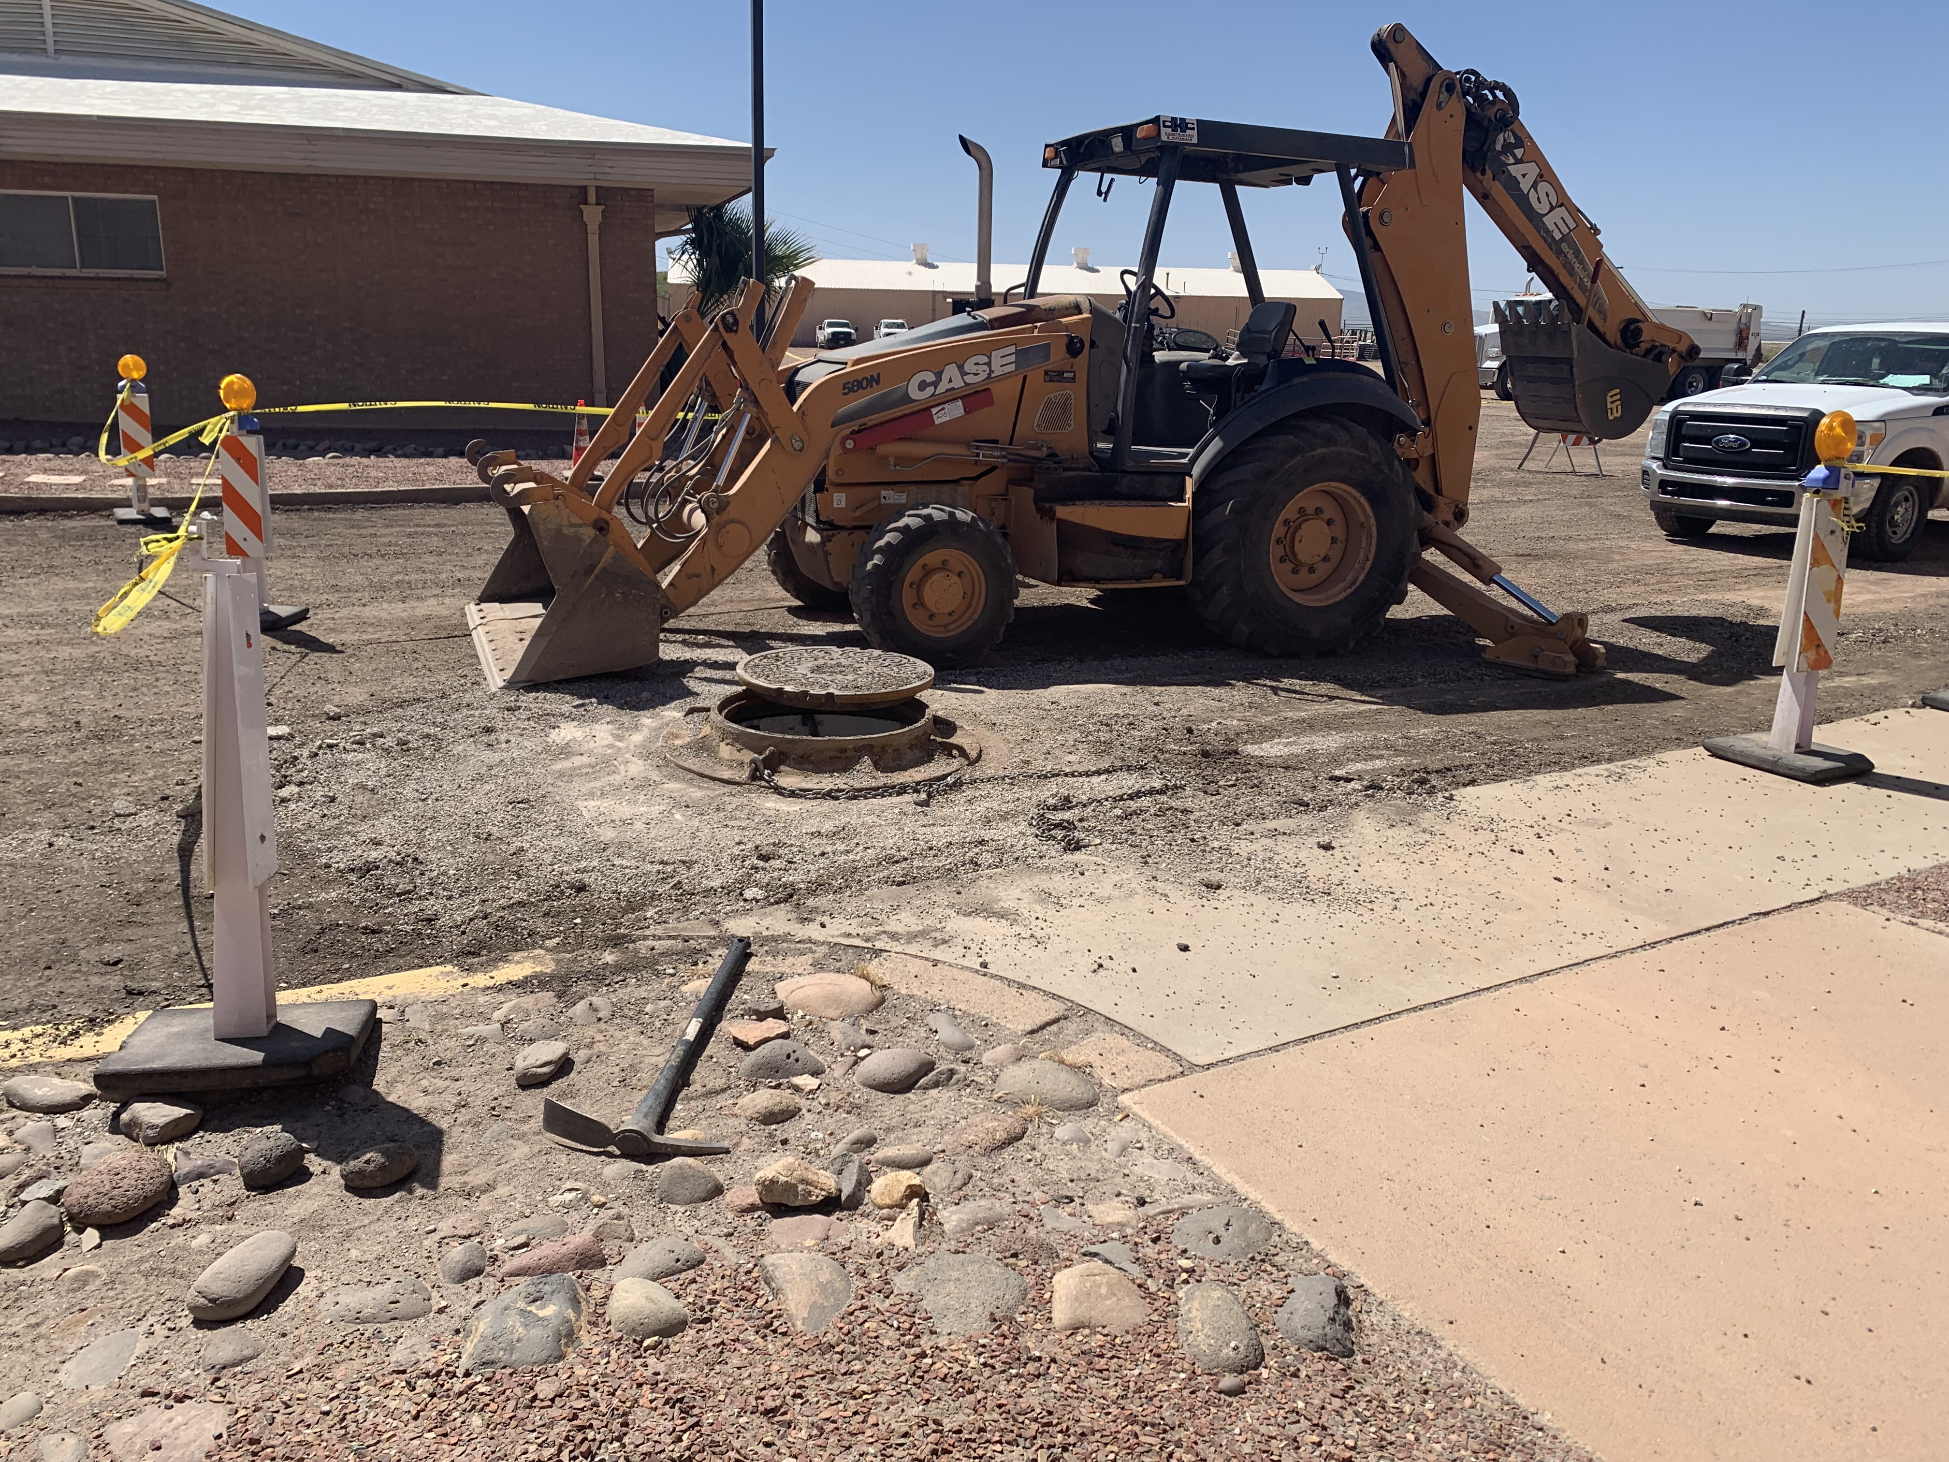
Open Hole - Event Details
At approximately 10:30 am supervisor told an equipment operator he had to go to CKC’s mini-yard to grab steel plate to use as a temporary hole.
The supervisor gave instructions to stay by the manhole until he got back. CKC had barricading and caution tape around the area but left one side exposed. The operator decided to walk over to his work truck 30 yds away to prepare a chain for when the supervisor returned. The chain would be needed to remove the MH Frame & Cover.
While the operator was away getting the chain an FMI Safety officer walked by and notified him that without somebody standing by the manhole there was a potential fall from heights safety violation
Open Hole
Chain retrieved by Pat

Slide 14
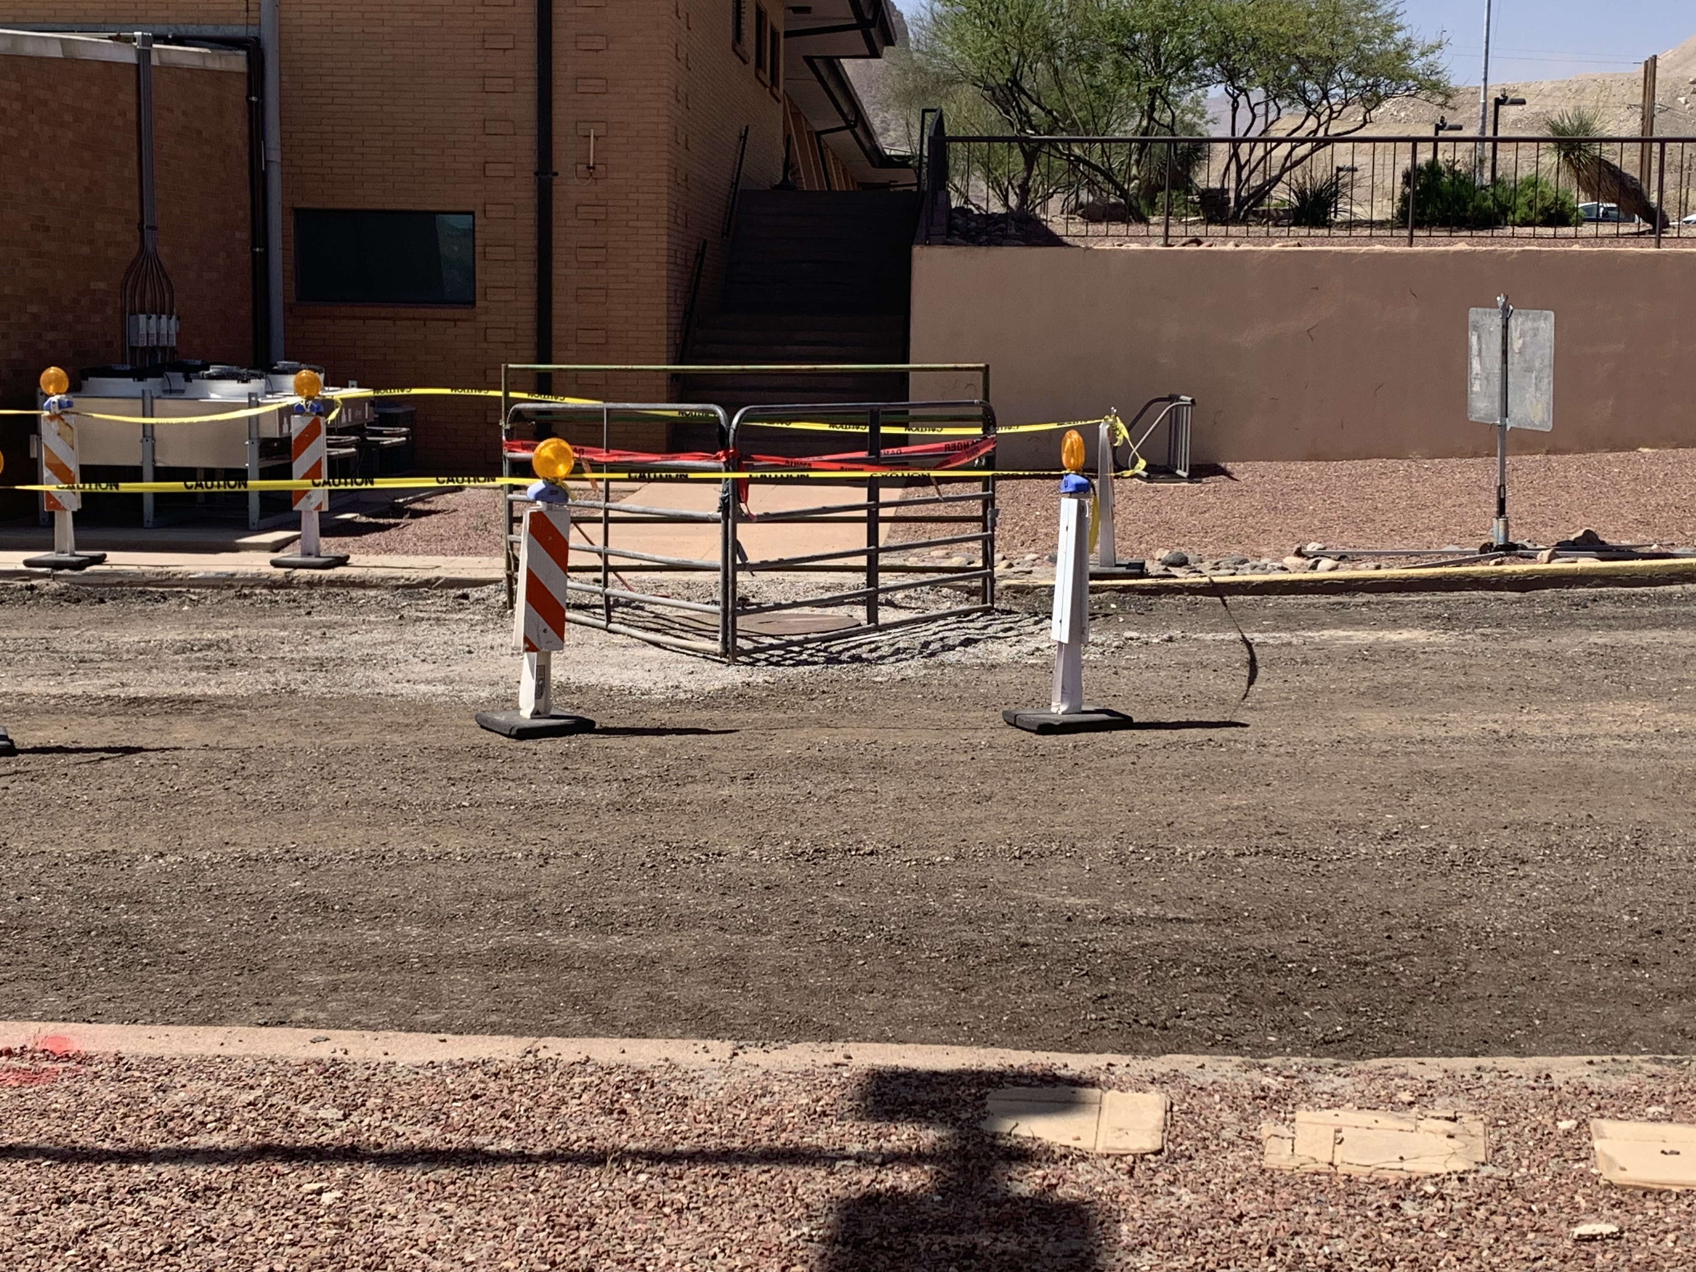
Open Hole - Event Details
After supervisor returned the Manhole Frame & Cover was replaced with a temporary steel plate.
There were three panels installed around the manhole to provide a hard barrier

Slide 15
Open Hole - Fatal Risks and Critical Controls
Fatal Risks
Learnings
Actions
Leading Edge /Open Hole Protection
Is installed edge protection adequate to prevent falls? Note: Includes railings, horizontal lifelines, rat lines, etc.
Am I adequately protected from falling into of off of all openings or leading edges i.e. using barricades, guards or other fall prevention/protection?
Have I inspected the edge protection devices to ensure they are maintained and in good working order?
Manholes vary in depth from 2 feet to 8 plus. (routine practices).
The Risk assessment from one side parking lot did not consider the hazard for another area of the parking lot. (did not include manhole removal.)
Do not place yourself in line of fire while correcting an identified hazard
Check for understanding
Immediate: Proper barricading
Set up Risk Assessment Process. Follow up with audits by Owner.
Conduct FRM review
Develop plan work processes to review prints- and create work plans commensurate to hazards
Notes:
Corporate Safety Portal - DOHS Policies - By Policy and Purpose (sharepoint.com)

Slide 16
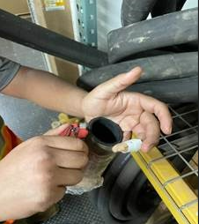
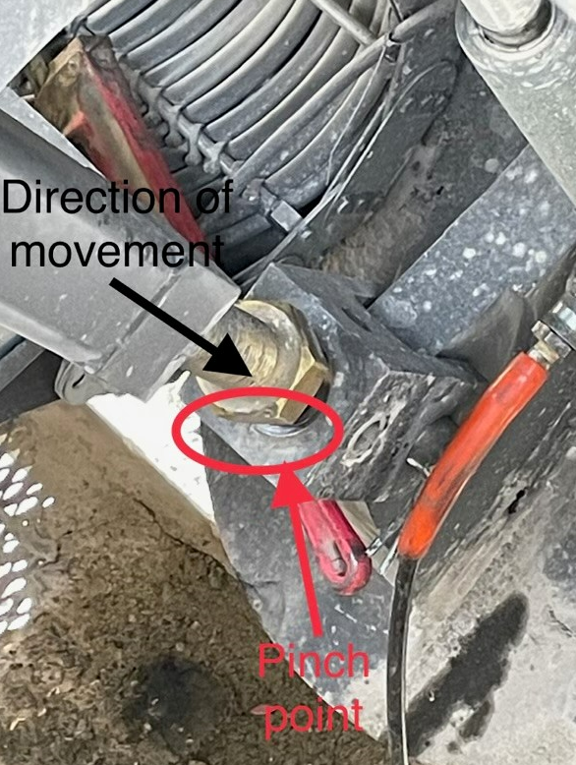
EMPIRE -
4-26-23
Installing belts on a 4100 shovel
Utility Knife Event

Slide 17
April/May
Recognition

Slide 18
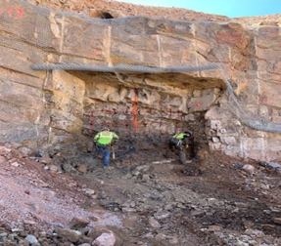
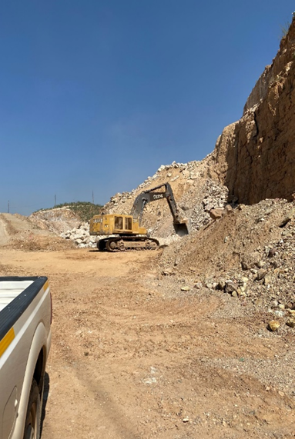
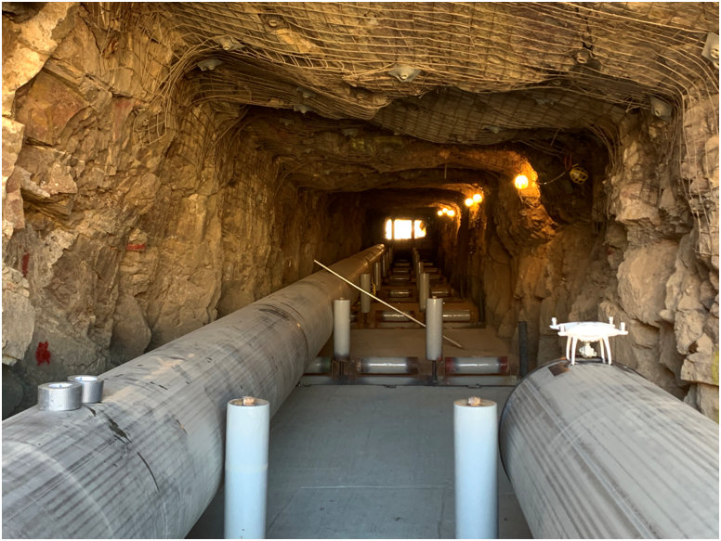
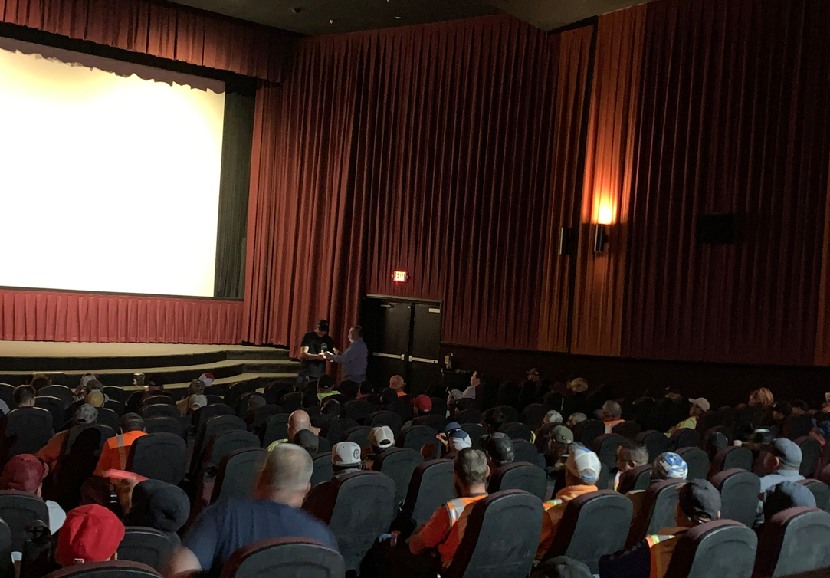
AMES Safety Milestone
500,000 Thousand Manhours – No Reportable Injuries

Slide 19
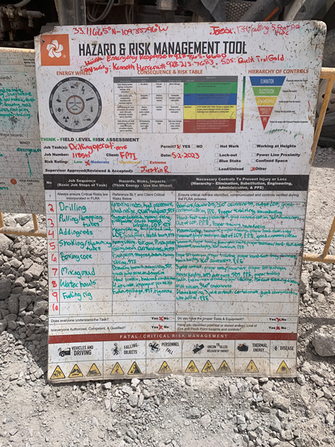
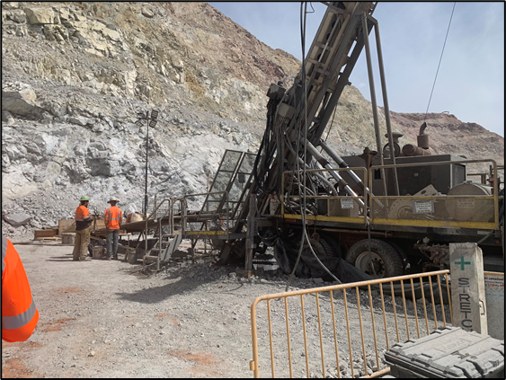
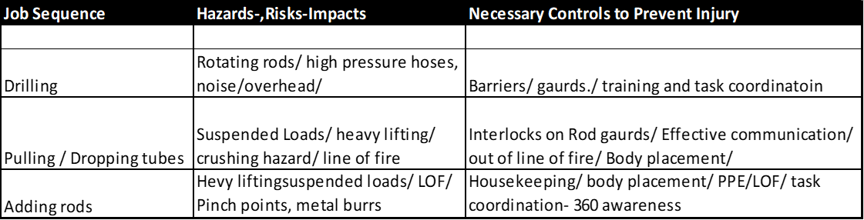
BOART Risk Assessment Process

Slide 20
Caesar Russell
World Renowned Fitness Expert

Slide 21
Caesar Russell
World Renowned Fitness Expert

Slide 22
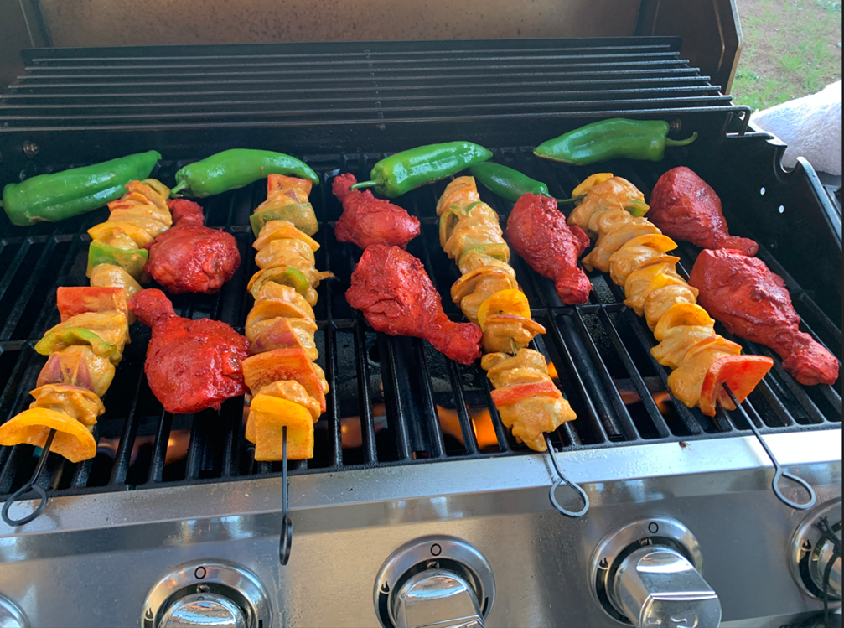

All this to enjoy and appreciate life!

Slide 23
Contractor Engagement Team Update

Slide 24
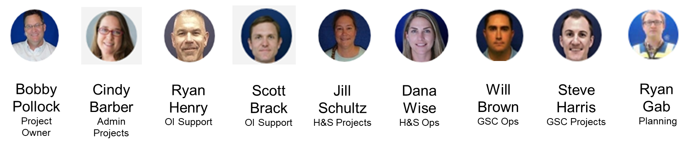
Contractor Engagement Team
Working in close collaboration with our Contractors to ensure we are collectively focused on:
Guiding Light: Right contractor, right time, right skills, performing high quality standards safely
Safety: Ensuring the contractors have been trained appropriately and have the right leadership and safety oversight to perform safely
Contractor Management: Ensuring accountability with contractors on safety, consistency, quality, accuracy with performance management tools to do so

Slide 25
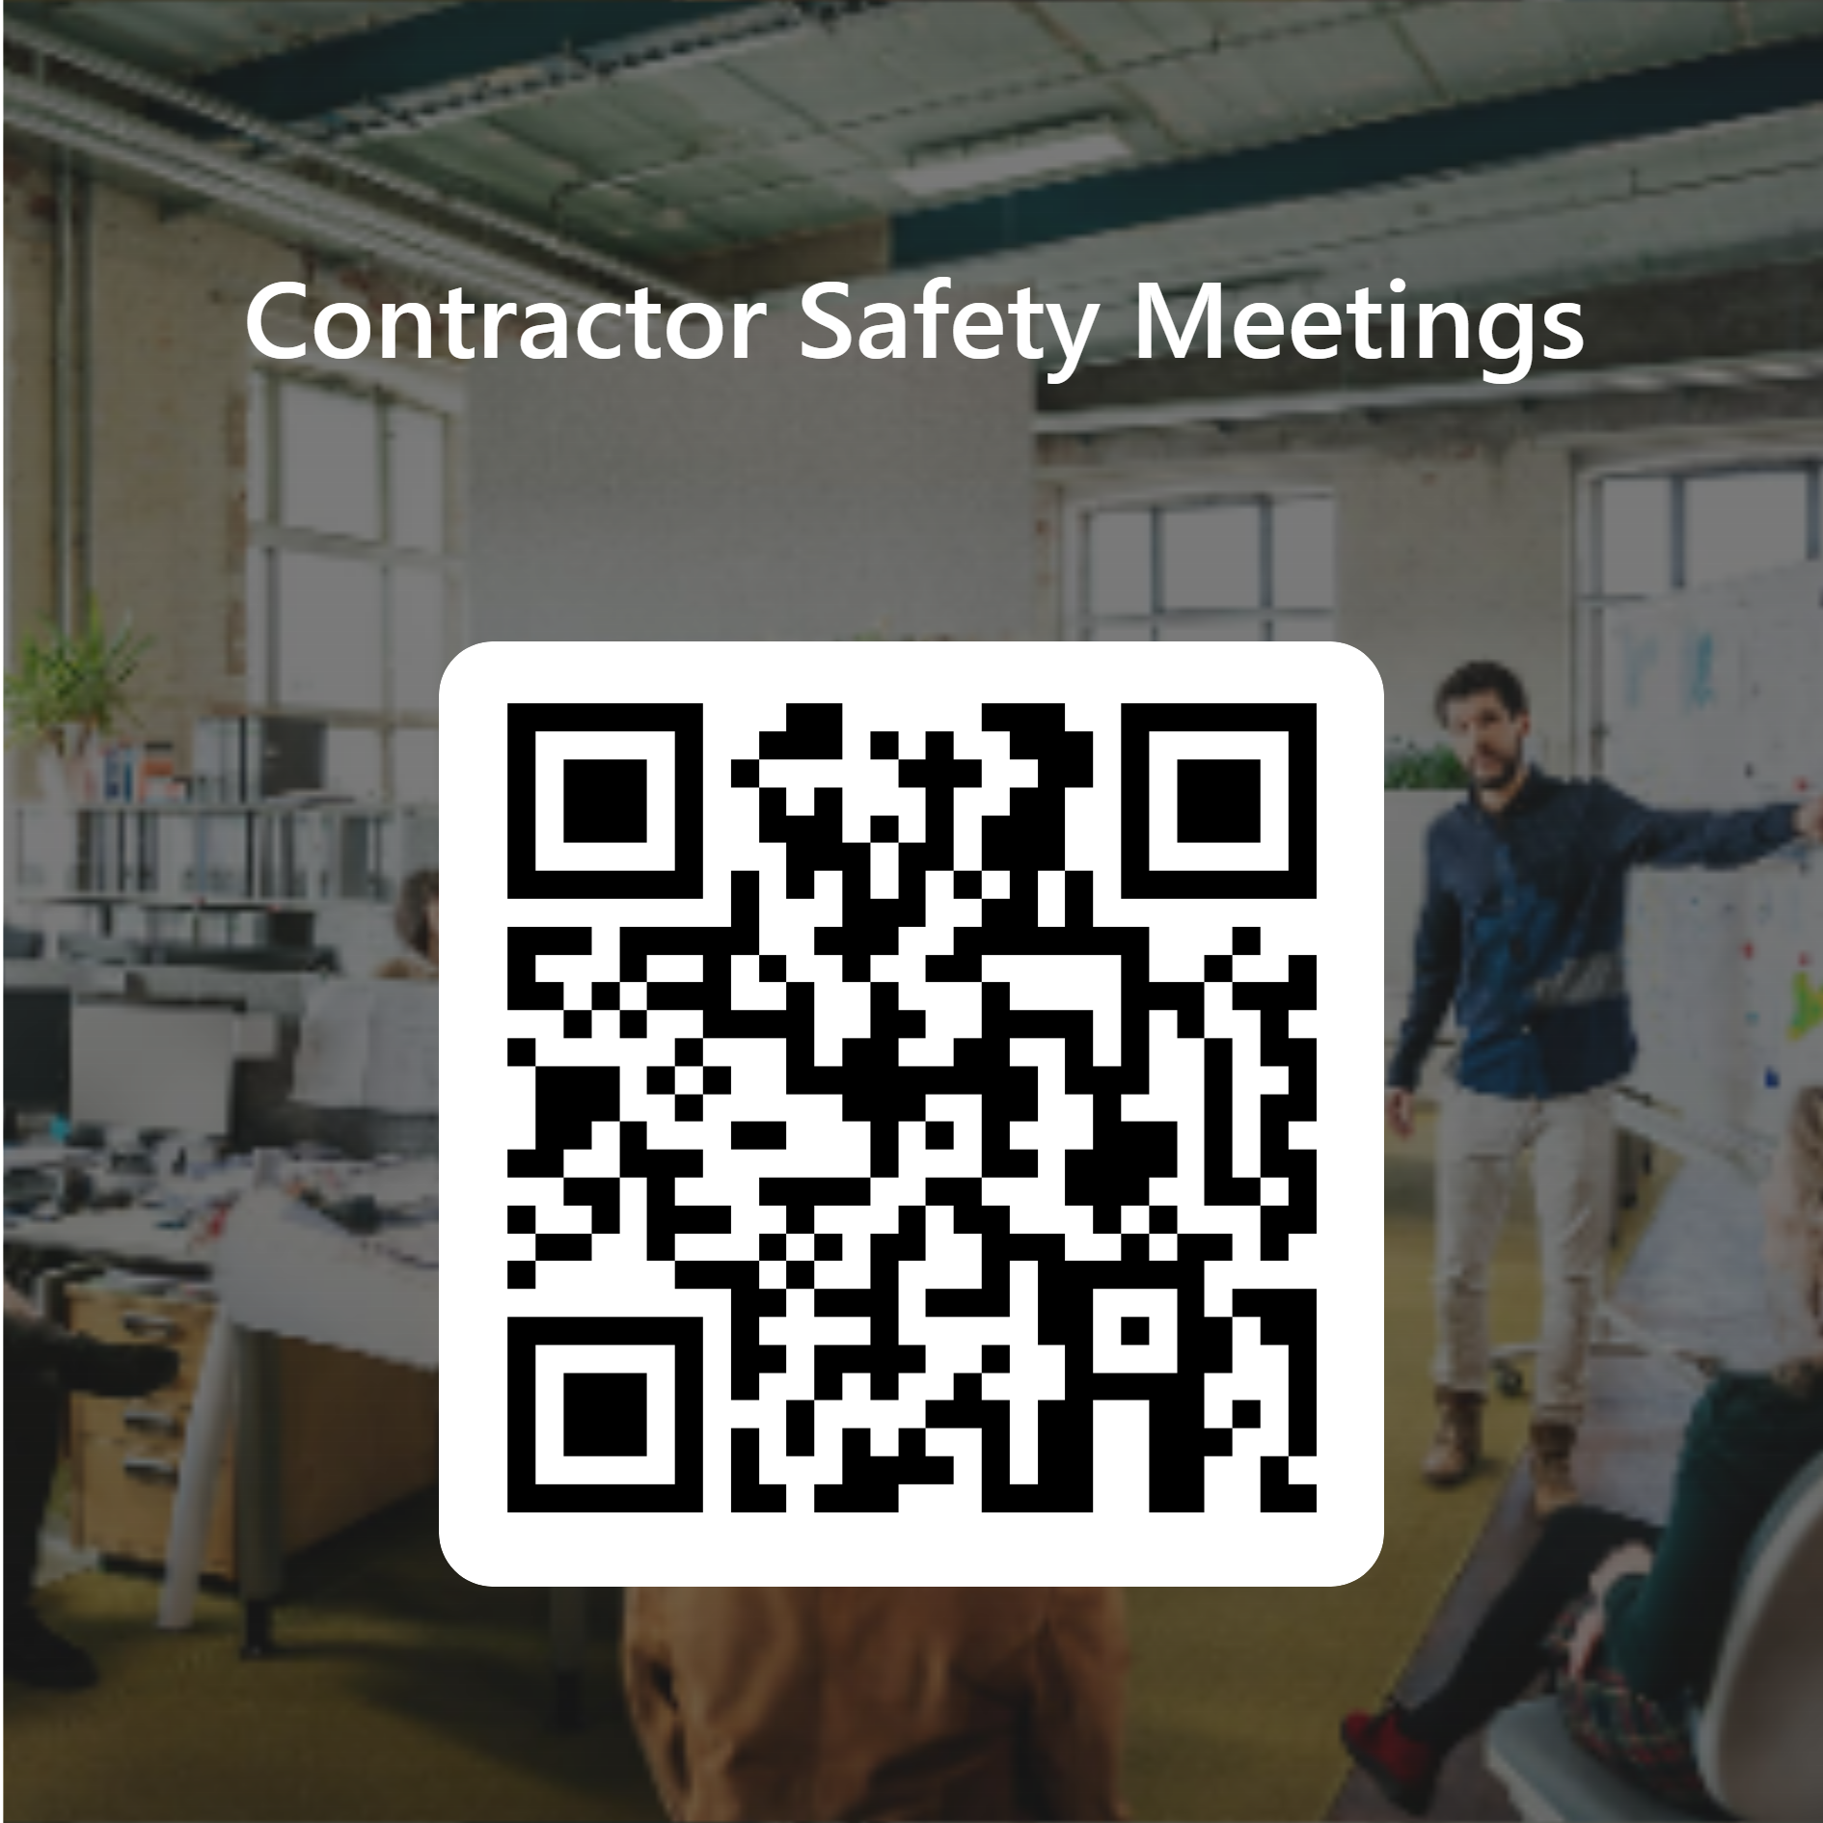
Request for Feedback
https://forms.office.com/r/dF1CRQCBbP

