Slide 1
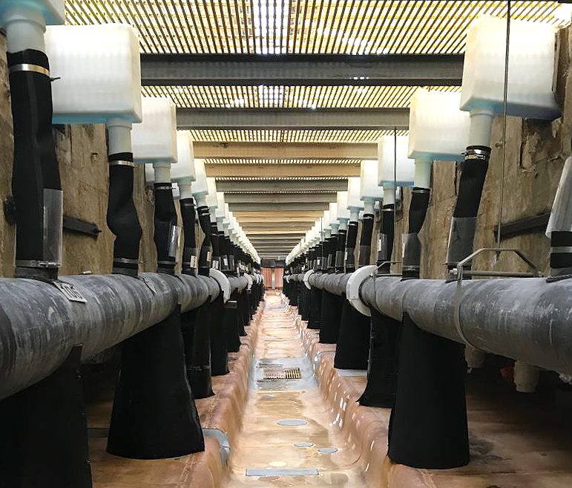
Module 5: Tankhouse Processes

Slide 2
Module 5 Learning Objectives
At the end of this Module, given the information by the facilitator and utilizing the Tankhouse Electrical Safety Student Guide v.2, the trainee will:
List the general terms and definitions for this Module.
Identify the arc flash and shock hazards, along with the safeguards and controls, relating to EW/ER tankhouse processes such as:
Breaking Cell Contact | Power Tool Usage
Jumper Frame Placement and Shunt Operation | Corded Power Tools
Shutdowns | Restricted Access Use
Housekeeping | Safety Signage
Metal Hand Tool Usage | Training
2

Slide 3
Nomenclature
Crossword Puzzle
Break into pairs (or groups) to complete the crossword puzzle based on EW/ER words and definitions for this Module.
Test yourselves! See how many you know or can figure out before looking at the EW/ER Glossary in the back of your Student Guide.
Time limit: 10 min.
Activity #9
3

Slide 4
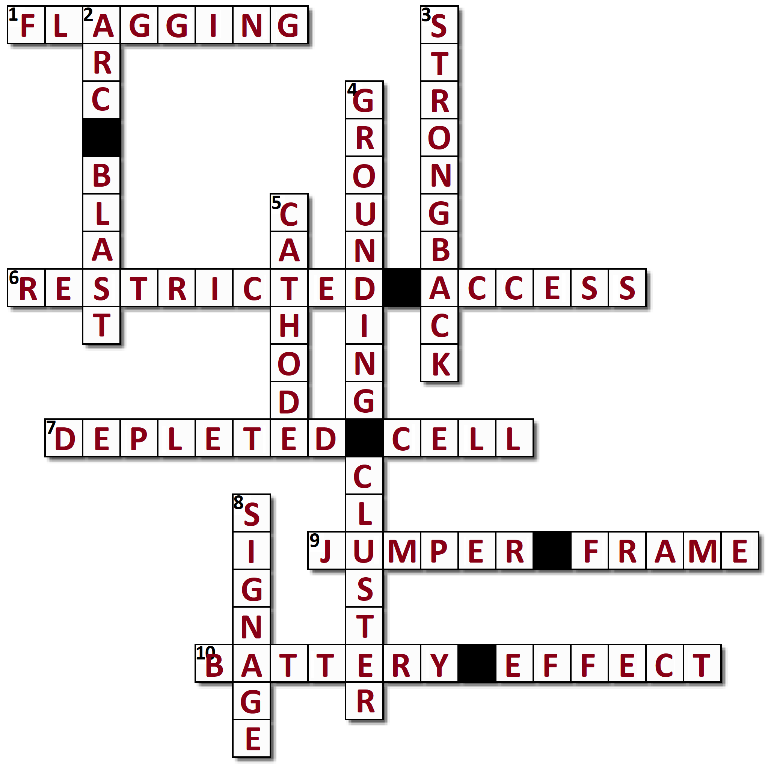
Crossword Puzzle Answer Key
Activity #9
4

Slide 5
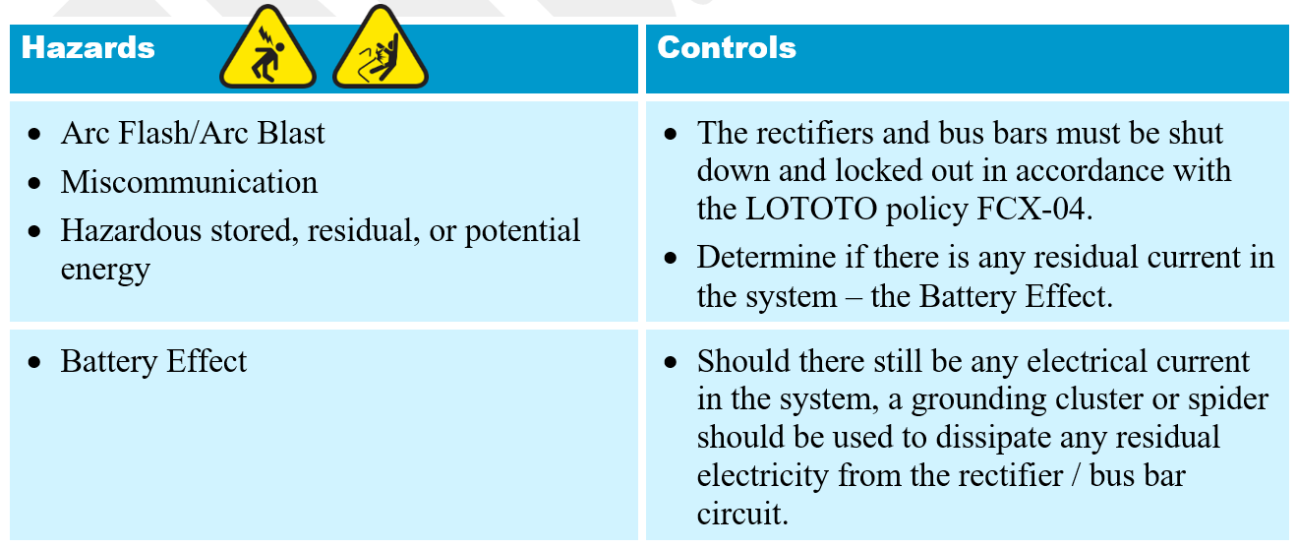
Tankhouse Processes
Shutdowns
5

Slide 6
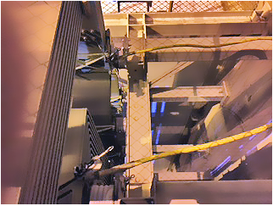
Tankhouse Processes
Battery Effect
Fig. 5.1. At left, a grounding cluster, also known as a spider, used to dissipate residual electricity in the circuit.
6
Notes:
Cell contact is normally broken for planned maintenance or during a power outage to prevent the battery effect of lead anodes and copper dissolution in a lead anode system. In this instance, ensure rectifier is off and power sources have LOTOTO in place per site procedures before breaking cell contacts.

Slide 7
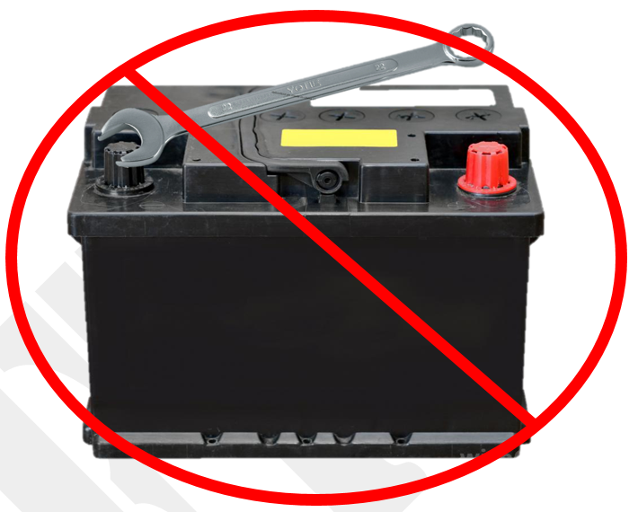
Tankhouse Processes
Battery Effect
The rectifier creates a lead oxide layer on the lead anodes similar to what a battery charger does for a lead car battery.
When the rectifier is turned off, the charged layer of lead oxide remains on the lead anodes.
It will discharge if a short occurs between electrodes (similar in fashion to when a wrench is placed across the terminals of a car battery).
This does not apply to electrorefinery cells.
Fig. 5.2. Shown: car battery with wrench about to come in contact with both posts. Arc Flash!
7
Notes:
When lead anodes are used the action of the rectifier is to create a lead oxide layer on the lead anodes similar in fashion to what a battery charger does for a lead car battery.
When the rectifier is turned off, the charged layer of lead oxide remains on the lead anodes, and it will discharge if a short occurs between electrodes (similar in fashion to when a wrench is placed across the terminals of a car battery) or if paths to ground become available.
This does not apply to electrorefinery cells.

Slide 8
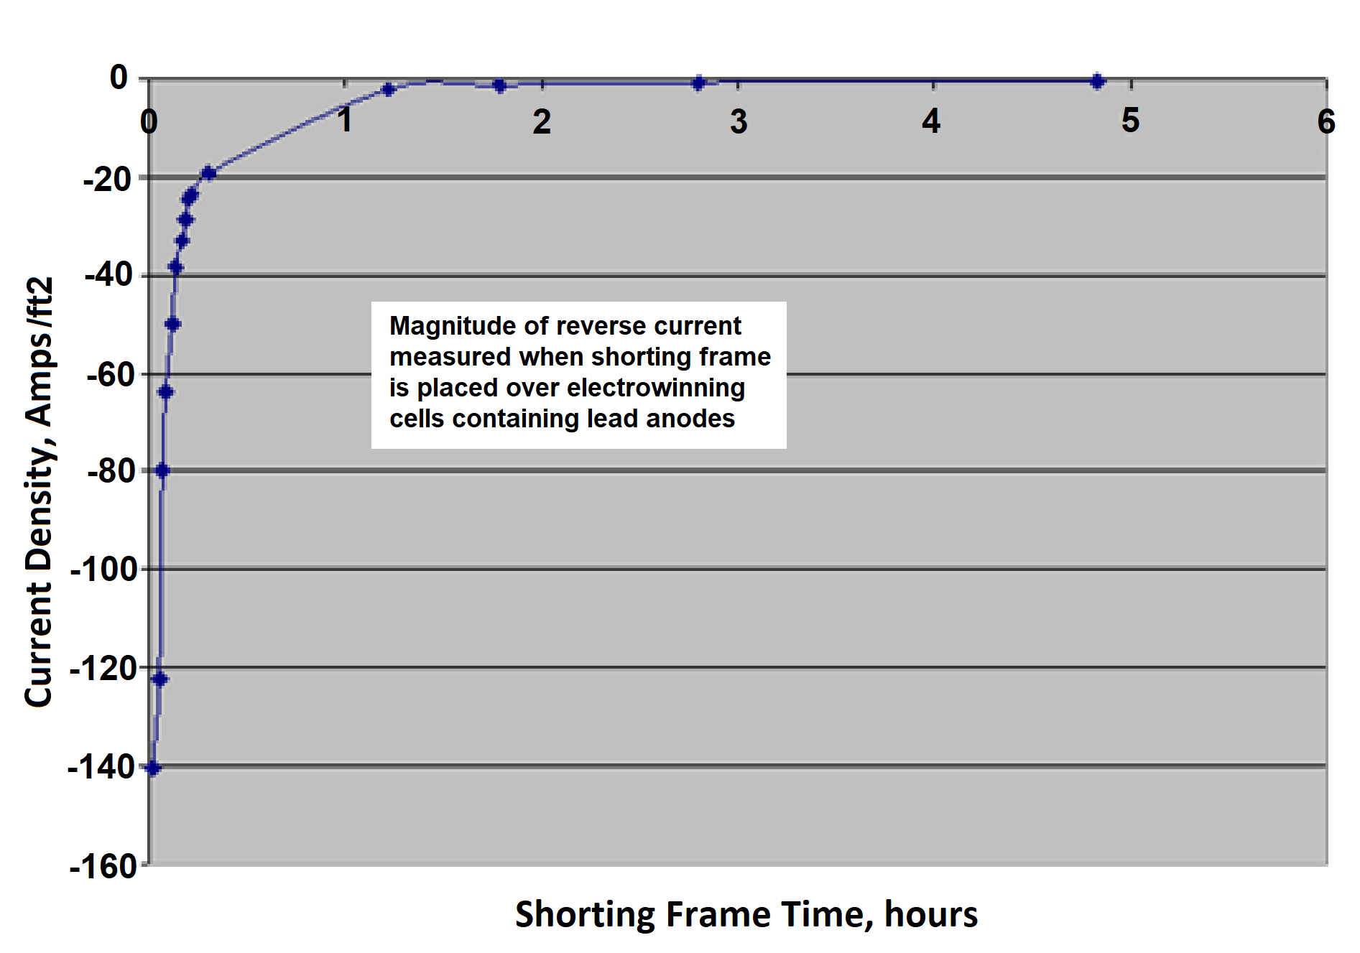
Tankhouse Processes
Battery Effect
Note: Even after the rectifier is locked out, an arc flash and shock hazard may still exist.
Fig. 5.3. The diagram at left illustrates that when a jumper frame is placed over the cells, a reverse current equal to -140 amps/ft² is generated.
Although this is a large amount of current at first, you can see that after an hour or so the battery effect has diminished to near zero.
8

Slide 9
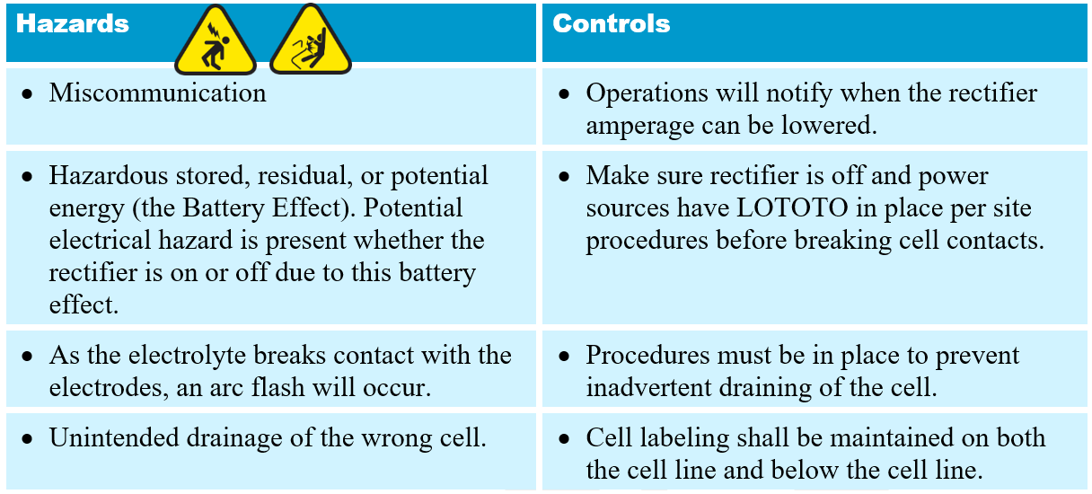
Tankhouse Processes
Breaking Cell Contact
9

Slide 10
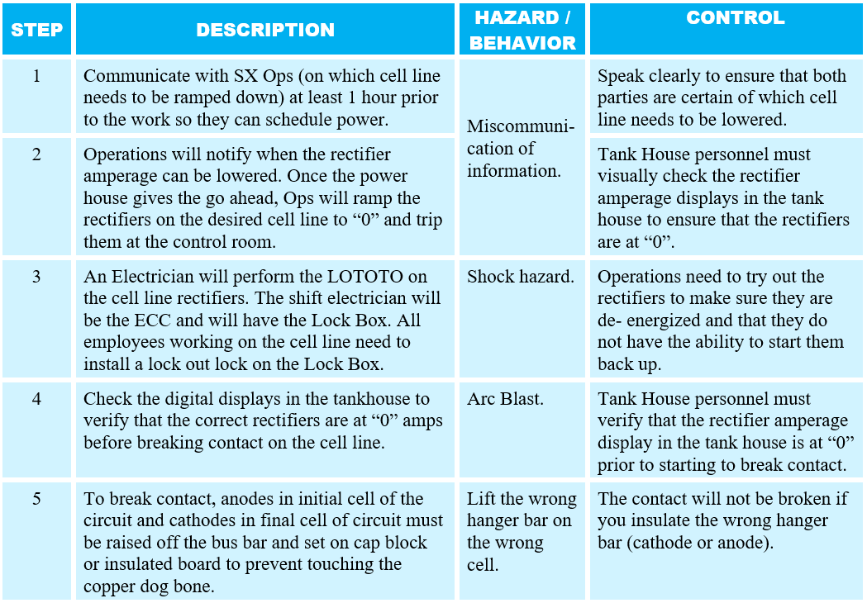
Tankhouse Processes
Breaking Cell Contact (sample SOP)
What to do
How to prevent it
What can go wrong
10
Notes:
An example of an SOP for Breaking the Cell Line Contact. Note the potential hazards and/or possible behavior breakdowns in the highlighted text. As people become more aware of stray current and arc flash hazards, SOPs should be reviewed to ensure the hazards are identified.

Slide 11
Tankhouse Processes
Breaking Cell Contact (sample SOP)
What can go wrong
What to do
How to prevent it
11
Notes:
An example of an SOP for Breaking the Cell Line Contact. Note the potential hazards and/or possible behavior breakdowns in the highlighted text. As people become more aware of stray current and arc flash hazards, SOPs should be reviewed to ensure the hazards are identified.

Slide 12
Tankhouse Processes
Breaking Cell Contact (sample SOP)
What to do
What can go wrong
How to prevent it
12
Notes:
An example of an SOP for Breaking the Cell Line Contact. Note the potential hazards and/or possible behavior breakdowns in the highlighted text. As people become more aware of stray current and arc flash hazards, SOPs should be reviewed to ensure the hazards are identified.

Slide 13
Tankhouse Processes
Breaking Cell Contact (sample SOP)
13
Notes:
An example of an SOP for Breaking the Cell Line Contact. Note the potential hazards and/or possible behavior breakdowns in the highlighted text. As people become more aware of stray current and arc flash hazards, SOPs should be reviewed to ensure the hazards are identified.

Slide 14
Tankhouse Processes
Breaking Cell Contact (sample SOP)
14
Notes:
An example of an SOP for Breaking the Cell Line Contact. Note the potential hazards and/or possible behavior breakdowns in the highlighted text. As people become more aware of stray current and arc flash hazards, SOPs should be reviewed to ensure the hazards are identified.

Slide 15
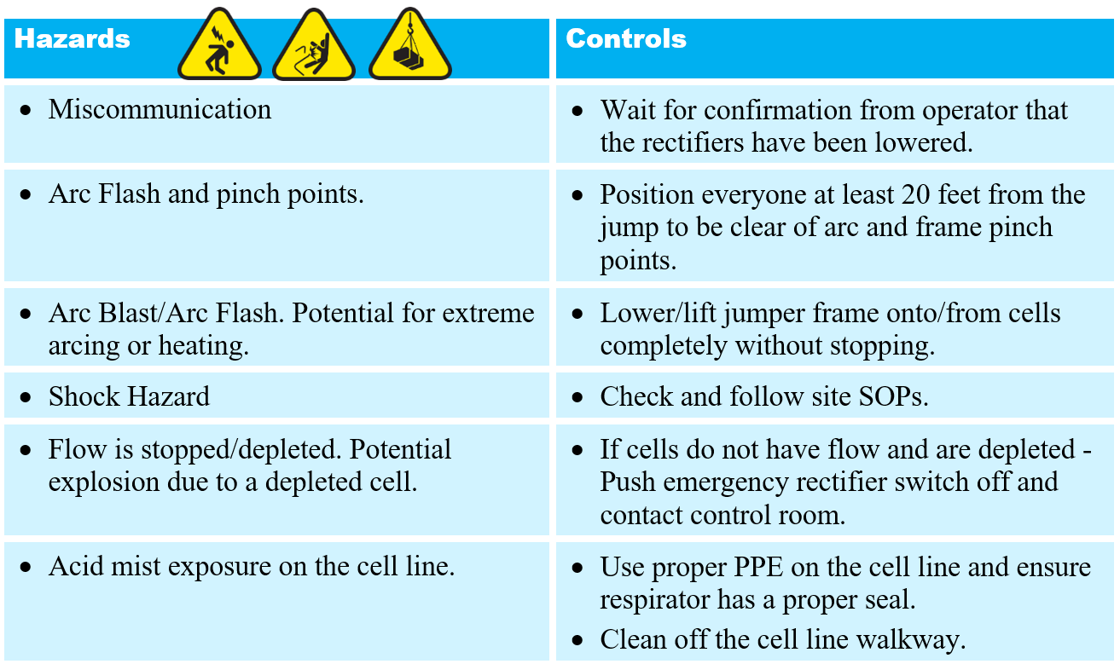
Tankhouse Processes
Jumper Frames
15

Slide 16
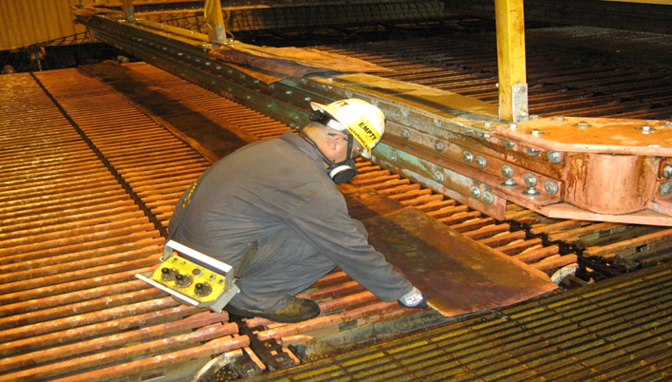
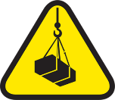
Tankhouse Processes
Jumper Frames
Fig. 5.4. Folded starter sheets are placed below the jumper frame to minimize damage from arc flash.
Exposure to Electrical Hazards
Uncontrolled Release of Energy
Lifting Operations
16

Slide 17
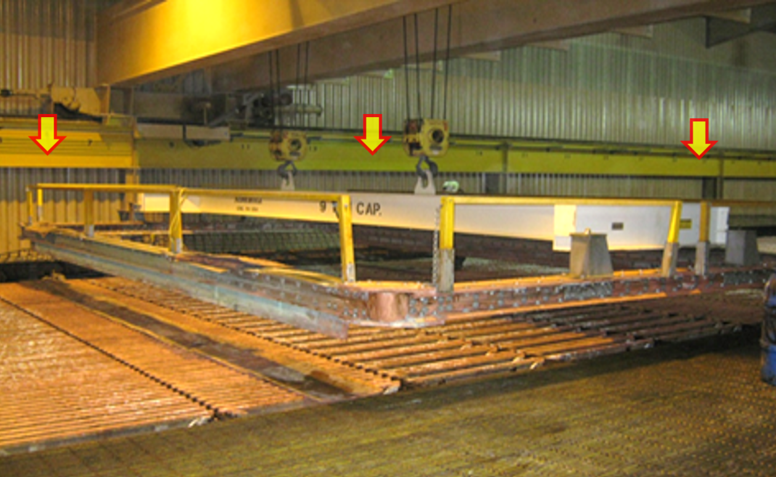
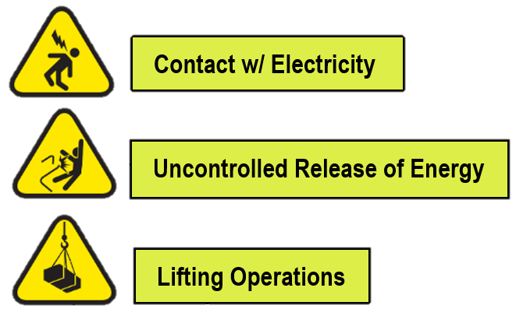
Tankhouse Processes
Jumper Frames
Fig. 5.5. The jumper frame is lowered onto cells - without stopping.
17

Slide 18
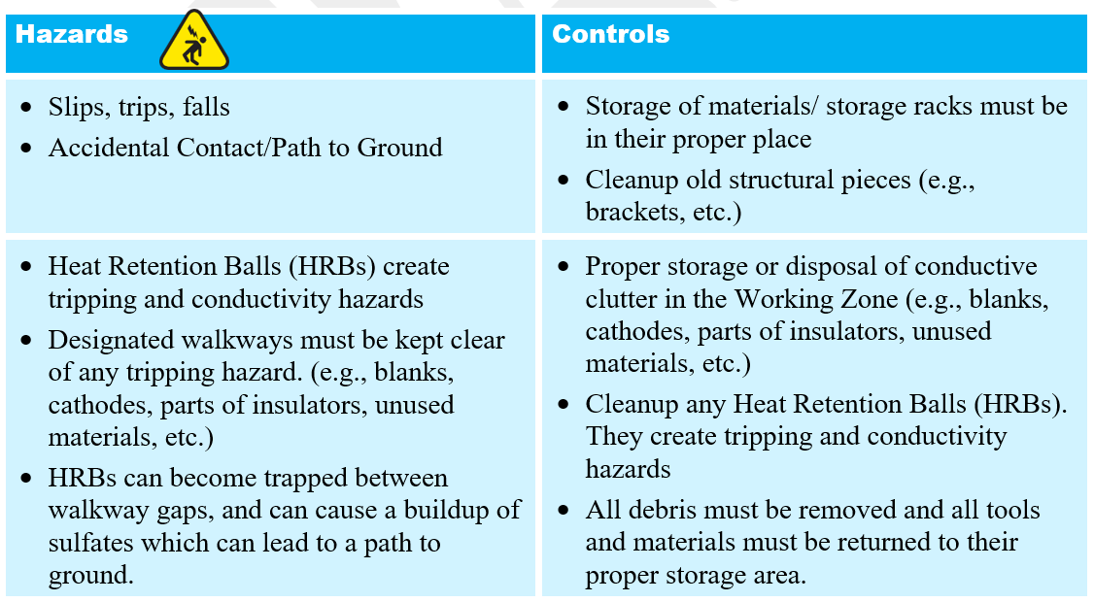
Tankhouse Processes
Housekeeping
18

Slide 19
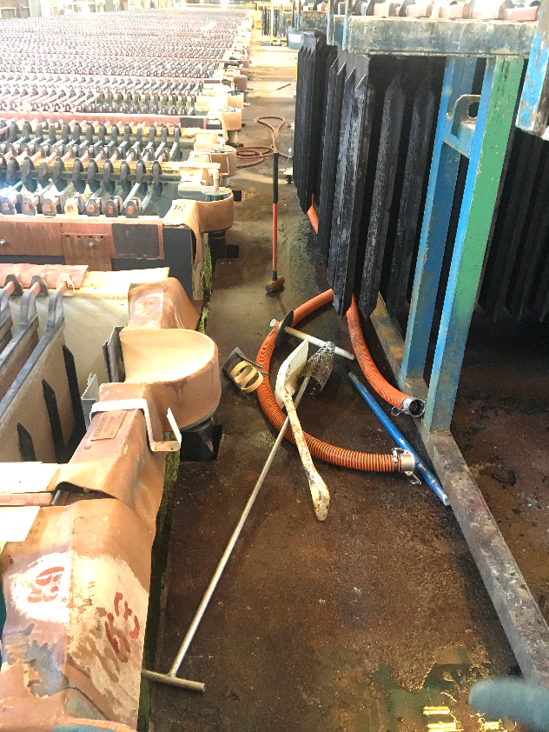
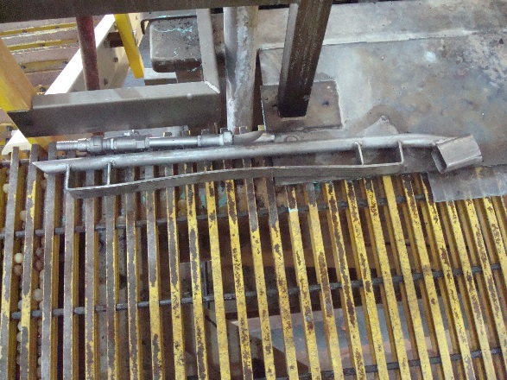
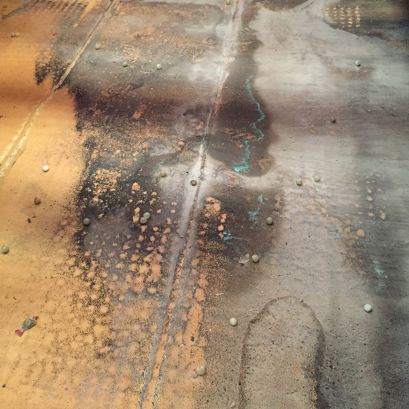
Tankhouse Processes
Housekeeping
19
Notes:
Secure all loose hand tools and hoses to prevent slipping and tripping hazards.
Designated walkways must be kept clear of any tripping hazard. Before an employee considers a job complete, all debris must be removed and all tools and materials must be returned to their proper storage area. HRBs can become trapped between walkway gaps, and can cause a buildup of sulfates which can lead to a path to ground.
More housekeeping items:
Storage of materials/ storage racks must be in their proper place
Cleanup old structural pieces (e.g., brackets, etc.)
Proper storage or disposal of conductive clutter in the Working Zone (e.g., blanks, cathodes, parts of insulators, unused materials, etc.)
Cleanup any Heat Retention Balls (HRBs). They create tripping and conductivity hazards

Slide 20
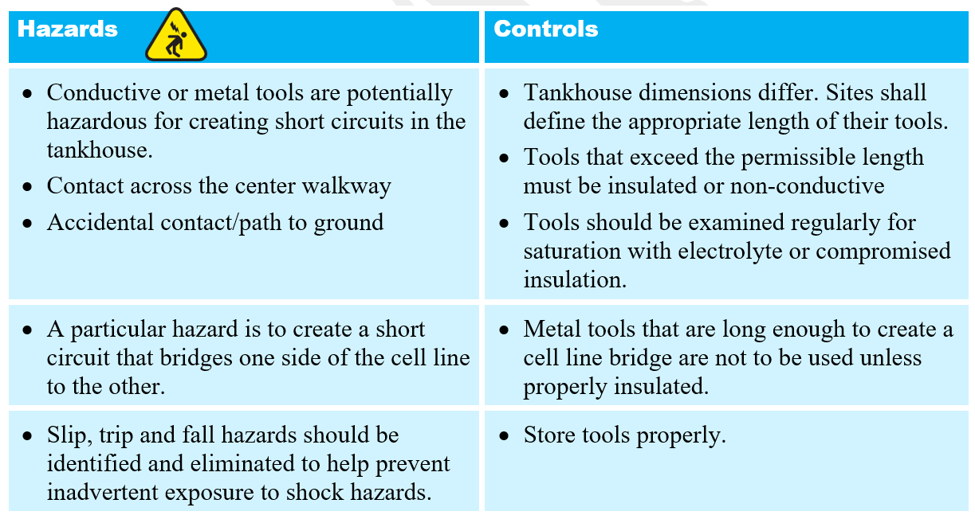
Tools and Equipment
Metal Hand Tools
20

Slide 21
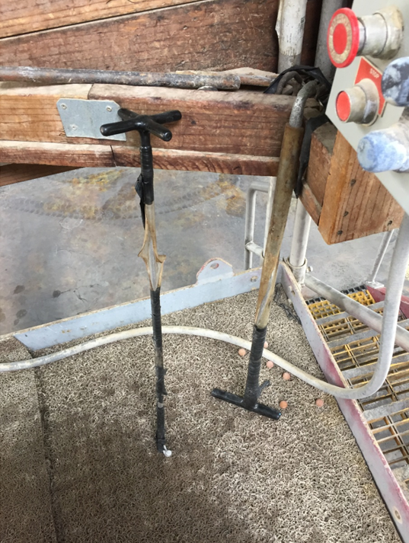
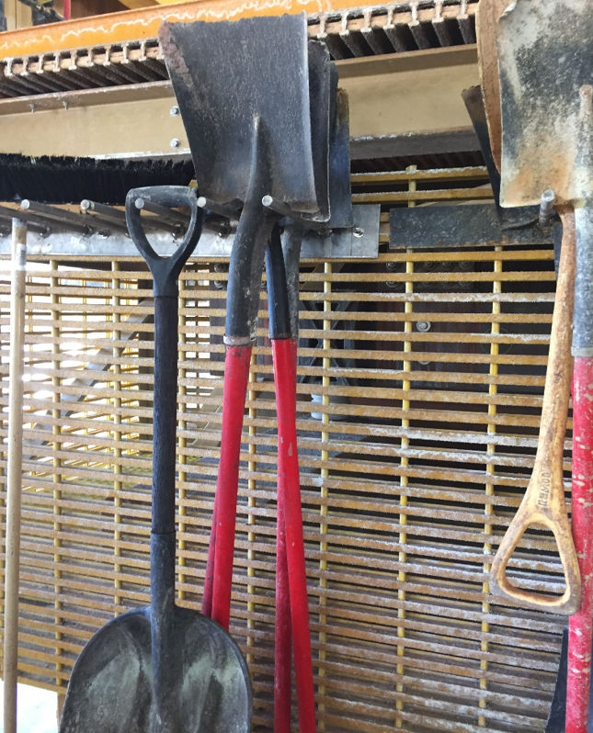
Tools and Equipment
Metal Hand Tools
BEFORE AFTER
21

Slide 22
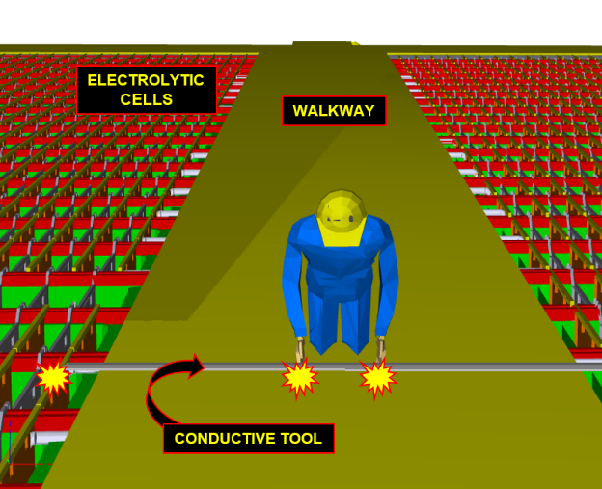
Tools and Equipment
Metal Hand Tools
Fig. 5.7. Metal tools that are long enough to create a cell line bridge are not to be used unless properly insulated.
22

Slide 23
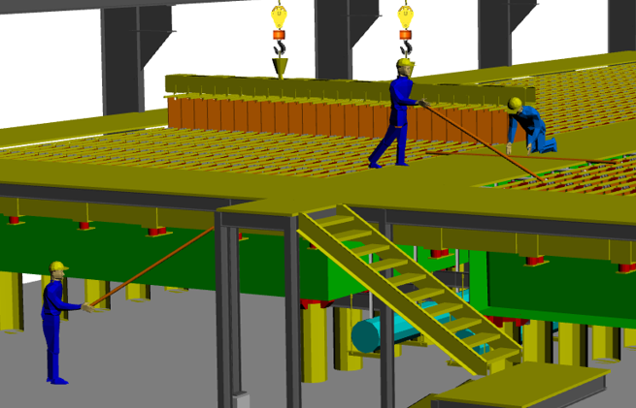
Tools and Equipment
Proper Length of Tools
Fig. 4.19. Illustration above shows three possible electrical hazards if long, conductive hand tools are used.
23
Notes:
Dependent on the distance between the cell rows and from cell to structure
Tools that exceed the permissible length must be insulated or non-conductive
Tools should be examined regularly for saturation with electrolyte or compromised insulation

Slide 24
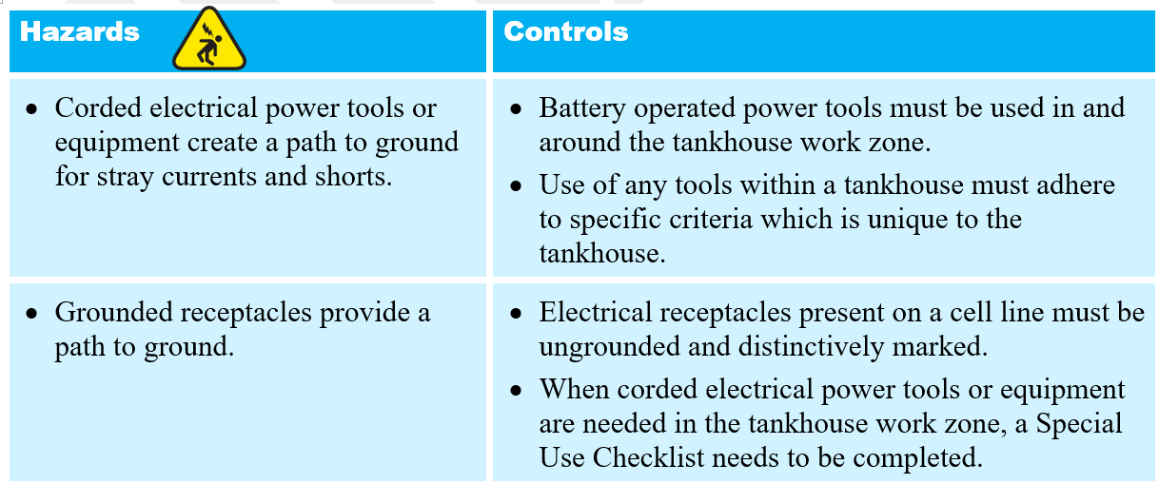
Tools and Equipment
Power Tools
24

Slide 25
Tools and Equipment
Power Tools
Fig. 5.9. Battery operated power tools must be used in and around the tankhouse work zone because they do not provide a pathway for current to ground.
25

Slide 26
Tools and Equipment
Power Tools
Use of any tools within a tankhouse must adhere to specific criteria which is unique to the tankhouse. All employees involved in activities within the tankhouse work zone must comply with this policy
Work activities (planned or unplanned) when corded electrical power tools or equipment are needed in the tankhouse work zone (such as welders, power water spray, generator, extension cords, etc.) require a Special Use Checklist to be performed.
A Special Use Checklist is not required for battery-operated tools.
26
Notes:
Use of any tools within a tankhouse must adhere to specific criteria which is unique to the tankhouse. All employees involved in activities within the tankhouse work zone must comply with this policy to mitigate and control risk of exposure to stray current, arc flash, and other hazards.
Battery operated power tools must be used in and around the tankhouse work zone because they do not provide a pathway for current to ground.
Work activities (planned or unplanned) when corded electrical power tools or equipment are needed in the tankhouse work zone (such as welders, power water spray, generator, extension cords, etc.) require a Special Use Checklist to be performed.
A Special Use Checklist is not required for battery-operated tools.

Slide 27
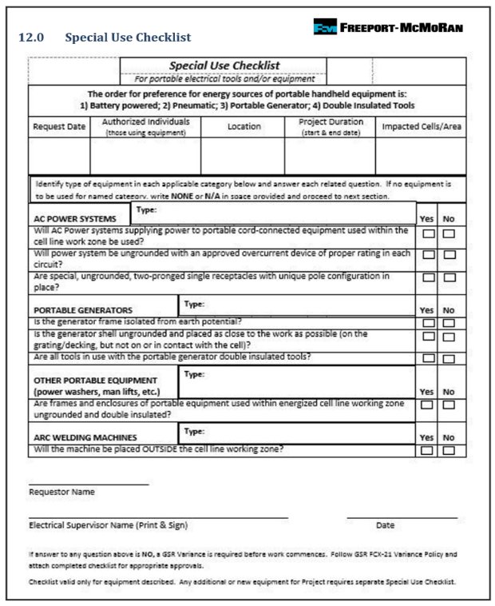
Tools and Equipment
Special Use Checklist
If corded electrical power tools or equipment are needed in the tankhouse work zone (such as welders, power water spray, generator, extension cords, etc.) the Special Use Checklist is required.
Each Special Use Checklist will be completed by an Electrical Supervisor, or designee, to determine if a variance is required before work commences.
27

Slide 28
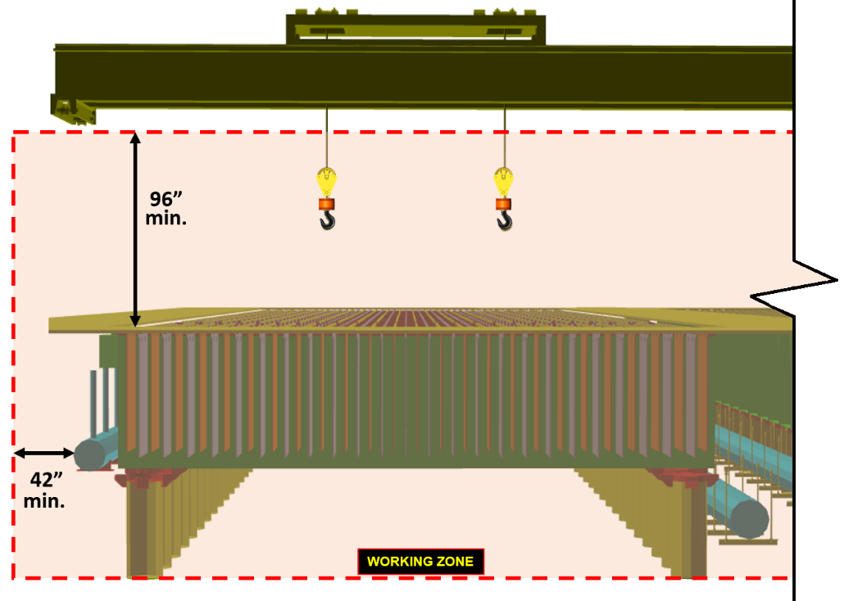
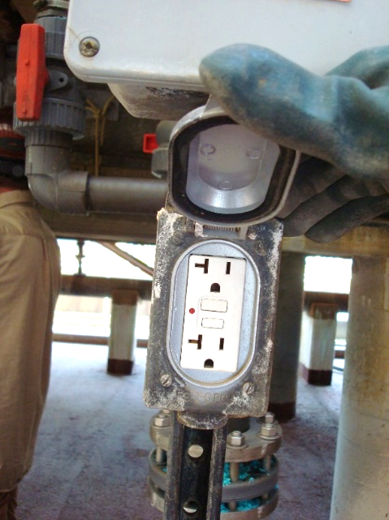
Tools and Equipment
Corded Power Tools & Electrical Outlets
Grounded receptacles provide a path to ground and may create a shock hazard to anyone touching a grounded power tool or equipment within the Working Zone.
28

Slide 29
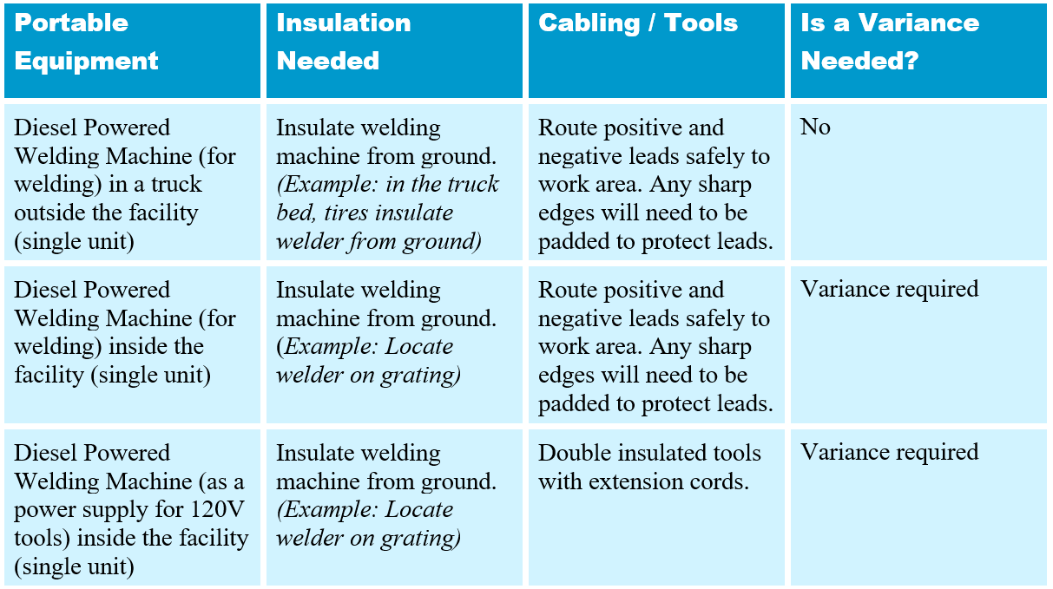
Tools and Equipment
Equipment Needed in the Tankhouse
29
Notes:
A table that summarizes what sites and contractors can use to weld/perform maintenance in the tankhouse and whether a Variance from the EW/ER Electrical Safety Policy is required.

Slide 30
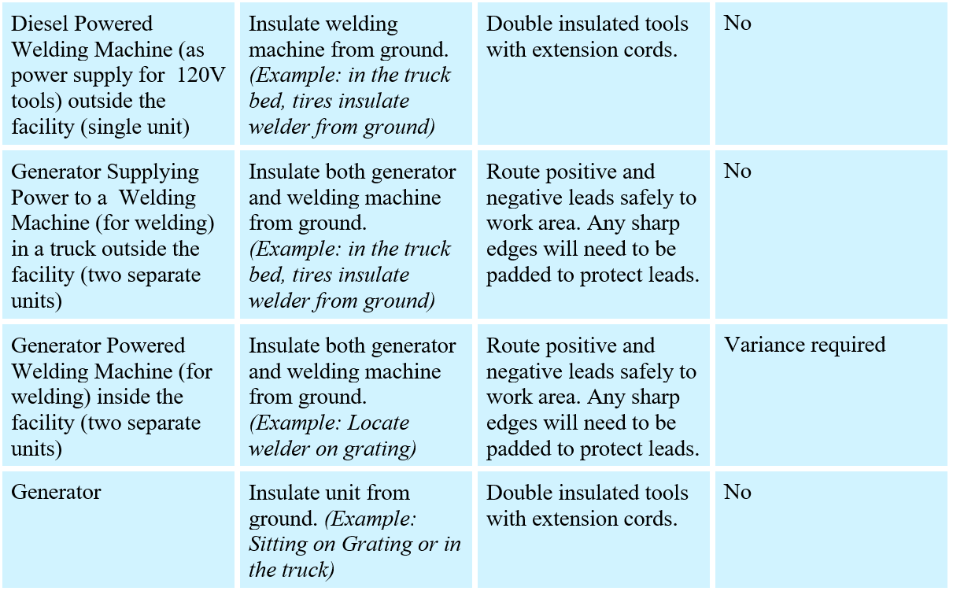
Tools and Equipment
Equipment Needed in the Tankhouse
30
Notes:
A table that summarizes what sites and contractors can use to weld/perform maintenance in the tankhouse and whether a Variance from the EW/ER Electrical Safety Policy is required.

Slide 31
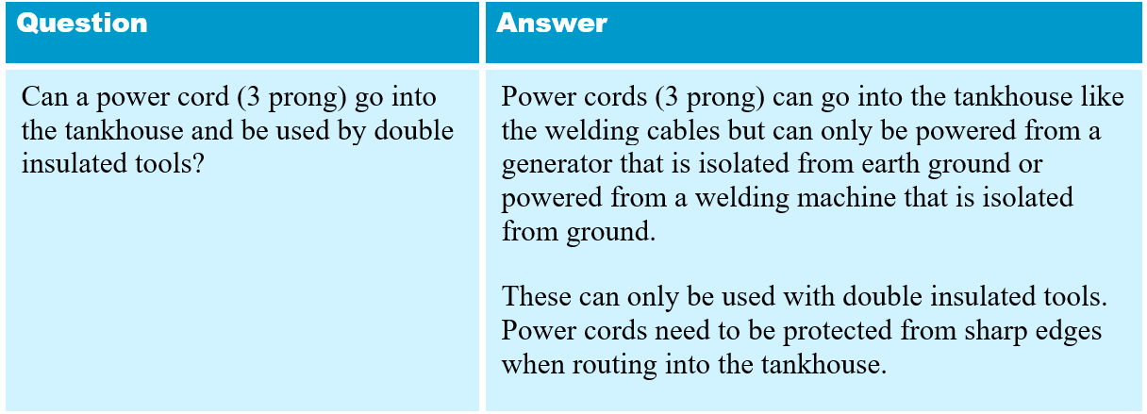
Tools and Equipment
Equipment Needed in the Tankhouse
c
31
Notes:
A table that summarizes what sites and contractors can use to weld/perform maintenance in the tankhouse and whether a Variance from the EW/ER Electrical Safety Policy is required.

Slide 32
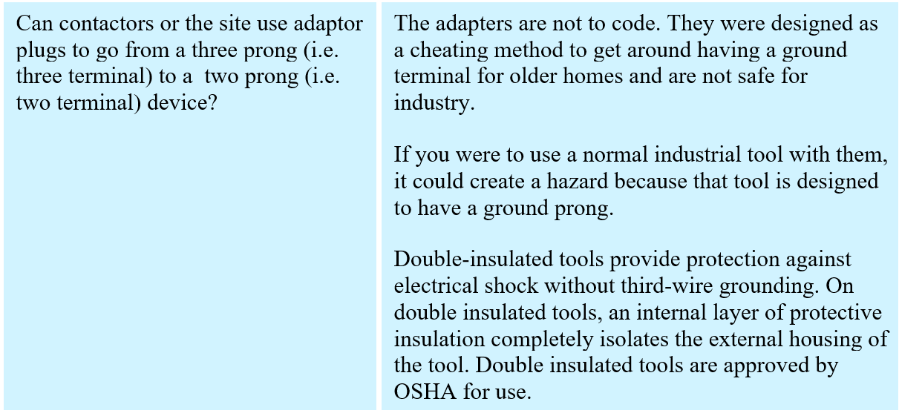
Tools and Equipment
Equipment Needed in the Tankhouse
32
Notes:
A table that summarizes what sites and contractors can use to weld/perform maintenance in the tankhouse and whether a Variance from the EW/ER Electrical Safety Policy is required.

Slide 33
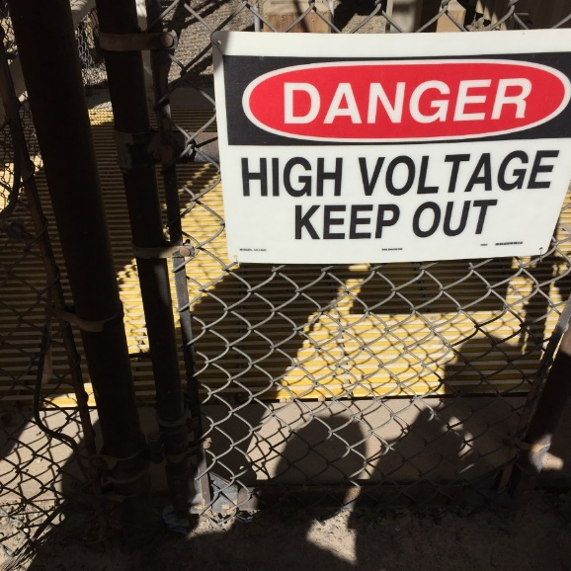
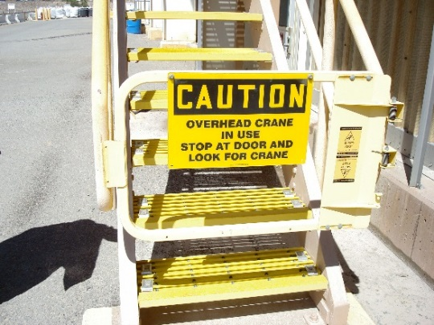
Tankhouse Processes
Restricted Access
33

Slide 34
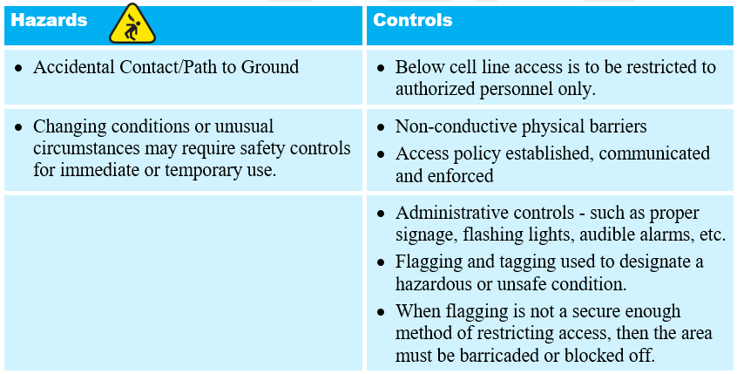
Tankhouse Processes
Restricted Access
(continued next slide)
34

Slide 35
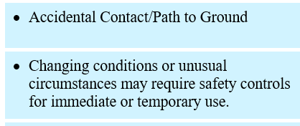
Tankhouse Processes
Restricted Access
(continued from previous slide)
35

Slide 36
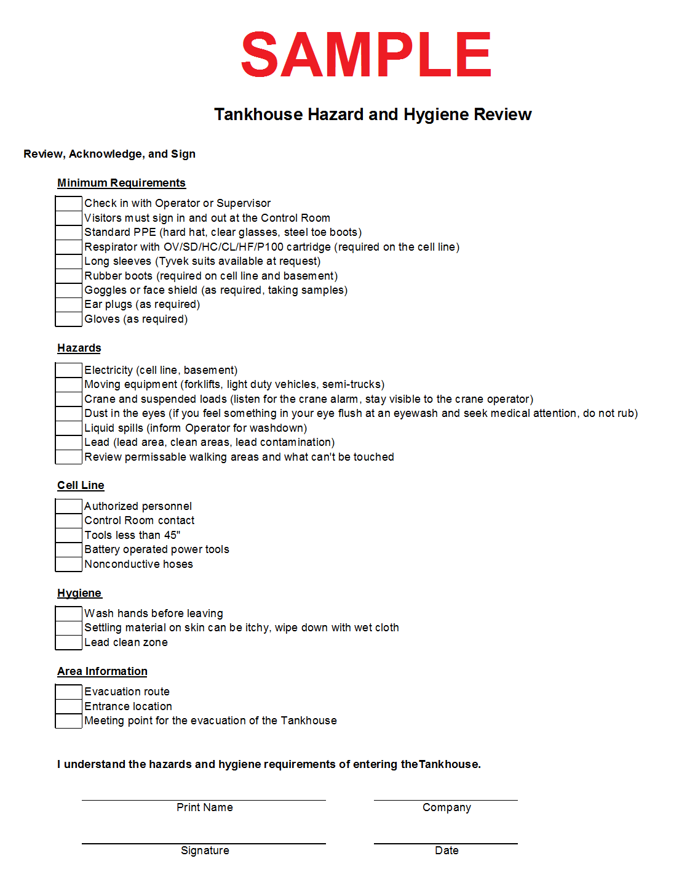
Tankhouse Processes
Restricted Access Areas in the Tankhouse
All personnel visiting or working in the EW/ER tankhouse and surrounding areas must complete site-specific hazard awareness training before access is permitted.
In addition, all visitors must be accompanied by authorized personnel.
Fig. 5.13a. Sample hazard awareness checklist reviewed and signed by all employees, contractors, vendors, and visitors.
36
Notes:
All personnel visiting or working in the EW/ER tankhouse and surrounding areas must complete site-specific hazard awareness training before access is permitted. In addition, all visitors must be accompanied by authorized personnel.
Examples of site-specific administrative controls regarding restricted access to the EW/ER tankhouse and surrounding areas.
This training shall include an overview of the hazards of the area. Completion and submittal of this form – with the emphasis on stray current hazard(s) if applicable – is vital and required for a proper review.

Slide 37
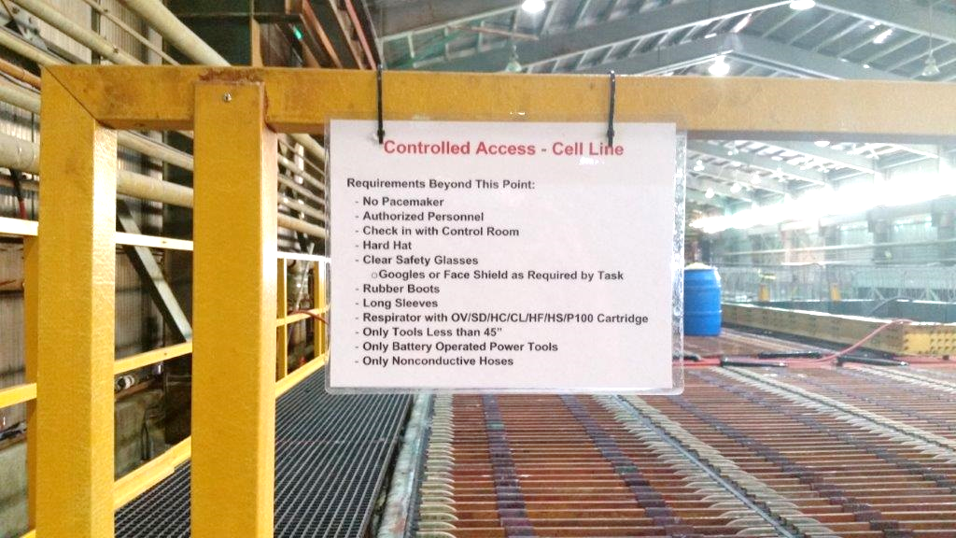
Tankhouse Processes
Restricted Access Areas in the Tankhouse
Fig. 5.13b. Example of administrative and engineering controls for restricted access to the EW/ER tankhouse and surrounding areas. Above is a barricade with a gate with signage posted prior to access to the cell line.
37

Slide 38
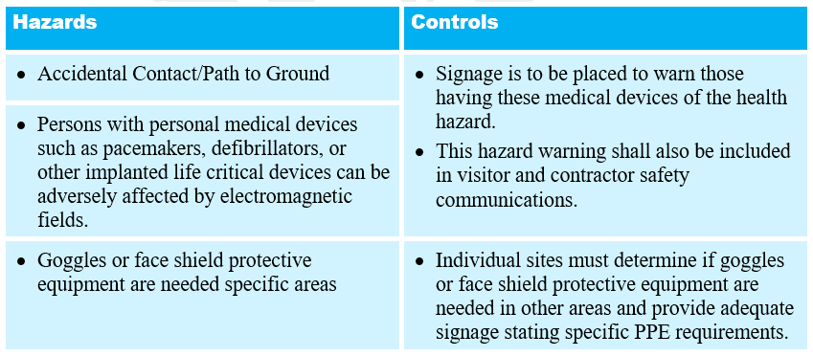
Tankhouse Processes
Safety Signage
38

Slide 39
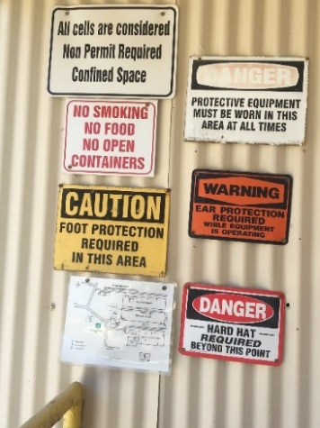
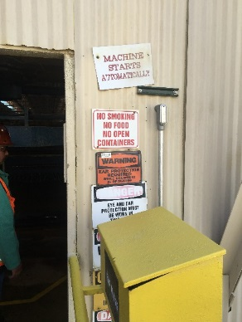
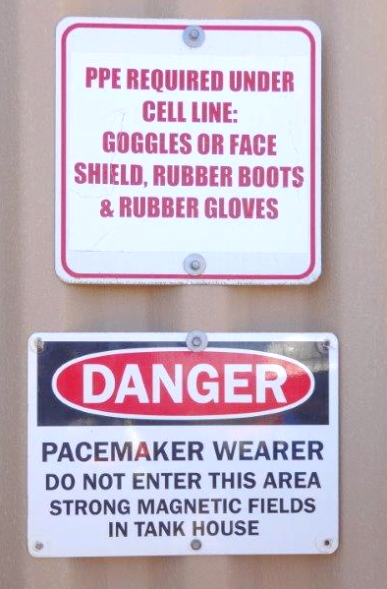
Tankhouse Processes
Safety Signage
39
Notes:
Signage is an important component of our administrative safety controls at our sites. The standardization of our signage for the EW/ER tankhouses and surrounding areas is currently under development. The goal is to provide a comprehensive and consistent signage program.
Anyone – employees, contractors, vendors, and visitors - with personal medical devices such as pacemakers, defibrillators, or other implanted life critical devices will not be allowed in the tankhouse work zone. Personal medical devices can be adversely affected by electromagnetic fields. Signage is to be placed to warn those individuals having these medical devices of the health hazard. This hazard warning shall also be included in visitor and contractor safety communications.
Adequate signage stating specific PPE requirements must be provided by each site.

Slide 40
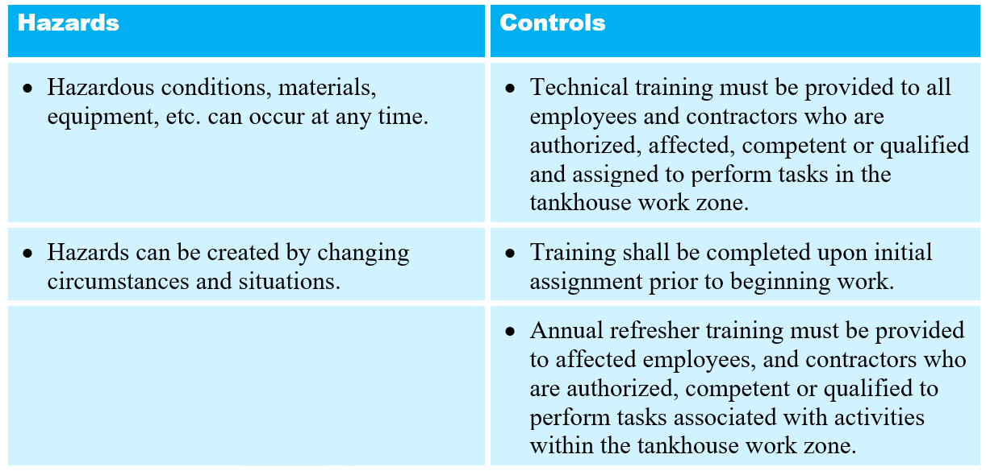
Tankhouse Processes
Training
40

Slide 41
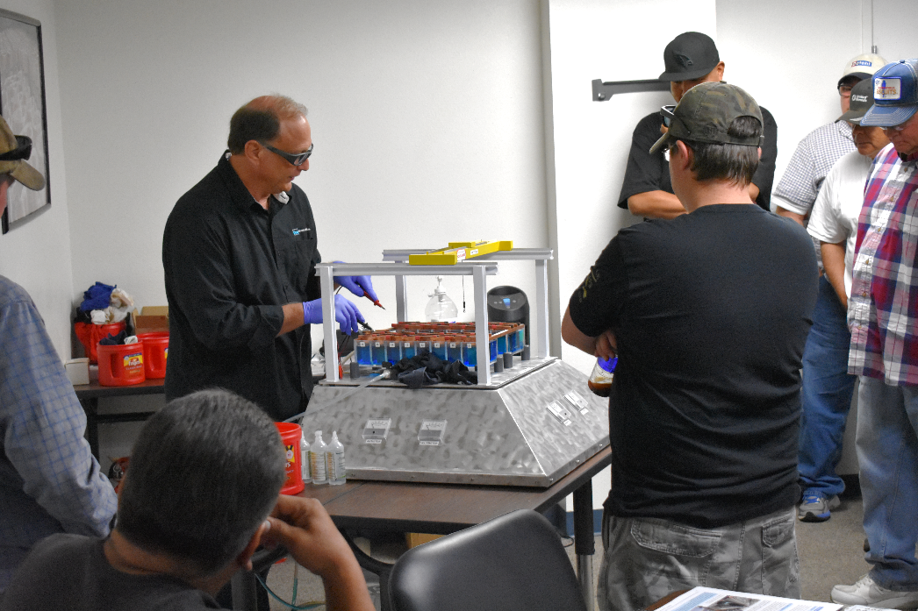
Tankhouse Processes
Training
Fig. 5.14. H.D. Moss - Technical Instructor/Facilitator in Miami - uses the Tankhouse Electrical Demonstrator (TED) to show his students the simulated tankhouse current and its effect on various tankhouse components.
41
Notes:
Technical training will be interactive and consist of classroom, video, and/or field demonstration of the hazards. Employees must demonstrate competency (both verbal and visual) to assess understanding.
In addition, annual refresher training will be provided to affected employees, and contractors who are authorized, competent or qualified to perform tasks associated with activities within the tankhouse work zone. It must include a review of existing policies and regulations and shall review any new or existing hazards and mitigations.

Slide 42
Module 5 Review
Review Questions
Review and discuss the content from Module 5 by answering the questions on the next eight (8) slides.
Activity #10

Slide 43
Module 5 Review
Should there still be any electrical current in the system, a __________ ____________ or spider should be used to dissipate any residual electricity from the rectifier / bus bar circuit.
Answer: grounding cluster

Slide 44
Module 5 Review
Voltage that still exists on the cell line after the power supply is disconnected is referred to as the ____________ ____________.
Answer: Battery Effect

Slide 45
Module 5 Review
To prevent injury due to arc flash when setting a Jumper Frame, position everyone at least _____ feet from the jump to be clear of arc and frame.
Answer: 20 (site-specific)

Slide 46
Module 5 Review
When setting a Jumper Frame, inspect cells for ___________ to prevent a potential explosion due to a depleted cell.
Answer: flow

Slide 47
Module 5 Review
When setting a Jumper Frame, stopping the crane ascent in mid-removal can cause excessive ____________ and damage to frame knives.
Answer: arcing

Slide 48
Module 5 Review
The permissible length of hand tools on the cell line is dependent on the distance between the cell rows and from the cells to the _________________.
Answer: structure

Slide 49
Module 5 Review
Battery operated power tools must be used in and around the tankhouse Work Zone because they do not provide a pathway for current to ________________.
Answer: ground

Slide 50
Module 5 Review
All personnel visiting or working in the EW/ER tankhouse and surrounding areas must complete ______-____________ hazard awareness training before access is permitted.
Answer: site-specific
End of Review

