Slide 1
Moly Plant H2S Hazards NaHS Awareness
2023

Slide 2
Training Objectives
Hazards and Health effects from NaHS exposure
Protective procedures
Restricted Area procedures
Evacuation Procedures

Slide 3
Health & Hazards of NaHS Exposure
The most serious safety concern associated with NaHS is its ability to produce large amounts of deadly hydrogen sulfide gas (H₂S) when it reacts with an acid or is exposed to high heat
NaHs is corrosive and is harmful to the skin and eyes
Contact with the eyes could cause corneal damage. Flush with large quantities of water.
Skin contact will cause skin irritation or burning sensation. Flush with large quantities of water.
Notes:
Like 2flush 0min of water.

Slide 4
H2S Toxicity Table
0.13 ppm - Minimal odor.
4.60 ppm - Easily detectable.
10 ppm - Beginning eye irritation.
27 ppm - Strong unpleasant odor.
100 ppm - Coughing, eye irritation loss of sense
of smell.
300 ppm - Respiratory tract irritation after one hour.
700 ppm - Loss of consciousness, possible death in 30 minutes-1 hour.
1000 ppm - Rapid unconsciousness, stopping of breathing, death.
2000 ppm - Unconsciousness at once, DEATH even if the person is moved to
fresh air.

Slide 5
Protective Procedures
You must have required PPE for possible exposure.
You must respond to the fixed monitors.
You must be equipped and respond to the personal gas monitor.
You must be equipped with an escape respirator.
Notes:
o Safety glasses with side shields
o Safety footwear- hard protective toe, six-inch top and a well-defined heel
o Personal H2S monitor
o NH15 escape respirator

Slide 6
Moly Plant Restricted Area Procedures
H2S gas could be generated anywhere that NaHS is present.
The ceramic filters in the Moly Plant is the location where this generation is likely to occur as Sulfuric Acid is used in the filter cleaning process. Although operational controls are in place to minimize this, it is still a concern.
Acid addition is not the only cause of the H2S gas generation.
Changes in the pH within the process solution can also trigger this occurrence. Awareness of this is critical in maintaining the safety of all employees and contractors in the restricted area.

Slide 7
Moly Plant Restricted Area Procedures
Areas where H2S gas can be generated include:
Reagent Tank Area – Personal monitors are required to work inside the Secondary Containment Area.
Anywhere within the Moly Plant building.
Within proximity to the Copper & Moly thickeners.
The Mill Water Trench/Tailings Launder Tunnel.

Slide 8
Moly Plant Restricted Area Procedures
The Moly Plant Restricted Area includes.
The Copper and Moly Thickener area and all floors of the Moly Plant.
There are many entrances into the Moly Plant Restricted Area. Do Not use entrances where scanners are not present.
You must scan in upon arrival and out upon leaving the Moly Plant Restricted Area.
There are 9 entrances that have scanners present.

Slide 9
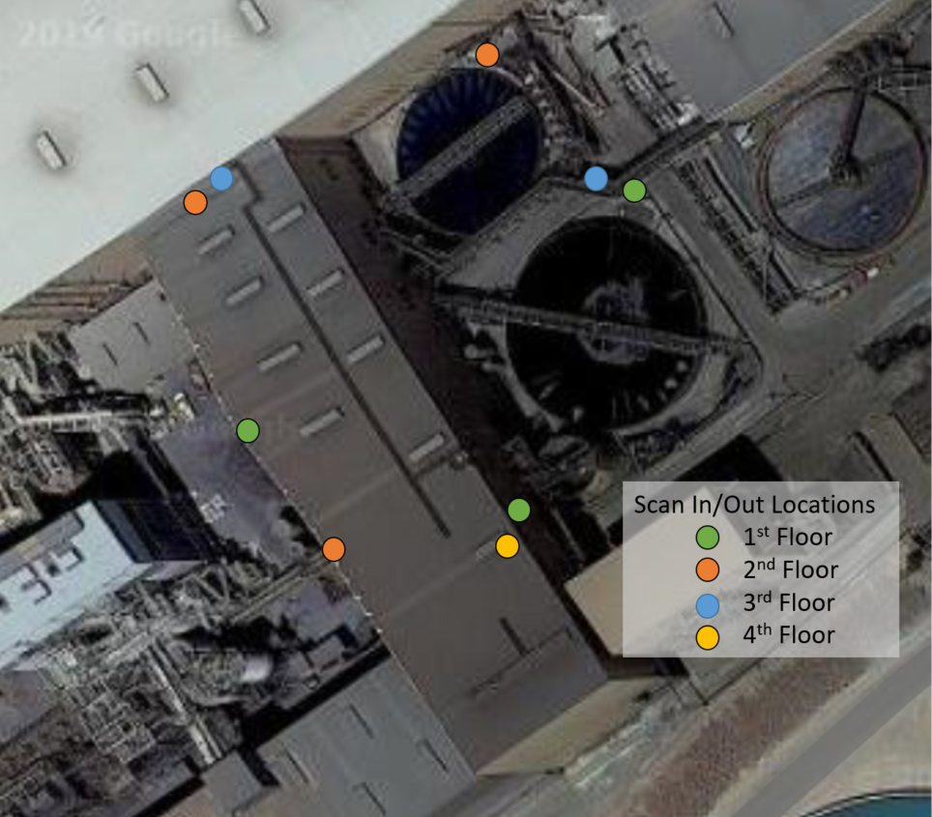
Moly Plant Restricted Area Procedures
Moly Plant Restricted Area scanner locations.
1. Driveway east end.
2. Catwalk from Regrind.
3. Mill to Shear Agitation.
4. Mill Rougher Tail Launder to the Moly Plant 2nd floor.
5. Mill to the Moly Plant 3rd floor.
6. Driveway west end.
7. Moly Plant 2nd Floor at the #2 Screws.
8. Railroad track to the Moly Plant.
9. Moly Plant 4th floor to the Larox Building.
10. Mill Control Room. (For evacuation only)
11. Roaster Leach Control Room.(For evacuation only)

Slide 10
Moly Plant Restricted Area Procedures
Moly Plant Restricted Area scanner locations.
1. Driveway east end.
2. Catwalk from Regrind.
3. Mill to Shear Agitation.
4. Mill Rougher Tail Launder to the Moly Plant 2nd floor.
5. Mill to the Moly Plant 3rd floor.
6. Driveway west end.
7. Moly Plant 2nd Floor at the #2 Screws.
8. Railroad track to the Moly Plant.
9. Moly Plant 4th floor to the Larox Building.
10. Mill Control Room. (For evacuation only)
11. Roaster Leach Control Room.(For evacuation only)

Slide 11
Moly Plant Restricted Area Procedures
Training Requirements for Entrance include:
Health & Hazards of NaSH exposure.
Escape Respirator & training.
H2S personal monitor & training.
Active R.F.I.D scanner badge. Anyone not having an active badge will be required to sign in and out in the Mill Control Room or the Roaster Leach Control Room.
If the R.F.I.D. scanners or computer system is not working, you will be required to sign in and out in the Mill Control Room or the Roaster Leach Control Room.
Hardhat sticker declaring the training has occurred.
Annual refresher training is required.
Access is NOT permitted without the above required training.

Slide 12
Moly Plant Restricted Area Procedures
Fixed Monitors
All fixed sensors will alarm at 10 ppm a flashing strobe light and audio alarm will occur.
- Clear that area and notify the operator of the location of the alarm.
- Wait 10 minutes after alarm has cleared before reentering that area.
- If the sensor does not clear notify the supervisor
Outside sensors will not create an evacuation of the Moly Plant Restricted Area. These sensors are located at the Shear Agitation, Moly Thickener, Copper Thickener & Copper Concentrate Storage Area.
It is important to note that if these monitors are alarming do not attempt to exit through that area. Be aware of your surroundings as you evacuate to the Mill Control Room or the Roaster Leach Control Room.

Slide 13
Moly Plant Restricted Area Procedures
Inside Fixed Monitors
When two inside monitors read H2S at 10 ppm for 15 seconds or any fixed monitor reads 20 ppm an evacuation alarm will be sounded and all personnel in the Moly Plant Restricted Area will evacuate to the Mill Control room or the Roaster Leach Control Room by the safest route possible.
During an evacuation you will not stop to scan out, make process adjustments or render aid. You will report to the Mill Control Room or the Roaster Leach Control Room to ensure that your name has been scanned from the list and wait for further instructions.

Slide 14
Moly Plant Restricted Area Procedures
Evacuation Alarm:
There are three conditions that can trigger the evacuation alarm.
1. When two or more fixed monitors inside the building register H2s at 10ppm for
15 seconds.
2. When any fixed monitor inside the building registers at 20ppm.
3. When there is a total loss of power at the Moly Plant (Loss of sensors/audible
alarms).
When an evacuation is triggered, an audio alarm will sound throughout the Moly Plant. It will continue to sound until it is reset by the Hazmat Team or Trained Mill Personnel. The alarm can be tested manually in the Moly Plant Control Room.

Slide 15
Moly Plant Restricted Area Procedures.
It is important to note that if the fixed monitors are alarming on your evacuation route avoid exiting through that area. Be aware of your surroundings as you safely evacuate to the Mill Control Room or the Roaster Leach Control Room.
It is imperative that you do not stop to render aid, scan out, or make any process adjustments. Report to the Mill Control Room or the Roaster Leach Control Room to ensure your name has been scanned from the list.
Re-Entry to the Moly Plant will only be allowed after the Hazmat Team or Trained Mill Personnel have given the "All Clear".

