Slide 1
Tankhouse Safety Certification
Chino/Tyrone Tankhouse Site Specific Training
2020

Slide 2
Tankhouse Area Access
Hydromet employees require proper training to work in the Tankhouse
  Example (Hydromet Electricians, Hydromet Maintenance, SX OP’s, EW OP’s, Admin Support)
Non Hydromet trained employees are required to sign in at the SX Control Room
  Example (Environmental, Boiler Shop, Shared Services, Contractors, etc…)
Individuals without training must sign in at the control room, review the hazard awareness checklist, and be accompanied by a qualified individual.
  Example (Visitors, Vendors, etc…) These individuals cannot perform work!

Slide 3
Smoking and Vaping
Smoking is prohibited in all Hydromet areas
  (Tankhouse, SX, Offices, Vehicles, Indoors, Outdoors)
Chino smoking areas
  East side of the Administration building in the designated area
  North side of the SX Maintenance shop in the designated area
Tyrone smoking area
  East side of the south Tankhouse in the designated area

Slide 4
Tankhouse Annex minimum PPE required to enter
Hard Hat
Safety Glasses with side shields
  (no dark lenses)
Long sleeve shirt and pants or coveralls
Safety toe boots
  (leather or rubber)
  (Unless around suspended loads)
  (EW’s are required to wear Metatarsals)
Hearing protection
  (only while noisy work is being performed)
Reflective vest or shirt (Both Sites))

Slide 5
Tankhouse Annex PPE to perform work
In addition to minimum PPE
  Gloves specific to the job being performed
    (EW’s cut resistant when working with starter sheets, cathodes, banding)
  Metatarsal boots when working around suspended loads
    (suspended load includes loading trucks, crane, forklift, unloading table, scale, and scissor table)
    (EW’s are required to wear metatarsal’s)
  Protective Apron (when cutting samples Chino specific)

Slide 6

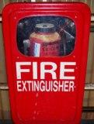
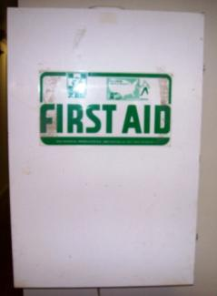
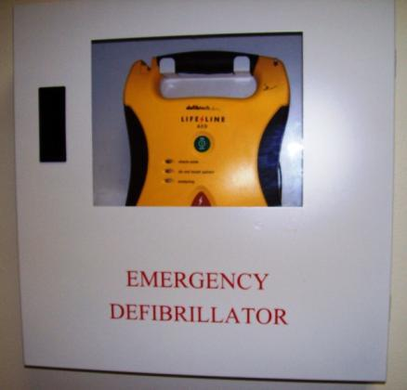
Emergency Equipment
Emergency showers and eyewash stations
Fire extinguishers
First Aid kit
AED (Automatic External Defibrillator)

Slide 7


Suspended load hazard
The higher the load, the wider the debris field
Notes:
Chino Alarm is continuous and can get complacent
45 degree away rom

Slide 8
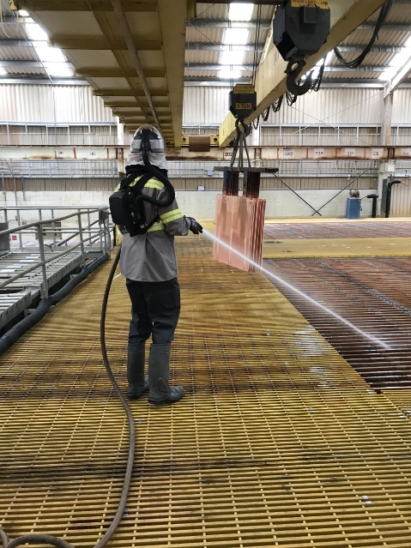
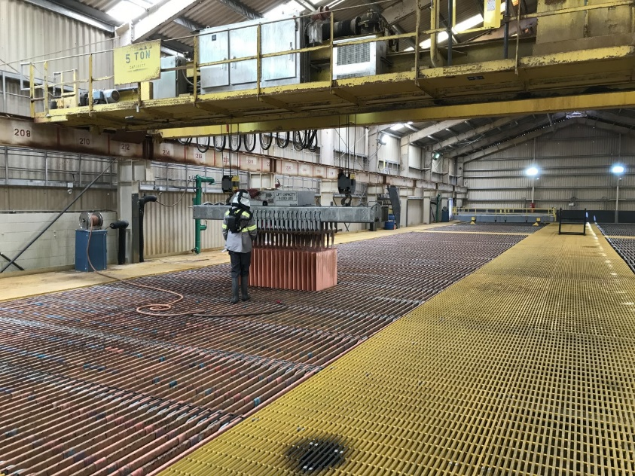
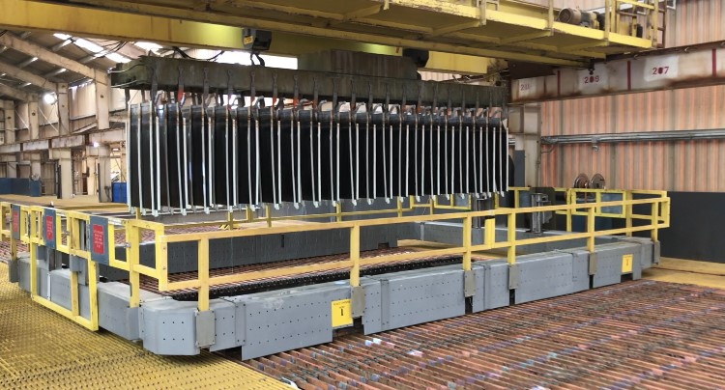
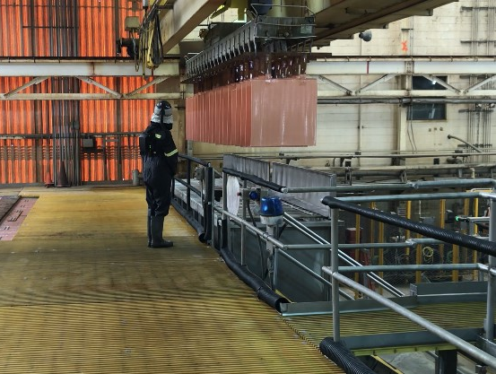
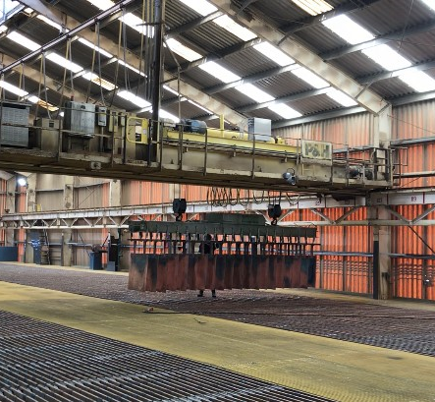
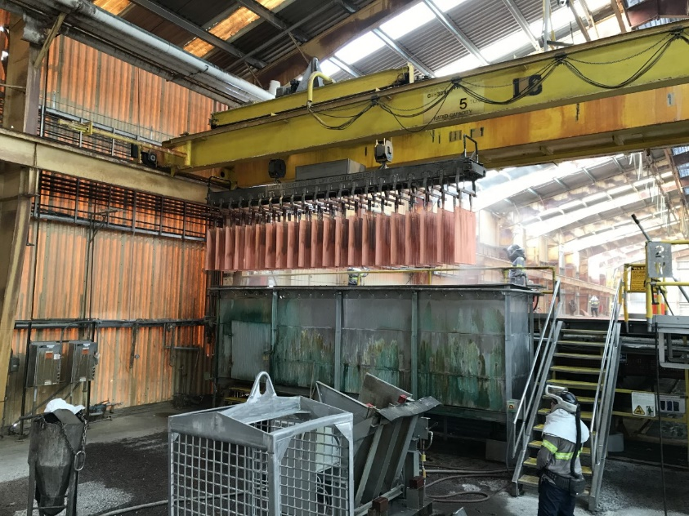
Tankhouse Equipment
Cranes
Notes:
Top Left -Jumper Frame

Slide 9
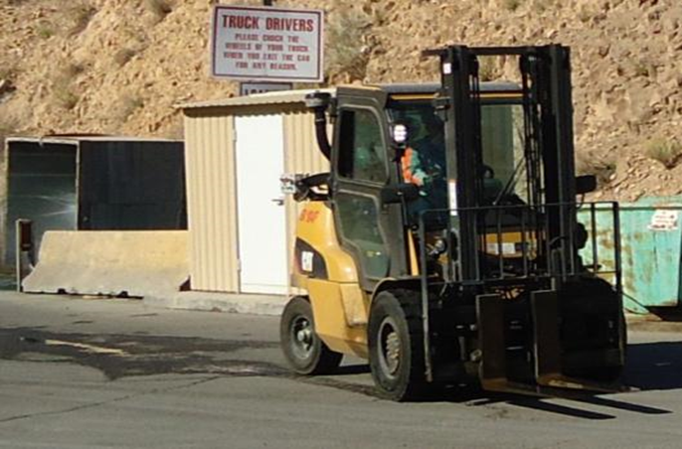
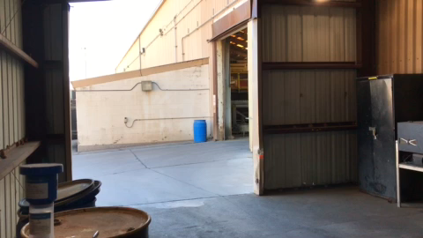
Tankhouse Equipment
Forklift

Slide 10
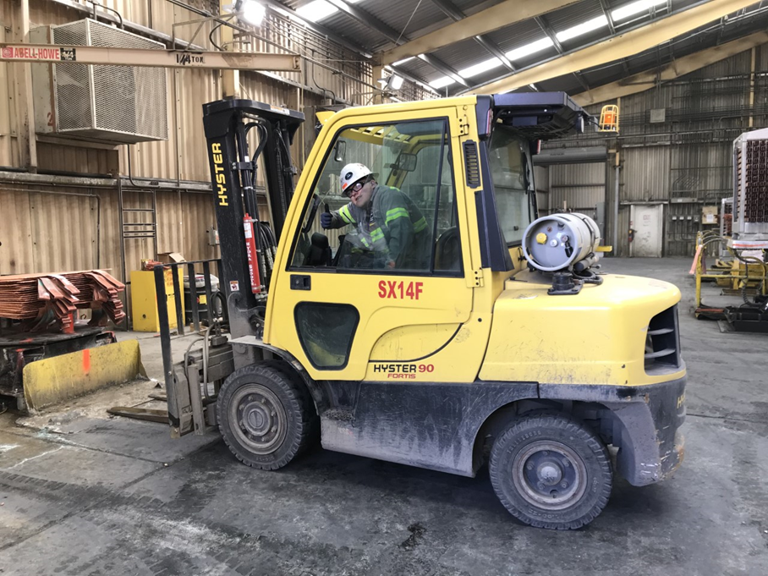
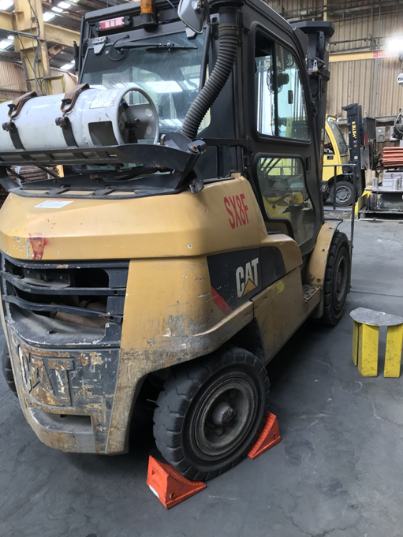
Forklift Safety
Sound horn when passing through a doorway and around pedestrians
Chock forklift when parked per the chocking policy
  Exception during the harvest for the harvest forklift (forks level on ground, transmission in neutral, park break set, engine off)

Slide 11
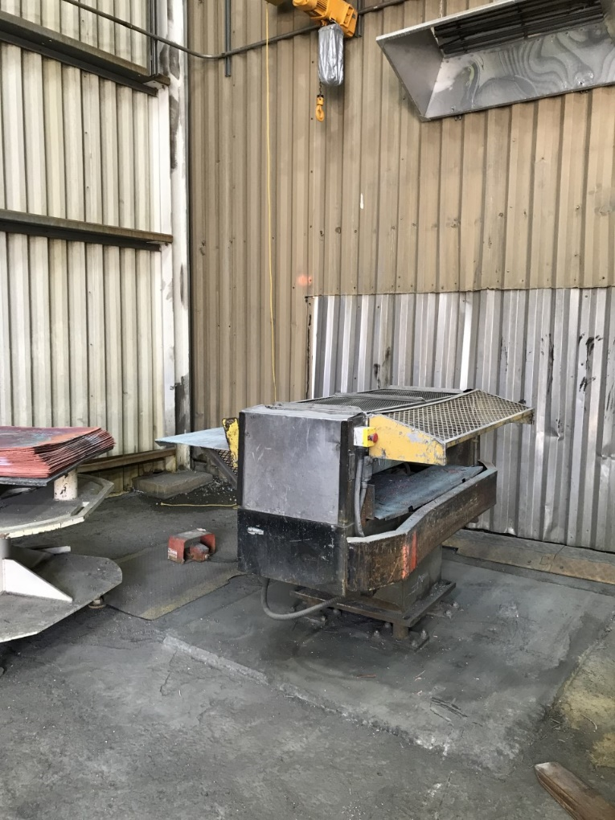
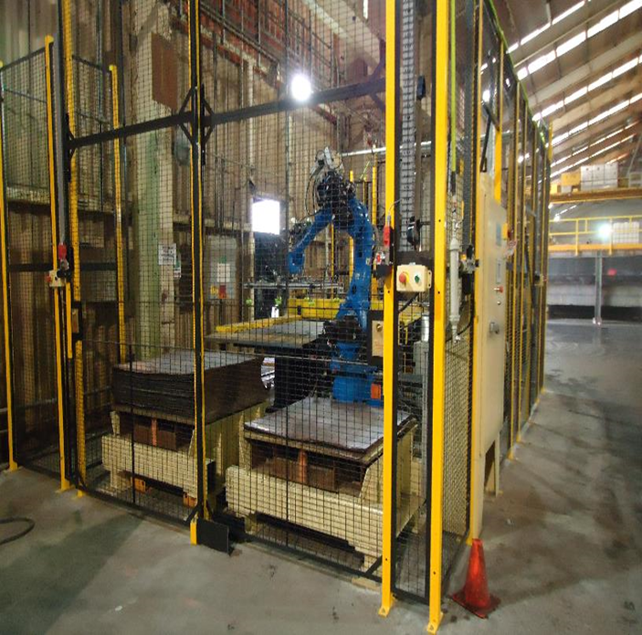
Tankhouse Equipment
Loop Slitter

Slide 12
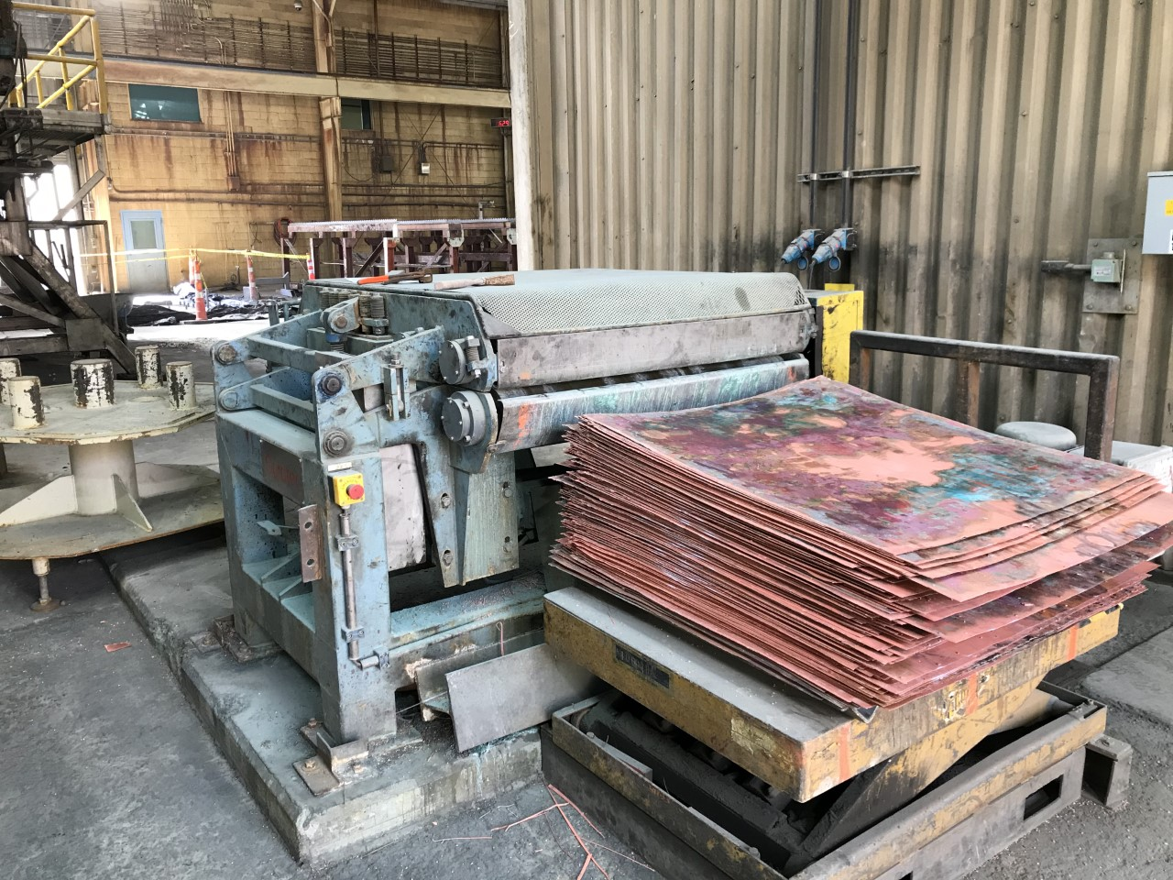
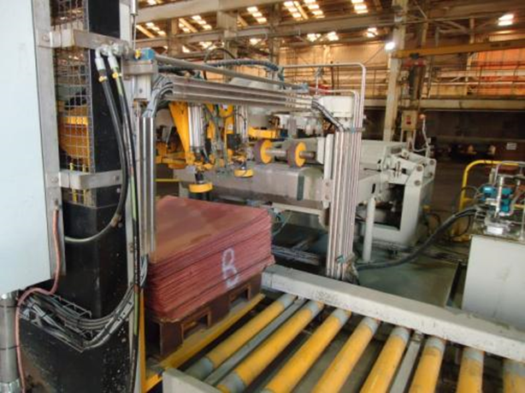
Tankhouse Equipment
Rigidizer

Slide 13
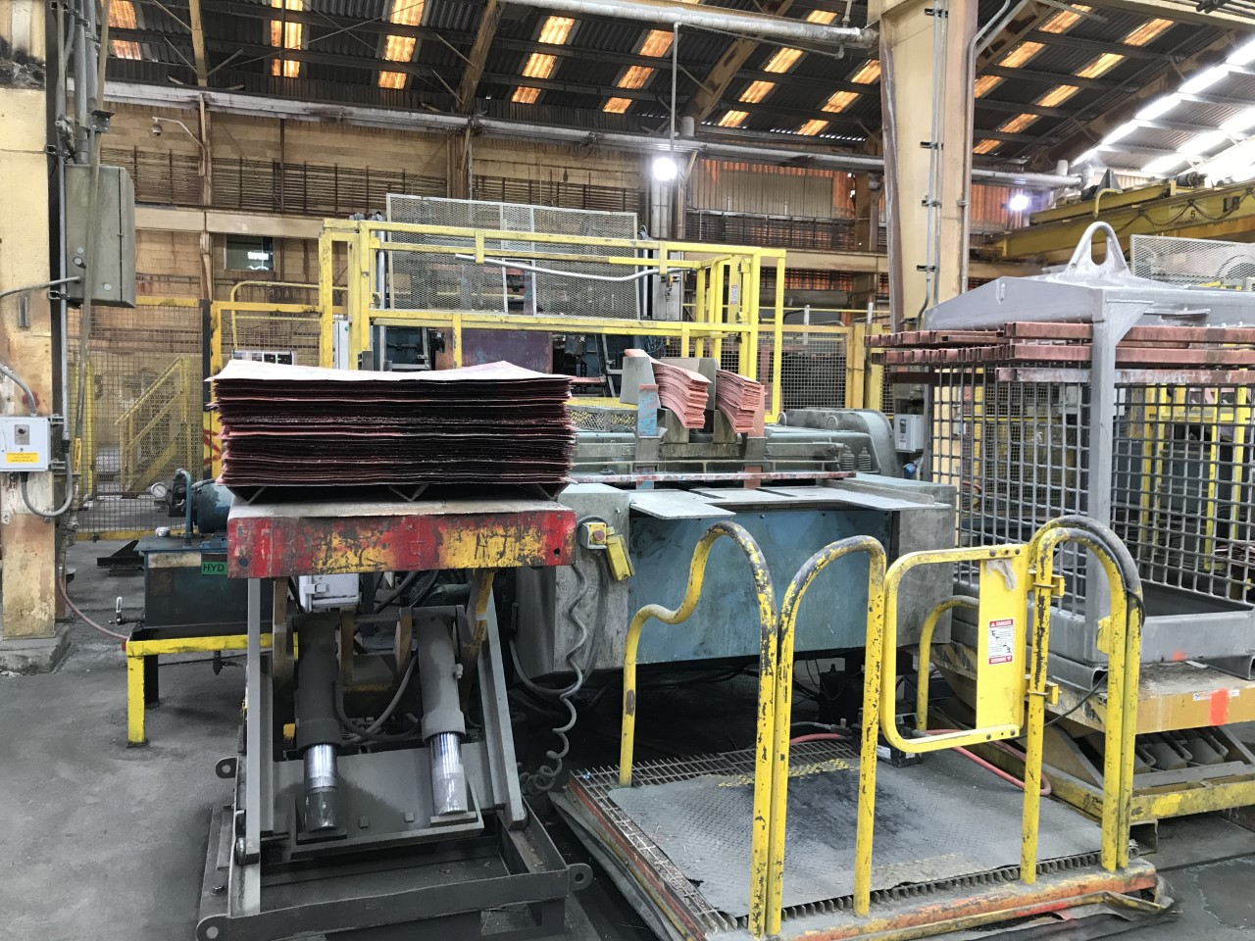
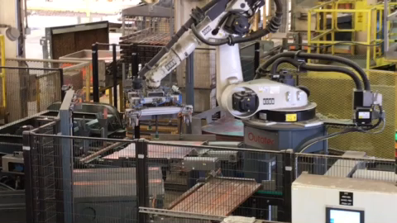
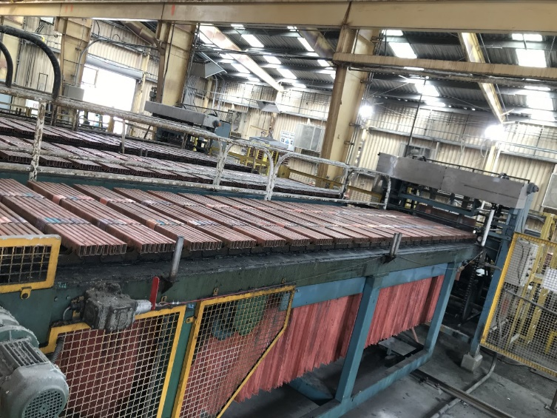
Tankhouse Equipment
Starter sheet machine

Slide 14
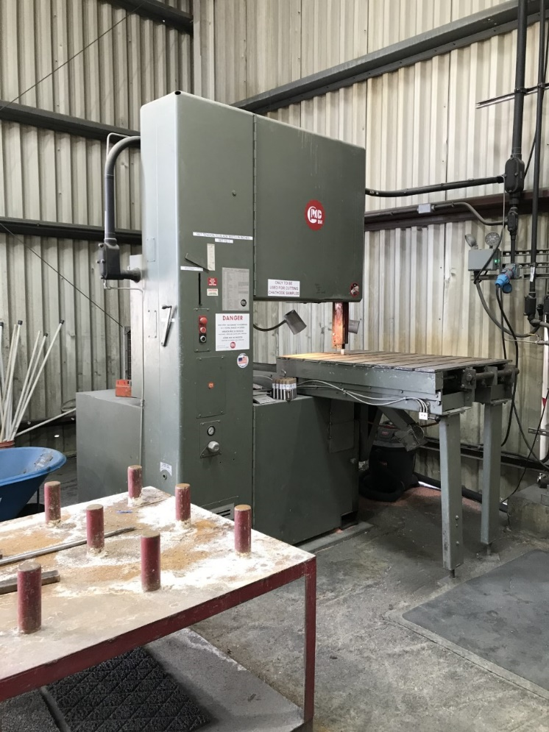
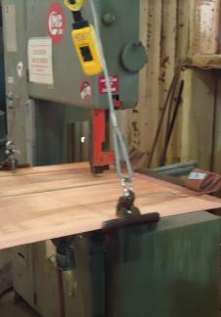
Tankhouse Equipment
Bandsaw

Slide 15
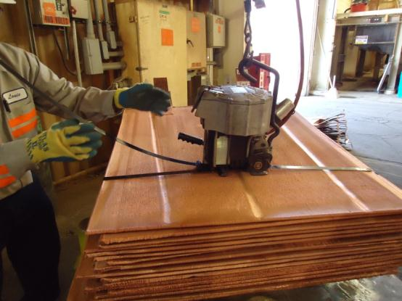
Tankhouse Equipment
Pneumatic Bander

Slide 16
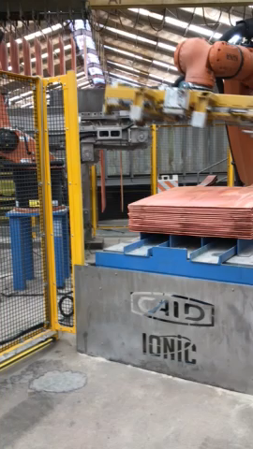
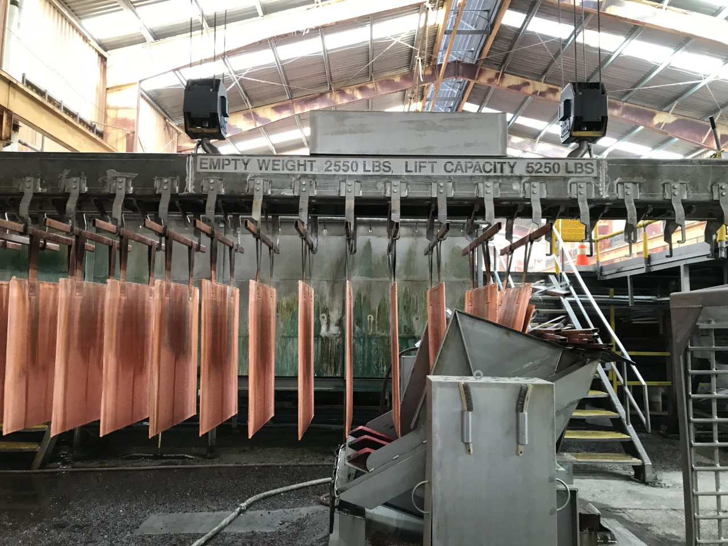
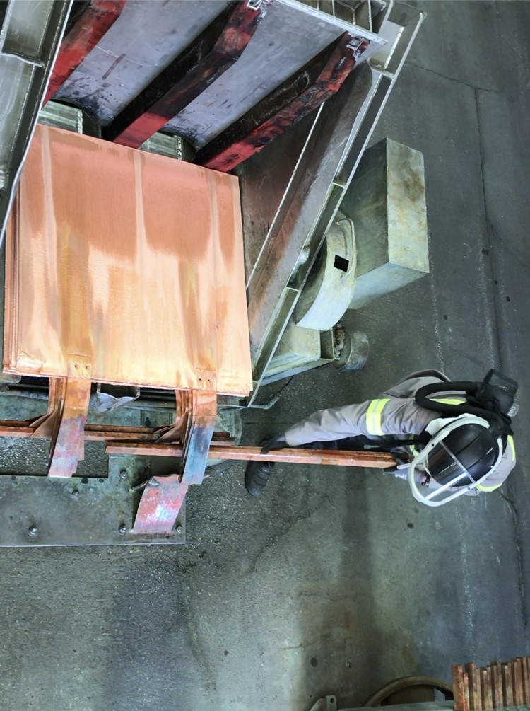
Tankhouse Equipment
Unloading Table

Slide 17
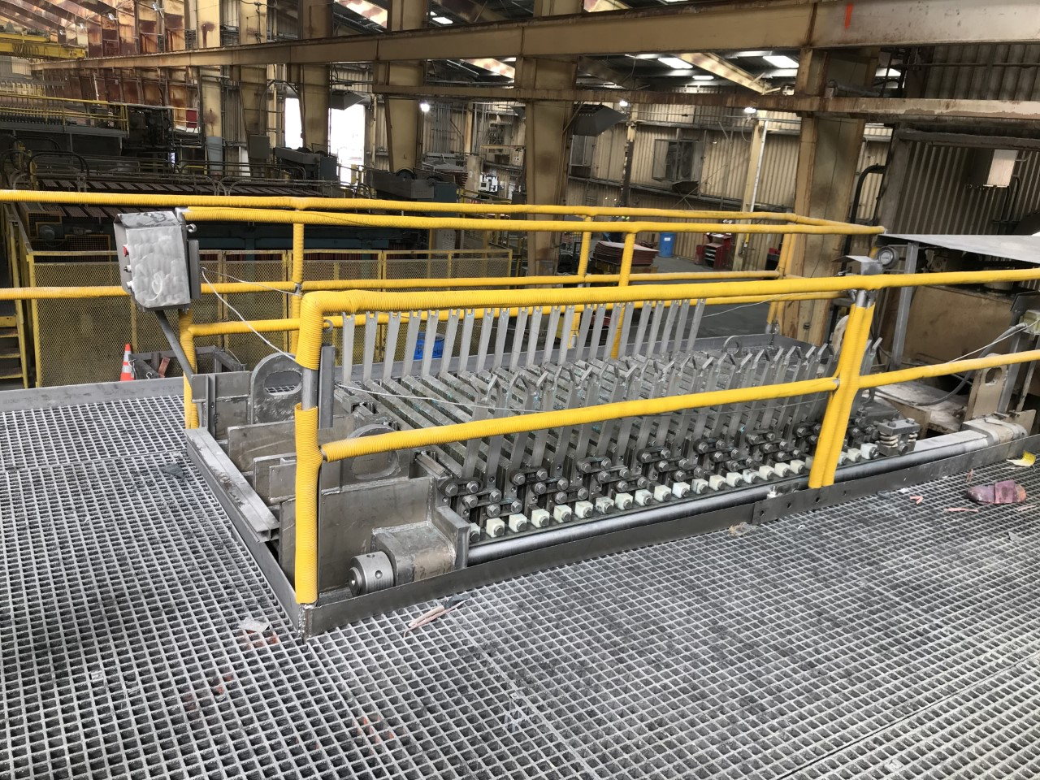
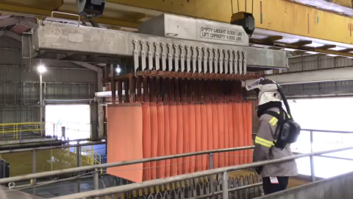
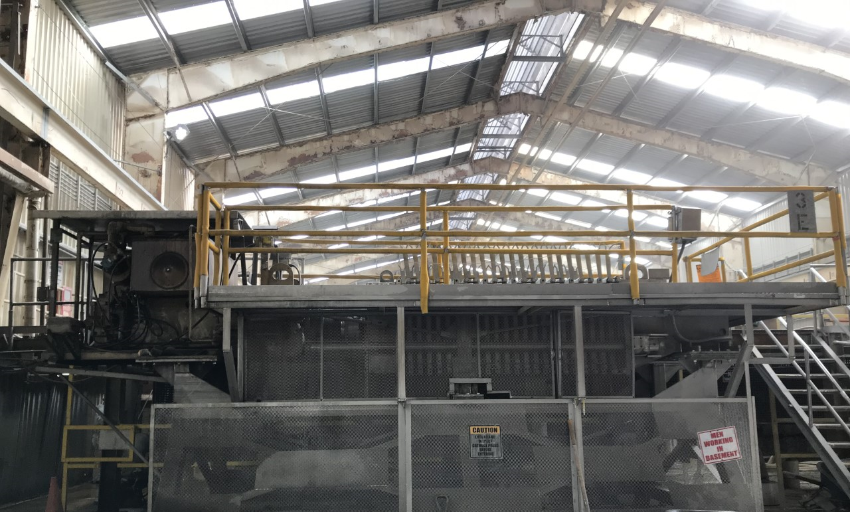
Tankhouse Equipment
Cathode Press

Slide 18
Chemical Hazards
Dolphin SDS Database
Safety Data Sheet
  SDS
Located on New Mexico Operations Website
  Webb Apps far right side of home page
  Or visit https://fcx.complyplus.com/default.asp

Slide 19
Chemical Hazards
Electrolyte
(acid mist) is an eye, skin and respiratory irritant.
It can cause severe burns.
It is carcinogenic.
If inhaled, ingested, contact with eyes or skin
  (inhaled) remove victim to fresh air
  (ingested) do not induce vomiting
  (contact with eyes or skin) flush with water for at least 15 – 20 minutes

Slide 20
Chemical Hazards
What is in electrolyte (acid mist)?
It is a mixture of the following:
  Water
  Sulfuric acid (17 – 20%)
  Copper (3 – 7 %)
  Arsenic (1 – 1.5%)
  Nickel (1 – 1.5%)
  Organic (diluent and Acorga; petroleum distillates)
  FC 1100 surfactant (trade secret)
  EW 50/Starch
  Salt (sodium chloride) Tyrone Specific
  Cobalt

Slide 21
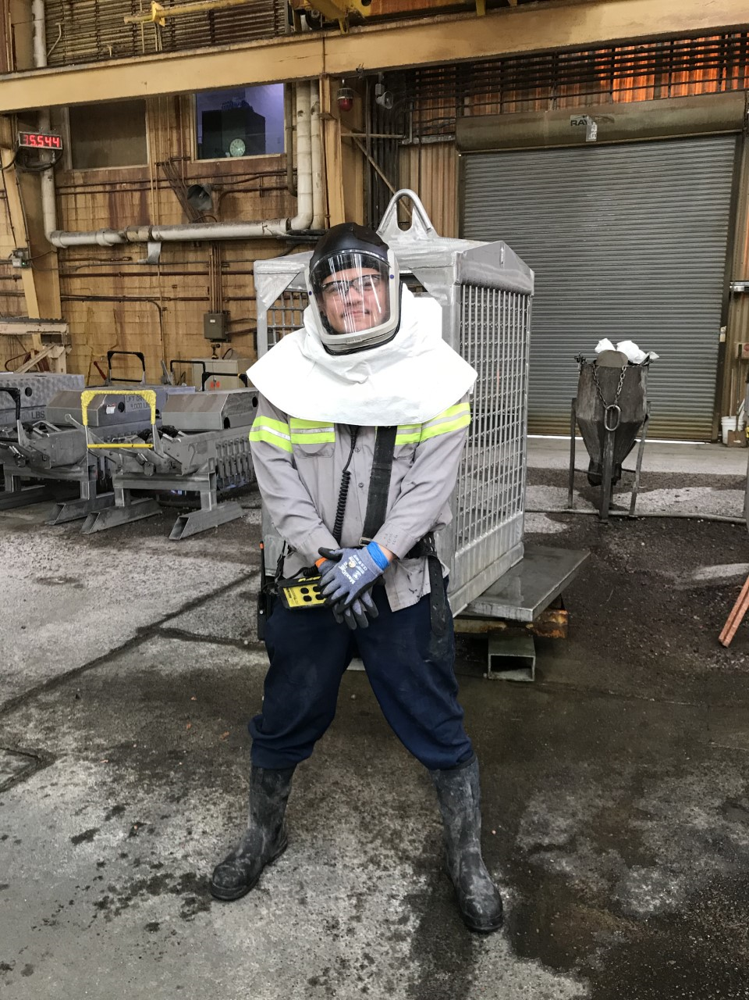
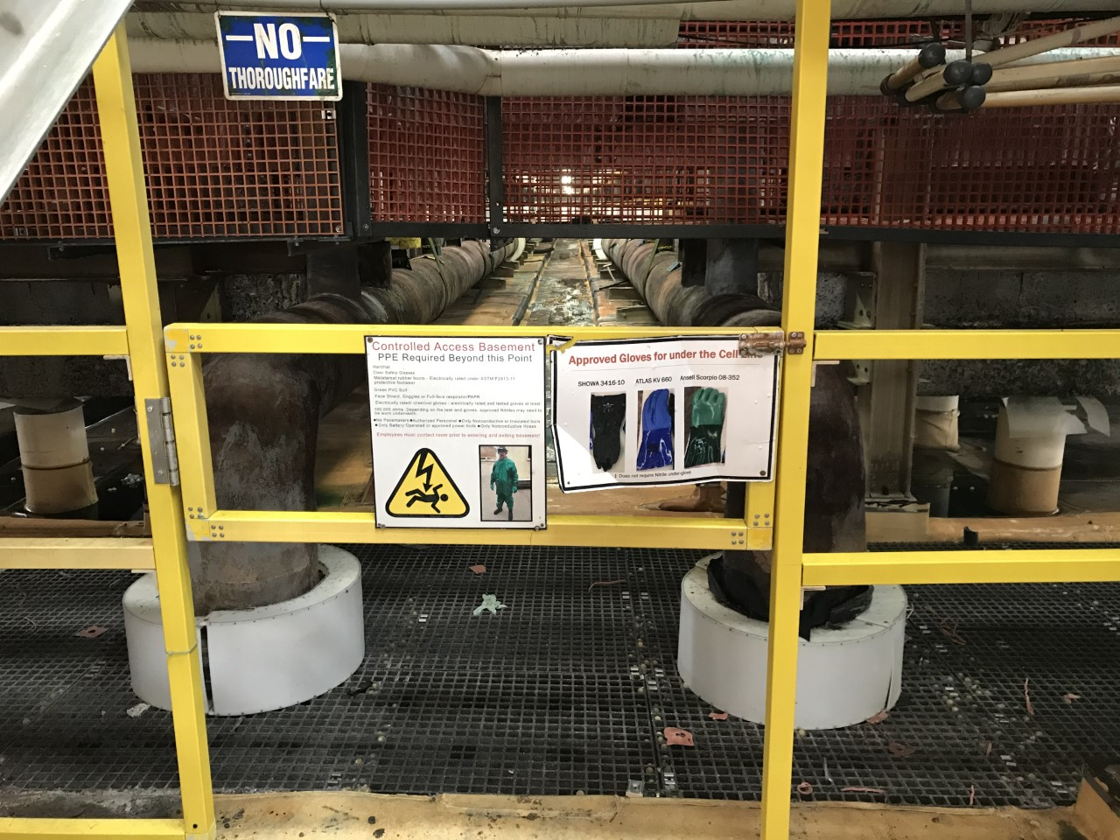
Tankhouse Working Zone
Tankhouse Electrical Training is required to access above or below the cell line
  Knowledge and understanding of hazards is policy
  Specific PPE required
  Proper tools are needed

Slide 22
Gloves Approved Above the Cell Line
Gloves for use in the EW/ER Tankhouse must protect workers from cuts, from chemicals (i.e. electrolyte) and from stray current
▪The minimum standards are:
•Cut rating: Above cell line: Minimum ANSI cut rating of 3 or EN388 cut rating of 4
Below cell line: Dependent on task and SOP
•Chemical rating: Exposure to 20% sulfuric acid in water (i.e. electrolyte)
•Electrical: At least 100,000 ohms resistance as measured by CASC Glove Tester
Cut resistant gloves to be worn with approved under glove
Approved under glove to be worn with cut resistant glove
Gloves that do not require under glove

Slide 23
Gloves Approved Below the Cell Line
All above Cell Line Approved Gloves as well as:
  These gloves do not require and under glove

Slide 24
Boots Approved Above or Below Cell Line
Boots for use in the EW/ER tankhouse must protect workers from mechanical injury, from chemicals (i.e. electrolyte) and from stray current
▪The minimum standards are:
•Steel-toe with metatarsal
•Mid-calf or higher
•Chemical rating: Exposure to 20% sulfuric acid in water (i.e. electrolyte)
•Electricity hazard “EH” rated or dielectric rated under ASTM F2413
Freeport-McMoRan has determined that “Footwear for wet service” for electricians, mechanics and welders in the Tankhouse shall be the same boots

Slide 25
Suits Approved Above or Below Cell Line
Suits for use in the EW/ER Tankhouse must protect workers from chemicals (i.e. electrolyte) and from stray current
The minimum standards are:
•Chemical rating: Exposure to 20% sulfuric acid in water (i.e. electrolyte)
•Electrical: At least 100,000 ohms resistance as measured by CASC Glove Tester (i.e. a portion of the suit is immersed in the Glove Tester using the same procedure as with EW/ER gloves)
Chino
Suits are required under the Cell Line at all times
Tyrone
Suits are required when performing wet work
Tingley Safetyflex
MCR 3882 Dominator

Slide 26
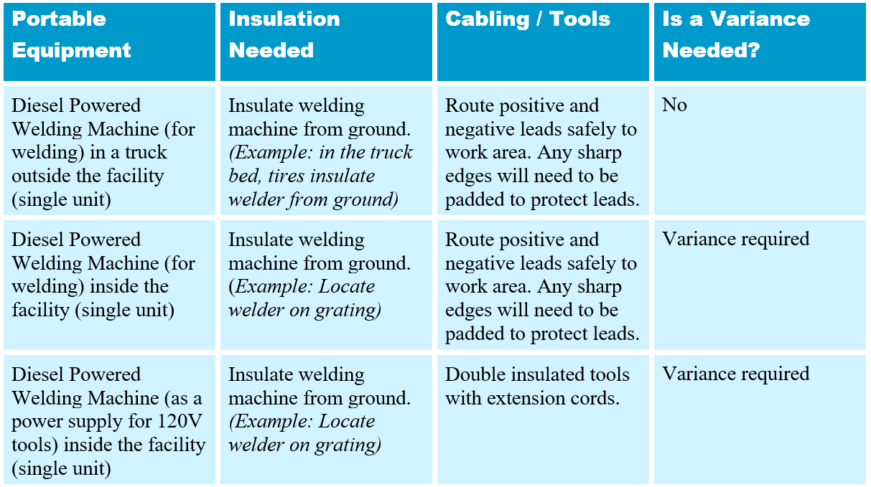
Tools and Equipment
Equipment Needed in the Tankhouse
Notes:
A table that summarizes what sites and contractors can use to weld/perform maintenance in the tankhouse and whether a Variance from the EW/ER Electrical Safety Policy is required.

Slide 27
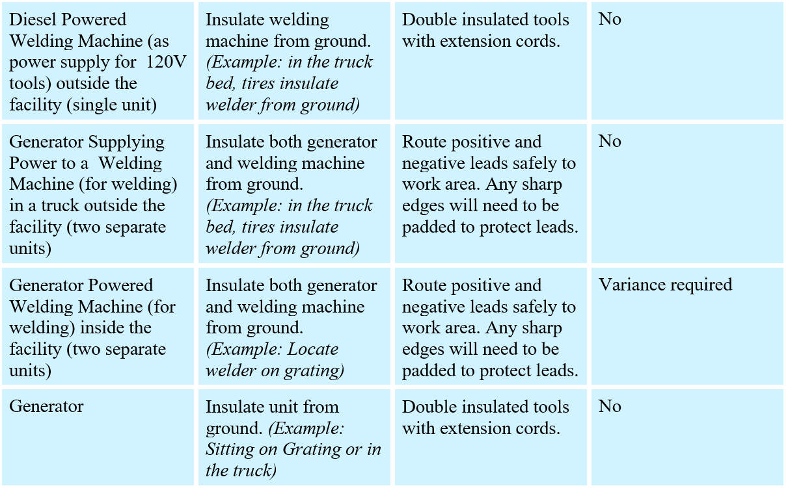
Tools and Equipment
Equipment Needed in the Tankhouse
Notes:
A table that summarizes what sites and contractors can use to weld/perform maintenance in the tankhouse and whether a Variance from the EW/ER Electrical Safety Policy is required.

Slide 28
Electro Chemical Reaction
Current
(electron flow: e⁻)
Rectifier
+++++++++++++++++
-----------------
O
O
S
O
O
Cu^{++.}
Anode
O₂
Cu^{++.}
Cathode
O
O
O
S
H
O
O
H
O
H
O
H
Notes:
Chemical reaction takes place in the solution when current is applied.
Electrowinning process oxidizes water into hydrogen and oxygen in the cells
Copper plates to the cathode
Sulfuric acid is made
Oxygen is released when bursts at surface of solution acid mist is created.
Thus the reason for respirator usage on the cell line when rectifiers are on.

Slide 29
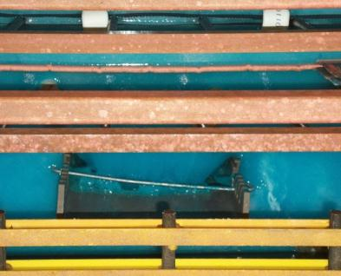
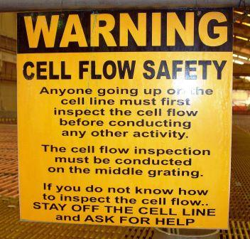
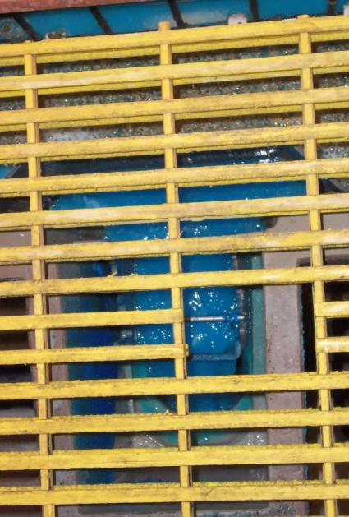
Cell Flow
Notes:
Walk down center isle checking each cell for flow and electrolyte is blue in color. If a cell is clear, milky, or white there may be HYDROGEN gas present. When a cell is depleted of copper it can release hydrogen gas at the surface of the solution. In the event of a spark hydrogen gas could ignite causing an explosion on the cell line.

Slide 30
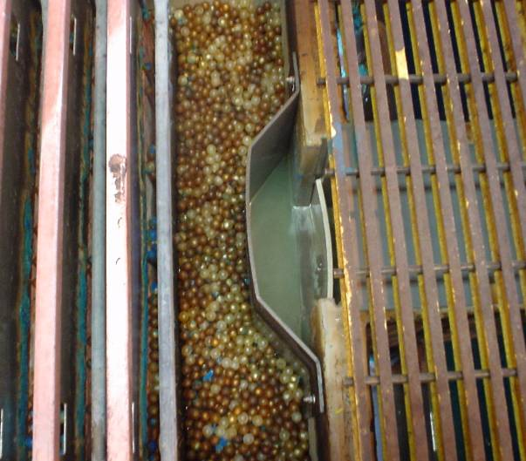
Depleted Cell
No flow
Electrolyte is a light blue, almost milk color, or clear;
Hydrogen gas may present walking on a cell could create a spark resulting in an explosion

Slide 31
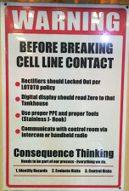
Breaking Cell Line Contact
Supervisor decision
Control room verifies which rectifiers to shut down
Electricians lock out rectifiers
EW’s lock out on lock box
  H.A.R.T. form
  Ensure rectifier key is in lock box
Verify rectifiers are shut down
  Electricians
  Control room
  Rectifier display
Use proper tool to remove anodes and cathodes from contacts

Slide 32
Daily Grating Inspection
Grating inspection is part of the daily work area inspection and is everyone’s responsibility
What to look for
  Missing or loose clips (anchors)
  Damage to grating (breaks, separations, etc.)
  Uneven grating (trip hazard)
  Excessive deflection when walking on grating
  Lack of support structure beneath
Grating that can cause a trip hazard needs to be yellow flagged and tagged
Grating that will cause a fall through hazard needs to be hard barricaded red flagged and tagged

Slide 33
Lead: Health Hazard Awareness

Slide 34
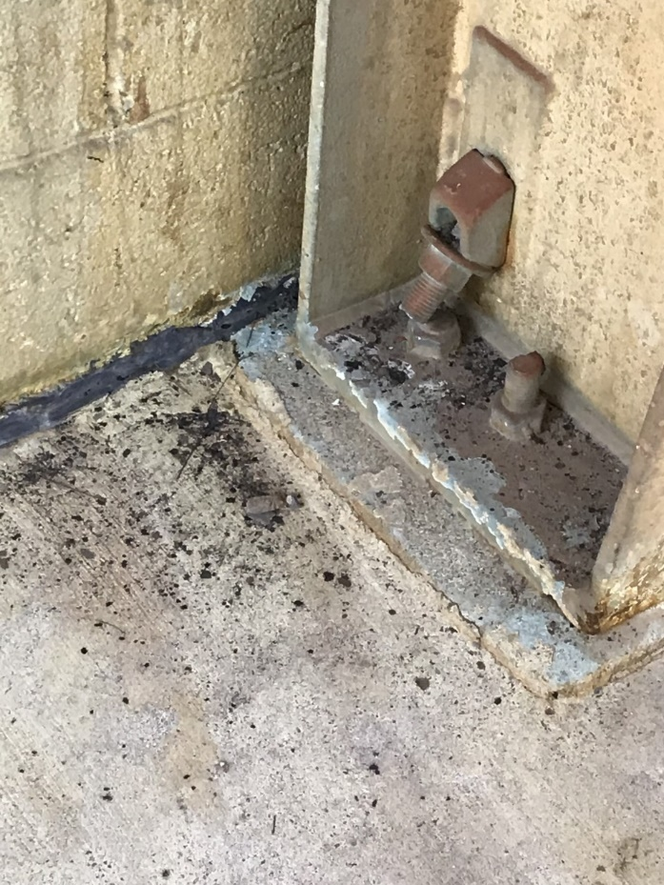
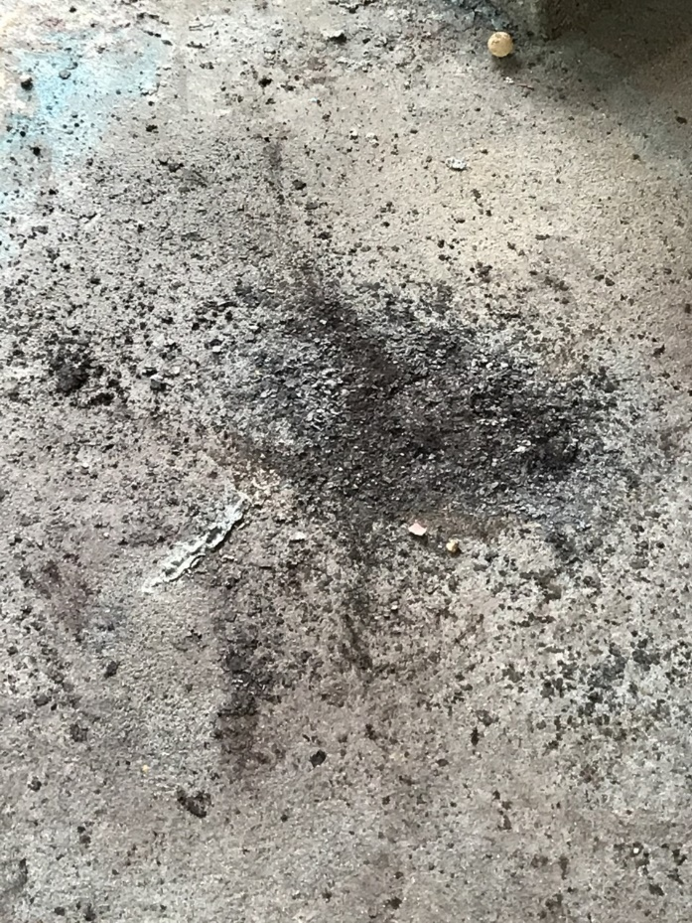
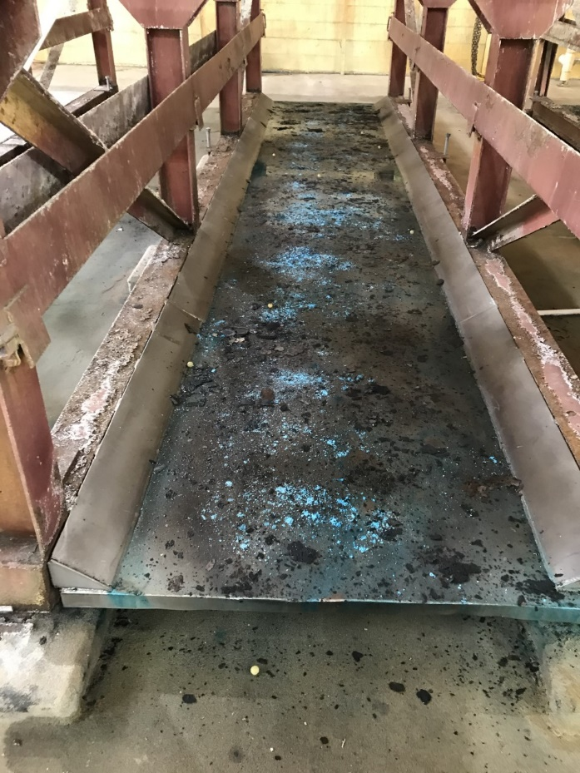
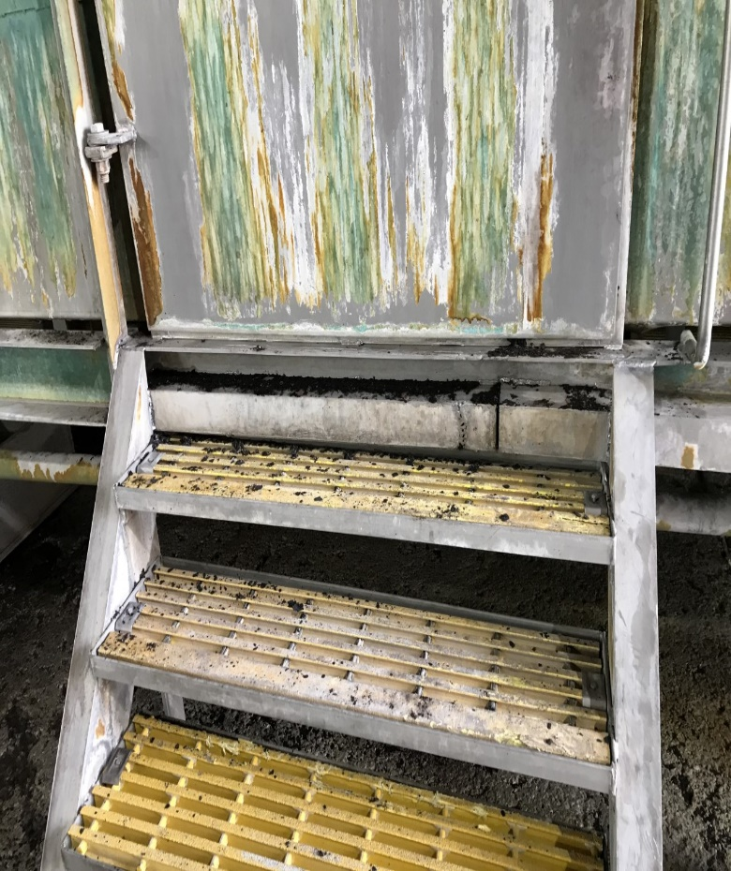
Sources of Exposure at Work
Notes:
Dry lead can become airborne and hazardous to all in contact.

Slide 35
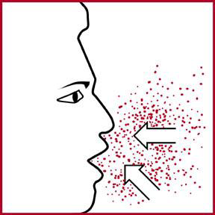

Lead Enters the Body
What are the two ways lead can enter the body?
INHALATION
INGESTION
  Dry sweeping or compressed air is prohibited
  Clean work area as work is completed

Slide 36

Health Risks of Lead Exposure

Slide 37

What is "Take Home" Lead?
Lead Exposure Hazards
Lead dust or particles brought into family home or vehicle on work clothes that could harm anyone exposed!
Who is Most at Risk to Lead Exposure?
Children under age 6 and pregnant women

Slide 38
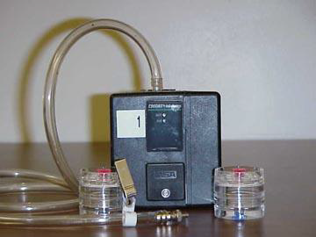
How is Lead Exposure Measured
PEL: Permissible Exposure Limit
  50 µg/m³ based on an 8-hour time weighted average
  PEL for 12-hour shifts will be adjusted to 33.3 µg/m³
Notes:
You are allowed to be exposed to the PEL established by OSHA of fifty micrograms per cubic meter based ion 8 hour shift.
Since we work 12 hour shifts it has been adjusted to thirty three and 3 tenths micrograms per cubic meter.

Slide 39
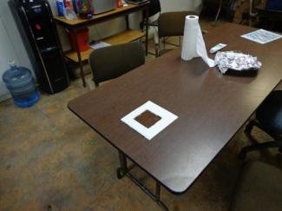
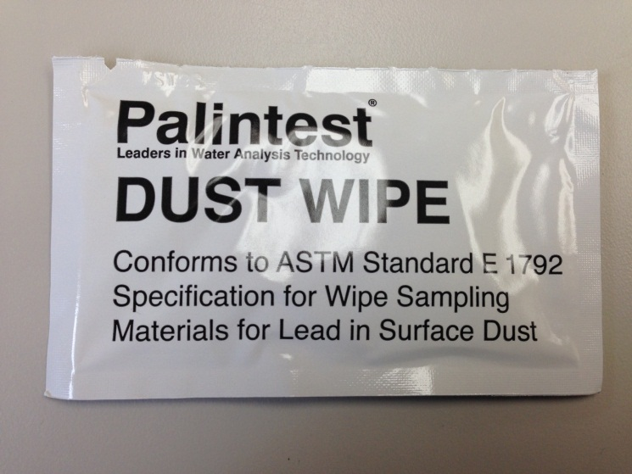
Surface Lead Wipe Sampling
Freeport-McMoRan recommended surface level (RSL) for lead on eating and food prep areas is 40 µg/ft²
Hydromet lunchrooms and other eating areas are sampled to quantify exposures
Notes:
Freeport-McMoRan recommended surface level (RSL) for lead on eating and food prep areas is 40 micrograms per square foot

Slide 40
Medical Surveillance Program
EW’s tested twice per year
Levels are above 50 micro grams per deciliter (μg/dl)
Removal from work area until levels return to safe level
    Chelation: Use of certain drugs to remove lead from the body. Used only in severe cases of lead poisoning and only by a qualified MD.

Slide 41
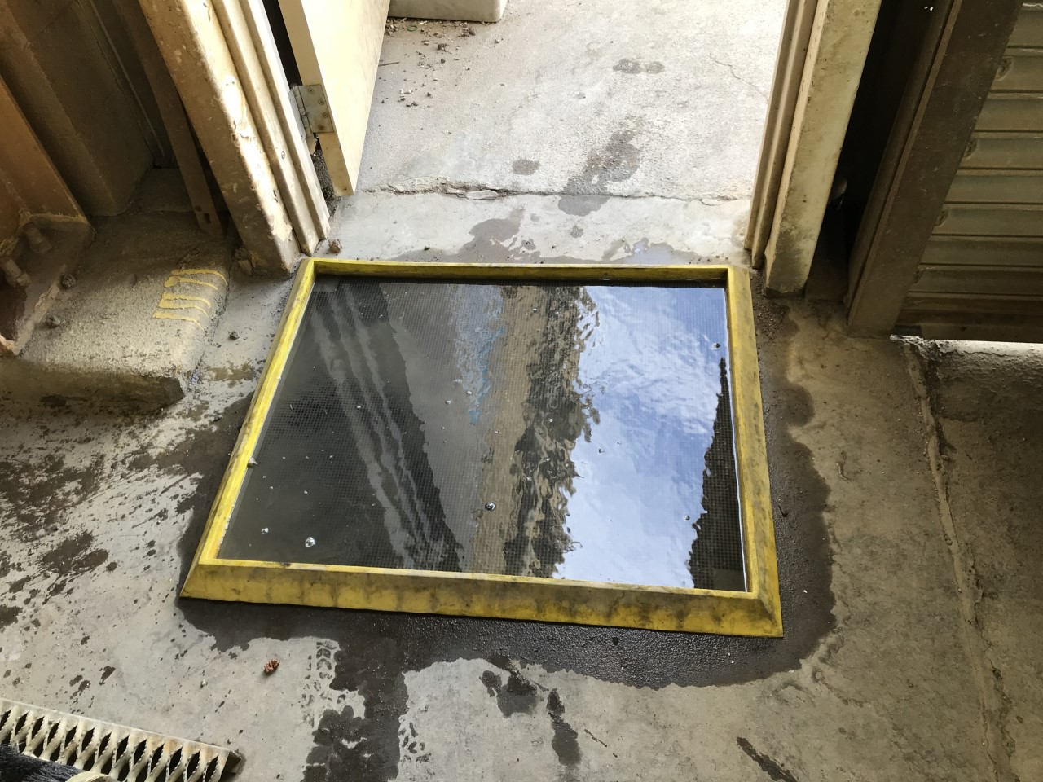
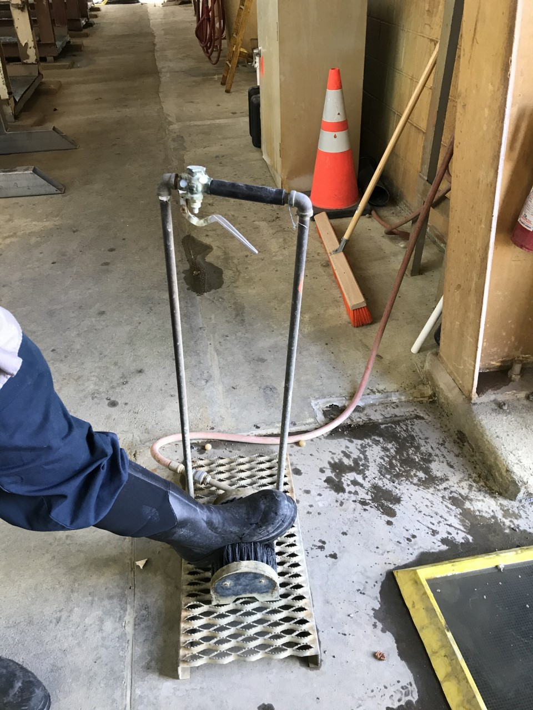
Methods to Control Lead Exposure
Engineering Controls:
  General ventilation
  Boot wash
Administrative Controls:
  Training
  SOP
  Sinage
Personal Protective Equipment:
  Last Line of Defense
  Examples:
  Safety Glasses or Goggles, Face Shield, Tyvek Coveralls, Gloves, Rubber Boots, Respirators
Notes:
Engineer controls (boot wash stations, General ventilation)
Administrative controls (SOP’s, training, job rotation)

Slide 42
Methods to Control Lead Exposure
Behavioral Controls
  Wash hands and face before you eat, drink, chew, or smoke
  Eat, drink and smoke only in areas free of lead dust and fumes
  Eating and drinking is prohibited in the Tankhouse
  Wear a clean, properly fitted respirator with Proper filter in all areas that have lead dust or fumes.
  Use PPE before engaging in work with lead
  Shower after working with lead before going home
  Do not take work clothes home

Slide 43
Lead Contaminated PPE
Prevent the spread of lead contamination by:
  Placing Tyvek suits and contaminated PPE in lead containment for recycling
  Boots must be washed off when exiting tankhouse, prior to entering the office and lunch room
  Dry sweeping or compressed air is prohibited
  Clean work area as work is completed

Slide 44
Knowledge Assessment

